Slide 1
Fall 2021 ECEN 5823
University of Colorado, Boulder
IoT Embedded Firmware : Health Tracker Proof-of-Concept Demonstration
Sayali Mule

Slide 2
Overview
I have selected option 1: BLE with custom GATT server
Design Health tracker system
Measure heartbeat in BPM
Detection of free fall of person(i.e when person falls unconscious)

Slide 3
Requirements
The server shall establish the encrypted link with the client via bonding.
Two services: 1)Free fall detection (Accelerometer) 2) Heartbeat (pulse rate sensor).
Provision for user to enable or disable pulse rate sensor using pushbutton PB1.
Server will be in Energy mode EM2.
LCD displays value of Heart rate in BPM, and free fall event(Boolean value)
Client mobile app(EFR32) will display value of heart rate and free fall.

Slide 4
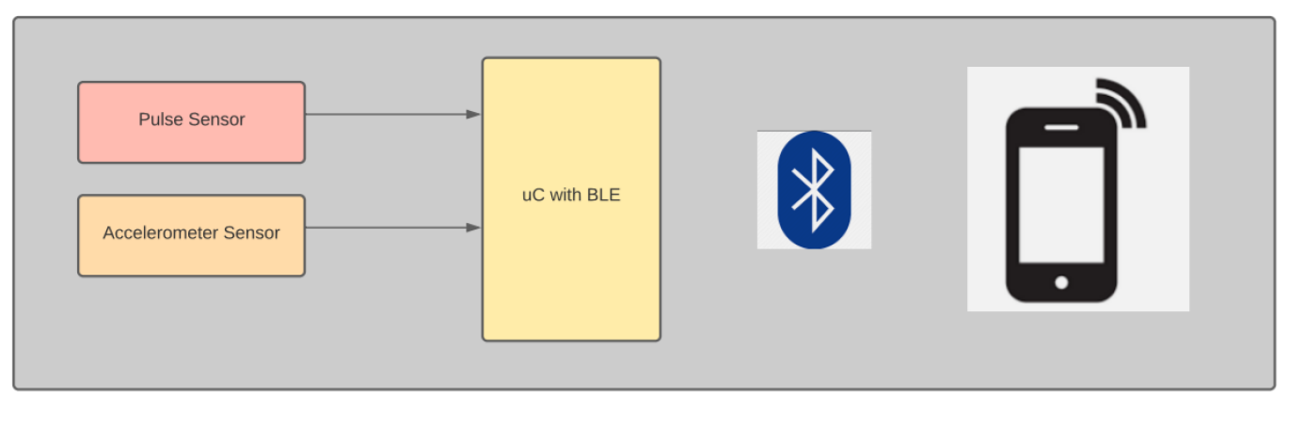
Hardware Block Diagram
Server
Client
Pulse sensor is read using ADC and converted into BPM
Accelerometer sensor generates interrupt on its INT pin connected to MCU GPIO.

Slide 5
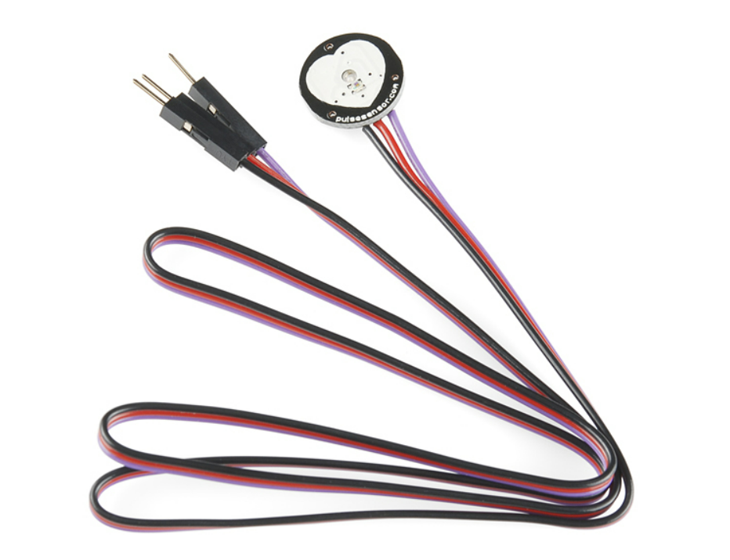
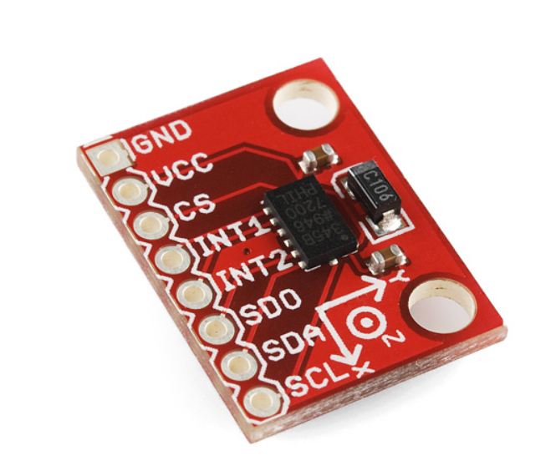
Sensors used:
Pulse rate sensor(SEN-11574) Accelerometer(ADXL345)

Slide 6
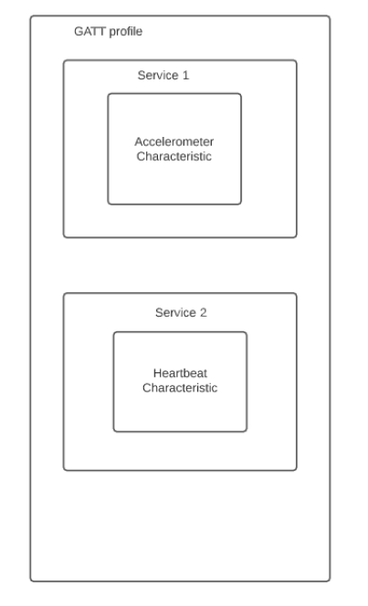
Software
Measurement | Unit | Datatype
HeartBeat | BPM | uint8_t
Free fall | boolean | uint8_t

Slide 7
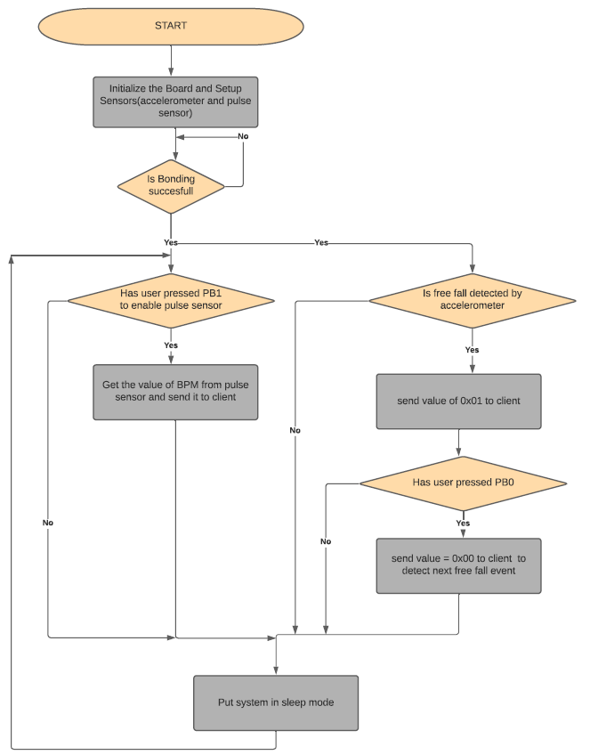
Flowchart:

Slide 8
Challenges and Blockages
Initially tried using PC10 to detect interrupt generated by accelerometer. However, PC10 is already used by LCD, this led to false interrupt detection. Solution was to use a different pin for accelerometer interrupt.
Free fall is detected when acceleration drops below certain threshold. Many test/trials were done in order to get proper free fall threshold.
Initially, push buttons were configured to generate interrupt on both falling/rising edge, this led to two events generation for one button press, solution was to configure GPIO to only set event on falling edge of button.

Slide 9
Demonstrate Your Project

