Slide 1
Acquire Valued Customers
predict repeat buyers
Mudassir Syed

Slide 2
Project
Predict Repeat Customer
Businesses run discounts on select items to increase sales and make the customers repeat their purchase.
Data used in this project is of customers transactions, history and offers.
Original data comprises of almost 350 million rows of completely anonymized transactional data from over 300,000 shoppers.
This project deals with a subset of original data.
Outcome from this Project
Provide insights into shopping patterns of customers.
Predict the repeat buyers based on different features.

Slide 3
Clients
Subscription Businesses
Companies with Business Model revolving around Subscriptions/renewals
Companies interested in building customer base
Grocery Stores
Which products when offered discount sell more
Help convert customers to repeat buyers
Retain existing customers

Slide 4
Data Acquisition
Retrieved dataset from https://www.kaggle.com/c/acquire-valued-shoppers-challenge/data
This data comprises anonymized fields with transactions for 1 year along with Offer and Offer History information.
Acquired dataset is reduced to manageable size for EDA and Model building.

Slide 5
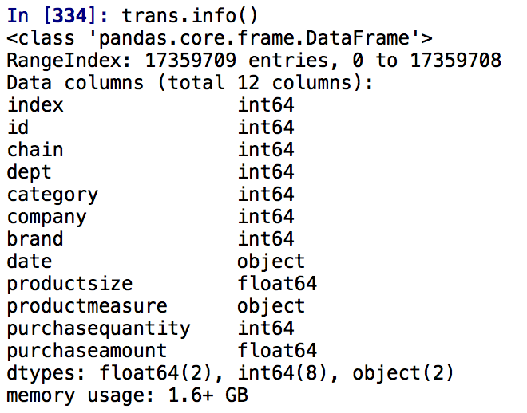
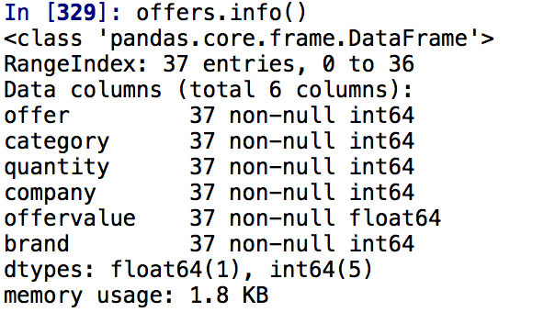
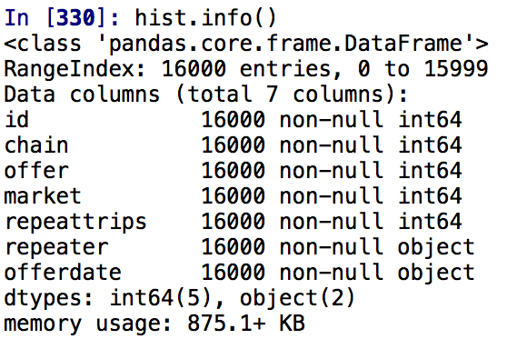
Dataset Exploration
16000 Customer records
1.6 GB (transactions)
875 KB (history)
1.8KB (offers)

Slide 6
Data Dictionary
transactions id - A unique id representing a customer chain - An integer representing a store chain dept - An aggregate grouping of the Category (e.g. water) category - The product category (e.g. sparkling water) company - An id of the company that sells the item brand - An id of the brand to which the item belongs date - The date of purchase productsize - The amount of the product purchase (e.g. 16 oz of water) productmeasure - The units of the product purchase (e.g. ounces) purchasequantity - The number of units purchased purchaseamount - The dollar amount of the purchase

Slide 7
Data Dictionary
offers offer - A unique id representing an offer category - The product category (e.g. sparkling water) quantity - The number of units one must purchase to get the discount company - An id of the company that sells the item offervalue - The dollar value of the offer brand - An id of the brand to which the item belongs
history id - A unique id representing a customer chain - An integer representing a store chain offer - An id representing a certain offer market - An id representing a geographical region repeattrips - The number of times the customer made a repeat purchase repeater - A boolean, equal to repeattrips > 0 offerdate - The date a customer received the offer

Slide 8
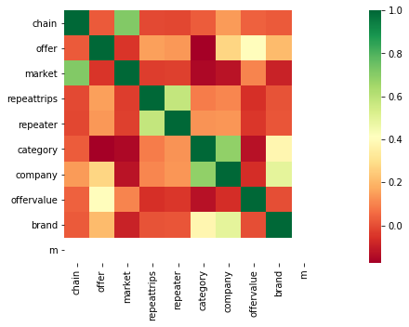
Data Aggregation & Feature Selection
Merge Offers and History data with OfferId into Hist_Offer
Category, Company, Offer and Brand are correlated to
target variable ‘repeater’
Chain and Market have little correlation to
target variable

Slide 9
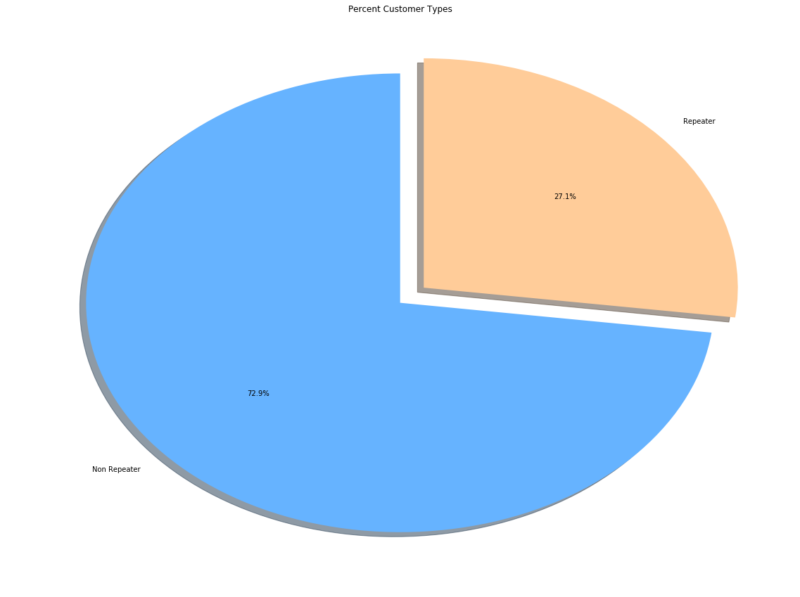
Explanatory Data Analysis
27 % of Customers repeat purchase when
Offered discount coupon

Slide 10
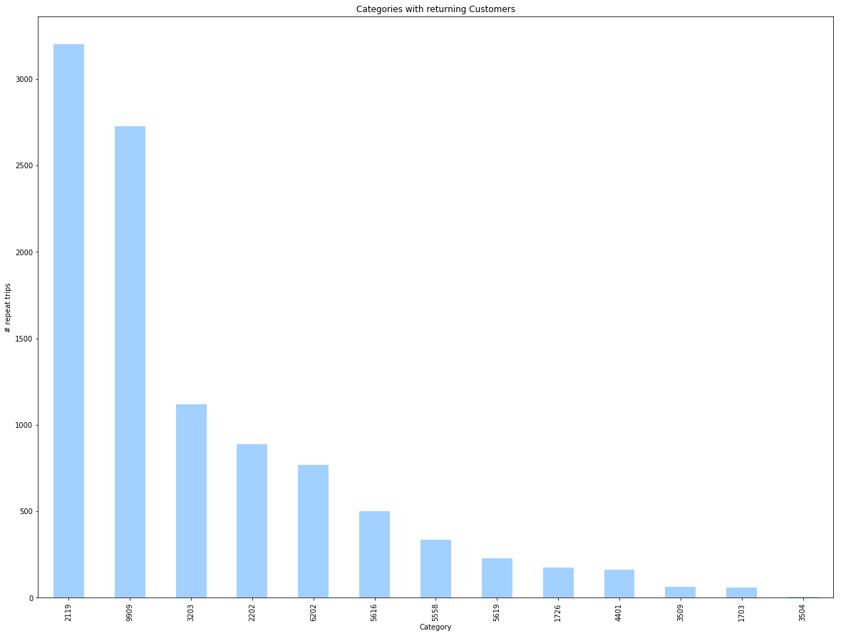
Explanatory Data Analysis
Returntrip count for each category

Slide 11
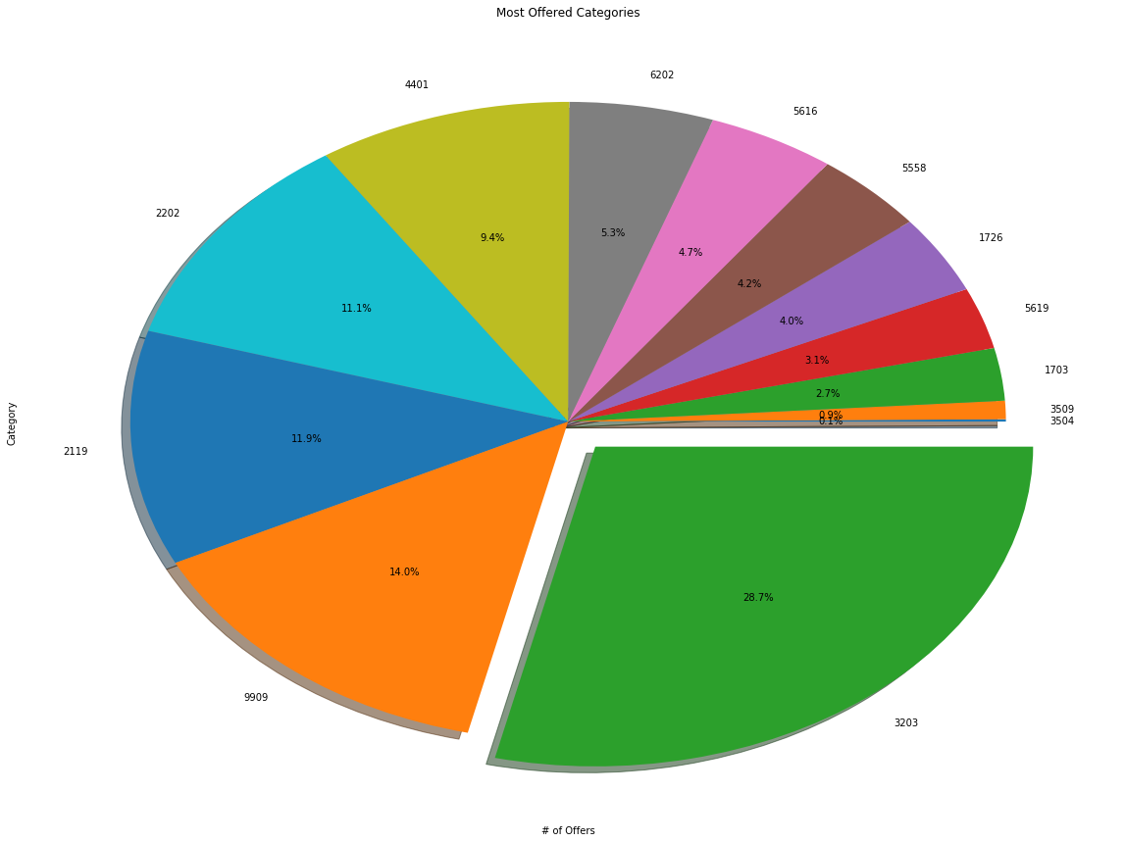
Explanatory Data Analysis
Category 3203 was offered to 27 % Customers

Slide 12
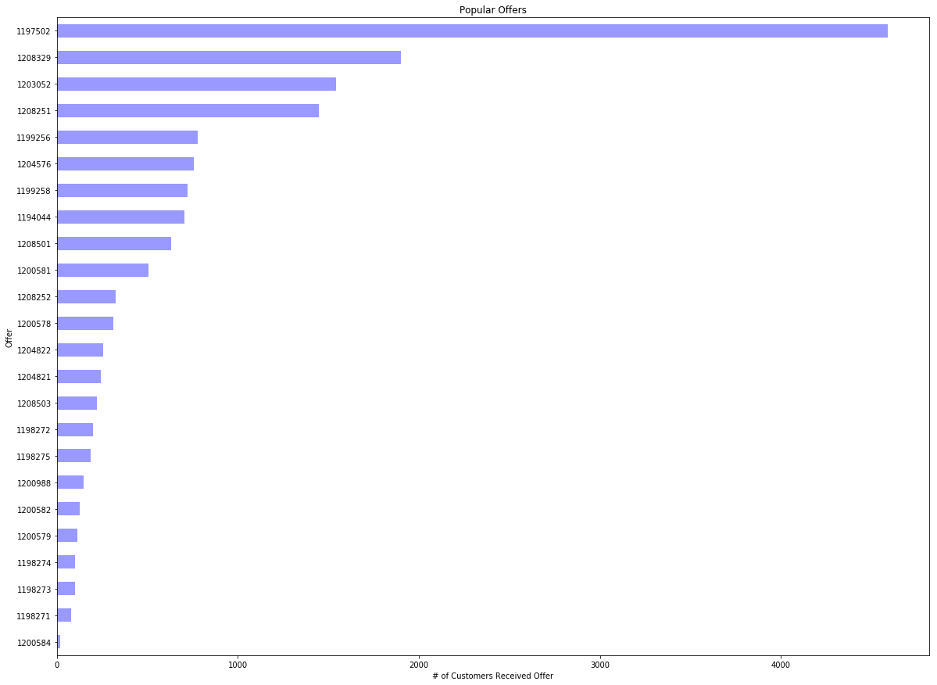
Explanatory Data Analysis
More than 4000 customers were
Offered coupon 1197502

Slide 13
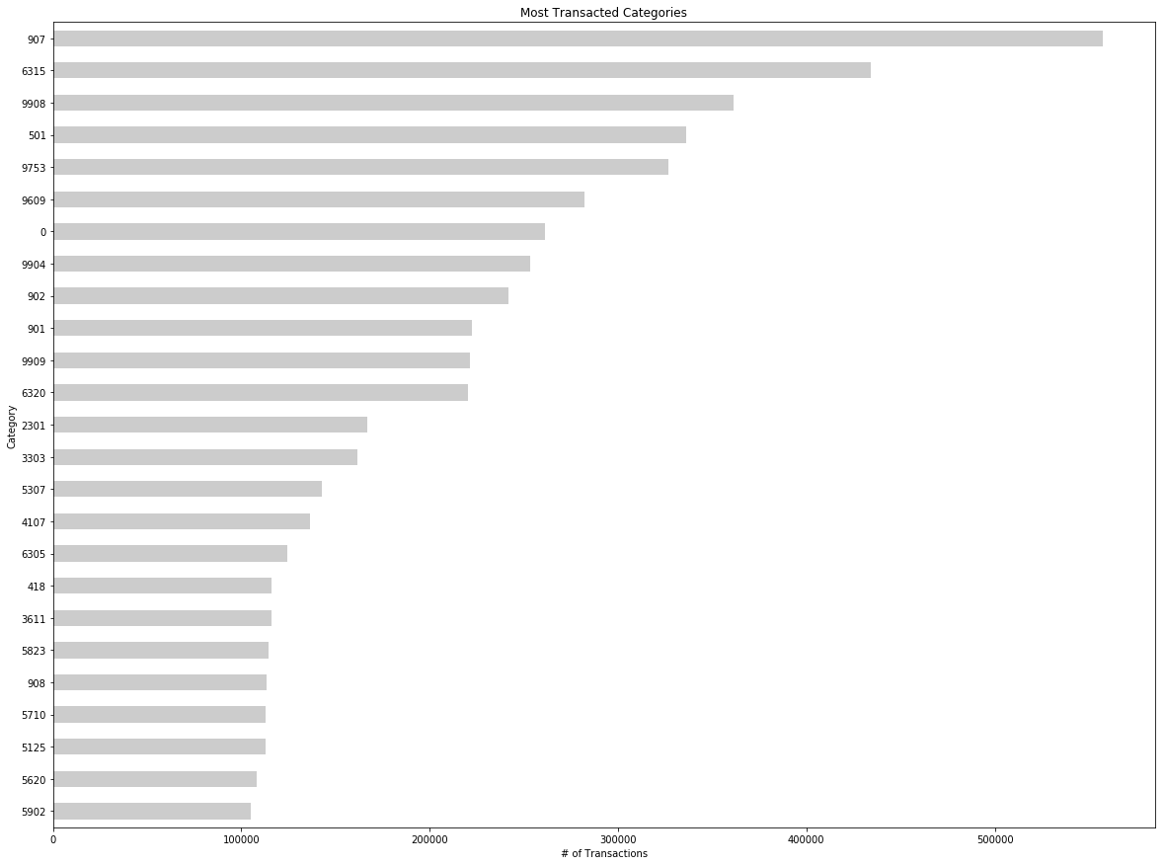
Explanatory Data Analysis
Top 25 highly transacted Categories which
could have impact on prediction

Slide 14
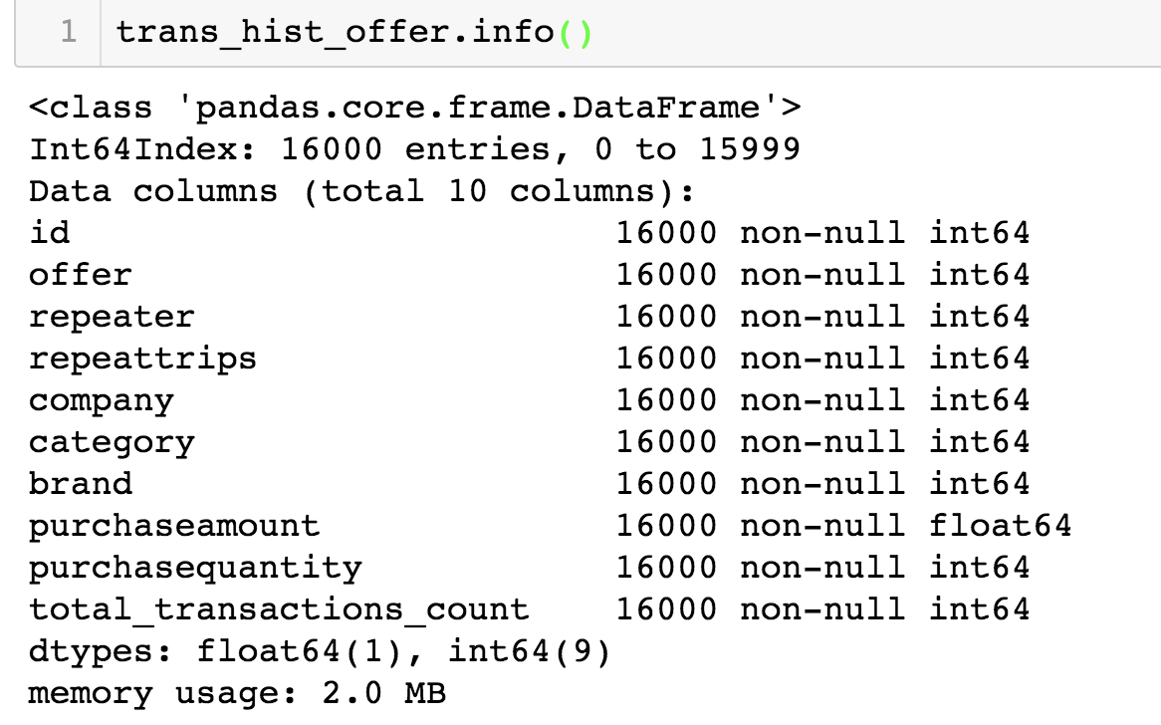
Data Aggregation
Aggregate purchase amount and quantity of transactions data for each customer.
Merge aggregated transactions and Hist_Offer.

Slide 15
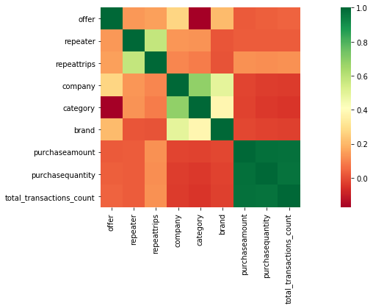
Explanatory Data Analysis
purchaseamount, purchasequantity
and total_transaction_count is found
correlated to repeattrips

Slide 16
Feature Extraction
[1,3,6,9,12]_month_total_purchase_amt
category_purchased_amt_[30,90,180,270]days category_purchased_qty_[30,90,180,270]days
company_purchased_amt_[30,90,180,270]days company_purchased_qty_[30,90,180,270]days
brand_purchased_amt_[30,90,180,270]days brand_purchased_qty_[30,90,180,270]days
offer repeater repeattrips company category brand
offervalue offeredmonth quantity
purchaseamount purchasequantity
total_trans_purchaseamount_avg purchaseamount_category_avg
total_transactions_count
total_purcahse_company_count total_purcahse_category_count total_purcahse_brand_count

Slide 17
Model Evaluation & Selection
Evaluated below 3 Classification Models
 | Logistic Regression | Decision Tree | Random Forest
AUC Score | 0.5225 | 0.5161 | 0.6118
Its evident from above metrics, that logistic regression is not the best model for this project
Random Forest have produced better results for n_estimators = 20

Slide 18
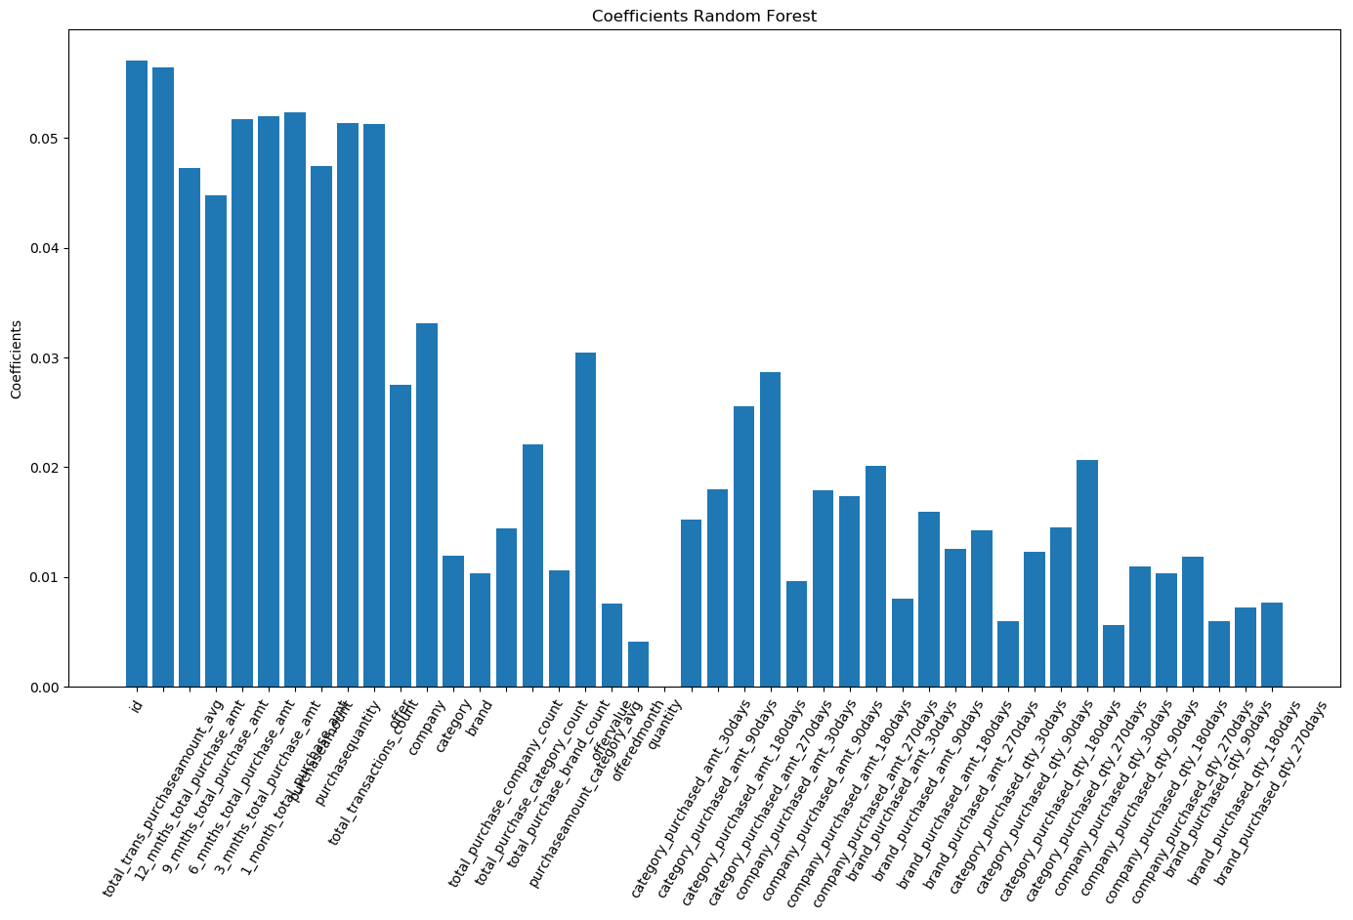
Model Evaluation & Selection

Slide 19
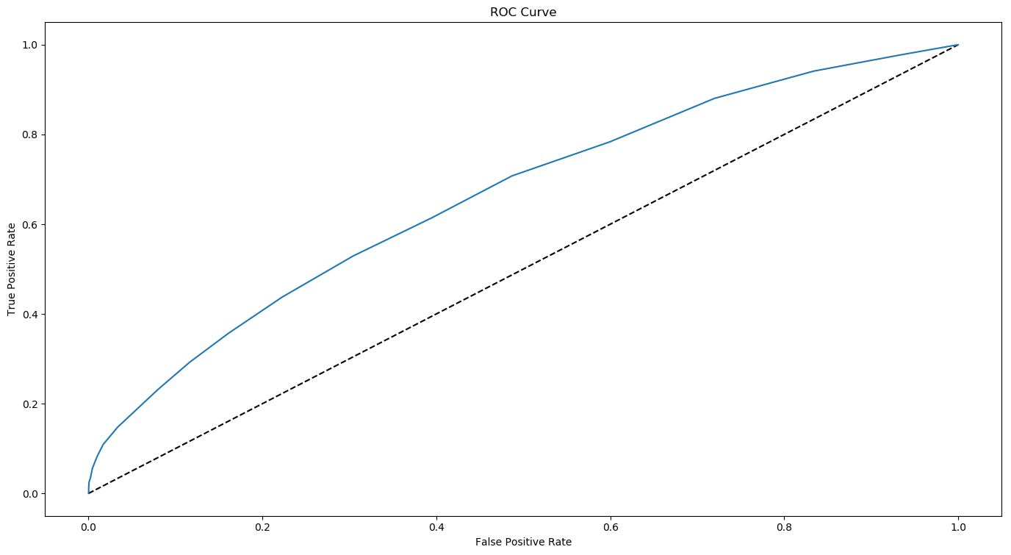
Model Evaluation & Selection

Slide 20
Recommendations to Clients
Factors Influencing customers to repeat purchases
Average customer spending
Recent Purchase trends of customer
History of Category, Company, Brand purchases by customer
Recommendations to Companies
Offers are effective way of improving sales and retaining customers
Choose right Offer for products of Category, Company, Brand

Slide 21
Thank You.

