Slide 1
Bike Sharing Demand
Springboard Capstone Project - I

Slide 2
Project
Bike Sharing Demand (Hourly)
Bike sharing systems automate obtaining bike riders membership, bike rental and return.
Data for capstone project is a historical log of rentals for year 2011, 2012.
Bike share data is aggregated on Hourly basis and combined with Weather data
This Project uses data from bike sharing systems in Washington D.C., USA.
Outcome from this Project
Provide insights into demand patterns.
Predict the demand based on different environmental and seasonal conditions.

Slide 3
Clients
Bike Rental Companies
Scale bike stations to be able to meet demand
Increase the demand of bike sharing in the City
Help convert casual riders to membership/registered riders
Retain existing registered riders
City Transportation
Manage city transit services based on bike demand
Society
Stress free Commute in City
Healthy Lifestyle

Slide 4
Data Acquisition
Retrieved dataset from https://www.kaggle.com/c/bike-sharing-demand
The core data set is from http://capitalbikeshare.com/system-data aggregated on hourly and daily basis combined with seasonal & weather information
This data is of Washington D.C area for year 2011 and 2012

Slide 5
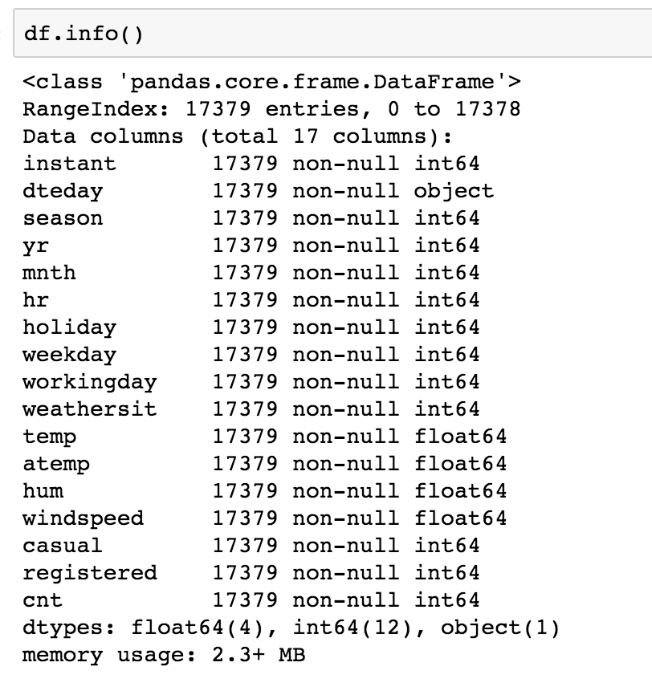
Dataset Exploration
Dataset has 17379 rows with 17 columns
Record ID is the Index
Data Size of 2.3 MB

Slide 6
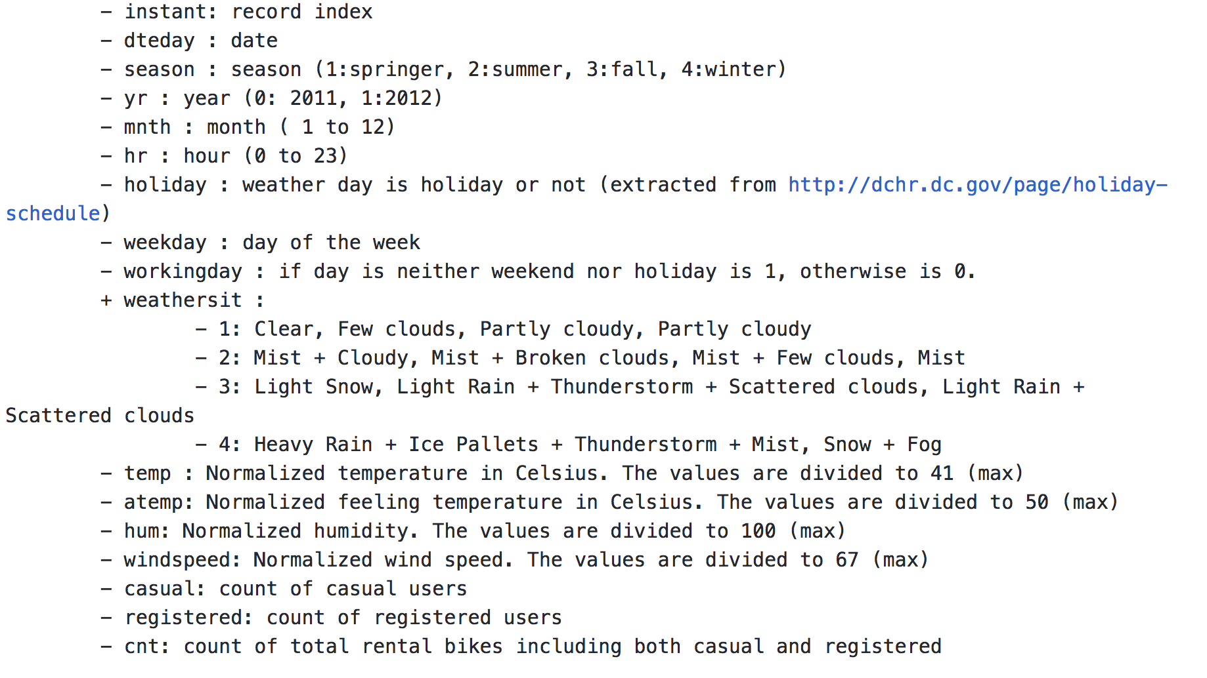
Data Dictionary

Slide 7
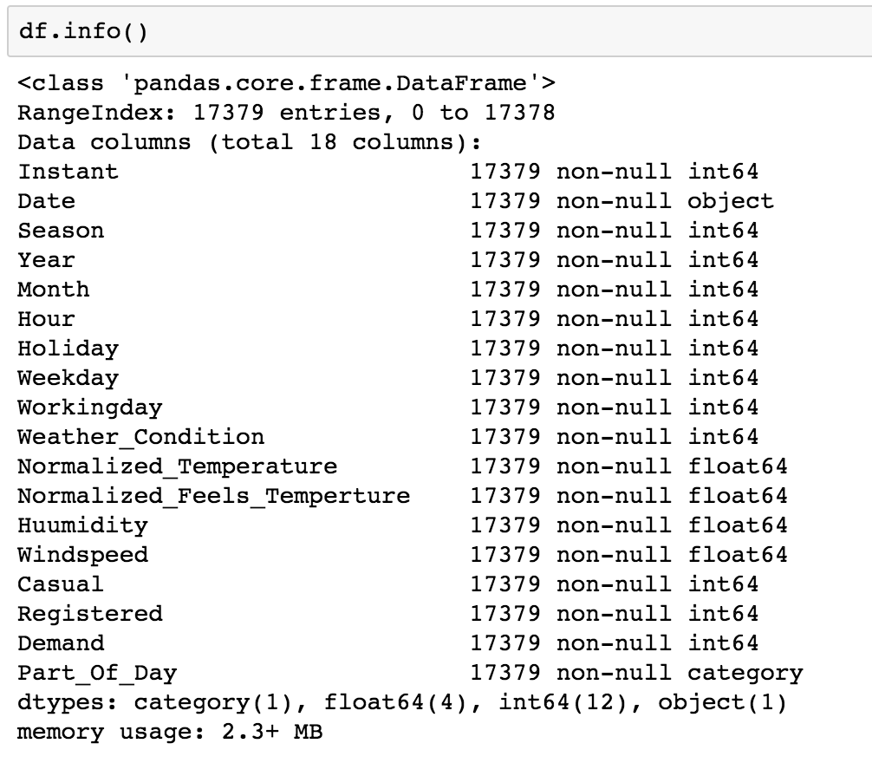
Data Wrangling
Rename column names
Combine Date and Hour columns as Index
Delete instant column
Create Part_Of_Day column
(divides a day in 6 windows/periods)
0-4 : 0
4-8 : 1
8-12 : 2
12-16 : 3
16-20 : 4
20-23 : 5

Slide 8
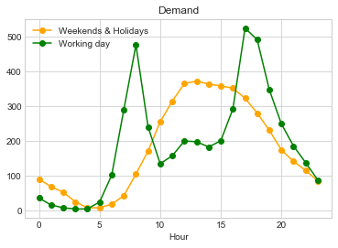
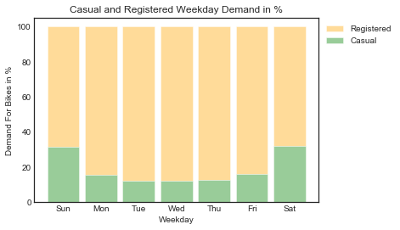
Weekdays Data Analysis
Weekends & Holidays
Demand peaks in afternoon
Workday
Demand peaks at Morning and Evening Hours
Registered riders contribute higher percentage demand

Slide 9
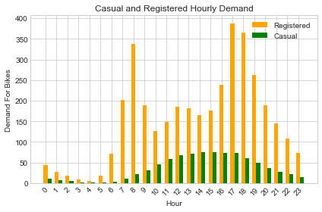
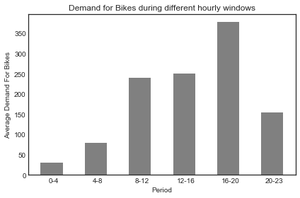
Hourly Data Analysis
Evening Hours have higher demand
than Mornings
Demand Peaks between 4 and 8 PM

Slide 10
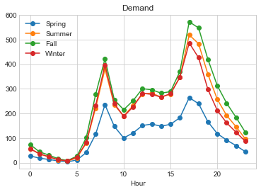
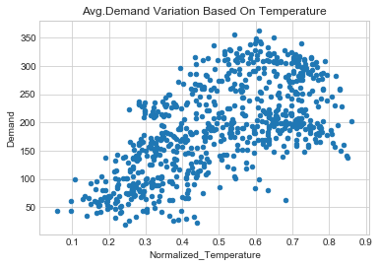
Seasonal Data Analysis
Demand is highest in Fall Season and lowest in Spring Season
Demand increases with temperature and it starts declining at very high temperature.

Slide 11
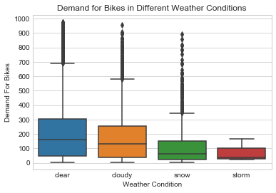
Weather Data Analysis
Average Demand is highest in Clear
Weather
Demand is lowest in Stormy Weather

Slide 12
Model Evaluation & Selection
Evaluated below 3 Linear Regression Models
 | Linear Regression | Ridge Regression | Lasso Regression
R ^ 2 | 0.40 | 0.40 | 0.38
RMSE | 139.97 | 140.23 | 139.85
Its evident from above metrics, that linear regression is not the best model for this project

Slide 13
Model Evaluation & Selection
Random Forest with One Hot Encoding
Determine important parameters to build a final model with RandomizedSearchCV
max_depth=25
min_samples_leaf= 1
min_samples_split= 2
n_estimators = 100
Random Forest regression with R^2 score of 0.94 is a better fit for this dataset
 | Decision Tree Regression | Random Forest Regression
R ^ 2 | 0.90 | 0.94
RMSE | 57.12 | 44.48

Slide 14
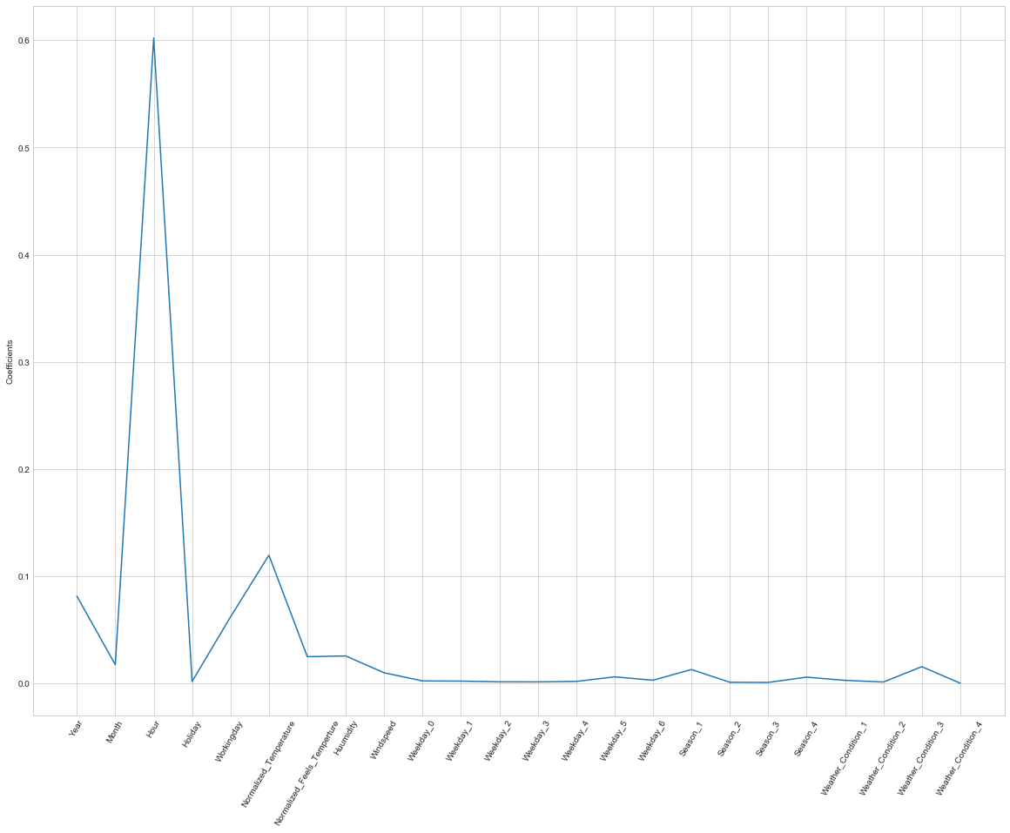
Model Evaluation & Selection
Feature Importance
Hour feature has very high importance

Slide 15
Recommendations to Clients
Factors Influencing increase in demand for bike sharing in city
Registered Ridership
Working Day
Evening Commute Hours (4 and 8 PM)
Clear Weather Conditions
Season
Moderate Temperatures
Recommendations to Bike Rental Companies
Convert Casual Riders to Registered
Adapt bike stations to meet evening demand
City Transportation
Increase services during bad weather conditions as bike rental demand decreases

Slide 16
Thank You.

