Slide 1
What Determines the Effectiveness of
3D Field of Junctions?
A Study of Volumetric Denoising Applications
SECTION C · TEAM 17
Samudraneel Sarkar · Sakshi Patil · Nikhil Kumar · Manpreet Singh
MNNIT Allahabad · co-authors contribute equally
github.com/samudraneel05/SectionC_Team17
Notes:
Introduce the team and the question in one sentence: the paper showed 3D FoJ denoising CT, cryo-ET, and point clouds — we ask WHEN it works, not whether it works.

Slide 2
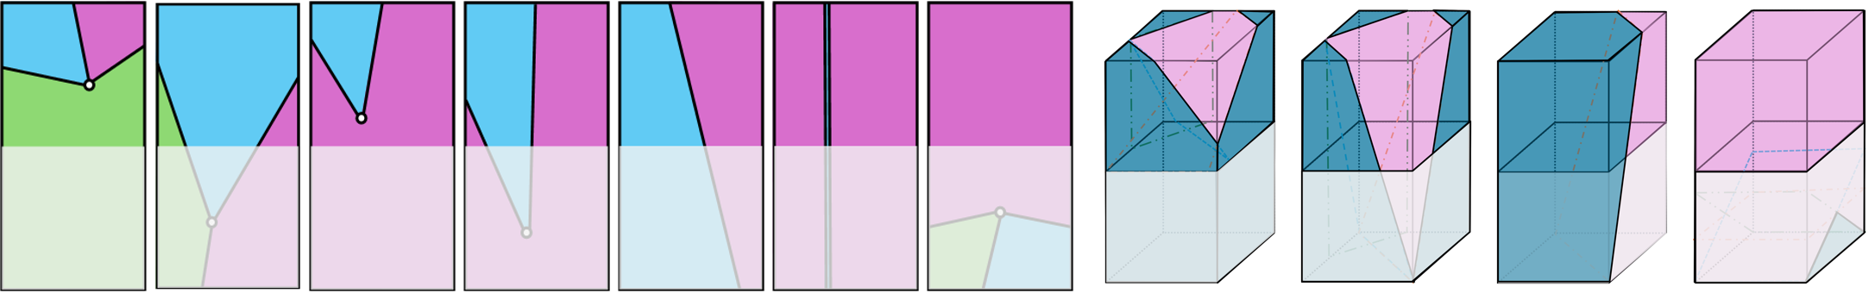
BACKGROUND
3D Field of Junctions, in one slide
Junction schematic from the original paper (Moeini et al., ECCV 2026)
Training-free
No network, no dataset, no training. The model is fit directly on the single noisy input volume.
Wedges per patch
Every R³ cubic patch is split by planes through one shared vertex into wedge regions; each region takes the mean of the voxels it covers.
Overlap averaging
Patches tile the volume on a grid. Each voxel is rendered by several patches and the outputs are averaged into the final volume.
Moeini, Kim, Romberg & Fridovich-Keil — released implementation used as-is
3D FoJ · Section C Team 17
2
Notes:
Mechanism in three steps: independent patches, each patch becomes a junction of constant wedges, overlaps averaged. Emphasize training-free — that's the appeal vs. learned denoisers.

Slide 3
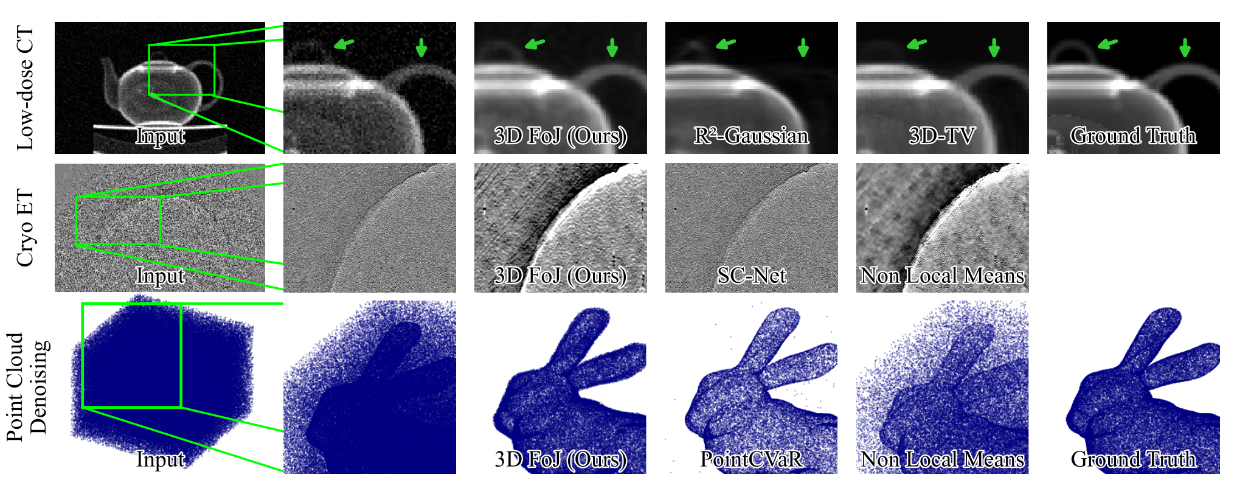
MOTIVATION
What the paper demonstrated — and what we test
Bentheim sandstone micro-CT
Grains and pores separated by sharp interfaces, 10–35 voxels across — exactly the shape the wedge prior assumes.
BrainWeb T1 MRI phantom
Anatomical tissue has smooth gradients, not plateaus — tests the piecewise-flat assumption.
Original teaser: low-dose CT, cryo-ET, point clouds
Demonstrated on sparse-view CT, cryo-electron tomography, and point-cloud denoising.
Open question: does the wedge prior transfer to volumes with different structure?
We apply the released implementation, unchanged, to three new domains.
Binary porous media
Sphere pack + Berea scan with ~2-voxel features, smaller than any patch — tests the scale assumption.
3D FoJ · Section C Team 17
3
Notes:
Deliberate domain design: one domain built like the prior assumes (Bentheim), two that violate it in different ways (smooth MRI, sub-patch binary). This is what makes the results a study of conditions, not just a benchmark.

Slide 4
MECHANISM
The effective estimator — and three requirements
The nominal model
A coupled field of junctions: boundary- and color-consistency terms tie overlapping patches together, weighted by λ ramps over refinement iterations.
What runs at the released defaults
With N_ref = 1 the consistency weights never engage, and the single refinement pass renders from pre-update parameters. Effectively: an independent wedge fit per patch + overlap averaging.
Three requirements for FoJ to help — all follow from “replace each wedge by its mean”:
1 · Unbiased input
Region intensities are voxel means. A systematic offset in the input is reproduced, not removed — e.g. clamping a CGLS reconstruction passes straight through.
2 · Structure ≥ patch scale
Wedges are piecewise-constant. Geometry finer than the patch, or smooth gradients, cannot be expressed — the fit collapses toward the mean.
3 · Noise above crossover
The wedge model is biased. It wins only when the noise it averages away costs more than the bias it introduces.
3D FoJ · Section C Team 17
4
Notes:
Key honest finding: the released defaults never activate the inter-patch consistency terms, so the estimator is just independent wedge fits + averaging. That simple mechanism is what makes the three requirements derivable — and testable.

Slide 5
REPRODUCTION
Step 0 — reproduce the published benchmark
Sparse-view CT ablation: engine volume, 20 cone-beam views, P50 Poisson noise.
Pipeline rebuilt end-to-end: R²-Gaussian benchmark + TIGRE projector + 60 CGLS iterations, then the released FoJ code.
Qualitative result reproduces exactly: quality rises monotonically with patch size R, best at R = 12, with shrinking marginal gains.
Absolute PSNR sits +1.2 to +3.4 dB above reported — consistent with the released M = 2 (vs. M = 3 in the paper) and unspecified reconstruction details.
R | Reported | Ours | Δ (dB)
4 | 11.33 | 14.72 | +3.39
6 | 14.37 | 16.93 | +2.56
8 | 16.18 | 17.99 | +1.81
10 | 17.17 | 18.58 | +1.41
12 | 17.70 | 18.86 | +1.16
Engine-volume CT ablation — denoised PSNR vs. patch size R
+1.2 → +3.4 dB
ours above reported, gap narrows as R grows
The implementation behaves as documented — so the domain study uses it as-is.
3D FoJ · Section C Team 17
5
Notes:
Before new domains we checked the released code reproduces the paper's headline ablation. It does — same monotone trend, same best patch size. Absolute offset explained by M=2 vs M=3, which the paper itself acknowledges. This validates using the released implementation for the study.

Slide 6
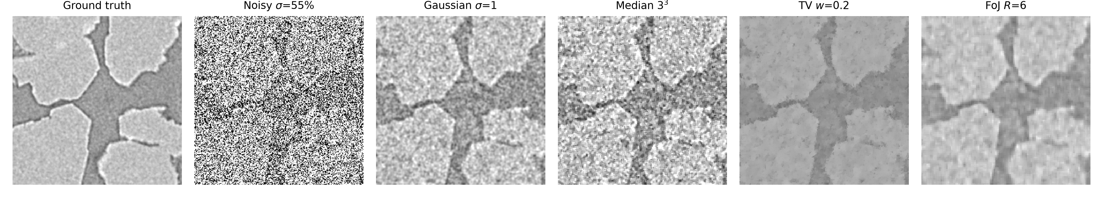
RESULT 1 · COMPATIBLE STRUCTURE + HIGH NOISE
Bentheim micro-CT — where FoJ wins
σ = 55% noise — FoJ keeps grain–pore interfaces sharp while Gaussian, median, and TV blur
σ | Noisy | Best classical | FoJ
15% | 16.89 | 28.51 | 26.55
30% | 12.00 | 26.03 | 25.64
40% | 10.28 | 23.39 | 24.93
55% | 8.76 | 21.05 | 24.29
+3.24 dB
FoJ over the best classical filter at σ = 55%
≈ 11 dB
3D PSNR (dB), 192³ crop of Bentheim sandstone
input-PSNR crossover — below this, the wedge prior pays off; above it, classical filters win
3D FoJ · Section C Team 17
6
Notes:
The headline positive result. Classical filters win at 15-30% noise; once input PSNR drops below ~11 dB they either under-smooth or blur interfaces, while FoJ's regional means kill variance and keep planes intact. Boundary-F1 0.85-0.88 vs 0.54 for TV.

Slide 7
RESULT 2 · VIOLATES PIECEWISE FLATNESS
BrainWeb MRI — where FoJ fails: smooth texture
BrainWeb T1 phantom (181×217×181), Rician noise σ = 3–13%.
Tissue gradients are smooth, so constant wedges quantize them into steps — model bias at every noise level.
FoJ trails the 3³ median filter at all five levels; larger patches only make it worse.
Same story in reconstruction: as a plug-and-play denoiser, FoJ-PnP reaches 27.99 dB vs. 30.39 dB for TV-PnP at 4× undersampling.
−5.13 dB
FoJ R=6 vs. median filter at σ = 3% — below the noisy input itself
0 / 5
σ | Median | FoJ R=6 | gap
3% | 30.80 | 25.67 | −5.13
7% | 24.58 | 22.52 | −2.06
13% | 19.28 | 18.31 | −0.97
noise levels where FoJ beats any classical baseline on MRI
3D PSNR (dB), Rician noise — gap narrows but never closes
3D FoJ · Section C Team 17
7
Notes:
Failure mode one: the wedge prior is piecewise-constant, MRI tissue is smooth — so bias dominates regardless of noise. The gap narrows with noise (variance reduction helps) but never closes. Plug-and-play reconstruction confirms it's the prior, not the task.

Slide 8
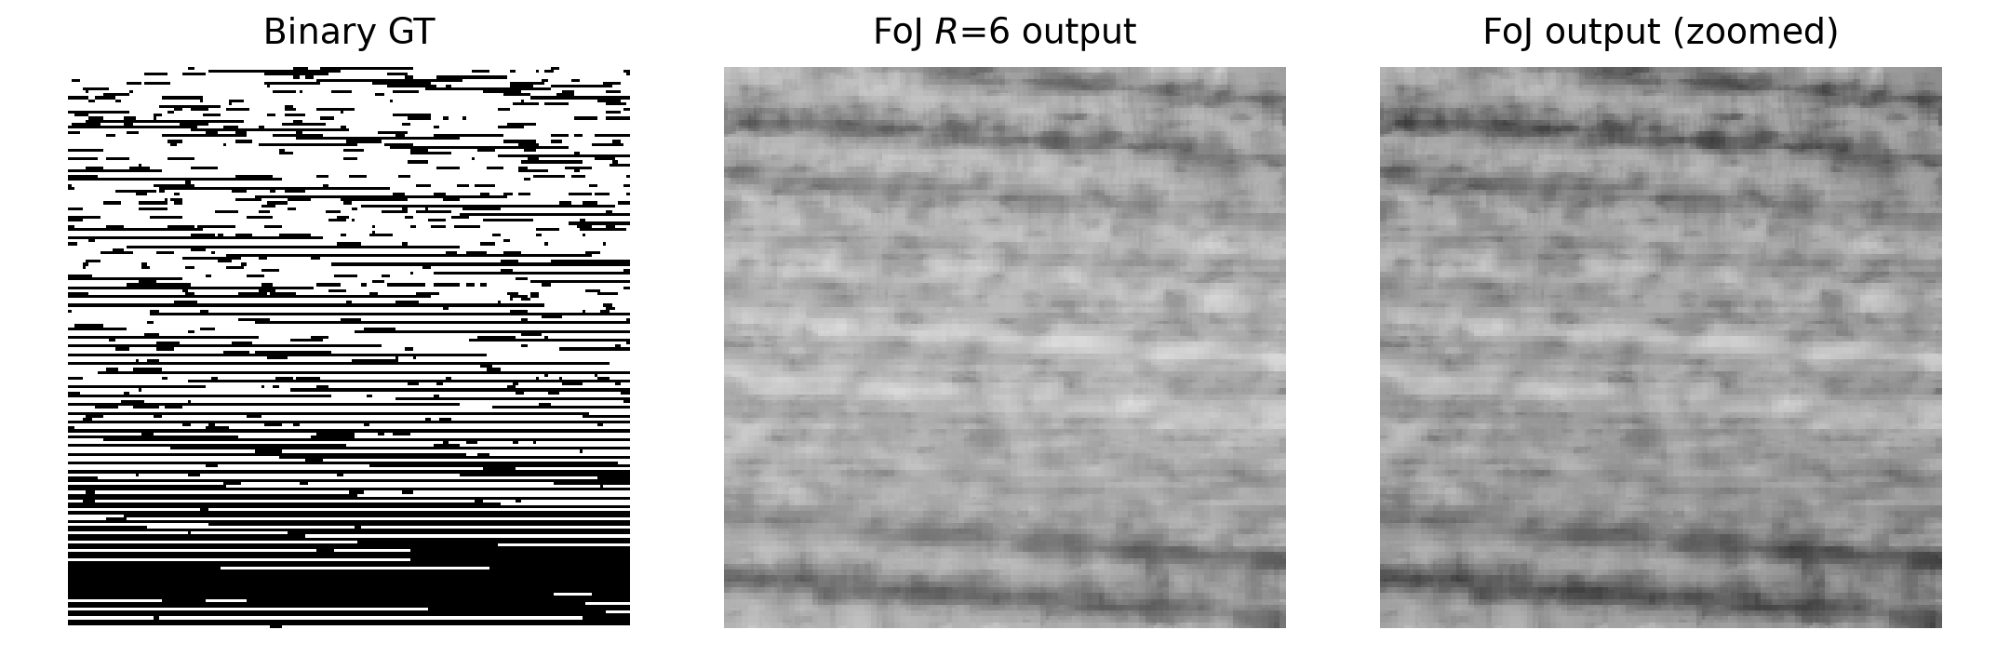
RESULT 3 · VIOLATES STRUCTURE SCALE
Binary porous media — where FoJ fails: sub-patch features
Berea, σ = 15%: binary ground truth (left) → FoJ output (right) collapses toward the volume mean
19.5 → 7.1 dB
FoJ scores below the noisy input — denoising destroys the signal it should keep.
σ 0.49 → 0.09
Output intensity spread shrinks 5×: the volume comes out nearly flat.
Why
Features are ~2 voxels; three planes through one vertex can't isolate dozens of pores in an R³ patch, so every wedge mean ≈ global mean.
3D FoJ · Section C Team 17
8
Notes:
Failure mode two, the most dramatic: geometry finer than the patch can't be partitioned by three planes, so wedge means degenerate to the global mean — output nearly flat. Even perfect structure type (binary = piecewise-constant) fails when it's below patch scale.

Slide 9
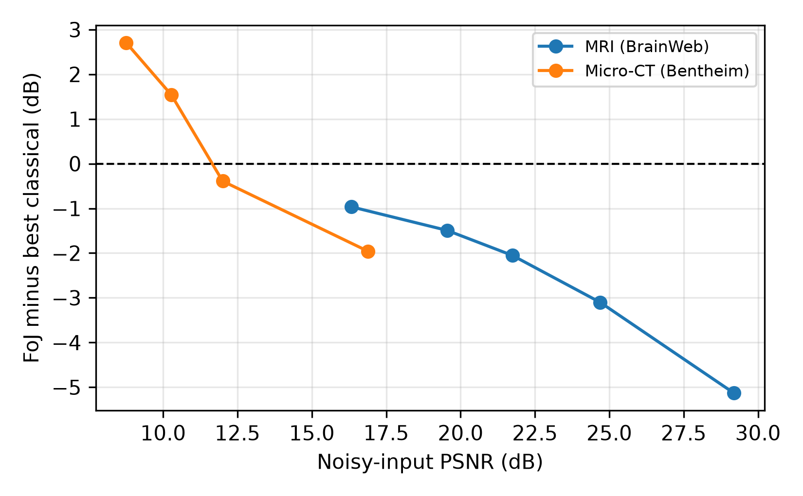
SYNTHESIS
One mechanism explains all three outcomes
FoJ helps only when all three hold:
unbiased input (means reproduce offsets),
piecewise-flat structure at ≥ patch scale,
noise high enough to pay for the wedge bias.
✓ Bentheim micro-CT
piecewise-flat grains > patch + input < 11 dB → best method (+3.2 dB)
✗ BrainWeb MRI
smooth gradients violate flatness → loses at every noise level
✗ Binary porous media
~2-voxel features < patch → collapses to the mean
FoJ margin (PSNR − best classical) vs. input PSNR across domains
3D FoJ · Section C Team 17
9
Notes:
The synthesis slide — the plot shows the same crossover on every domain: margin flips positive around ~11 dB input, but ONLY where structure is expressible. Structure decides whether FoJ can win; noise decides when it does.

Slide 10
Takeaways
3D FoJ is a structural prior, not a universal denoiser.
It wins where structure is piecewise-flat at patch scale and noise is severe — Bentheim micro-CT at 8.8 dB input: +3.2 dB over every classical filter.
It loses where gradients are smooth (MRI) or features are finer than a patch (binary media) — classical filters are better and cheaper.
Before adopting it check three things: is the input unbiased, is the structure expressible at patch scale, and is the noise above the crossover.
github.com/samudraneel05/SectionC_Team17
Thank you — questions?
Notes:
Close on the honest framing: FoJ isn't better or worse overall — it has knowable conditions. The three checks let a practitioner predict the outcome before running it.

