Slide 1
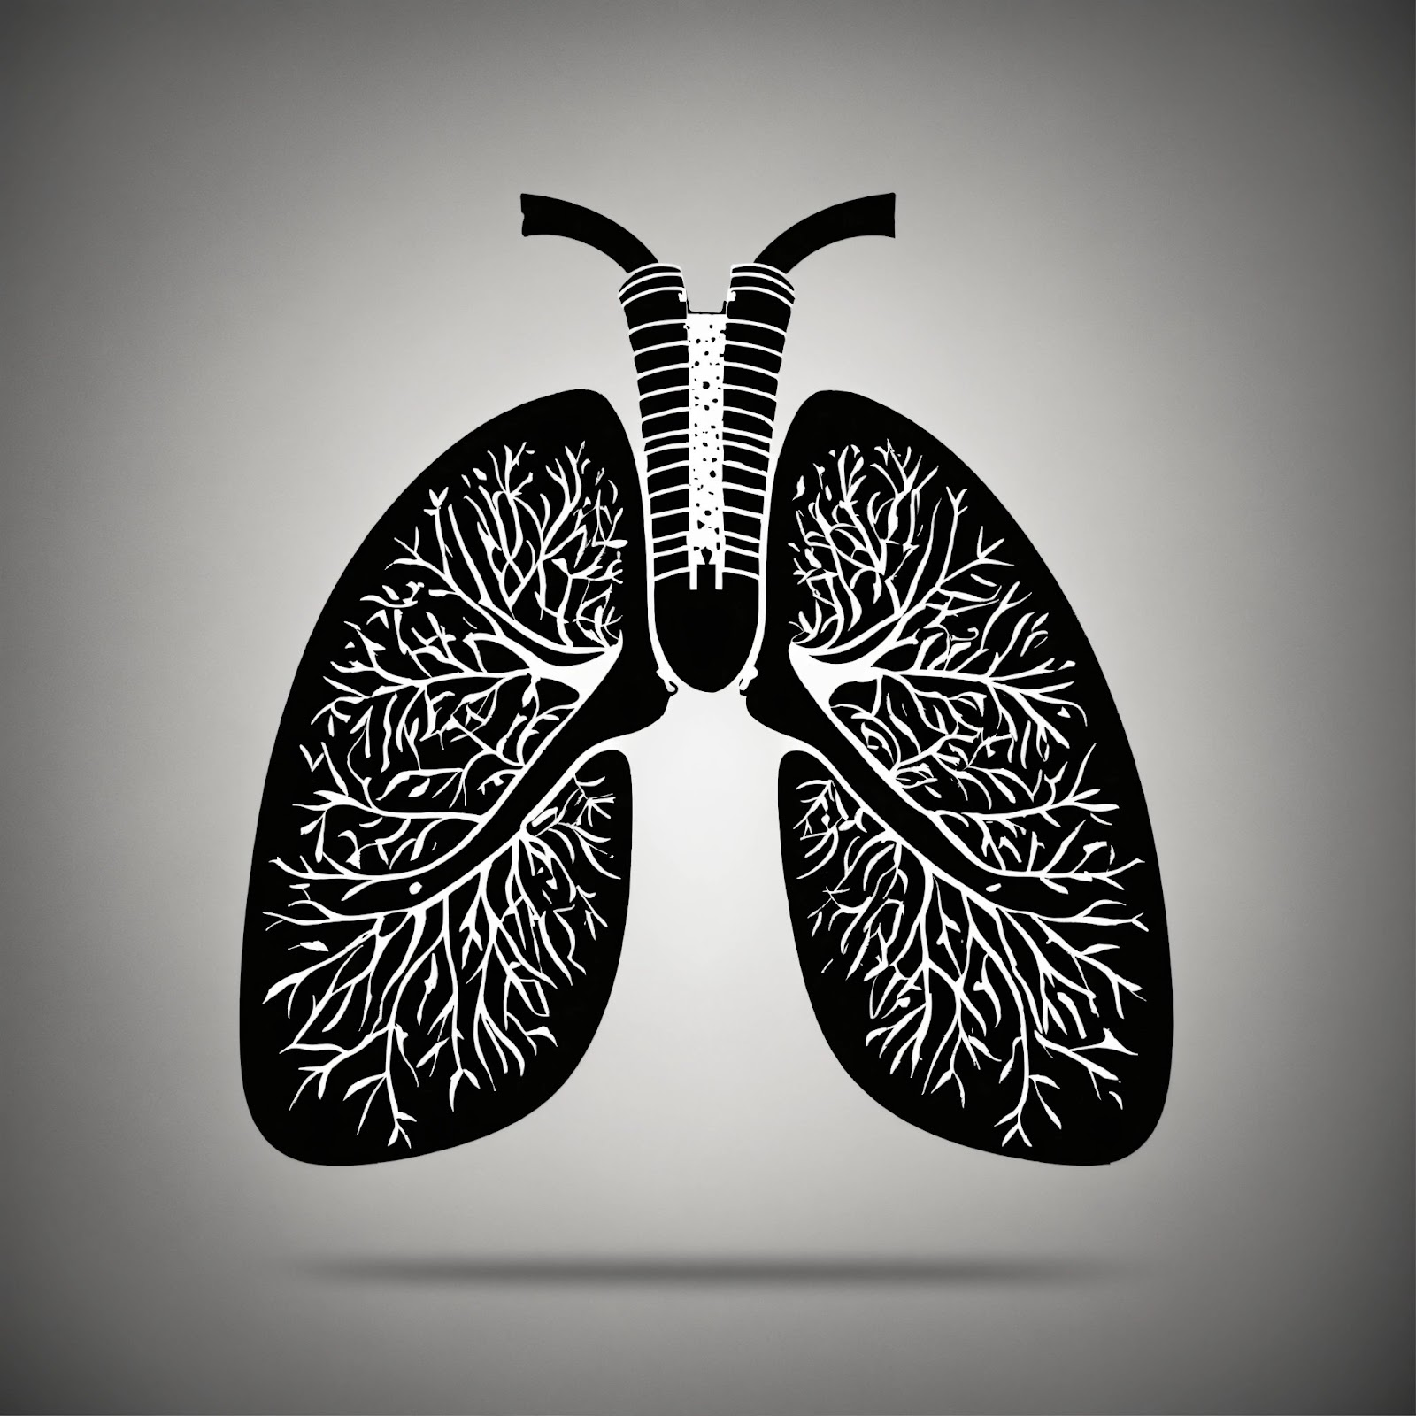
Deep Learning based diagnosis of tuberculosis using X-Ray Images
Presented by -
Under the Guidance of
Samudra Kumar Rana (10300120141)
Arnab Ghorai (10300320038)
Santu Mondal (10300121209)
Sagar Boyal (10300121208)
Mrs. Jheelam Mondal
Assistant Professor Department
of
Computer Science & Engineering

Slide 2
ABSTRACT
Create a smart system program that can look at X-ray pictures of lungs and tell if someone has tuberculosis using a special type of learning called Deep Learning. This will help doctors catch TB early and make the diagnosis process faster and more accurate, improving how patients are treated for this disease.
1

Slide 3
INTRODUCTION
TB is the second leading infectious killer after COVID-19
Caused by Mycobacterium tuberculosis
A total of 1.3 million people died from TB in 2022
It primarily affects the lungs, causing symptoms like cough, fever, and weight loss, posing a global health challenge.
2

Slide 4
LITERATURE / DOMAIN SURVEY
Exploring TB Diagnosis Literature
Overview of historical approaches to tuberculosis diagnosis.
Analysing X-ray Images for Enhanced TB Diagnosis.
Transfer learning and advanced preprocessing techniques showed high accuracy
3

Slide 5
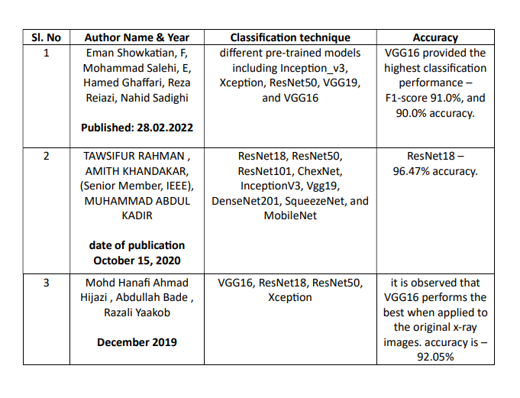
4

Slide 6
TECHNICAL SURVEY
Utilizing CNNs like VGG-16, VGG-19, Inception_v3, ResNet50 this survey explores automated TB diagnosis from X-ray images.
It covers CNN architectures, dataset utilization, model training and future advancements in TB diagnosis.
5

Slide 7
SYSTEM HW/SW REQUIREMENTS
Hardware: Minimum 8GB RAM, 256GB storage.
Software: Python 3.7+, Google Colab, CUDA-enabled GPU for efficient model training.
6

Slide 8
PROJECT REQUIREMENTS
Dataset Collection:
Utilized Kaggle dataset for X-ray images
Implemented techniques to balance the dataset, ensuring even representation of different classes or categories in the X-ray images.
Convolution Neural Network:
Architecture Application Applied CNN architecture for analyzing X-ray images.
Image Classification Used CNN for the classification of X-ray images.
Tuberculosis Detection Adapted CNN specifically for detecting tuberculosis in X-ray images.
7

Slide 9
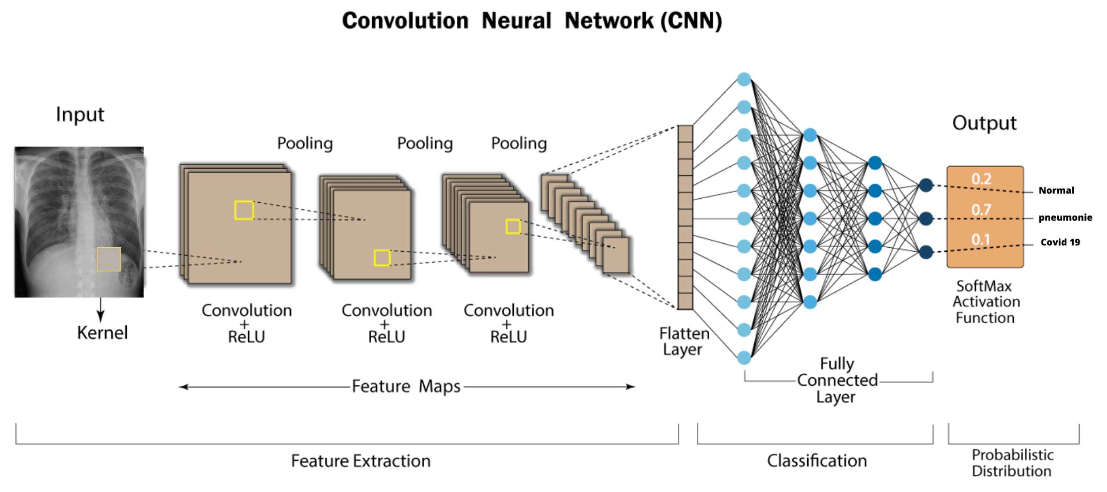
Fig 1: Simple CNN architecture [4]
8

Slide 10
DESIGN: IMPLEMENTATION OVERVIEW
Model Selection: Chose VGG16, VGG19, Inception_v3, ResNet50.
Coding: Used Keras to build models for TB detection.
Preprocessing: Enhanced X-ray images with Keras.
Training: Used categorical crossentropy and Adam optimizer.
Configuration: Trained models for 30 epochs.
Evaluation: Measured accuracy, precision, recall, F1-score.
9

Slide 11
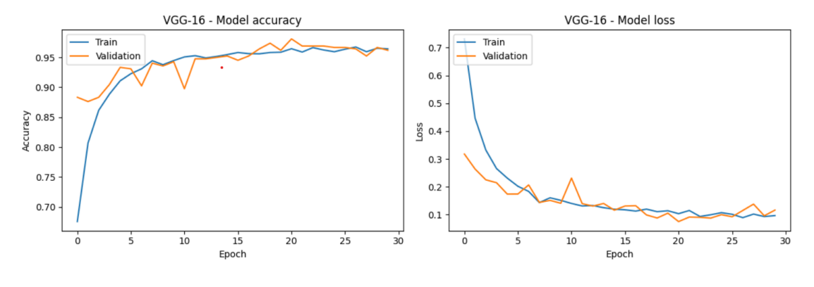

SNAPSHOT
Best Performing Pre-trained Model
Presentation of experimental results of VGG-16
Classification Report of VGG-16
10

Slide 12
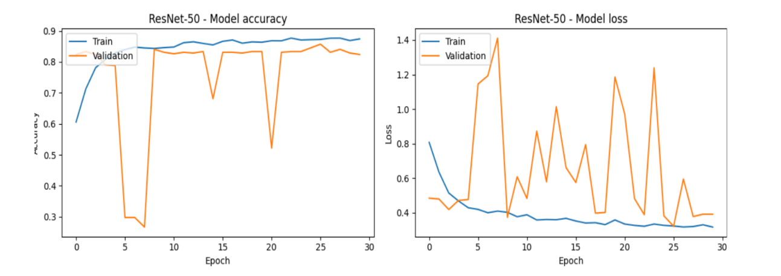

Worst Performing Pre-trained Model
Presentation of experimental results of ResNet50
Classification Report of ResNet50
11

Slide 13
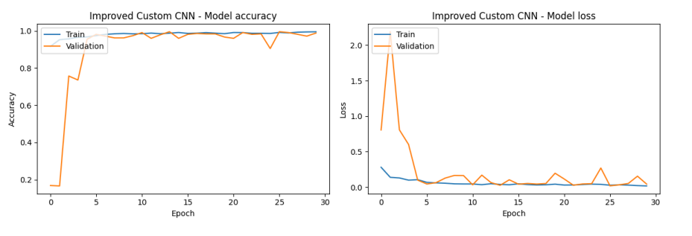

Performance of Our Proposed Custom CNN Model
Presentation of experimental results of Custom CNN
Classification Report of Custom CNN
12

Slide 14
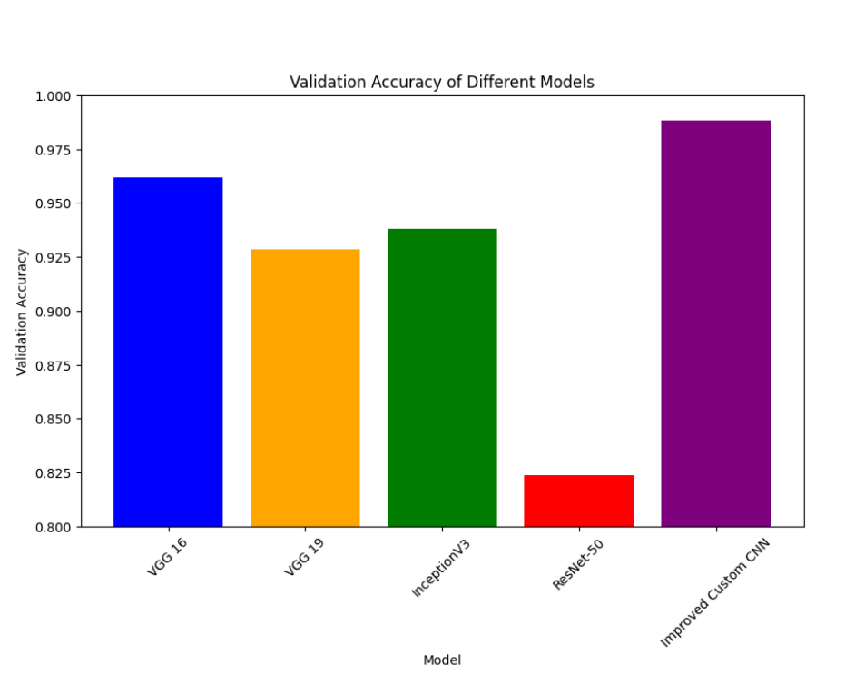
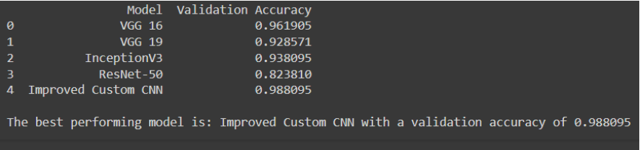
Result and Discussion
Fig 2: Validation Accuracy of Different Models & Best Performing Model
13

Slide 15
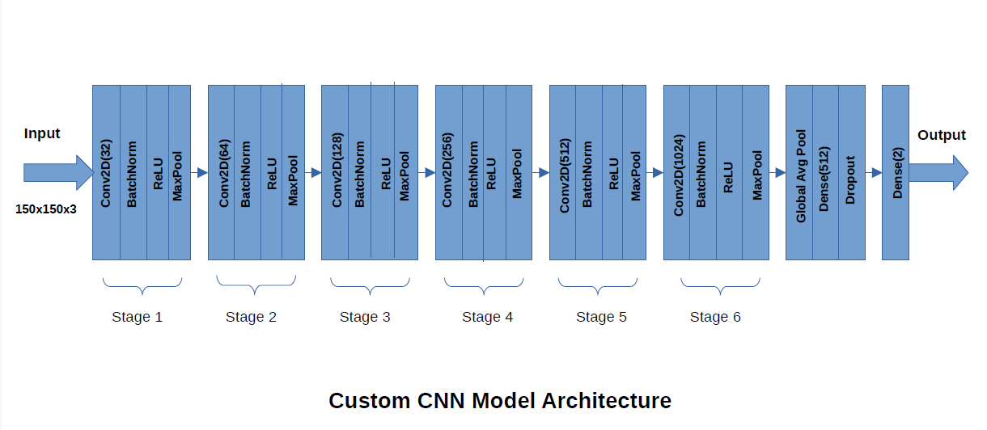
Custom CNN Model Architecture
14

Slide 16
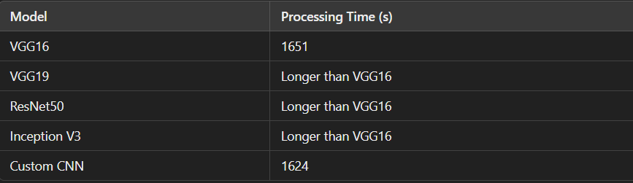
1. Improved custom CNN model achieved 98.8% validation accuracy. Significantly higher accuracy than previous models, which are shown in fig.3
2. Improved custom CNN trains faster than VGG16
3. VGG16 takes 1651 seconds for 30 epochs. Improved custom CNN takes 1624 seconds for 30 epochs
Fig 3: Model Processing Time
15

Slide 17
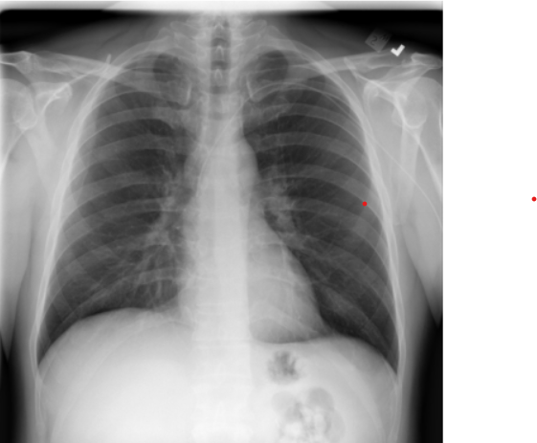
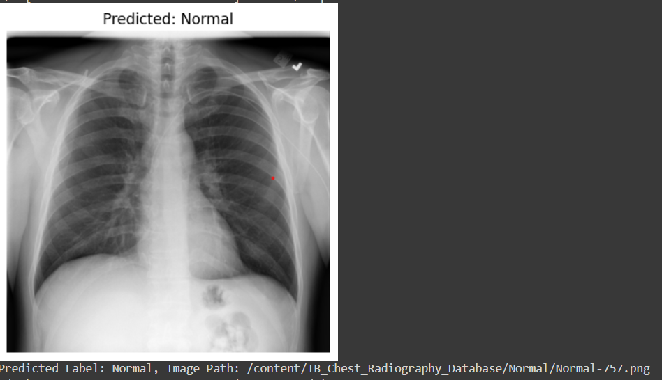
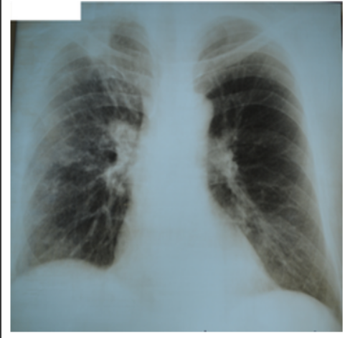
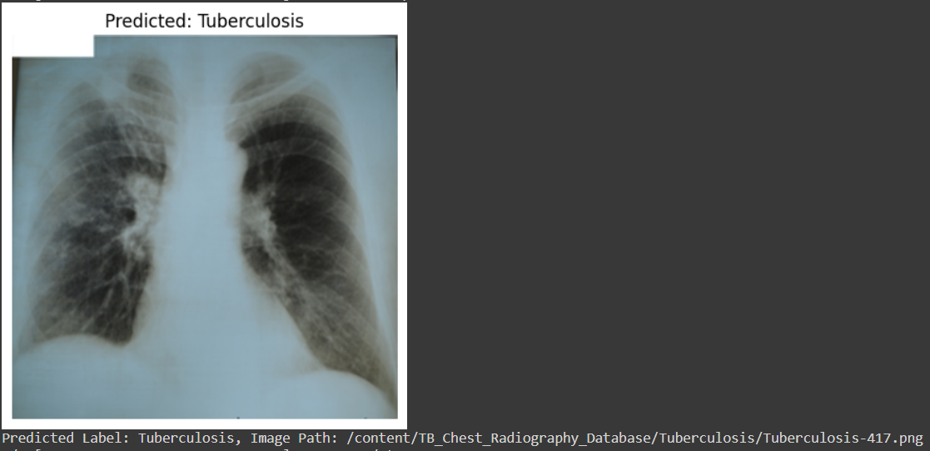
TB Prediction Using Custom CNN Model
Prediction Using Custom CNN
Fig 4: Normal Image
Fig 5: Predicted Normal Image
Prediction Using Custom CNN
Fig 7: Predicted TB Effected Image
Fig 6: TB Effected Image
16

Slide 18
FUTURE SCOPE
Enhance Algorithm Efficiency: Optimize and refine current algorithms to improve diagnostic accuracy and reduce computational costs.
Data Augmentation & Segmentation: Implement advanced data augmentation and segmentation techniques to increase the robustness of the model.
Explore Diverse Deep Learning Architectures: Investigate and test various deep learning models to identify the most effective architecture for tuberculosis detection.
Integrate More Medical Data: Incorporate additional medical datasets to enhance diagnostic comprehensiveness and reliability.
Custom CNN Model Improvement: Continue developing and refining our custom CNN model for better performance and efficiency.
17

Slide 19
CONCLUSION
Successful use of deep learning for TB diagnosis
Promising results and achievements
Future potential for enhanced accuracy and broader impact
Till now, our custom CNN model provides the best accuracy for tuberculosis detection among all the models we have explored.
18

Slide 20
REFERENCES
[1] Global Tuberculosis Report 2023, WHO, Geneva, Switzerland, 2023
[2] S. K. Sharma and A. Mohan, ‘‘Tuberculosis: From an incurable scourge to a curable disease-journey over a millennium,’’ Indian J. Med. Res., vol. 137, no. 3, p. 455, 2013.
[3] C. Silverman, ‘‘An appraisal of the contribution of mass radiography in the discovery of pulmonary tuberculosis,’’ Amer. Rev. Tuberculosis, vol. 60, no. 4, pp. 466–482, 1949.
[4] https://www.mdpi.com/2079-9292/11/11/1775
[5] Dataset collection - [Kaggle](https://www.kaggle.com/datasets/tawsifurrahman/tuberculosis-tb-chest-xray-dataset)
19

Slide 21
THANK YOU

