Slide 1
MACROECOECONOMIC DYNAMICS OF KENYA AND ETHIOPIA 1995 - 2030
© 2025

Slide 2
This presentation will analyze macroeconomic variables of both countries and present findings either to substantiate or refute the claims made by the IMF and World Bank.
MAIN QUESTION?
PURSOSE
Will Kenya surpass Ethiopia and become the largest economy in East Africa?
AUTHOR
SAMUEL ASRADE

Slide 3
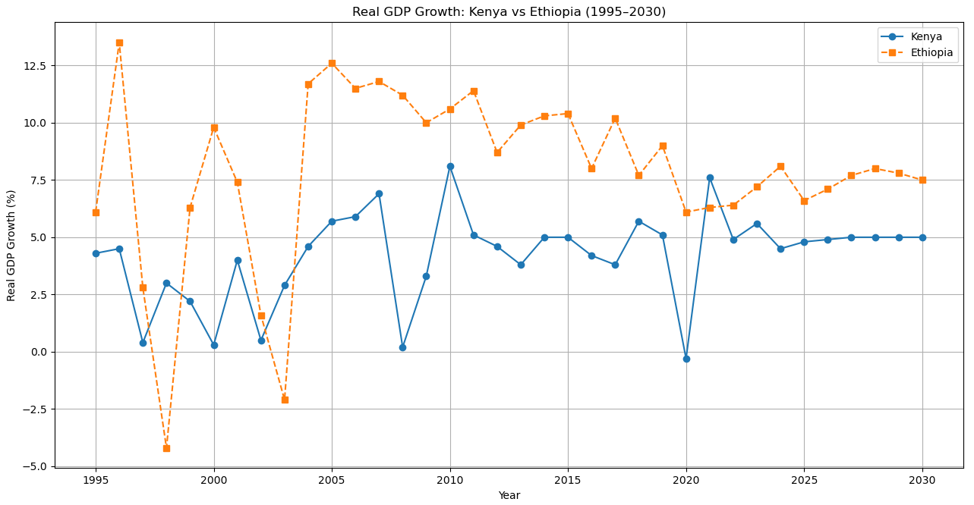
Ethiopia and Kenya are the two largest economies in East Africa.
While Ethiopia has been a dominant economic hub in the region for several decades, its economy has experienced significant fluctuations, particularly in the past four years.
Major international institutions, including the IMF and World Bank, forecast that Kenya’s economy will surpass Ethiopia’s by 2026.
KEY POINTS FROM THE FIGURE:
Real GDP of both Ethiopia and Kenya has fluctuated over time.
Ethiopia maintained a higher real GDP than Kenya from the early 2000s to early 2020s, despite a brief sudden drops 1997 and 2004.
Both countries’ real GDP fell in 2020, possibly due to the impact of COVID 19. Kenya was hit hard, but was able to recover faster.
As of the latest data, Ethiopia’s real GDP remains higher and is projected to stay ahead over the next five years.
The Data from 2025 to 2030 are based on IMF predictions.

Slide 4
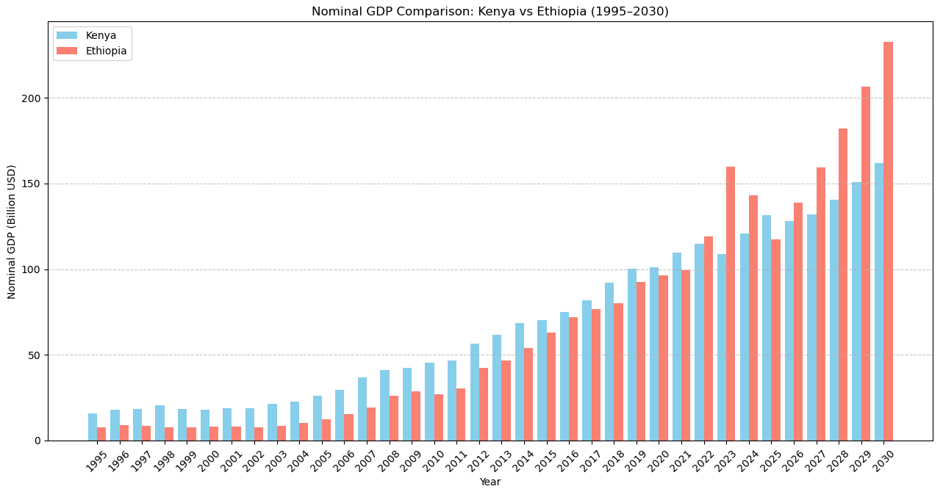
Nominal GDP is one of the most closely monitored macroeconomic indicators.
However, it is also highly susceptible to political manipulation, as it can be influenced without reflecting actual changes in the economy.
By inflating a country’s currency, the nominal GDP can appear to grow, even if there is little or no real change in output or income.
KEY POINTS FROM THE FIGURE:
Generally, Ethiopia and Kenya had a growing nominal GDP over the observed period. Ethiopia’s growth rate was faster, surpassing Kenya’s nominal GDP in 2022.
Ethiopian nominal GDP sharply increased in 2023, but began to decline, allowing Kenya to regain the lead in 2025. Possible factors for the decline in Ethiopian nominal GDP could be devaluation of birr, exclusion from AGOA and political conflicts across the country.
According to IMF Ethiopia will maintain a higher nominal GDP in the next five years.
The Data from 2025 to 2030 are based on IMF predictions.

Slide 5
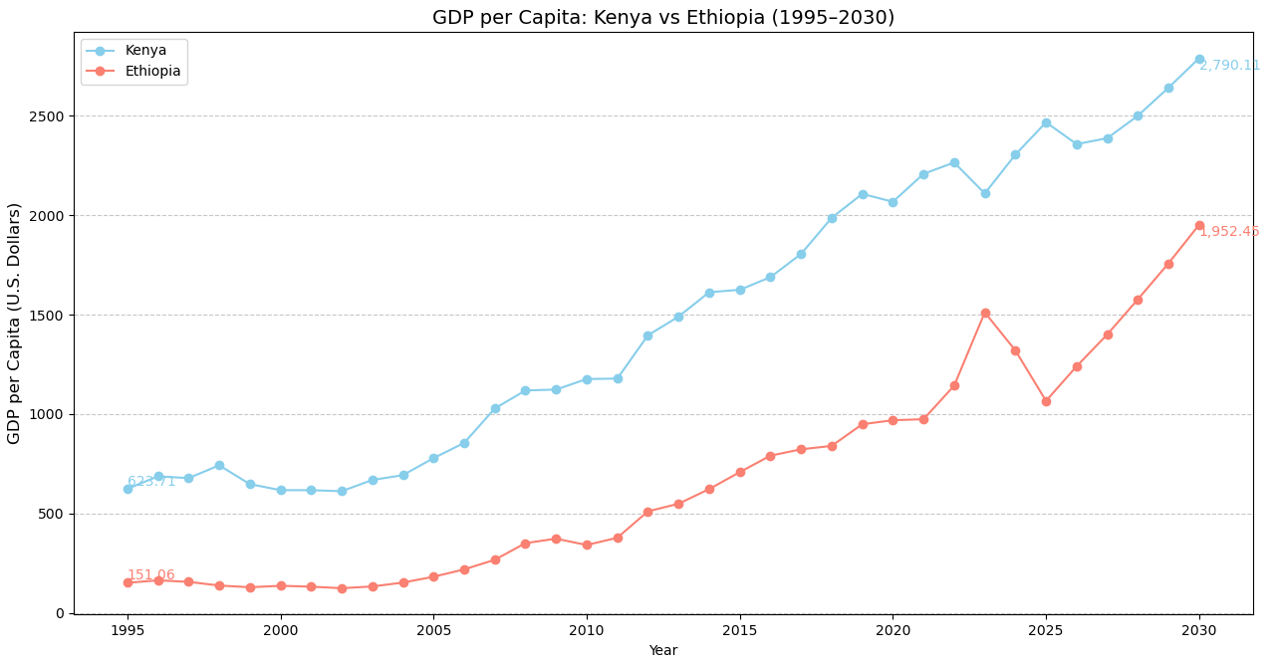
Per Capita GDP is one of the most comprehensive and accurate measures of a nation's economic performance.
It represents the average income of individuals if the country’s total output were evenly distributed across the population.
While theoretical, it provides a clear indication of economic performance relative to the size of the population.
KEY POINTS FROM THE FIGURE:
Both countries saw rising GDP per capita, but Kenya’s per capita output remains far higher. In 2024 Kenya’s GDP per capita (~$2,305) was twice Ethiopia’s (~$1,320).
Both economies contracted in 2023; however, Kenya demonstrated a swift recovery, whereas Ethiopia’s GDP per capita continued to decline through 2025.
Ethiopian population has been growing at a faster pace than Kenya’s; thus, even if Ethiopia’s aggregate GDP growth exceeds Kenya’s, the faster population growth pulls down its per-capita growth.
Forecasts suggest a gradual recovery for Ethiopia, but the gap is expected to widen.
The Data from 2025 to 2030 are based on IMF predictions.

Slide 6
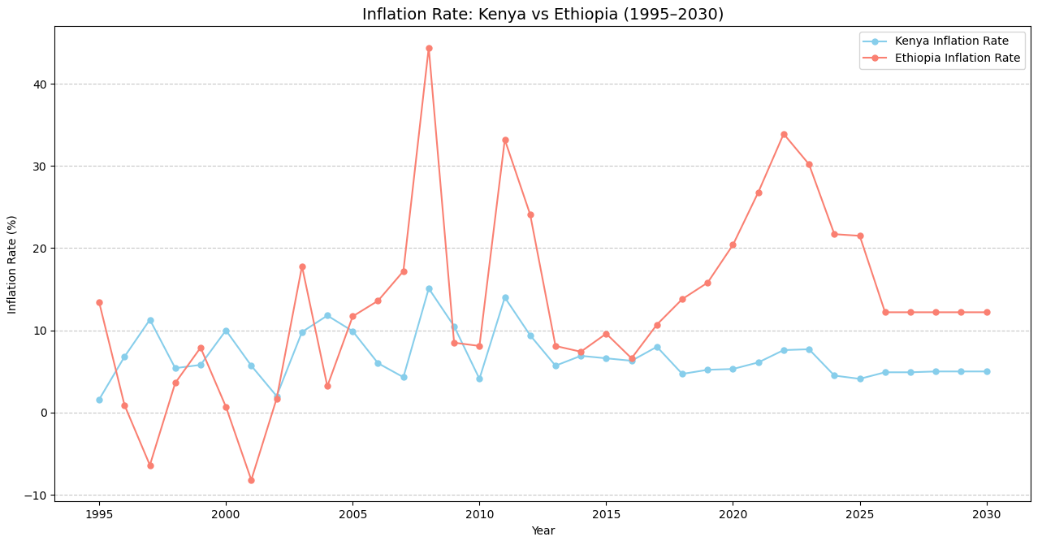
Inflation is a key macroeconomic indicator that reflects the stability and health of an economy.
The inflation rate measures the percentage change in the general price level of goods and services within a specific economy.
It is an essential gauge of changes in the purchasing power of money over time, influencing consumer behavior and economic decision-making.
KEY POINTS FROM THE FIGURE:
Kenya’s inflation has been relatively moderate and stable: typically single digits or low double digits.
Ethiopia’s inflation has been volatile and very high in recent years, reflecting currency devaluations and economic shocks. For example, there was a peaked in 2008 and 2022, and notable disinflation in the late 1990s and early 2000s.
Ethiopia’s chronic fiscal and supply pressures (financed by money printing) drive its high inflation, whereas Kenya has pursued tighter monetary policy and fiscal restraint.
The Data from 2025 to 2030 are based on IMF predictions.

Slide 7
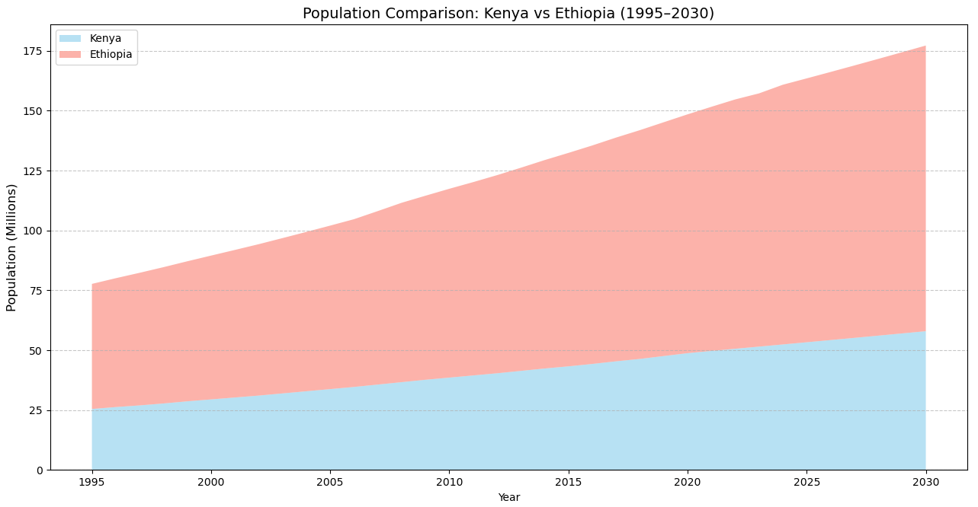
Historically, large populations were often linked to poverty, as the focus was placed on the marginal consumption of people rather than their potential economic contribution.
However, in recent decades, several populous Asian countries have achieved rapid development by optimizing the allocation of human capital.
This highlights the importance of investing in and developing human capital to foster sustainable economic growth.
KEY POINTS FROM THE FIGURE:
Both nations have rising population, with Ethiopia’s growth rate outpacing Kenya’s.
Between 1995 and 2024, Ethiopia’s population grew from 52 million to 108 million, while Kenya’s increased from 25 million to 52 million.
By 2030, Ethiopia’s population is expected to surpass 175 million—nearly three times the size of Kenya’s.
With proper human capital investment, Ethiopia’s population can be a strategic asset. Without it, population growth may intensify dependency and deepen the poverty trap.
The Data from 2025 to 2030 are based on IMF predictions.

Slide 8
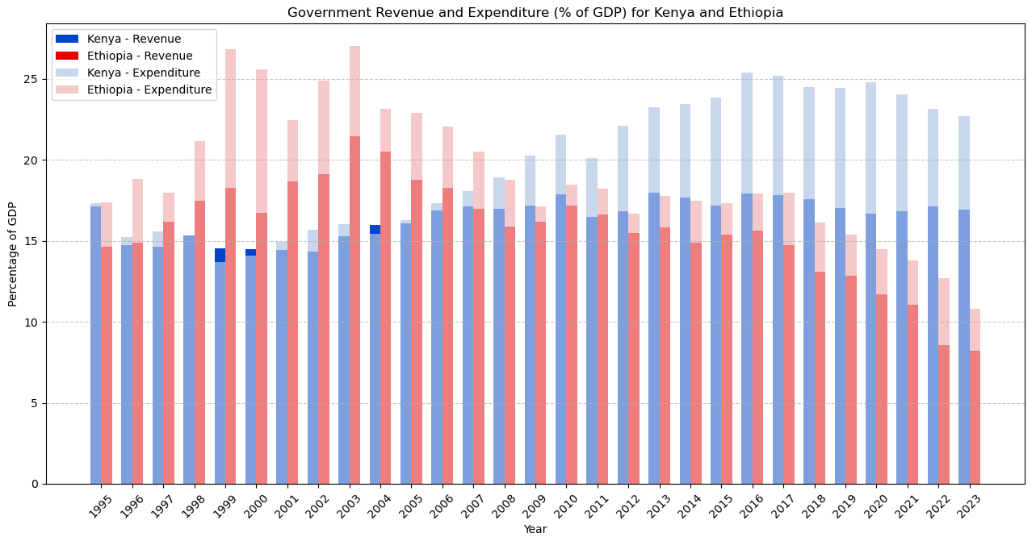
Increased public expenditure—especially on infrastructure, social programs, or stimulus measures—can drive economic expansion by boosting aggregate demand.
Government revenue, mainly sourced from taxation and state asset sales, finances essential public services and can be used to curb inflation through fiscal tightening, such as spending cuts or tax increases. The balance between these two determines the government’s fiscal stance and its impact on the broader economy.
KEY POINTS FROM THE FIGURE:
From 1995 to 2008, Kenya maintained a fiscal balance, with government revenue and expenditure roughly equal. Post-2008, Kenya’s expenditure steadily outpaced its revenue, exceeding it by approximately 35% in 2023.
Ethiopia stringent had fiscal deficits in the entire period. In the late 1990s and early 2000s, Ethiopia’s fiscal size (both revenue and expenditure) was up to 85% larger than that of Kenya.
Even though Kenya’s fiscal gap was increasing, its government revenue was significantly larger than that of Ethiopia, reaching over 100% higher by 2023.

Slide 9
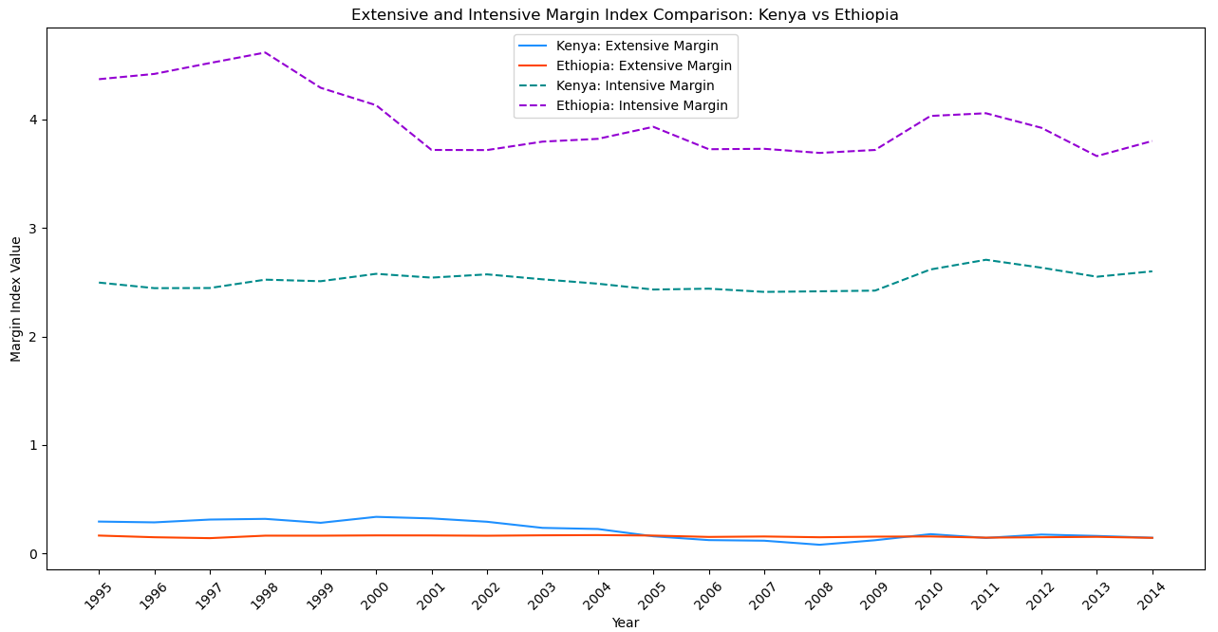
The extensive margin measures the extent to which a country diversifies into new products, export destinations, or production: a shift toward broadening economic activity.
The intensive margin captures efforts to deepen existing export lines, improve current production capabilities, or expand trade volume within established markets. These indicators assess whether an economy is focused on diversification or on maximizing returns from existing strengths.
KEY POINTS FROM THE FIGURE:
Both Ethiopia and Kenya had relatively stable but lower extensive margin indices, with Kenya’s marginally being higher
Ethiopia’s intensive margin was consistently higher than Kenya’s, but exhibited significant fluctuations. Kenya’s intensive margin remains steady across the years.
The figure suggests both countries are more focused on the intensive margin (e.g., scaling up existing exports like coffee and horticulture) rather than prioritizing the extensive margin (e.g., diversifying into manufactured goods or technology exports).

Slide 10
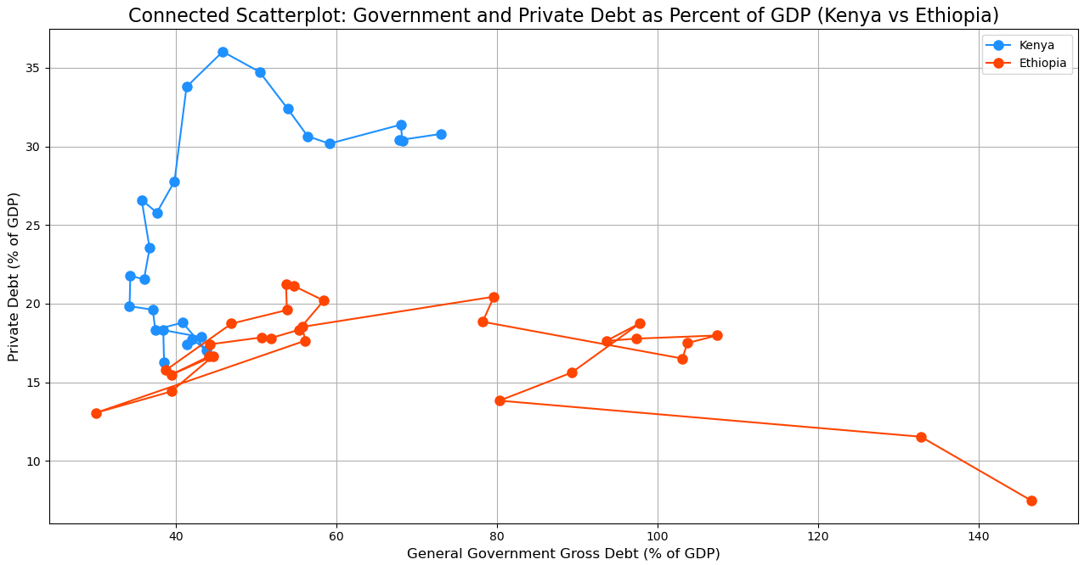
Both the government and the private sector rely on borrowing—typically for infrastructure and investment, respectively.
In Kenya, the private sector has long enjoyed access to both domestic and international financial markets. In contrast, private firms were restricted from accessing foreign credit markets in Ethiopia, resulting in constrained private sector growth. Only in recent years did such restrictions begin to ease for Ethiopian businesses.
KEY POINTS FROM THE FIGURE:
From 1995 to 2023, government borrowing in Ethiopia rose by 1000% (from 0.15% to 1.5% of GDP), while it increased by 75% (from 0.4% to 0.7% of GDP) in Kenya.
Private sector borrowing declined by 70% in Ethiopia but doubled in Kenya over the same period. This suggests that Kenya promoted private sector development through greater credit access, whereas Ethiopia maintained a state-dominated financial system.
The data indicates a rapidly expanding role of the state in Ethiopia’s economy, in contrast to a relative modest role in Kenya.

Slide 11
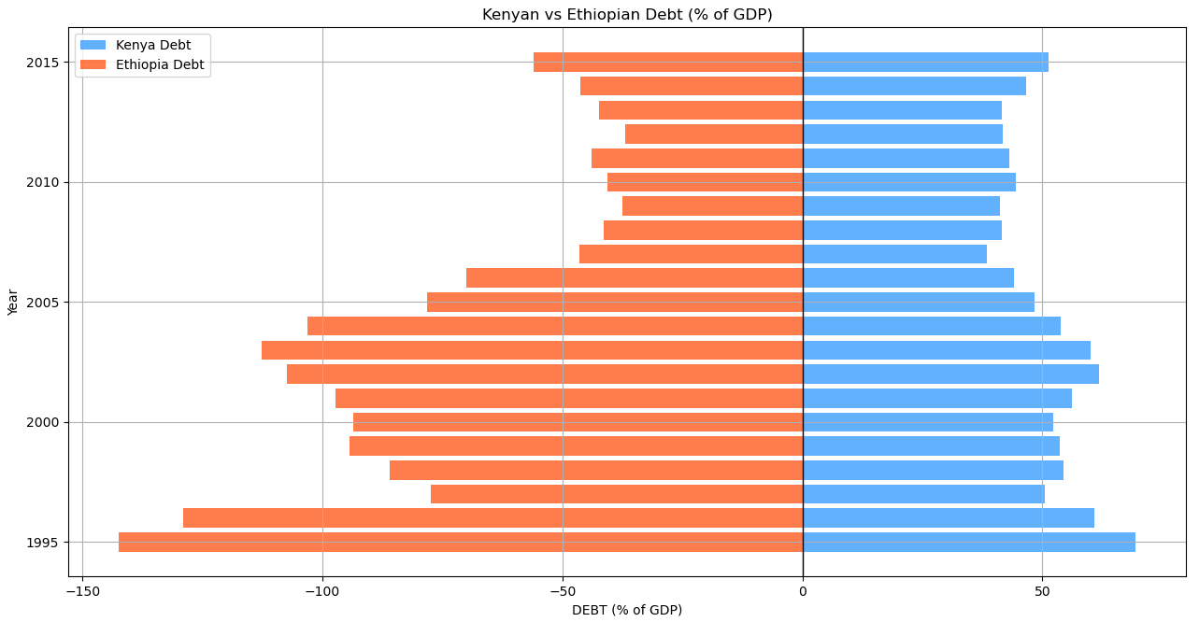
In recent years, debt has become one of the most pressing issues that many economies—both developed and developing—are grappling with.
Besides to the rising cost of debt servicing, high debt levels can crowd out critical public investment, increase the risk of inflation, weaken investor confidence, reduce the government’s ability to respond to future economic shocks, and ultimately lead to debt distress and dependence on external financial assistance.
KEY POINTS FROM THE FIGURE:
Ethiopia had a significantly higher public debt-to-GDP ratio than Kenya from the mid-1990s to the mid-2000s, peaking at around 140%
Kenya maintained a relatively stable and manageable debt profile over the period, consistently below 50% of its GDP.
Post-2005, Ethiopia’s debt burden declined sharply, converging with Kenya’s and remaining under 50% of GDP.
Although recent debt data is not included, historical patterns suggest Kenya has maintained a more stable debt trajectory over time.

Slide 12
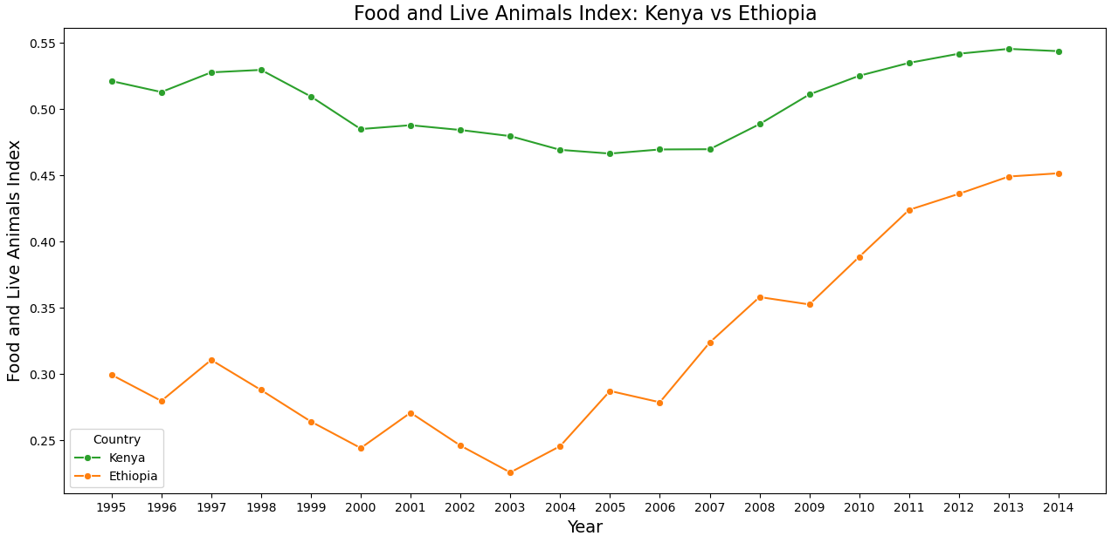
Agriculture remains the primary source of livelihood for the majority of Kenyans and Ethiopians.
The Food and Live Animals Index tracks the trade performance in terms of price levels and volume of food and livestock products in international markets.
An increase in this index typically reflects an improved trade performance, either through higher export volumes, better global prices, or both.
KEY POINTS FROM THE FIGURE:
Kenya maintained a consistently higher and more stable Food and Live Animals index over the observed period.
Ethiopia’s Food and Live Animals index declined steadily until reaching its lowest point in 2003; thereafter, it experienced a strong upward trajectory, reaching 0.45 by 2014, compared to Kenya’s 0.54.
The data highlights Ethiopia’s slow but tangible performance in narrowing its gap with Kenya in this trade category.

Slide 13
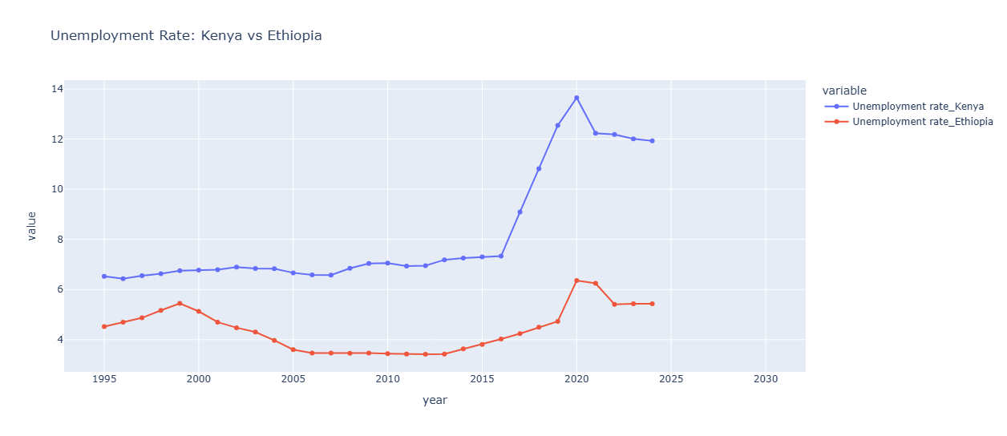
The unemployment rate measures the proportion of individuals who are actively seeking employment but are unable to find work, relative to the total labor force. The labor force comprises all individuals who are either employed or actively looking for work.
An individual is classified as unemployed if s/he possess the necessary qualifications, skills, or physical capacity to work and have been actively searching for a job during the past four weeks but remain without employment.
KEY POINTS FROM THE FIGURE:
Ethiopia maintained a relatively low unemployment rate—below 7%—throughout the observed period.
Kenya, on the other hand, exhibited stable unemployment levels until 2016, after which the rate surged, peaking at 14% in 2020. Although Kenya’s unemployment rate declined post-2020, it remained elevated compared to earlier years.
As of 2024, Ethiopia’s unemployment rate stood at 5%, while Kenya’s was significantly higher at 12%.

Slide 14
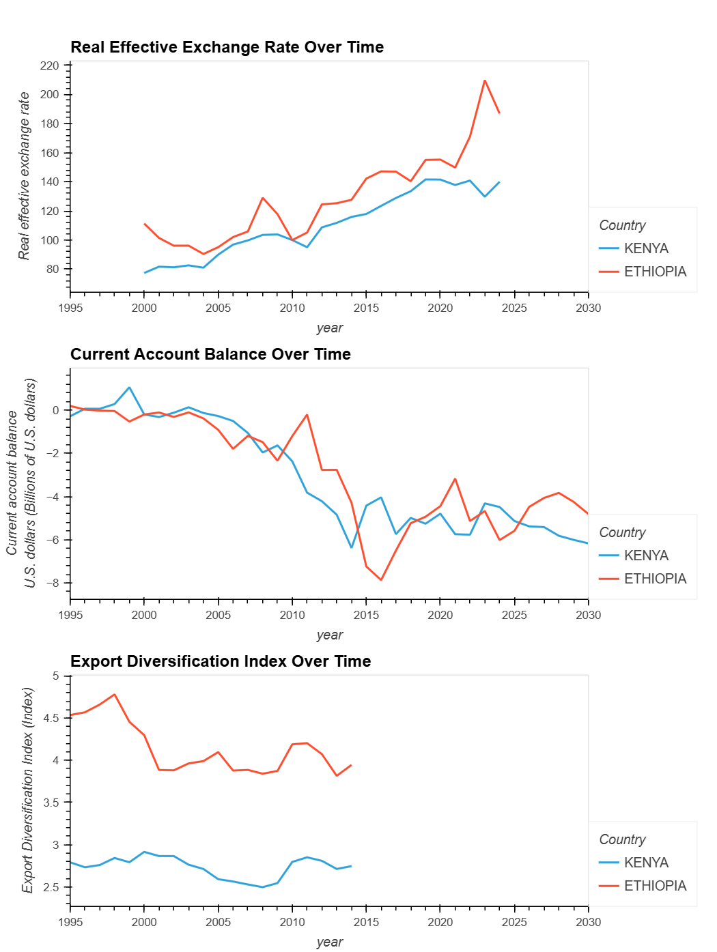
KEY POINTS FROM THE FIGURE:
From 1995 to 2020, both Ethiopia and Kenya had a generally increasing Real Effective Exchange Rate (REER), though Ethiopia's showed more volatility.
Ethiopia’s real effective exchange rate appreciated into 2020, implying reduced export competitiveness, whereas Kenya’s REER had been relatively stable (and even eased slightly post-2020).
A rising REER in Ethiopia made exports less competitive and imports cheaper, potentially creating current account deficits and harming domestic industries.
/////////////////////////////////////////////////////////////////////////////////////////////////////////////////////////////////////////////////////////////////////////
Both countries maintained relatively balanced current account in the mid-1990s, but deficits widened over time, peaking in the mid-2010s.
Ethiopia is projected to have a higher current account deficit than Kenya over the next five years.
////////////////////////////////////////////////////////////////////////////////////////////////////////////////////////////////////////////////////////////////////////////
Export diversification data (1995–2014) indicates Ethiopia outperformed Kenya, likely driven by its expanding service exports, notably in the aviation, hydro-electric energy and small manufacturing sector.

Slide 15
Back to Our Question: Will Kenya Become East Africa’s Largest Economy?
By nominal GDP (market-adjusted), the IMF projections indicate that Kenya (~$132 b in 2025) will surpass Ethiopia (~$117 b) by 2025–2026. But, by the real GDP (inflation adjusted), Ethiopia likely remains slightly larger through 2030. Hence, under current conditions, Kenya is poised to become the largest economy in East Africa by mid-2020s, especially on a nominal GDP basis.
Macroeconomic theory suggests growth depends on productivity and capital accumulation. Kenya’s economy benefits from better infrastructure, stronger institutions, and a diversified private sector. Ethiopia’s growth has been driven by heavy public investment (roads, energy) but lately hampered by conflict and inflation.
A stable political arena in Kenya (multi-party democracy) has generally supported foreign investment, whereas Ethiopia’s recent conflicts in Tigray and Amhara have increased security risks and significantly reduced investors confidence.

Slide 16
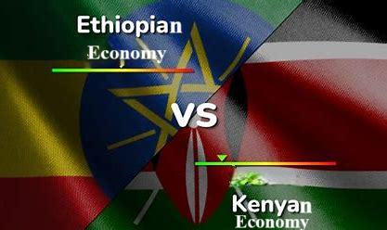
Data Source:
https://www.imf.org/external/datamapper/profile/ETH
https://www.imf.org/external/datamapper/profile/KEN
https://fred.stlouisfed.org/series/SLUEM1524ZSETH
https://fred.stlouisfed.org/series/SLUEM1524ZSKEN
https://data.worldbank.org/indicator/PX.REX.REER?end=2024&locations=KE&start=2006
https://data.worldbank.org/indicator/PX.REX.REER?end=2024&locations=ET&start=2000&type=points&view=chart&year=2000
Graphical visualizations are done by python
© 2025

