Slide 1
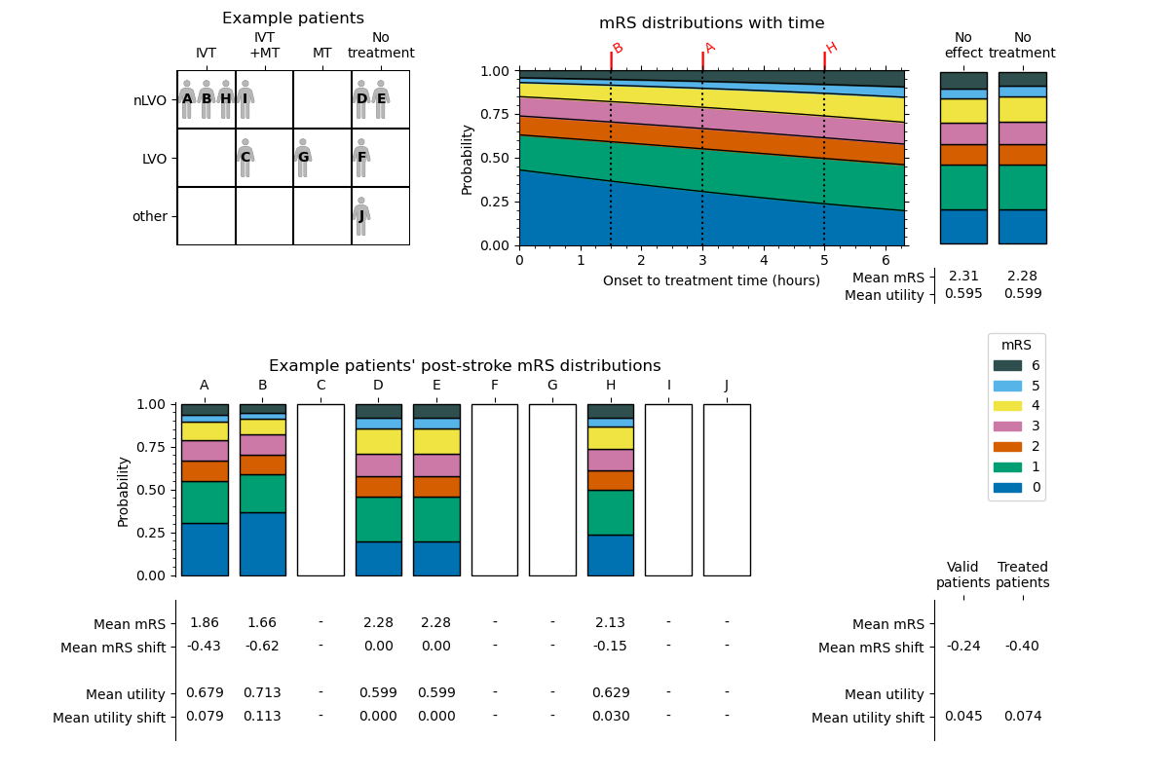
mrs_not_treated
mrs_no_effect
utility_no_effect
utility_not_treated
each_patient_mrs_dist_post_stroke
treated_patients_
mean_mrs_shift
valid_patients_
mean_mrs_shift
each_patient_mrs_post_stroke
each_patient_mrs_shift
each_patient_utility_post_stroke
treated_patients_
mean_utility_shift
each_patient_utility_shift
valid_patients_
mean_utility_shift

