Slide 1
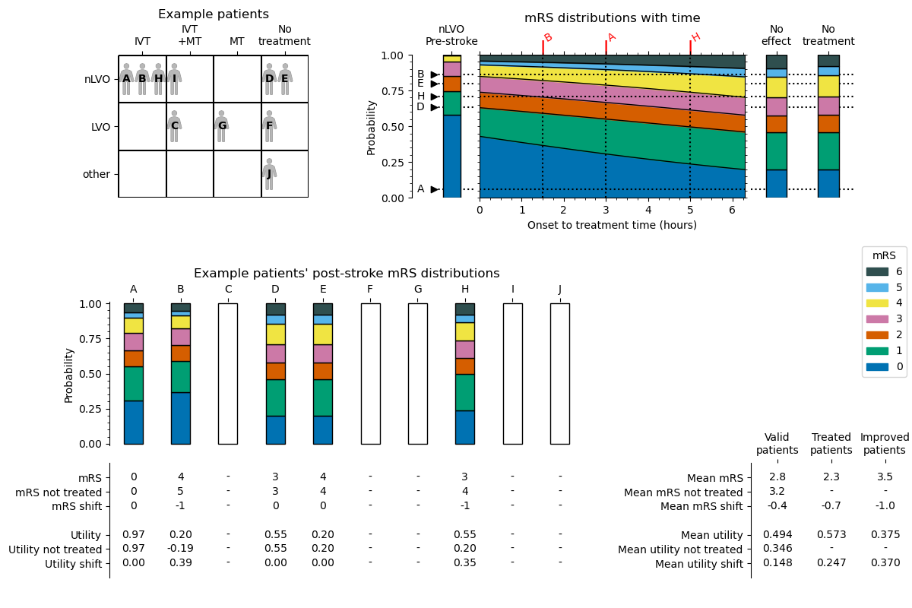
each_patient_mrs_dist_post_stroke
mean_mrs_post_stroke
mean_mrs_not_treated
mean_mrs_shift
mean_utility_post_stroke
mean_utility_not_treated
mean_utility_shift
valid_
patients_
improved_
patients_
treated_
patients_
each_patient_mrs_post_stroke
each_patient_mrs_not_treated
each_patient_mrs_shift
each_patient_utility_post_stroke
each_patient_utility_not_treated
each_patient_utility_shift

