Slide 1
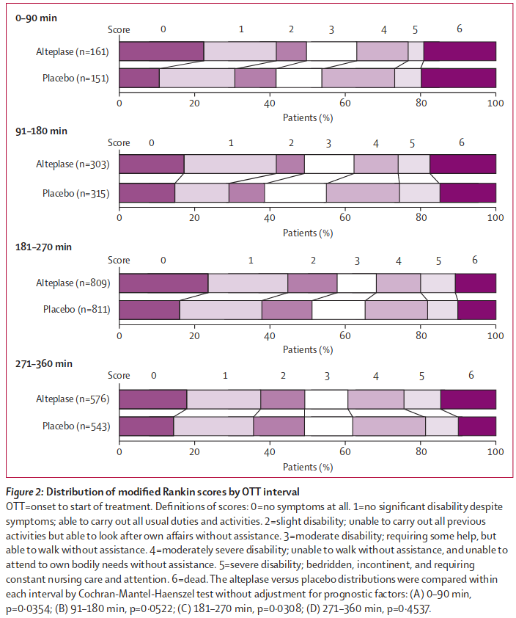
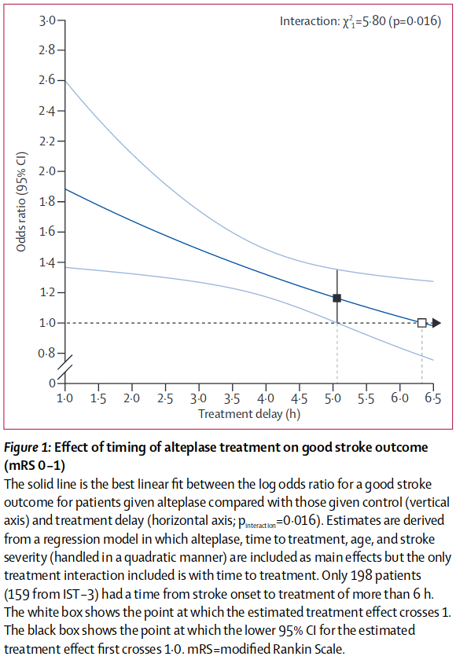
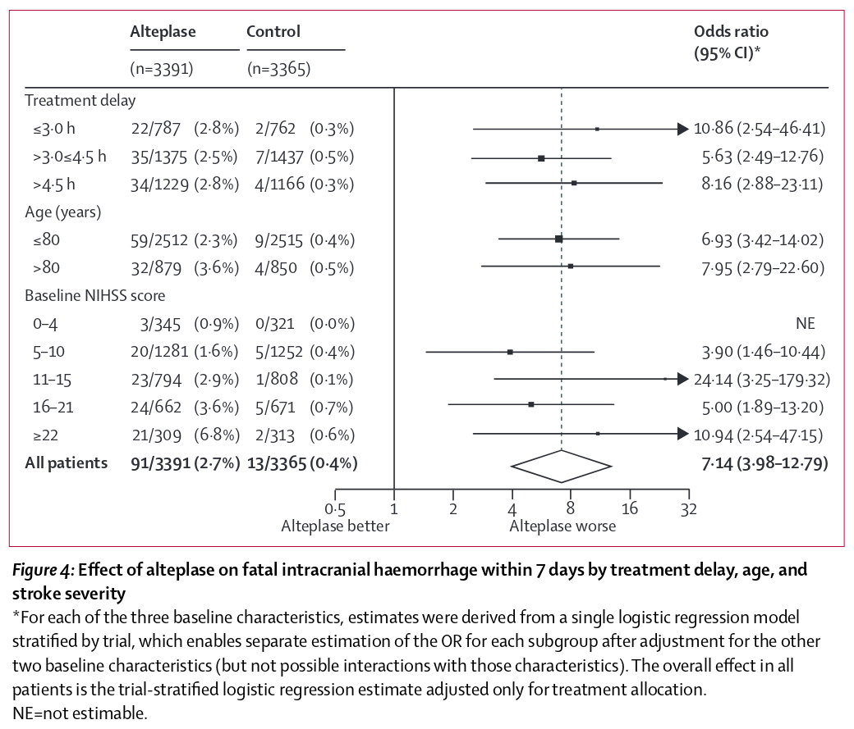
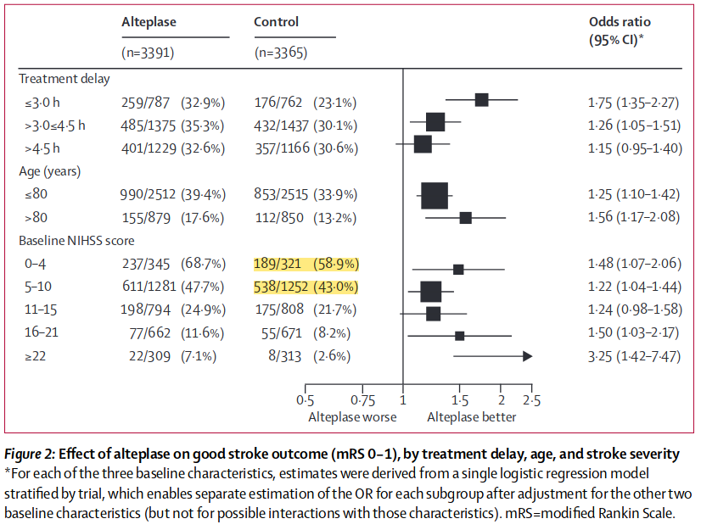
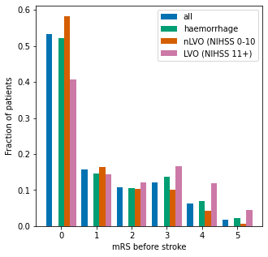
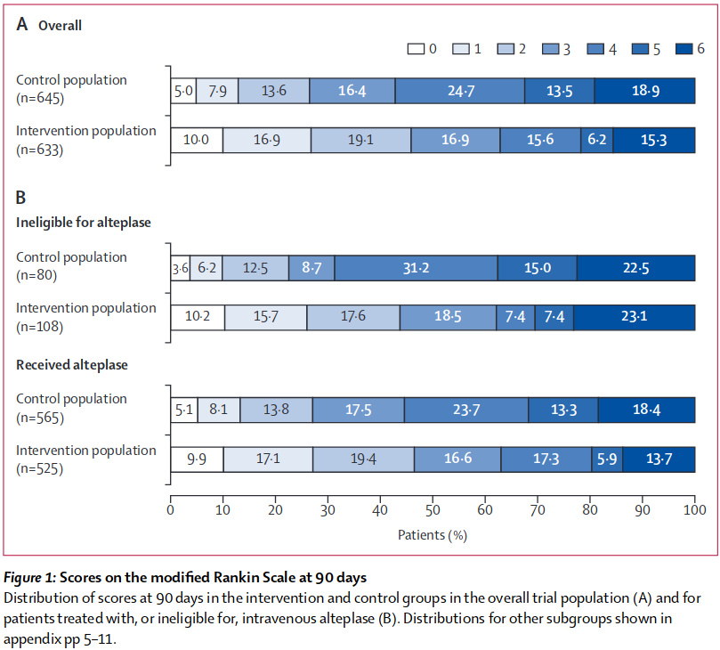
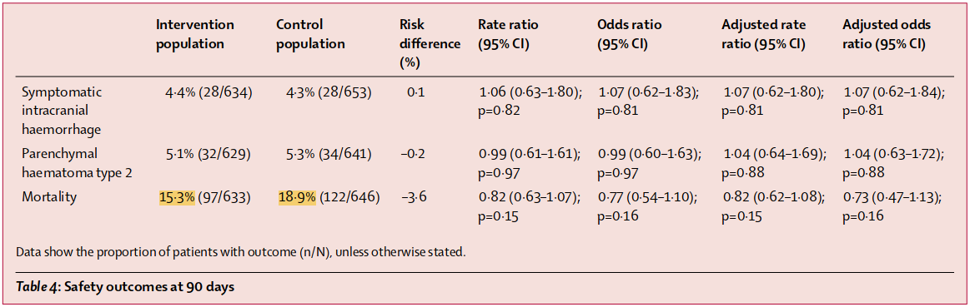
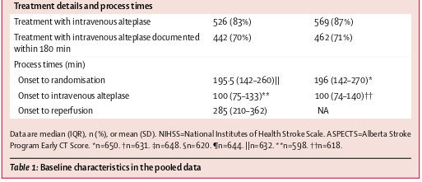
Derived mRS distributions
mRS | Pre-stroke | IVT at time zero | IVT at no-effect time | No treatment
0 | 0.583 | 0.445 | 0.196 | 0.198
1 | 0.163 | 0.197 | 0.259 | 0.262
2 | 0.104 | 0.110 | 0.119 | 0.120
3 | 0.101 | 0.110 | 0.127 | 0.128
4 | 0.042 | 0.079 | 0.146 | 0.148
5 | 0.007 | 0.026 | 0.061 | 0.062
6 | 0.000 | 0.033 | 0.092 | 0.082
Intravenous alteplase meta-analysis
Lees et al. 2010
nLVO
“placebo” population mRS distributions for nLVO and LVO patients combined.
SAMueL-1 survey
Pre-stroke patient mRS scores.
Alteplase
meta-analysis
Emberson et al. 2014
Decline of odds ratio of good outcome with time.
Mortality rates with and without IVT.
NIHSS < 11 probabilities of good outcome.
mRS | IVT at time zero | IVT at no-effect time
0 | 0.140 | 0.048
1 | 0.093 | 0.076
2 | 0.128 | 0.131
3 | 0.161 | 0.159
4 | 0.208 | 0.239
5 | 0.108 | 0.130
6 | 0.162 | 0.217
mRS | Pre-stroke
0 | 0.408
1 | 0.144
2 | 0.120
3 | 0.166
4 | 0.118
5 | 0.044
6 | 0.000
mRS | No treatment
0 | 0.050
1 | 0.079
2 | 0.136
3 | 0.164
4 | 0.247
5 | 0.135
6 | 0.189
LVO
mRS | MT at time zero | MT at no-effect time
0 | 0.306 | 0.048
1 | 0.123 | 0.076
2 | 0.119 | 0.131
3 | 0.159 | 0.157
4 | 0.144 | 0.237
5 | 0.064 | 0.130
6 | 0.085 | 0.221
mRS distribution of control population.
“Our traditional meta-analysis yielded a pooled rate of successful recanalization for IVT+MT of 75% (95% CI, 65%–83%; Figure XIC in the Data Supplement).”
Recanalisation meta-analysis
Hui et al. 2020
75% weight for pre-stroke mRS distribution.
Mortality rate with MT and average time to MT.
HERMES thrombectomy meta-analysis
Goyal et al. 2016

Slide 2
Pre-stroke
Data sources
Method
SAMueL-1 survey
Data: pre-stroke patient mRS scores.
Location: SAMueL-1 online book, “Additional analysis (not in NIHR report) / Analysis of pre-stroke modified Rankin Scale”
https://samuel-book.github.io/samuel-1/descriptive_stats/08_prestroke_mrs.html
1. Collect data.
Take SAMueL-1 survey data for patients with ischaemic stroke only.
The data includes pre-stroke mRS scores.
2. Split into nLVO and LVO.
Split the data into two groups using the NIHSS scale cutoff:
LVO with NIHSS greater than 10 (>=11)
nLVO with NIHSS of 10 or less (< 11)
3. Find the proportions of each group with each mRS score.
→ Result:
RACE scale
de la Ossa Herrero et al. 2013
Info: NIHSS <=10 for nLVO and NIHSS >= 11 for LVO.
Location: final sentence of “Results” section.
“Best overall accuracy [for LVO prediction] for the NIHSS scale was achieved for a score >=11, with a sensitivity 0.88, specificity 0.72, and overall accuracy 0.76.”
nLVO pre-stroke
mRS | Probability
0 | 0.583
1 | 0.163
2 | 0.104
3 | 0.101
4 | 0.042
5 | 0.007
6 | 0.000
LVO pre-stroke
mRS | Probability
0 | 0.408
1 | 0.144
2 | 0.120
3 | 0.166
4 | 0.118
5 | 0.044
6 | 0.000

Slide 3
LVO - no treatment
Data sources
Method
HERMES thrombectomy meta-analysis
Goyal et al. 2016
Data: mRS distribution of control population.
Location: Figure 1, Group A: Overall, bar labelled “Control Population”).
1. Collect data.
Use the “Control population” set of data with no changes.
→ Result:
LVO no treatment
mRS | Probability
0 | 0.050
1 | 0.079
2 | 0.136
3 | 0.164
4 | 0.247
5 | 0.135
6 | 0.189

Slide 4
nLVO - no treatment
Data sources
Method
1. Collect data.
The sizes of the bars are not given in the text.
Measure the number of pixels in each section of each “Placebo” bar in the image.
Combine the bars and scale so that they sum to 1.
→ Result:
2. Find a reference probability.
The proportion 727 out of 1573 is 46%.
→ Probability P(mRS<=1)=0.46
3. Remove the LVO patients.
To reach P(mRS<=1)=0.46 in the nLVO-only distribution, use the following weighted distributions:
Scale the “nLVO & LVO” distribution up to 149%.
Scale the “LVO” distribution down to 49%.
Take the difference to leave only the “nLVO” patients.
→ Result:
Intravenous alteplase meta-analysis
Lees et al. 2010
Data: “placebo” population mRS distributions for nLVO and LVO patients combined.
Location: Figure 2, all “placebo” bars.
nLVO & LVO no treatment
mRS | Probability
0 | 0.149
1 | 0.202
2 | 0.125
3 | 0.140
4 | 0.181
5 | 0.086
6 | 0.118
RACE scale
de la Ossa Herrero et al. 2013
Info: NIHSS <=10 for nLVO and NIHSS >= 11 for LVO.
Location: final sentence of “Results” section.
“Best overall accuracy [for LVO prediction] for the NIHSS scale was achieved for a score >=11, with a sensitivity 0.88, specificity 0.72, and overall accuracy 0.76.”
Alteplase meta-analysis
Emberson et al. 2014
Data: NIHSS < 11 probabilities of good outcome.
Location: Figure 2, “Control” column, “Baseline NIHSS score” rows “0-4” and “5-10”.
Baseline NIHSS score | Number of patients with mRS 0 or 1 | Total number of patients
0-4 | 189 | 321
5-10 | 538 | 1252
Total: | 727 | 1573
mRS distribution
as calculated earlier.
LVO no treatment
mRS | Probability
0 | 0.050
1 | 0.079
2 | 0.136
3 | 0.164
4 | 0.247
5 | 0.135
6 | 0.189
nLVO no treatment
mRS | Probability
0 | 0.198
1 | 0.262
2 | 0.120
3 | 0.128
4 | 0.148
5 | 0.062
6 | 0.082

Slide 5
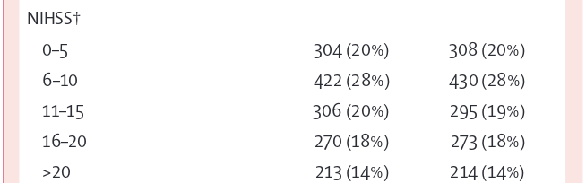
Sanity check – nLVO / LVO split
Data sources
Method
Intravenous alteplase meta-analysis
Lees et al. 2010
Data: “placebo” population mRS distributions for nLVO and LVO patients combined.
Location: Figure 2, all “placebo” bars.
1. Check Lees et al 2010 data.
Number of patients in total is 3670.
The nLVO/LVO split is not given.
2. Check IST-3 2012 data.
Number of patients in total is 3035.
Of these, 1464 have nLVO (NIHSS <= 10) and 1571 have LVO (NIHSS >= 11).
→ 51.7...% LVO, 48.2...% nLVO.
3. Check Emberson et al. 2014 data
Number of patients in total is 6756.
Of these, 3199 have nLVO (NIHSS <= 10) and 3557 have LVO (NIHSS >= 11).
→ 52.6…% LVO, 47.3...% nLVO.
The patients in Emberson are mostly made up of:
3035 from IST-3 +
3670 from Lees et al. 2010
= 6705 patients.
→ Expect the same nLVO/LVO split for Lees et al. 2010 as in IST-3.
4. Compare with derived split.
51% LVO, 49% nLVO – close enough to the above.
IST-3 thrombolysis clinical trial
Sandercock et al. 2012
Data: proportions of patients with nLVO and LVO.
Location: Table 1, “NIHSS”
RACE scale
de la Ossa Herrero et al. 2013
Info: NIHSS <=10 for nLVO and NIHSS >= 11 for LVO.
Location: final sentence of “Results” section.
“Best overall accuracy [for LVO prediction] for the NIHSS scale was achieved for a score >=11, with a sensitivity 0.88, specificity 0.72, and overall accuracy 0.76.”
Alteplase meta-analysis.
Emberson et al. 2014
Data: numbers of patients by NIHSS score.
Location: Figure 2.

Slide 6
Excess deaths - IVT
Data sources
Method
Alteplase meta-analysis
Emberson et al. 2014
Data: Mortality rates with and without IVT.
Location: Figure 4, “Alteplase” and “Control” columns, “Baseline NIHSS score” section, rows labelled “0-4” and “5-10”.
1. Calculate excess deaths for nLVO patients.
Excess deaths is the difference in percentages.
→ Excess death is 1.1%.
2. Calculate excess deaths for LVO patients.
Excess deaths is the difference in percentages.
→ Excess death is 3.4%.
 | Given IVT |  |  | No treatment
NIHSS → | 0-4 | 5-10 | 0-10 | 0-4 | 5-10 | 0-10
Number of patients | 345 | 1281 | 1626 | 321 | 1252 | 1573
Deaths | 3 | 20 | 23 | 0 | 5 | 5
% deaths |  |  | 1.41% |  |  | 0.32%
RACE scale
de la Ossa Herrero et al. 2013
Info: NIHSS <=10 for nLVO and NIHSS >= 11 for LVO.
Location: final sentence of “Results” section.
“Best overall accuracy [for LVO prediction] for the NIHSS scale was achieved for a score >=11, with a sensitivity 0.88, specificity 0.72, and overall accuracy 0.76.”
Alteplase meta-analysis
Emberson et al. 2014
Data: Mortality rates with and without IVT.
Location: Figure 4, “Alteplase” and “Control” columns, “Baseline NIHSS score” section, rows labelled “11-15”, “16-21” and “>=22”.
Given IVT
NIHSS | 11-15 | 16-21 | >=22 | >=11
Number of patients | 794 | 662 | 309 | 1765
Deaths | 23 | 24 | 21 | 68
% deaths |  |  |  | 3.85%
No treatment
NIHSS | 11-15 | 16-21 | >=22 | >=11
Number of patients | 808 | 671 | 313 | 1792
Deaths | 1 | 5 | 2 | 8
% deaths |  |  |  | 0.45%

Slide 7

nLVO – IVT at no-effect time
Data sources
Method
1. Apply excess deaths to “no treatment” distribution.
For a population treated at the time of no effect, expect no improvement compared with the no-treatment distribution but for some additional deaths.
Assume excess death is equally likely for all patients.
→ Result:
IVT excess deaths
as calculated earlier.
1.1%
mRS distribution
as calculated earlier.
nLVO no treatment
mRS | Probability
0 | 0.198
1 | 0.262
2 | 0.120
3 | 0.128
4 | 0.148
5 | 0.062
6 | 0.082
mRS | nLVO no treatment | 1.1% deaths | nLVO no treatment with excess deaths
0 | 0.198 | -0.002 | 0.196
1 | 0.262 | -0.003 | 0.259
2 | 0.120 | -0.001 | 0.119
3 | 0.128 | -0.001 | 0.127
4 | 0.148 | -0.002 | 0.146
5 | 0.062 | -0.001 | 0.061
6 | 0.082 | +0.010 | 0.092
nLVO IVT at no-effect time
mRS | Probability
0 | 0.196
1 | 0.259
2 | 0.119
3 | 0.127
4 | 0.146
5 | 0.061
6 | 0.092
Patient transport model
Holodinsky et al. 2018
Data: decline of chance of good outcome (mRS <= 1) with time to thrombolysis.
Location: Table, “Non-Large-Vessel Occlusion” section
Sanity check
In the patient transport model, for IVT at the time of no effect the probability P(mRS<=1) = 0.4622.
The equivalent measure from the above distribution is P(mRS<=1) = 0.196 + 0.259 = 0.455.

Slide 8
LVO – IVT at no-effect time
Data sources
Method
1. Apply excess deaths to “no treatment” distribution.
For a population treated at the time of no effect, expect no improvement compared with the no-treatment distribution but for some additional deaths.
Assume excess death is equally likely for all patients.
→ Result:
IVT excess deaths
as calculated earlier.
3.4%
mRS distribution
as calculated earlier.
LVO no treatment
mRS | Probability
0 | 0.050
1 | 0.079
2 | 0.136
3 | 0.164
4 | 0.247
5 | 0.135
6 | 0.189
mRS | LVO no treatment | 3.4% deaths | LVO no treatment with excess deaths
0 | 0.050 | -0.002 | 0.048
1 | 0.079 | -0.003 | 0.076
2 | 0.136 | -0.004 | 0.131
3 | 0.164 | -0.005 | 0.159
4 | 0.247 | -0.008 | 0.239
5 | 0.135 | -0.004 | 0.130
6 | 0.189 | +0.027 | 0.217
LVO IVT at no-effect time
mRS | Probability
0 | 0.048
1 | 0.076
2 | 0.131
3 | 0.159
4 | 0.239
5 | 0.130
6 | 0.217

Slide 9
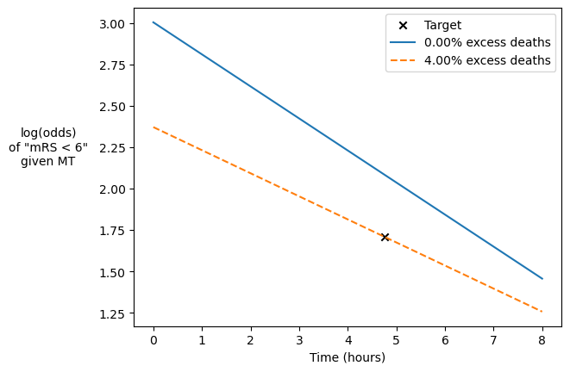
Excess deaths - MT
Data sources
Method
HERMES thrombectomy meta-analysis
Goyal et al. 2016
Data: Mortality rate with MT and average time to MT.
Locations:
Mortality rate: Table 4.
Time: Table 1.
1. Find reference data point.
The average MT treatment time is 285 minutes and the death rate of patients given MT is 15.3%.
This gives a probability that mRS is less than 6 of 84.7%.
Convert this probability to log-odds. The log-odds of mRS being less than 6 when MT is given at 285 minutes is 1.709.
→ log-odds reference = 1.709
2. Define time-zero distribution.
Calculate two distributions:
Full-effect data: pre-stroke data with excess deaths.
No-effect data: no-treatment data with excess deaths.
Combine 75% of the full-effect data with 25% of the no-effect data to make the time-zero data.
3. Method for finding excess deaths:
Set the excess death value e.
As above, use these excess deaths to calculate:
  The full-effect data
  The no-effect-time data
  The time-zero data
Take the probability that mRS is less than 6 in the time-zero and the no-effect-time distributions.
Convert the probabilities to log-odds.
Plot the two log-odds values and treatment times and connect the points with a straight line.
How close is the straight line to the reference point?
These steps can be repeated with different values of excess death e until the line passes exactly through the reference data point.
Using an optimiser function, we find the best e=4.00%.
→ Excess death is 4.0%.
Recanalisation meta-analysis
Hui et al. 2020
Info: 75% weight for pre-stroke mRS distribution.
Location: “Secondary Outcome: Recanalization” section, final sentence.
“Our traditional meta-analysis yielded a pooled rate of successful recanalization for IVT+MT of 75% (95% CI, 65%–83%; Figure XIC in the Data Supplement).”
mRS distributions
as calculated earlier.
 | LVO pre-stroke | LVO no treatment
mRS | Probability | Probability
0 | 0.408 | 0.050
1 | 0.144 | 0.079
2 | 0.120 | 0.136
3 | 0.166 | 0.164
4 | 0.118 | 0.247
5 | 0.044 | 0.135
6 | 0.000 | 0.189

Slide 10
LVO – MT at no-effect time
Data sources
Method
1. Apply excess deaths to “no treatment” distribution.
For a population treated at the time of no effect, expect no improvement compared with the no-treatment distribution but for some additional deaths.
Use the excess death rate of 4.0%.
Assume excess death is equally likely for all patients.
→ Result:
MT excess deaths
as calculated earlier.
4.0%
mRS distribution
as calculated earlier.
LVO no treatment
mRS | Probability
0 | 0.050
1 | 0.079
2 | 0.136
3 | 0.164
4 | 0.247
5 | 0.135
6 | 0.189
mRS | LVO no treatment | 4.0% deaths | LVO no treatment with excess deaths
0 | 0.050 | -0.002 | 0.048
1 | 0.079 | -0.003 | 0.076
2 | 0.136 | -0.005 | 0.131
3 | 0.164 | -0.006 | 0.157
4 | 0.247 | -0.009 | 0.237
5 | 0.135 | -0.005 | 0.130
6 | 0.189 | +0.040 | 0.221
LVO MT at no-effect time
mRS | Probability
0 | 0.048
1 | 0.076
2 | 0.131
3 | 0.157
4 | 0.237
5 | 0.130
6 | 0.221

Slide 11
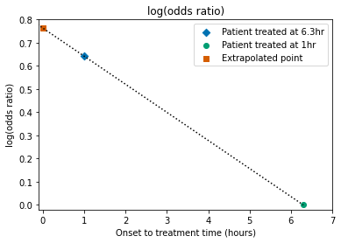
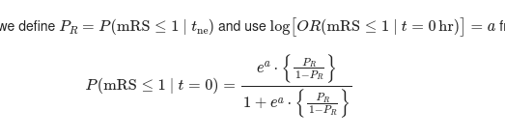
Chance decay over time
Data sources
Method
Alteplase meta-analysis
Emberson et al. 2014
Data: decline of odds ratio of good outcome with time for all patients (i.e. any NIHSS score) treated with alteplase compared with a control group.
Location: Figure 1
1. Get reference data points
Take two odds ratio points from this chart and convert them to log(odds ratio), where “log” means “natural log”:
2. Straight line fit
Connect the two “log(odds ratio)” and time points with a straight line.
The slope of the line is:
b = (0.00000 – 0.64185) ÷ (6.3 – 1.0)
b = -0.1211…
The line hits time zero at a log(odds ratio) value:
a= 0.76296.
3. Convert to probability
If we use a reference probability value, then we can calibrate the straight line fit and use it to calculate a probability of mRS <= 1 at any time.
For a reference point at the no-effect time tne, the probability at time zero is:
where:
4. Usage
This straight line fit applies to mRS <= 1 data only.
The same value of a can be used to fit the decay with time for:
nLVO and LVO patients combined
nLVO patients only
LVO patients only
Treatment delay (hours) | Odds ratio | log(odds ratio)
1.0 | 1.9 | 0.64185
6.3 | 1.0 | 0.00000
Alteplase meta-analysis
Emberson et al. 2014
Info: use same slope for all straight line fits.
Location: “Results” section, paragraphs 2 and 3.
“The effect of alteplase on a good outcome was chiefly driven by treatment delay; after controlling for treatment delay, neither age nor severity of stroke contributed significant additional predictive value (appendix p 5).”

Slide 12
nLVO – IVT at time zero
Data sources
Method
mRS distribution
as calculated earlier.
nLVO IVT at no-effect time
mRS | Probability
0 | 0.196
1 | 0.259
2 | 0.119
3 | 0.127
4 | 0.146
5 | 0.061
6 | 0.092
1. Get reference probability at no-effect time.
Take the probability of mRS being less than or equal to 1. This matches the data that went into the formula for probability at time zero.
→ P(mRS<=1 | t=t_ne) = 45.5%
2. Calculate a reference probability at time zero.
Plug the values of a and PR=45.5% into the formula.
→ P(mRS<=1 | t=0) = 64.2%
3. Combine mRS distributions.
To reach P(mRS<=1 | t=0)=0.642 in the time-zero distribution, use the following weighted distributions:
Apply the excess deaths to the pre-stroke data.
Multiply the “pre-stroke data with excess deaths” data by 0.643.
Multiply the “IVT at no-effect time” data by 0.357.
Add these two sets of data together.
→ Result:
Formula for probability at time zero
as calculated earlier.
a= 0.76296
IVT excess deaths
as calculated earlier.
1.1%
mRS distribution
as calculated earlier.
nLVO pre-stroke
mRS | Probability
0 | 0.583
1 | 0.163
2 | 0.104
3 | 0.101
4 | 0.042
5 | 0.007
6 | 0.000
nLVO IVT at time zero
mRS | Probability
0 | 0.445
1 | 0.197
2 | 0.110
3 | 0.110
4 | 0.079
5 | 0.026
6 | 0.033
Patient transport model
Holodinsky et al. 2018
Data: decline of chance of good outcome (mRS <= 1) with time to thrombolysis.
Location: Table, “Non-Large-Vessel Occlusion” section
Sanity check
In the patient transport model, for IVT at time zero the probability P(mRS<=1) = 0.6343.
The equivalent probability from the above distribution is P(mRS<=1) = 0.642.

Slide 13
LVO – IVT at time zero
Data sources
Method
mRS distribution
as calculated earlier.
LVO IVT at no-effect time
mRS | Probability
0 | 0.048
1 | 0.076
2 | 0.131
3 | 0.159
4 | 0.239
5 | 0.130
6 | 0.217
1. Get reference probability at no-effect time.
Take the probability of mRS being less than or equal to 1. This matches the data that went into the formula for probability at time zero.
→ P(mRS<=1 | t=t_ne) = 12.4%
2. Calculate a reference probability at time zero.
Plug the values of a and PR=12.4% into the formula.
→ P(mRS<=1 | t=0) = 23.3%
3. Combine mRS distributions.
To reach P(mRS<=1 | t=0)=0.233 in the time-zero distribution, use the following weighted distributions:
Apply the excess deaths to the pre-stroke data.
Multiply the “pre-stroke data with excess deaths” data by 0.255.
Multiply the “IVT at no-effect time” data by 0.745.
Add these two sets of data together.
→ Result:
Formula for probability at time zero
as calculated earlier.
a= 0.76296
IVT excess deaths
as calculated earlier.
3.4%
mRS distribution
as calculated earlier.
LVO pre-stroke
mRS | Probability
0 | 0.408
1 | 0.144
2 | 0.120
3 | 0.166
4 | 0.118
5 | 0.044
6 | 0.000
LVO IVT at time zero
mRS | Probability
0 | 0.140
1 | 0.093
2 | 0.128
3 | 0.161
4 | 0.208
5 | 0.108
6 | 0.162

Slide 14
LVO – MT at time zero
Data sources
Method
Recanalisation meta-analysis
Hui et al. 2020
Info: 75% weight for pre-stroke mRS distribution.
Location: “Secondary Outcome: Recanalization” section, final sentence.
“Our traditional meta-analysis yielded a pooled rate of successful recanalization for IVT+MT of 75% (95% CI, 65%–83%; Figure XIC in the Data Supplement).”
1. Define time-zero distribution.
Combine 75% of the full-effect data with 25% of the no-effect data. The full-effect data is the pre-stroke data with the excess deaths as a result of MT.
2. Add excess deaths to pre-stroke distribution.
3. Combine the data for full effect and no effect of recanalisation.
Multiply the “LVO pre-stroke with excess deaths” data by 0.75.
Multiply the “LVO MT at no-effect time” data by 0.25.
Add these two sets of data together.
→ Result:
MT excess deaths
as calculated earlier.
4.0%
mRS | LVO pre-stroke | 4.0% deaths | LVO pre-stroke with excess deaths
0 | 0.408 | -0.016 | 0.392
1 | 0.144 | -0.006 | 0.138
2 | 0.120 | -0.005 | 0.115
3 | 0.166 | -0.007 | 0.160
4 | 0.118 | -0.005 | 0.113
5 | 0.044 | -0.002 | 0.042
6 | 0.0000 | +0.040 | 0.040
mRS distribution
as calculated earlier.
LVO pre-stroke
mRS | Probability
0 | 0.408
1 | 0.144
2 | 0.120
3 | 0.166
4 | 0.118
5 | 0.044
6 | 0.000
mRS distribution
as calculated earlier.
LVO MT at no-effect time
mRS | Probability
0 | 0.048
1 | 0.076
2 | 0.131
3 | 0.157
4 | 0.237
5 | 0.130
6 | 0.221
LVO MT at time zero
mRS | Probability
0 | 0.306
1 | 0.123
2 | 0.119
3 | 0.159
4 | 0.144
5 | 0.064
6 | 0.085

Slide 15
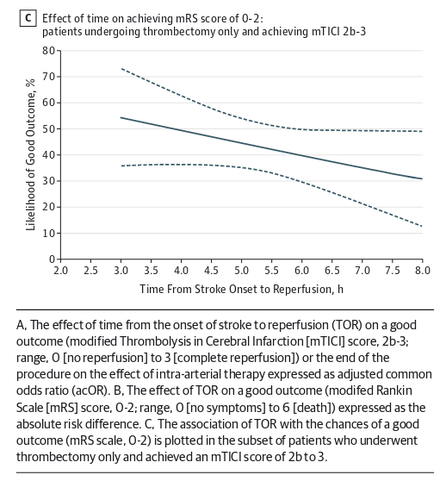
Sanity check – MT success rate
Data sources
Method
MR CLEAN Recanalisation clinical trial
Fransen et al. 2016
Data: decline of chance of good outcome (mRS 0-2) with time to thrombectomy for successful reperfusion only.
Location: Figure C, end points of graph stated in “Tertiary analysis” subsection.
1. Extrapolate the line back to time zero.
End points from the graph (given in “Tertiary analysis” section):
Assume the decrease with time is constant and that the graph shows a straight line. This gives an average decrease in probability of 4.8% per hour.
At time zero, the probability would be 55% + (3 x 4.8%) = 69.4%.
Pre-stroke probability of mRS 0-2 is:
0.408+0.144+0.120 = 67.2%.
→ for successful recanalisation, use the full recovery mRS distribution.
2. Check treatment at 8 hours.
From the graph, the end point is 31%. Scaling down by 0.75 successful recanalisation gives 31% x 0.75 = 23.25%.
Probability of mRS 0-2 given MT at time of no effect (8 hours) is 0.048 + 0.076 + 0.131 = 25.5%.
3. Check treatment at 0 hours.
From the graph, the extrapolated point at time zero is 69.4%. Scaling down by 0.75 successful recanalisation rate, 69.4% x 0.75 = 52.05%.
MT at time zero probability of mRS 0-2 is:
0.306 + 0.123 + 0.119 = 54.8%.
→ 75% successful recanalisation gives a good enough match.
Time (hours) | Probability of mRS 0-2
3.0 | 55%
8.0 | 31%
LVO pre-stroke
mRS | Probability
0 | 0.408
1 | 0.144
2 | 0.120
3 | 0.166
4 | 0.118
5 | 0.044
6 | 0.000
mRS distribution
as calculated earlier.
Recanalisation meta-analysis
Hui et al. 2020
Info: 75% weight for pre-stroke mRS distribution.
Location: “Secondary Outcome: Recanalization” section, final sentence.
“Our traditional meta-analysis yielded a pooled rate of successful recanalization for IVT+MT of 75% (95% CI, 65%–83%; Figure XIC in the Data Supplement).”
mRS | LVO MT at no-effect time | LVO MT at time zero
0 | 0.048 | 0.306
1 | 0.076 | 0.123
2 | 0.131 | 0.119
3 | 0.157 | 0.159
4 | 0.237 | 0.144
5 | 0.130 | 0.064
6 | 0.221 | 0.085
mRS distributions
as calculated earlier.

