Slide 1

Random generalized linear model: a highly accurate and interpretable ensemble predictor Song L, Langfelder P, Horvath S. BMC Bioinformatics 2013 Steve Horvath (shorvath@mednet.ucla.edu) University of California, Los Angeles

Slide 2
Generalized linear model (GLM)
Flexible generalization of ordinary linear regression.
Allows for outcomes that have other than a normal distribution.
R implementation considers all models and link functions implemented in the R function glm
Aside: randomGLM predictor also applies to survival outcomes
Normally distributed outcome
Logistic
Binary outcome
Multi-nomial
Multi-class outcome
Poisson
Count outcome
Linear
Linear
Your Text
Logistic
Multi-nomial
Poisson

Slide 3
Common prediction algorithms
Generalized linear model (GLM)
Penalized regression models
Ridge regression, elastic net, lasso.
Recursive partitioning and regression trees (rpart)
Linear discriminant analysis (LDA)
Special case: diagonal linear discriminant analysis (DLDA)
K nearest neighbor (KNN)
Support vector machines (SVM)
Shrunken centroids (SC) (Tibshirani et al 2002, PNAS)
Ensemble predictors:
Combination of a set of individual predictors.
Special case: random forest (RF), combination of tree predictors.

Slide 4
Bagging
Bagging = Bootstrap aggregating
Nonparametric Bootstrap (standard bagging):
Bag is drawn at random with replacement from the original training data set
individual predictors (base learners) can be aggregated by plurality voting
Relevant citation: Breiman (1996)

Slide 5

Random Forest (RF)
An RF is a collection of tree predictors such that each tree depends on the values of an independently sampled random vector.

Slide 6
Rationale behind RGLM
Forward
regression
models
RF
Good
accuracy
Hard to
interpret
Bad
accuracy
Easy to
interpret
RGLM
Breiman L: Random Forests. Machine Learning 2001, 45:5–32.
Derksen S, Keselman HJ: Backward, forward and stepwise automated subset selection algorithms: Frequency of obtaining authentic and noise variables. British JMathematical Stat Psychology 1992, 45(2):265–282.

Slide 7
RGLM construction

Slide 8
RGLM construction
RGLM: an ensemble predictor based on bootstrap aggregation (bagging) of generalized linear models whose covariates are selected using forward regression according to AIC criteria.

Slide 9
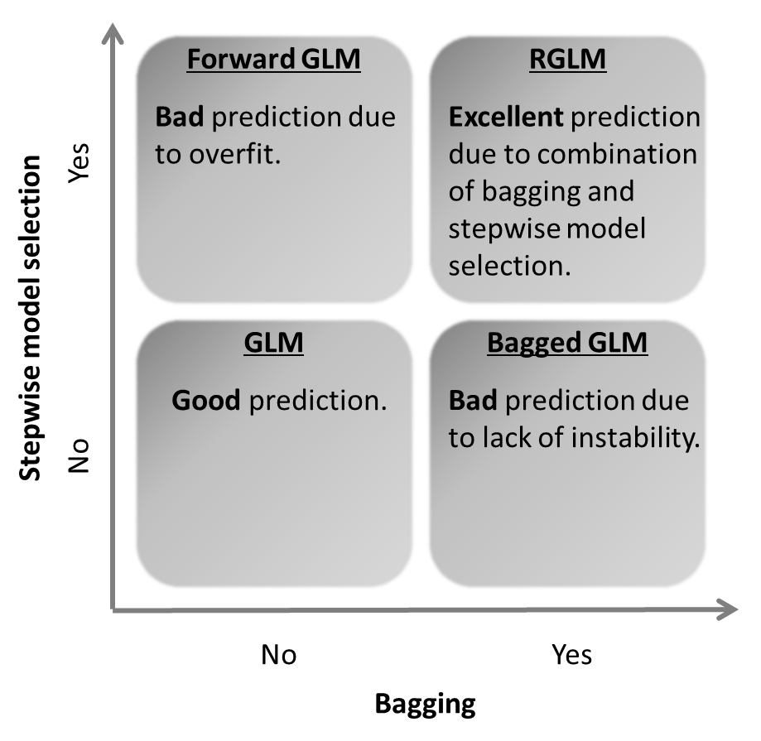
RGLM construction combines 2 seemingly wrong choices, forward regression and bagging, for GLMs to arrive at a superior method. Two wrongs make a right. Not mentioned here: additional elements of randomness.
Breiman L: Random Forests. Machine Learning 2001, 45:5–32.
Derksen S, Keselman HJ: Backward, forward and stepwise automated subset selection algorithms: Frequency of obtaining authentic and noise variables. British JMathematical Stat Psychology 1992, 45(2):265–282.

Slide 10
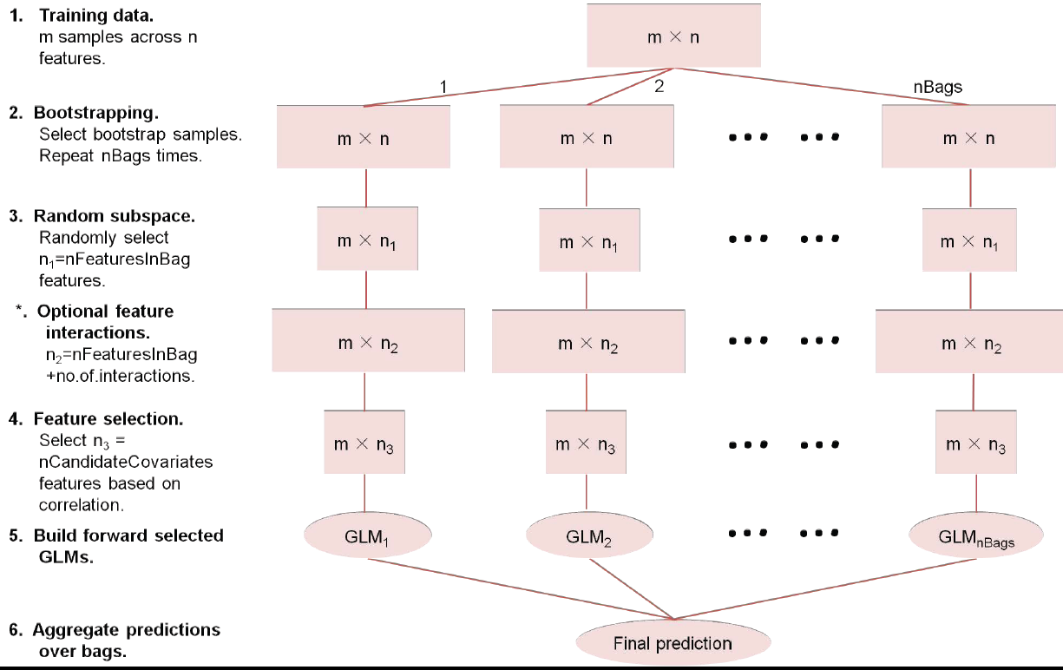
RGLM construction
RGLM: an ensemble predictor based on bootstrap aggregation (bagging) of generalized linear models whose covariates are selected using forward stepwise regression according to AIC criteria.

Slide 11
RGLM evaluation

Slide 12
RGLM prediction evaluation
Binary outcome prediction:
20 disease-related expression data sets.
700 comparisons with dichotomized gene traits.
12 UCI benchmark data sets.
180 simulations.
Continuous outcome prediction:
Mouse tissue data with 21 clinical traits.
700 comparisons with continuous gene traits.
180 simulations.
RGLM ties for 1st.
RGLM ranks 1st.
RGLM ties for 1st.
RGLM ties for 1st.
Accuracy: proportion of observations corrected classified.
RGLM ranks 1st.
RGLM ranks 1st.
RGLM ranks 1st.
Accuracy: correlation between observed and predicted outcome.
RGLM often outperforms alternative prediction methods like random forest in both binary and continuous outcome predictions.

Slide 13
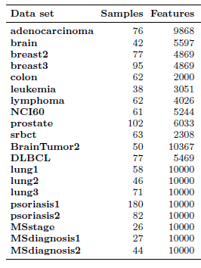
20 disease-related expression data sets

Slide 14
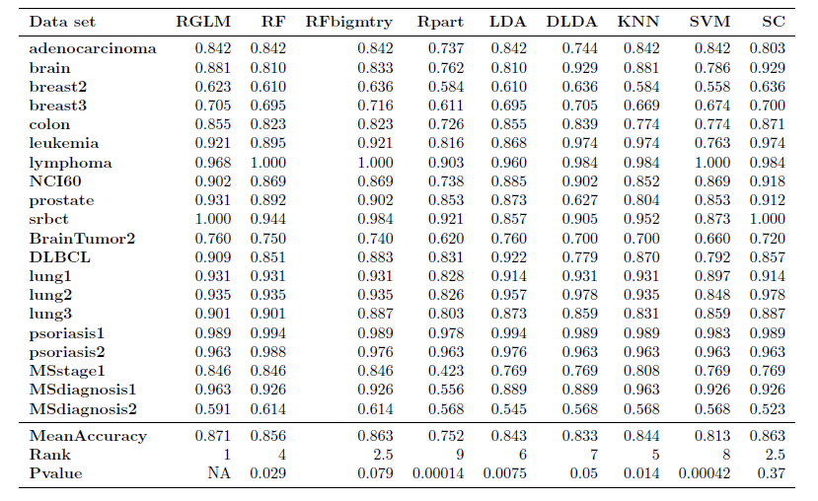

Prediction accuracy in 20 disease-related expression data sets
RGLM achieves the highest mean accuracy, but not significantly better than RFbigmtry, DLDA and SC.

Slide 15
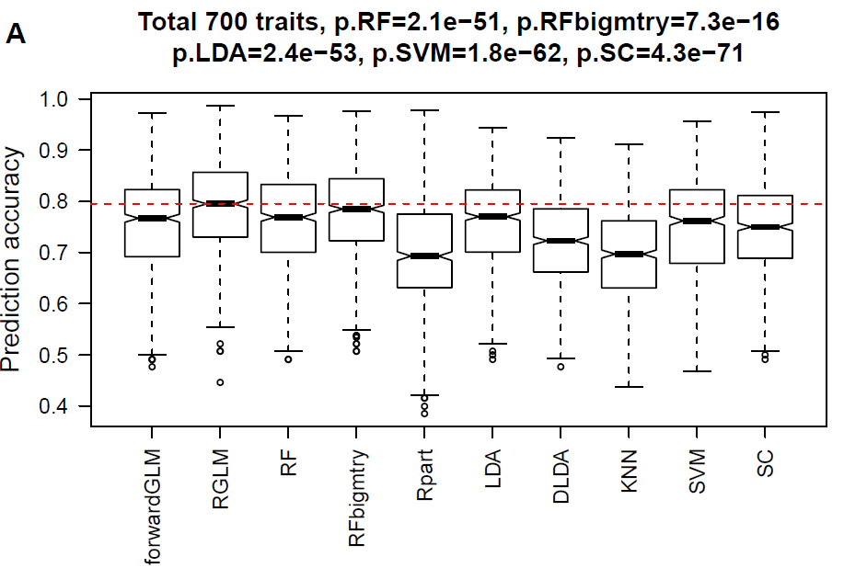
700 gene expression comparisons with dichotomized gene traits
700 = 7*100. Start with 7 human and mouse expression data sets. Randomly choose 100 genes as gene traits for each data set, dichotomize at median.
RGLM performs significantly better than other methods, although the increase in accuracy is often minor.

Slide 16
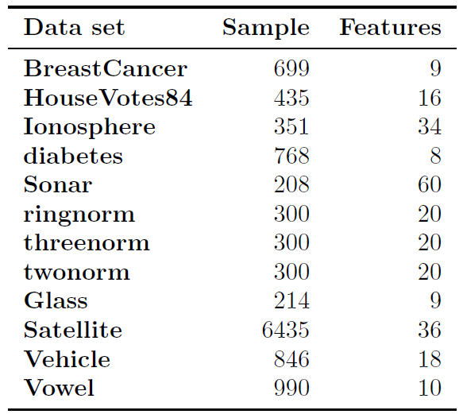
12 UCI machine learning benchmark data sets
12 famous data sets with binary or dichotomized outcomes.
Different from many genomic data sets, they have large sample sizes and few features.

Slide 17
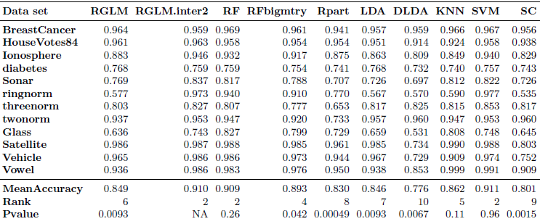
12 UCI machine learning benchmark data sets
RGLM.inter2 (RGLM considering 2-way interactions between features) ties with RF and SVM.
RGLM without interaction terms does not work nearly as well.
Pairwise interaction terms may improve the performance of RGLM in data sets with few features.

Slide 18
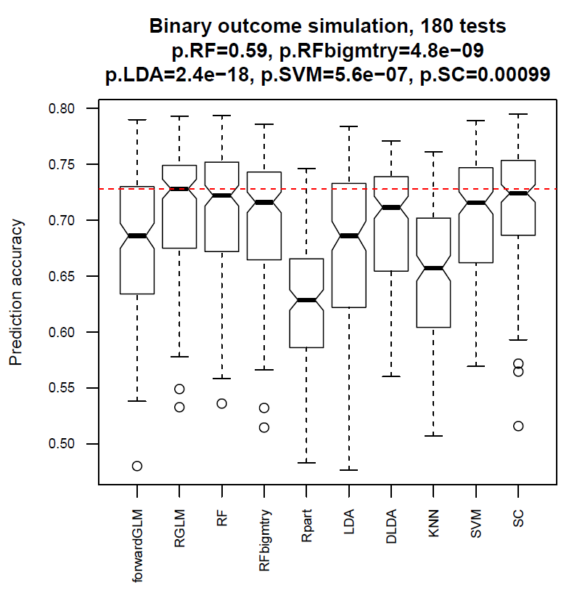
180 simulations
Number of features varies from 60 to 10000, training set sample size varies from 50 to 2000, test set sample size is fixed to 1000.
RGLM ties with RF.

Slide 19
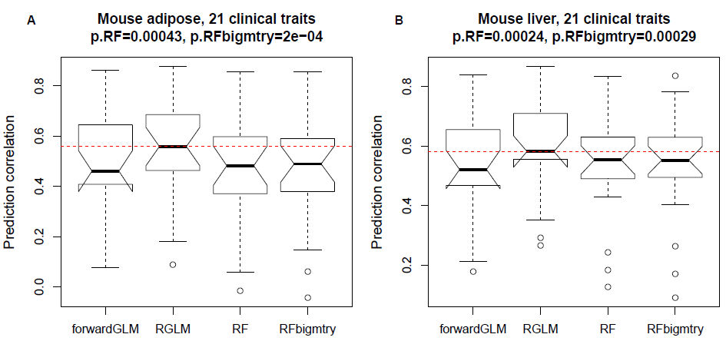
Mouse tissue data with 21 clinical traits
RGLM performs best when predicting 21 continuous physiological traits based on adipose or liver expression data.
Data from Jake Lusis

Slide 20
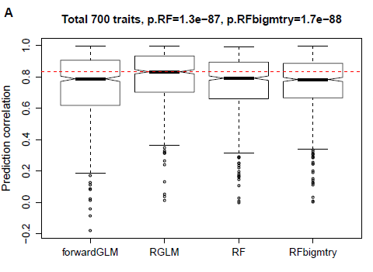
700 gene expression comparisons with continuous gene traits

Slide 21
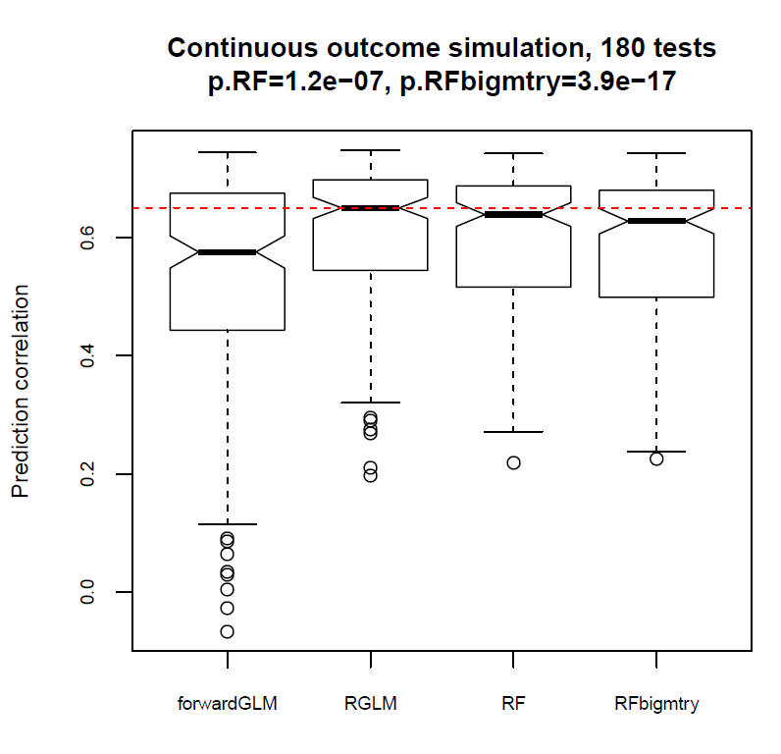
180 simulations
Number of features varies from 60 to 10000, training set sample size varies from 50 to 2000, test set sample size is fixed to 1000.
RGLM performs best.

Slide 22
Comparing RGLM with penalized regression models implemented in R package glmnet Friedman, J., Hastie, T. and Tibshirani, R. (2008) Regularization Paths for Generalized Linear Models via Coordinate Descent, Journal of Statistical Software, Vol. 33(1), 1-22 Feb 2010

Slide 23

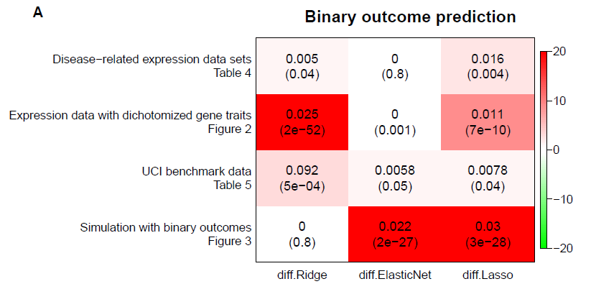
Overall, RGLM is significantly better than ridge regression, elastic net, and lasso for binary outcomes
Table contains differences in accuracy
(and corresponding p-value in brackets)

Slide 24
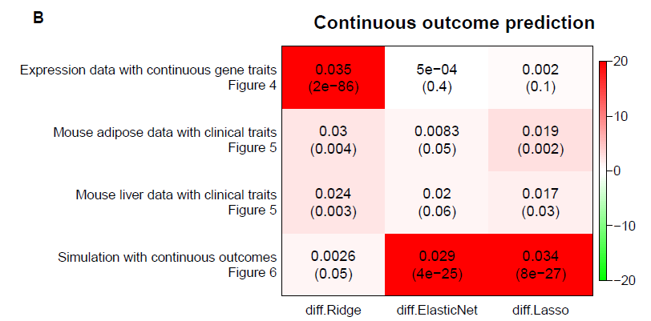
In general, RGLM is significantly better than ridge regression, elastic net, and lasso for continuous outcomes
Table contains differences in accuracy
(and corresponding p-value in brackets)

Slide 25
Ensemble thinning

Slide 26
Thinned version of RGLM
Goal:
Define a sparse predictor that involves few features, i.e. thin the RGLM out by removing rarely occuring features.
Observation: Since forward variable selection is used for each GLM,
some features are rarely selected and contribute little to the ensemble prediction.
Idea:
Omit features that are rarely used by the GLMs.
Refit each GLM (per bag) without the omitted features.

Slide 27
How many features are being used ?
Example: binary outcome gene expression analysis with 700 comparisons. Total number of features is around 5000 for each comparison.
We find that RGLM uses far fewer features than the RF
Reason: RGLM uses forward selection with AIC criterion in each bag
Question: Can we further thin the RGLM predictor out by removing rarely used features?
Random forest
40% ~ 60%
RGLM
2% ~ 6%

Slide 28
RGLM predictor thinning
For thinning use the RGLM variable importance measure:
timesSelectedByForwardRegression that counts the number of times a feature is selected by a GLM (across the number of bags)
…
3
2
1
Thinning threshold

Slide 29
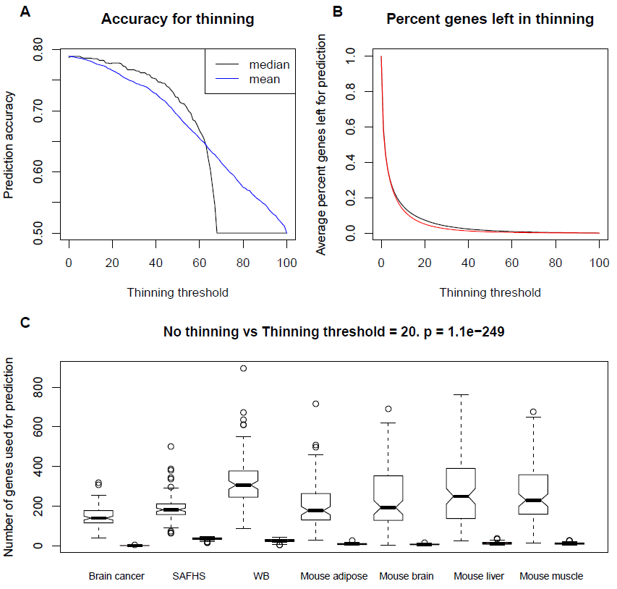

Over 80% features removed
Median accuracy decreases only 0.009
Mean accuracy decreases 0.023

Slide 30
Including mandatory covariates
In many applications, one has a set of mandatory covariates that should be part of each model.
Example: When it comes to predicting lung disease (COPD) then it makes sense to include smoking status and age in each logistic model
and let randomGLM select additional gene expression levels, see
Straightforward in the randomGLM model:
use argument “mandatoryCovariates” in the randomGLM R function, see help(randomGLM)

Slide 31
RGLM pros and cons
Pros
Astonishing accuracy: it often outperforms existing methods.
Few features contribute to the prediction especially if RGLM thinning is used.
Easy to interpret since it involves relatively few features and uses GLMs.
Provides useful by-products as part of its construction including out-of-bag estimates of the prediction accuracy, variable importance measures.
GLM formulation allows one to apply the RGLM to different types of outcomes: binary, quantitative, count, multi-class, survival.
RGLM allows one to force specific features into regression models in all bags, i.e. mandatory covariates.
Cons
Slower than many common predictors due to the forward selection step (AIC criterion). Work-around: randomGLM R implementation allows users to parallelize the calculation.

Slide 32
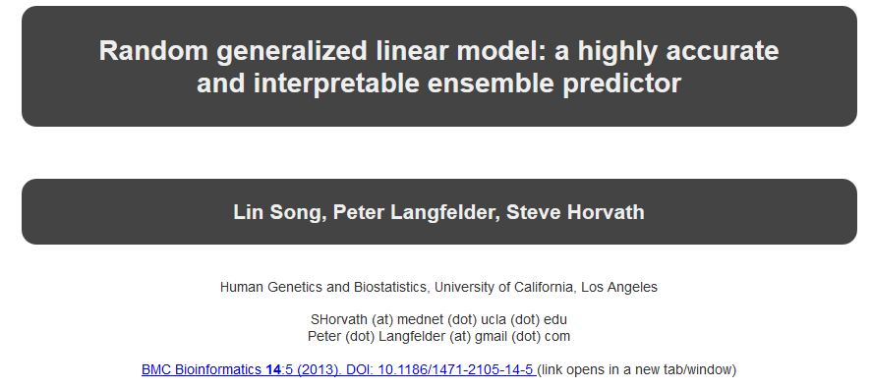
R software implementation
The RGLM method is implemented in the freely available R package randomGLM.
Peter Langfelder contributed and maintains the package.
Tutorials can be found at the following webpage: http://labs.genetics.ucla.edu/horvath/RGLM
Can be applied to survival time outcome Surv(time,death)

Slide 33
R software implementation
The RGLM method is implemented in the freely available R package randomGLM.
randomGLM function outputs training set predictions, out-of-bag predictions, test set predictions, coefficient values, and variable importance measures
predict function for test set predictions
Tutorials can be found at the following webpage: http://labs.genetics.ucla.edu/horvath/RGLM.

Slide 34
Conclusions
RGLM shows superior prediction accuracy compared to existing methods, such as random forest, in the majority of studies using simulation, gene expression and machine learning benchmark data sets. Both binary and continuous outcome prediction were considered.
RGLM is recommended for high-dimensional data, while RGLM.inter2 is recommended for low-dimensional data.
OOB estimates of the accuracy can be used to inform parameter choices
RGLM variable importance measure, timesSelectedByForwardRegression, allows one to define a "thinned" ensemble predictor with excellent prediction accuracy using only a small fraction of original variables.
RGLM variable importance measures correlate with other importance measures but are not identical to them. Future evaluations are needed.

Slide 35
Selected references (more can be found in the article)
Song L, Langfelder P, et al (2013) Random generalized linear model: a highly accurate and interpretable ensemble predictor. BMC Bioinformatics. PMID: 23323760, PMCID: PMC3645958
[1] Breiman L: Bagging Predictors. Machine Learning 1996, 24:123-140.
[2] Breiman L: Random Forests. Machine Learning 2001, 45:5-32.
[3] Dudoit S, Fridlyand J, Speed TP: Comparison of Discrimination Methods for the Classification of Tumors Using Gene Expression Data. Journal of the American Statistical Association 2002, 97(457):77-87.
[4] Diaz-Uriarte R, Alvarez de Andres S: Gene selection and classification of microarray data using random forest. BMC Bioinformatics 2006, 7:3.
[5] Frank A, Asuncion A: UCI Machine Learning Repository 2010, [http://archive.ics.uci.edu/ml].
[6] Meinshausen N, Buhlmann P: Stability selection. Journal of the Royal Statistical Society: Series B (Statistical Methodology) 2010, 72(4):417-473.
[7] Perlich C, Provost F, Simono® JS: Tree Induction vs. Logistic Regression: A Learning-Curve Analysis. JOURNAL OF MACHINE LEARNING RESEARCH 2003, 4:211-255.
[8] Buhlmann, Yu B: Analyzing Bagging. Annals of Statistics 2002, 30:927-961.

