Slide 1

Contact Tracing
Prediction of Disease Outbreaks

Slide 2
Abstract
The epidemic spread of infectious disease occurs sporadically and rapidly, it is not easy to predict whether an infectious disease will emerge or not. Furthermore, accumulating data related to a specific infectious disease is not easy. For these reasons, finding useful data and building a prediction model with these data is required. The Internet press releases numerous articles every day that rapidly reflect currently pending issues.
Prediction of disease outbreaks, or disease forecasting, provides warning that a certain amount of disease may occur at a particular time in the future. Contact tracing is a process used by public health ministries to help stop the spread of infectious disease, such as COVID-19, within a community.

Slide 3
Introduction
Statistical modeling and prediction in epidemiology provide a method to understand why and how infections spread and how they might be prevented or restricted. For instance, when a new infectious disease emerges or there is an outbreak of a known infectious disease, epidemiologists are the scientists, who collect, analyze, and interpret information to indicate interventions for halting further dissemination.
Many infectious diseases do not respect national boundaries, color, creed, caste, communities, etc. initially affecting only one region of the world, and rapidly disseminates to other regions and ultimately may become a pandemic like COVID-19 .

Slide 4

How Contact Tracing Works
Contact tracing is a valuable method of stopping disease spread of any kind. It is currently being used to help prevent the spread of the COVID-19 pandemic.
Those who have been identified as contacts will be advised on their own preventative measures to ensure they do not pass on the virus to other people and to ensure they are safe if they develop symptoms.

Slide 5
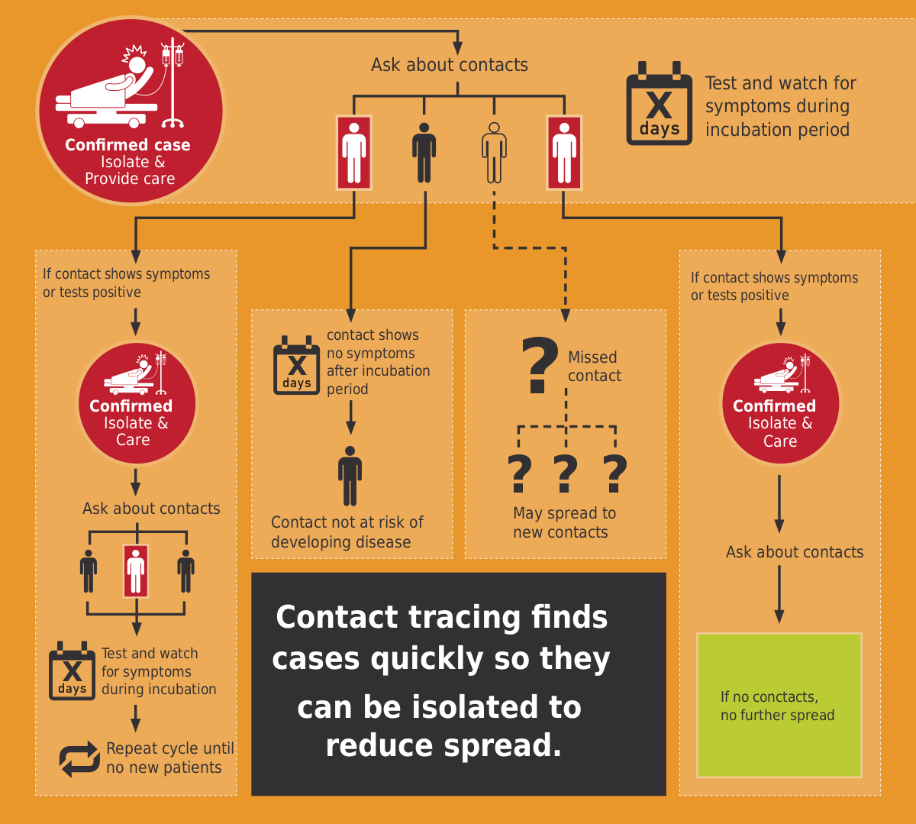

Slide 6

Our Big Idea
A Contact Tracking Model is designed to combat the disease outbreak by incorporating through Clustering-
DBSCAN Algorithm ,which fall under the realm of Machine Learning.

Slide 7

Contact Tracing Using Ml
The ongoing development in AI and ML has significantly improved treatment, medication, screening, prediction, forecasting, contact tracing, and drug/vaccine development process for the Covid-19 pandemic and reduce the human intervention in medical practice. However, most of the models are not deployed enough to show their real-world operation, but they are still up to the mark to tackle the SARS-CoV-2 epidemic.
The DBSCAN model, using this model we will generate clusters, which will help identify infections by filtering the data in the clusters.

Slide 8
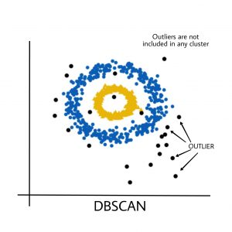
Clustering
DBSCAN ALGORITHM
DBSCAN is a density-based data clustering algorithm that groups data points in a given space. The DBSCAN algorithm groups data points close to each other and marks outlier data points as noise. And the clustering algorithm like DBSCAN can perform data point clustering without prior knowledge of the datasets
The DBSCAN model, using this model we will generate clusters, which will help identify infections by filtering the data in the clusters.

Slide 9
Specifications & Requirements
Advantages of using DBSCAN:
Does not require to specify number of clusters beforehand.
Performs well with arbitrary shapes clusters.
DBSCAN is robust to outliers and able to detect the outliers.
In order to build a contact tracing algorithm, we need to follow three steps:
Get location data of different users within a specific time and place.
Apply a density-based clustering algorithm on the data.
Use the clusters to predict infected people.

Slide 10
Objective of the ML Model
To identify and classify contacts as early as possible for preventing spread of further transmission. The decision to test some of the contacts and to quarantine others is based on risk assessment process considering factors like –proximity, duration, nature of exposure as well as other factors. –
Important considerations for Contact tracing
A contact is a person who is likely to acquire infection from a positive case through any of the known modes of transmission.
Anyone exposed to a symptomatic COVID-19 case, from 2 days before to 14 days after the onset of symptoms, if not isolated earlier.
For asymptomatic or pre-symptomatic cases, the period for contact tracing is taken as 2 days before to 14 days after the date sample collection if not isolated earlier.

Slide 11
Dataset
The dataset which we is used in our model is from kaggle.
The JavaScript Object Notation (JSON) is a standard text-based format dataset that we used in this task is a JSON data for representing structured data based on JavaScript object syntax.
Reference:
https://drive.google.com/file/d/1s2jlxrhAtfd337If7KJhQeL14eH4Dg94/view?usp=sharing

Slide 12

Project screens:
User Interface

Slide 13
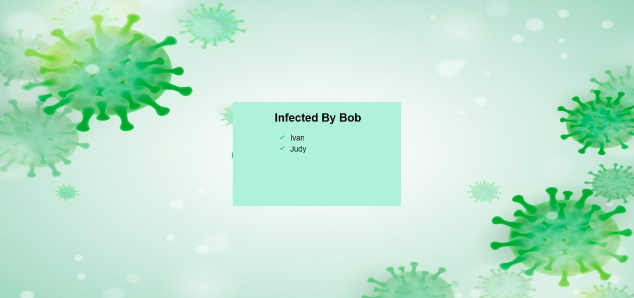
Output:
Result

Slide 14


