Slide 1
Medical Insurance Cost Prediction Using Machine Learning
SUPERVISOR TEAM MEMBER
M.SHEEBA A.NAGA VENKATA THARUN(1521051002)
G.SAMUEL KIRAN BABU(1521051037)
K.SASANKA REDDY(1521051057)

Slide 2
Objectives
The use of an ensemble of regression to predict medical insurance costs accurately.
Analyze and utilize key features such as age, sex, BMI, number of children, smoking status, and region to predict the cost of medical insurance
Aim to enhance the accuracy of cost predictions by combining multiple models and leveraging their individual strengths.
Compare the performance of different regression models to identify the most effective approach for predicting insurance costs.

Slide 3
Abstract
Develop a machine learning model to predict medical expenses using multiple regression algorithms.
Leverage an ensemble method to combine the strengths of Linear Regression, SVM, Random Forest Regressor, and Gradient Boosting Regressor.
Utilize demographic and lifestyle data, including age, sex, BMI, number of children, smoking status, and region, as input features.
Perform data preprocessing and feature selection to enhance the accuracy and relevance of the model.
Compare the performance of individual models and the ensemble approach to identify the most accurate prediction method.

Slide 4
Develop a Streamlit-based web application for real-time cost predictions based on user inputs.
Validate the model using a separate test dataset to ensure robustness and reliability.
Optimize the model through hyperparameter tuning to achieve the best predictive performance.
Ensure the model’s predictions are interpretable, allowing users to understand the impact of each factor on the overall cost.
Consider future improvements, such as incorporating additional features or more advanced algorithms, to further enhance prediction accuracy.

Slide 5
Software Requirements
Operating System : Windows OS
System type : 32 or 64-bit OS
IDE : Spyder, Jupyter Notebook
Python : Version 3.7 or higher
Libraries : Numpy,Pandas,Sk-Learn….
Web Browser : For viewing the Streamlit application

Slide 6
Existing System
Traditional Actuarial Methods:
Manual Underwriting: Time-consuming and may overlook certain risk factors, relying on individual evaluations based on medical history, age, lifestyle, etc.
Linear Models: Use of Generalized Linear Models (GLMs) that assume a linear relationship, which may not capture the complexities of the data.
Data Limitations: Dependence on limited datasets like claims history and demographics, leading to less accurate predictions and failure to recognize emerging trends.

Slide 7
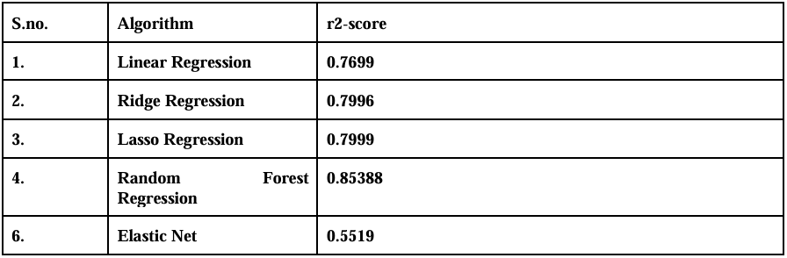

Slide 8
Limitations
Inflexibility: Difficulty in adapting to new data sources or changes in healthcare, leading to outdated predictions.
Manual Errors: Increased risk of human error due to reliance on manual processing.
Limited Personalization: Generalized models that don't account for unique health profiles, resulting in less accurate cost estimates.

Slide 9
Proposed System
Develop an accurate model for predicting medical insurance costs using advanced machine learning algorithms.
Identify key factors influencing premiums to create a precise prediction model.
Key Features:
Age: Older individuals generally have higher healthcare costs.
Gender: Affects insurance costs based on health risk factors.
Smoking Status: Smokers incur higher medical expenses, leading to higher premiums.
Number of Children: Reflects potential healthcare needs.
Region: Costs vary by region, affecting pricing.

Slide 10
Algorithms Implemented:
Linear Regression: Baseline model.
Support Vector Machine (SVM): Effective in high-dimensional spaces.
Random Forest Regressor: Improves accuracy by averaging multiple trees.
Gradient Boosting Regression: Iteratively improves accuracy.
Evaluation Metrics:
Mean Absolute Error (MAE): Average magnitude of errors.
R-squared: Proportion of variance explained by the model.

Slide 11
Tools and Technologies:
Streamlit: For interactive web applications.
Spyder: IDE for scientific programming in Python.
Joblib: Efficient serialization of large objects for model saving/loading.
This streamlined methodology aims to create a robust model for predicting insurance costs, ensuring accurate and fair premium determination.

Slide 12
Advantages
Comprehensive Factor Analysis:
Considers key features like age, smoking status, and region, leading to a well-rounded understanding of cost drivers.
Focus on Significant Variables:
Special emphasis on age and smoking status ensures the model addresses the most impactful factors.
Diverse Algorithm Comparison:
Evaluates multiple algorithms (Linear Regression, SVM, Random Forest, Gradient Boosting) to identify the most accurate model.

Slide 13
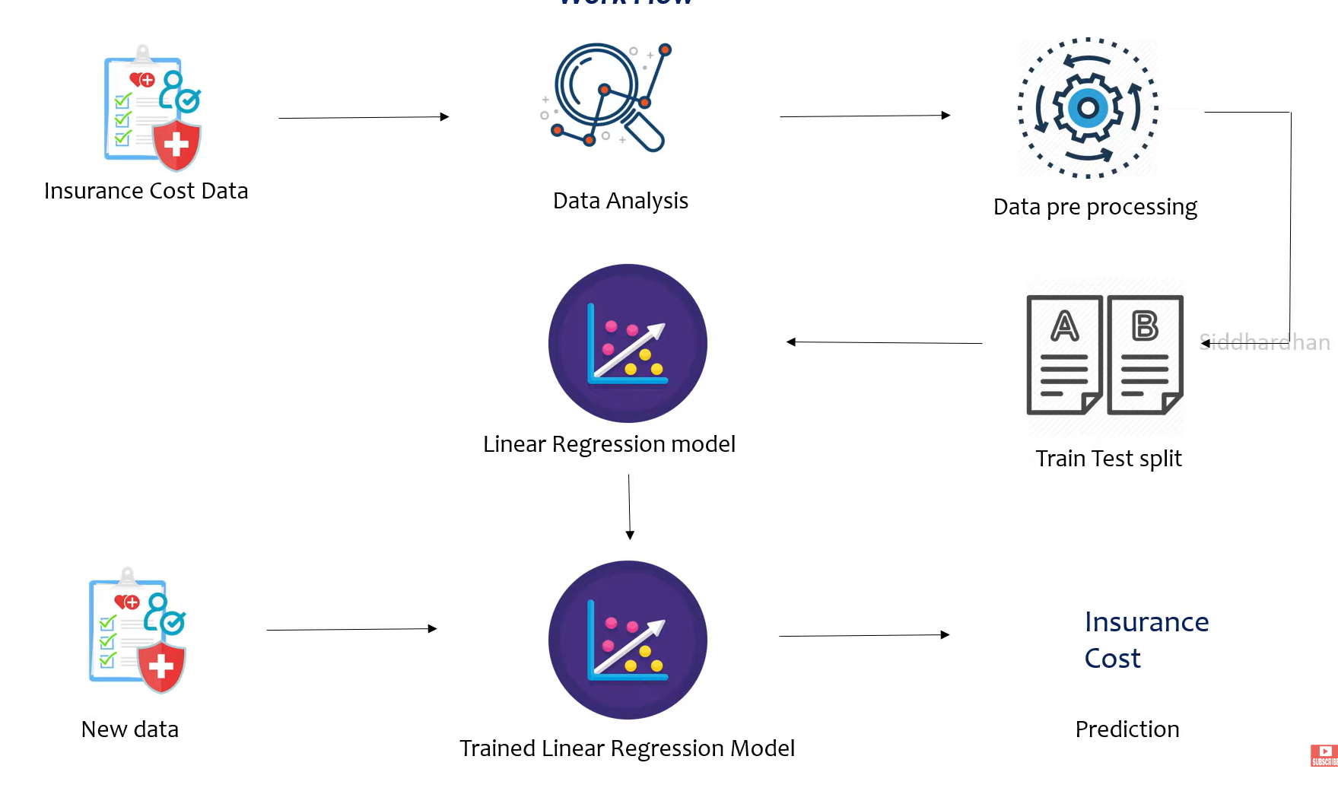
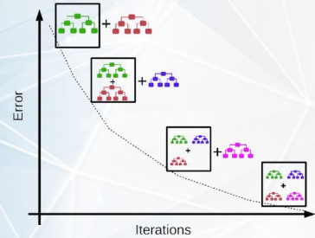
Architecture Diagram
Gradient Boosting Regression
Trained Gradient Boosting Model

Slide 14
List of modules
Data Collection
Data Analysis
Data Preprocessing
Training and Testing Split
Model Evaluation
Test new Data
Predicting insurance cost

Slide 15
Module Description
Data Collection: This dataset typically includes features such as age, sex, BMI, number of children, smoking status, and region, along with the target variable, which is the insurance cost.
Data Analysis:Once the data is collected, the next step is to analyze it to understand its structure and underlying patterns. This involves summarizing the data with statistical measures (mean, median, mode, etc.)
Data Preprocessing: Data preprocessing is crucial to prepare the data for modeling.
This includes:
Handling Missing Values
Encoding Categorical Variables
Outlier Treatment

Slide 16
Training and Testing Split:
The dataset is then split into training and testing sets. Typically, 70-80% of the data is used for training the model, while the remaining 20-30% is reserved for testing its performance.
Model Training:
Four regression algorithms will be used to train models on the training dataset:
Linear Regression
Support Vector Machine (SVM) Regression
Random Forest Regression
Gradient Boosting Regression

Slide 17
Model Evaluation:
Train models and assess their accuracy using metrics like MAE, and R-squared.
Test New Data:
Validate the model by predicting costs on new, unseen data.
Predicting Insurance Cost:
Use the trained model to predict insurance costs based on input features.

Slide 18
Conclusion
Compared Linear Regression, SVM, Random Forest with Gradient Boosting models, Gradient boost provides the most accurate predictions.
BMI and smoking status significantly influenced insurance costs, while age and region had varying impacts across models.
Ensured model reliability through cross-validation, hyperparameter tuning, and residual analysis, confirming that models generalized well to unseen data.
Successfully developed accurate predictive models for estimating medical insurance costs and gained valuable insights into factors affecting premiums.

Slide 19
Future enhancement
Consider adding features like medical history, occupation, or lifestyle factors to improve accuracy.
Explore advanced algorithms like XGBoost or Neural Networks for better prediction performance.
Apply more sophisticated feature engineering techniques to capture complex relationships.
Expand the dataset with more diverse samples to enhance model generalization.
Integrate real-time predictions into the existing Streamlit interface for immediate insights. Incorporate user feedback to refine models and improve usability over time.

Slide 20
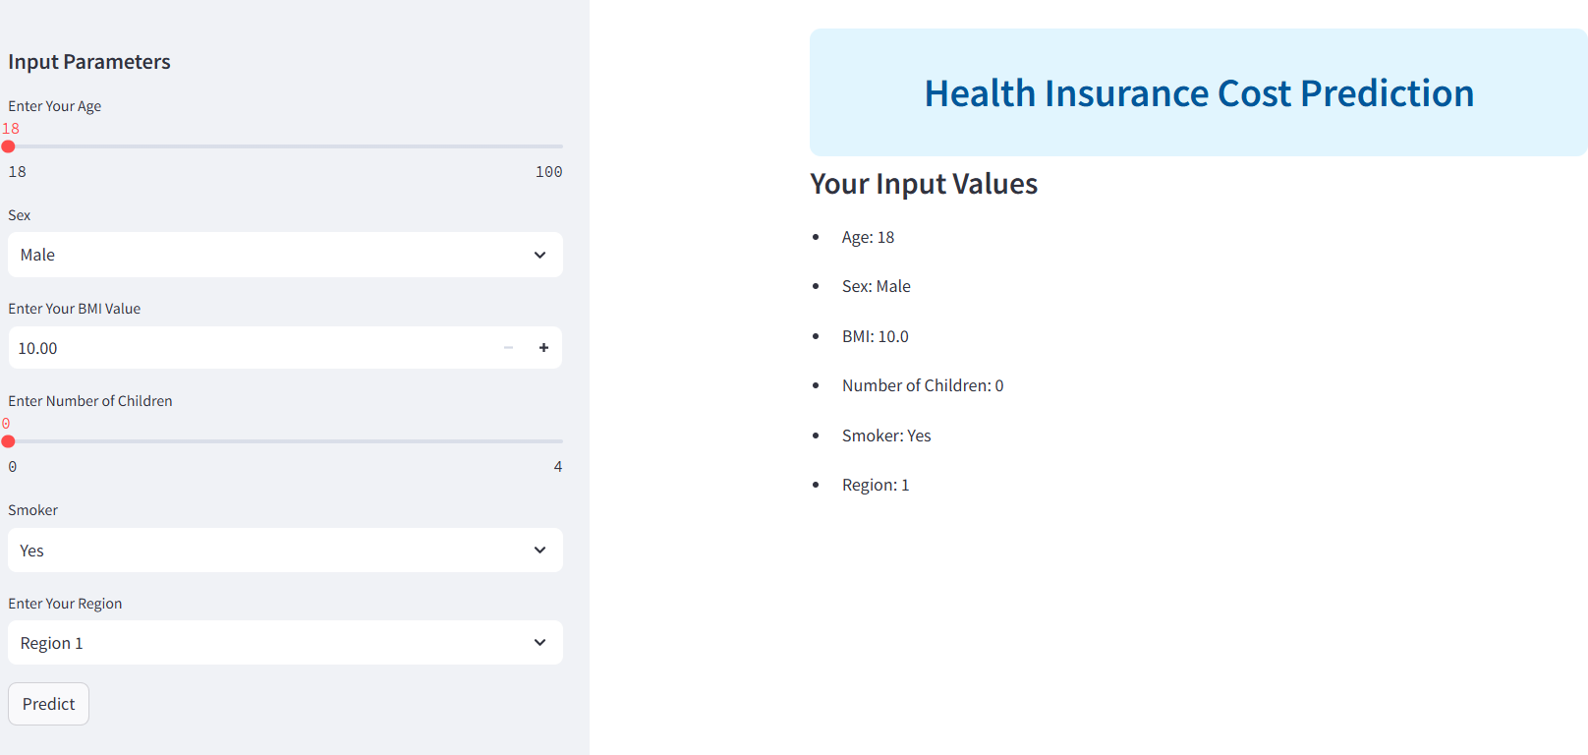
Screenshot

Slide 21
References
Ayushi Bharti, Lokesh ,Electronics and communication engineering, Computer Science and Engineering, 1MSIT,2 DU, New Delhi, India, Regression Analysis and Prediction of Medical Insurance Cost
https://ijcrt.org/papers/IJCRT2203462.pdf
Predict Health Insurance Cost by using Machine Learning International Journal of Innovative Technology and Exploring Engineering
Volume-10(Issue-3):137 DOI:10.35940/ijitee.C8364.0110321
License CC BY- NC-ND 4.0
Medical Insurance Premium Prediction Using Regression Models Kamma Lakshmi Narayana1, Yogesh2, Putta Kowshik3
© 2023 IJRTI | Volume 8, Issue 4 | ISSN: 2456-3315

Slide 22
Donald W. Marquardt, Ronald D. Snee et al.,”Rigde Regression in practice". "The American Statistician”,vol.29,pp-3-20,2012
Kaggle Medical Cost Personal Dataset. Kaggle inc https://www.kaggle.com/datasets/mirichoi0218/insurance?select=insurance.csv
Machine learning ridge regression using sklearn from geeksforgeeks https://www.geeksforgeeks.org/ml-ridge regressor-using-sklearn/
Linear regression in machine learning from great learning https://www.mygreatlearning.com/blog/linear-regression-in machine-learning/

Slide 23


