Slide 1

COLLAGE OF INFORMATICS
DEPARTMENT OF INFORMATION SYSTEM
INTRODUCTION TO MACHINE LEARNING
GROUP MEMBERS
Amy Mulugeta.............................................GUR/02929/14
Eneb Hussen................................................GUR/01095/14
Feven Mesfin...............................................GUR/02340/14
Samuel Aemro.............................................GUR/02991/14
Dawit Tadegew.............................................GUR/01826/14
Yeabsra Shambel............................................GUR/00755/15
Submission to: ALEXANDER. AND MELAKU A. Submission date: 3/07/2017 E.C

Slide 2
Title: Breast Cancer Prediction Using Machine Learning Subtitle: Supervised Learning Algorithms (RF, NB, SVM)

Slide 3
Introduction
Objective: Predict breast cancer recurrence using supervised machine learning.
Dataset: Breast cancer dataset with 286 instances and 9 features + target variable (Class).
Key Challenge: Handle missing values, categorical data, and class imbalance.

Slide 4
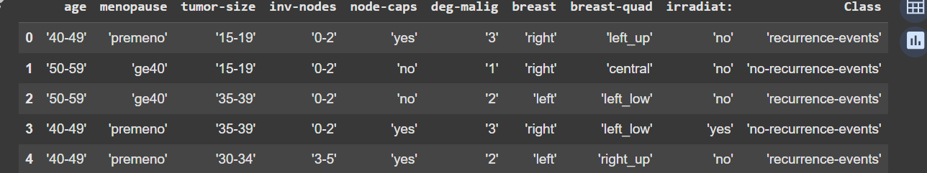
Dataset Overview
Contains features like age, tumor size, degree of malignancy, and irradiation status.
Target variable: Class (binary classification: recurrence-events vs. no-recurrence-events).

Slide 5
Steps in Model Development
Data Preprocessing:
After dropping duplicate rows, current row size is 272
Handle missing values (nan) by replacing them with appropriate strategies (e.g., mode for categorical variables).
Encode categorical variables into numerical format using techniques like Label Encoding.
Split dataset into features (X) and target (y).

Slide 6
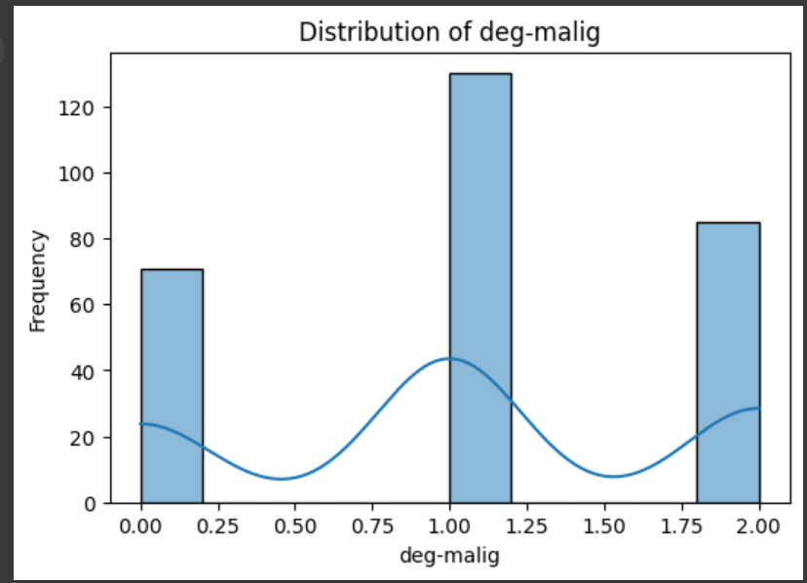
Cont..
Exploratory Data Analysis (EDA):
Visualize distributions of numerical features (e.g., deg-malig).
Identify class imbalance (recurrence-events is the minority class).
Relationships between features and the target variable.
Outliers in numerical features like deg-malig.

Slide 7
Con..
Train-Test Split:
Split data into training (80%) and testing (20%) sets.
Ensure reproducibility by setting random_state=42.
Model Training:
Train three models:
Random Forest: Ensemble learning method robust to overfitting.
Naive Bayes: Probabilistic model based on Bayes' theorem.
SVM: Finds optimal hyperplane for classification.
Evaluation Metrics:
Focus on F1-Score for the minority class (recurrence-events) due to class imbalance.
Compare Accuracy as a secondary metric.

Slide 8
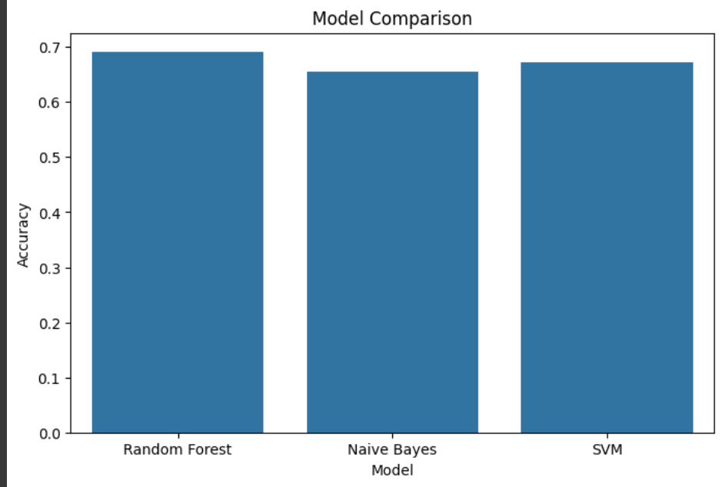
Model Evaluation Results
Accuracy
Random Forest 69.09%
Naive Bayes 65.45%
SVM 67.27%

Slide 9
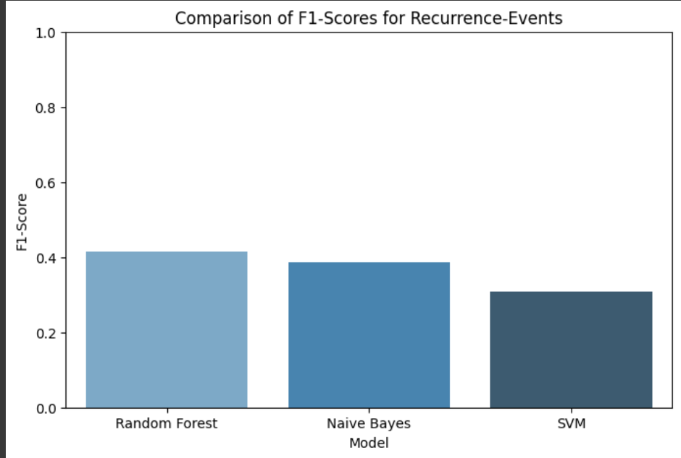
cont...
F1-Scores (Recurrence-Events):
Random Forest : 0.41
Naive Bayes: 0.39
SVM : 0.31

Slide 10
Key Findings
Random Forest achieves the highest F1-Score (0.41) for detecting recurrence-events.
Although Naive Bayes has reasonable accuracy (65.45% ), its F1-Score (0.39 ) indicates it struggles with detecting recurrence-events.
SVM performs the worst in terms of both accuracy (67.27% ) and F1-Score (0.31 ), suggesting it is less reliable for this task.

Slide 11
Conclusion
Features like deg-malig, tumor-size, and inv-nodes appear to influence predictions significantly. Further exploration of feature importance could help refine the models.
Early detection of recurrence-events is crucial for improving patient outcomes. While Random Forest performs the best among the evaluated models, its F1-Score of 0.41 suggests there is significant room for improvement.

Slide 12
Any Questions?

