Slide 1
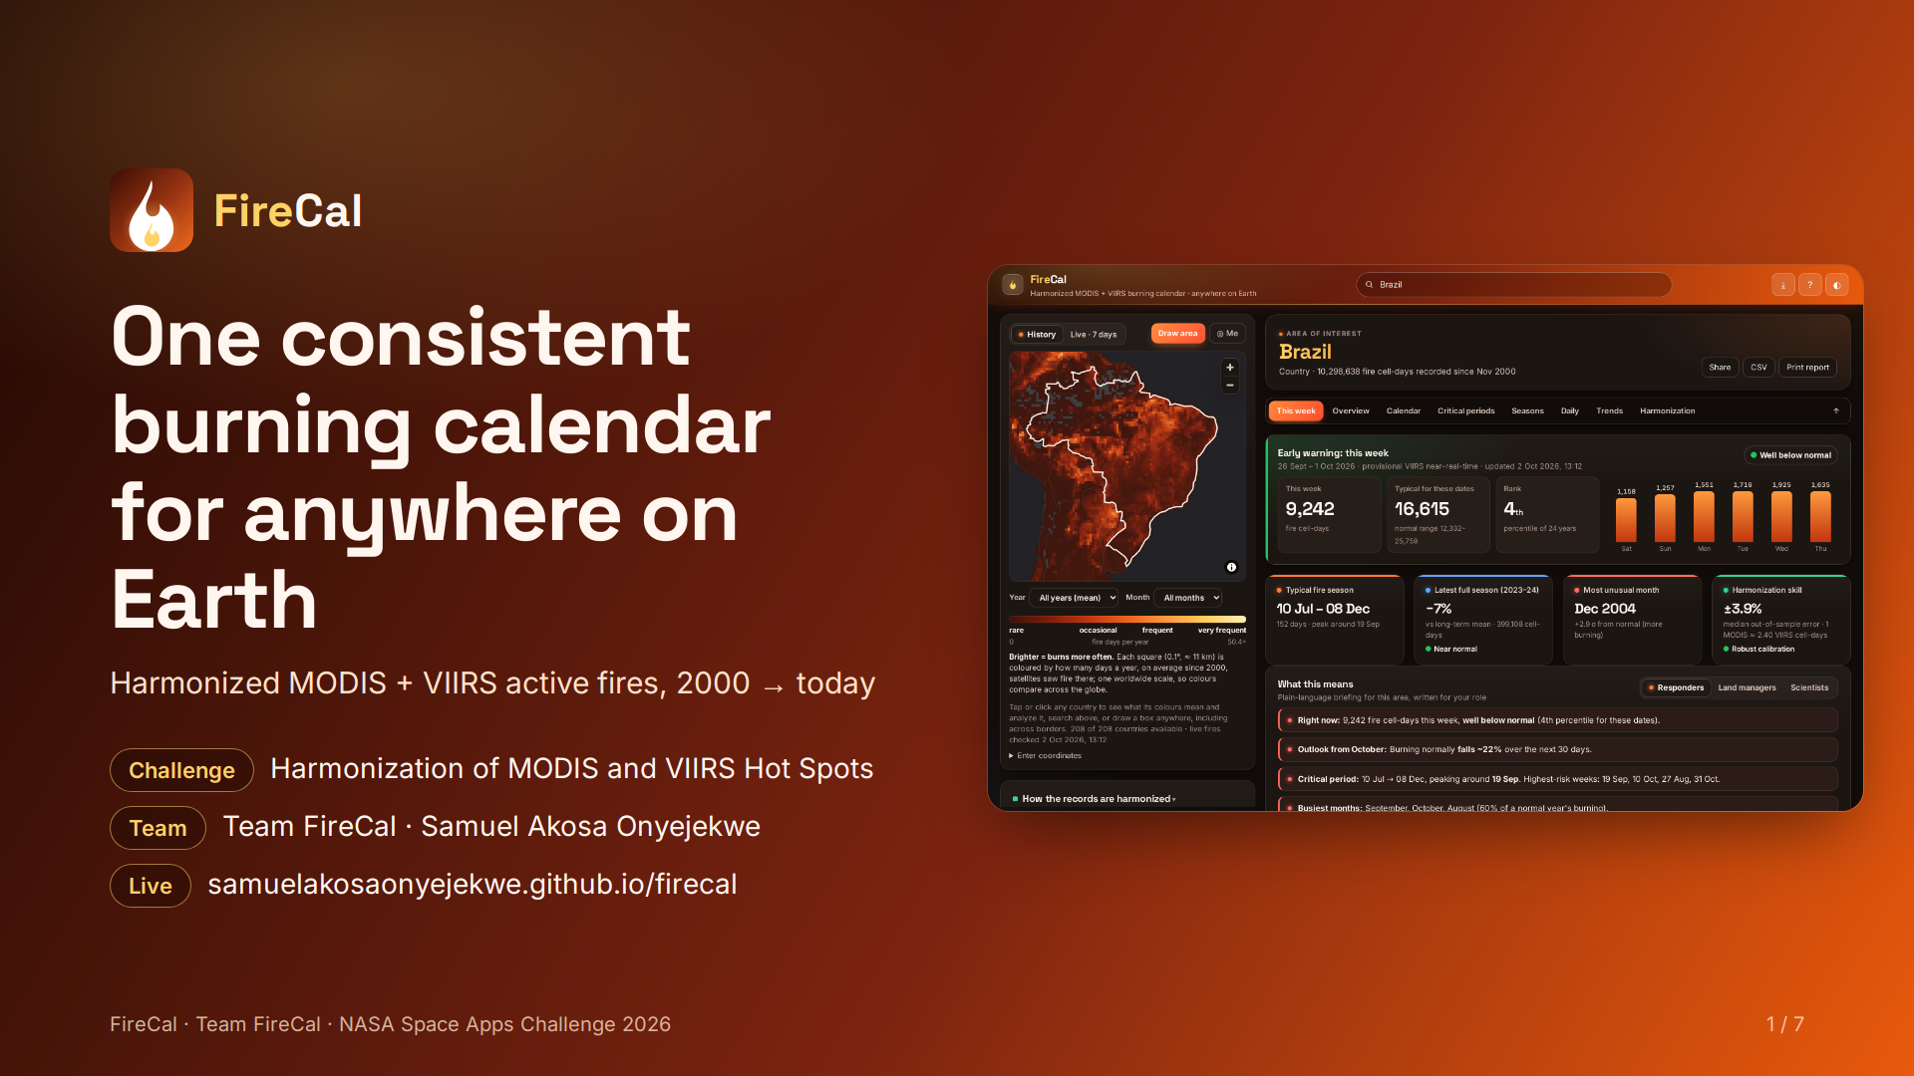
Notes:
FireCal harmonizes MODIS and VIIRS active fires from 2000 to today into one calendar for any country or drawn area. Team FireCal, Samuel Akosa Onyejekwe. Live at samuelakosaonyejekwe.github.io/firecal.

Slide 2
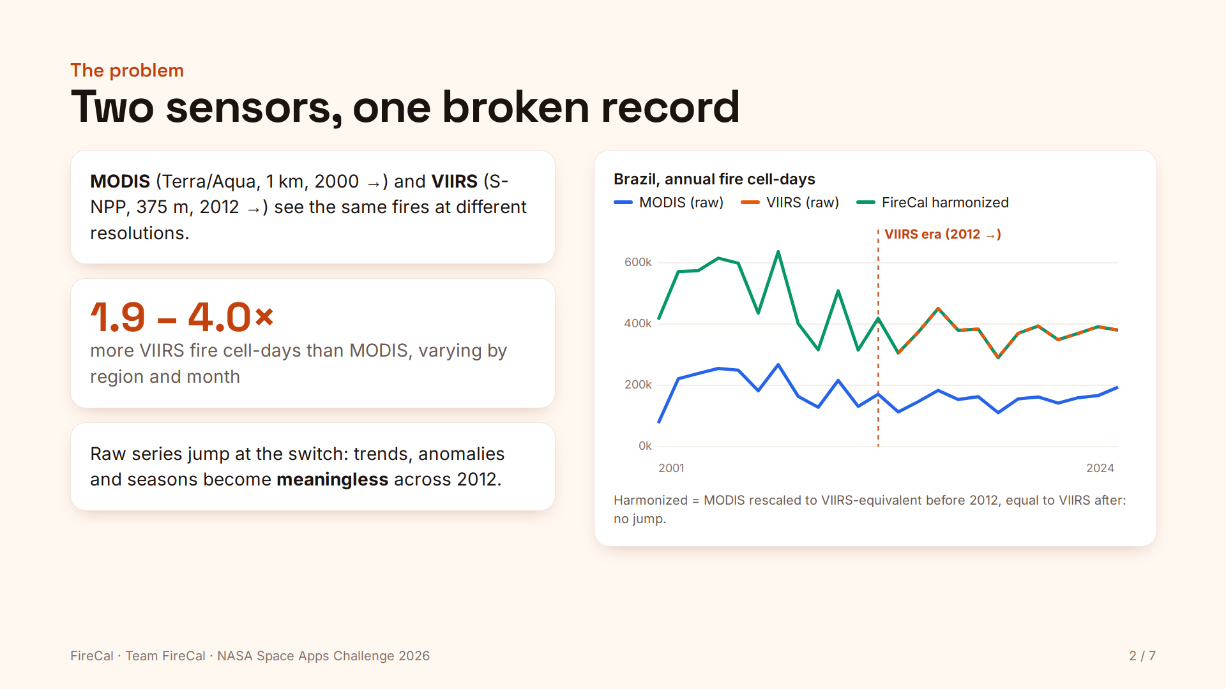
Notes:
MODIS (1 km, 2000 onward) and VIIRS (375 m, 2012 onward) see the same fires differently; VIIRS records 1.9 to 4.0 times more fire cell-days depending on region and month. Raw series jump at the switch, so trends, anomalies and seasons break across 2012. The harmonized record removes the jump.

Slide 3
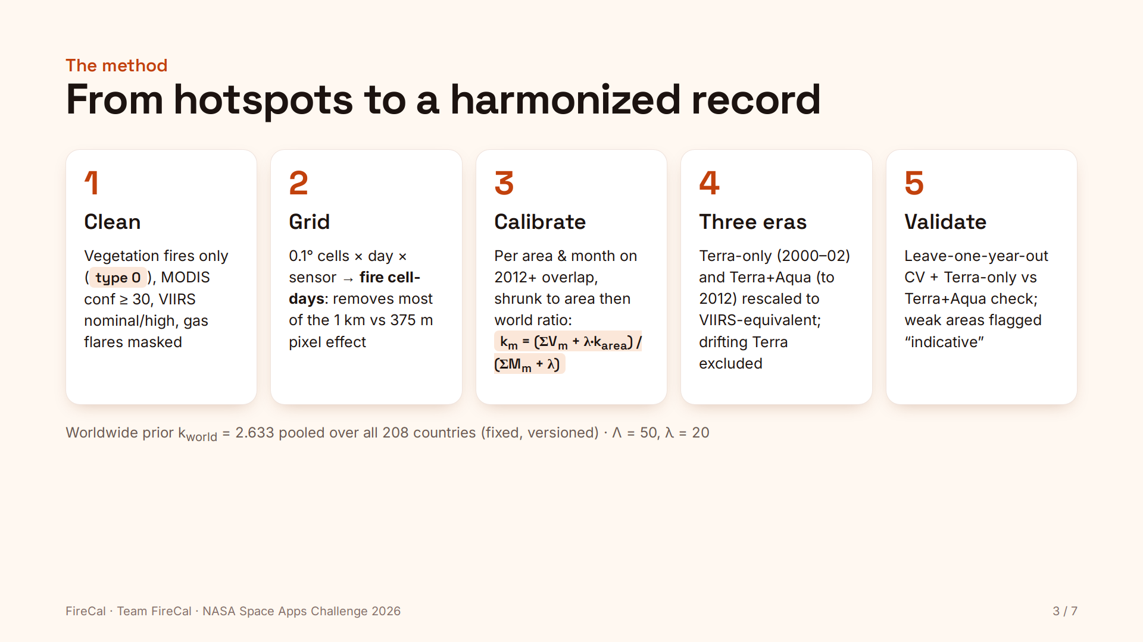
Notes:
Clean: vegetation fires, confidence filters, gas flares masked. Grid: 0.1 degree fire cell-days per sensor. Calibrate: monthly VIIRS/MODIS ratio per area on the 2012+ overlap, shrunk toward the area and worldwide ratios (k_world 2.633 from 208 countries, Lambda 50, lambda 20). Three eras: Terra-only and Terra+Aqua rescaled to VIIRS-equivalent. Validate: leave-one-year-out cross-validation and a Terra-only vs Terra+Aqua check.

Slide 4
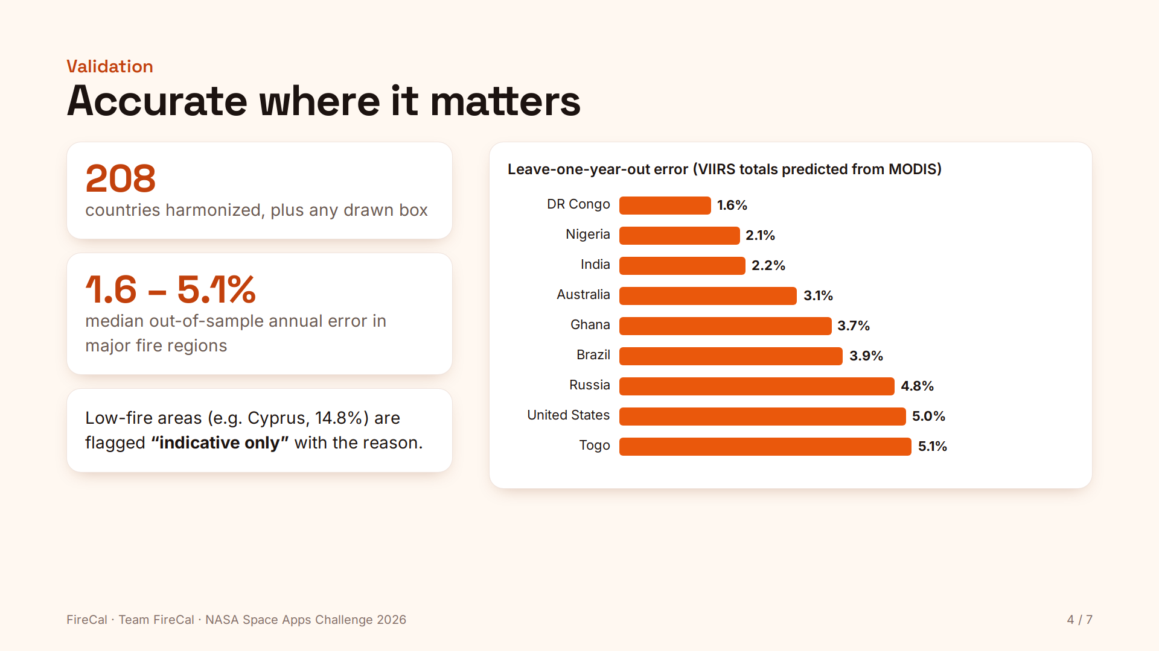
Notes:
Errors: DR Congo 1.6%, Nigeria 2.1%, India 2.2%, Australia 3.1%, Ghana 3.7%, Brazil 3.9%, Russia 4.8%, United States 5.0%, Togo 5.1%. Low-fire areas such as Cyprus (14.8%) are flagged indicative only.

Slide 5
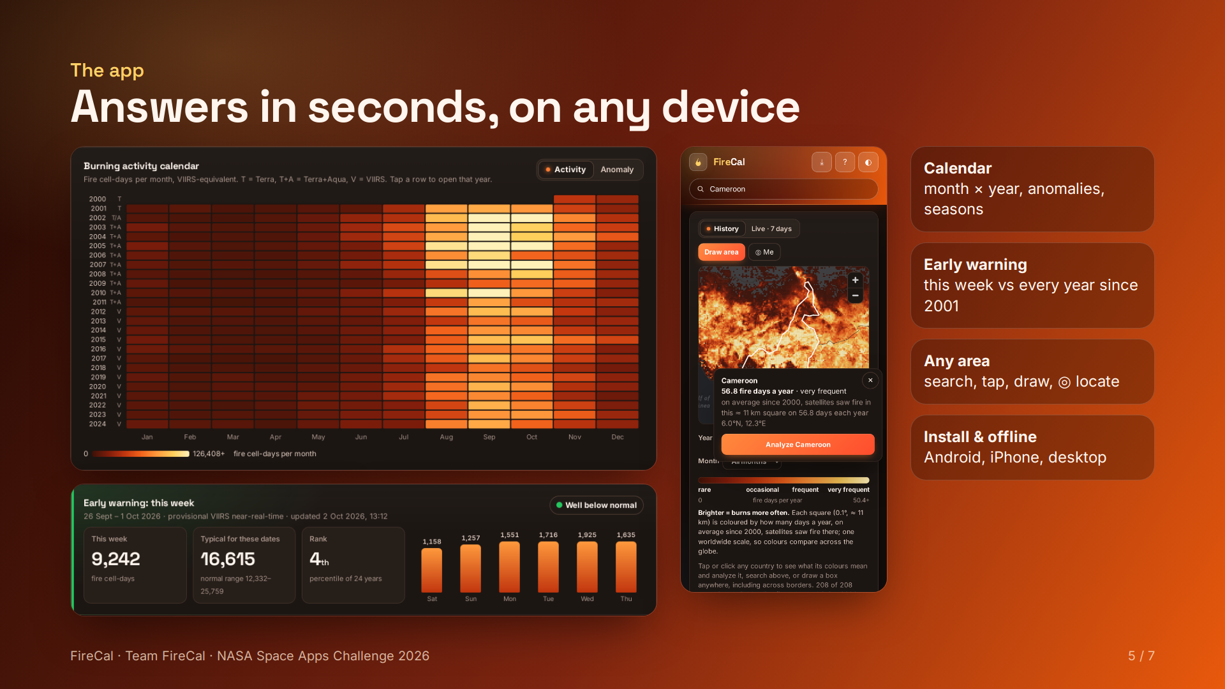
Notes:
Calendar of every month since 2000 with anomalies and seasons; early warning ranks this week against every year since 2001; any area by search, tap, draw or geolocation; installs on Android, iPhone and desktop and works offline.

Slide 6
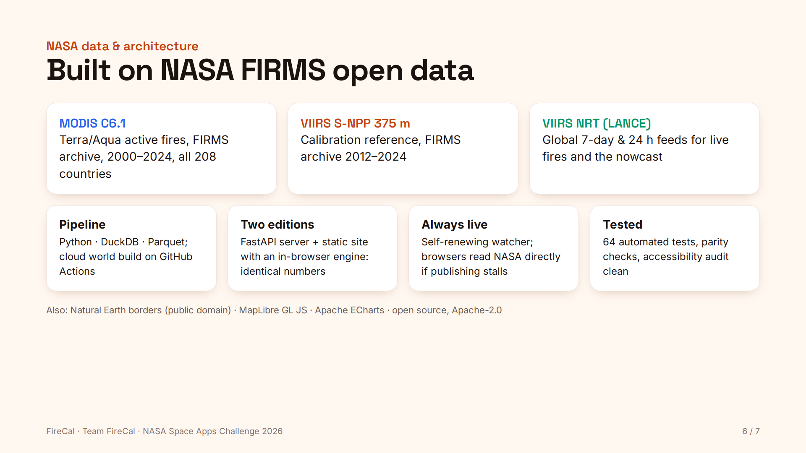
Notes:
Data: NASA FIRMS MODIS Collection 6.1 and VIIRS S-NPP 375 m archives for all 208 countries, and the VIIRS NRT feeds from LANCE. Python, DuckDB and Parquet pipeline; FastAPI server and a static site with an in-browser engine giving identical numbers; a self-renewing watcher keeps live fires current; 64 automated tests.

Slide 7
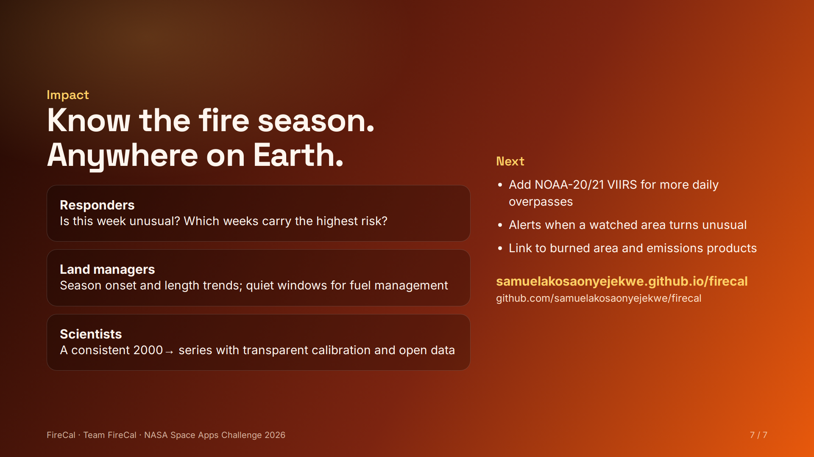
Notes:
Responders: is this week unusual and which weeks are riskiest. Land managers: season onset and length trends, quiet windows for fuel management. Scientists: a consistent series with transparent calibration. Next: NOAA-20/21 VIIRS, alerts for watched areas, links to burned area and emissions products.

