Slide 1
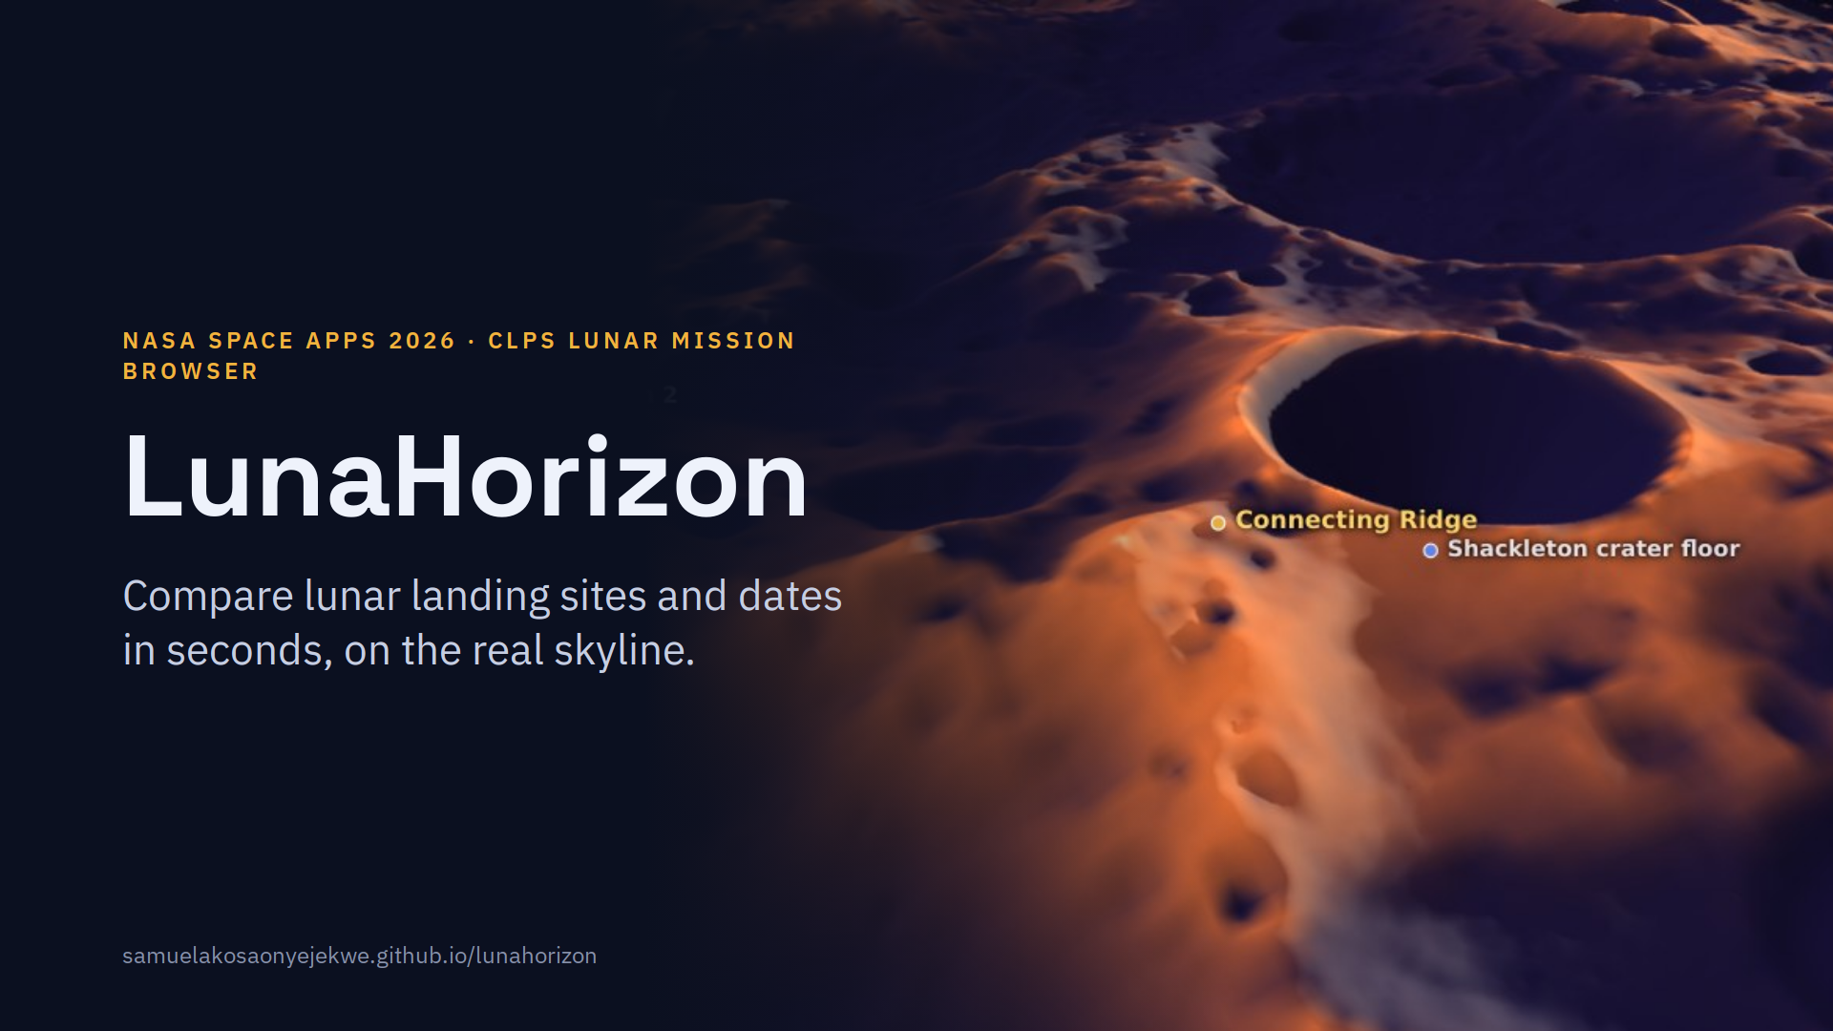
Notes:
LunaHorizon answers one question for the Moon's south pole: at this site, on this date, will the Sun and Earth be above the horizon? The image is the app's 3D view, colored by how much of the year each spot is sunlit. Everything runs in the browser on any phone or laptop.

Slide 2
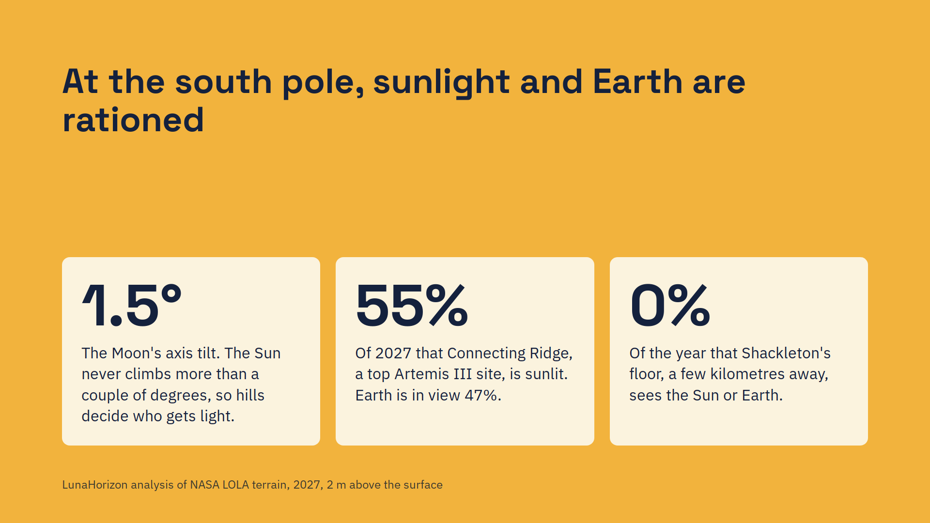
Notes:
Existing tools can compute this, but they need specialists and scripting. Planners, educators and the public need an answer in seconds: which site, which week.

Slide 3
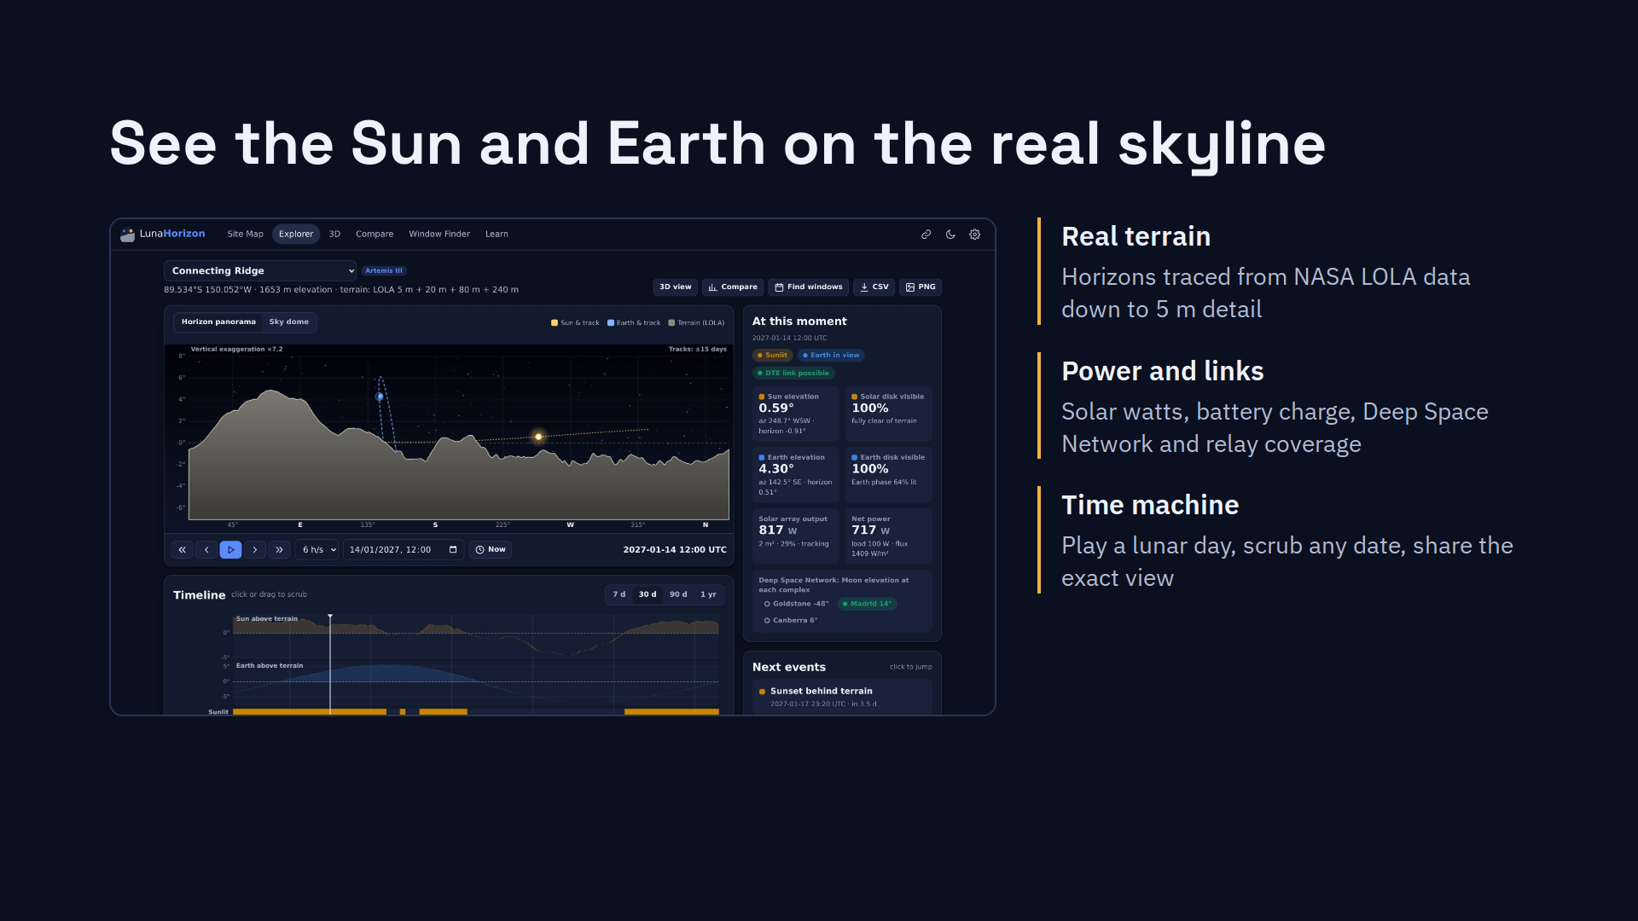
Notes:
This is Connecting Ridge on 14 January 2027. The gray silhouette is the real skyline. The Sun, in amber, skims just above it; Earth, in blue, bobs up and down with libration. The panel shows 817 watts from a 2 square-metre array and which DSN station can take the downlink.

Slide 4
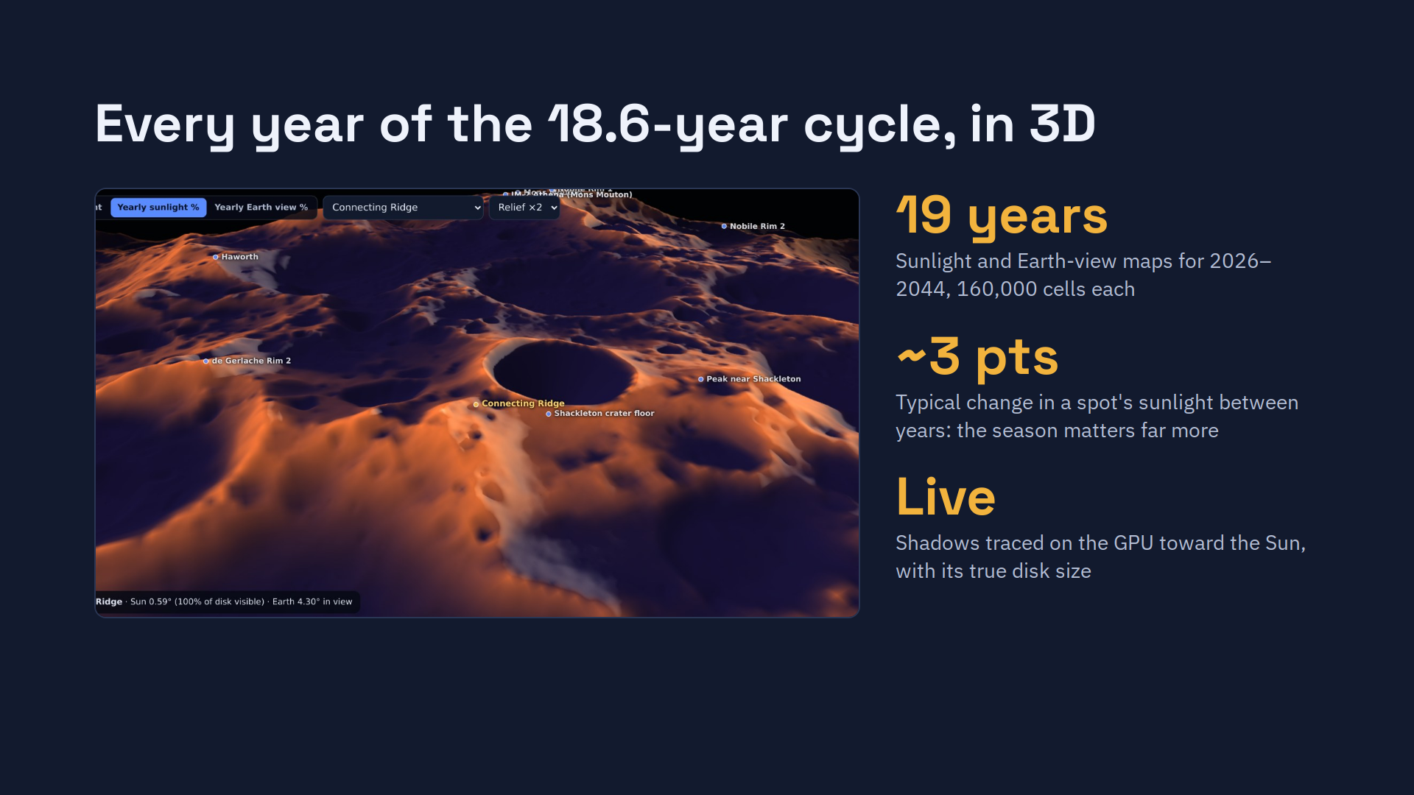
Notes:
The 3D view drapes real LOLA terrain in the browser. In this mode, color shows the share of an average year each spot is sunlit: ridges glow, crater floors stay dark. Switch to live sunlight and shadows are traced toward the Sun through 200 km of terrain, including the Moon's curvature. The maps cover a full 18.6-year lunar cycle, and the surprise is how little years differ: about 3 percentage points at a typical spot.

Slide 5
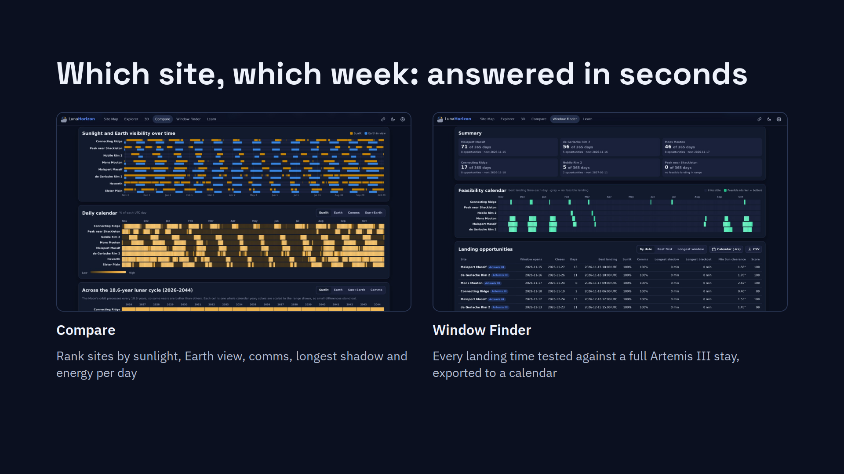
Notes:
Left: a year across eight Artemis III regions, computed in about half a second. Right: the Window Finder tests a landing every 3 hours against a 6.5-day crewed stay that needs continuous sunlight. From November 2026, Malapert Massif works on 71 days of the next year; Nobile Rim 2 on only 5.

Slide 6
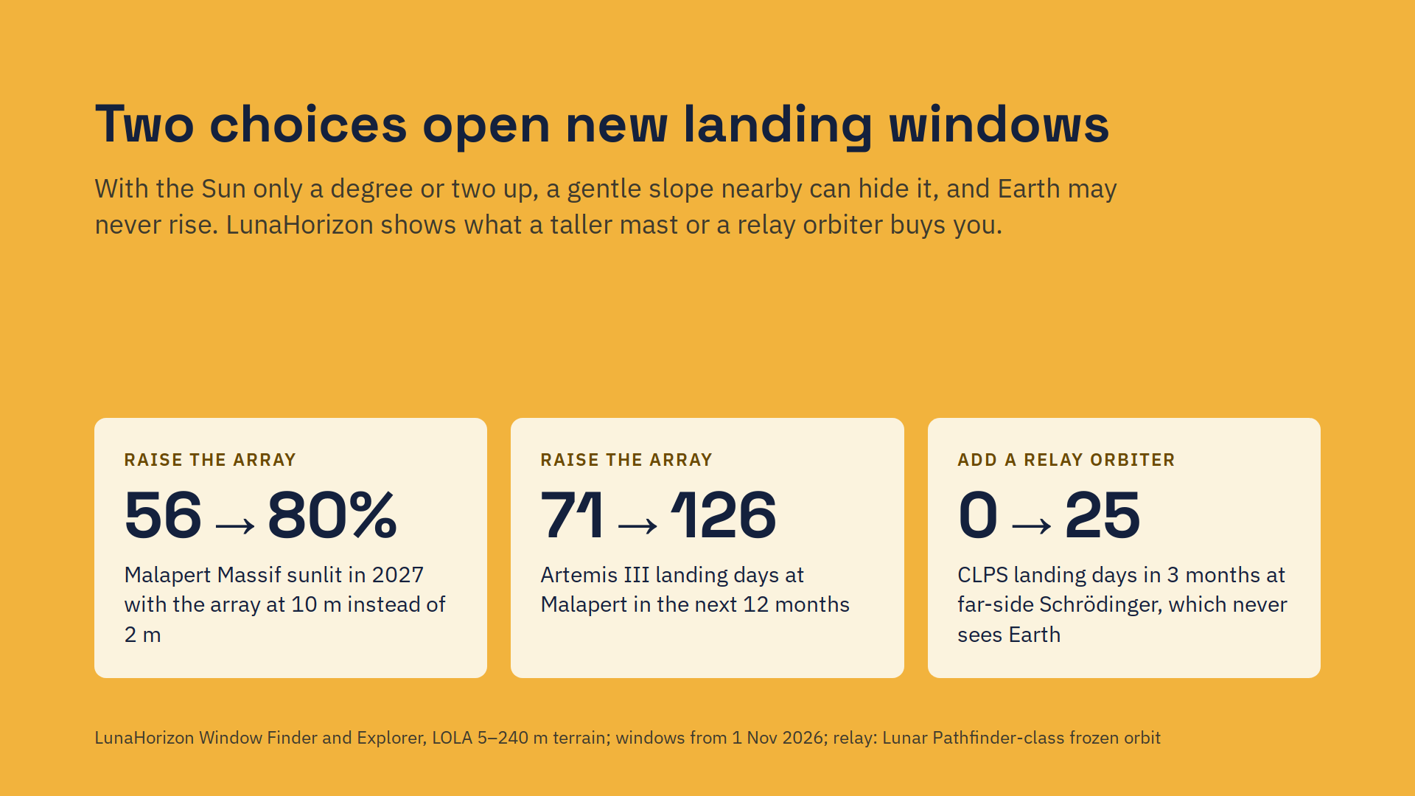
Notes:
With the Sun a degree or two above the horizon, even a gentle 2 to 3 degree slope nearby hides it from a panel near the ground. Lifting the array from 2 to 10 metres nearly doubles the Artemis III landing opportunities at Malapert Massif. For communications, a relay orbiter over the south pole opens landing windows at far-side Schrödinger basin, which never sees Earth directly. Both are one click in Settings.

Slide 7
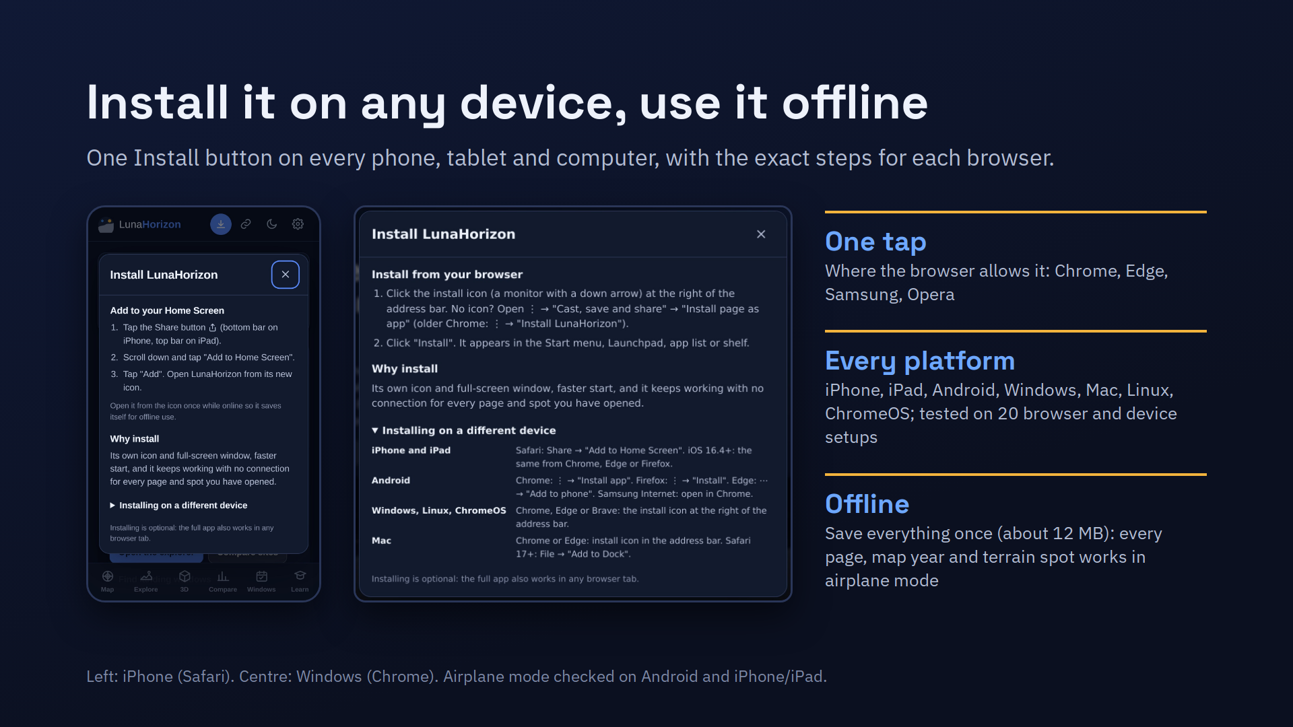
Notes:
LunaHorizon installs like an app on any device. There is one Install button. Where the browser allows it, it installs in one tap; everywhere else it shows the exact steps for that browser, from iPhone Safari to Chrome on Windows. Once installed, or simply after a first visit, it works with no connection, so it can go into a classroom or a field site without signal.

Slide 8
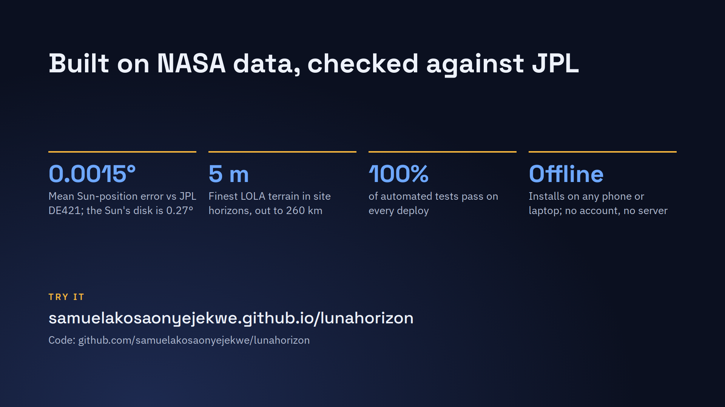
Notes:
Sun and Earth positions match JPL's DE421 ephemeris to 0.0015 degrees on average and 0.01 degrees at worst. Terrain comes from NASA's LOLA elevation models, down to 5 metres near each site. LunaHorizon is free, open source and runs in any browser. Thank you.

