Slide 1


SNAPCHAT PROTOTYPE PROJECT
SNAPCLONE
Samuel Akurang Sampong-Sasu
Software Engineer

Slide 2



APP OVERVIEW: SNAPCLONE
A prototype of Snapchat designed for ephemeral social interaction, focusing on the "here and now."
Snaps: Send temporary photos and videos that disappear after viewing.
Stories: Share moments that automatically expire after 24 hours.
Communication: Integrated real-time chat and contact management.

Slide 3

THE SNAPCHAT REVOLUTION
Redefining Social Media through Ephemerality since 2011.
Real-Life Mimicry
Ephemeral Shift
Gallery vs. Moment
Designed to mimic natural, face-to-face conversations where words are temporary and moments are fleeting.
Introduced content that disappears, removing the pressure of the "permanent record" in digital life.
Moves away from the "permanent gallery" model of Facebook and Instagram toward living in the present.

Slide 4



CORE FEATURES
AUTHENTICATION
SNAP SYSTEM
Secure sign-up and login systems to protect user identity and personal data.
Instant image uploads with a "view once" mechanism, ensuring content remains temporary.
24-HOUR STORIES
SOCIAL NETWORK
A dedicated space for sharing moments that automatically expire after exactly 24 hours.
Integrated real-time chat system and comprehensive friend management tools.

Slide 5







DATABASE SCHEMA
Users Table
Friends Table
Snaps Table
Profiles & Authentication
Social Connections
Ephemeral Media Tracking
Stories Table
Messages Table
PostgreSQL
24-Hour Public Posts
Direct Communication
Relational Engine

Slide 6
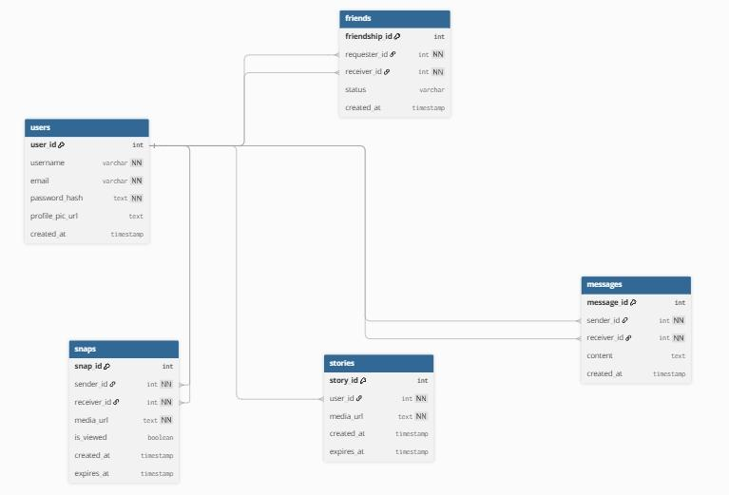
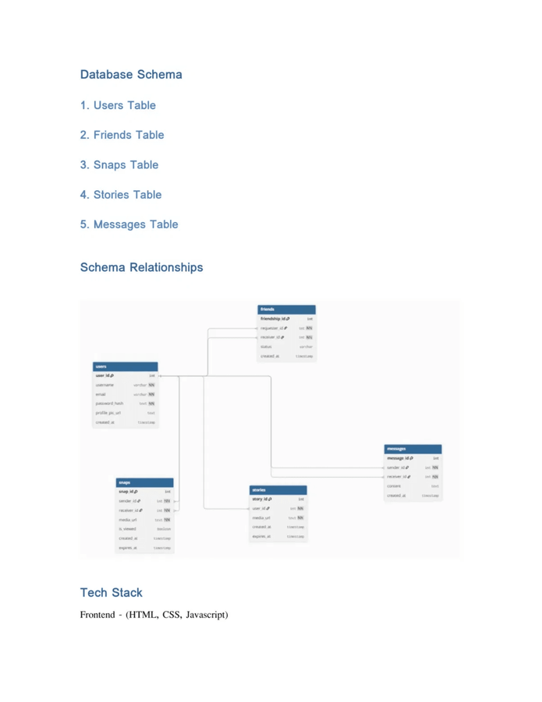
SCHEMA RELATIONSHIPS
The relational structure ensures data integrity between users, their social connections, and the ephemeral content (snaps and stories) they create.

Slide 7



TECH STACK
FRONTEND
BACKEND
DATABASE
HTML
CSS JavaScript
Node.js Express Framework
PostgreSQL Relational Storage

Slide 8

CONCLUSION
Core Concept
Solid Foundation
Future Ready
Successfully demonstrates the ephemeral nature of modern social interaction.
Built on a robust database design and scalable system architecture.
A scalable prototype prepared for advanced feature expansion.
Thank You for Your Attention!

