Slide 1
Introduction to Spring Boot
Overview of Spring Boot
Tooling up

Slide 2
Section 1. Overview of Spring Boot
What is Spring Boot?
Getting Spring Boot
Spring Boot documentation
What can you do with Spring Boot?
Spring Boot in the enterprise

Slide 3
What is Spring Boot?
Spring Boot is a popular Java-based framework from Pivotal
Simplifies creating and running enterprise applications
Allows you to create completely standalone applications
Applications can contain built-in servers, e.g. Tomcat or Jetty
No need for an external web server host to run on
You can just run a Spring Boot application as a regular Java app
java –jar MySpringBootApp.jar

Slide 4
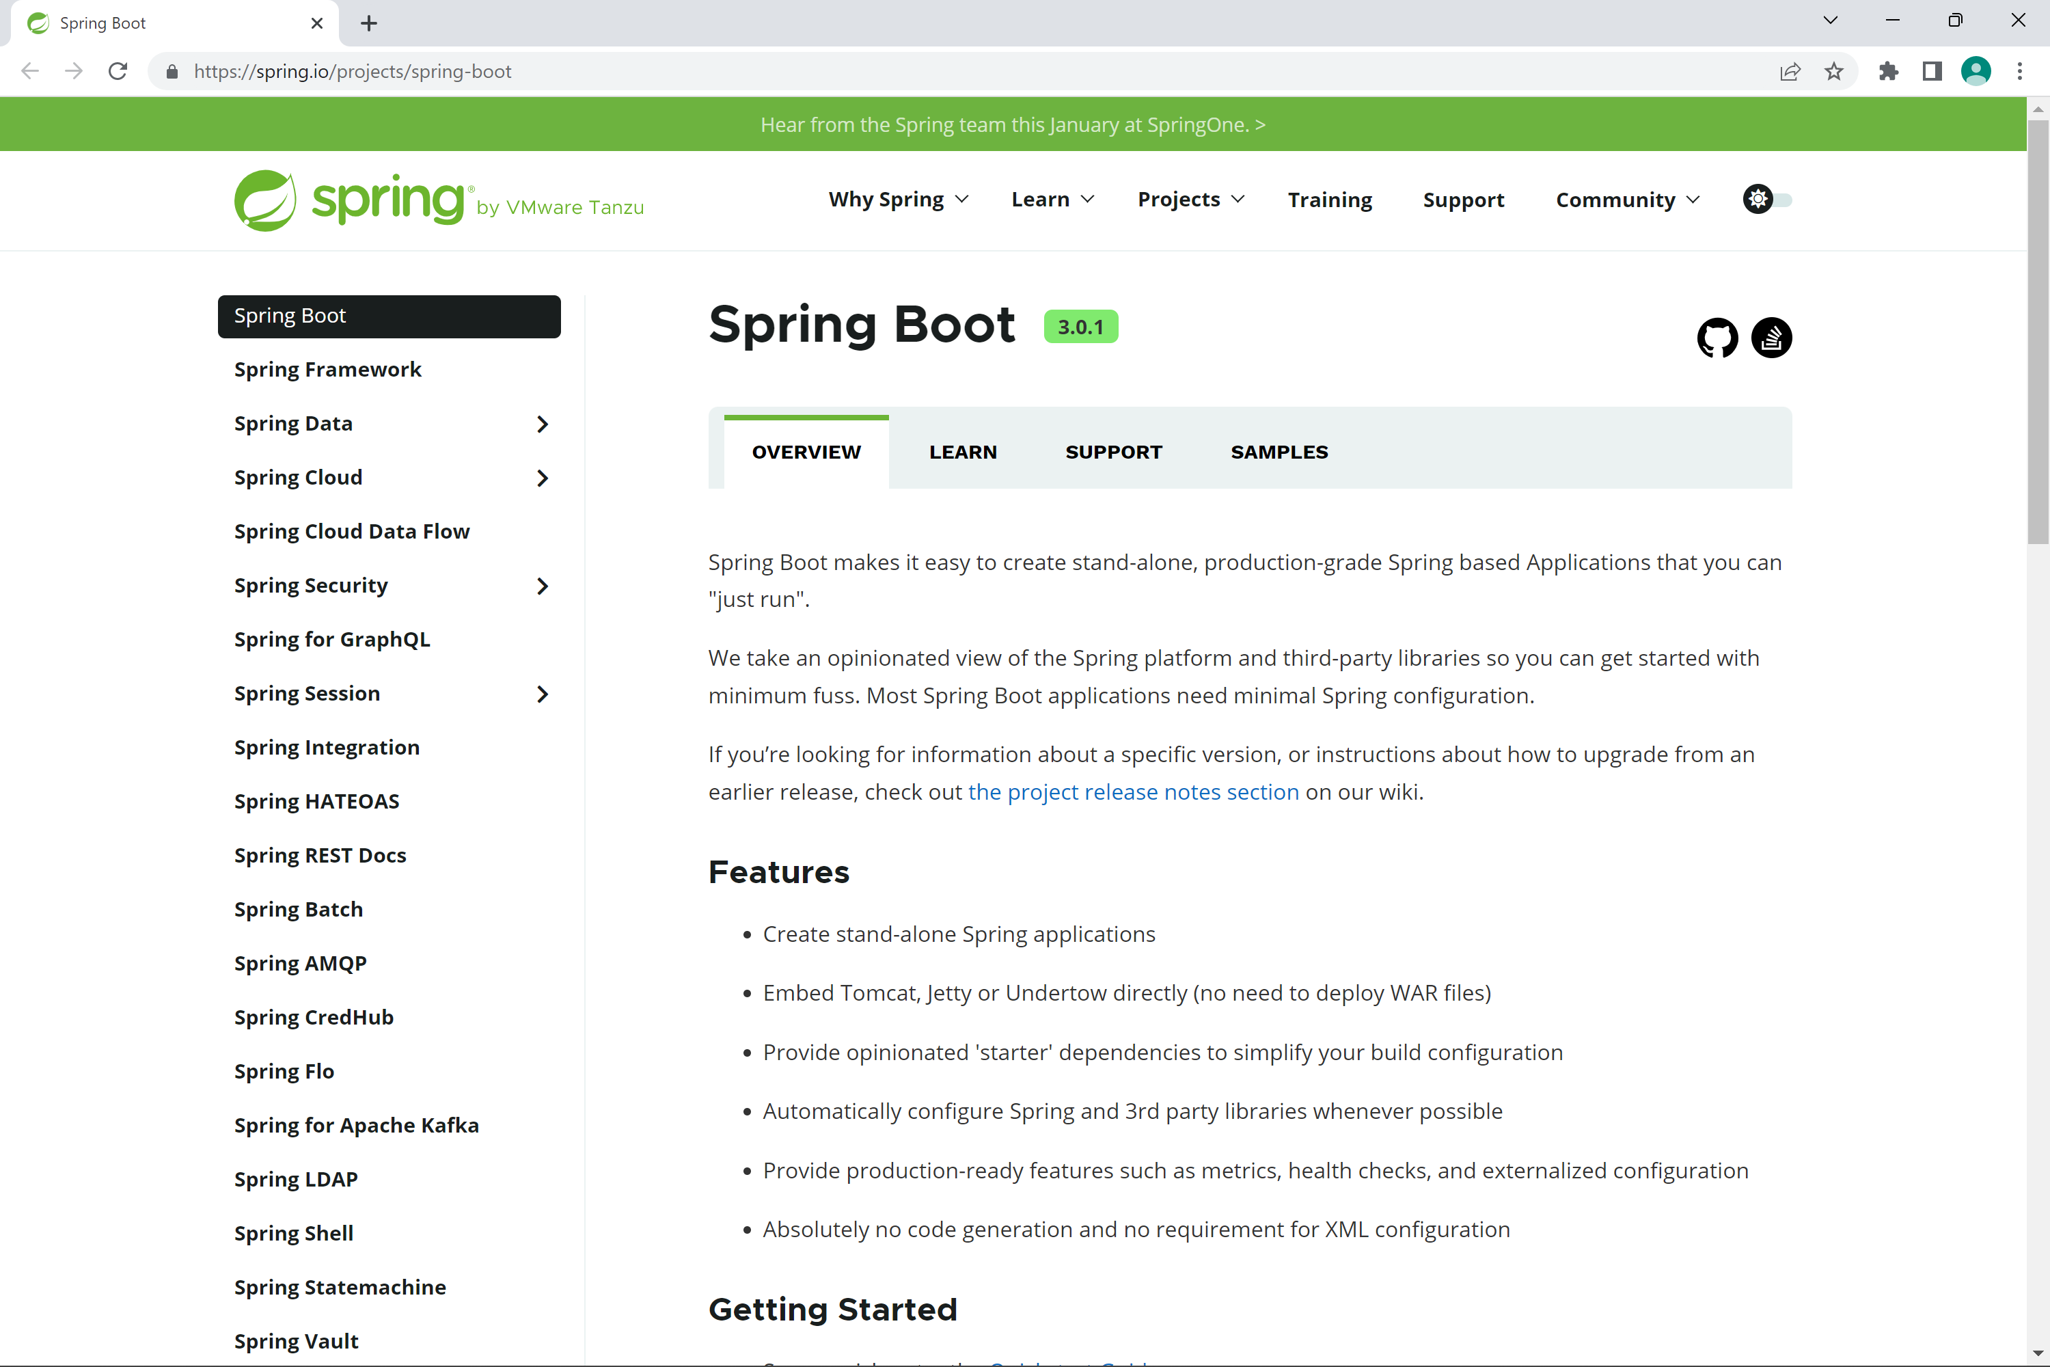
Getting Spring Boot
You can get the Spring Boot project here:
https://spring.io/projects/spring-boot

Slide 5
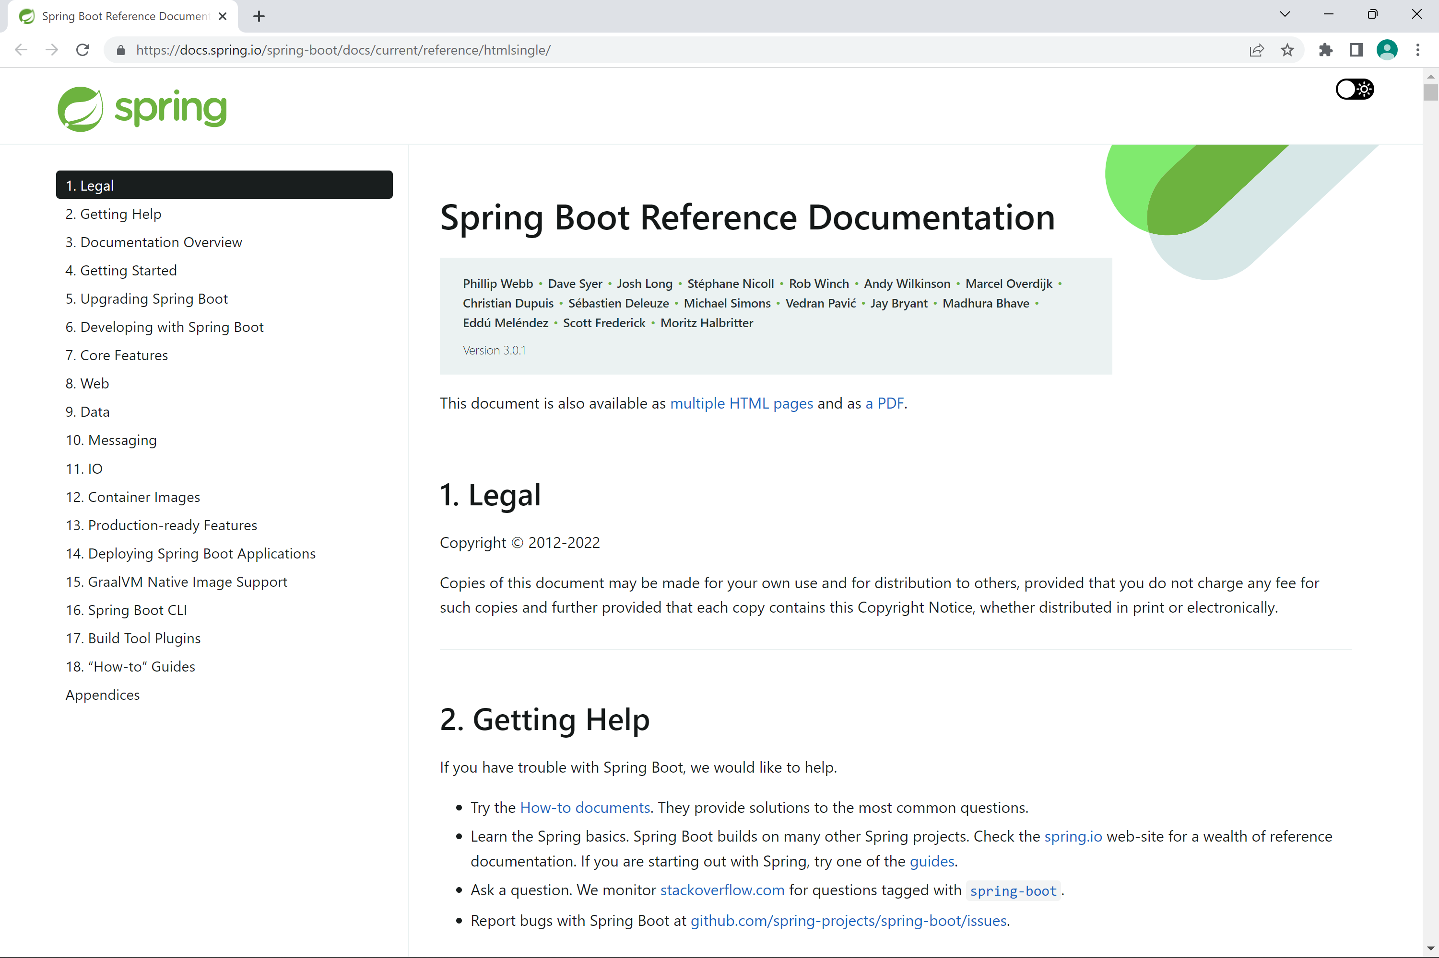
Spring Boot Documentation
Extensive Spring Boot documentation is available here:
https://docs.spring.io/spring-boot/docs/current/reference/htmlsingle/

Slide 6
What Can You Do With Spring Boot?
Spring Boot has extensive APIs that address all aspects of contemporary systems
REST services and Web applications
SQL and NoSQL data sources
Messaging, e.g. with Kafka
Spring Batch
Spring Cloud
Web sockets
Plus testing, security, logging, etc.

Slide 7
Spring Boot in the Enterprise
Web UI
Spring Boot
application
Persistence
Queue
Other clients

Slide 8
Section 2: Tooling Up
Overview
Setting up the Java Development Kit (JDK)
Setting up IntelliJ IDEA Ultimate Edition

Slide 9
Overview
We're going to use the following tools during this video series:
Java Standard Edition Development Kit (JDK) version 17
IntelliJ IDEA Ultimate Edition
Let's see how to set up these tools…

Slide 10
Setting up the Java Development Kit
You can install the Oracle JDK, which is available here:
https://www.oracle.com/java/technologies/javase/jdk17-archive-downloads.html
Alternatively, you can install OpenJDK, which is available here:
https://openjdk.java.net/install/
You must also set two environment variables:
JAVA_HOME - must point to your JDK folder
PATH - must include your JDK binary folder

Slide 11
Setting up IntelliJ IDEA Ultimate Edition
You can install IntelliJ IDEA Ultimate Edition from here:
https://www.jetbrains.com/idea/
Make sure you install the Ultimate Edition
You can install a free 30-day trial if you like
We'll use IntelliJ IDEA to create and run Spring Boot apps

Slide 12
Summary
Overview of Spring Boot
Tooling up

