Slide 1
Creating a Spring Boot Web App
Creating a web app project in IntelliJ
Understanding the web app
Defining application properties

Slide 2
1. Creating a Web App Project in IntelliJ
Overview
Creating a Spring Boot web project
Specifying project dependencies

Slide 3
Overview
Spring Boot applications are typically "web apps"
Listen for HTTP requests from web client (e.g. a browser)
Return static or dynamic content
We'll see how to return static content for now
Later we'll see how to return dynamic content, via REST services
Web client
HTTP request
Spring Boot web app
HTTP response
Static or dynamic content

Slide 4
Creating a Spring Boot Web Project
Start IntelliJ, click New Project, and select Spring Initializr
Specify project info as follows:
Enter a suitable project name and location
Language - Java
Type - Maven
Enter a suitable group ID, artifact ID, and package name
Project SDK - Java 17
Java version - 17
Packaging - Jar
Then click Next

Slide 5
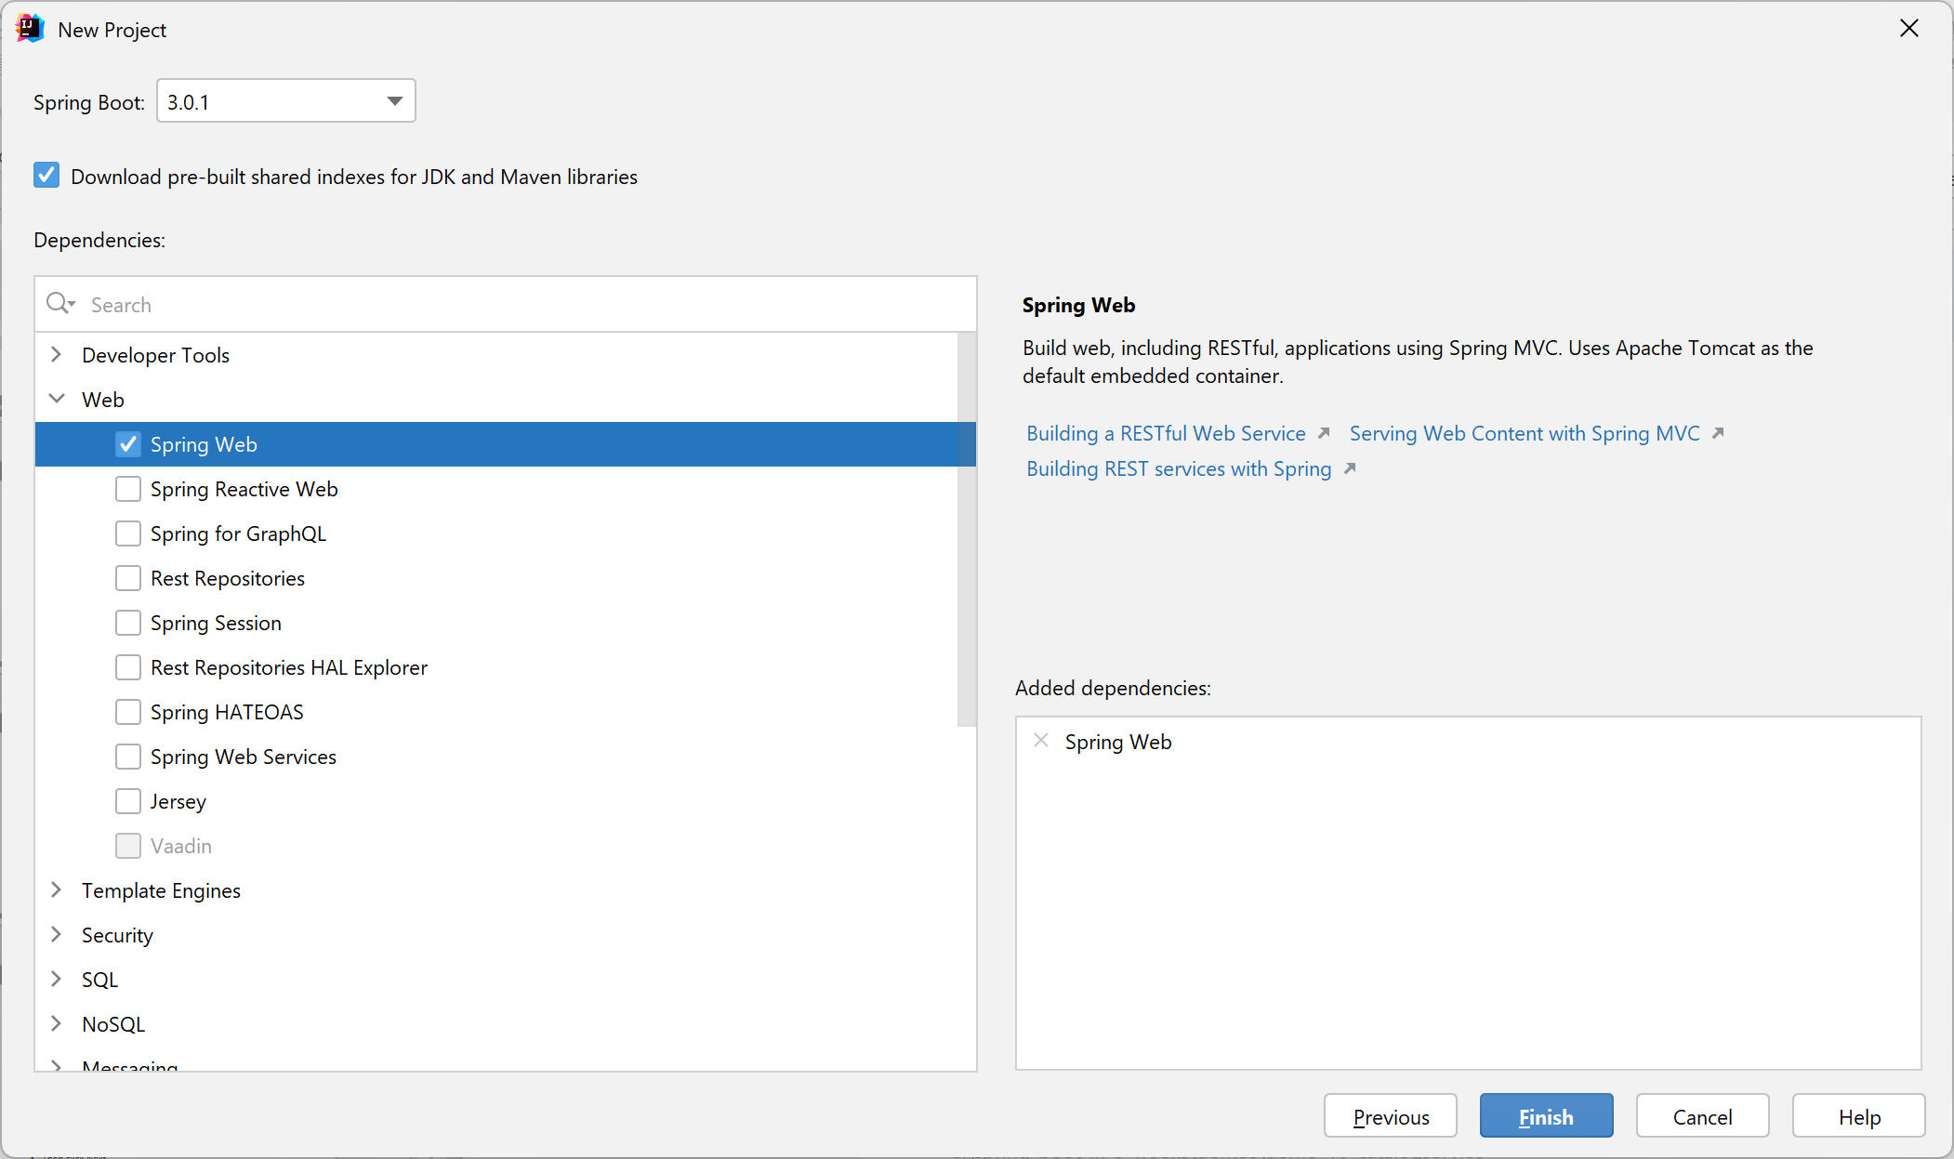
Specifying Project Dependencies
In the next window you can add dependencies to your project
Expand Web and select Spring Web

Slide 6
2. Understanding the Web Application
Understanding the web application structure
Understanding the Maven POM file
Adding web content
Running the application
Pinging the application

Slide 7
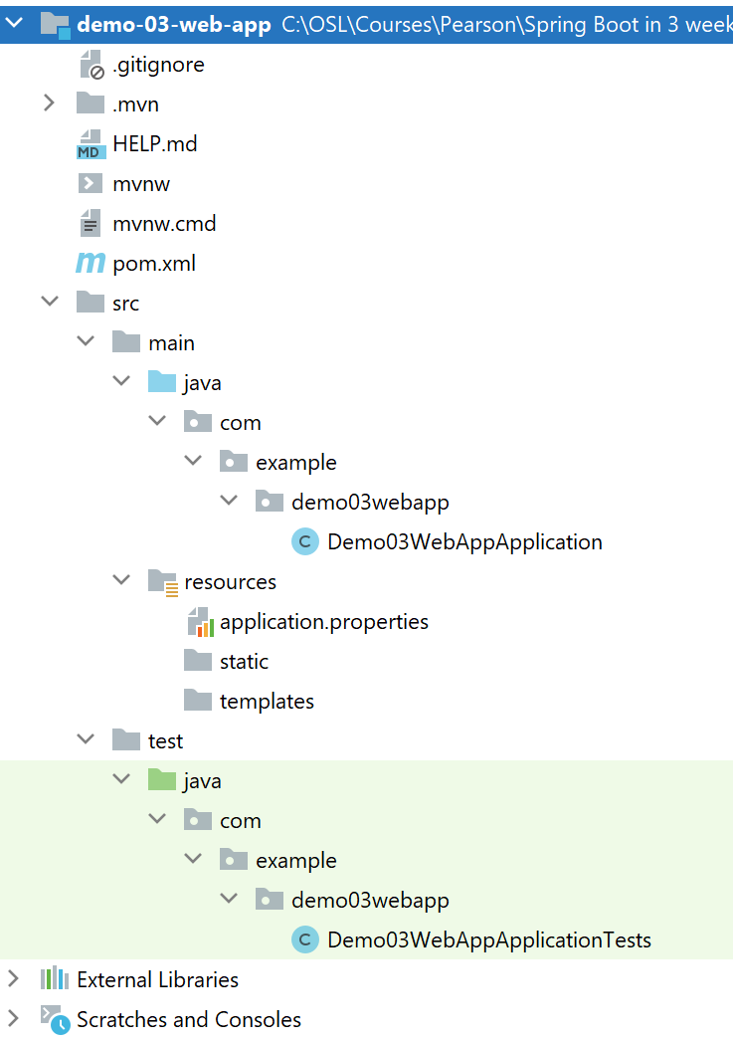
Understanding the Web Application Structure
The generated application is a regular Maven web project:
Put static web content here

Slide 8
Understanding the Maven POM File
Here's the relevant section in the Maven POM file:
<project … >
…
<dependencies>
<dependency>
<groupId>org.springframework.boot</groupId>
<artifactId>spring-boot-starter-web</artifactId>
</dependency>
<dependency>
<groupId>org.springframework.boot</groupId>
<artifactId>spring-boot-starter-test</artifactId>
<scope>test</scope>
</dependency>
</dependencies>
…
Spring Boot web dependency
pom.xml

Slide 9
Adding Web Content
You can add static web content in the following directory:
src\main\resources\static
For example, add an index.html file:
<!DOCTYPE html>
<html lang="en">
<head>
<meta charset="UTF-8">
<title>Home</title>
</head>
<body>
Hello world!
</body>
</html>
index.html

Slide 10
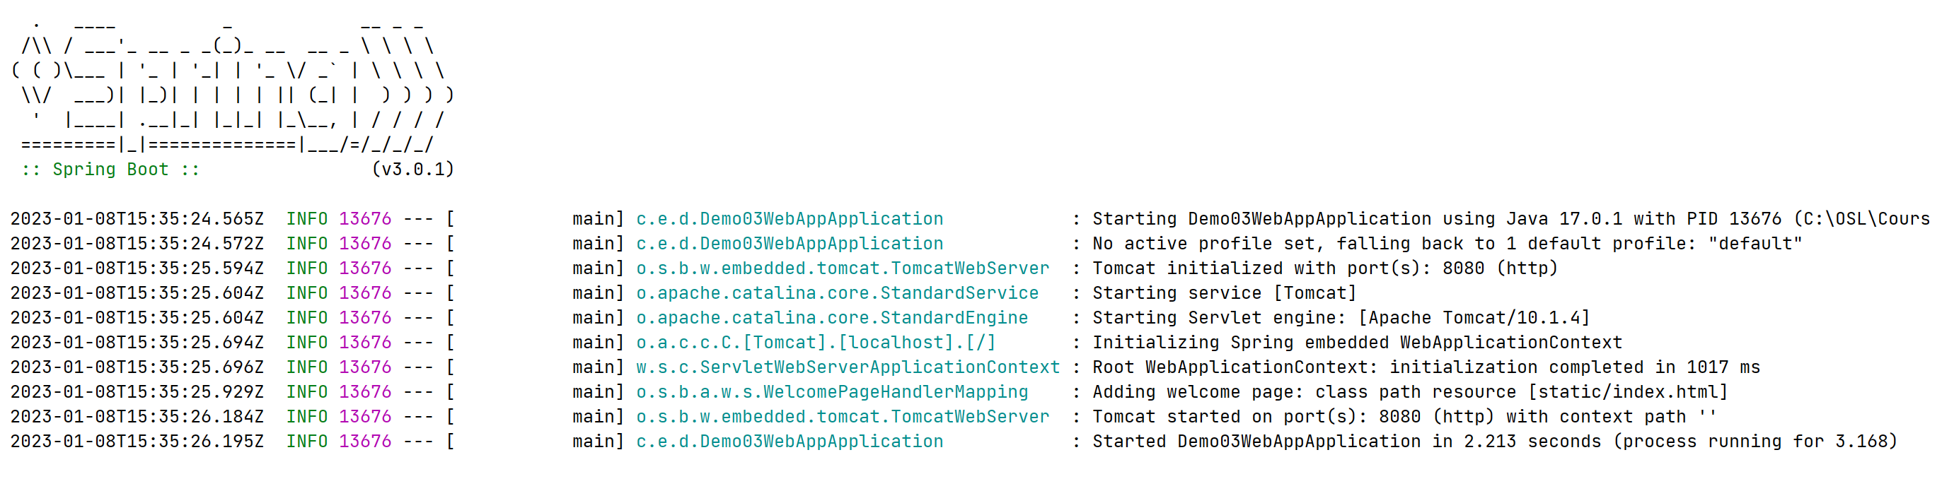
Running the Application
To run the application:
Right-click the Java app file, then click Run
Compiles the code, bundles into a JAR, then runs the JAR
The application has an embedded Tomcat web server

Slide 11
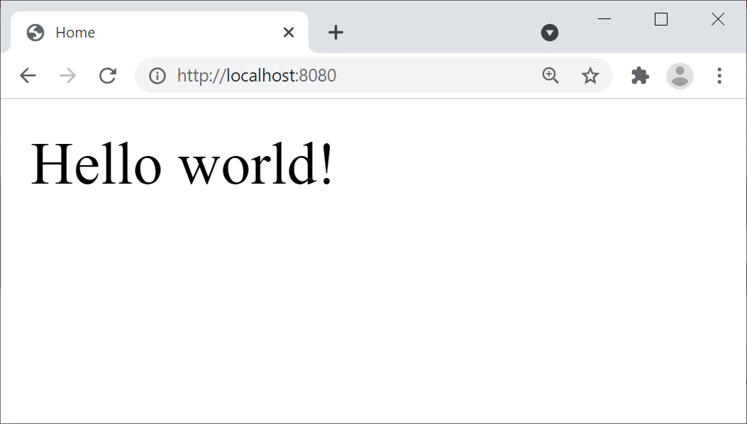
Pinging the Application
Open a browser and go to http://localhost:8080
Renders index.html (a standard welcome page in Java web)

Slide 12
3. Defining Application Properties
Overview of application properties
Editing application properties
Restarting the application

Slide 13
Overview of Application Properties
Spring Boot applications have a standard text file named application.properties
Very important!
The recommended place to set application properties
i.e. name=value pairs
You can also use YAML if you like
YAML = "YAML Ain't Markup Language"
More on YAML files later…
13

Slide 14
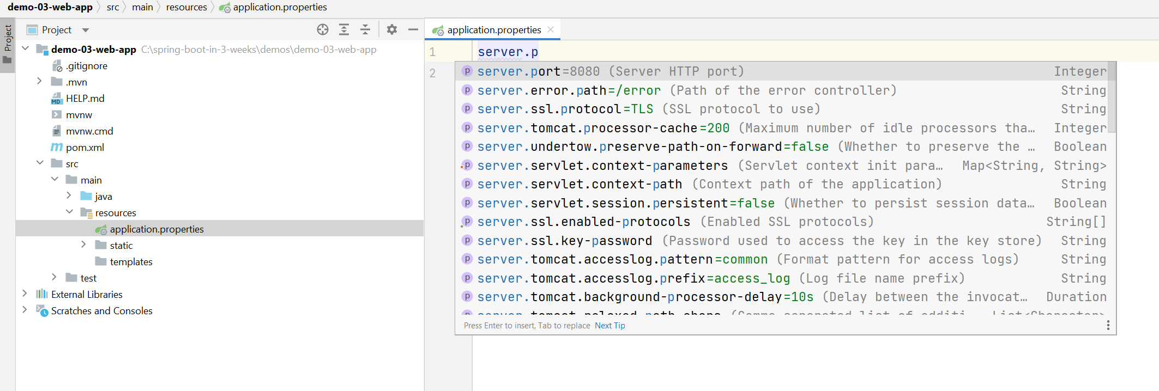
Editing Application Properties
To help you edit application.properties, IntelliJ provides a Spring Properties Editor tool
Provides nice content assistance and error checking
server.port=8111
14

Slide 15
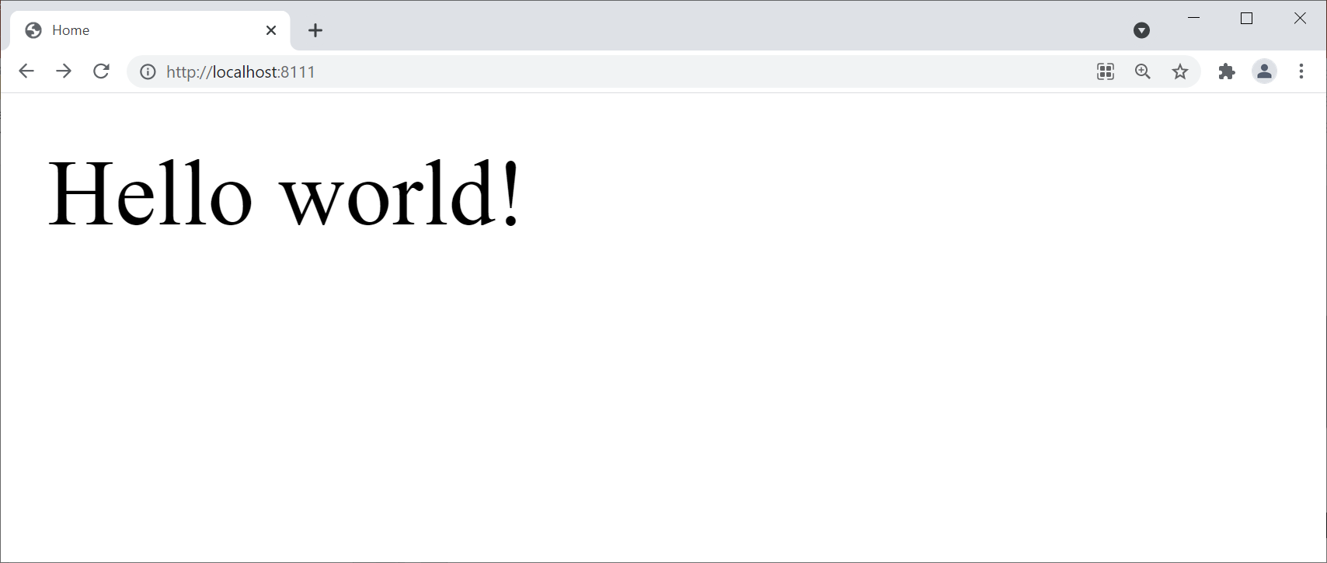
Restarting the Application
Restart the application, and verify Tomcat starts on the new port number, 8111
Ping the Web server using the new port number, 8111
15

Slide 16
Summary
Creating a web app project in IntelliJ
Understanding the web app
Defining application properties

