Slide 1
Consuming REST Services
Overview
Key methods in RestTemplate
Example
Key classes in the REST client application
Aside: Consuming a REST service from HTML

Slide 2
Overview
Spring enables you to implement client code to consume REST services
Via the RestTemplate class
Include the following POM dependency:
<dependency>
<groupId>org.springframework.boot</groupId>
<artifactId>spring-boot-starter-web</artifactId>
</dependency>
pom.xml

Slide 3
Key Methods in RestTemplate
Here are some of the key methods in RestTemplate:
ResponseEntity<T> getForEntity(String, Class<T>, Object...)
ResponseEntity<T> postForEntity(String, Object, Class<T>, Object...)
void put(String, Object, Object...)
void delete(String, Object...)
ResponseEntity<T> exchange(String, HttpMethod, object, Class<T>)

Slide 4
Example
Let's see an example of how to consume REST endpoints:
REST request
REST client
MyRestClient
REST service
/full/products
REST response
demo-13-rest-clients app
http://localhost:8181
demo-13-rest-services app
http://localhost:8080

Slide 5
Key Classes in the REST Client Application
MyRestClient
Calls REST service endpoints, by using RestTemplate
Product
Product objects passed to/from REST service
Serialized/deserialized by RestTemplate

Slide 6
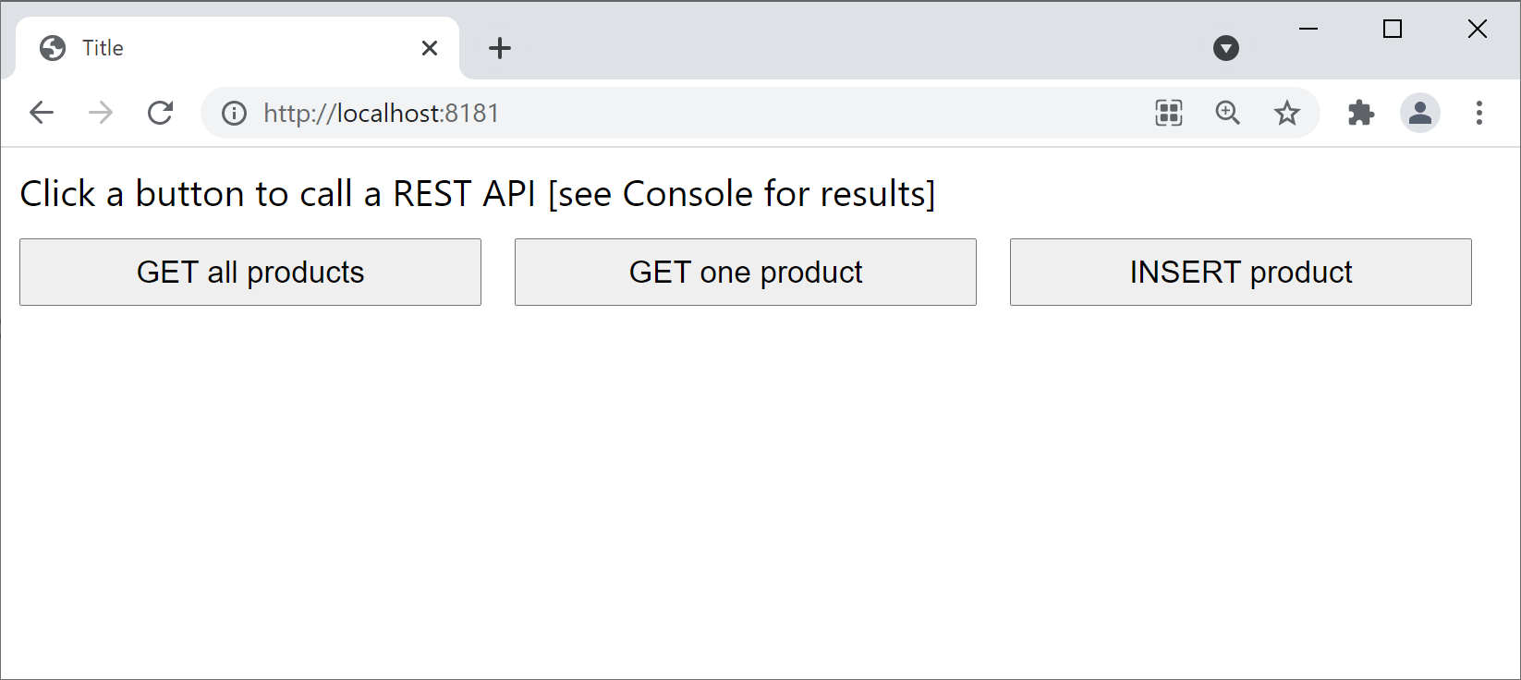
Aside: Consuming a REST service from HTML
We've also implemented a simple HTML page to show how to consume a REST service from a web UI
Project: demo-13-rest-clients
Folder: src/main/resources/static
Open a browser and browse to http://localhost:8181

Slide 7
Summary
Overview
Key methods in RestTemplate
Example
Key classes in the REST client application
Aside: Consuming a REST service from HTML

