Slide 1
Spring Cloud Microservices
Overview of microservices
Microservices application example
Implementing circuit breaker behaviour

Slide 2
1. Overview of Microservices
The challenges
What are microservices?
Characteristics of a microservice architecture
Benefits of the microservices approach
Microservices and the cloud
Microservices and Spring

Slide 3
The Challenges
Globalization and interconnectivity place new demands on organizations and IT departments…
Applications need to communicate with many external service providers over the Internet - the age of silo applications is over
Customers expect incremental product updates and feature upgrades, rather than complete product releases once a year
Architectures must be flexible enough to scale up across multiple servers quickly when volume spikes
Availability and resilience in the worldwide market are essential

Slide 4
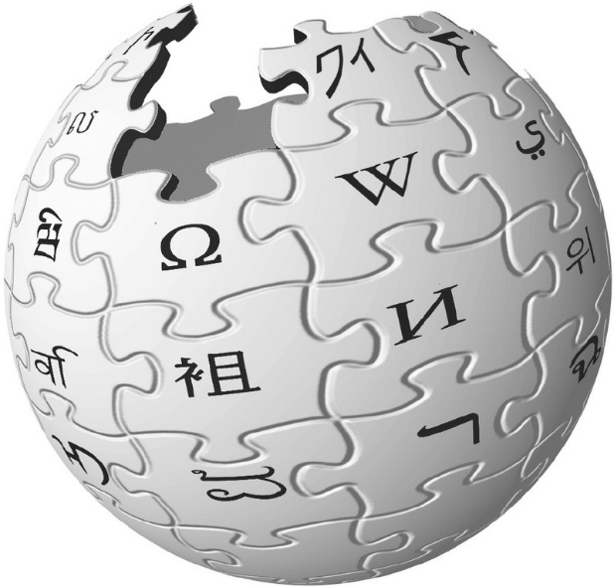
What are Microservices?
According to Wiki:
Microservices is a specialisation of an implementation approach for service-oriented architectures (SOA) used to build flexible, independently deployable software systems.
Services in a microservice architecture (MSA) are processes that communicate with each other over a network in order to fulfil a goal. These services use technology-agnostic protocols.
The microservices approach is a first realisation of SOA that followed the introduction of DevOps and is becoming more popular for building continuously deployed systems.

Slide 5
Characteristics of a Microservice Architecture
Microservices are a move away from monolithic architectures
Functionality is delivered as fine-grained distributed components
Each microservice is highly cohesive
Has responsibility for a very specific piece of domain logic
Has well-defined boundaries
The implementation technology of a microservice is irrelevant
Microservices are loosely coupled
Each microservice is deployed independently of other ones
Communicate via technology-neutral protocols, e.g. HTTP, JSON

Slide 6
Benefits of the Microservices Approach
Scalability
Microservices can be distributed across multiple servers
Easier to scale-out specific services as needed
Flexibility
Microservices offer a finer level of granularity than traditional apps
Easier to compose and rearrange to deliver new functionality
Resilience
Microservices are decoupled, so they degrade/fail in isolation
Failures can be contained locally, without crashing the whole app

Slide 7
Microservices and the Cloud
Microservices are ideally suited for deployment on the cloud
Easy to deploy individually
Typically small in size, so it's OK to start up a large number of the same microservice if demand spikes
Increases scalability and resilience

Slide 8
Microservices and Spring
Spring Boot and Spring Cloud are well suited to microservices
Spring Boot
Focuses on common core development features for creating and packaging REST-oriented microservices
Spring Cloud
Makes it simple to deploy and operate microservices in the cloud (public or private)

Slide 9
2. Microservices Application Example
Overview
Implementing the catalog service
Implementing the client service

Slide 10
Overview
In this section we'll show a complete (simple) example of how to create a Spring Cloud microservice application
There are two Spring Boot applications in the demo:
demo-16-clientservice
demo-16-catalogservice
client service
catalog service

Slide 11
Implementing the Catalog Service (1 of 2)
The "catalog" service is a Spring Boot application with a REST service that returns catalog info
See demo-16-catalogservice
The server.port property is 8081
Take a look at the endpoints in CatalogController:
/catalog
/catalog/{index}

Slide 12
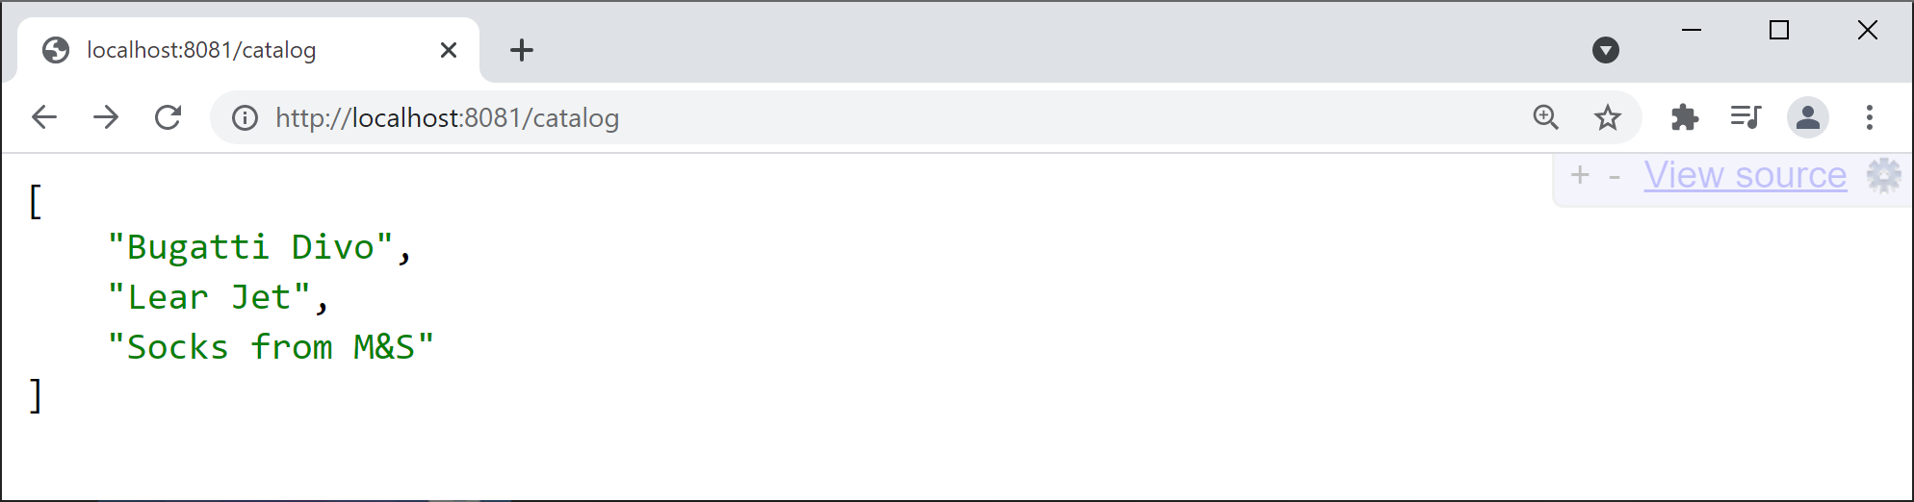
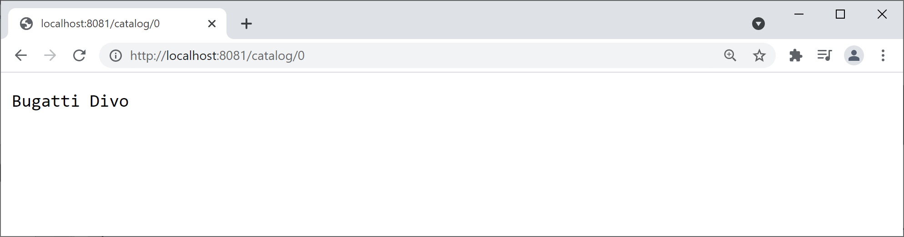
Implementing the Catalog Service (2 of 2)
Run the catalog app and ping the following URLs…
http://localhost:8081/catalog
http://localhost:8081/catalog/0

Slide 13
Implementing the Client Service (1 of 3)
The "client" service is another Spring Boot application with a REST service
See demo-16-clientservice
The server.port property is 8080
Take a look at the endpoint in ClientController:
/client/{index}

Slide 14
Implementing the Client Service (2 of 3)
The "client" service invokes the "catalog" service
Using a Spring RestTemplate
@RestController
public class ClientController {
@GetMapping("/client/{index}")
public String getItem(@PathVariable int index){
URI catalogUrl = URI.create("http://localhost:8081/catalog/" + index);
RestTemplate restTemplate = new RestTemplate();
String result = restTemplate.getForObject(catalogUrl, String.class);
return String.format("[%s] Item %d %s", LocalTime.now(), index, result);
}
}
HTTP request
Catalog service

Slide 15
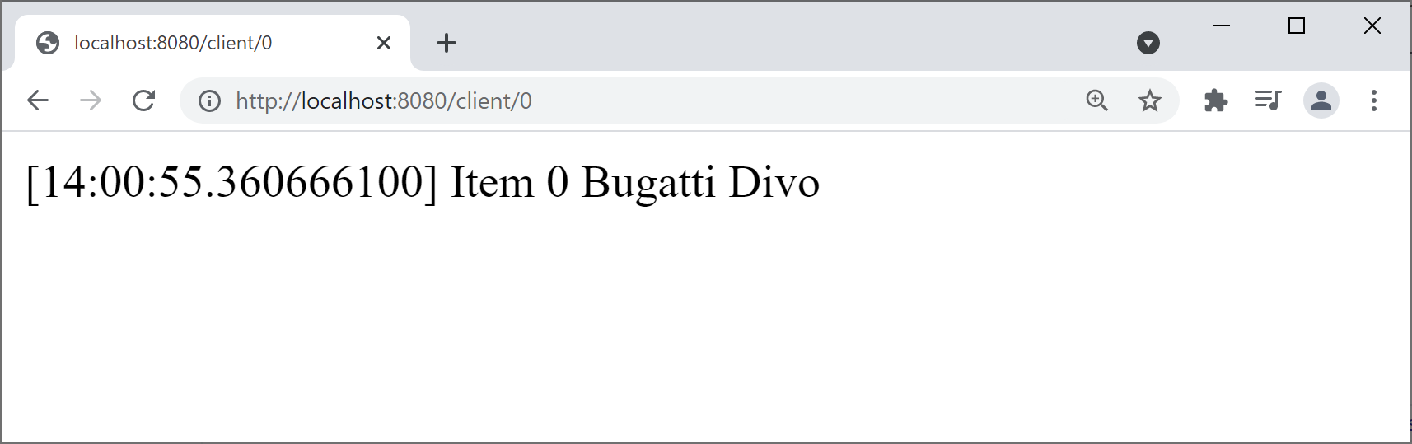
Implementing the Client Service (3 of 3)
Run the client app and ping the following URL…
http://localhost:8080/client/0

Slide 16
3. Implementing Circuit Breaker Behaviour
Overview
Circuit breakers in Spring Cloud
Spring Cloud circuit breaker dependency
Spring Cloud circuit breaker example
Seeing a circuit breaker in action

Slide 17
Overview
In a microservice application, services call other services
E.g. ServiceA calls ServiceB, ServiceB calls ServiceC, etc.
If any service is down, you get a ripple effect of failures
E.g. if ServiceC is down…
Then ServiceB will fail (because it depends on ServiceC)
Then ServiceA will fail (because it depends on ServiceB), etc.
To avoid the ripple effect of failures, use a circuit breaker
Specify a fallback method that can be called, if a service fails

Slide 18
Circuit Breakers in Spring Cloud
Spring Cloud provides a circuit breaker API
Via the CircuitBreakerFactory class
CircuitBreakerFactory is an abstraction over various circuit breaker implementations, including:
Resilience4J (we'll use this)
Netfix Hystrix
Sentinel
Spring Retry

Slide 19
Spring Cloud Circuit Breaker Dependency
To use the Resilience4J circuit breaker implementation, add the following dependency to the pom file in your (client) project :
Once you've added this dependency, Spring Boot autoconfig will automatically create a Resilience4J bean
This bean is exposed via CircuitBreakerFactory
See next slide for an example of how to use a circuit breaker…
<dependency>
<groupId>org.springframework.cloud</groupId>
<artifactId>spring-cloud-starter-circuitbreaker-resilience4j</artifactId>
<version>3.0.0</version>
</dependency>
pom.xml (client project)

Slide 20
Spring Cloud Circuit Breaker Example
@RestController
public class ClientWithFallbackController {
@Autowired
private CircuitBreakerFactory factory;
@GetMapping("/clientWithFallback/{index}")
public String getItem(@PathVariable int index){
URI catalogUrl = URI.create("http://localhost:8081/catalog/" + index);
RestTemplate restTemplate = new RestTemplate();
CircuitBreaker circuitBreaker = factory.create("circuitbreaker");
String result = circuitBreaker.run(
() -> restTemplate.getForObject(catalogUrl, String.class),
err -> getFallback(index));
return String.format("[%s] Item %d %s", LocalTime.now(), index, result);
}
public String getFallback(int i) { return "FALLBACK-ITEM-" + i;}
}
HTTP request
Catalog service

Slide 21
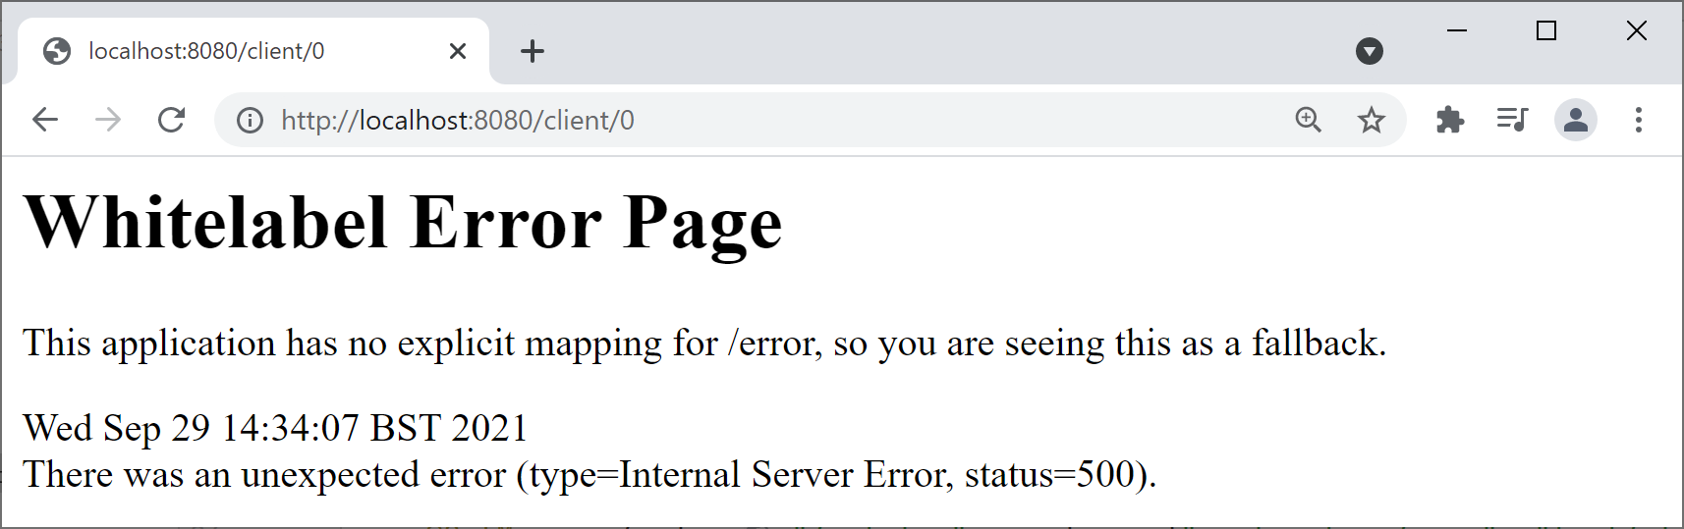
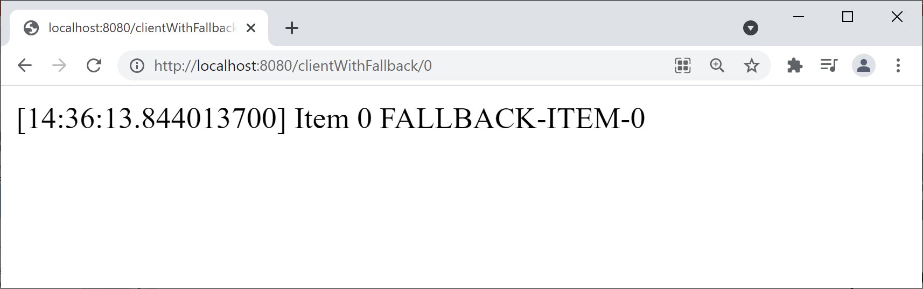
Seeing a Circuit Breaker in Action
To see the effect of the circuit breaker, follow these steps:
Stop the catalog service
Then ping the following client endpoints…
http://localhost:8080/client/0
http://localhost:8080/clientWithFallback/0

Slide 22
Summary
Overview of microservices
Microservices application example
Implementing circuit breaker behaviour

