Slide 1

EFFECT OF BUBBLE RATING ON HOTEL VIEWS
CAUSAL INFERENCE AND IMPACT EVALUATION 23/24
Matching analysis
I. Cappiello, M. Doka, S. Paci, M. Pagan

Slide 2

TABLE OF CONTENTS
Research question
Model description
Motivation
Descriptive statistics
Dataset Description
Results and robustness check
Model specification
Conclusions and limitations
Matching model
Bibliography

Slide 3
RESEARCH QUESTION
What is the causal impact of having a high TripAdvisor bubble rating on the number of hotel views?

Slide 4
MOTIVATION
Online Reviews and Consumer Behavior
Economic Implications for Hotel Industry
In digital age, online reviews shape consumer decisions more than ever.
Understanding how bubble ratings impact hotel popularity is crucial for:
Hotel owners seeking to improve their online reputation
Consumers making informed travel decisions
Platforms optimizing their review systems
For a hotel, advantages in ratings could mean:
Higher booking rates
Increased pricing power
Better customer trust and engagement
Understanding these effects helps hotels adjust their strategies
Notes:
1. Online Reviews and Consumer Behavior
In the digital age, online reviews shape consumer decisions more than ever. Platforms like TripAdvisor influence where people choose to stay, dine, or visit. Since hotel ratings are among the first things a traveler sees, understanding how bubble ratings impact hotel popularity is crucial for:
Hotel owners seeking to improve their online reputation;
Consumers making informed travel decisions;
Platforms optimizing their review systems.
2. Economic Implications for the Hotel Industry
For a highly competitive tourism destination like Rome, small advantages in ratings could mean:
Higher booking rates;
Increased pricing power;
Better customer trust and engagement.
Understanding these effects helps hotels adjust their strategies—whether through better service, review management, or marketing.

Slide 5


DATASET
DESCRIPTION
4,599 Hotels data
Rome, Italy
TripAdvisor is one of the world's largest travel platforms, allowing users to review hotels, restaurants, and attractions to help travelers make informed decisions.
December, 2019
TripAdvisor

Slide 6
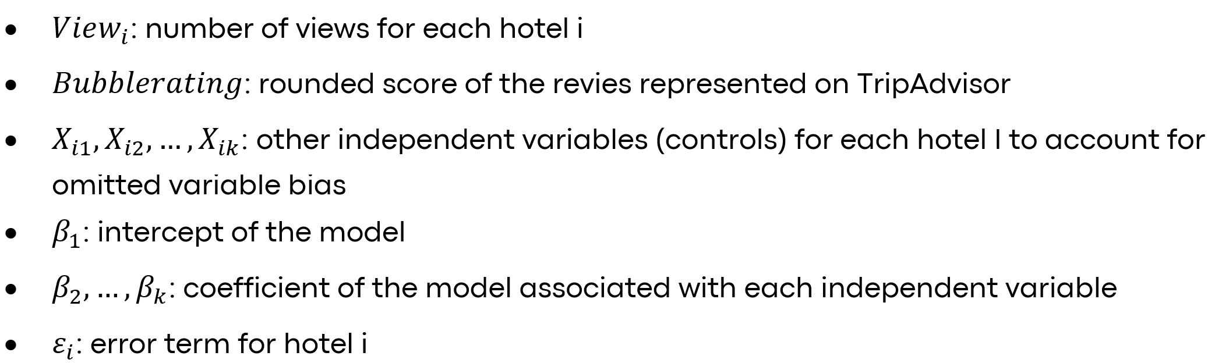
MODEL SPECIFICATION
Where:

Slide 7
MATCHING MODEL
Estimates causal effects by pairing treated and control units with similar characteristics

Slide 8


TREATMENT
BUBBLE RATING
CONTROL UNITS
TREATED UNITS
Bubble rating = 0
if ≤ 4
Bubble rating = 1
if > 4
Total = 1375
Total = 1830

Slide 9



DEPENDENT VARIABLE
VIEWS
Number of views of a hotel, on Tripadvisor, in December 2019
Views have a left-skewed distribution
Using the logarithm helps make the distribution
more symmetric and reduce variance

Slide 10
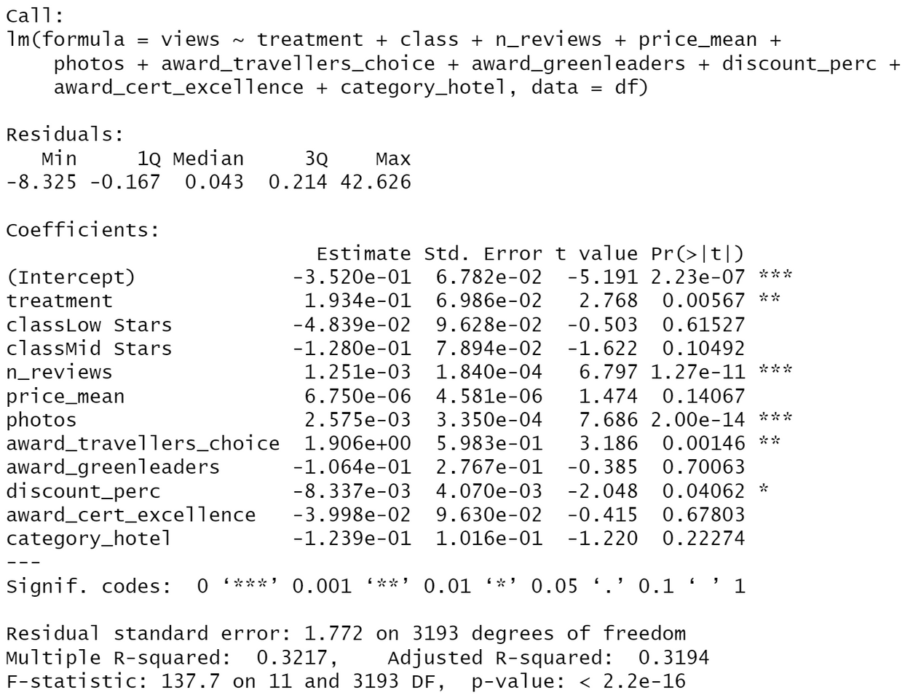
MODEL DESCRIPTION
WITHOUT LOG
Without the logarithmic transformation, many variables show lower statistical significance and the model fit is weak (low R²).
The model has more difficulty capturing the relationship between the variables.

Slide 11
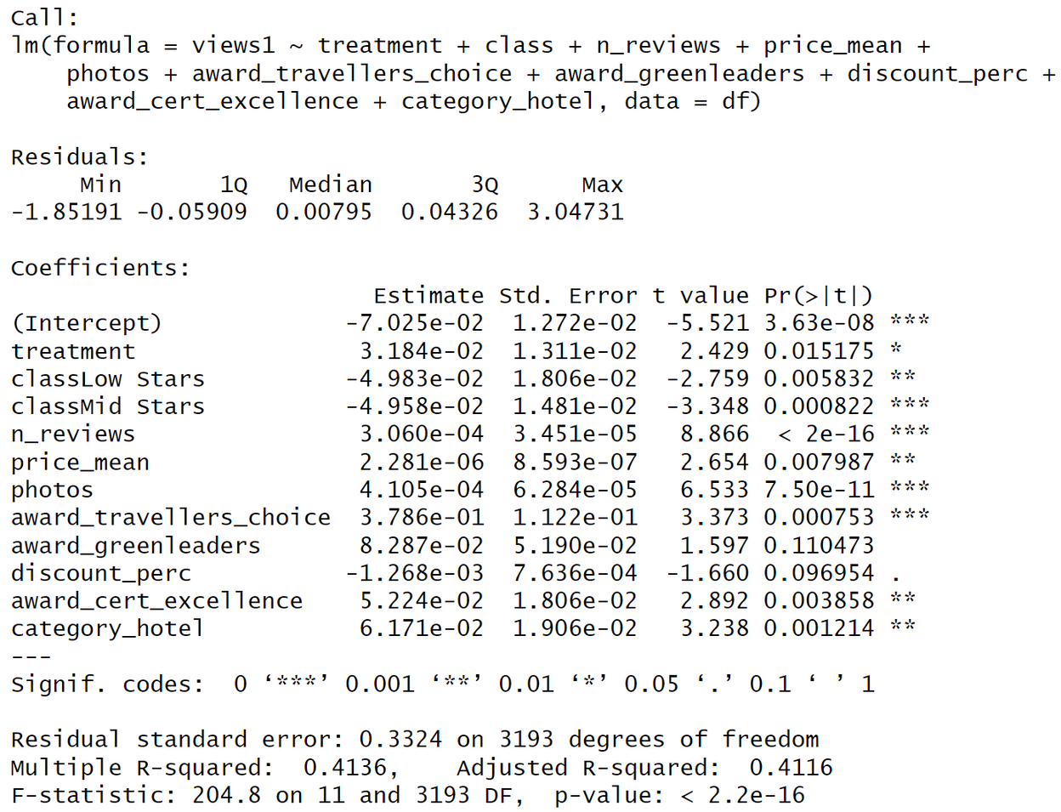
MODEL DESCRIPTION
WITH LOG
By applying the log to the dependent variable, the quality of the model improves (higher R²): the independent variables’ coefficients have higher significance (lower p-value).
This suggests that the relationship between the variables is better captured.

Slide 12
DESCRIPTIVE STATISTICS
BINARY VARIABLE | T - TEST | P - VALUE | MEAN GROUP 0 | MEAN GROUP 1
AWARD TRAVELLERS CHOICE | -2.4973 | 0.0370 | 0.0936 | 1.0813
AWARD CERTIFIED EXCELLENCE | -11.434 | < 2.2e-16 | 0.0220 | 0.3997
CATEGORY HOTEL | -12.943 | < 2.2e-16 | 0.0085 | 0.4307

Slide 13
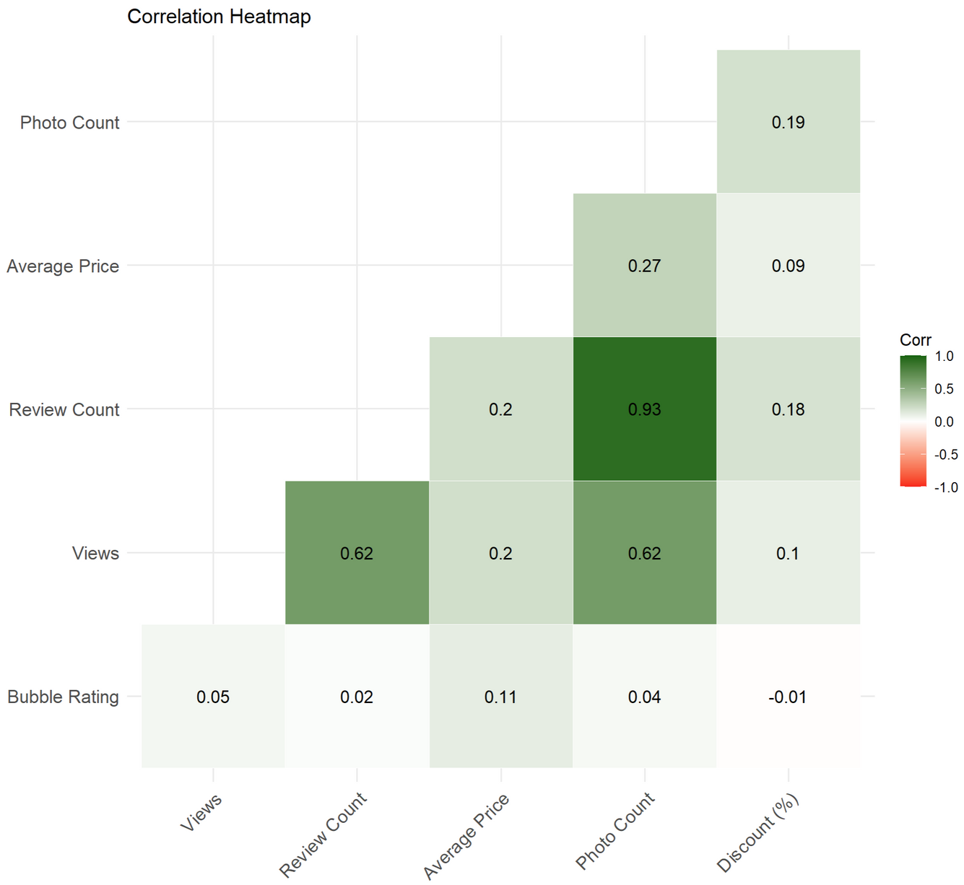
DESCRIPTIVE STATISTICS
CONTINUOUS VARIABLE
Bubble Rating shows very low correlations with other variables, meaning that it is relatively independent of them
These variables are still included in the propensity score estimation to ensure balance between treated and control groups, reducing potential confounding

Slide 14

ASSUMPTIONS
Conditional Independence
Common Support Assumption
Conditional on observables, treatment assignment is independent of potential outcomes
For each level of x we need to have at least one treated unit and at least one control unit
Conditional on propensity score, treatment assignment is as random
For each unit, the probability of being treated given propensity score is smaller than 1

Slide 15

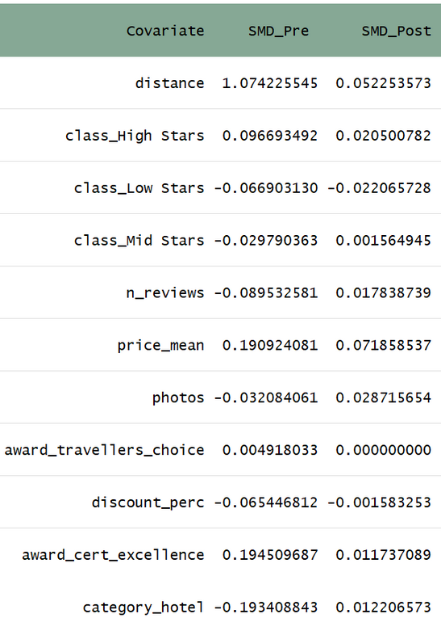
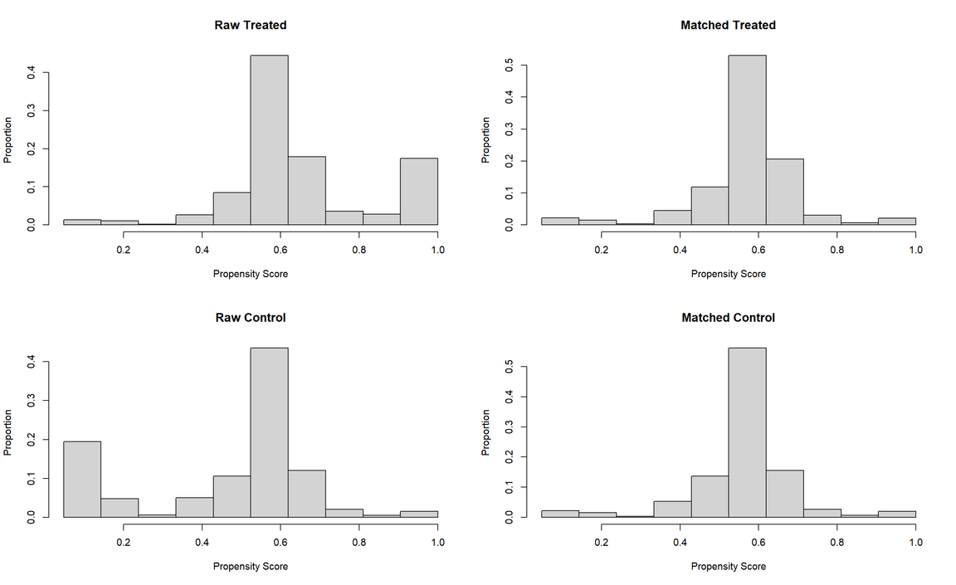
ASSUMPTIONS
As proven by the distribution of the propensity score , the COMMON
SUPPORT assumption holds
CHECK OF MATCH QUALITY*
* usually, an SMD lower than 0.1 is considered acceptable

Slide 16

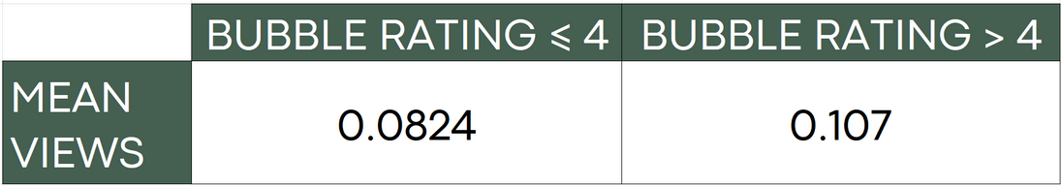

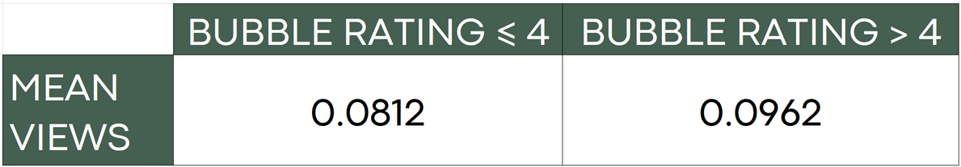
ASSUMPTIONS
BEFORE MATCHING
The CIA is valid after the matching procedure, because the treatment is assigned as random and the only difference between treated units and control units is due to the treatment.
BIASED ATT
AFTER MATCHING
UNBIASED ATT

Slide 17


RESULTS NN
REPLACE | RATIO | CALIPER | TREATMENT EFFECT | P-VALUE
False | 4 | 0.05 | 0.00857 | 0.61
Not statistically significant
Treatment effect very small
This suggests that there is no evidence of an impact of the treatment on the Hotel views

Slide 18
ROBUSTNESS CHECK
 | METHOD | REPLACE | RATIO | CALIPER | TREATMENT EFFECT | P-VALUE
MODEL 2 | Nearest | False | 2 | 0.05 | 0.01246 | 0.47
MODEL 3 | Nearest | False | 2 | 0.1 | 0.01888 | 0.29
MODEL 4 | Nearest | False | 6 | 0.05 | 0.01014 | 0.54
MODEL 5 | Optimal | True | 4 | 0.05 | 0.0187 | 0.25
Not statistically significant
Regardless of the matching methodology used and variations in parameters, the results remain consistent confirming the stability of the non-significant findings

Slide 19
CONCLUSIONS
The estimated Average Treatment Effect on the Treated (ATT) is 0.00857 (p = 0.6) suggesting that having a bubble rating greater than 4 leads to a negligible increase in views
However, the effect is statistically insignificant, indicating that differences in views between treated and control groups could be due to random variation rather than a causal impact of bubble ratings
This result aligns with Pokryshevskaya & Antipov (2020) research, which found that a half-bubble rating difference does not significantly influence attention on TripAdvisor, likely due to the platform’s comprehensive hotel information and filtering options

Slide 20

LIMITATIONS IN OUR STUDY
High zero-inflation: many hotels had zero views, making it difficult to detect an effect
December seasonality bias: data covers only December, which may not represent typical booking trends.
TripAdvisor’s filtering system: Users may sort hotels by price, location, or awards, reducing the direct impact of ratings.
Competing platforms: Google Travel, Booking.com, and Airbnb may have a stronger influence on hotel visibility than TripAdvisor.
TripAdvisor provides extensive information, which we did not include in our covariates that could have improved our model (such as amenities), reducing reliance on bubble ratings.

Slide 21
BIBLIOGRAPHY
https://blog.osum.com/online-travel-agency-market-share/
https://www.enterpriseappstoday.com/stats/airbnb-statistics.html
Pokryshevskaya, E. B., & Antipov, E. A. (2020). Robust regression discontinuity estimates of the causal effect of TripAdvisor’s bubble rating on hotel popularity. Higher School of Economics Research Paper No. WP BRP 63/MAN/2020. http://dx.doi.org/10.2139/ssrn.3745552

Slide 22
THANKS FOR YOUR ATTENTION!

