Slide 1

BAHIR DAR UNIVERSITY
Bahir Dar Institute of Technology · Faculty of Computing · Dept. of Software Engineering
INTERNSHIP DEFENSE PRESENTATION
EstateLink
A Web-Based Real Estate Listing and Rental Management System
PREPARED BY
HOSTING COMPANY
SUPERVISION
DATE
Rediet Gebrehiwot · BDU1505929
Tamer Getaw · BDU1507859
Ethioden IT Consultancy PLC
Signal Mall, Bahir Dar
Mentors: D. Lake · T. Abebe
Supervisor: D. Aklog
Bahir Dar, Ethiopia
September 2026

Slide 2
AGENDA
Presentation Outline
01
Company Background
Ethioden IT Consultancy PLC — history, services and structure
02
Internship Experience
Our placement, tasks, tools, challenges and learning outcomes
03
Project Work — EstateLink
Problem, objectives, architecture and core features
04
Results & Evaluation
Testing outcomes and user acceptance feedback
05
Conclusion & Recommendations
What we achieved, and what comes next

Slide 3
PART I · COMPANY BACKGROUND
Ethioden IT Consultancy PLC
Founded in 2021 as a joint venture between an Icelandic ICT investor and a group of Ethiopian professionals, the company pairs international practice with a close understanding of the local market.
FOUNDED
2021
From a small start-up consultancy it has grown into an established regional player, delivering technology consultancy, custom system development, capacity building and post-deployment support across the public, private and non-profit sectors.
HEADQUARTERS
Signal Mall, 3rd Floor, Bahir Dar
FOCUS
ICT Consultancy & Custom Development
“Empowering Businesses through Technology & Innovation”
AMBITION
Ethiopia → Pan-African reach
Source: company orientation briefings · internship report §2.1–2.3

Slide 4
PART I · COMPANY BACKGROUND
Services & Organisation
Service Line | Focus
Technology Consultancy | Digital strategy, IT audits, cybersecurity, change management
Custom System Development | Web & mobile apps, ERP and specialised systems, agile delivery
Capacity Building & Training | Workshops and mentoring in software, data, cloud, security
IT Support & Maintenance | Monitoring, defect correction, helpdesk, performance tuning
Executive Management
Project Management Office
Software Development Team — hosted our internship
Interns (us)
Consultancy & BA, QA & Testing and Support & Training operate alongside Software Development, all reporting to the PMO.
Across every service line, the company emphasises quality assurance, on-time delivery and a measurable return on the client's investment.

Slide 5
PART II · INTERNSHIP EXPERIENCE
Placement: Software Development Team
Chosen jointly with our supervisor during orientation week, on the strength of our background in software engineering, database design and OOAD.
01
02
03
Curriculum Fit
Ground-Floor Project
Cross-Team Visibility
Requirements engineering, UML, web programming, databases and testing map directly onto the unit's daily work.
The property platform was just starting — we joined EstateLink from its very first requirement.
Sitting at the centre of the company workflow gave us sight of business analysis, QA and support as well.
We worked mainly on backend & integration, while contributing to frontend components, database design and testing — alongside two permanent developers acting as reviewers.

Slide 6
PART II · INTERNSHIP EXPERIENCE
A 15-Week Engagement
Period | Focus | Deliverable
Week 1 | Orientation, induction, environment setup | Configured workstation, signed plan
Weeks 2–3 | Requirement elicitation & problem identification | Requirement specification draft
Weeks 4–5 | UML modelling, database design, architecture review | Diagram set & ERD
Weeks 6–10 | Auth, listings, search & filter, real-time messaging | Working REST API & live chat
Weeks 11–13 | Chapa payment integration, frontend & admin panel | Integrated test environment
Weeks 14–15 | Testing cycle, UAT support, documentation | Test report & internship report
Each phase closed with a review, a test, and a demonstration before the next began.

Slide 7
PART II · INTERNSHIP EXPERIENCE
Engineering Toolkit
Frontend
Backend
Database
React (Vite) · Tailwind CSS · Axios
FastAPI · Uvicorn · Pydantic · SQLAlchemy
PostgreSQL 15+ on Neon · pgAdmin
Security
Real-Time & Payment
Modelling & Design
JWT · bcrypt · CORS configuration
WebSockets (WSS) · Chapa gateway
PlantUML · Draw.io · Figma
Testing
Collaboration
Editor & OS
pytest · Jest · Postman · Swagger · Lighthouse
Git & GitHub · issue tracker · team chat
VS Code · Windows 11 & Ubuntu 22.04

Slide 8
PART II · INTERNSHIP EXPERIENCE
Challenges & Measures Taken
Challenge | Measure Taken
Unstable WebSocket connections | Auto-reconnect with back-off; server persists every message before broadcast
Draft listings leaking publicly | Corrected query to filter on status & draft flag, plus a regression test
Large image uploads failing | Client-side compression, enforced size/MIME limits, clear validation errors
Payment state uncertainty | Explicit Chapa verification by transaction reference before activation
Incorrect combined search filters | Query builder rewritten so only supplied filters add a condition
Each fix was root-caused, not patched — the two most serious (WebSocket drops, draft-listing leak) were corrected structurally and backed by a regression test.

Slide 9
PART II · INTERNSHIP EXPERIENCE
What We Gained
T
G
U
Technical Skills
Theory, Grounded
Teamwork
Secure REST APIs, ORM-modelled databases, real-time features end to end
Process models, OOAD and testing theory acquired practical meaning
Shared code ownership, honest review, and helping teammates unblock
L
W
E
Leadership
Work Ethics
Entrepreneurship
Owned modules end to end; ran two internal knowledge-sharing sessions
Confidentiality, punctuality, and honest reporting of our own defects
Read a broker-dependent market as a product opportunity, MVP first

Slide 10
PART III · PROJECT WORK
EstateLink
A centralised, trustworthy platform for listing and renting property in Ethiopia
Owners publish verified listings for houses and apartments; seekers browse, search, save favourites and message owners in real time — all on one three-tier web application secured with JWT authentication and role-based access.
23
150
92%
3
Functional requirements
Test cases executed
UAT satisfaction
Architecture tiers

Slide 11
PART III · PROJECT WORK
Problem & Objectives
THE PROBLEM
OUR OBJECTIVE
Search is manual and broker-dependent, with no centralised listing source
Design, build and evaluate a web platform enabling efficient property advertisement, search and direct owner–seeker communication in Ethiopia.
Price, size and availability information is inconsistent and often stale
✓
Secure, role-based authentication with JWT & bcrypt
Owner – seeker communication is slow, unstructured, relayed by phone
✓
Real-time owner–seeker messaging over WebSockets
✓
Subscription payments through the Chapa gateway
Listings are hard to verify, which opens the door to fraud
✓
Document verification with administrative approval

Slide 12
PART III · PROJECT WORK
Three-Tier System Architecture
PRESENTATION TIER
React (Vite) Single Page Application
Tailwind CSS · runs in the seeker's and owner's browser
APPLICATION TIER
EXTERNAL
FastAPI Server
Chapa Payment Gateway
REST endpoints + WebSocket endpoint · all business logic
EXTERNAL
DATA TIER
File Storage (Images & Docs)
PostgreSQL Database
Hosted on Neon · users, listings, messages, payments

Slide 13
PART III · PROJECT WORK
Seven Core Modules
Authentication
User Management
Listing Management
Search & Filter
JWT issuing, bcrypt hashing, password reset
Profiles, roles, account status
CRUD, draft & publish, status transitions
Price, location, bedrooms, bathrooms, type
Messaging
Payment
Administration
7
WebSocket conversations & full history
Chapa subscription lifecycle
Verification, payment review, activity logs
modules, independently owned

Slide 14
PART III · PROJECT WORK
Security & Access Control
Role-Based Access
Defence in Depth
Role | Permitted Operations
Seeker | Browse, search, save favourites, message owners
Owner | All of the above, plus create/publish listings, subscribe
Admin | User management, verification, payment approval, logs
Passwords hashed with bcrypt — never stored in plain text
JWT access tokens carry role and expire on a fixed interval
Every protected endpoint re-checks role server-side
SQLAlchemy ORM with parameterised queries prevents SQL injection
Verified in testing: TC-NF-07 password hashing, TC-NF-08 JWT expiry, TC-NF-09 role-based access — all three passed.

Slide 15
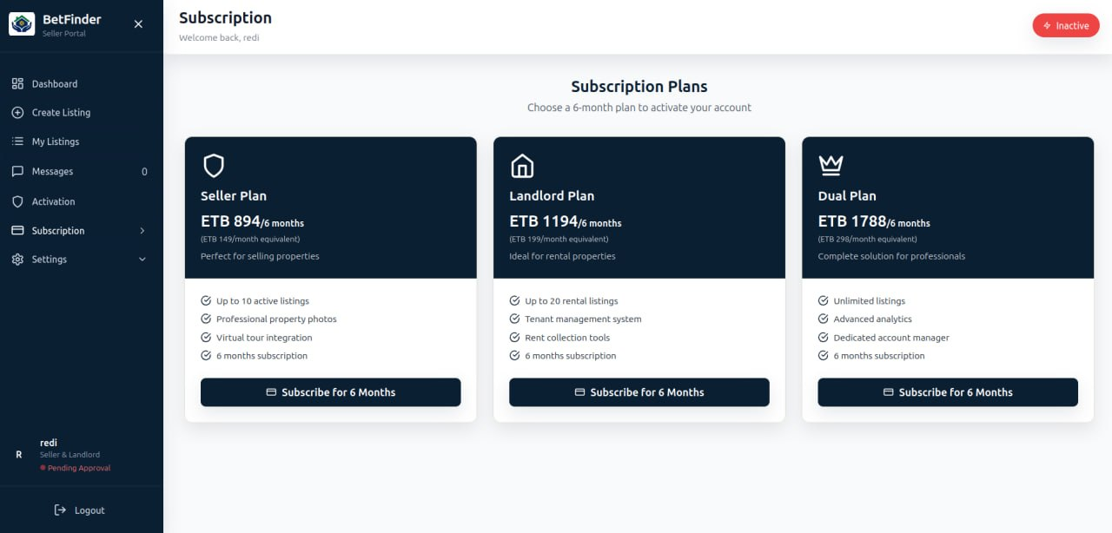
PART III · PROJECT WORK
A Sustainable Subscription Model
Owners pay a subscription, verified through Chapa, before they can publish — funding the platform without ever charging seekers, so the demand side of the market stays as large as possible.
Seller Plan
894 ETB
Landlord Plan
1,194 ETB
Dual Plan
1,788 ETB
Six-month plans, paid through the Chapa gateway
Subscription plans screen

Slide 16
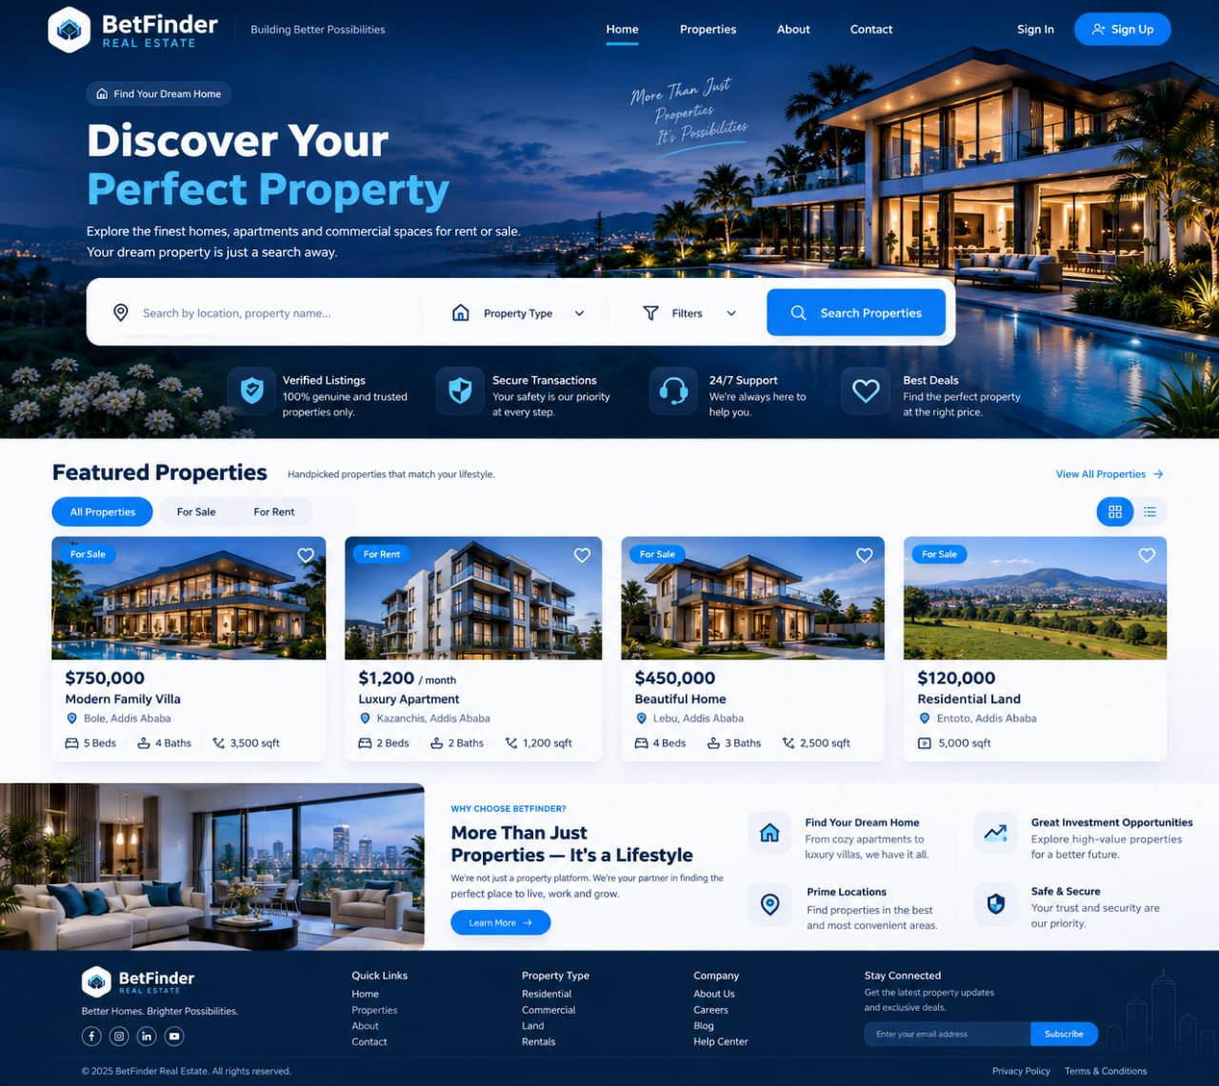
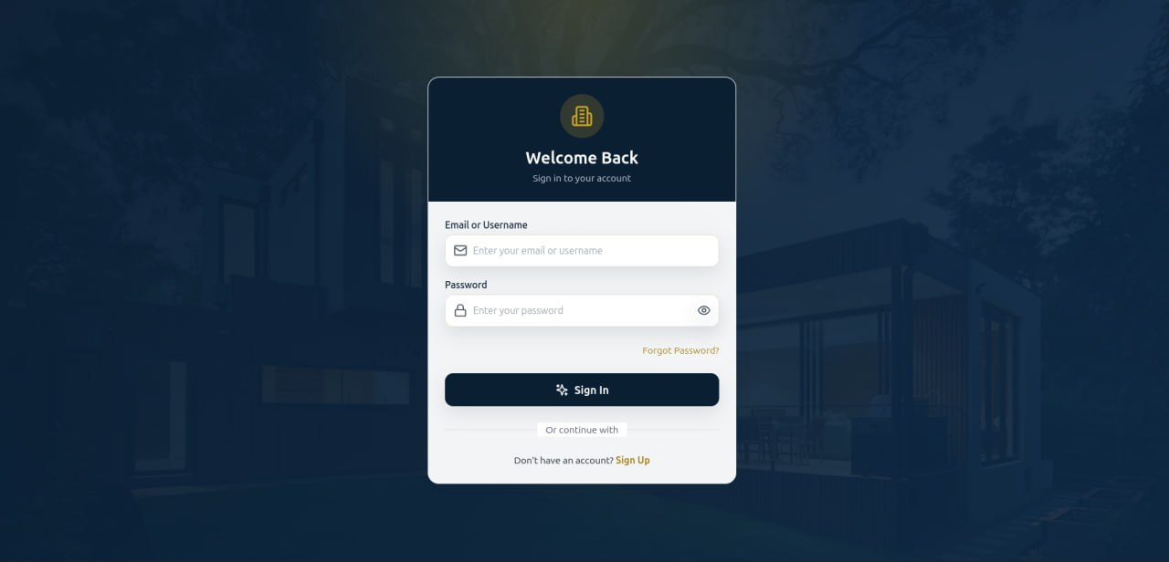
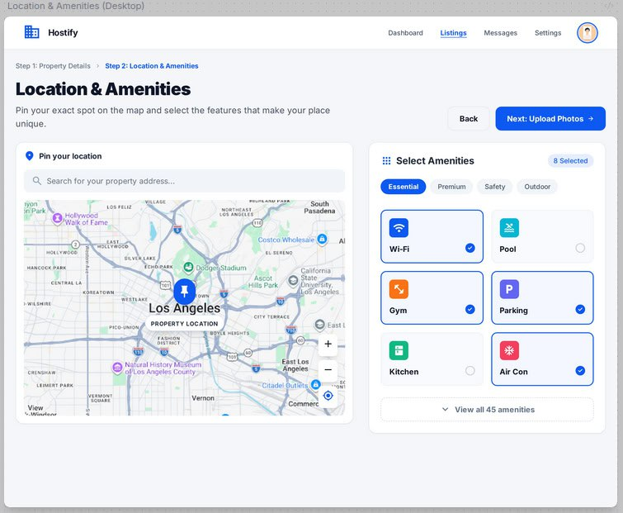
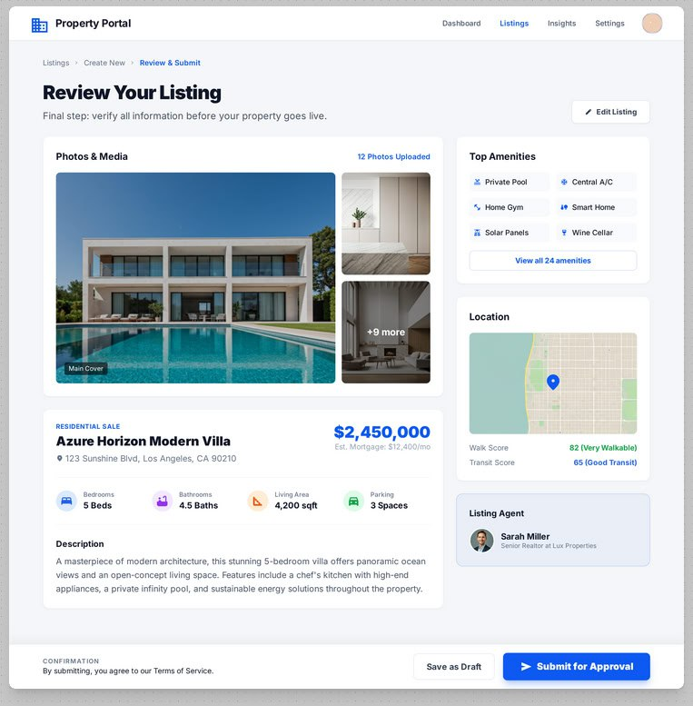
PART III · PLATFORM WALKTHROUGH
Discovery & Listing Creation
Public landing page & property search
Secure sign-in (JWT session)
Listing creation — location & amenities
Review & submit for approval

Slide 17
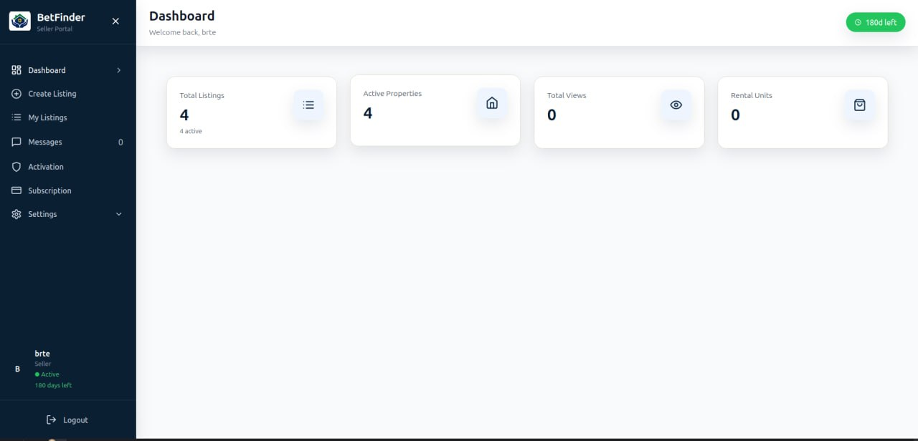
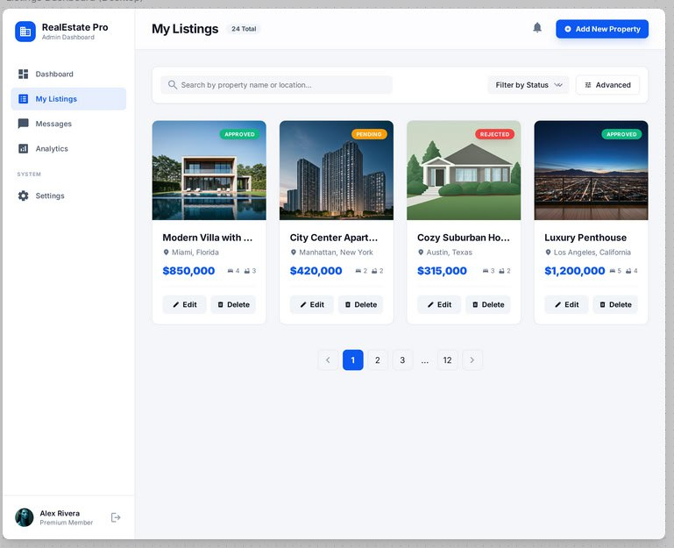
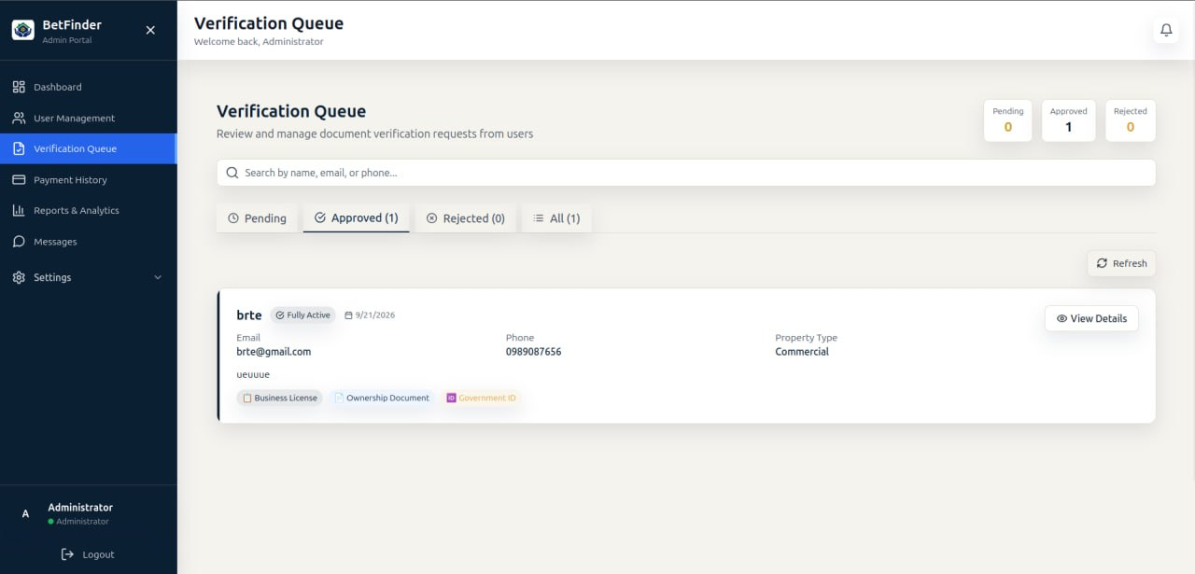
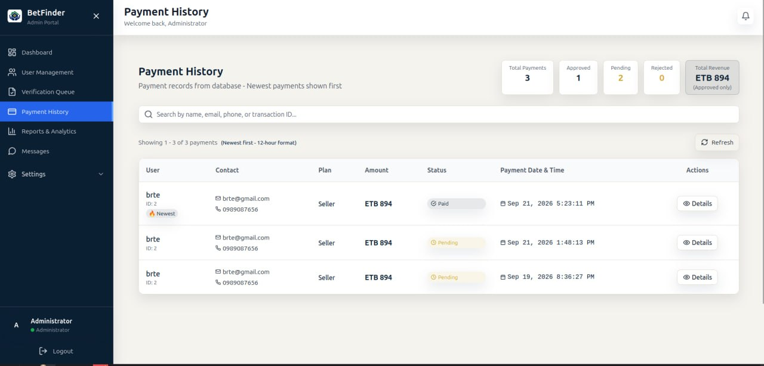
PART III · PLATFORM WALKTHROUGH
Owner & Admin Operations
Owner dashboard — listings at a glance
Listing status: approved, pending, rejected
Admin verification queue (owner documents)
Admin payment history (Chapa transactions)

Slide 18
PART IV · RESULTS & EVALUATION
Testing & User Acceptance
150/150
23/23
92%
6
Test cases passed
Functional requirements met
UAT satisfaction (17 users)
Defects found & resolved
COVERAGE BY TEST TYPE
Unit · 45
Integration · 28
Functional · 52
Security · 15
Performance · 10
Pages loaded in 1.8s (target 3s) and WebSocket delivery averaged 0.5s (target 2s) — both non-functional targets exceeded.

Slide 19
PART V · CONCLUSION
Conclusion & Future Work
What We Achieved
Recommended Next Steps
A working, tested platform ready for pilot deployment — all 23 requirements met
→
Native mobile applications
→
Map-based property search
Hands-on mastery of secure APIs, real-time systems and payment integration
→
Additional payment gateways (TeleBirr, CBE Birr)
→
Amharic language support
A genuine company problem carried through requirements to deployment
→
Production load & stress testing

Slide 20
Thank You
Questions & Discussion
Rediet Gebrehiwot · BDU1505929 Tamer Getaw · BDU1507859
EstateLink · Ethioden IT Consultancy PLC · Bahir Dar University, September 2026

