Slide 1
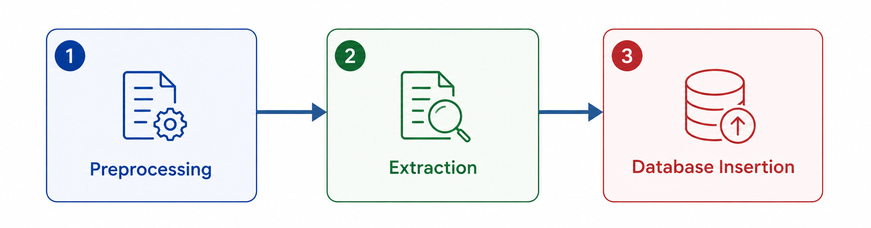
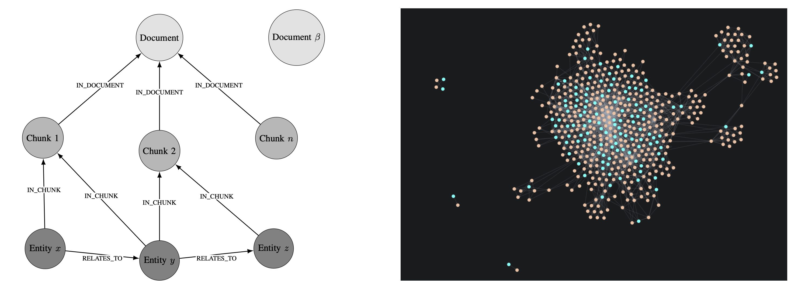
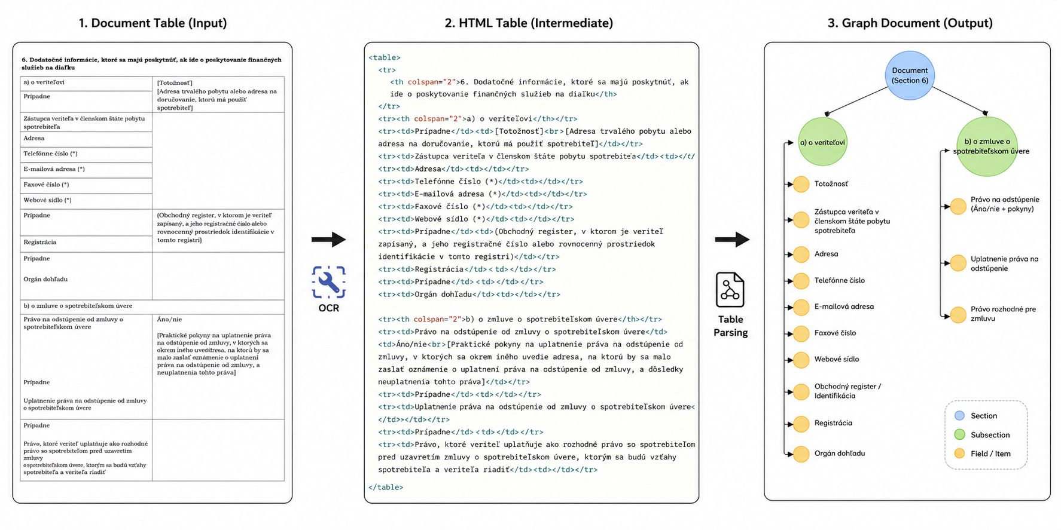
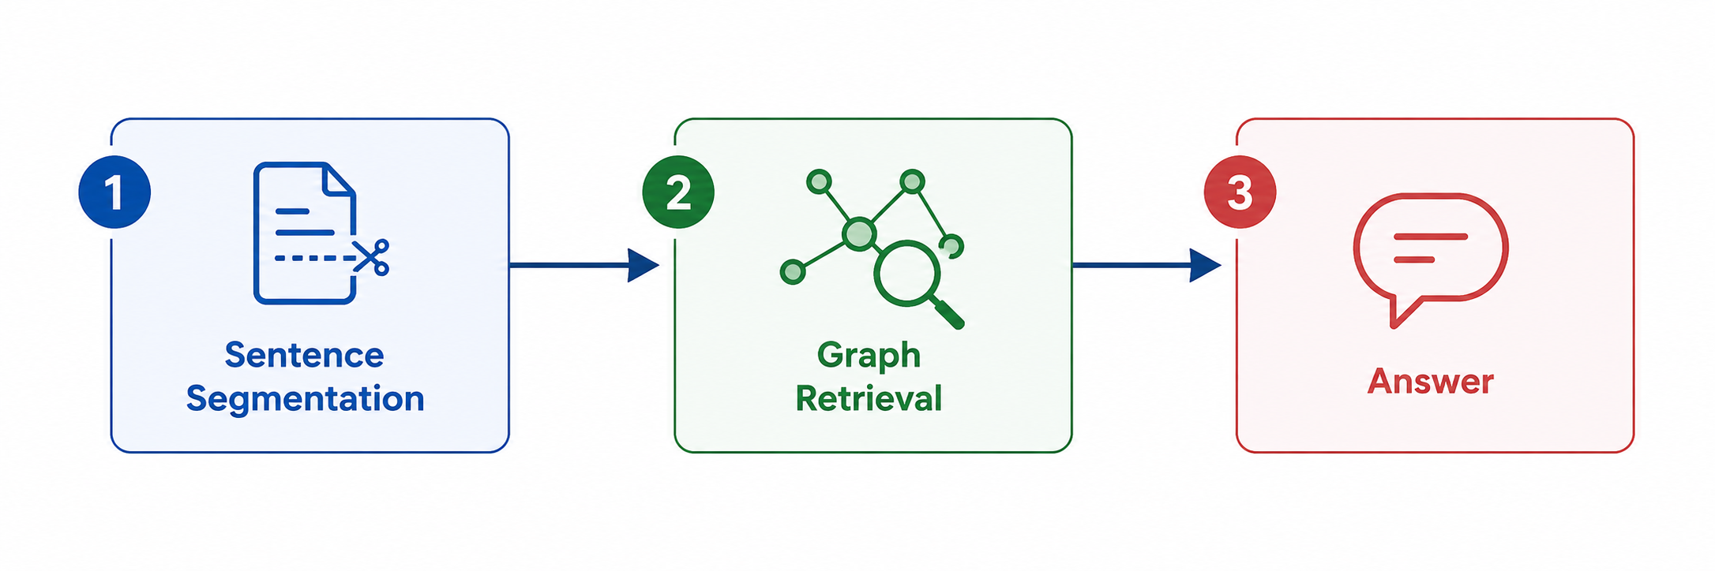
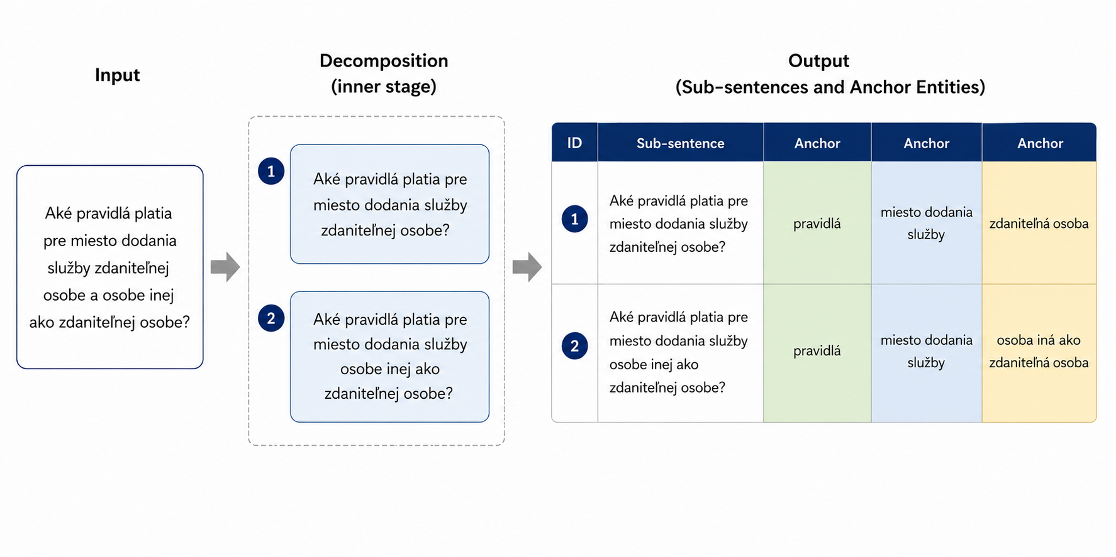
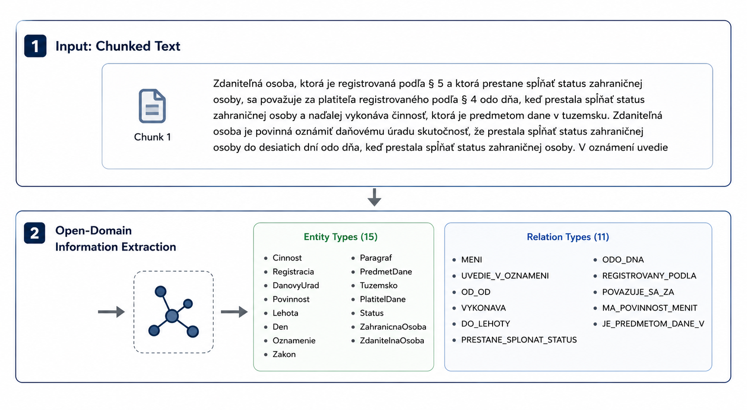
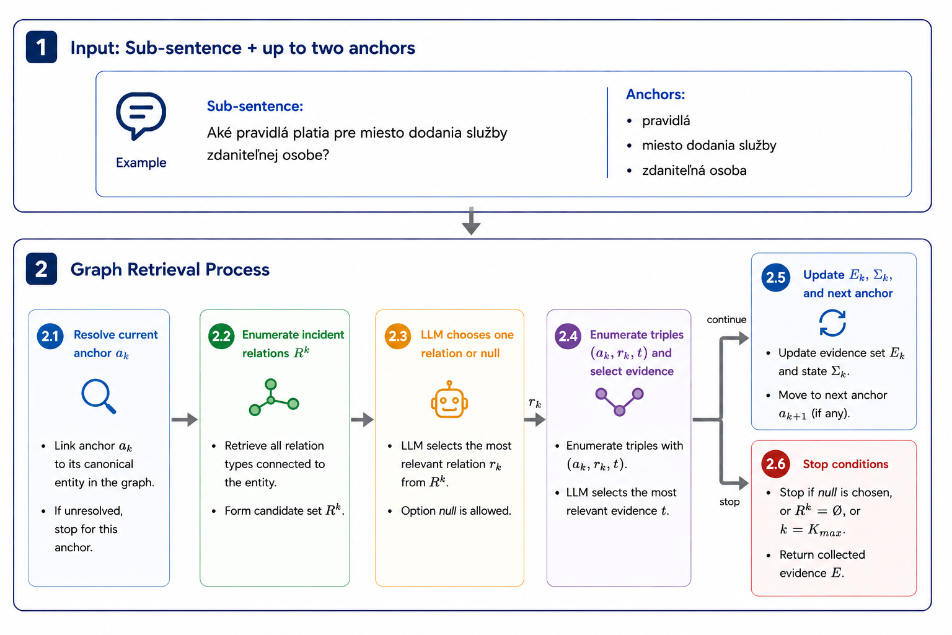
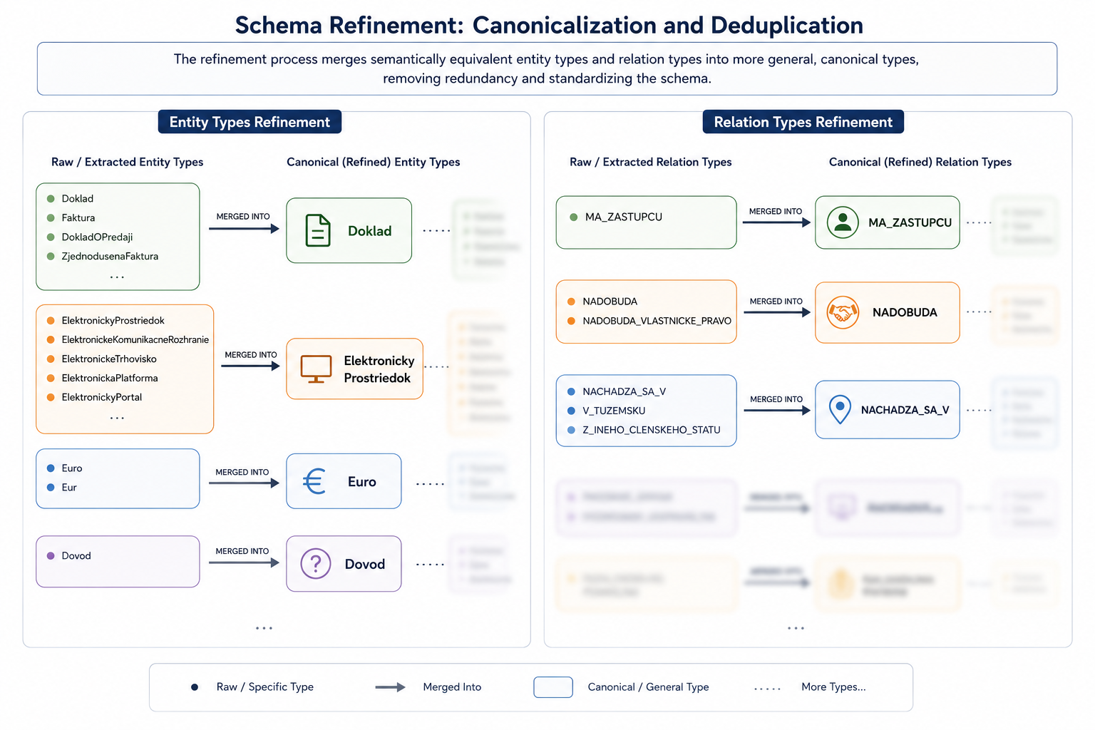
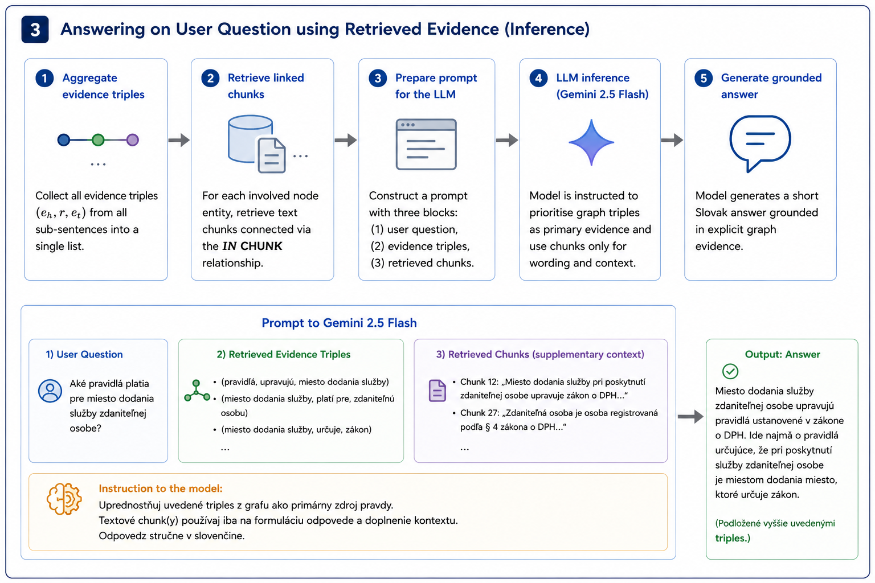
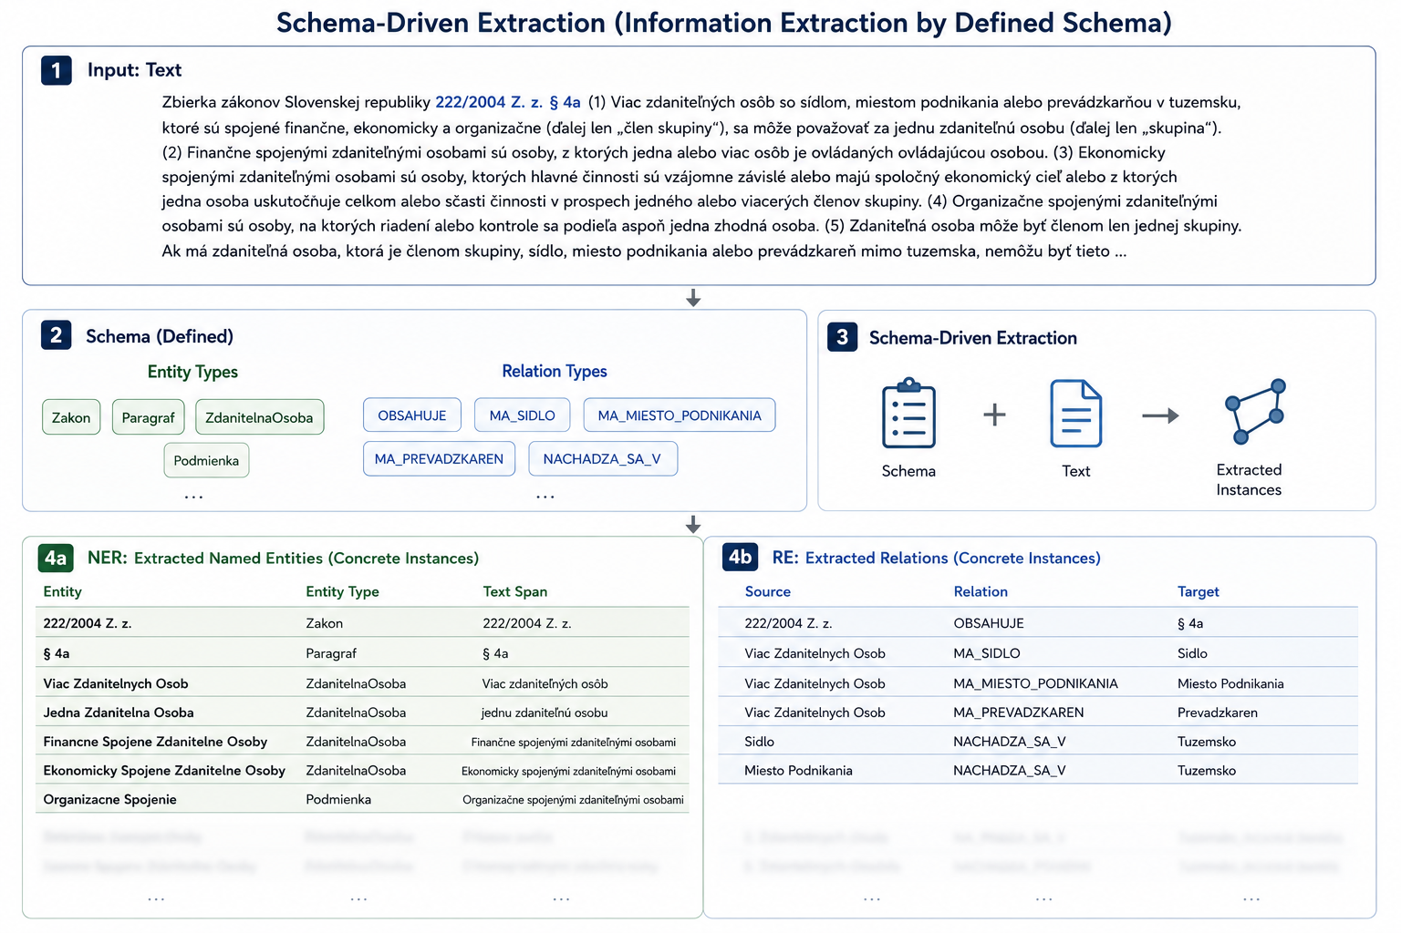
LLM-Based Knowledge Graph Construction and Retrieval for Legal Document Analysis
Samuel Bagín, Marek Vančo
Faculty of Electrical Engineering and Information Technology, Slovak University of Technology, Bratislava, Slovakia
Pipeline of a document processing
Database Insertion
Preprocessing stage
Structure of document in graph database.
Visualized graph of processed document.
Pipeline of search and retrieval
Tables are detected across document and then processed into GraphDocument using html as middle stage.
Extraction stage
The extraction stage has three processes. First, open-domain detection where are detected possible entities. Second, schema refinement, where entities and relation are canonicalized. Third, schema driven extraction where are information extracted as concrete instances.
1. Sentence Segmentation
1. Open-Domain Detection (Information Extraction)
2. Graph Retrieval
2. Schema Refinement
3. Schema Driven Extraction
3. Inference

