Slide 1
CPSC Intro to CS Conditionals
Decision Making with Booleans
if / if – else / if – elif – else
Ternary Operators

Slide 2
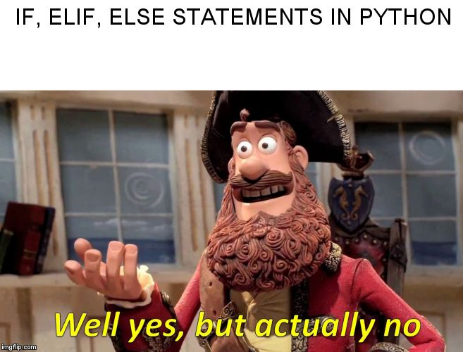
Conditionals in Python be like:

Slide 3
Decision Making
How do we make decisions?
Scenario: You come home from school on Friday. Your only obligation is to finish homework which is due on Monday. What do you do with your time?
Homework?
Exercise?
Scroll through social media?
Play games?
Read?
Etc.

Slide 4
Decision Tree Representation
Homework?
Yes
No
No
For which class?
No
Exercise?
Yes
Math?
Computer Science?
History?
No
Exercise
Scroll through social media?
Yes
Yes
Yes
Do Math HW
Do CS HW
Write Paper
Yes
No
Which platform?
…
What kind of questions do you ask yourself?
i.e. What type of questions are in the red boxes?

Slide 5
Answer: Boolean Questions

Slide 6
Python’s Primary Decision Tool: if / elif / else
if (condition == True):
Do something
The rest of the code…
if (condition == True):
Do something
Else:
Do something else
if (condition == True):
Do x
elif (condition2 == True):
Do y
elif (condition3 == True):
Do x
…
else:
Do a

Slide 7
Example Decision Tree in Python
print(“You can either choose ‘homework’, ‘exercise’, or ‘social media.’”)
activity = input(“What would you like to do? “)
if (activity == “homework”):
type = input(“For which class? “)
if (type == “math”):
print(“Do you math homework”)
elif (type == “CS”):
print(“Open VS Code and start your assignment”)
…
elif (activity == “exercise”):
print(“You should go to the gym”)
elif(activity == “social media”):
print(“Interesting choice”)
else:
print(“You need to pick one of the available options”)

Slide 8
Reminder: Boolean Operators
==
Equality
!=
Non-equality
>
Greater than
>=
Greater than or equal to
<
Less than
<=
Less than or equal to

Slide 9
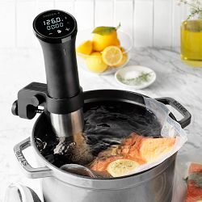
Nesting Conditionals
Alternative to adding multiple statements in conditional expression
Adds extra functionality
Example:
heater_on = 1
pump_on = 1
temp_increasing = True
if heater_on:
temp_increasing = True
if pump_on:
print(“Pump not on”)
else:
temp_increasing = False

Slide 10
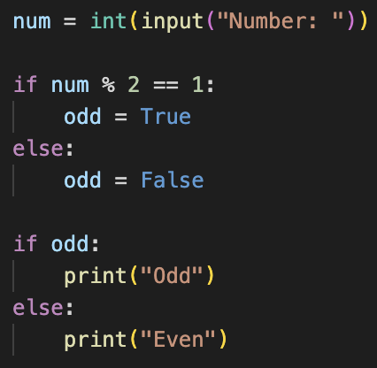
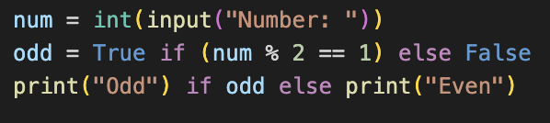
Conditional Expressions
AKA Ternary Expressions
Compact if – else block
Syntax: val_if_true if condition else val_if_false

