Slide 1
CPSC 230: Intro to CS While Loops
What are they?
How do you use them?
Control Statements

Slide 2
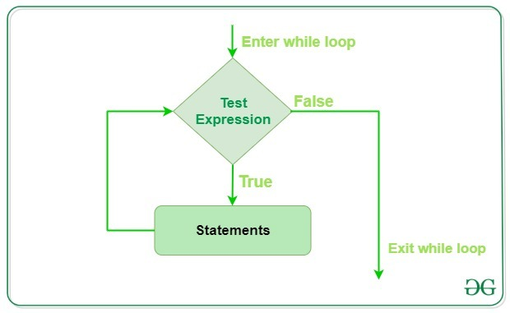
What Are They?
Block of statements to be repeated
Number of times usually indeterminate – indefinite iteration
Runs until a given condition is met (the expression is false)
Syntax
while expression:
# do something
Source: GeeksforGeeks

Slide 3
Similarity to Conditionals
Conditionals
While Loops
Execute once
Multiple keywords:
if
elif
else
Once finished, execution resumes with code after conditional
Nesting is allowed
Execute until condition met
One (ish) keyword:
while
no need for else
Optional, however
Once finished, execution resumes with code after loop
Nesting is allowed

Slide 4
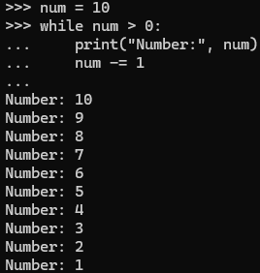
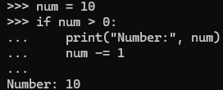
Similarity to Conditionals: Example
Conditionals
While Loops

Slide 5
When to Use Them
Repeating an operation or a block until a condition is met
Note: this runs an indeterminate number of times unless modeled like a for loop
More on that later
When you feel like they are useful!
You learn the constructs and apply them as you see fit

Slide 6
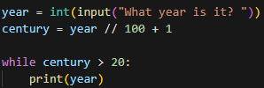
Question
What will the output be, assuming the user enters 2024 ?

Slide 7
Output

Slide 8
Caution!!
Infinite Loops
No update condition
Impossible to exit loop
Infinite Loop

Slide 9
Control Statements within While Loops
Break
Continue

Slide 10
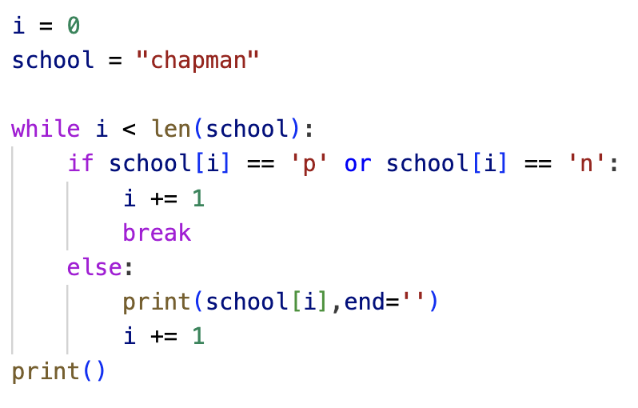
Break keyword
Immediately exits the current loop regardless of the expression
Even skips the else part of the loop
Adapted from GeeksforGeeks

Slide 11
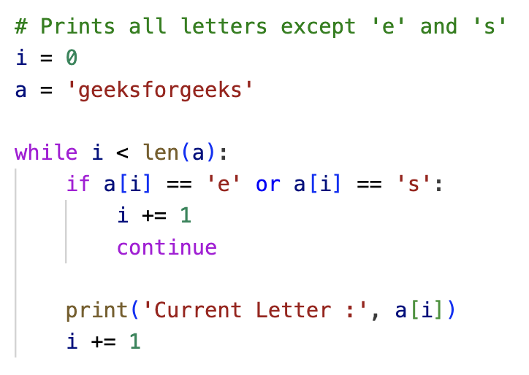
Continue keyword
Brings execution control to the beginning of the loop
i.e. continue exits from the current iteration of the loop
Source: GeeksforGeeks

Slide 12
Classwork

