Slide 1
CPSC 230: Intro to cs strings & Modules
Basics
slicing
methods

Slide 2
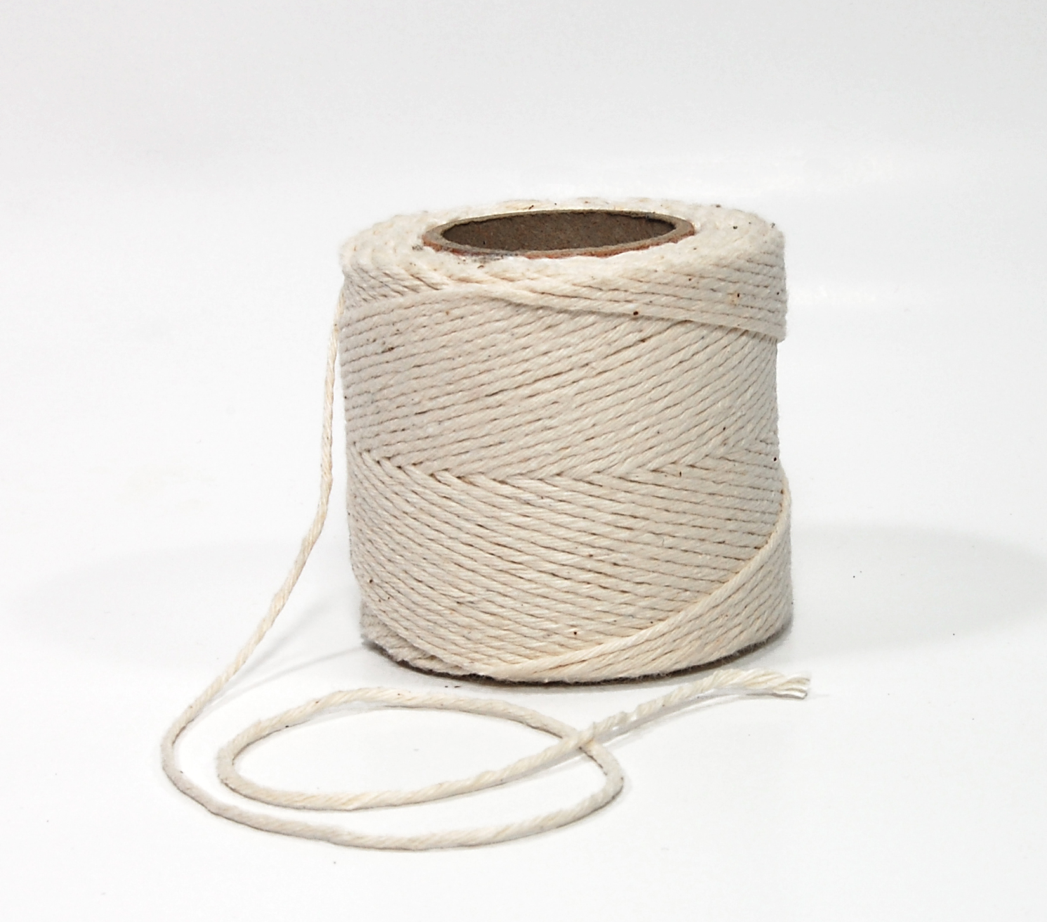
String basics
Strings are a sequence of characters
E.g. “Computer”, “alphanumeric”, ‘milk’, etc.
Surrounded by quotes
‘’ , “ ”, or even ‘’’ ‘’’, “”” “””
Can be stored in a variable
E.g. School = “FSE”
Characters ordered from first to last
Starts at index 0 in python
This Photo by Unknown Author is licensed under CC BY-SA

Slide 3
Input()
Remember input() function?
Takes input from the user via the command line and turns it into a string
Can be type casted into a different data type by type constructors

Slide 4


Len()
To find the length of a given string, use built-in len() function

Slide 5
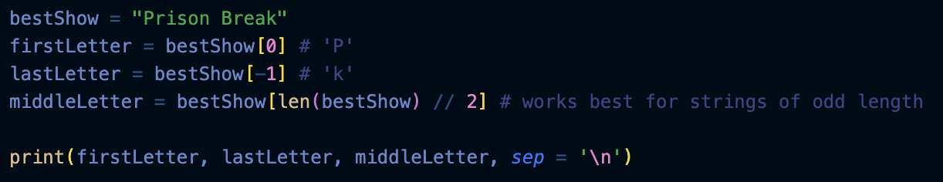

indexing
Accessing individual characters in a string
Starts at 0
Ends at -1
Bracket notation []
Note: strings are immutable, which means they cannot be changed once created

Slide 6
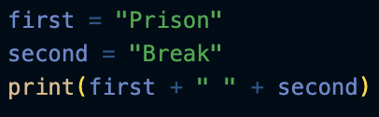

Concatenation
Despite being immutable, characters can be appended
Creates a new string, so original string is unaltered
+ joins two strings

Slide 7
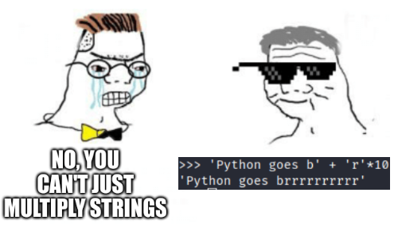
repetition
* can repeat strings
"A" * 5 = "AAAAA"
Remember: if a number is stored as a string, you must convert to a float or int if you want the mathematical result

Slide 8
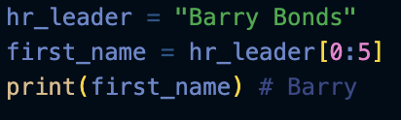
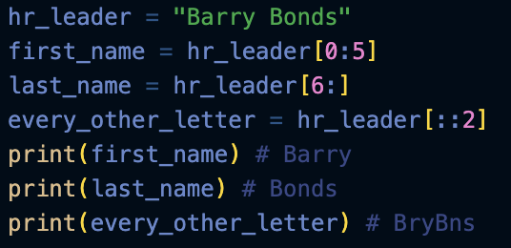
slicing
Grabbing multiple characters from a string
Notation: my_string[start:end+1:Stride]
Stride = 1 by default
Creates a new string
End+1 because the final character is omitted
For final character, leave the end blank

Slide 9
Additional methods
String.replace(old, new): returns a copy of the string with all occurances of the substring “old” replaced by the string “new”
String.replace(old,new,Count): only replaces the first “Count” occurances of ”old”
String.find(x): returns index of the first occurance of item “x” in the string. If no such substring is found, -1 is returned
Count(x): returns the number of times “x” occurs in the string

Slide 10
String comparisons
Relational operators: <, <=, >, >=
Equality operators: ==, !=
Membership operators: in, not in
Identity operators: is, is not

Slide 11
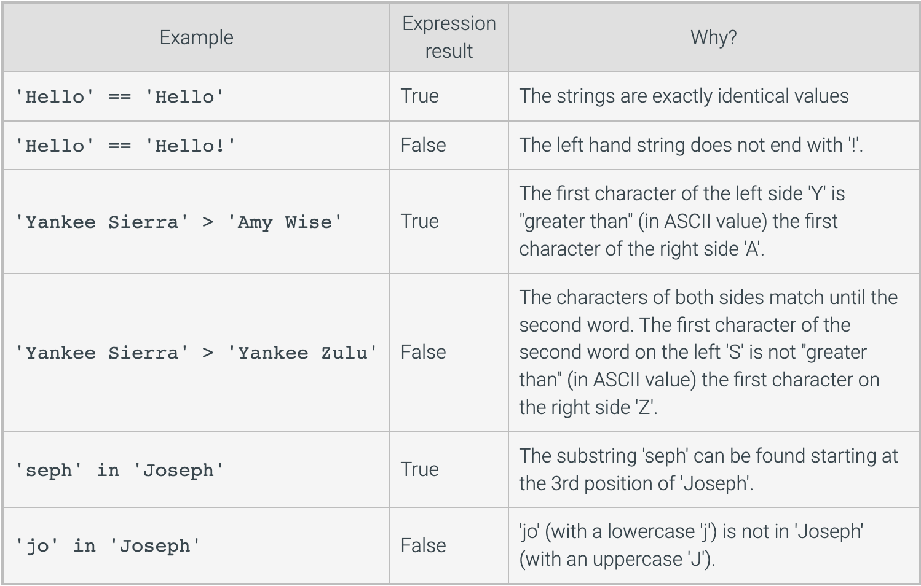
String Comparisons cont.
Source: Zybooks

Slide 12
Other Methods
String.Isalnum(): True if all characters in the string are only letters or numbers
String.isdigit(): True if all characters are numbers 0-9
String.islower(): true if all cased characters are lowercase letters
String.isupper(): true if all cased characters are uppercase letters
String.isspace(): True if all characters are whitespace
String.startswith(x): true if string starts with “X”
String.endswith(x): True if string ends with “X”
Note: the above methods return booleans
Notes:
Mostly for referecne

Slide 13
Creating new strings from a string
String.capitalize(): returns a copy of the string with the first letter capitalized and the rest lowercase
String.lower(): returns a copy of the string with all characters lowercase
String.upper(): returns a copy of the string with all characters uppercase
String.strip(): Returns a copy of the string with the leading and trailing whitespace remoeved
String.title(): returns a copy of the string with first letters of each word capitalized
Notes:
Mostly for reference

Slide 14
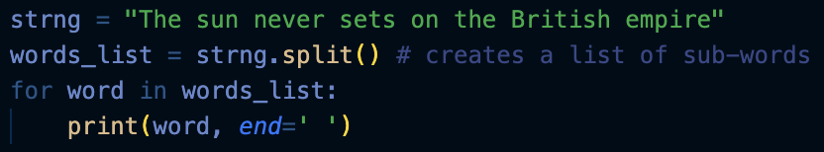
Splitting and Joining
String.split(): creates a list of strings in string that are separated by a space
String.split(‘split_char’): Creates a list of string in string that are separated by split_char
String.join(): joins a list of strings to create a single string

Slide 15

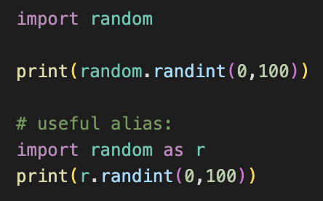
Modules
Common place for functions and global variables to be used elsewhere
your .py files are both scripts and modules
To use things from other modules in a script, use import
E.g. import random
Can redefine the name in script for convenience
Notes:
random.randint returns an integer between two specified bounds

Slide 16
Modules Cont
Good practice is to import modules at the top of a script
Use stuff from the modules later in the code

