Slide 1
File Processing
Files
Reading
Writing
File System Interaction
CL Arguments
with Keyword for Automation

Slide 2
Files
Often, you may want to access information outside of your python module
This information may be stored in a file
Files contain information in a specified format
E.g. .py, .ipynb, .txt, .md, .csv, .html
These are all extensions
We will focus on reading and writing with .txt and .csv files

Slide 3
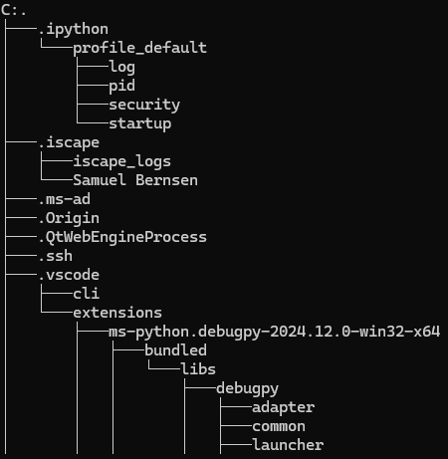
Your File System
File systems help to store, organize, and manage data
They are a bridge between the OS and physical storage medium/media
Your computer stores files in a directory (folder) structure, regardless of OS variant
On Windows and Mac, type in tree in command prompt to see the structure
You may have to install tree by running brew install tree on Mac

Slide 4
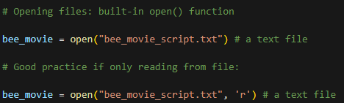
Opening files: open()
Assuming the file exists in the same directory as you python script, you can use open() built-in function
File mode (read, write, append) specified in 2nd argument
r, w, a respectively
r+ for reading and writing

Slide 5

Reading from File
Now we have a file object, stored in bee_movie
To read, use .read(), .readline(), or .readlines()
read()
returns all the file’s information into a single string
readline()
Returns a single line at a time
Useful for extremely large files
Readlines()
Returns the lines in the file as strings in a list

Slide 6

Writing to Files: .write()
Once the file is open (and writable), use the .write() method
Only accepts strings as arguments
If you want to write other data types, you must first convert them to strings
If you want to add to the current contents of the file, use .write() but make sure the file is in append mode (‘a’ as second argument in open() function)
Can call multiple write functions between opening and closing the file

Slide 7
Quirk about .write()
Output is buffered before being written to the file
Data only written once newline(\n) is seen
Can cause delays between .write() calls and actual writing of data
To force buffer to be written, use .flush() method
Not a common problem, but something to be aware of

Slide 8
File System Interaction: os module
Some operations can only be performed by interfacing with the operating system
For such operations, you can import the os module
import os
Removing a file: os.remove(<filename>)
For increased portability between OSes, os.path.join()
Usage: os.path.join(<parent_directory>,<sub_directory>,…,<filename>)
This builds out the path to the file for the given OS
Therefore, your program is OS agnostic
Other os functions shown in notes

Slide 9
Command Line Arguments
Allow the user to specify the path and filename before runtime
E.g., when running python3 <python_script_name.py>, you can add more arguments to the interpreter
Looks like: python3 py_script.py my_text_file.txt
import sys module
sys.argv is a collection of the arguments after python3
E.g., sys.argv[0] is the python_script_name; sys.argv[1] is the text file (in this case)

Slide 10
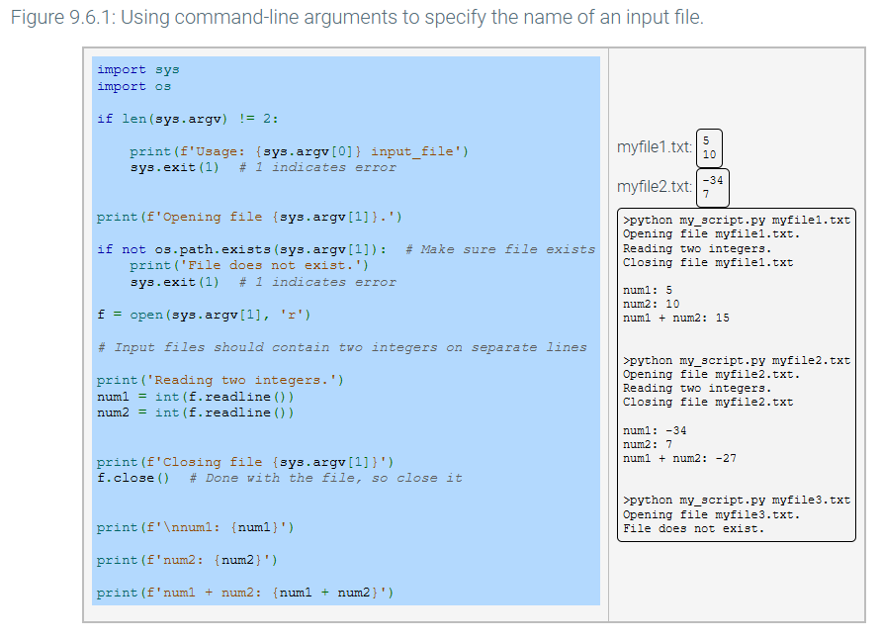

Slide 11
with
Isn’t it annoying that you need to close a file every time you open it?
Enter…the with keyword
Technically, with creates a context manager which automatically manages the use of a resource like a file
Simply, you can use the with keyword and the open() function to perform the necessary operations and automatically close the file once you are done

