Slide 1
CPSC 230: Intro to CS For Loops
What are they?
Iterators
Break & Continue

Slide 2

What are they?
Another kind of looping mechanism
Similar to while loop and can perform similar functions
E.g. Looping for a specified number of times
Iterates over a sequence
Common use: iterate for a specific number of times using range() function
E.g. for i in range(0,11):
Iterates over the numbers 0 to 10 (final number is not included)
Sequence can be a list, a tuple, a dictionary, a set, or a string

Slide 3


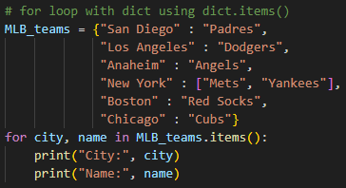
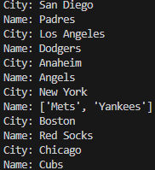
Tuple, Dictionary (Sets and Strings in Examples)

Slide 4
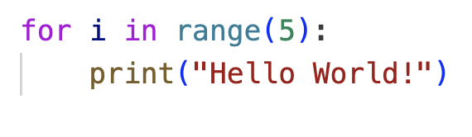
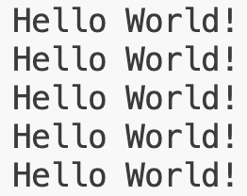
Range() function
Very useful for iterating a certain number of times
Returns a sequence of numbers
Starts at 0 by default
Uses incrementor of 1 by default
Syntax: range(<start number>, <end number>+1, <increment by>)
E.g. range(0,5,1) returns all numbers from 0 to 4
range(5) does the same as above

Slide 5
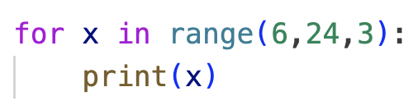
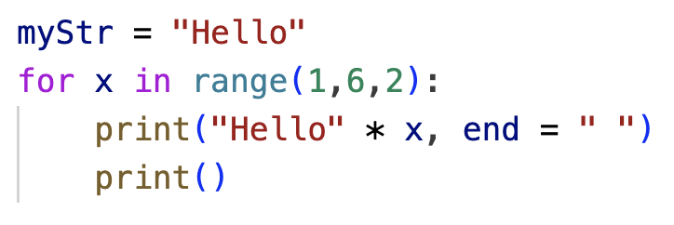

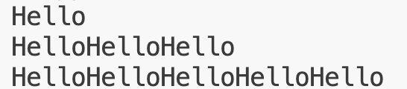
More range() examples

Slide 6
Break and Continue
Both still apply to for loops
Break exits loop
Avoids else block if there is one
Continue immediately jumps to the top of the loop
Continues to next item in the sequence

Slide 7
Else
Similar to while loop else
Specifies a block of code to be executed when the loop is finished
Why use it? Doesn’t this happen automatically?
Yes, but it will execute even if break happens
for i in range(5):
print(i)
if i == 3:
break
else:
print(“Exited without hitting break”) # this will never get printed

Slide 8
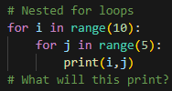
Nesting Loops
As with conditionals and while loops, we can embed for loops inside each other
CAUTION: This can result in high computational complexity
Number of iterations can be very high
Outer loop begins first
Inner loops then executes
Once inner loop finishes, outer loop sequence increments
Meaning outer loop moves on to the next sequence item

Slide 9
Classwork

