Slide 1
CPSC 230: Intro to CS Functions
Definitions
Invocation
Return statements
Namespaces
Parameter passing methods

Slide 2
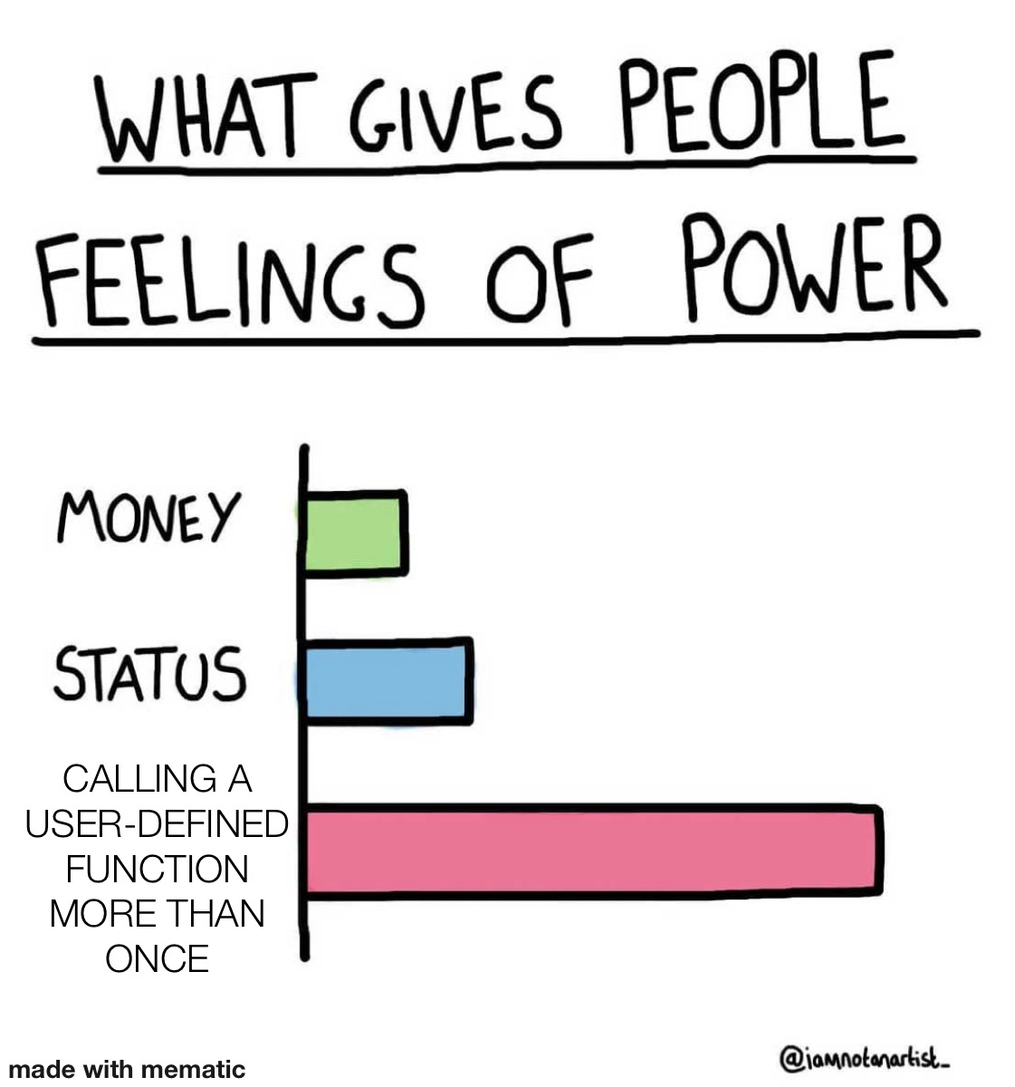

Slide 3




What is a function?
Takes in 0+ inputs
Does some operation
Spits out an output object

Slide 4
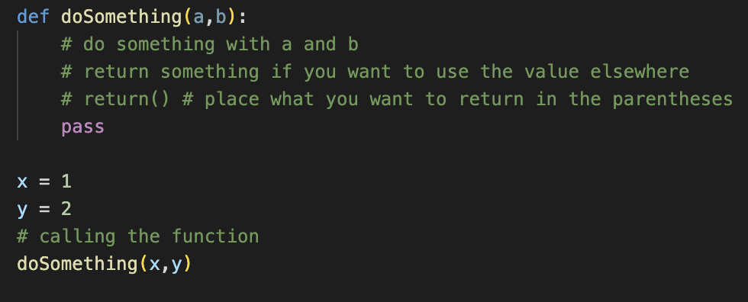
Function Basics
Function definition: name of the function and a block to be executed
Function call: invocation of the function by way of the function name
Syntax

Slide 5
Why Functions?
Code reusability and lower verbosity
Less code you need to write!
Only write it in one place, then use it anywhere (that has access to that function)
For most, helps us understand code better
Cleans up our workspace
Can share with others
E.g. math.pi

Slide 6
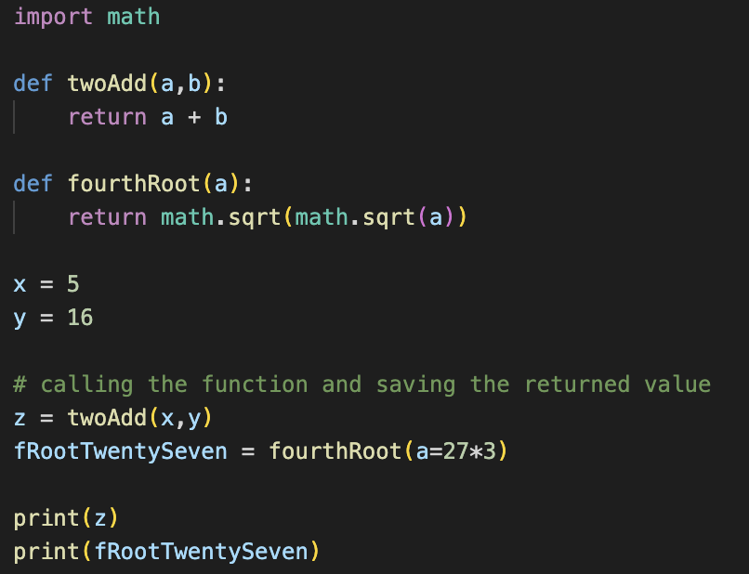
Best Practice
Parameters
Functions must be defined before they are called
Typically, programmers define functions at the top of their scripts
Not necessary, but recommended
Terminal output:
21
3.0
Argument

Slide 7
Return Statements
Functions can return values for later use
But can only return one item (tuples and lists count as an item)
return <value_to_be_returned>
Functions with no return statement return the value None (no value)
Return statements can appear anywhere in a function definition

Slide 8
Namespaces
Namespace: area of code the contains information only visible to that area
Values found only within functions are local to that function
Intermediate variables usually used for calculations
When you call a function, the script “pauses” and begins to run the function, waiting for the output
This creates the function’s own little “world”

Slide 9
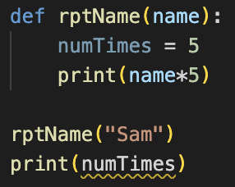
What is wrong? Why is numTimes unerdlined?
Notes:
numTimes is local to the function itself

Slide 10
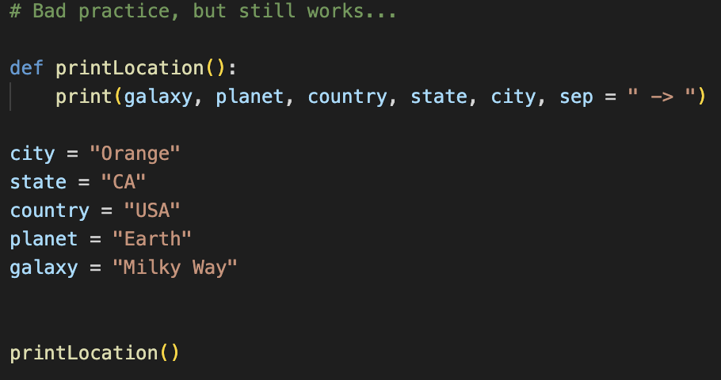
Why do I say this is bad practice?
Notes:
It is bad practice because the function can only be used with the variables defined outside of the function. If the variable names change, then the function won’t work.

Slide 11
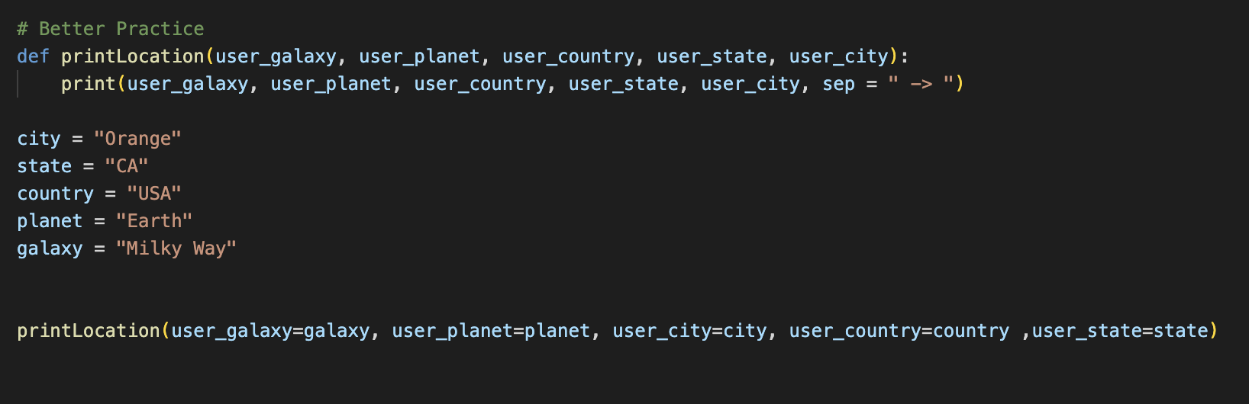
Notes:
This is better because the values being printed and the values given as arguments. We can print values other than the ones defined in the global scope. Also, notice how I passed in the arguments. They are now named instead of necessarily ordered.

Slide 12
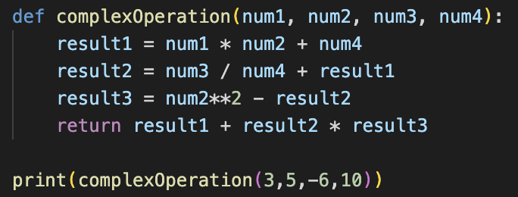
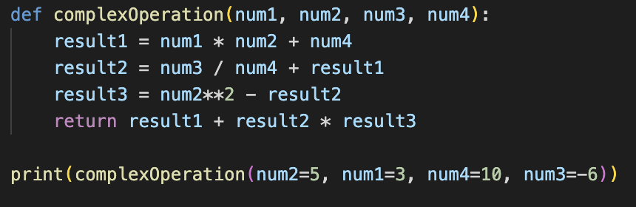
ordered vs named argument passing
Ordered
Named
Same output:
39.640000000000036

Slide 13
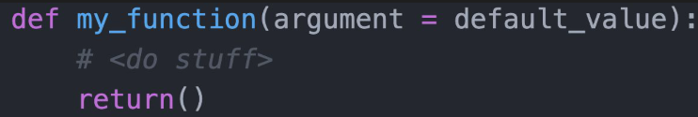
Default arguments
If there is a common value used for a given parameter, we can use default arguments
Defined in the function definition

Slide 14
Function practice
Create a function store() that has parameters shirtPrice, shirtBought, shoePrice, shoeBought, socksPrice, socksBought, and tax
The function should calculate a customer’s total. Give defaults to one or more of your arguments
Call you function with the default arguments first. Then call using ordered arguments, then call with named arguments

