Slide 1
AGST 50104 Experimental Design
Samuel B. Fernandes, Ph.D. E-mail: samuelbf@uark.edu

Slide 2
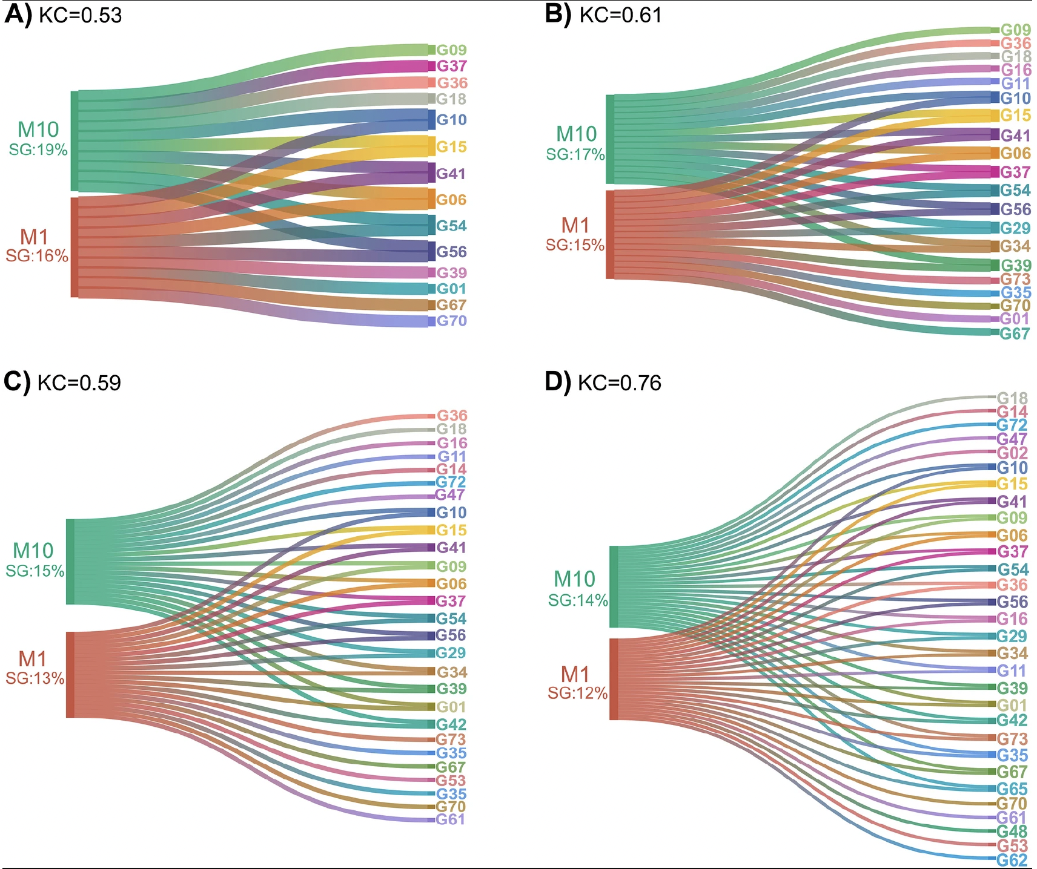
Example of ANOVA vs LMM
Evangelista et al. (2023)

Slide 3
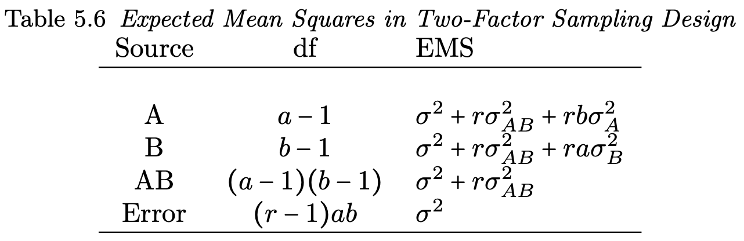
Variance Estimation (ANOVA vs ML/REML)
Using ANOVA to estimate variances, all of the assumptions still hold.
Negative variances (<10 levels)
ML and REML don’t generate negative variances

Slide 4
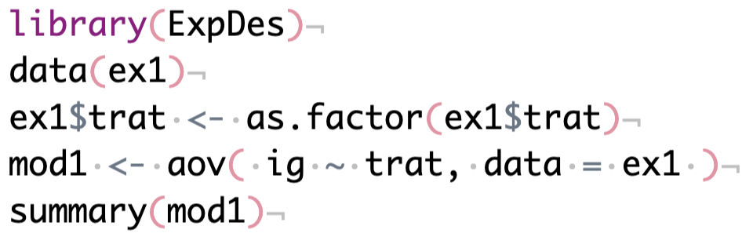
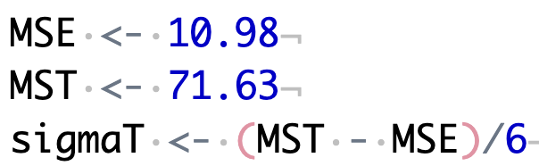
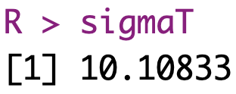
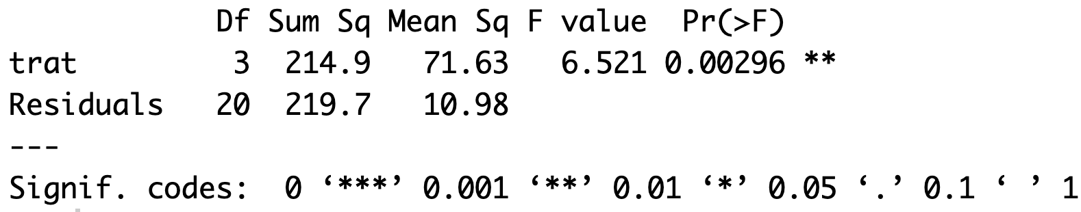
With balanced data: REML = ANOVA

Slide 5
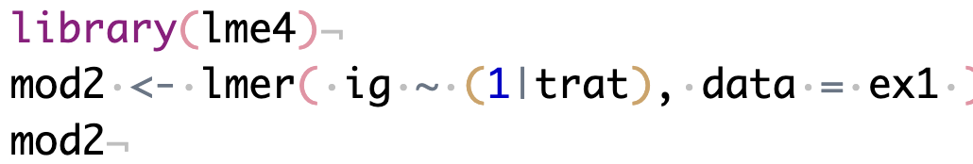
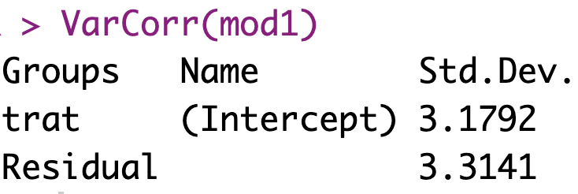
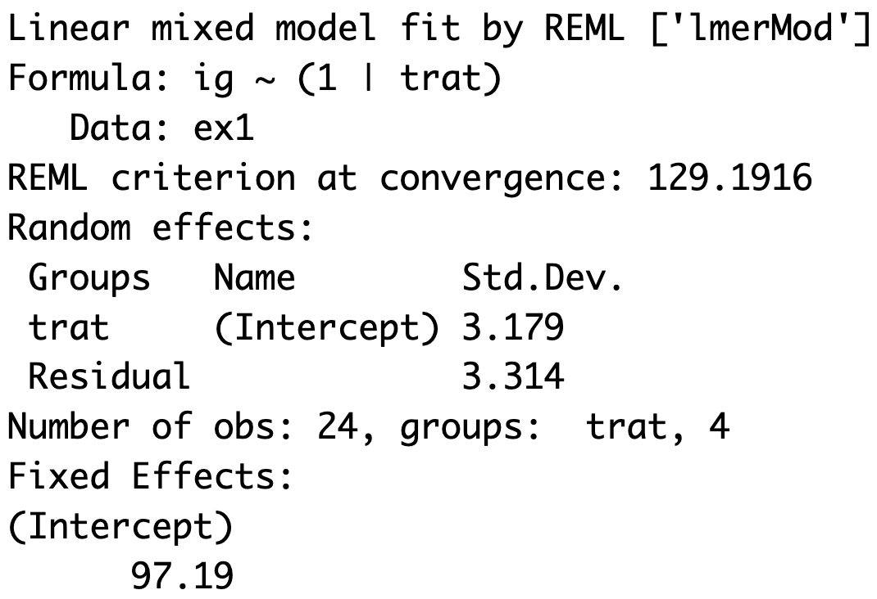
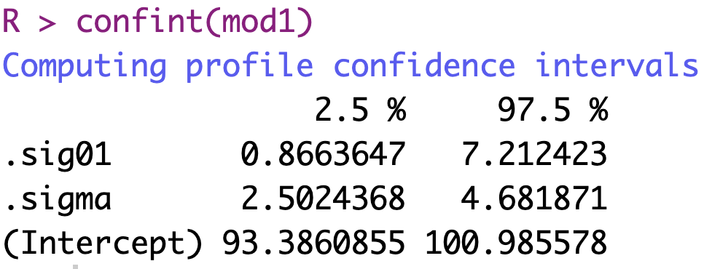
With balanced data: REML = ANOVA

Slide 6
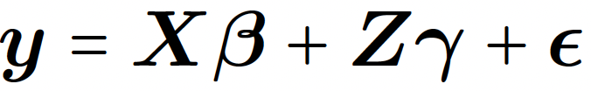
Some considerations
Confidence interval very similar with DF >45
a_{i}, b_{j}, and ab_{ij} are assumed to be independent
If either a_{i} or b_{j} is random ab_{ij} will be random as well.

Slide 7
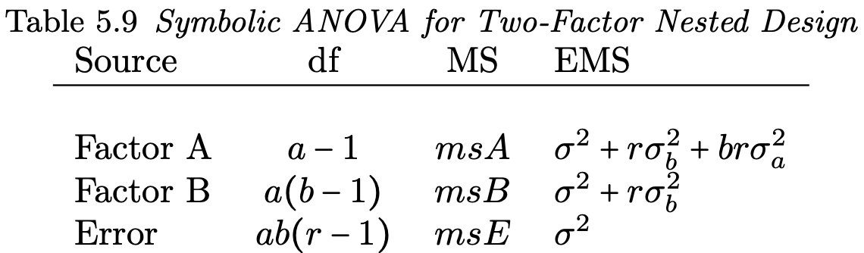


Interaction vs nesting

Slide 8
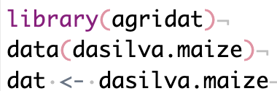
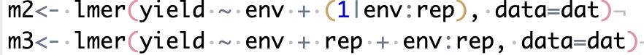
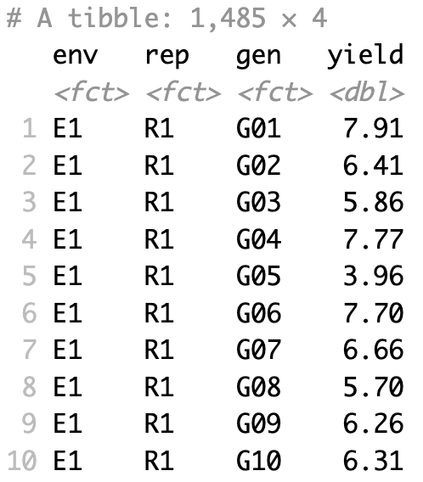
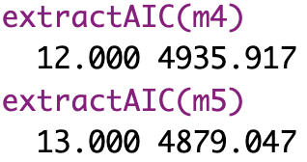
Model Selection (AIC/BIC)

Slide 9
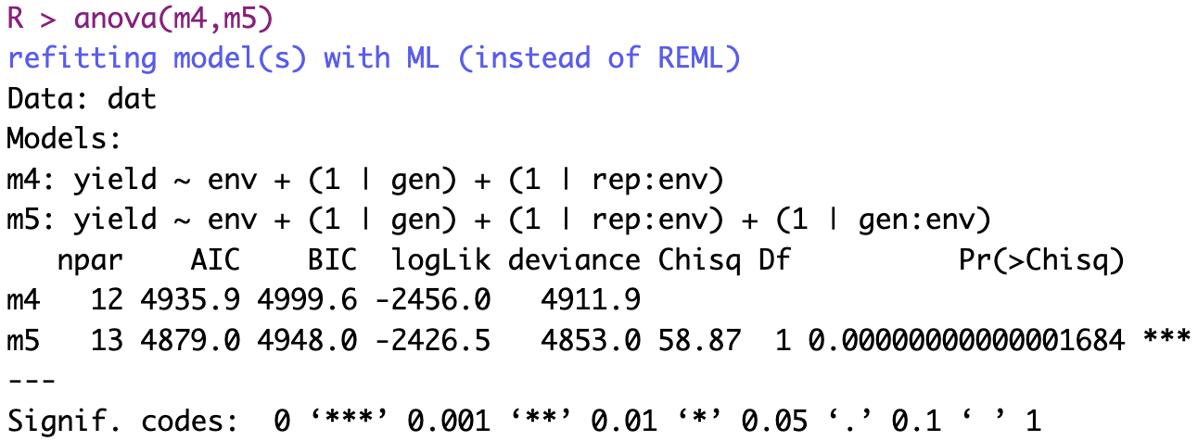
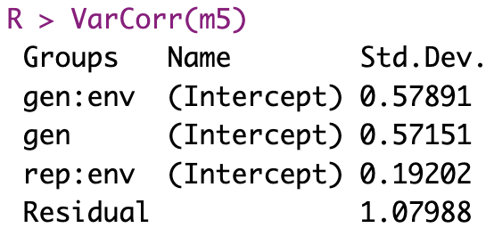
Example

Slide 10
Extra materials
Mixed Models for Agriculture in R
https://schmidtpaul.github.io/MMFAIR/index.html
The great debate: Fixed vs. random blocks in experimental design
https://vsni.co.uk/blogs/the-great-debate-fixed-vs-random-blocks-in-experimental-design/

