Slide 1

AGST 50104 Experimental Design
Samuel B. Fernandes, Ph.D. E-mail: samuelbf@uark.edu

Slide 2
Comparing different designs (in an RCBD)
Treatments:
Row spacing (30cm, 50cm, 80cm)
Irrigation (1x, 2x, 3x/week)
Split-plot
Block 1
30 | 50 | 80
50 | 30 | 80
80 | 30 | 50
1x
3x
2x
Factorial
Block 1
1x 30 | 2x 30 | 1x 80
3x 30 | 1x 50 | 3x 80
2x 80 | 3x 50 | 2x 50
Strip-plot
Block 1
1x
3x
2x
1x
3x
2x
30 | 80 | 50

Slide 3
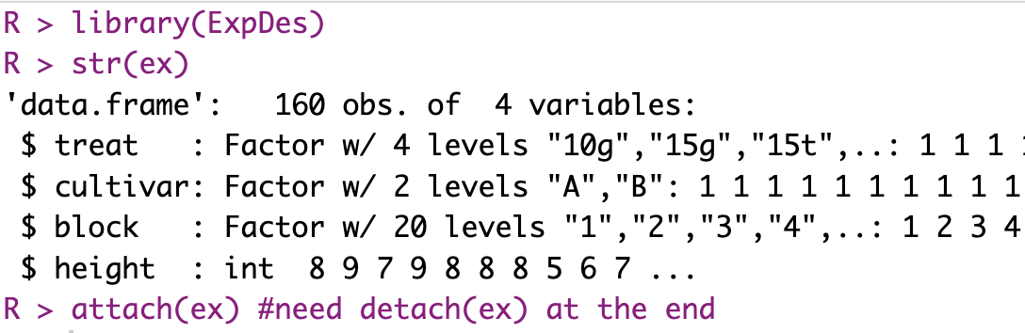
Comparing different designs

Slide 4
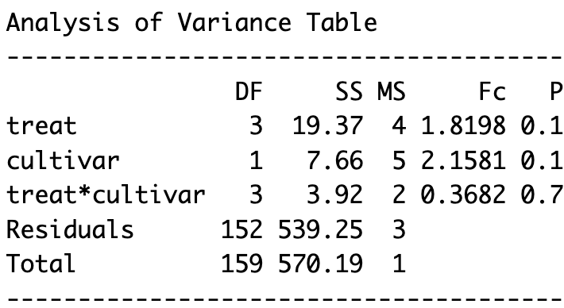
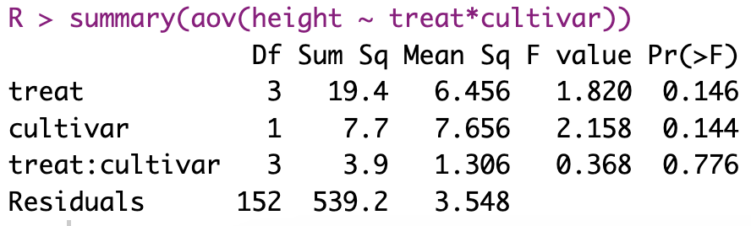
Factorial CRD
fat2.crd(treat, cultivar, height, fac.names = c("treat","cultivar"))

Slide 5
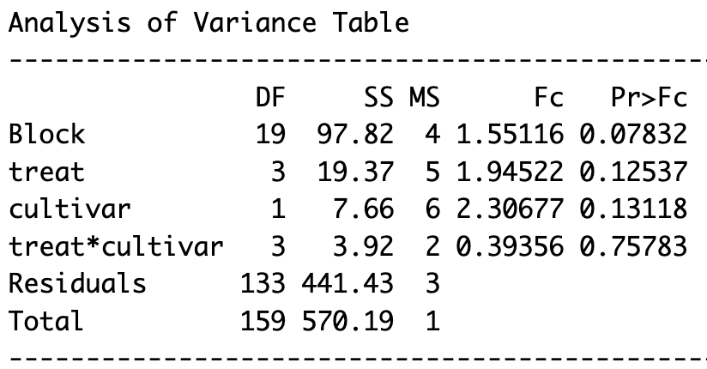
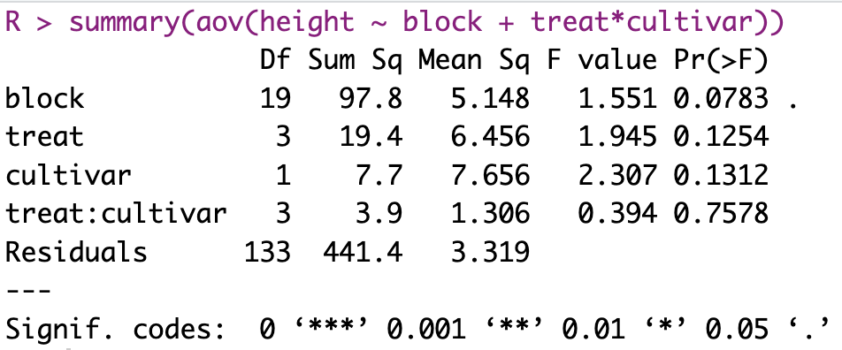
Factorial RCBD
fat2.rbd(treat, cultivar, block, height, fac.names = c("treat","cultivar"))

Slide 6
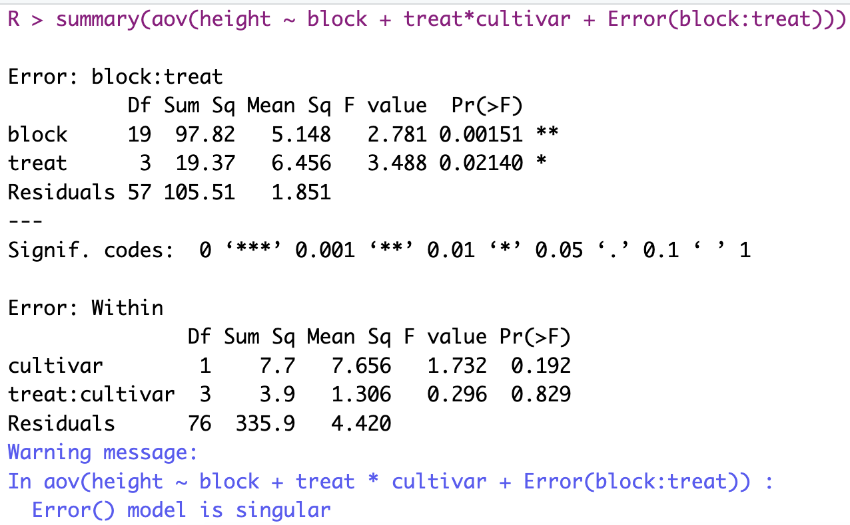
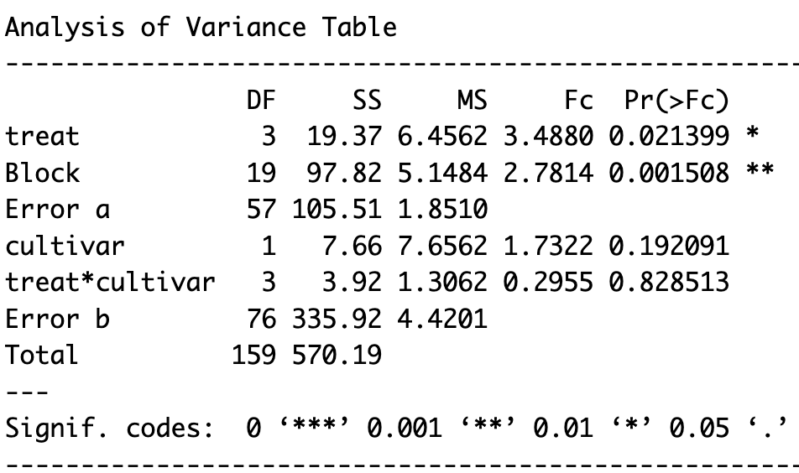
Split-plot RCBD
Block is a fixed effect
split2.rbd(treat, cultivar, block, height, fac.names = c("treat","cultivar"))

Slide 7
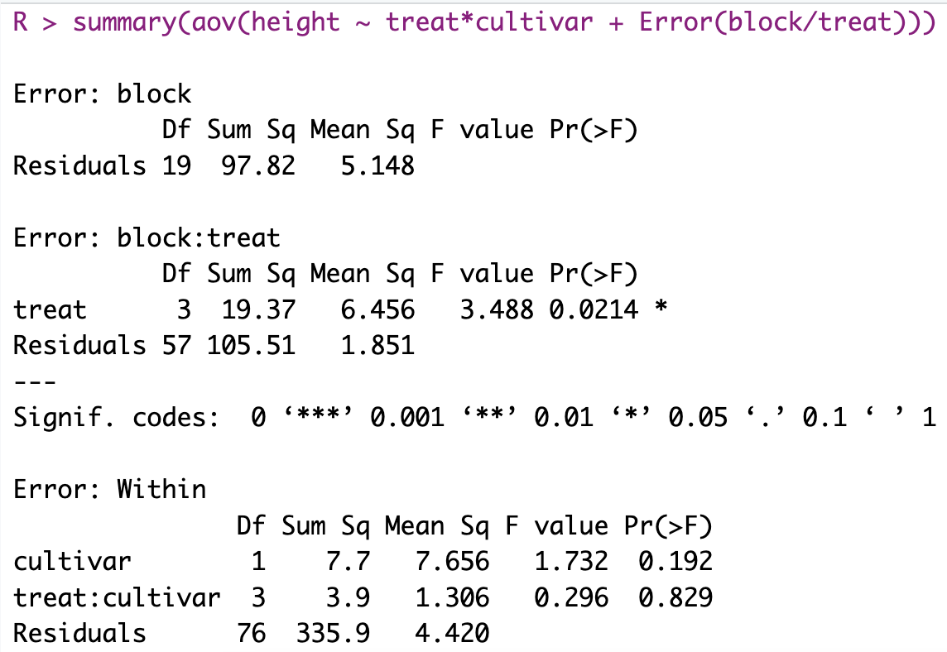
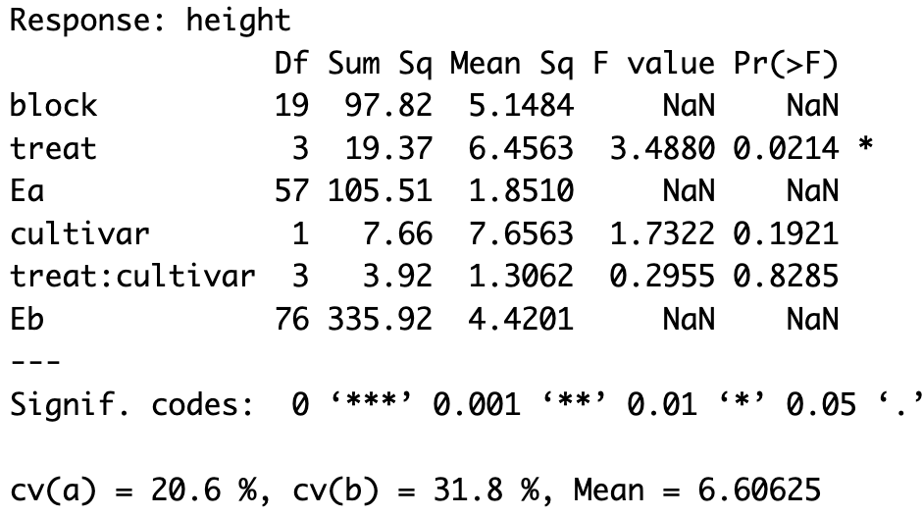
Split-plot RCBD (with agricolae)
Block is a random effect
sp.plot(block = block, pplot = treat, splot = cultivar, Y = height)

Slide 8
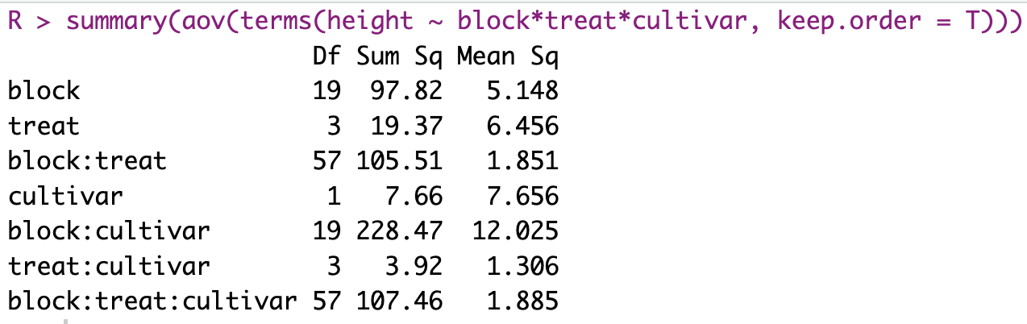
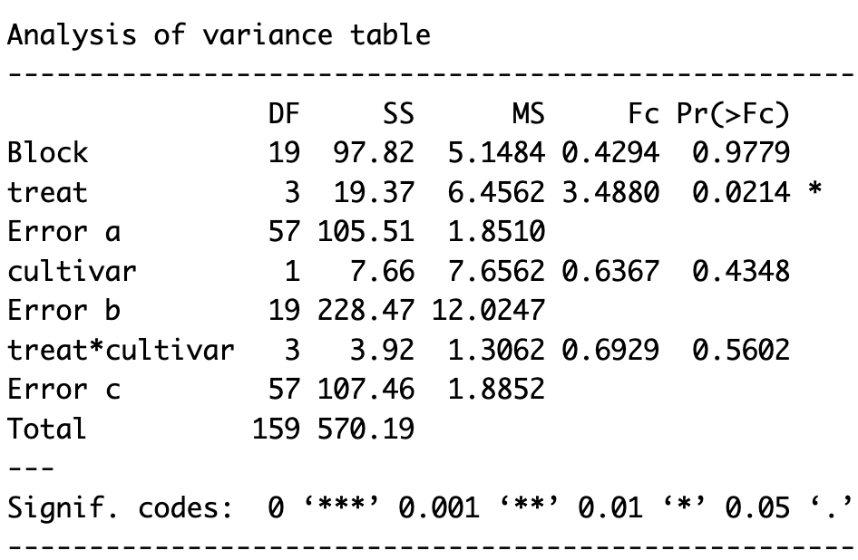
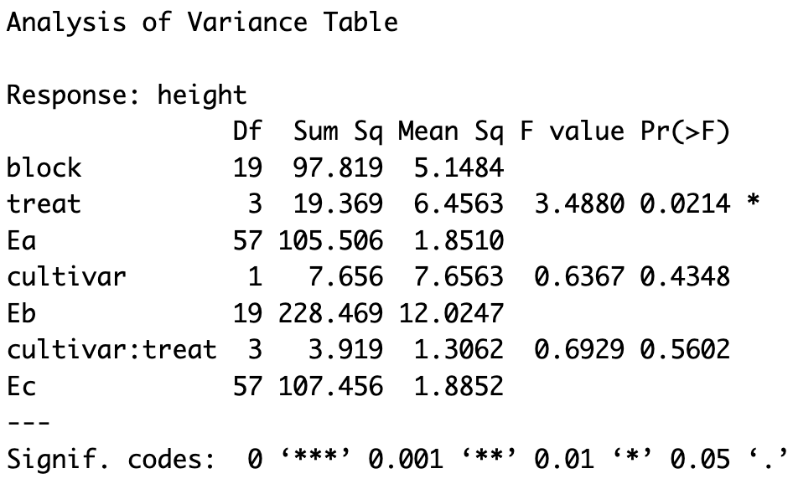
Strip-plot RCBD
ExpDes:
agricolae:

Slide 9
Factorial x Split-plot x Strip-plot
Factorial RCBD
Strip-plot RCBD
Split-plot RCBD

Slide 10
Linear Mixed Models
What are Linear Mixed Models (LMMs)?
Statistical models that incorporate both fixed and random effects
ANOVA and linear regression can be seen as special cases of a mixed model
Some advantages of mixed models over traditional ANOVA:
Useful for modeling correlated data and accounting for within-group variability
Better handle unbalanced data, missing values, and unequal variances
allow for more complex experimental designs, including nested and crossed factors, repeated measures

Slide 11
Fixed vs Random
Fixed Effects:
Factors where we want to estimate specific differences (e.g., treatment groups, specific diets, fertilizers).
Effects apply to the whole population.
Random Effects:
Factors that introduce variation but are not of primary interest (e.g., farm-to-farm variation, individual differences in repeated measures).
Effects represent a random sample from a larger population.
Analogy:
Fixed Effect = “Recipe ingredients” (we care about which flour makes the best cake).
Random Effect = “Different ovens” (we recognize they add variability, but we don’t care which oven exactly).

Slide 12
Examples of random and fixed effects
Suppose we test different fertilizers on multiple farms:
Fixed Effect: The fertilizer type (since we are interested in comparing them).
Random Effect: The different farms (since they represent a larger population, and we don’t care about their individual identities).

Slide 13
When Do We Need Mixed Models?
Where Mixed Models are Useful:
Block Designs (e.g., RCBD): When blocks (e.g., farms, labs) introduce variation.
Repeated Measures (e.g., time-based studies): When measurements are taken over time from the same subjects.
Hierarchical/Clustered Data: When subjects belong to groups (e.g., students in different schools).
Example: Suppose we study student test scores from multiple schools.
Fixed Effect: Teaching method.
Random Effect: Schools (since each school represents a random selection of all schools).

Slide 14
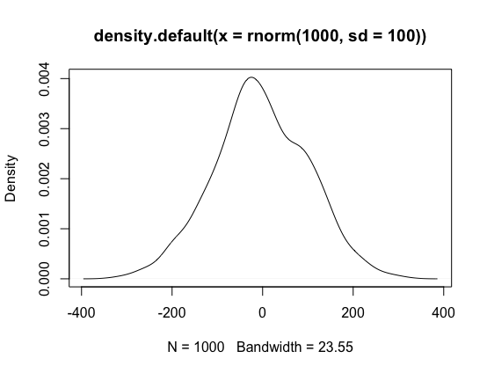
Maximum likelihood (ML) estimation and Variance components
What are the parameters that most likely generated our data?
Iterative process
ML is a more general method for estimating model parameters that does not assume normality or equal variances. ML estimates the model parameters that maximize the likelihood of the observed data, given the assumed distribution of the data.
Our data
>y1 <- rnorm(n = 10, mean = 10, sd = 1)
>y2 <- rnorm(n = 10, mean = 10, sd = 1000)

Slide 15
Fixed vs. random effects
Fixed effects: the primary interest in the study → we want to make inferences about.
Example: In a study comparing the effect of three different fertilizers on crop yield, the type of fertilizer is a fixed effect.
Random effects: Not of primary interest, their values are assumed to be sampled from a larger population.
Example: In a study that aims to estimate heritability of milk production, different caws are considered a random effect
The choice between fixed and random effects depends on the research question and the nature of the data.
Blocks as fixed vs random: ASSIGNMENT – READ IT: https://newprairiepress.org/cgi/viewcontent.cgi?referer=&httpsredir=1&article=1474&context=agstatconference

Slide 16
Fixed vs. random effects
Example: If the goal of the study is to compare the effects of different fertilizers on yield, then the type of fertilizer should be treated as a fixed effect. However, if the goal is to estimate the overall variability in yield across different fields, then the field should be treated as a random effect.
The choice between fixed and random effects can have a significant impact on the results of the analysis, and it is important to choose the appropriate model specification.
Treating a random effect as a fixed effect can lead to biased estimates of the fixed effects, and treating a fixed effect as random can lead to an overestimation of the random effects.
Fixed or random?
Field, location, year, genotype, type of fertilizer, type of crop, irrigation method

Slide 17
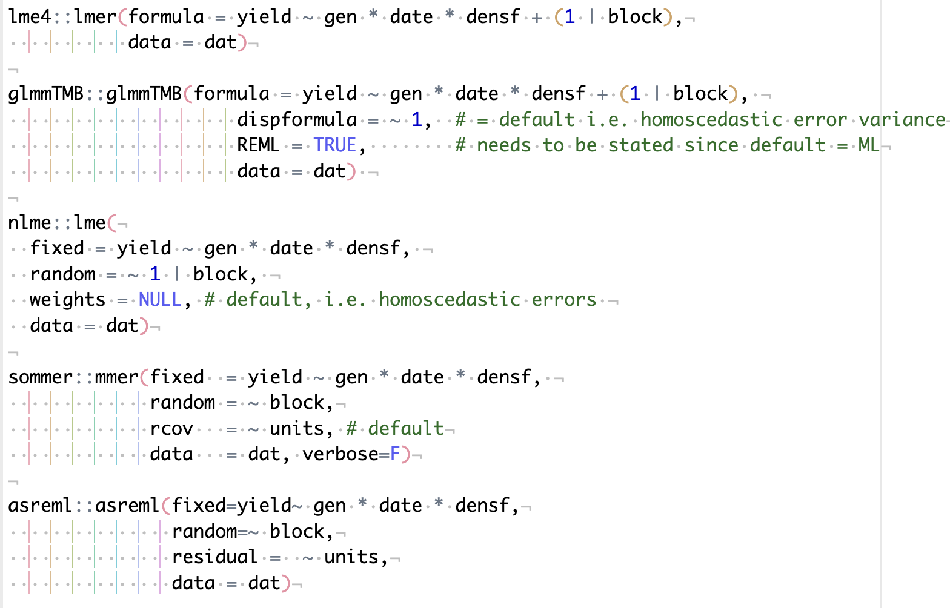
Mixed models in R

Slide 18
Some interesting resources
Statistical Analysis of Agricultural Experiments using R https://rstats4ag.org/index.html#section
Mixed models with R
https://m-clark.github.io/mixed-models-with-R/

