Slide 1
AGST 50104 Experimental Design
Samuel B. Fernandes, Ph.D. E-mail: samuelbf@uark.edu

Slide 2
Consistency of chocolate chip cookie
Factors: temperature (3 levels) and amount of baking soda (4 levels)
Design 1:
12 combinations of temp and baking soda are replicated three times. You mix up cookie dough and then cook it 36 times.
Design 2:
Four batches of dough are created, each with a different amount of baking soda. Oven is heated to specific temp and the four doughs are put in the oven at the same time. Repeat for the other temperatures This means we make 36 batches of dough but only run 9 cooking trials.

Slide 3

Example: Irrigation (2), cultivar (4), fertilizer, herbicide, …
Irrigation (whole plot)
Just like a block
Cultivar (split plot)
1 | 2 | 4 | 4 | 1 | 3
2 | 4 | 1 | 2 | 3 | 1
3 | 1 | 3 | 1 | 4 | 2
4 | 3 | 2 | 3 | 2 | 4
© nd3000 / Shutterstock.com

Slide 4
Response surface methodology (RSM)
After we determine the significant factors
Determine the optimal combination of factors to obtain the best response within the experimental region (max, min)
Each response surface is typically a simple regression polynomial
You can use first–order designs that fit a linear approximation
When you are a long way from the top of the mountain, a slope may be a good approximation
When you are close to an optimum you need quadratic models and second–order designs to model curvature

Slide 5
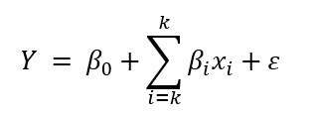
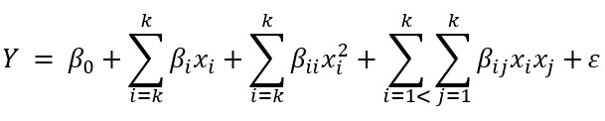
Approach
First-order designs (start here)
Second-order designs
looking for the experimental region where the curvature is found

Slide 6
Quadratic (second order) Models:
Maximum
Minimum
Saddle Point
Stationary Ridge

Slide 7
RSM designs
Three Level Factorial Experiments
Central Composite Designs (CCD)
Box Behnken Designs

Slide 8
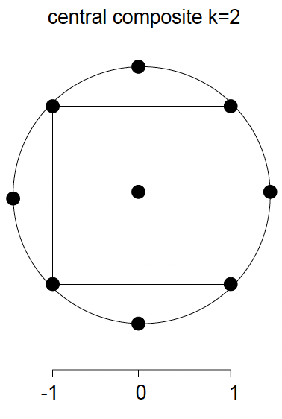
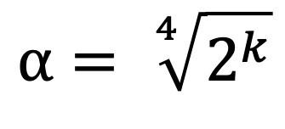
Central Composite Design (CCD)
2^{k} Factorial
2k Axial
n_{c} center
X_{A} | X_{B} | X_{C}
- | - | -
- | - | +
- | + | -
- | + | +
+ | - | -
+ | - | +
+ | + | -
+ | + | +
X_{A} | X_{B} | X_{C}
-⍺ | 0 | 0
+⍺ | 0 | 0
0 | -⍺ | 0
0 | +⍺ | 0
0 | 0 | -⍺
0 | 0 | +⍺
X_{A} | X_{B} | X_{C}
0 | 0 | 0
0 | 0 | 0
0 | 0 | 0
$$\text{⍺}= \sqrt[4]{2^{k}}$$
Notes:
No replication in the factorial and axial part, more reps at the center provides better predictions

Slide 9
Sequentially designed experiment
Full Factorial
w/Center points
Main effects
Interactions
Curvature check
Fractional Factorial
Linear model
Central Composite Design
Full quadratic model

Slide 10
Example
Our cake mix recommends 35 minutes at 350º, but we are going to try to find a time and temperature that suit our palate better.
We begin with a first order design in baking time and temperature, so we use a 2² factorial with three center points.
Use the coded values –1, 0, 1 for 33, 35, and 37 minutes for time, and the coded values –1, 0, 1 for 340, 350, and 360 degrees for temperature.
We will thus have three cakes baked at the package-recommended time and temperature (our center point), and four cakes with time and temperature spread around the center. Our response is an average palatability score, with higher values being desirable (data set CakeBaking1):

Slide 11
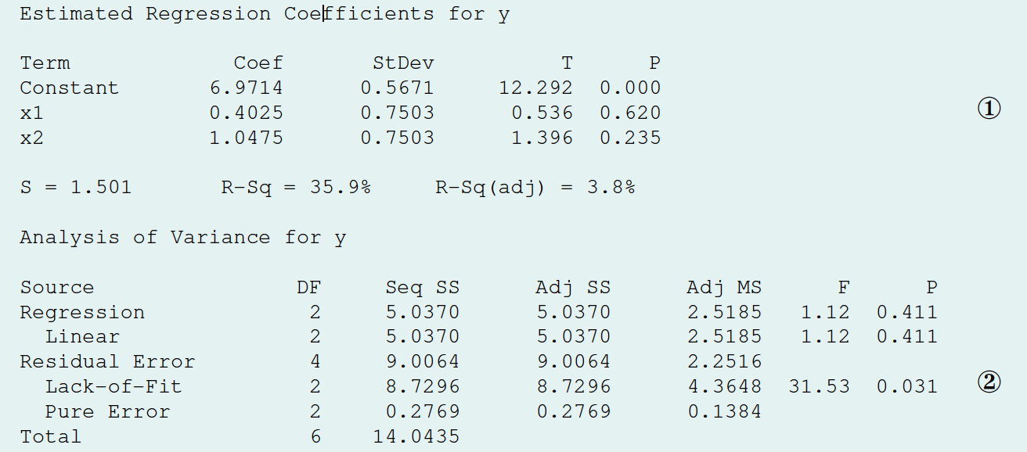
Data set:
X1 | X2 | y
-1 | -1 | 3.89
1 | -1 | 6.36
-1 | 1 | 7.65
1 | 1 | 6.79
0 | 0 | 8.36
0 | 0 | 7.63
0 | 0 | 8.12
Here are three possible goals when analyzing data from a first-order design:
Determine which design variables affect the response.
Determine whether there is a lack of fit.
Determine the direction of the steepest ascent.

Slide 12
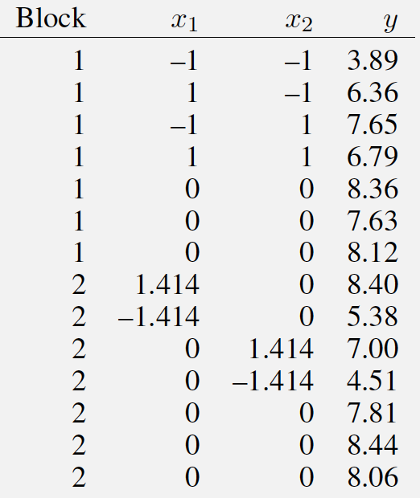
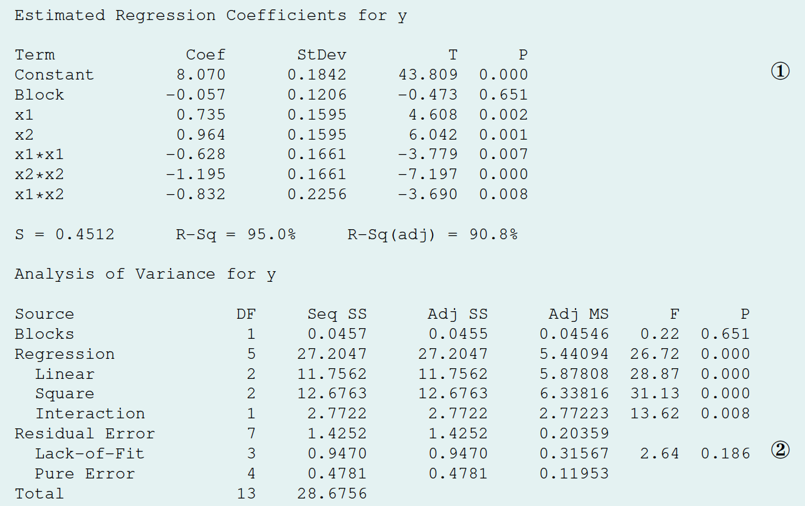
Complete CCD
Here are three possible goals for the analysis of second-order models:
Determine which design variables affect the response.
Determine whether there is a lack of fit.
Determine the stationary point and surface type.

Slide 13
Example: Improving the Yield of a Chemical Process
Levels

Slide 14
Results From First Factorial Design

Slide 15
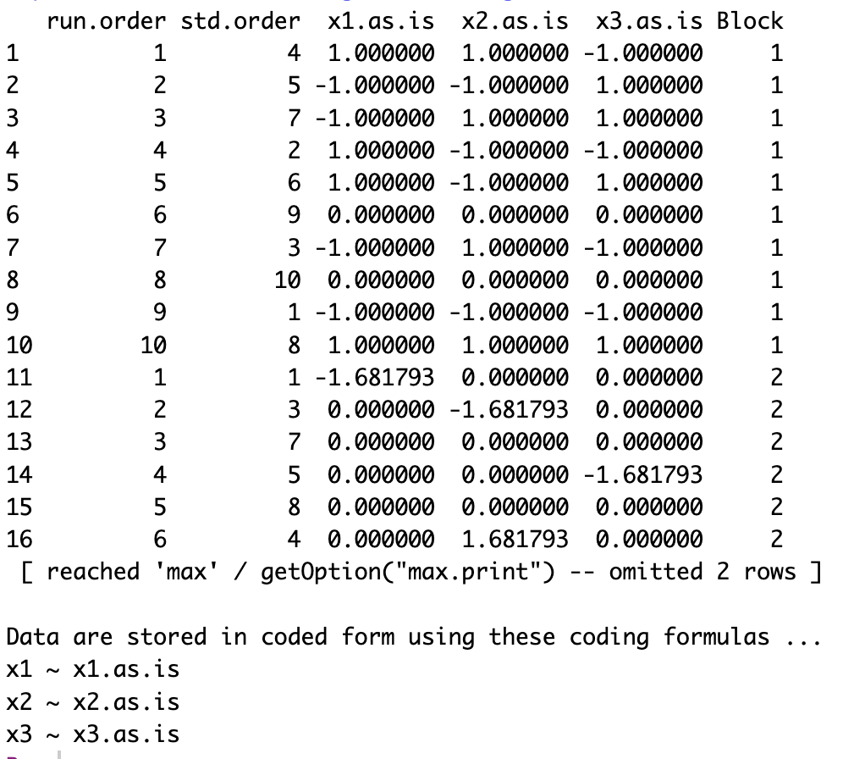
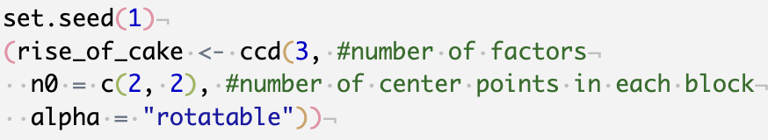
Generation of surface designs with the rsm package
central composite design: ccd() function
By default ccd() creates two blocks, one for regular experimental runs and another block for “start” points.

Slide 16
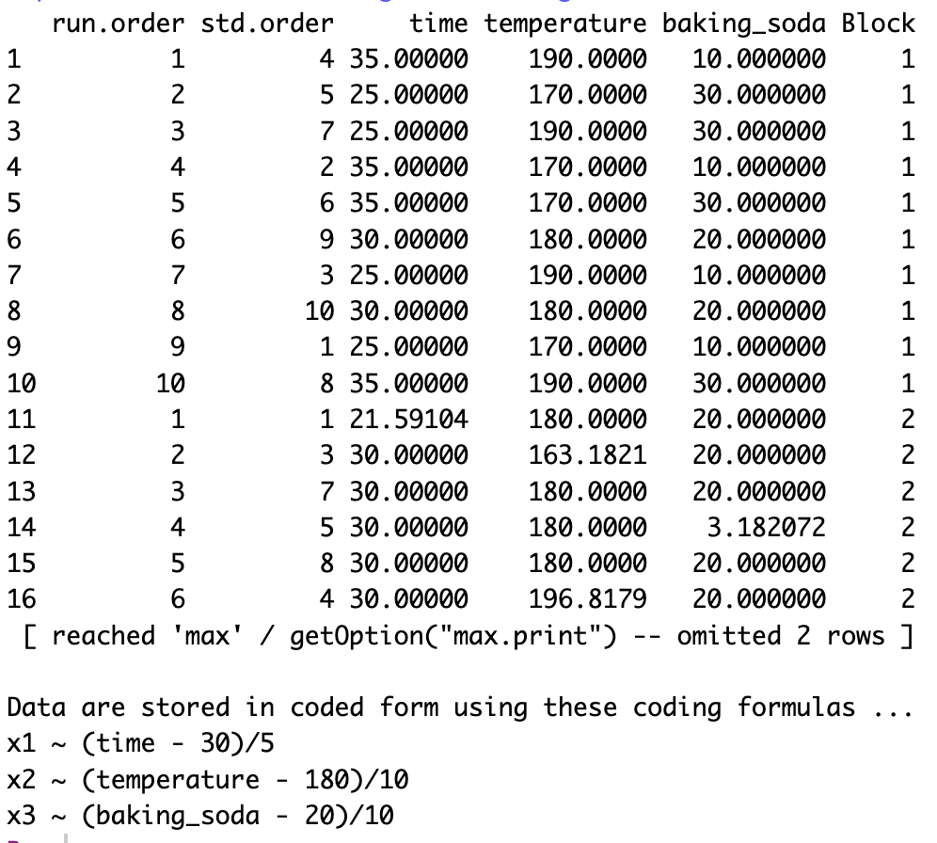
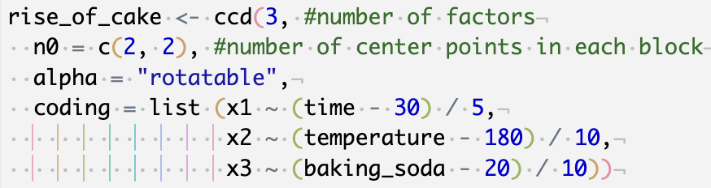

Slide 17
Generation of surface designs with the rsm package
Analyze with rsm() function
quality of the model:
Adjusted R² (Values close to 1 are preferred) and lack of fit
(p-value > ⍺ tells us that the model is “adequate”)

Slide 18
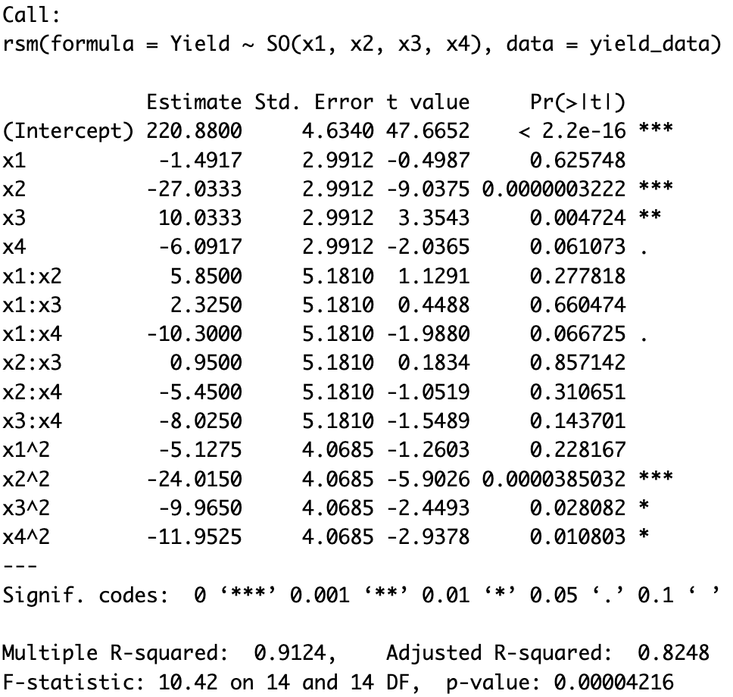
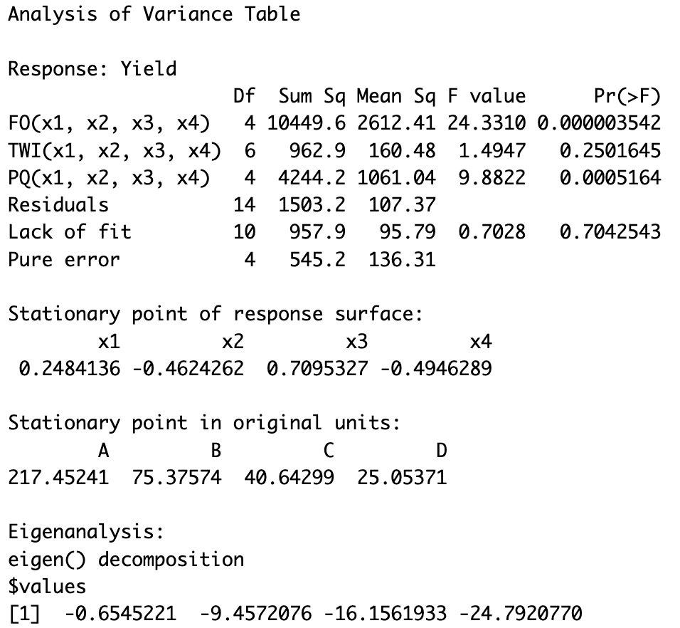

Slide 19
Magnitudes of the eigenvalues
Eigenvalues | Type of surface
All positive | Minimum
All negative | Maximum
At least one zero | Ridge
Some negative and some positive | Saddle point

Slide 20
Pipeline for RSM
Use a first-order model (factorial experiment) in the neighborhood of the current conditions
Test for lack of fit
If no significant lack of fit, then locate the path of the steepest ascent (Largest slope)
Run a series of experiments along the path until no additional increase in response is evident
6. If lack of fit is present, then use response surface design to investigate curvature
7. If the curvature is present, use RSM to locate the optimum (either graphically or by setting derivatives = 0). Beware of saddle points!

Slide 21
Other resources
https://statdoe.com/rsm/
https://www.coursera.org/learn/response-surfaces-mixtures-model-building

