Slide 1

AGST 50104 Experimental Design
Samuel B. Fernandes, Ph.D. E-mail: samuelbf@uark.edu

Slide 2
Incomplete Block Design

Slide 3
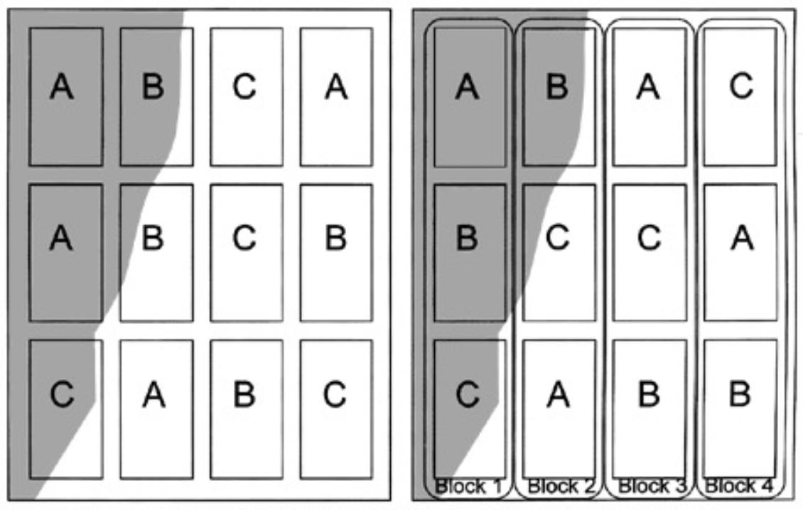

RCBD is not always possible
Homogeneity within block
A rater has to rate 10 brands of whiskey
k: treat/block, b: blocks, r: reps, t: treat
RCBD → k=t vs IBD → k<t → kb = tr = N

Slide 4
Some types of Incomplete Block Designs
Augmented Block Designs
Balanced Incomplete Block Design
Partially Balanced Incomplete Block Design
Cyclic Designs
Lattices (Square, Cubic, Rectangular, alpha )
Notes:
Must compute adjusted means (lsmeans)

Slide 5
Some Types of Design | Blocks Structure | When to Use | Advantages | Disadvantages
RCB | All treatments appear in each block | Small to moderate trials where complete replication is possible | Easy to analyze; strong control of variability | Not feasible when too many treatments exist
Augmented Block | Some treatments appear in all blocks (checks), but most are unreplicated | Large experiments where replication is impossible | Land and other resources are limited | few degrees of freedom for experimental error; Imprecise (unreplicated)
Balanced Incomplete Block (BIB) | Each treatment appears in equal frequency across blocks | Large trials where full replication is not possible | Good balance; precise comparisons | Requires a specific mathematical setup (equal replications)
Partially Balanced Incomplete Block (PBIB) | Treatments appear in unequal frequency but still maintain balance | When some treatments are more important than others | More flexible than BIBD; allows prioritization of treatments | More complex analysis
Cyclic | Treatments follow a fixed cyclic pattern across blocks | When a structured treatment order is useful | Easy to implement; systematic treatment distribution | Less flexible for adjusting block sizes
Lattice (Square, Cubic, Rectangular, Alpha) | Treatments are arranged in multiple dimensions | Large trials (e.g., plant breeding), especially for yield testing | High efficiency; good balance; allows spatial adjustments | More complex analysis

Slide 6
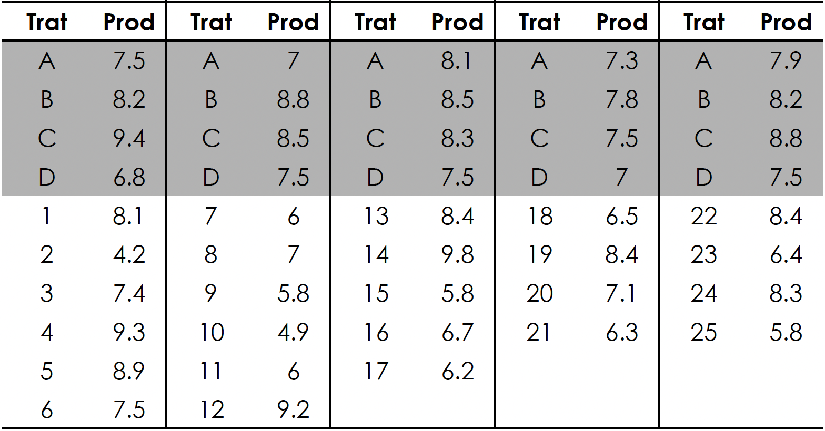
Example if ABD: Maize production for different hybrids
Block 1
Block 2
Block 3
Block 4
Block 5

Slide 7
Analyzing it in R (review of RCBD)
df <- data.frame(
Trat = c("A", "B", "C", "D", "1", "2", "3", "4", "5", "6"),
Prod = c(7.5, 8.2, 9.4, 6.8, 8.1, 4.2, 7.4, 9.3, 8.9, 7.5),
Trat = c("A", "B", "c", "D", "7", "8", "9", "10", "11", "12"),
Prod = c(7, 8.8, 8.5, 7.5, 6, 7, 5.8, 4.9, 6, 9.2),
Trat = c("A", "B", "c", "D", "13", "14", "1 5", "1 6", "1 7", NA),
Prod = c(8.1, 8.5, 8.3, 7.5, 8.4, 9.8, 5.8, 6.7, 6.2, NA),
Trat = c("A", "B", "c", "D", "18", "19", "20", "21", NA, NA),
Prod = c(7.3, 7.8, 7.5, 7, 6.5, 8.4, 7.1, 6.3, NA, NA),
Trat = c("A", "B", "c", "D", "22", "23", "24", "25", NA, NA),
Prod = c(7.9, 8.2, 8.8, 7.5, 8.4, 6.4, 8.3, 5.8, NA, NA)
)

Slide 8
Balanced Incomplete Block Designs (BIB)
All pairs of treatments occur together (𝜆 times) in the same block equally often
The precision (variance) of the estimated treatment differences 𝛼_{𝑖}−𝛼_{𝑗} is the same for all pairwise combinations
SS type III
Partially Balanced Incomplete Block Designs (PBIB)
First associates occur together 𝜆₁ times
Second associates occur together 𝜆₂ times (𝜆₁> 𝜆₂ )
More precision in comparing first associates than second associates

Slide 9
Examples [that CAN be] Resolvable Designs
Square lattice designs
Number of treatments must be a perfect square (t = k² )
Blocks per replicate (s) and plots per block (k) are equal (s = k) and are the square root of the number of treatments (t)
For complete balance, number of replicates (r) = k+1
Rectangular lattice designs (t = s*k and k = s-1)
Example: 4 x 5 lattice has 4 plots per block, 5 blocks per replicate, and 20 treatments
Alpha lattices (t = s*k)
more flexibility in choice of s and k

Slide 10
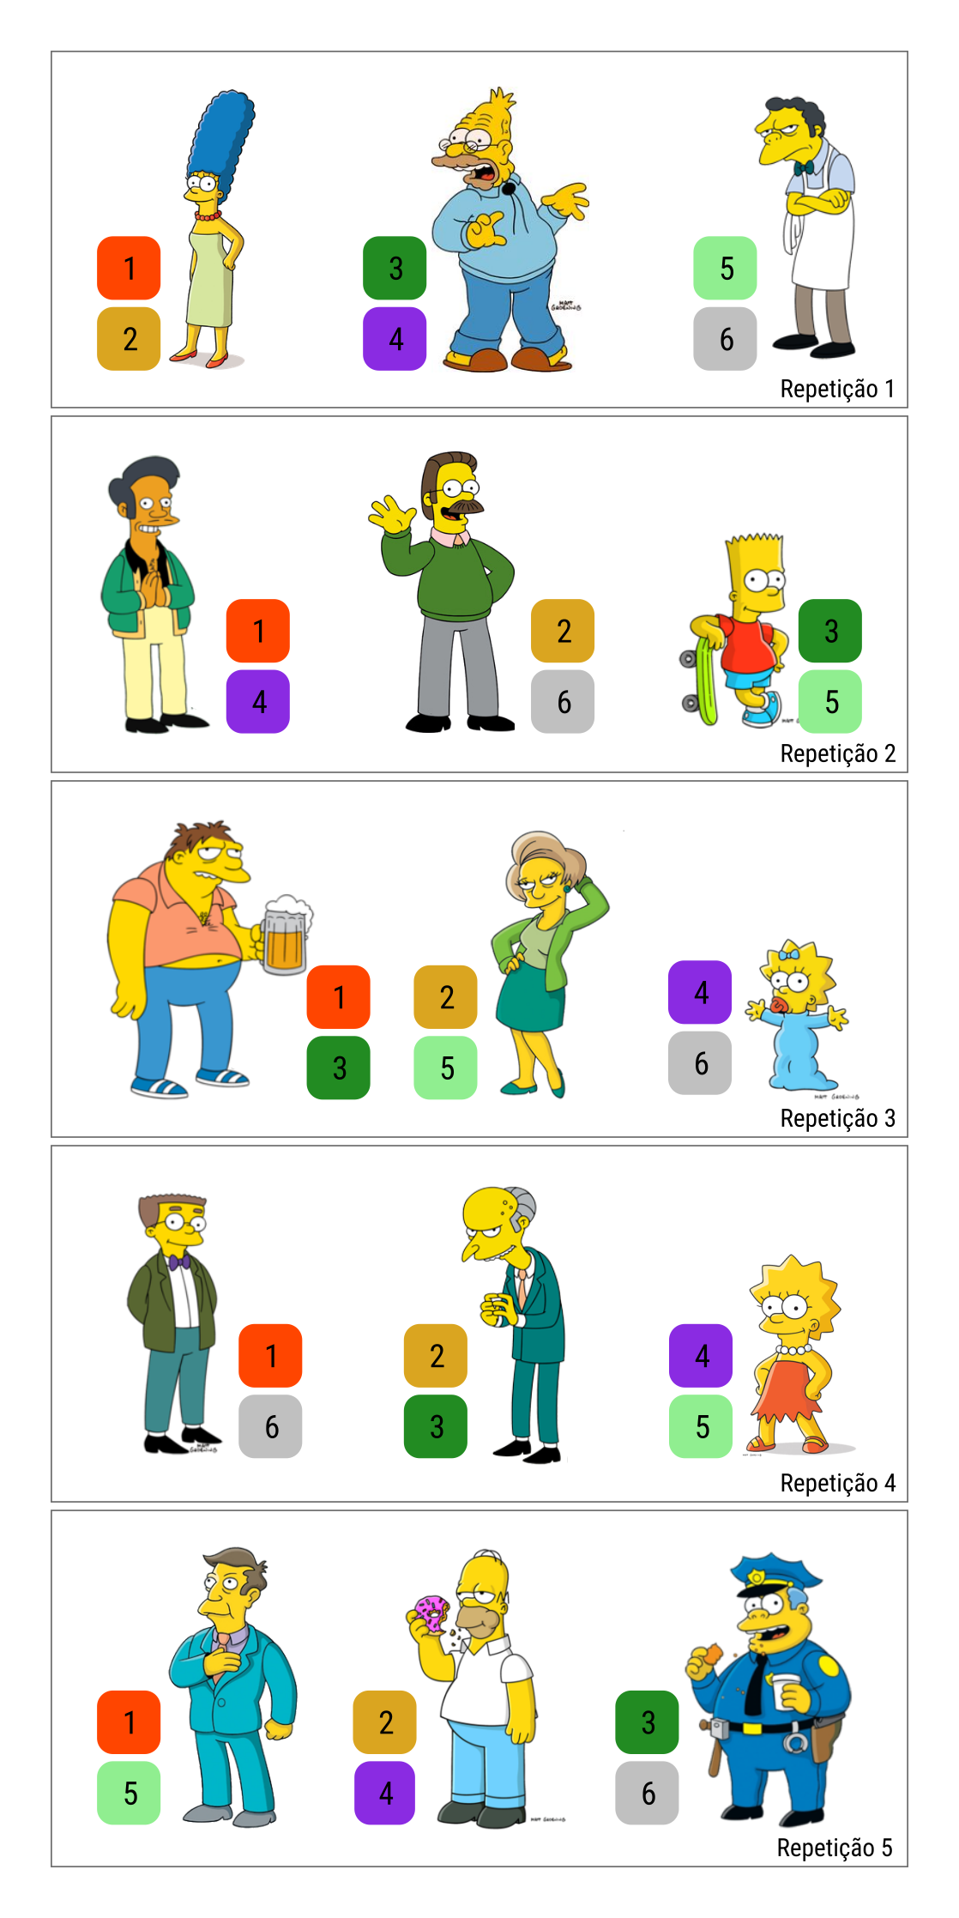
Resolvable (a type of BIB)
Treatments t= 6
Size k = 2
Rep r = 5
Blocks b = 15
λ=1
What’s the statistical model?
From: Zeviani 2019

Slide 11
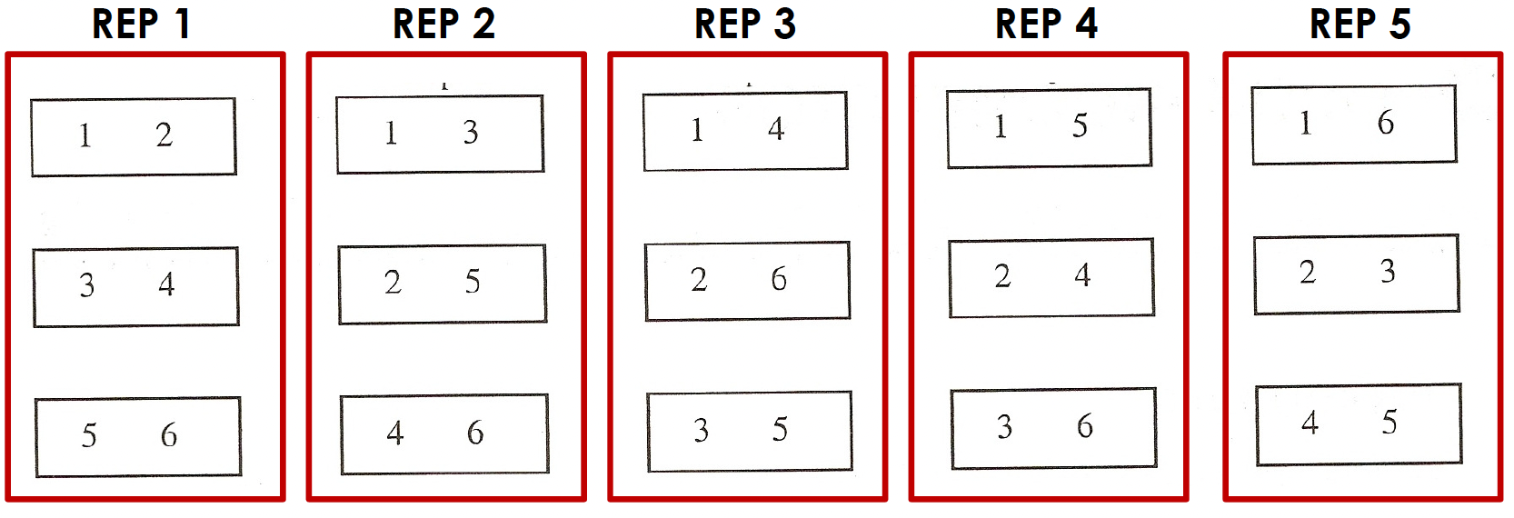
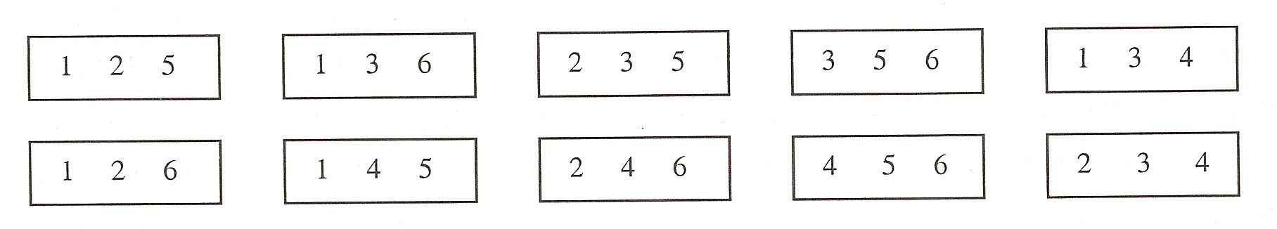
Resolvable: v=6 b=15 k=2 r=5
y_{ijk} = μ + r_{k} + b_{j(k)} + t_{i} + e_{ij(k)}
“block” = inc. block = “sub-block”
replication = “superblock”
Non-Resolvable designs:
v=6 b=10 k=3 r=5
y_{ij} = μ + b_{j} + t_{i} + e_{ij}
Notes:
you can analyze as an RCBD if the blocking turns out to be ineffective

Slide 12
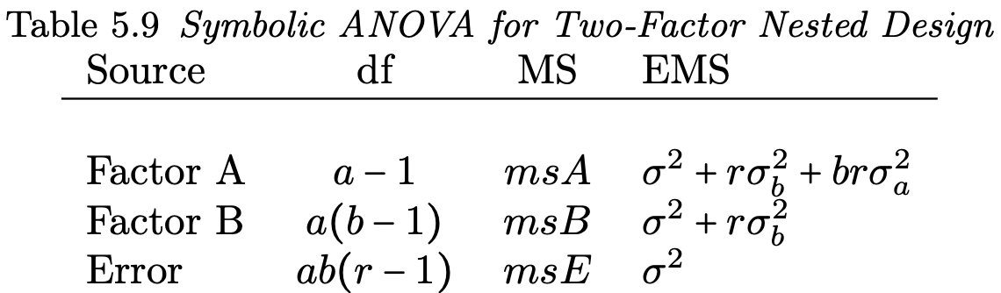
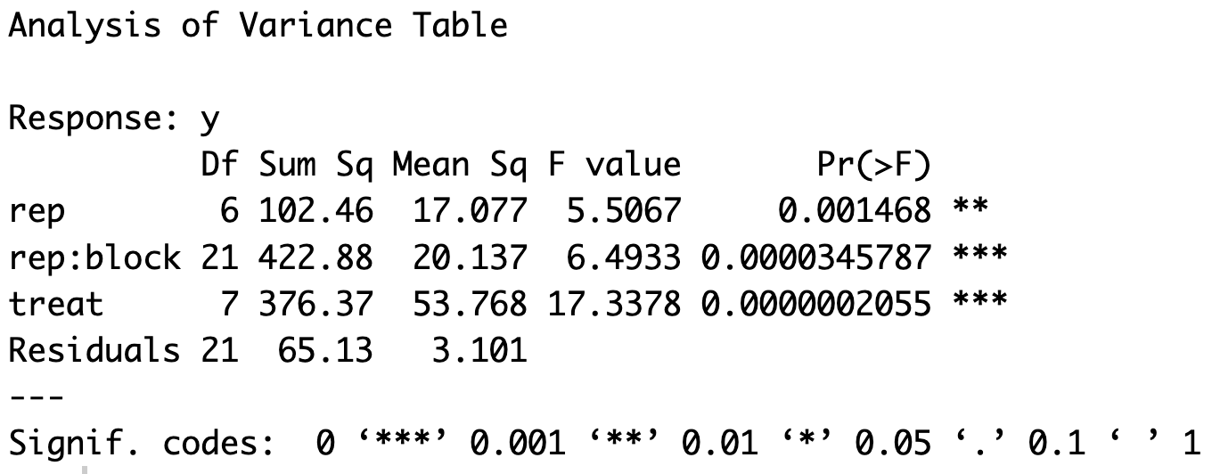
Resolvable designs
y_{ijk} = μ + r_{k} + b_{j(k)} + t_{i} + e_{ij(k)}
y_{ij} = μ + b_{j} + t_{i} + e_{ij}
What is k?

Slide 13
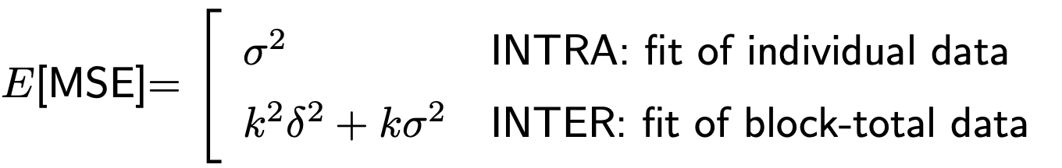
Fixed vs random
Block as a fixed effect: intra-block analysis
treatment information only from within-block comparisons
Block as a random effect: inter-block analysis
comparisons are confounded with unknown block effects

Slide 14
Packages for experimental design
Several Packages on DoE https://cran.r-project.org/web/views/ExperimentalDesign.html
Alpha Lattice on FieldHub https://cran.r-project.org/web/packages/FielDHub/vignettes/alpha_lattice.html
Analysis of ABD (https://aravind-j.github.io/augmentedRCBD/index.html)
MrBean (https://beanteam.shinyapps.io/MrBean_BETA/)

