Slide 1
AGST 50104 EXPERIMENTAL DESIGN
Review – CRD, Factorial Design, and RCBD
Notes:
f

Slide 2
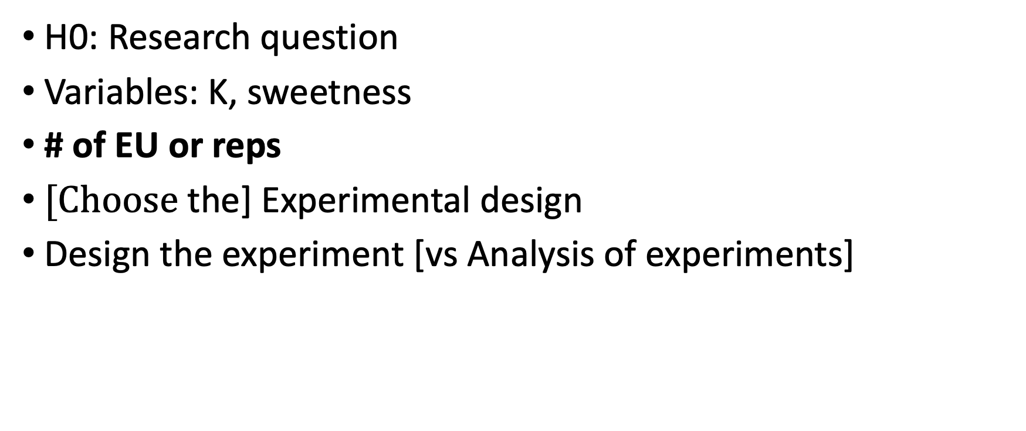
Doses of K vs blackberry sweetness
H0: Research question
Variables: K, sweetness
# of EU or reps
$[Choose \text{the}\text{] }\text{Experimental} \text{design}$
Design the experiment [vs Analysis of experiments]
Notes:
What is the null hypothesis;
What type of experiment I’d need to test it;
Factors/levels
# of reps, is the experimental area homogeneous?
Statistical model
Design the experiment

Slide 3
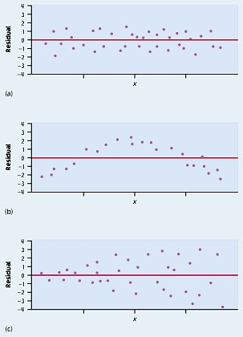
Assumptions (on the residuals not the raw data)
Residuals are randomly scattered → good!
Curved pattern → the relationship is not linear.
Change in variability across plot → σ not equal for all values of x.

Slide 4
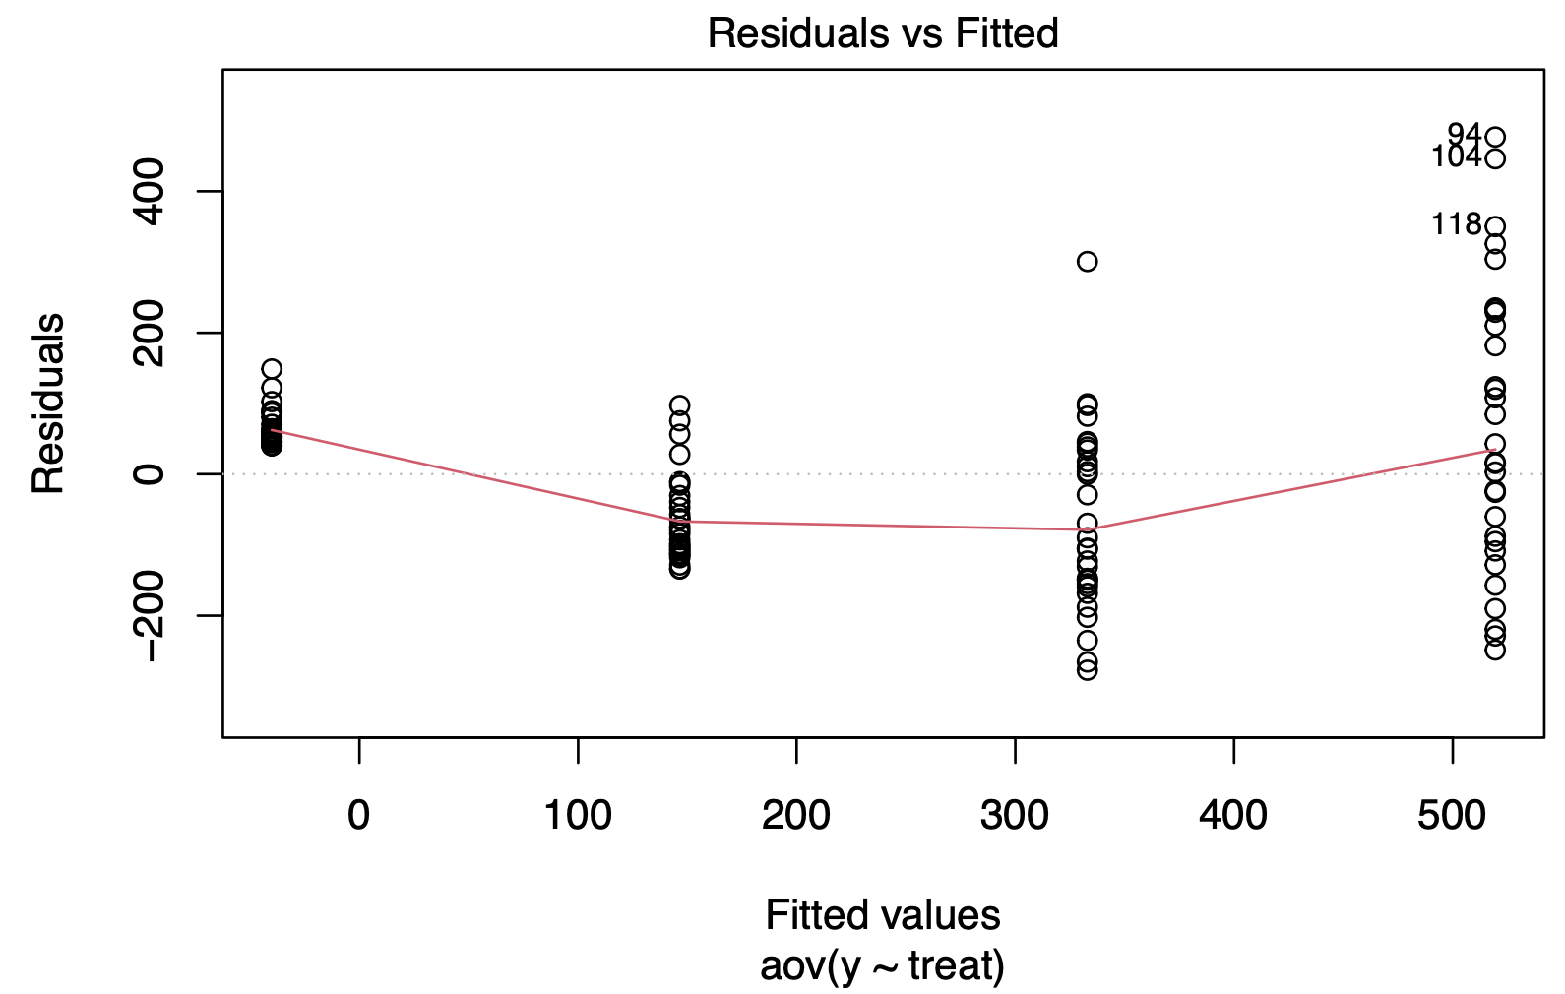
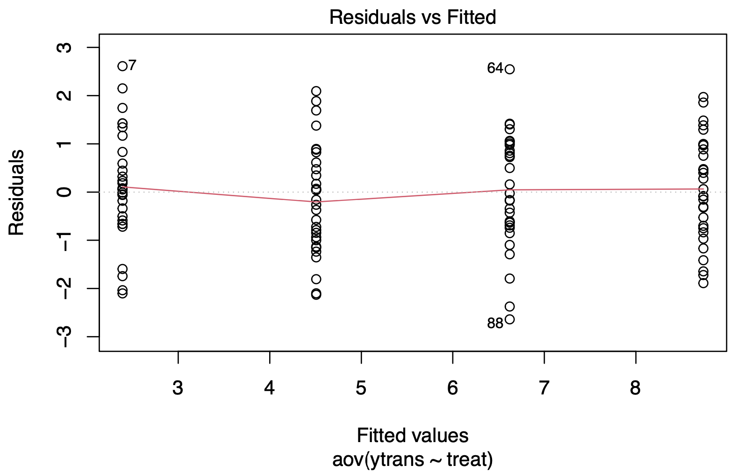
Diagnostic Plots

Slide 5
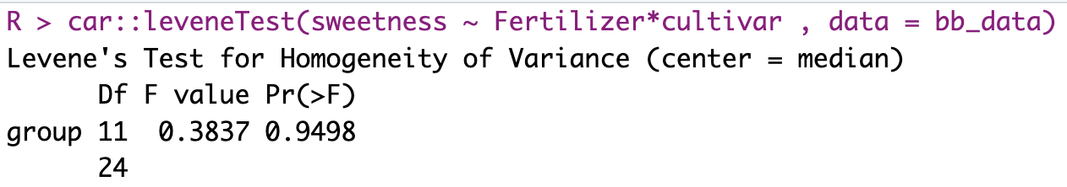
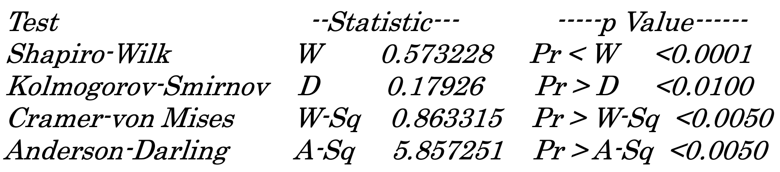
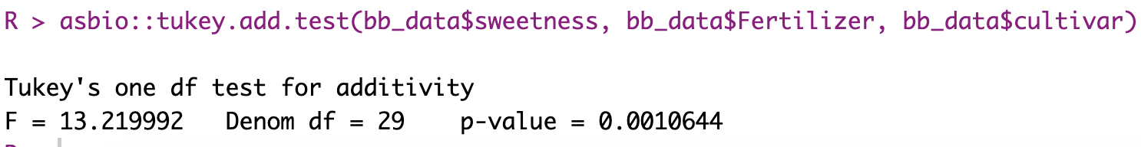
Statistical tests

Slide 6
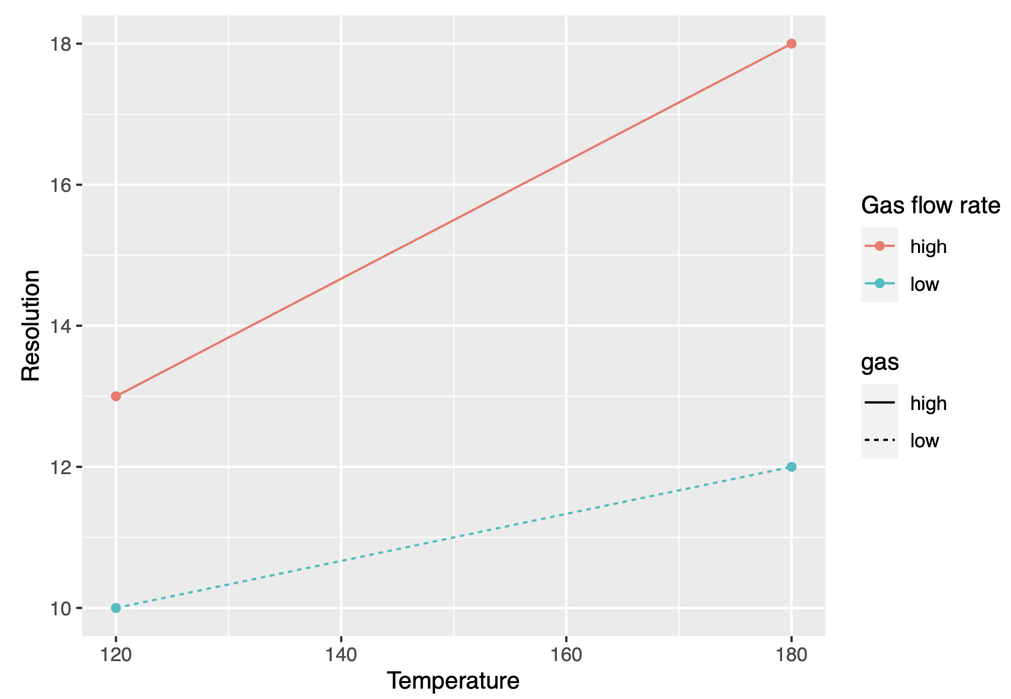
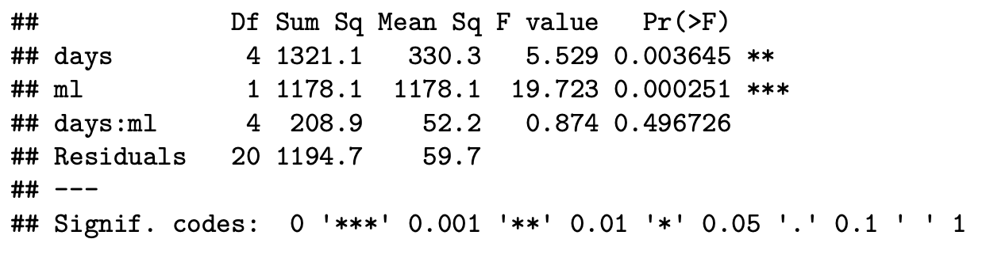
Interaction
Do we have interaction in the model?
No need for an interaction plot

Slide 7
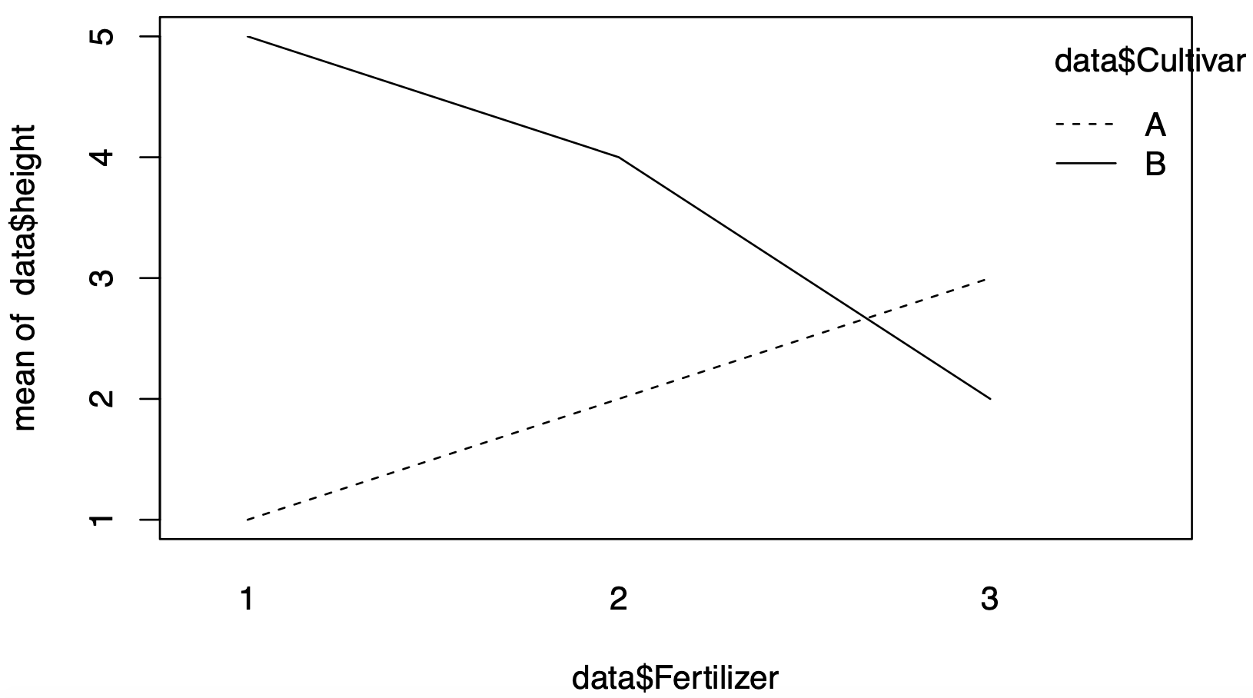
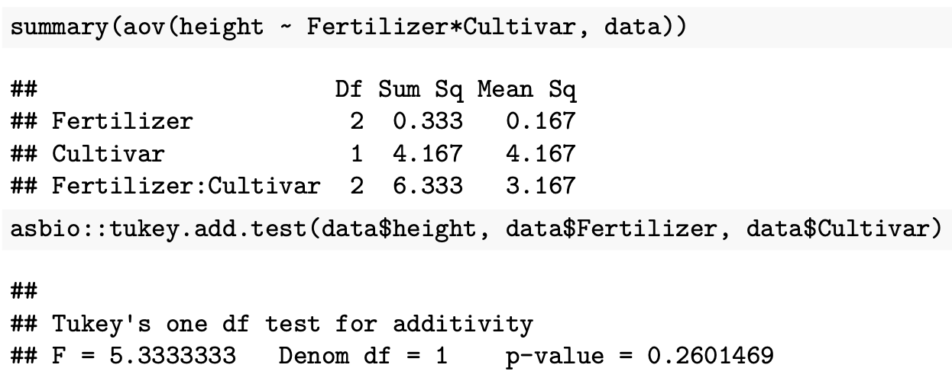
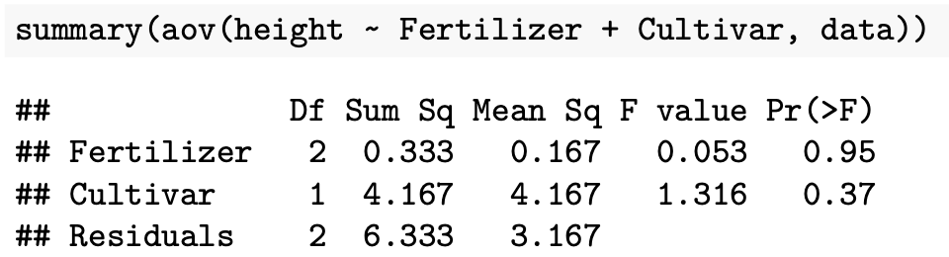
Interaction
Do we have interaction?

Slide 8
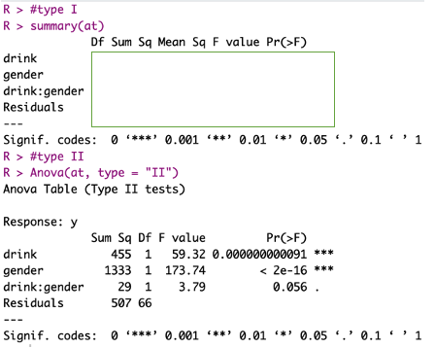
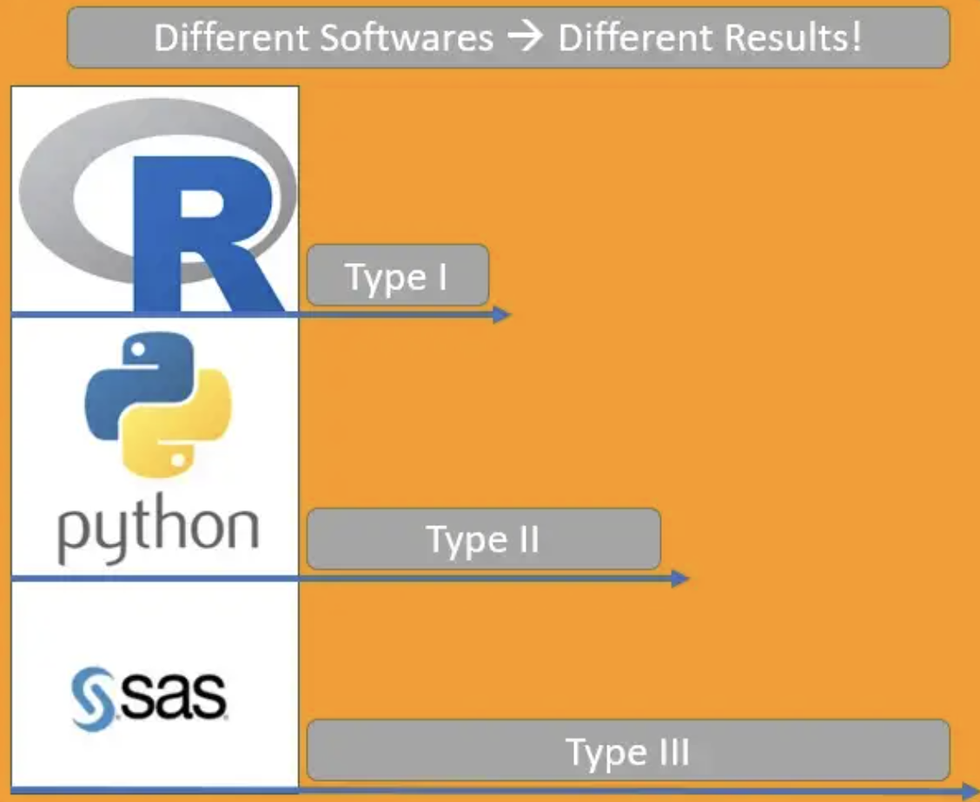
Type I vs Type II and III [Balanced data]
Source: link

Slide 9
Type I vs Type II and III [unbalanced data]

Slide 10

What design does this model represent?
1- $\text{Y}\text{ij}\text{k}\text{ =}μ+$⍺$i+βj+\text{⍺}βij+εijk$
2- $\text{Y}\text{ij} \text{=}μ+bi+\text{⍺}j+εij$
3- $\text{Y}\text{ij} \text{=}μ+\text{⍺}i+εij$
$\text{4}\text{−} \text{Y}\text{ij} \text{=}μi+εij$
$\text{5− }\text{Y}\text{ij}\text{k}\text{ =}μ+bi+$⍺$j+βk+\text{⍺}βjk+εijk$
→ Factorial CRD
→ RCBD
→ CRD
→ CRD
→ Factorial RCBD

Slide 11


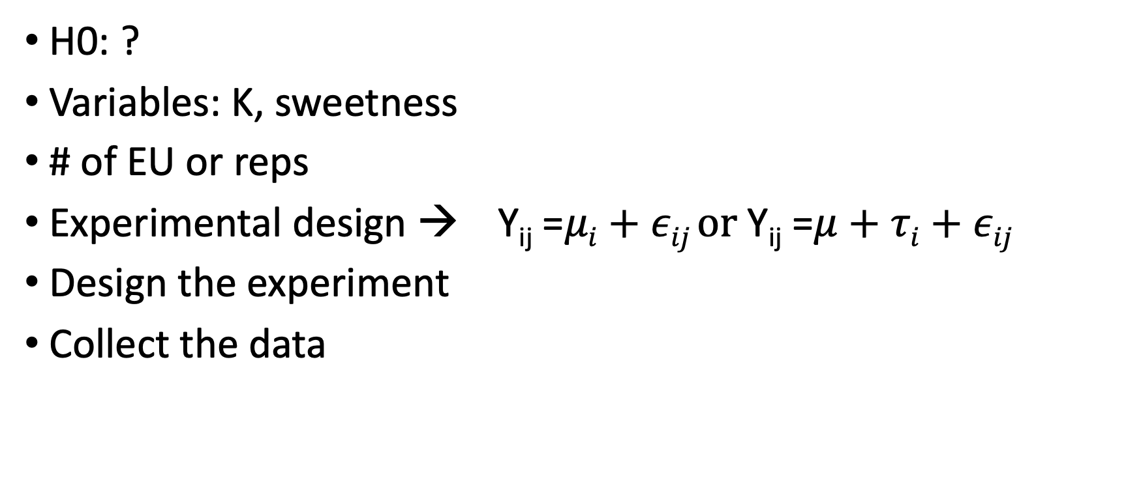
Doses of K vs blackberry sweetness
H0: ?
Variables: K, sweetness
# of EU or reps
$\text{Experimental} \text{design} → \text{Y}\text{ij}\text{ =}μi+εij \text{or} \text{Y}\text{ij}\text{ =}μ+τi+εij$
Design the experiment
Collect the data
Notes:
What is the null hypothesis;
What type of experiment I’d need to test it;
Factors/levels
# of reps, is the experimental area homogeneous?
Statistical model
Design the experiment

Slide 12
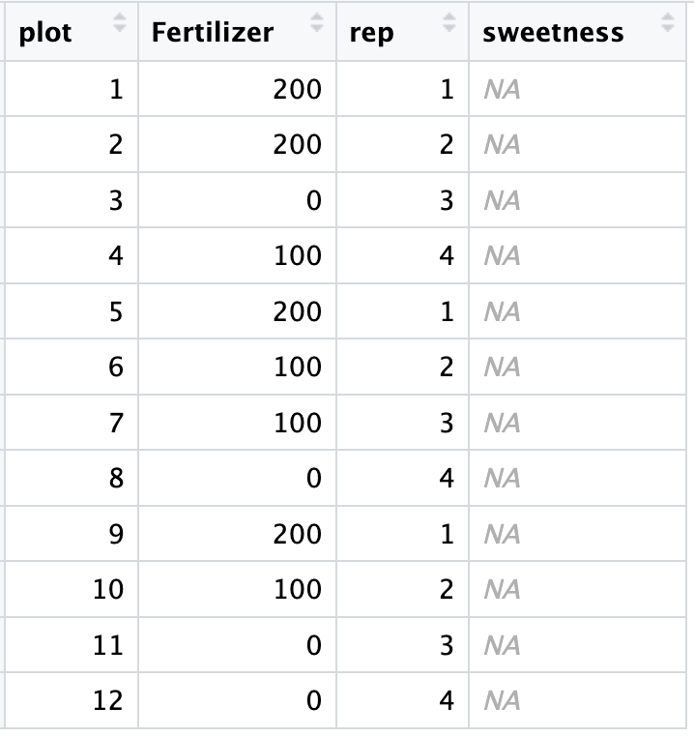
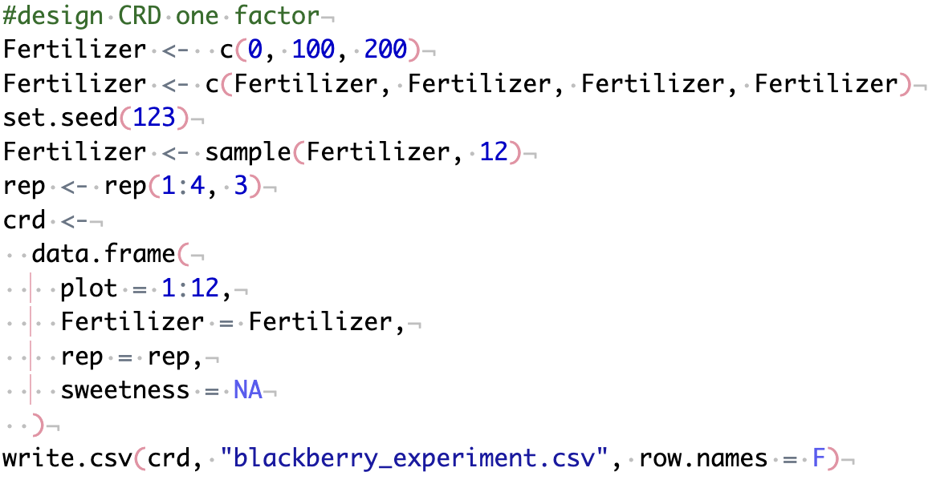
Design an experiment with one factor

Slide 13
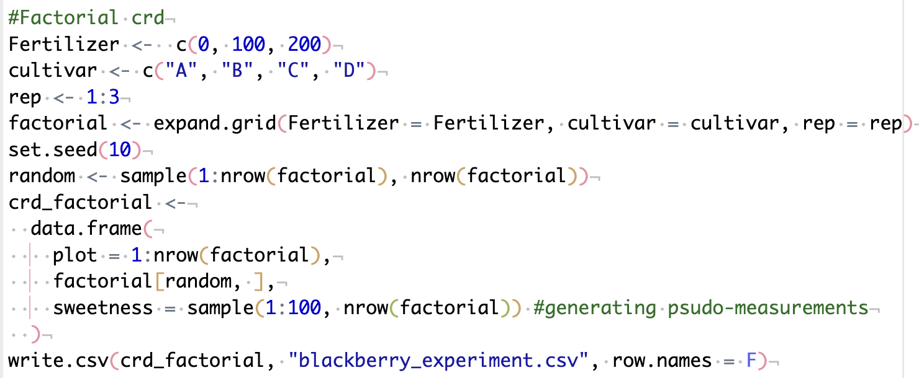
Design an experiment with multiple factors

Slide 14
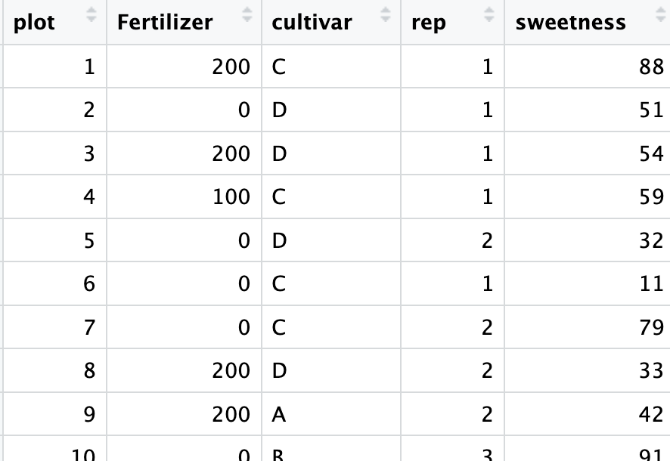
Field layout:

Slide 15
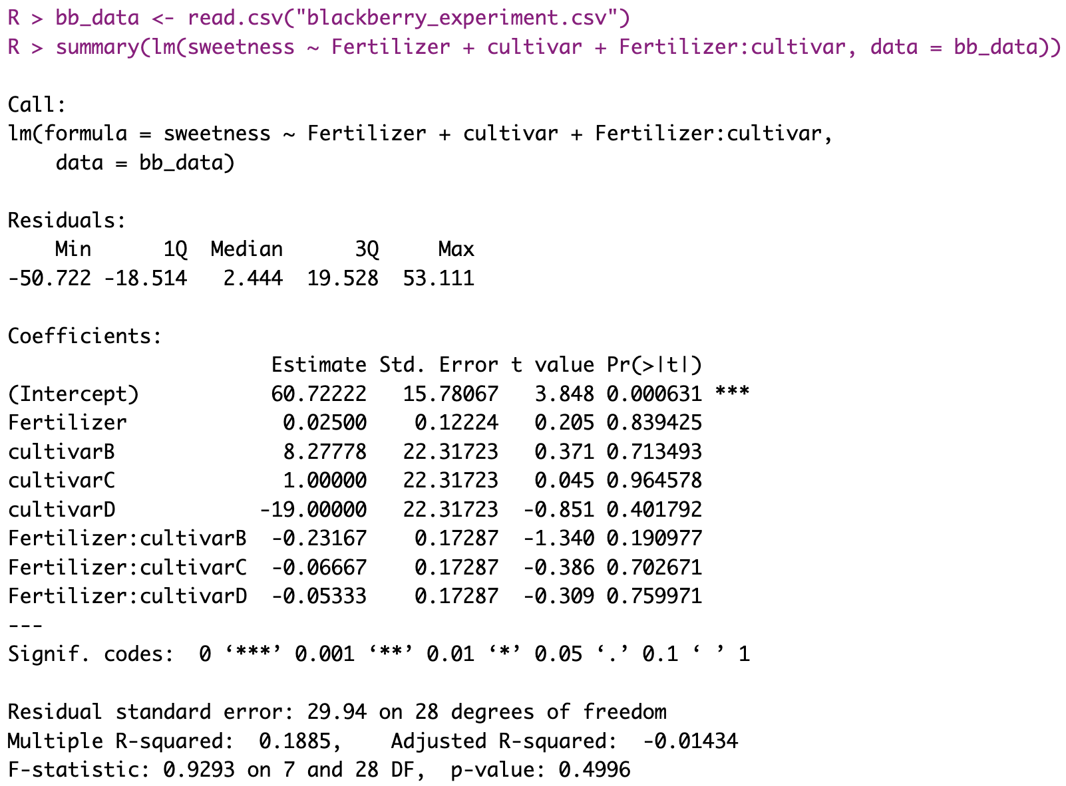

Slide 16
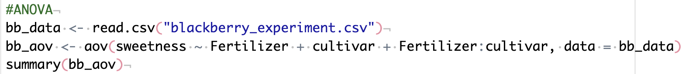
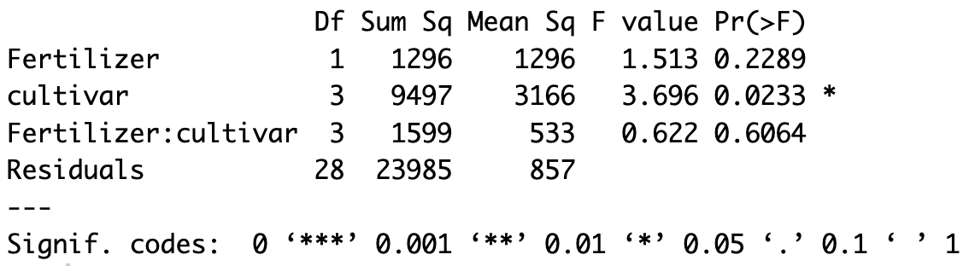
ANOVA: are we missing something?

Slide 17
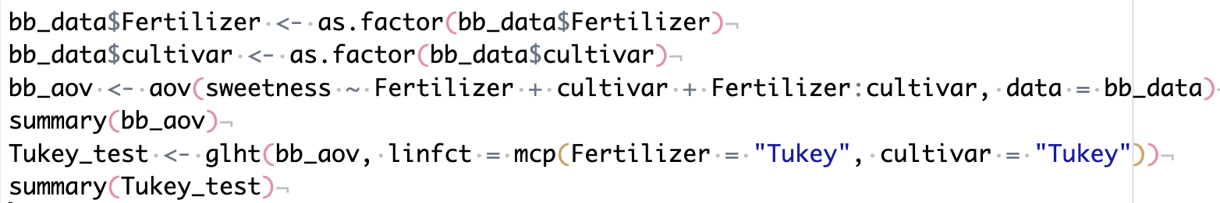
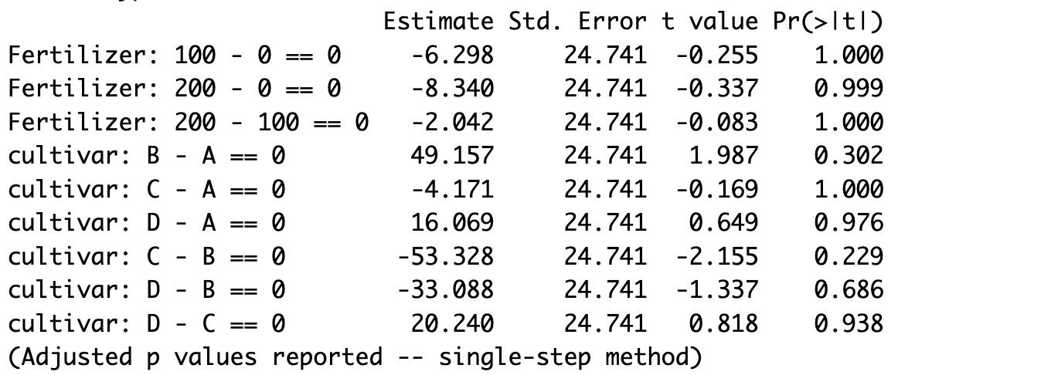
ANOVA: are we still missing something?

Slide 18
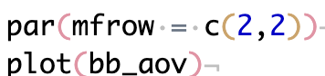
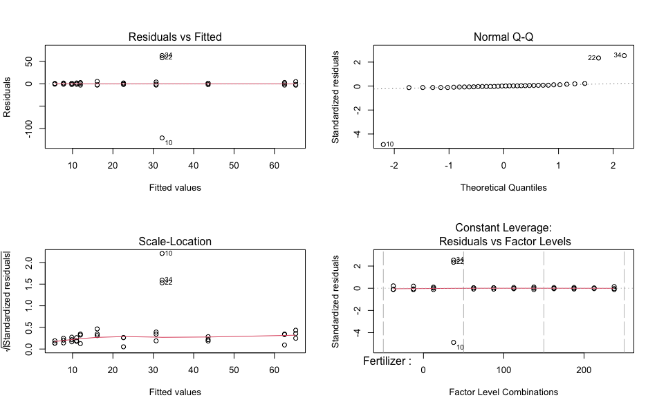

Slide 19
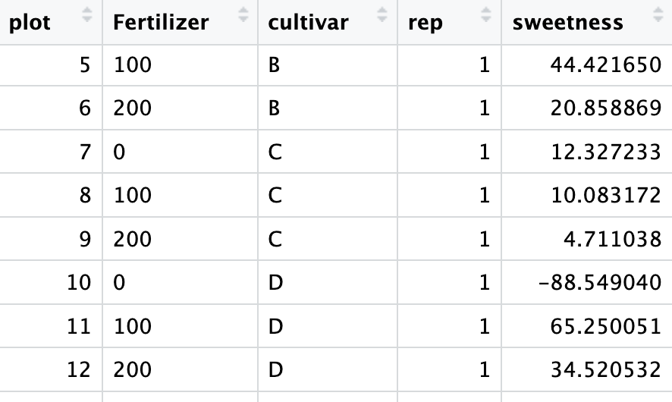

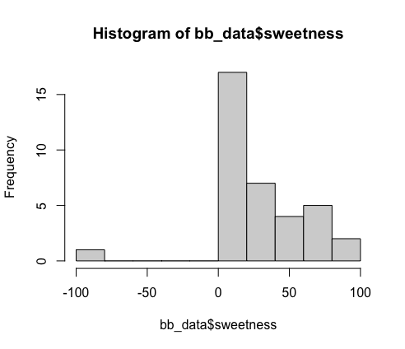
OUTLIER

Slide 20
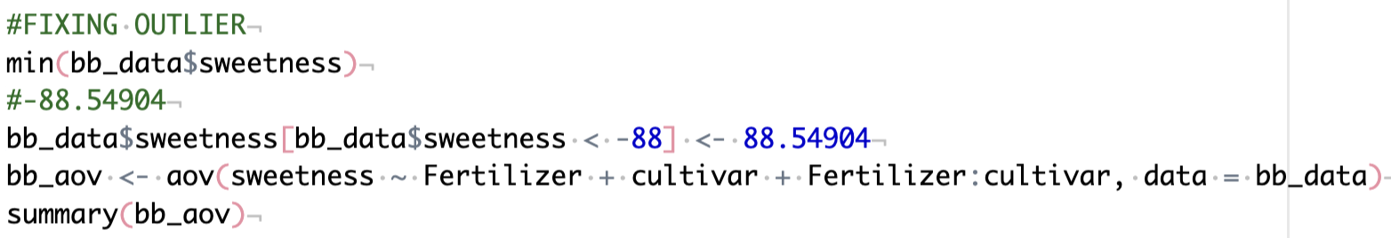
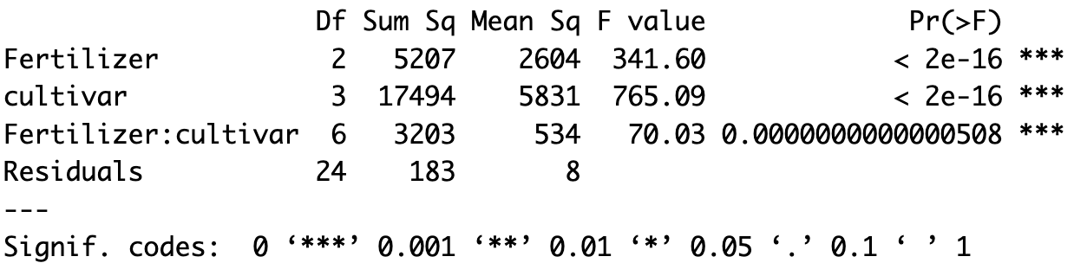
ANOVA without outlier
Before

Slide 21
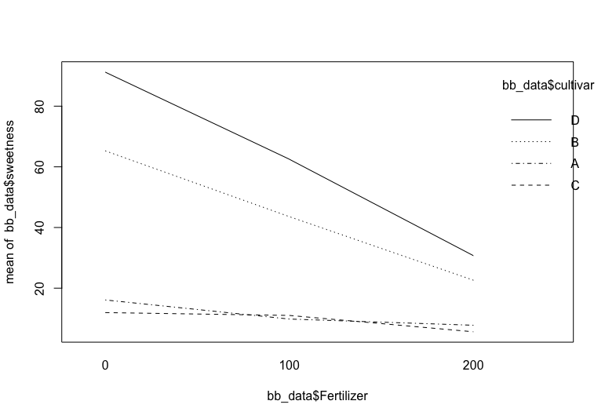
Interaction plot

