Slide 1

AGST 50104 Experimental Design
Samuel B. Fernandes, Ph.D. E-mail: samuelbf@uark.edu

Slide 2
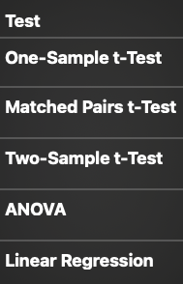
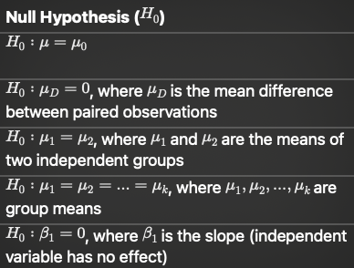
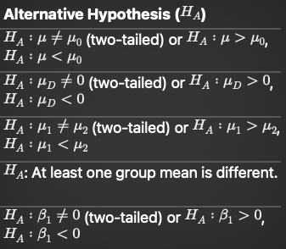
The hypothesis we test with different analysis

Slide 3
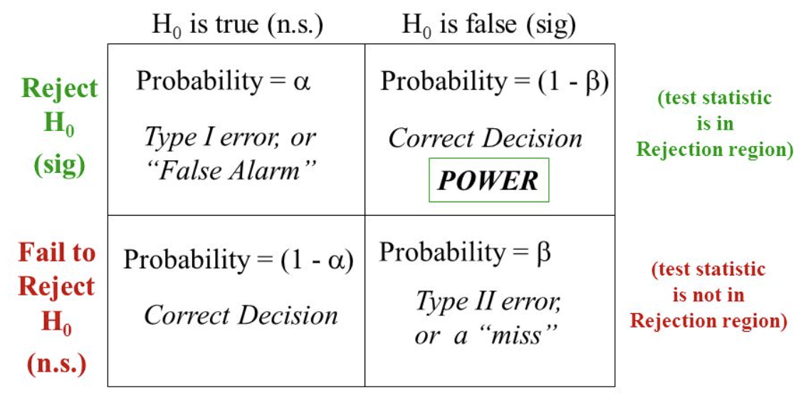
Error in Hypothesis testing
Reality
Output from R

Slide 4
Linear regression vs ANOVA
linear regression - one dependent (response) variable and one independent variable and you want to predict the value of the dependent variable based on the independent variable.
multiple linear regression - one dependent variable and multiple independent variables and you want to predict the value of the dependent variable based on the independent variables.
ANOVA - one dependent variable and you want to compare the means of multiple groups (any number of dependent variables).
Numeric independent variables
Categorical (Factors) independent variables

Slide 5
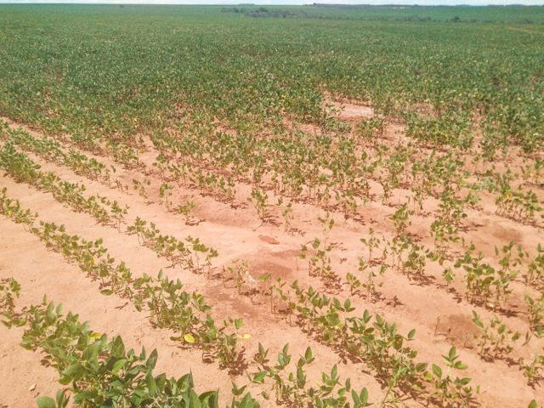
When should we use a CRD?
n = Experimental units (EU)
t = Treatments
r = reps
n = tr
Pseudo-rep! It is in the same experimental unit.
It doesn’t fix the lack of replication.

Slide 6
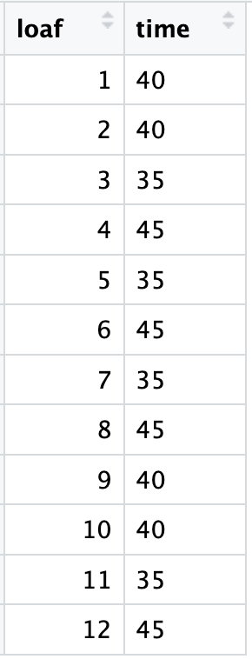
Example data sets
Rise times in bread:
35 minutes, 40 minutes, and 45 minutes
4 reps
Times of planting
no NPK
NPK applied in January
NPK applied in April
Regression vs ANOVA

Slide 7
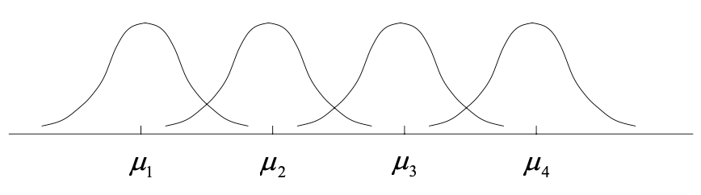
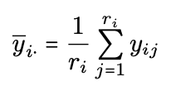




Linear Model for CRD
$\text{Y}\text{ij}\text{ =}μi+εij$
$\text{Y}\text{ij}\text{ =}μ+τi+εij$

Slide 8

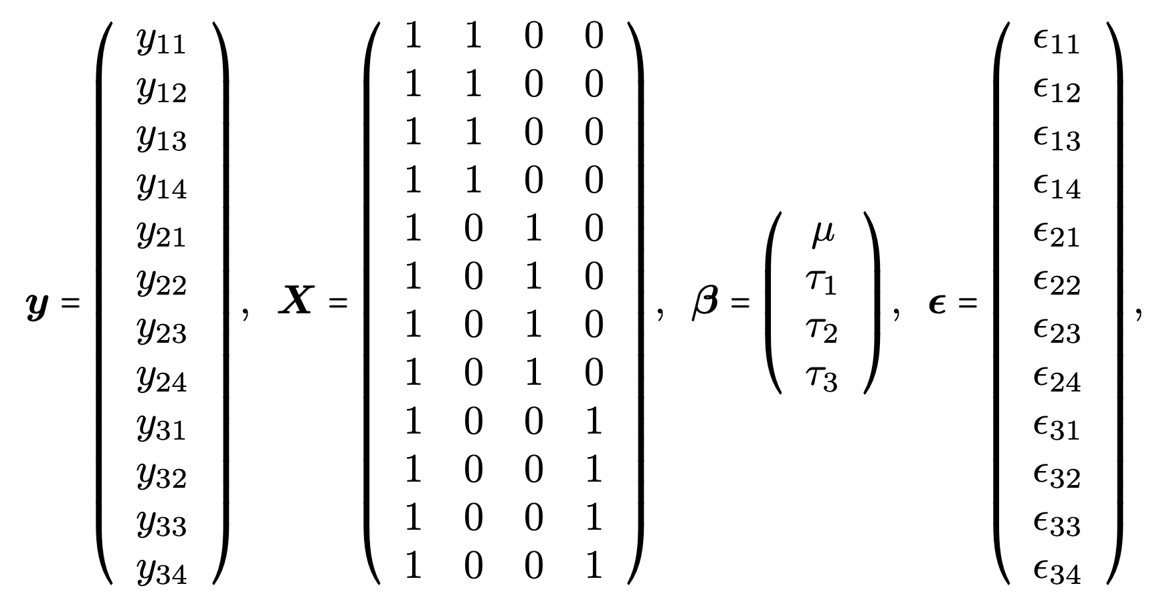

Linear Model in Matrix form
$\text{y}\text{ =}Xβ+ε$

Slide 9

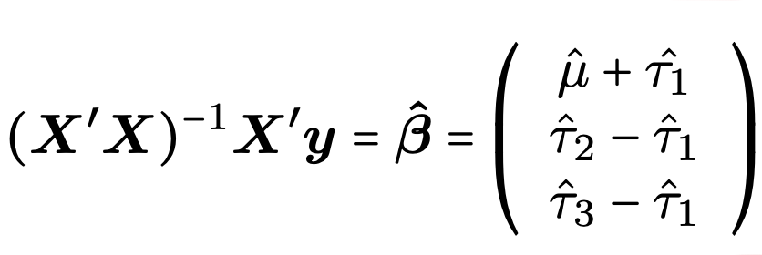
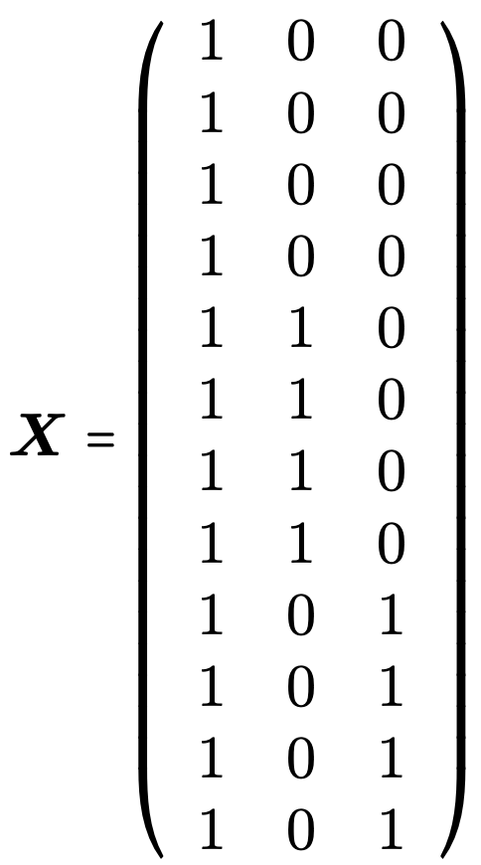
Normal equations and constraints
→
→

Slide 10
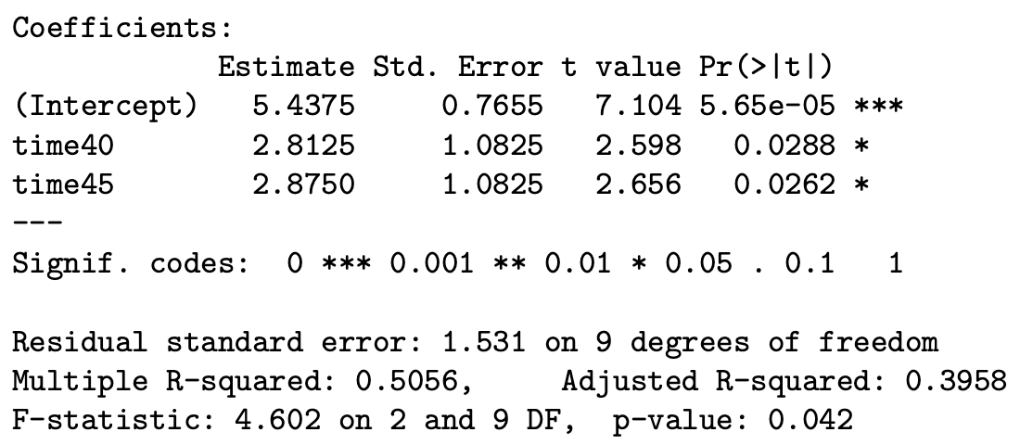
The bread rise example
mod0 <- lm( height ~ time, data = bread )
summary( mod0 )

Slide 11
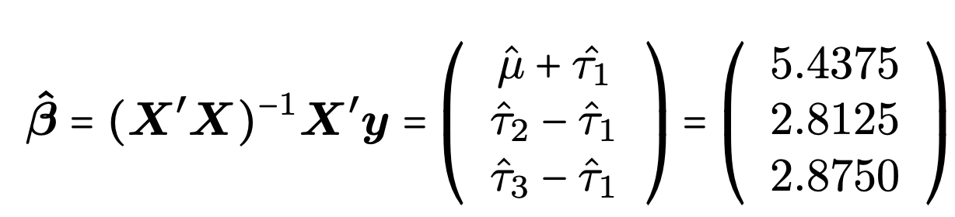
The bread rise example

Slide 12
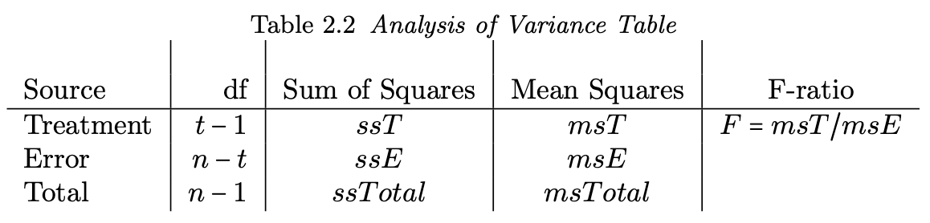
Hypothesis testing
H0 ∶ μ₁ = μ₂ =...=μ_{t} or τ₁ =τ₂ =...=τ_{t}
If H0 is true: y_{ij} = μ_{i}+ε_{ij} = μ+τ_{i}+ε_{ij} → y_{ij} = μ + ε_{ij}
Under the null hypothesis, the F-ratio msT /msE follows the F-distribution with t − 1 and n − t degrees of freedom

Slide 13
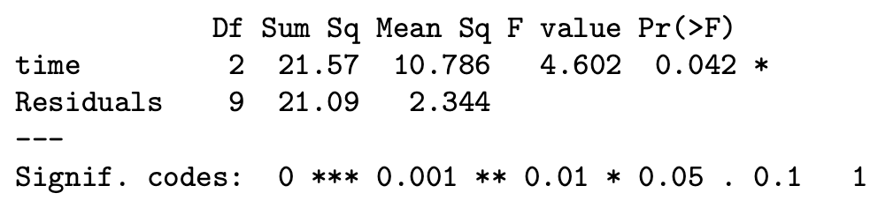

Analysis of Variance (ANOVA)
mod1 <- aov( height ~ time, data = bread ) summary(mod1)

Slide 14
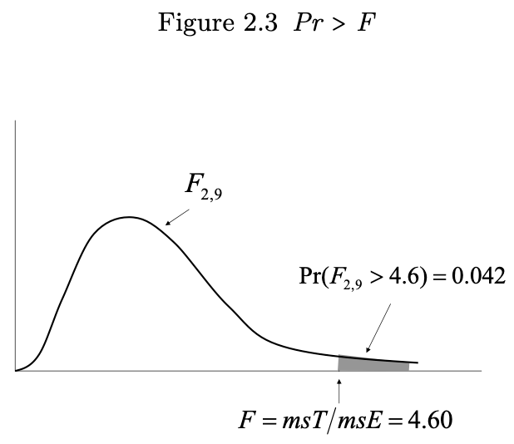
Analysis of Variance (ANOVA)

