Slide 1

AGST 50104 Experimental Design
Samuel B. Fernandes, Ph.D. E-mail: samuelbf@uark.edu

Slide 2
Completely Randomized Design (CRD)

Slide 3
Side note for Normal Equations
Regular Algebra:
3x = 6
To solve for x, we undo the multiplication by dividing both sides by 3:
x = 6/3 = 2
Another way to think about this is using the multiplicative inverse of 3, which is 1/3:
(3⁻¹) * 3x = (3⁻¹) * 6 ➔ x = 2

Slide 4
Side note for Normal Equations
Matrices work similarly, but instead of dividing by a number, we multiply by something called the matrix inverse.
Suppose we have a system of equations written in matrix form:
AX = B
Where:
A is a matrix (just like a number in regular algebra),
X is what we’re solving for,
B is the result.
To solve for X, we need to get rid of A , just like we did with 3. But matrices don’t have division, so instead, we multiply both sides by the inverse of A , written as A⁻¹:
A⁻¹ AX = A⁻¹ B
Since multiplying a matrix by its inverse gives the identity matrix (like 1 in regular algebra), we get:
IX = A⁻¹B
And since I (the identity matrix) doesn’t change anything, we simplify to:
X = A-1B

Slide 5
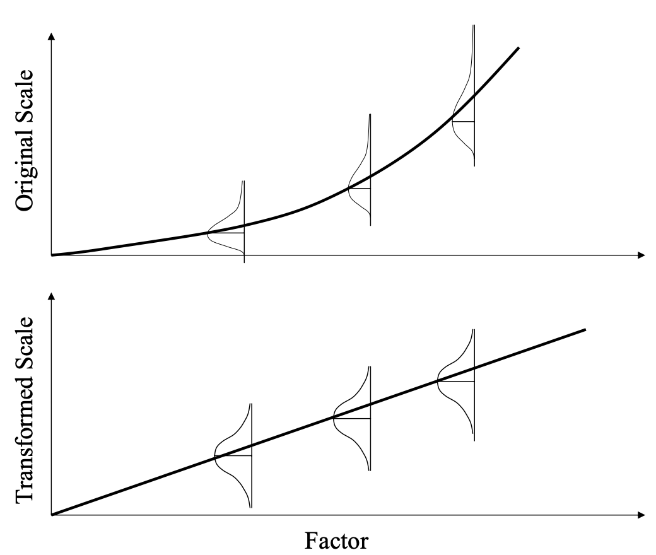

What if the assumptions are violated?
The errors:
Are independent of each other
Are normally distributed
Have a mean of 0 at all values of X
Have constant variance
(homoscedasticity)
ε~ i.i.d. N(0, σ²)

Slide 6


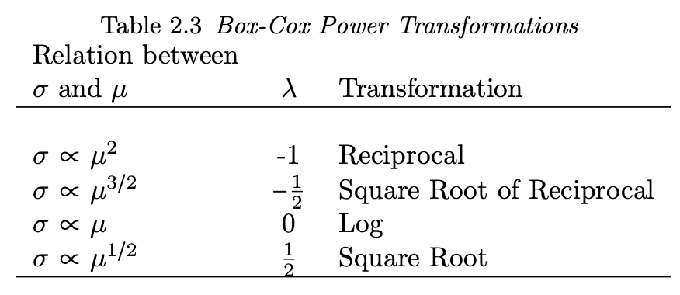
Box-Cox Power transformations
If the variance tends to increase as the mean increases, choose a value of λ less than one
If the variance tends to de- crease as the mean increases, choose a value of λ greater than one.

Slide 7
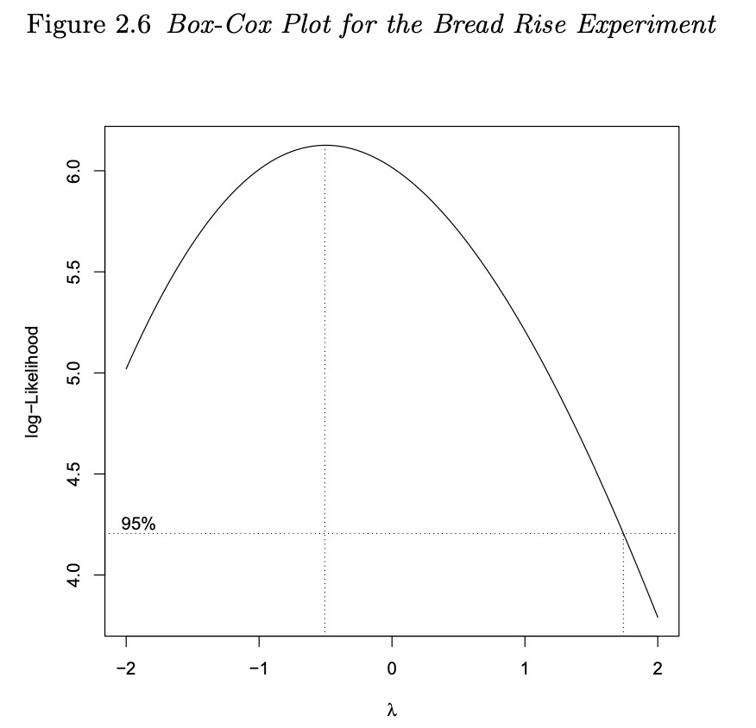
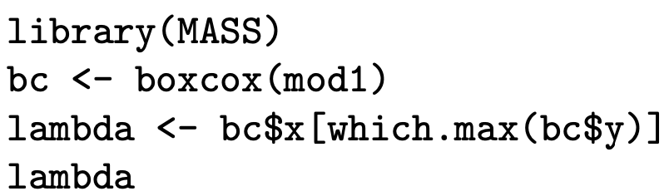

Slide 8
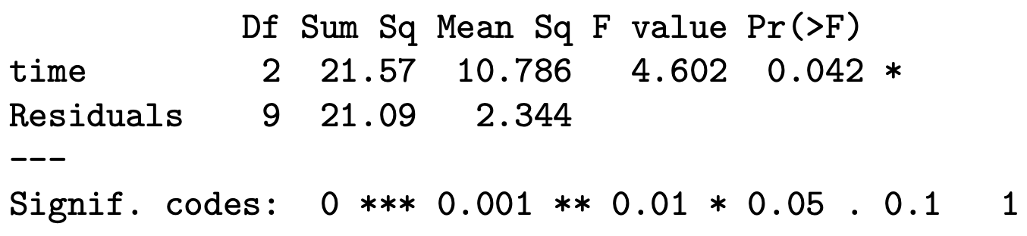
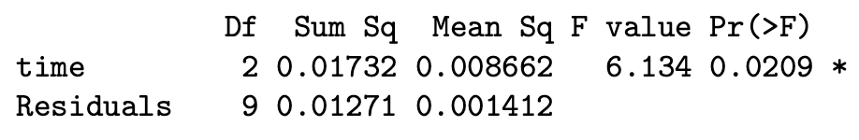
Analysis of the transformed data
Original data:
Transformed data:

Slide 9
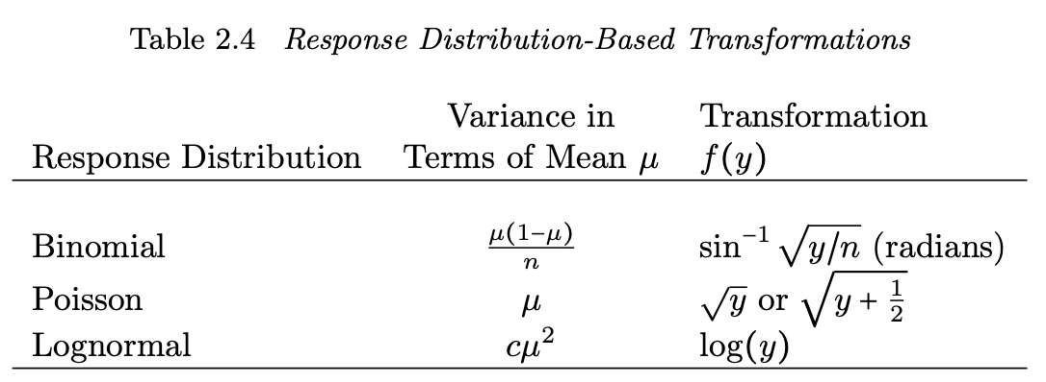
Known distribution

Slide 10

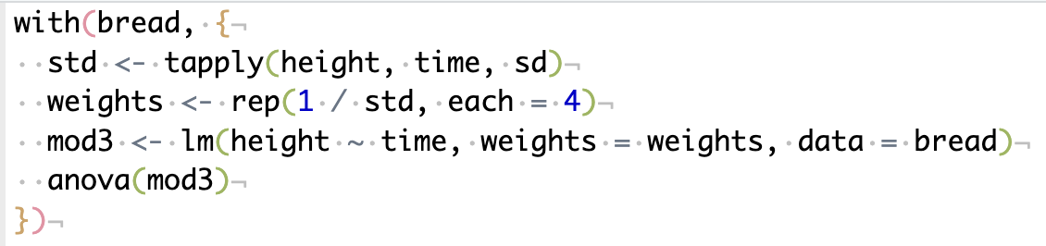
Weighted least squares
W is a diagonal matrix whose diagonal elements are the reciprocals of the standard deviation within each treatment level

Slide 11
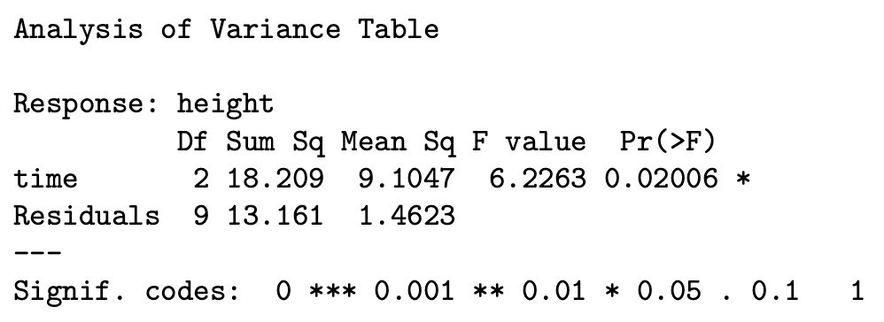
WLS vs OLS
The weighted least squares is more sensitive than the unweighted least squares

Slide 12
Generalized linear model
Must specify the error distribution and a link function in addition to the model
When the link function is the identity, and the distribution is normal, the generalized linear model analysis = OLS (ANOVA F-test)
More in future classes

Slide 13
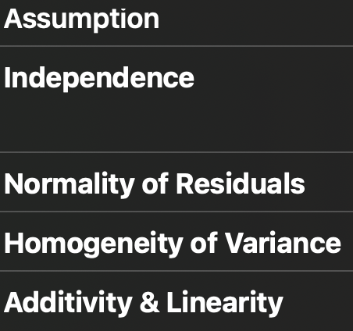
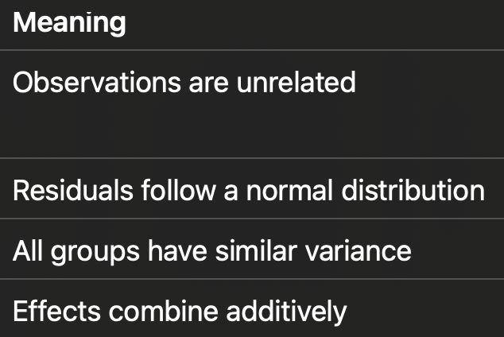
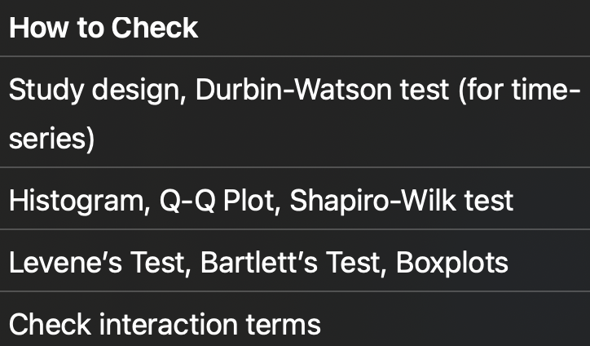
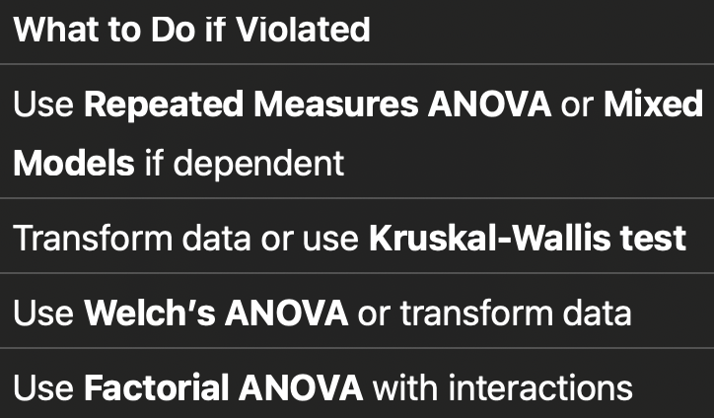
Summary Table of ANOVA Assumptions

Slide 14
Number of Replicates
Statistical significance =/= practical significance
Increasing the number of replicates increases the sensitivity of the experiment
Power: Probability of rejecting a false null hypothesis
Sensitivity: Probability of correctly identifying true positives
Power for a two-sample t-test
library(pwr)
pwr.t.test(n = 50, d = 0.5, sig.level = 0.05, type = "two.sample", alternative = "two.sided")
• n = 50 (sample size per group)
• d = 0.5 (moderate effect size)
• sig.level = 0.05 (alpha level)
• type = "two.sample" (two-sample t-test)
How to increase power?
✅ Increase sample size ( n ) → Best method.
✅ Increase effect size ( d ) → Not always possible.
✅ Increase alpha (e.g., from 0.01 to 0.05) → Higher risk of Type I error.
✅ Reduce variability (better measurement techniques, control extraneous factors).

Slide 15
Additional information
Reference
Most Figures and R codes from week 3 are coming from
Design and Analysis of Experiments with R. Lawson, 2015. ISBN 9781439868133
Another material for CRD:
https://www.theopeneducator.com/doe

