Slide 1


sMAP:
Standard Microarray Analysis Pipeline
An R Shiny Educational App for Transcriptomic Analysis
GitHub: https://github.com/BI-STEM-Away/sMAP
Documentation: https://bi-stem-away.github.io/sMAP_doc/
sMAP Website: https://bi-stem-away.github.io/sMAP/

Slide 2
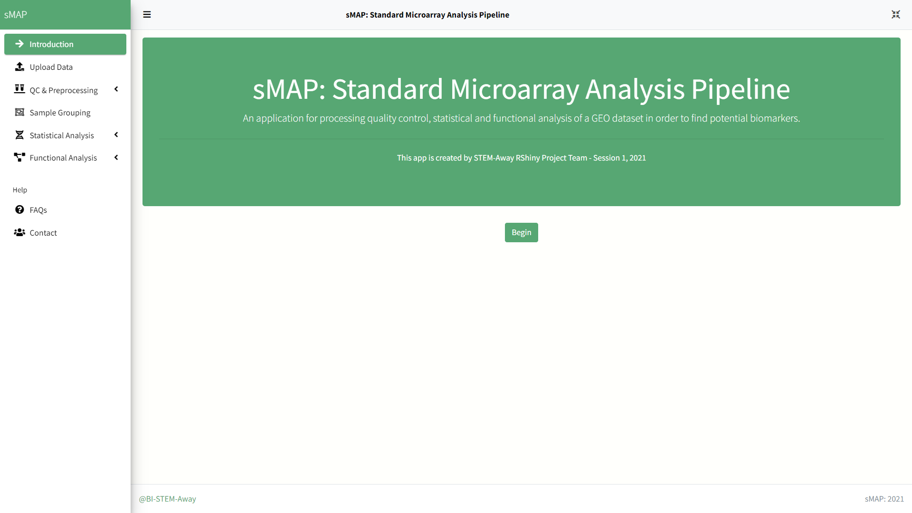
Welcome screen of sMAP
Click on Fullscreen mode for better visualization
Click on Begin to get started with sMAP.

Slide 3
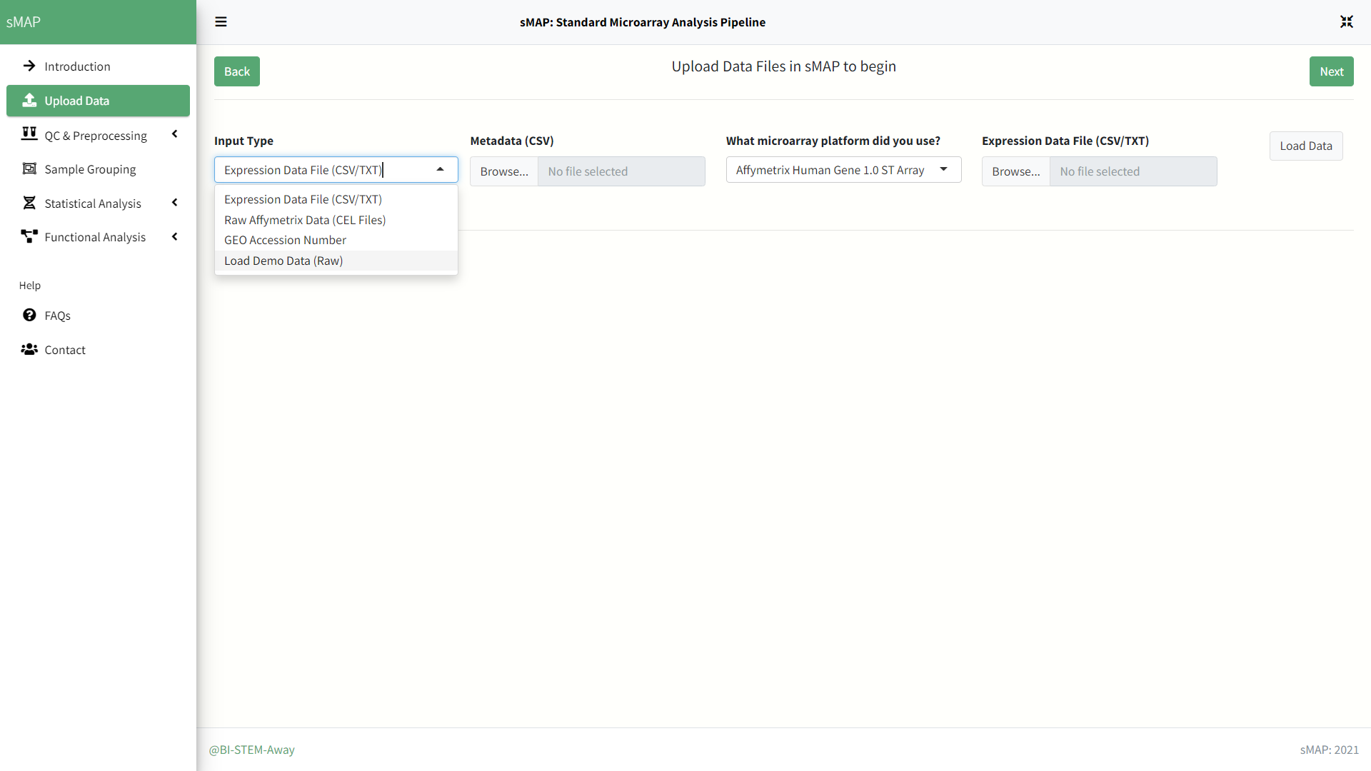
Data Importation
Select one of the 3 data input methods sMAP provides or get started with an installed demo dataset.

Slide 4
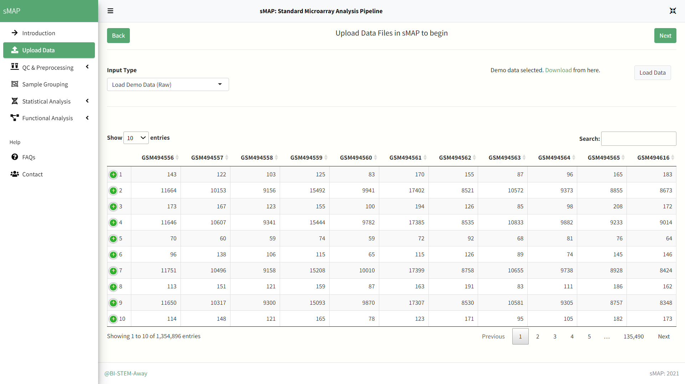
Data Loading
Click on load data after selecting input method and uploading datasets.
Here we will use demo dataset that comes installed in sMAP.

Slide 5
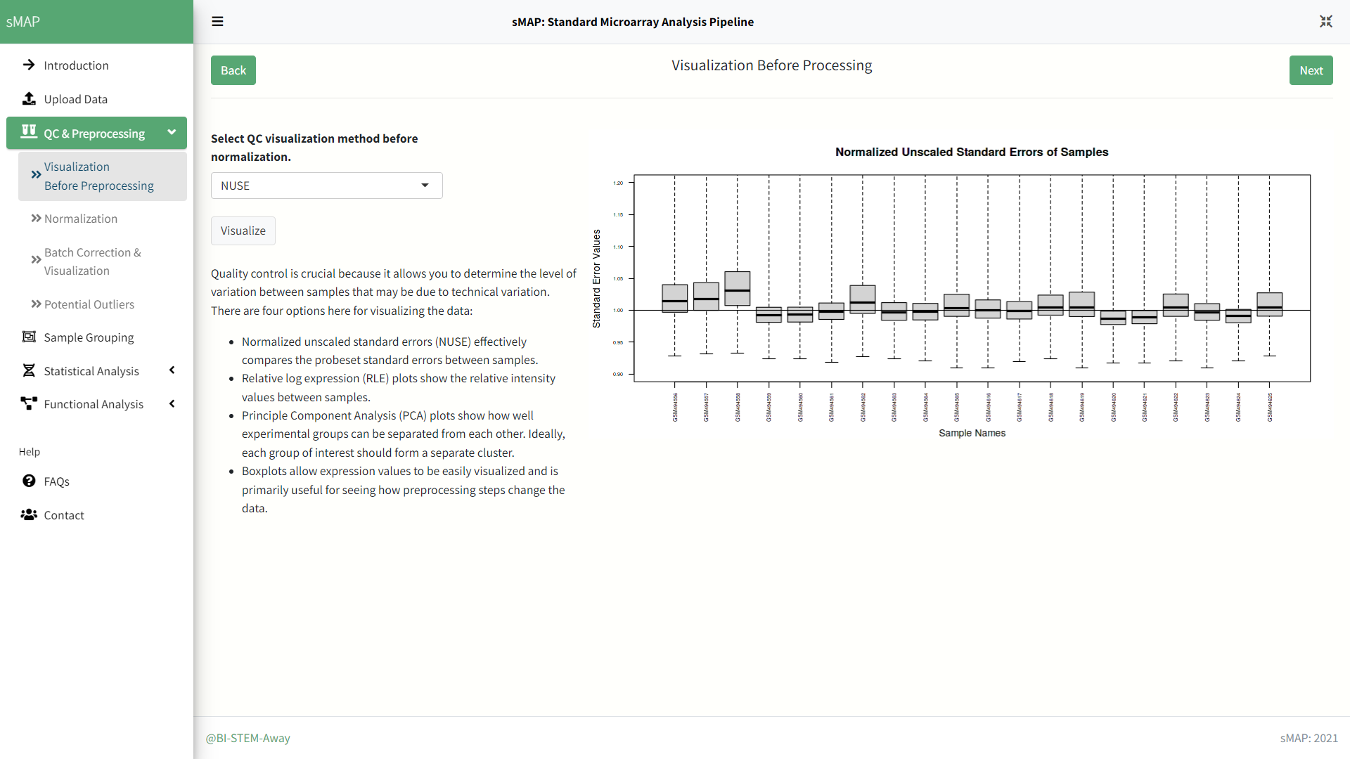
QC: Visualization of raw data before normalization
Select one of the 4 visualization methods.
Click on visualize to load the plot.

Slide 6
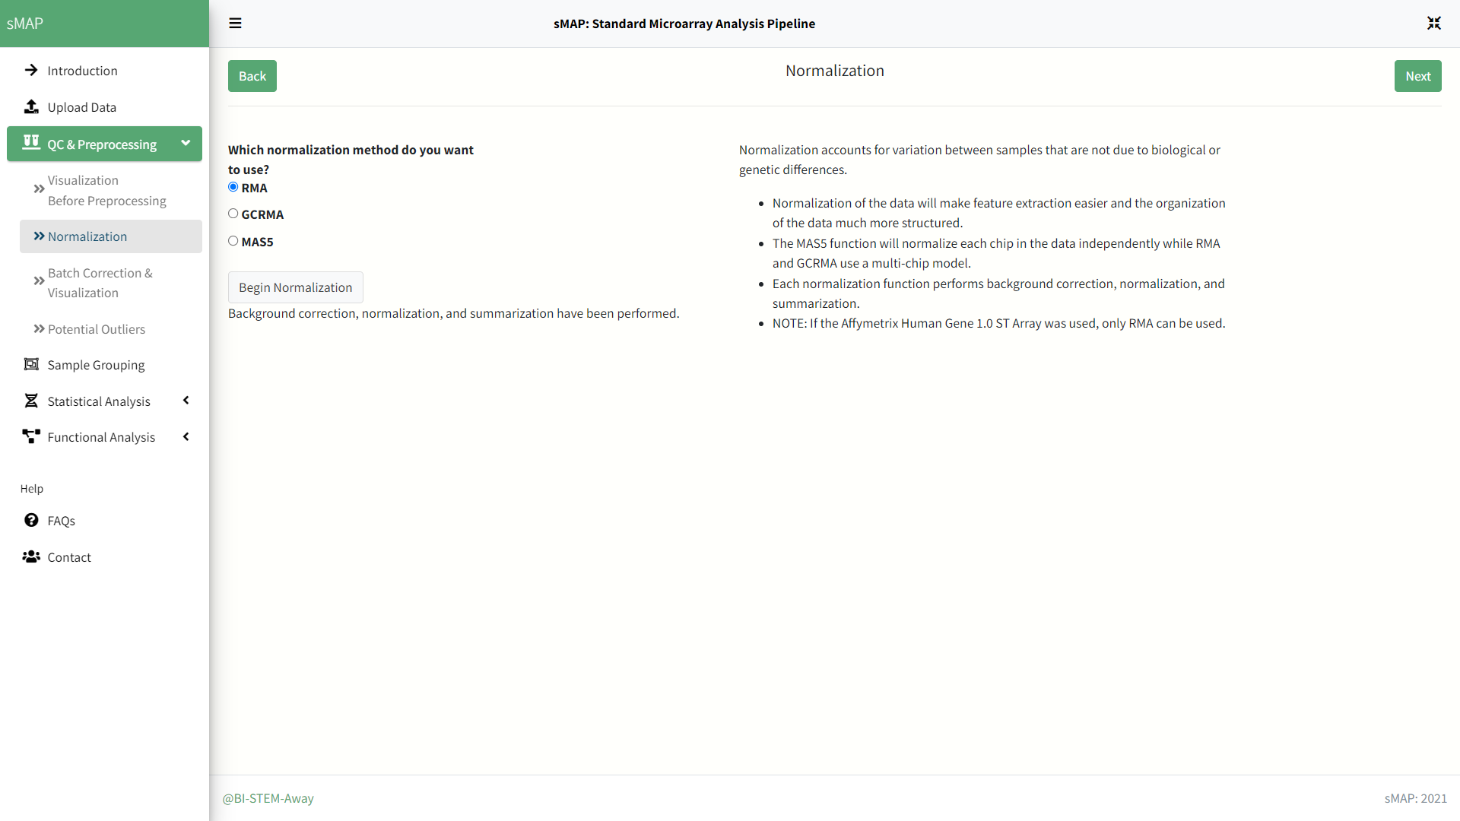
QC: Normalization of raw data
Select one of the 3 methods for normalization of raw data.
Click on begin normalization to normalize and wait for the message to appear below indicating completion..

Slide 7
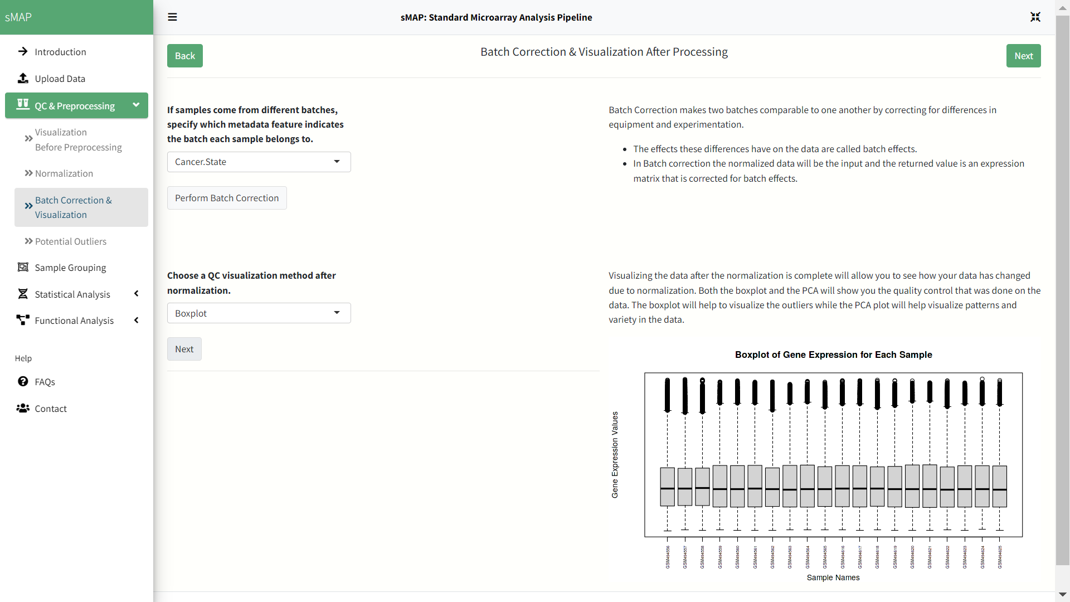
QC: Batch Correction + Visualization of normalized data
Here we will not use batch correction since demo dataset is from single batch.
Select visualization method to check data after normalization and click next to generate plot.

Slide 8
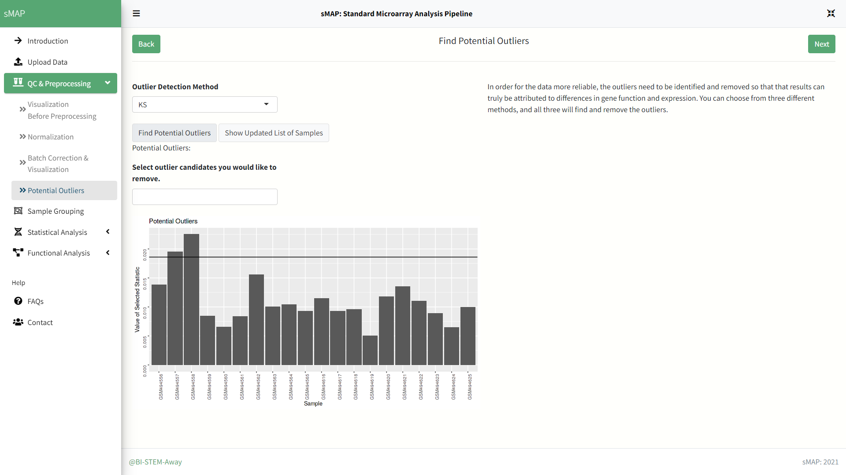
QC: Detection and remove of outliers
Find potential outliers and if need remove them from dataset.

Slide 9
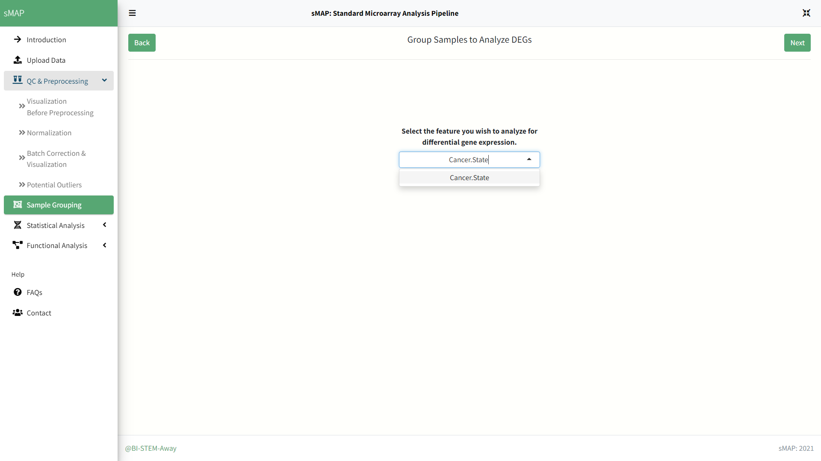
Sample Grouping for DEG Analysis
Select column name in metadata file which contains sample grouping information.

Slide 10
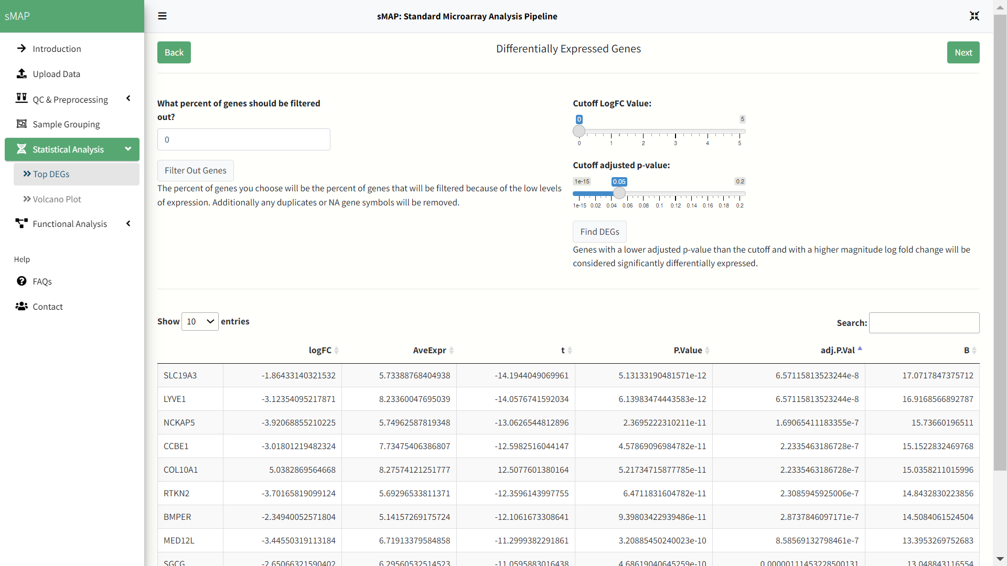
Gene Filtering and Differentially Expressed Gene Analysis
Adjust required parameters for DEG analysis.
Click on find DEGs to start analysis.
* We didn’t use gene filtering option for this demo but can be used as per requirement of user.

Slide 11
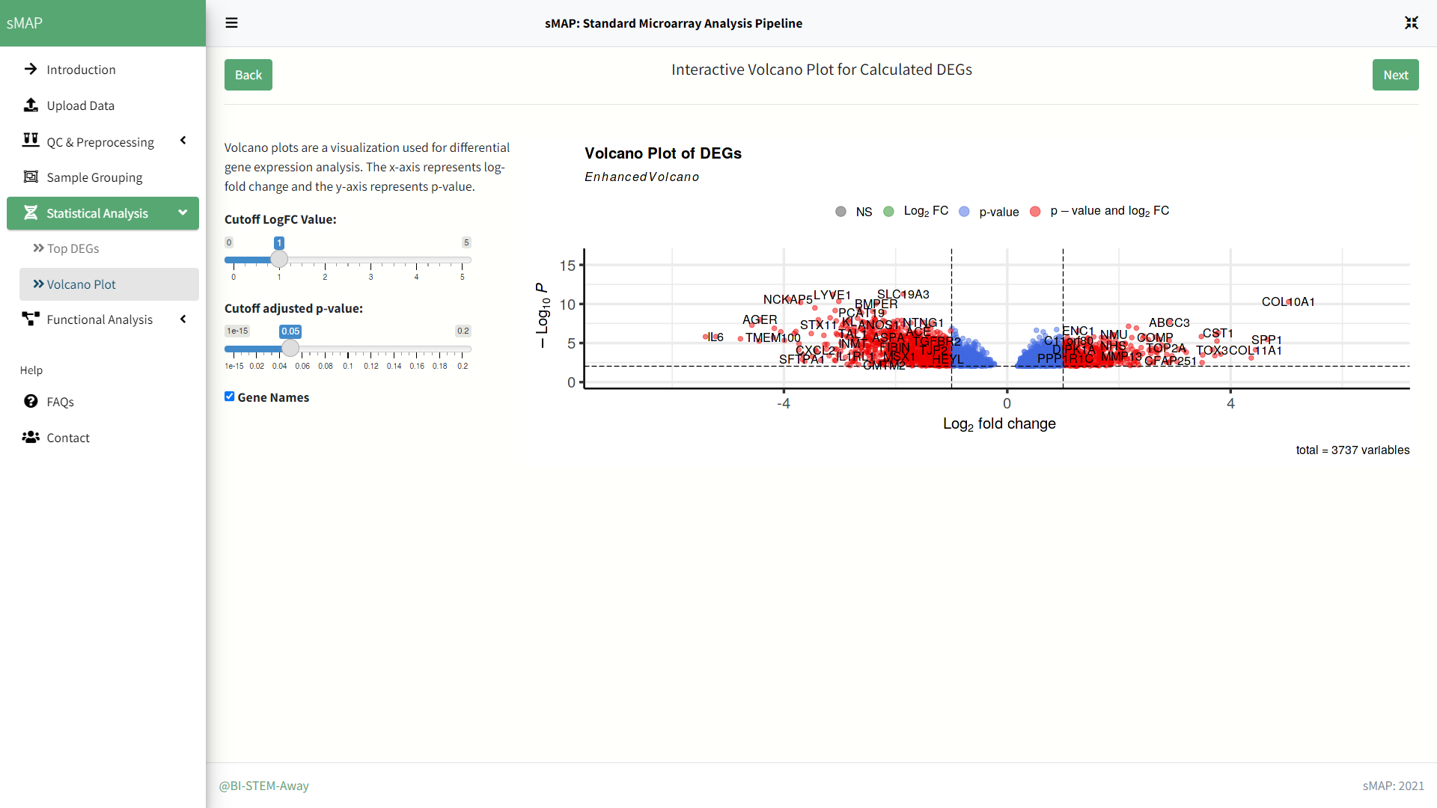
Volcano plot
Adjust parameters for volcano plot visualization and use check box to show/hide gene symbols.

Slide 12
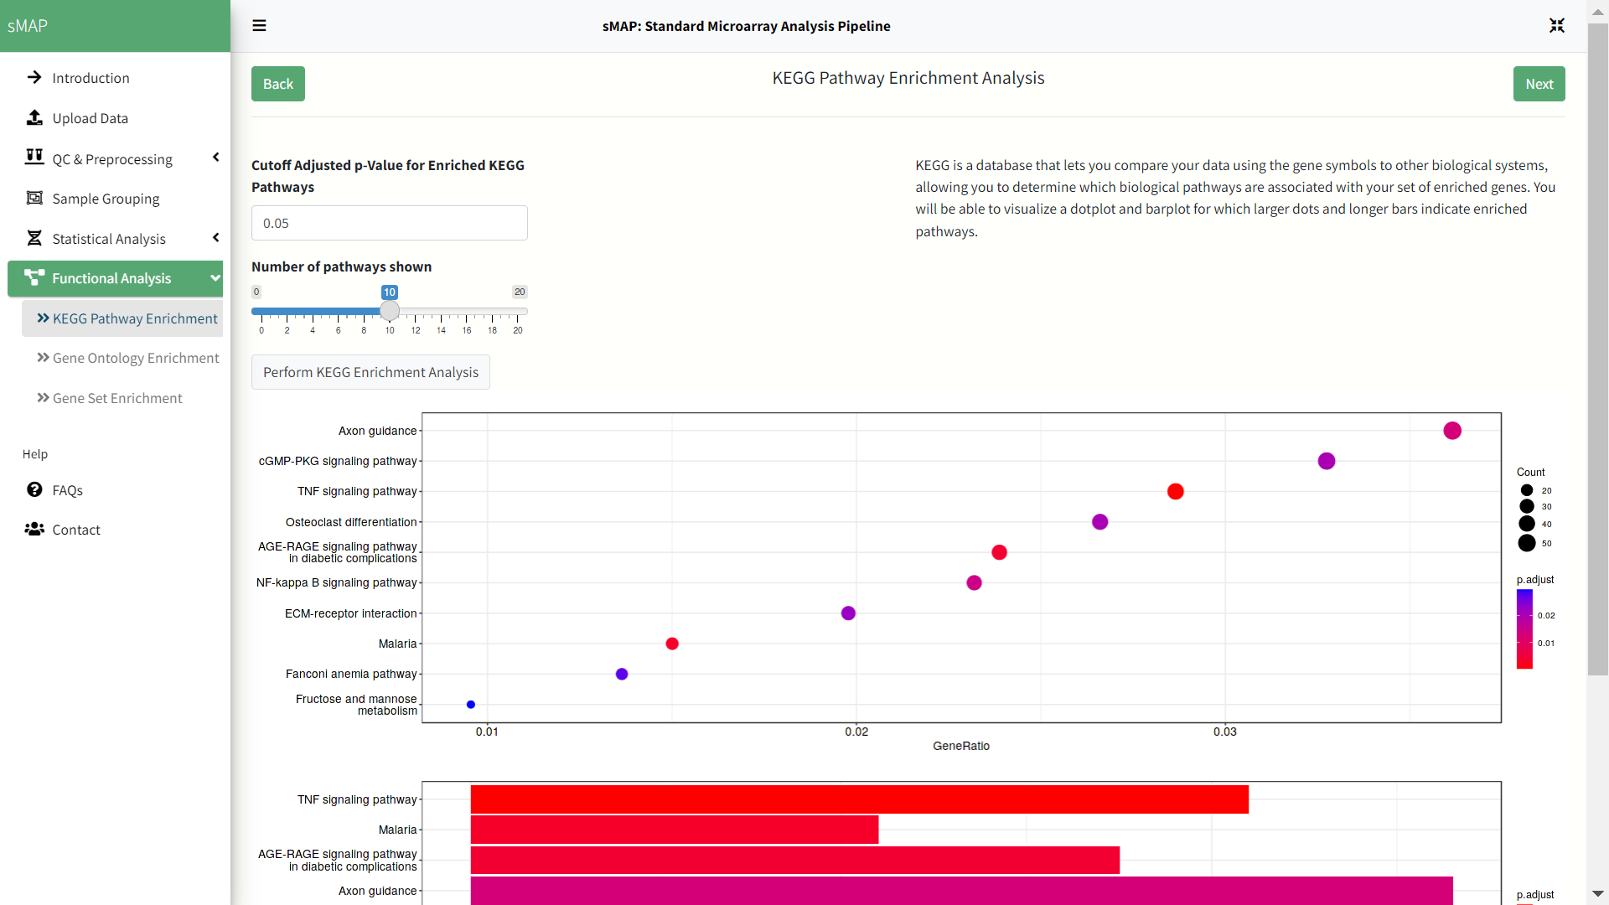
Enrichment Analysis: KEGG Pathway Enrichment Analysis
Adjust P-value and other parameters for KEGG pathway enrichment analysis.

Slide 13
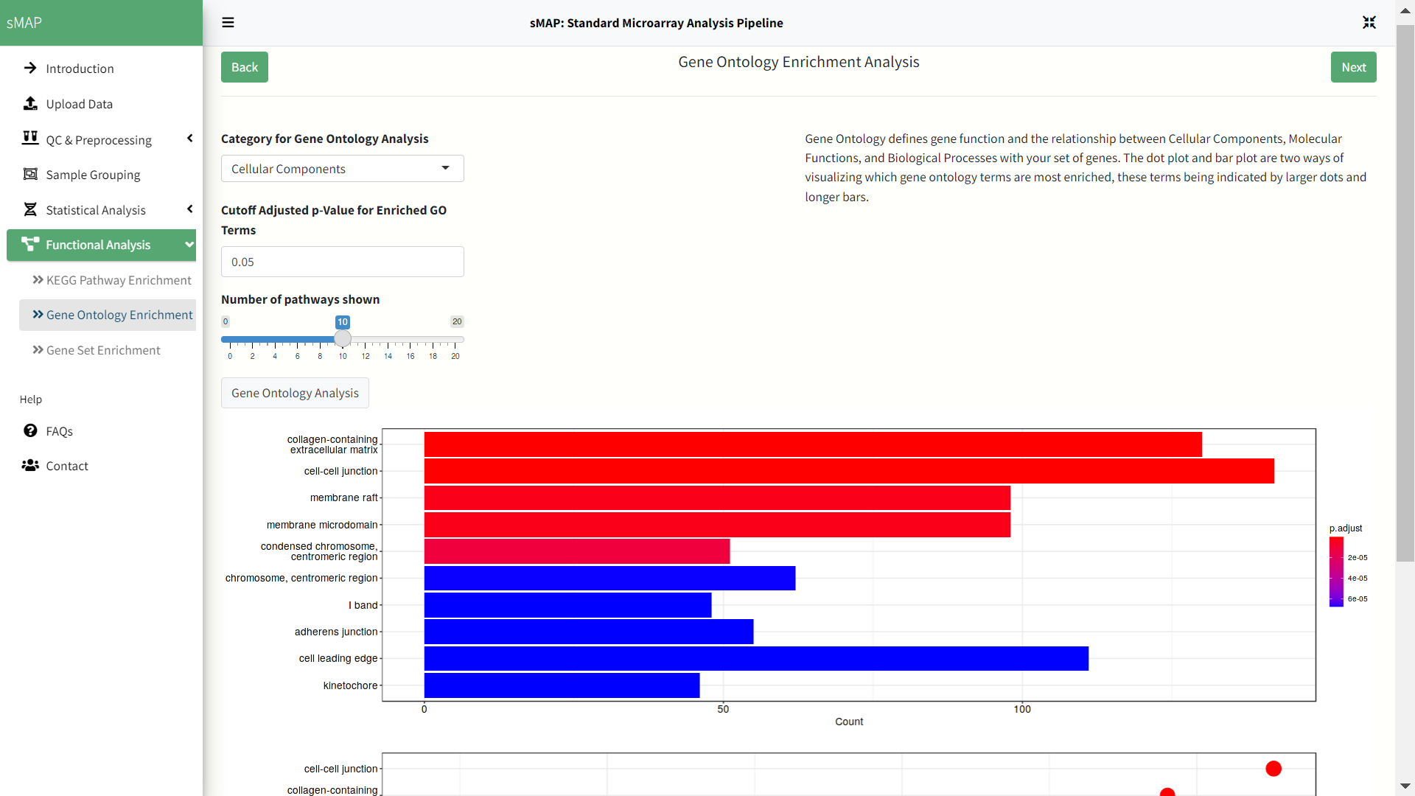
Enrichment Analysis: Gene Ontology Enrichment Analysis
Select one of the three GO categories.
Adjust P-value and other parameters for GO enrichment analysis.

Slide 14
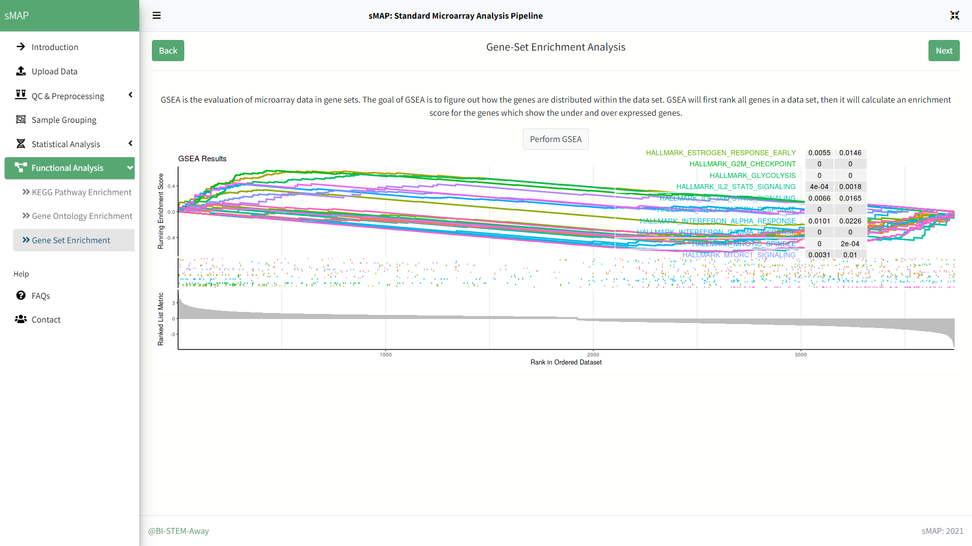
Enrichment Analysis: Gene Set Enrichment Analysis
Perform GSEA analysis.

Slide 15
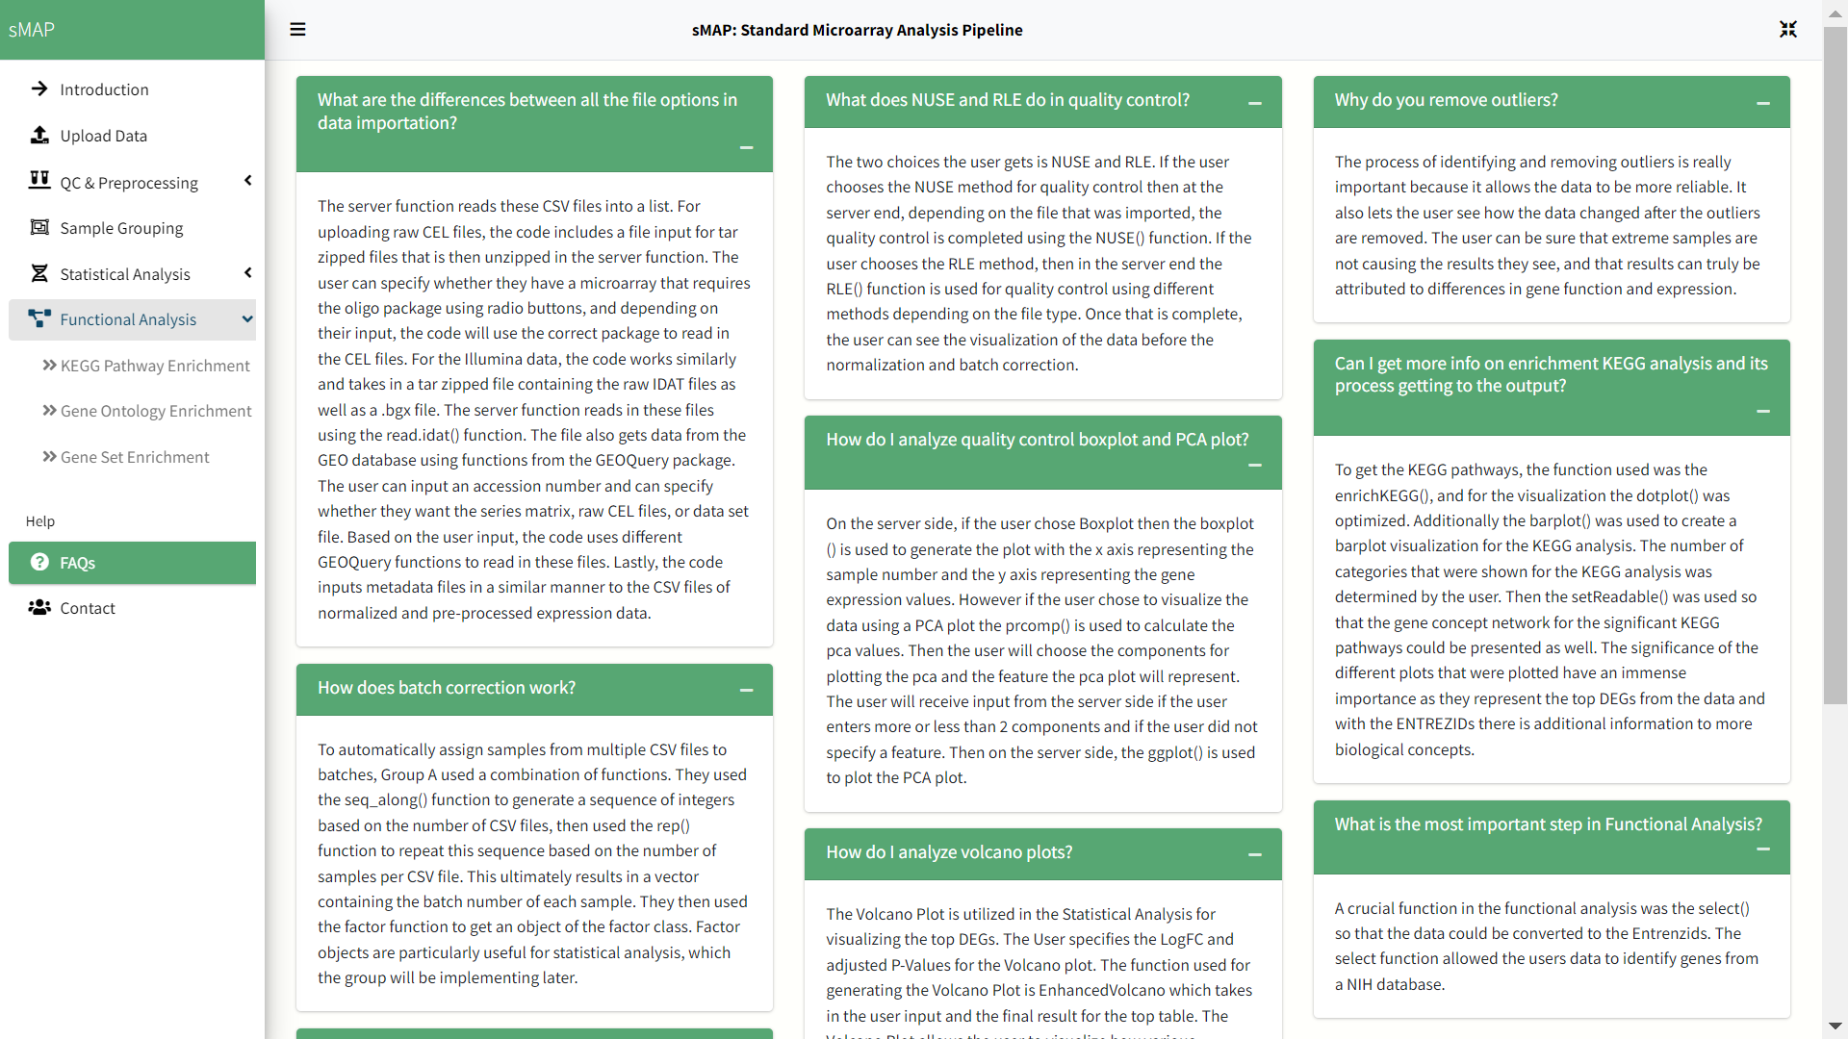
Help Sections: Frequently Asked Questions
Use this section for FAQs/help

Slide 16
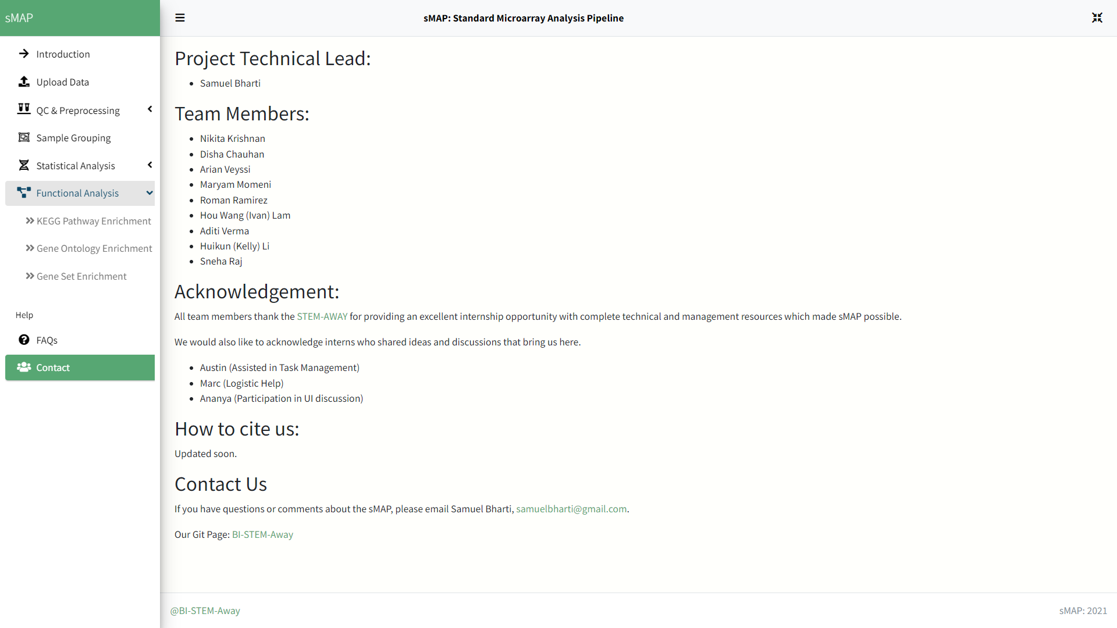
Help section: Contact us and check out stemaway.com
Visit STEM-Away to check out more interesting projects and see how STEM-Away is changing the shape of hiring industry and career advancements
Visit out GitHub Page to clone repo and get docker image

