Slide 1
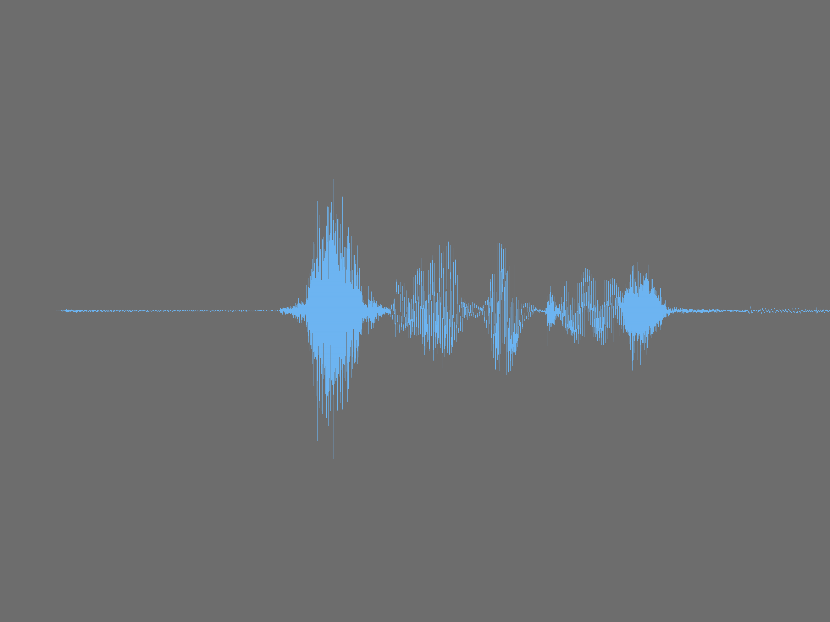
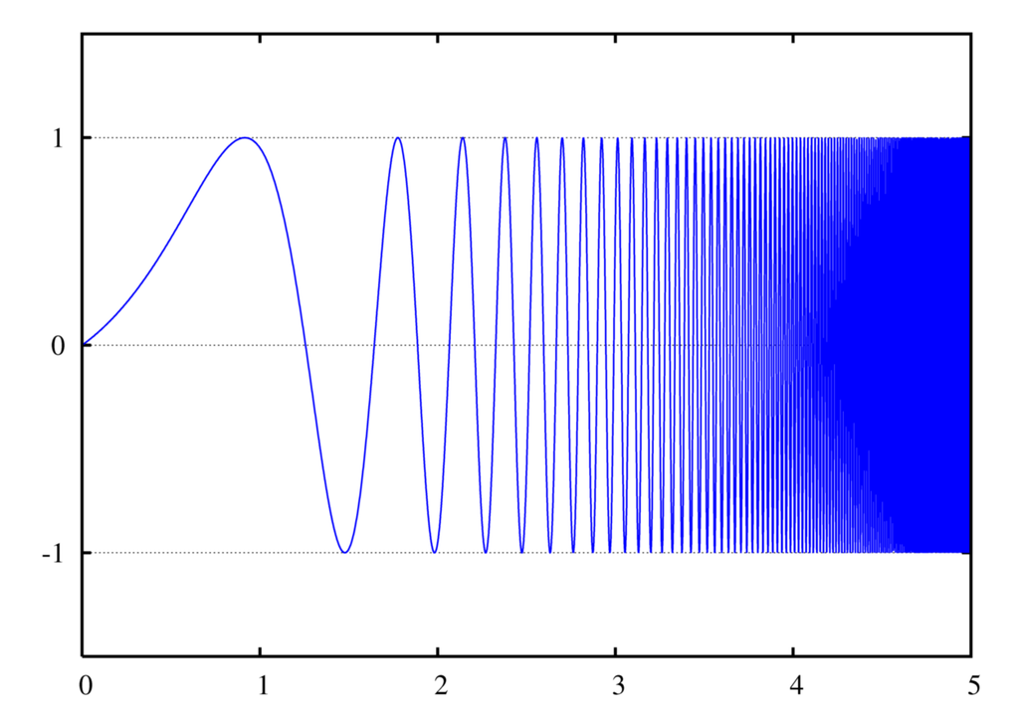
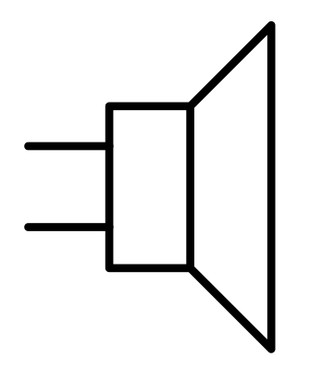

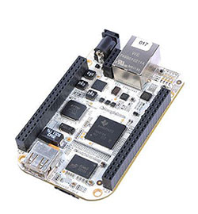
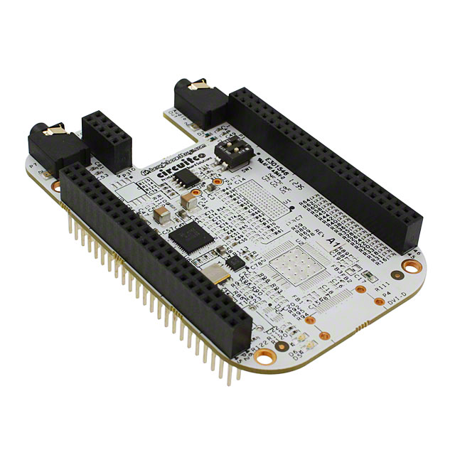
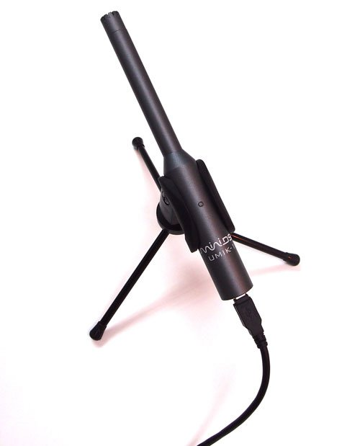
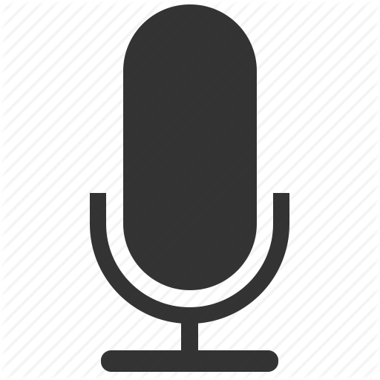

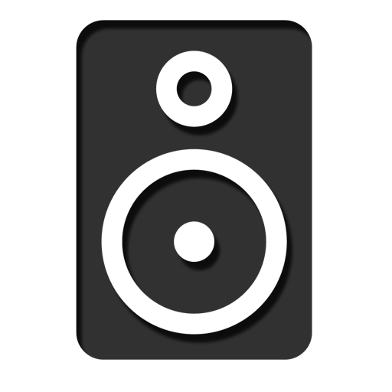





Sound-Sifter
Automatic Speaker Equalization System
Introduction
1 MEASUREMENT PHASE
Parts
Think about all of the places you hear audio throughout the day. From noisy coffee shops to carefully controlled movie theaters, our experience with speakers varies drastically. Sometimes the music creates a welcoming soundscape, but often you are just wishing someone would turn the volume down. It is likely that the quality of the sound, and not just what’s being played, that reduces your enjoyment. Many of these quality issues cannot be solved by simply purchasing better speakers, and need the room to be physically modified. Using signal processing, our project aims to improve your listening experience without the need to change your room or speakers.
Log Swept Sine
First, a swept sine or “chirp” is played through the speakers. This signal goes from 20Hz to 20kHz.
The microphone captures the sweep, resulting in an impulse response.
Then the frequency response is obtained by taking the Fourier Transform of the impulse.
Fourier Transform
Overall System Diagram
Microphone
Measured Frequency Response
dB
BeagleBone
a credit-card sized Linux computer
Hz
Audio In
BeagleBone
+
Audio Cape
Loudspeakers
2 CORRECTION PHASE
Identify Problems
Results
The frequency response from the measurement phase is divided into smaller frequency bands.
Then the bands are analyzed and the largest deviating bands are identified.
A reverse filter is created that addresses these problem bands. This is done by applying an inverting peak that cancels out the response.
The calibration subsystem computes a high resolution response of the room. A million point FFT creates an accurate frequency response based on the measurement.
The processor has the capacity to implement filters for correction on up to __ frequency bands.
A audible difference can be heard before and after filtering when the adjustments needed are significant.
dB
Filtering Subsystem
Calibration Subsystem
Hz
Create Inverse Filter
Audio In
Speaker
Speaker
MIC
dB
Sound Card
DAC
ADC
DAC
Hz
DAC
Sound Card
Fourier Transform
3 FILTERATION PHASE
Future Expansion
The system package could be modified to include smaller units that implement just the filtering. This would allow to Sound-Sifter to be used for multiple rooms without the cost of a microphone and calibration processing for each room.
Additionally, the Sound-Sifter does not currently identify if room defects are specifically due to reverberation. Additional algorithms could be included to better correct these problems.
Signal Processing
Sine Sweep
CPU
Audio destined for the speaker first goes through the inverse filter, correcting the output.
Corrected Frequency Response
CPU
dB
Audio Input
Calculated Filter
Hz
Samuel Bhushan
bhushan.samuel@gmail.com
Hailey Parkin
hrparkin@gmail.com

