Slide 1
Motivation and Summary Slide
Our team was interested in analyzing factors that we believe effected the attendance of baseball games
We started with the following questions to help us get started with what we wanted to analyze
Do the variables below effect the attendance of the games? Which variables are the strongest?
Weather
Star Player Salary
Stadium Built
Quality of Stadium
Demographics
Wins/Loss percentage
How long the team has been around
Describe whether you were able to answer these questions to your satisfaction, and briefly summarize your findings

Slide 2
Questions & Data
Elaborate on the questions you asked, describing what kinds of data you needed to answer them, and where you found it

Slide 3
Data Cleanup & Exploration
Describe the exploration and cleanup process
Discuss insights you had while exploring the data that you didn't anticipate
Discuss any problems that arose after exploring the data, and how you resolved them
Present and discuss interesting figures developed during exploration, ideally with the help of Jupyter Notebook

Slide 4
Data Analysis
Discuss the steps you took to analyze the data and answer each question you asked in your proposal
Present and discuss interesting figures developed during analysis, ideally with the help of Jupyter Notebook

Slide 5
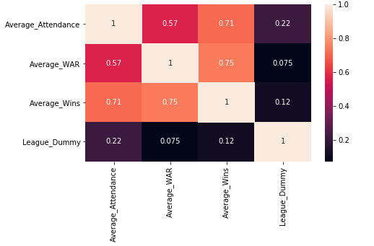
Correlation table, wins and WAR (star power) appear relevant…what about the league?

Slide 6
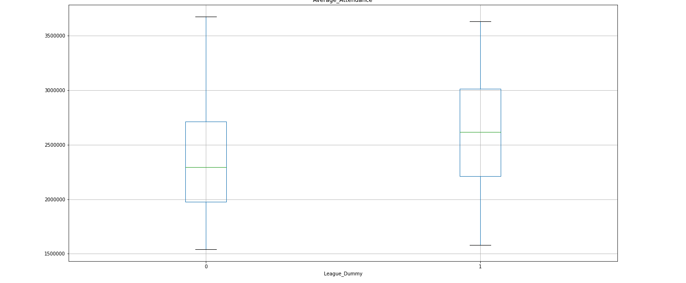
League Box Plot for attendance: American left, National right. NOT a statistically significant difference of means

Slide 7
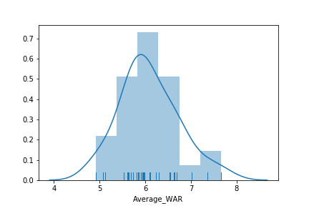
WAR kernel density/histogram plot
Notes:
Peak displays where values are concentrated over the interval

Slide 8
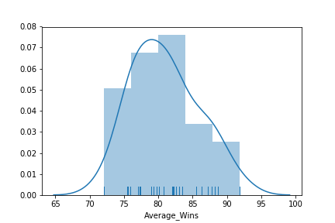
Wins kernel density/histogram plot

Slide 9
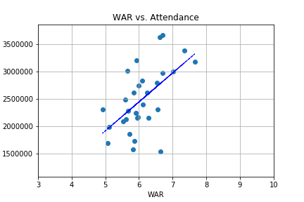
Does WAR affect attendance?

Slide 10
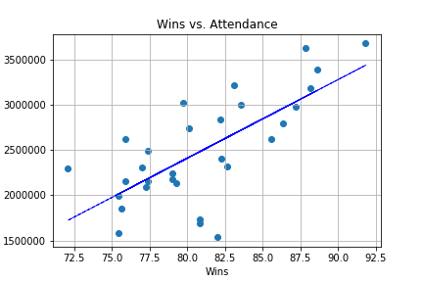
Does the number of wins affect attendance? Outliers yes, but overall there is correlation.

Slide 11
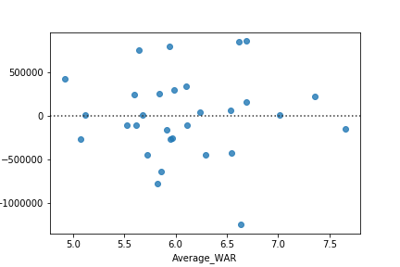
WAR residual plot, lots of outliers, larger residuals than those of the wins variable.

Slide 12
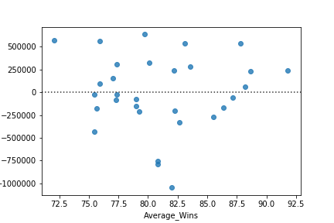
Astros had the lowest number of wins; however, Tampa Bay Rays had the lowest attendance. Is wins a statistically significant variable in spite of outliers?
Notes:
Astros had 500,000 more than expected, Tampa Bay Rays had one million less than expected, although 82 wins, which is one above average.

Slide 13
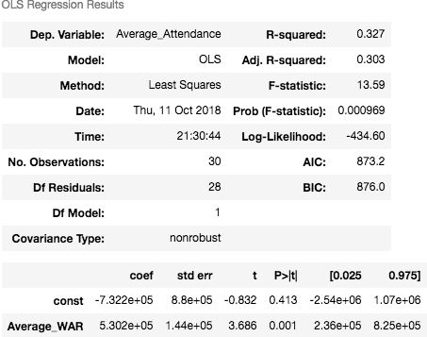
Regression table for WAR. By itself, significant.

Slide 14
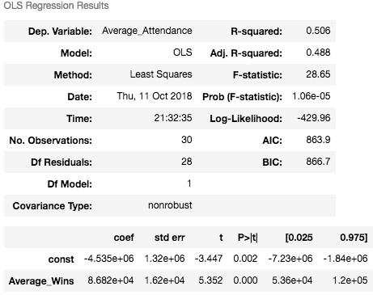
Regression table for wins, by itself significant.

Slide 15
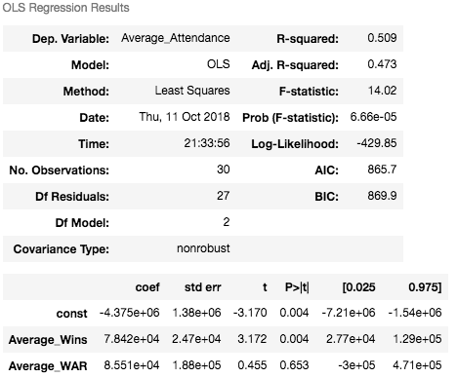
Wins and WAR, lower adj R sq. and higher AIC than wins alone, so do not choose this model.

Slide 16
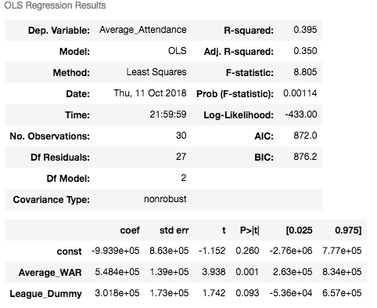
WAR and League, not a good model.

Slide 17
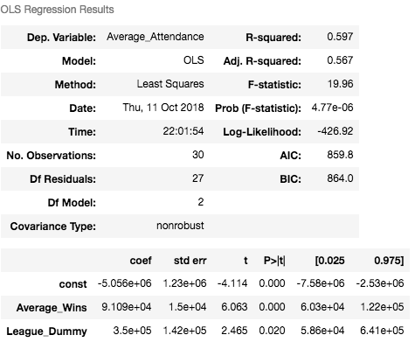
Wins and League Dummy, together significant. Adj sqr of 0.567 and lowest AIC at 859

Slide 18
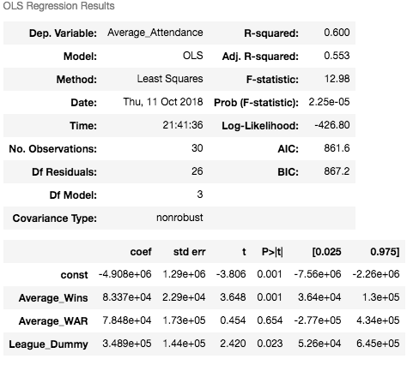
Regression with all variables, adj. r sq. decreases, AIC increases. WAR not necessary.

Slide 19
Discussion
Discuss your findings. Did you find what you expected to find? If not, why not? What inferences or general conclusions can you draw from your analysis?

Slide 20
Post Mortem
Discuss any difficulties that arose, and how you dealt with them
Discuss any additional questions that came up, but which you didn't have time to answer: What would you research next, if you had two more weeks?

Slide 21
Questions
Open-floor Q&A with the audience

