Slide 1


QuickShop A faster way to shop
Kunal Malhotra
Sam Britt
College of Computing
Georgia Institute of Technology

Slide 2
Motivation
User shopping behavior:
- Adds items to an empty list
- Categorizes them
- Starts shopping !!!!
Existing shopping list apps mostly categorize items into predefined categories, display available coupons, saving cards, display grocery stores in the vicinity, etc.
Not much work done in optimizing the user’s path through the grocery store
Categories close together in the list can be in different parts of the store which makes the user go back and forth between aisles of the store.
What is needed? - A grocery list which dynamically sorts itself by category based on the location of items in the store.

Slide 3

Various Publix Stores across Atlanta
Produce
Meats
Meats
Produce
F r o z e n
F r o z e n
B a k e r y
B a k e r y
Pharmacy
Pharmacy
Publix - Holcomb Bridge Road
Publix - Atlantic Station
Meats
P h a r m a c y
Produce
B a k e r y
F r o z e n
Publix - Shallowford Road

Slide 4
Functionality of existing shopping list apps
Help users make a grocery list categorized under existing categories
Offer free-form item input or have a large database of items for the users to choose from.
Add frequently purchased items to new lists and keep track of items which have been checked out.
Store specific coupon recommendation.
Sync lists with friends / spouse.

Slide 5
QuickShop
Android app to sort a shopping list by category to make the user pick up items in one pass without returning to a section
Store layout stored in a SQLite Database
Dynamic sorting of categories
Helps saving user’s time and effort
List becomes a virtual guide helping picking up items in the right order.
Great help in an unfamiliar store
Notes:
Some times the user is familiar with a store so he uses existing apps to manually sort the list . But our app does it dynamically.

Slide 6
DEMO

Slide 7
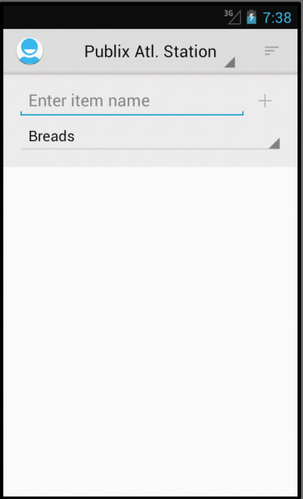
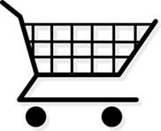
W A L L
I n s e c t I c I d e s
C a n n e d F r u I t s
C o n d I m e n t s
B a b y F o o d
W I n e
C e r e l s
R I c e
S o f t D r I n k s
Peanut Butter
C o l d B e e r
C a n n e d v e g e t a b l e s
W I n e C o o l e r s
C o o k I e s
C a n n e d M I l k
V I t a m I n s
Wine
P a p e r P l a t e s
Cereals
P e a n u t B u t t e r
W a t e r
F r u I t J u I c e s
P e t F o o d
C o f f e / T e a
B r e a d s
S n a c k s
M I l k
Start point

Slide 8
W A L L
I n s e c t I c I d e s
C a n n e d F r u I t s
C o n d I m e n t s
B a b y F o o d
W I n e
C e r e l s
R I c e
S o f t D r I n k s
Peanut Butter
C o l d B e e r
C a n n e d v e g e t a b l e s
W I n e C o o l e r s
C o o k I e s
C a n n e d M I l k
V I t a m I n s
Cereals
P a p e r P l a t e s
Wine
P e a n u t B u t t e r
W a t e r
F r u I t J u I c e s
P e t F o o d
C o f f e / T e a
B r e a d s
S n a c k s
M I l k
Start point

Slide 9
W A L L
I n s e c t I c I d e s
C a n n e d F r u I t s
C o n d I m e n t s
B a b y F o o d
W I n e
C e r e l s
R I c e
S o f t D r I n k s
Peanut Butter
C o l d B e e r
C a n n e d v e g e t a b l e s
W I n e C o o l e r s
C o o k I e s
C a n n e d M I l k
V I t a m I n s
Cereals
P a p e r P l a t e s
Wine
Cold Beer
P e a n u t B u t t e r
W a t e r
F r u I t J u I c e s
P e t F o o d
C o f f e / T e a
B r e a d s
S n a c k s
M I l k
Start point

Slide 10
W A L L
I n s e c t I c I d e s
C a n n e d F r u I t s
C o n d I m e n t s
B a b y F o o d
W I n e
C e r e l s
R I c e
S o f t D r I n k s
Peanut Butter
C o l d B e e r
C a n n e d v e g e t a b l e s
W I n e C o o l e r s
C o o k I e s
C a n n e d M I l k
V I t a m I n s
Cold Beer
P a p e r P l a t e s
Cereals
Wine
P e a n u t B u t t e r
W a t e r
F r u I t J u I c e s
P e t F o o d
C o f f e / T e a
B r e a d s
S n a c k s
M I l k
Start point

Slide 11
W A L L
I n s e c t I c I d e s
C a n n e d F r u I t s
C o n d I m e n t s
B a b y F o o d
W I n e
C e r e l s
R I c e
S o f t D r I n k s
Breads
C o l d B e e r
C a n n e d v e g e t a b l e s
W I n e C o o l e r s
C o o k I e s
C a n n e d M I l k
V I t a m I n s
Canned Milk
P a p e r P l a t e s
Condiments
Fruit Juices
Wine
P e a n u t B u t t e r
W a t e r
F r u I t J u I c e s
P e t F o o d
C o f f e / T e a
B r e a d s
S n a c k s
M I l k
Start point

Slide 12
W A L L
I n s e c t I c I d e s
C a n n e d F r u I t s
C o n d I m e n t s
B a b y F o o d
W I n e
C e r e l s
R I c e
S o f t D r I n k s
Breads
C o l d B e e r
C a n n e d v e g e t a b l e s
W I n e C o o l e r s
C o o k I e s
C a n n e d M I l k
V I t a m I n s
Wine
P a p e r P l a t e s
Canned Milk
Fruit Juices
Condiments
P e a n u t B u t t e r
W a t e r
F r u I t J u I c e s
P e t F o o d
C o f f e / T e a
B r e a d s
S n a c k s
M I l k
Start point

Slide 13
W A L L
I n s e c t I c I d e s
B a b y F o o d
C a n n e d F r u I t s
C o f f e e / T e a
P e t F o o d
Kroger How Mill
B a b y F o o d
F r u I t J u I c e
S o f t D r I n k s
Breads
C a n n e d v e g e t a b l e s
P e a n u t B u t t e r
B r e a d s
Wine
V I t a m I n s
W I n e
C a s n n e d M I l k
Canned Milk
C o o k I e s
W a t e r
Fruit Juices
Condiments
W I n e C o o l e r s
P a p e r P l a t e s
C o n d I m e n t s
D r y B e a n s
C o l d B e e r
M I l k
S n a c k s
C e r e l s
Start point

Slide 14
W A L L
I n s e c t I c I d e s
B a b y F o o d
C a n n e d F r u I t s
C o f f e e / T e a
P e t F o o d
Kroger How Mill
B a b y F o o d
F r u I t J u I c e
S o f t D r I n k s
Condiments
C a n n e d v e g e t a b l e s
P e a n u t B u t t e r
B r e a d s
Wine
V I t a m I n s
W I n e
C a s n n e d M I l k
Fruit Juices
C o o k I e s
W a t e r
Canned Milk
Breads
W I n e C o o l e r s
P a p e r P l a t e s
C o n d I m e n t s
D r y B e a n s
C o l d B e e r
M I l k
S n a c k s
C e r e l s
Start point

Slide 15
W A L L
I n s e c t I c I d e s
B a b y F o o d
C a n n e d F r u I t s
C o f f e e / T e a
P e t F o o d
Kroger How Mill
B a b y F o o d
F r u I t J u I c e
S o f t D r I n k s
Condiments
C a n n e d v e g e t a b l e s
P e a n u t B u t t e r
B r e a d s
Wine
V I t a m I n s
W I n e
C a s n n e d M I l k
Canned Milk
C o o k I e s
W a t e r
Breads
Fruit Juices
W I n e C o o l e r s
P a p e r P l a t e s
C o n d I m e n t s
D r y B e a n s
C o l d B e e r
M I l k
S n a c k s
C e r e l s
Start point

Slide 16
Technologies used
Java - Programming language
Eclipse IDE - Development engine
Android SDK -17 - Application development
SQLite Database - To record store layout information

Slide 17
Database Design
- Store names and location coordinates (Coordinates of the entrance)
- System specified categories
- Coordinates of each category for every store in the database
- Each category spans one or more segments
- Items can be along the aisle as well as perpendicular to the aisle (Coordinates spanning multiple aisles)
Store Layout
Segment
(xs, ys)
Category A
Category B
(x, y)
(x, y)
(x, y)
AISLE
Category Q
Category C
Category D
Category E
Category F
Category G
Category H
AISLE
Category I
Category J
Category K
Category R
Category L
Category M
Category N
AISLE
Category O
Category P
Category Q
Category R
Category S
Category T
Notes:
Each Category is an edge ..

Slide 18
Database Design
The design is comprehensive since it plays a primary role in sorting the user’s grocery list in a way that can optimize the time he takes to finish shopping.
Topological component of the store was critical in designing the database
Store floor plans of major chains are hard to get
Manual collection of data - imported into our database

Slide 19
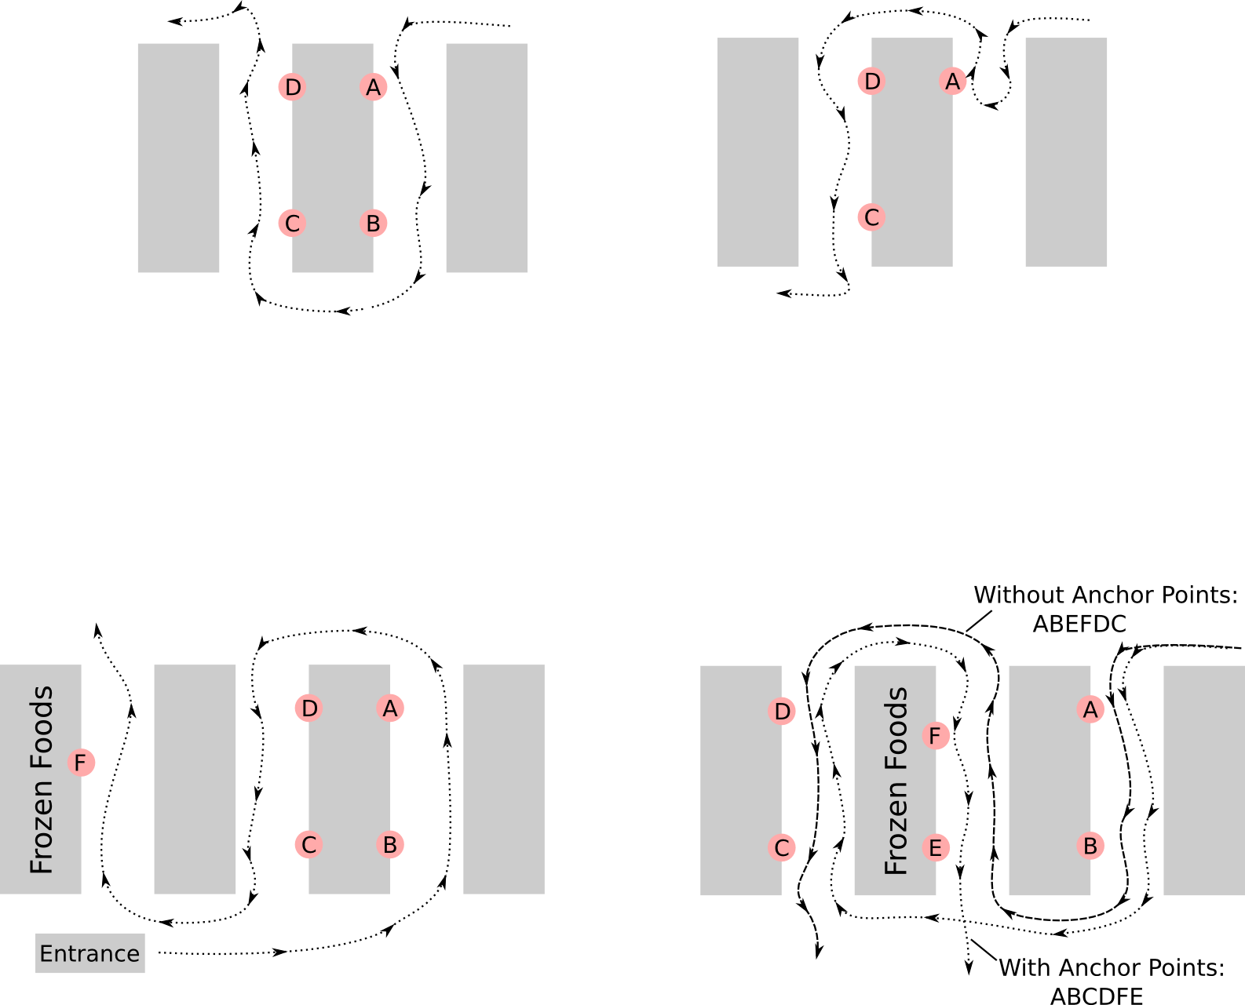
Issues in finding “best” path
Not the “shortest” path
Considering U-Turns
Respecting anchor points

Slide 20
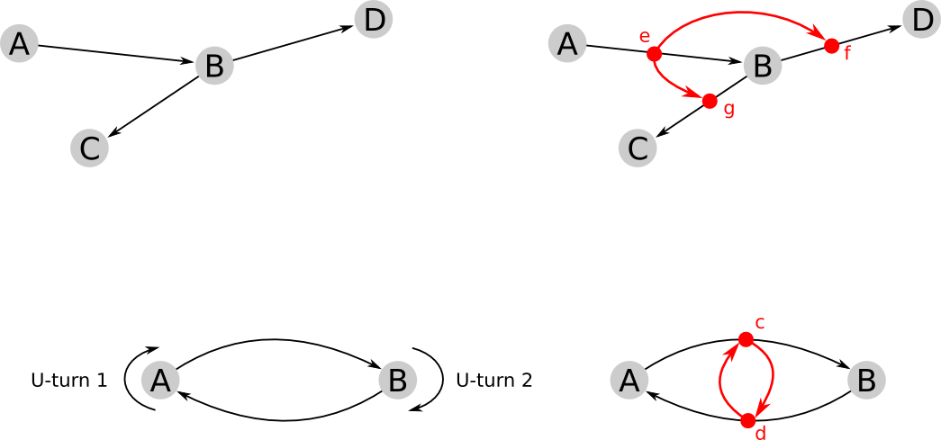
Modeling Turns
Primal Graph
Dual Graph:
Nodes: Primal edges
Edges: Turns in primal graph
U-turns modeled naturally
Stephan Winter: Modeling Costs of Turns in Route Planning. GeoInformatica 6(4): 363-380 (2002)

Slide 21
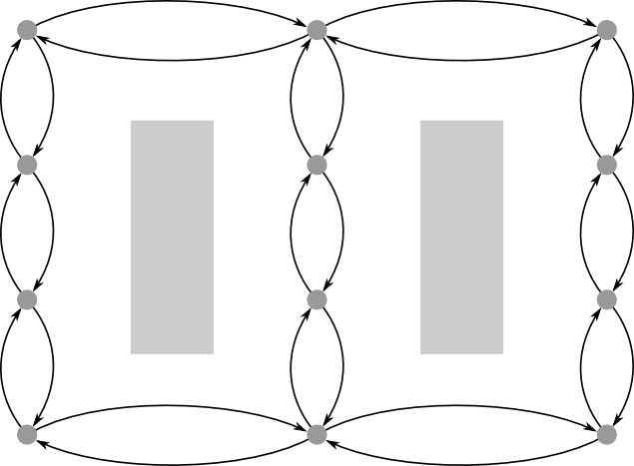
Layout of the store

Slide 22
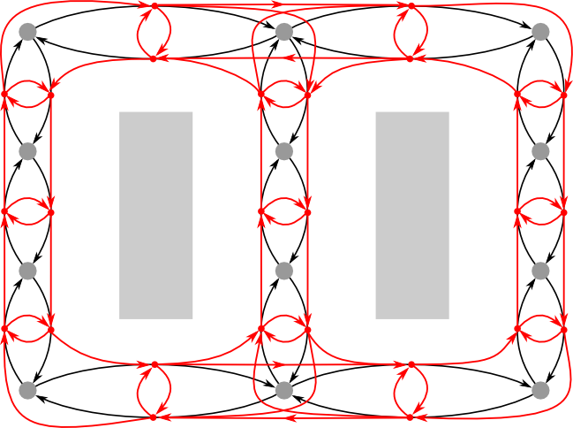
Layout of the store

Slide 23
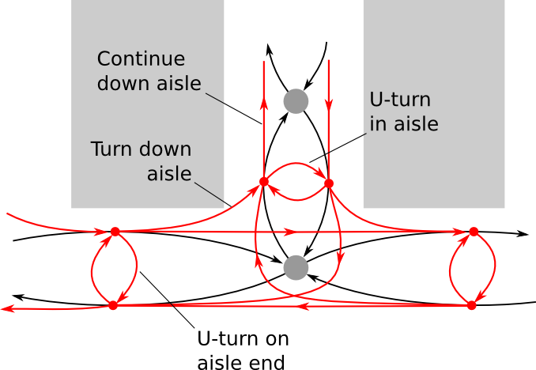
Turns in detail

Slide 24

Algorithm
Start with fully characterized Dual graph
Use all-pairs shortest path finder (Dijkstra’s algorithm on every node)
Each category associated with
a set of primal edges
a set of dual nodes
Consider distance from a dual node to a category as:
Large distance added to a category with an anchor point.
Greedy algorithm to walk from category to category

Slide 25
Future Work
Sync the app to automatically gather store layout data into the database.
Integrate Google Maps in the app to automatically get the store location.
A useful additional feature for QuickShop would be an easy way for a user to map out a store himself; such data could then be made available to other users in the same area

Slide 26
Thank you

