Slide 1
Phase Field Solidification Modeling
Sam Britt
December 14, 2012

Slide 2
Solidification
Casting, welding
Consider:
  Nucleation and growth (hetero/homogeneous)
  Thermal and constitutional undercooling
  Solute segregation
  Cellular and dendritic growth
  Multi-phase systems, decomposition

Slide 3
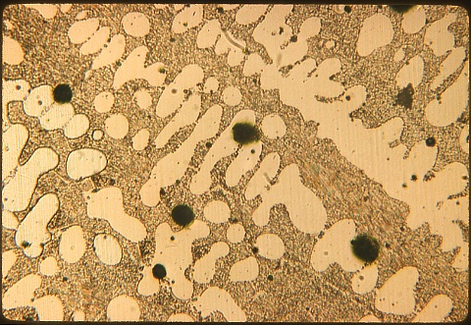
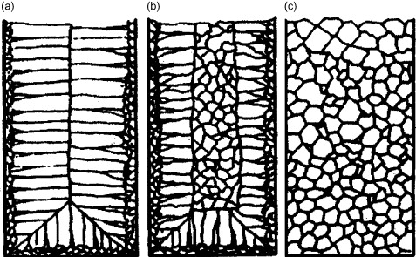
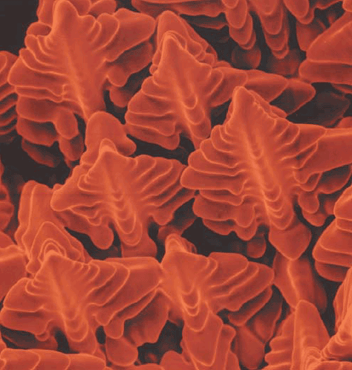
Solidification Microstructures
Eutectic in cast Cu
George Langford, MIT
Classic Casting
microstructures
Kelton and Greer (2010)
Serious impact on
mechanical properties!
Dendrites in Ni-based superalloy weld
David et al. (2003)

Slide 4
Modeling Solidification
Option 1: “Sharp Interface Model”
  Explicitly keep track of the interface
  Conserve heat, mass in solid & liquid, couple with transport eqns. across boundary, add interfacial effects
  Very computationally intensive for complex, realistic microstructures

Slide 5
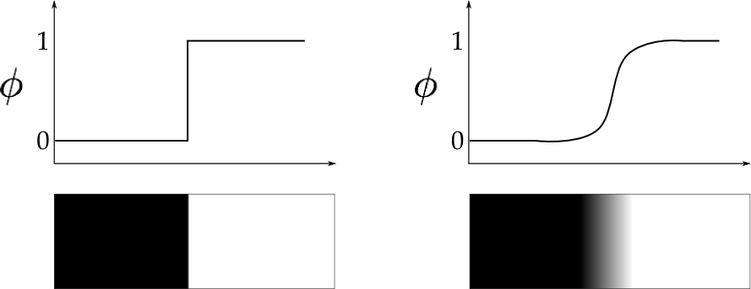
Modeling Solidification
Option 2: “Phase Field” (diffuse interface) model
  Order parameter φ: a field that describes the phase:
    Where φ = 1, solid. Where φ = 0, liquid.
    Where 0 < φ < 1, “Interface”
  Interface is not tracked, but φ is allowed to evolve

Slide 6
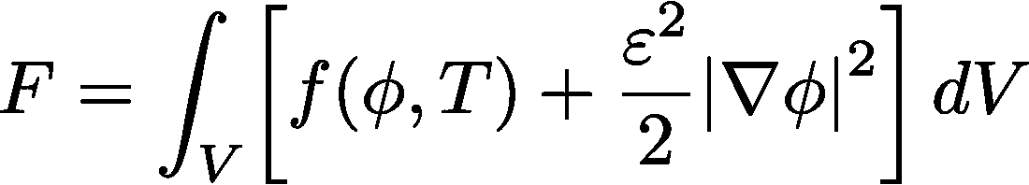
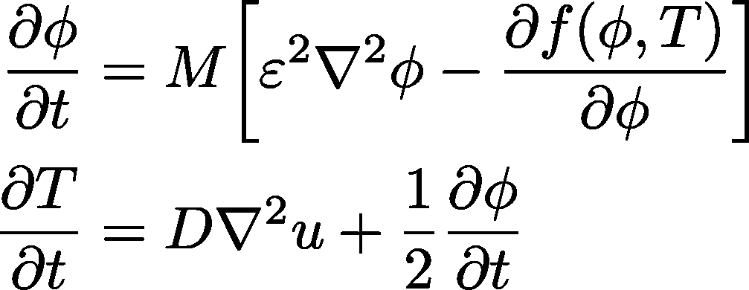
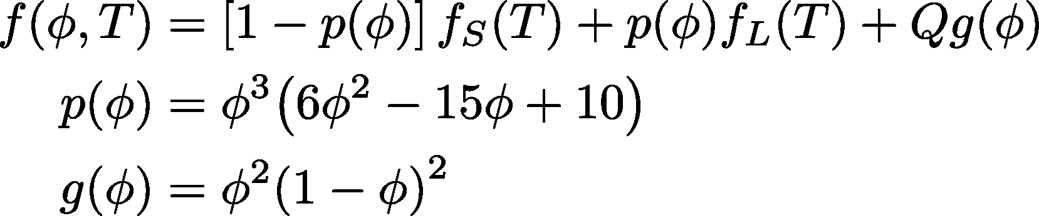
Governing Equations
“Gradient energy coefficient”
Contributions from pure phases
Only non-zero at interface
“Interface mobility”
(for non-isothermal case)
(interpolation)
(double well)

Slide 7
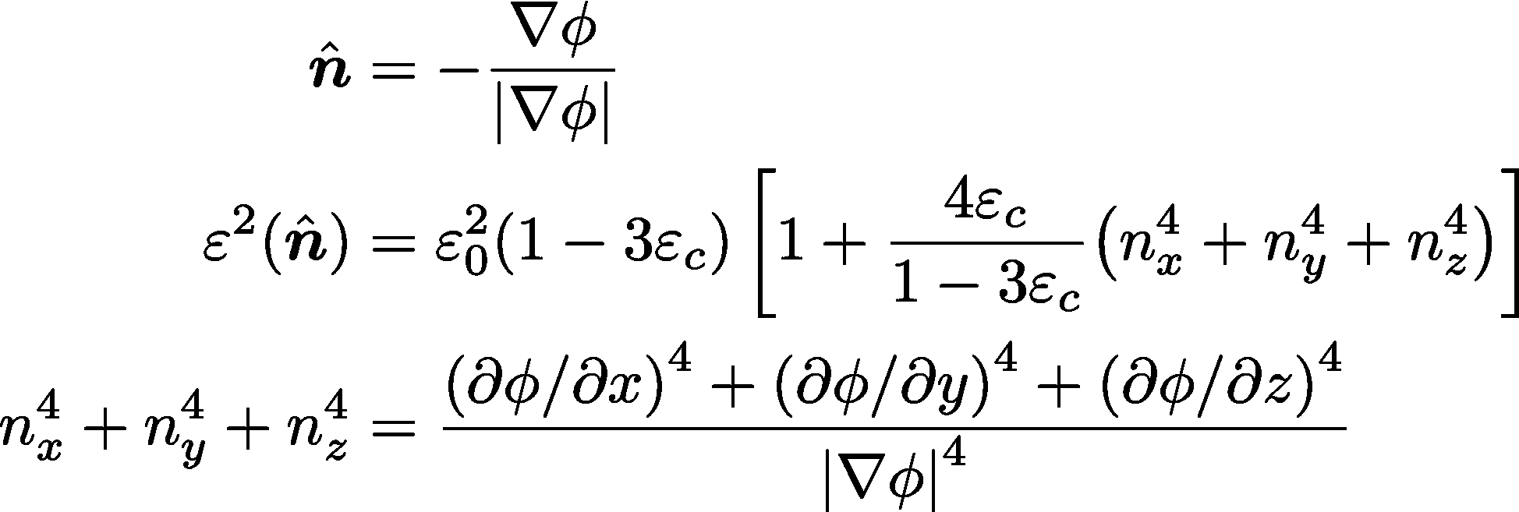

Anisotropy
To model, e.g., dendrites, need anisotropic (direction-dependent) crystal growth: use gradient energy coefficient
2D phase field simulation of dendrites (not mine)
Furrer (2011)

Slide 8
This Work
Implemented single component 1-D phase field simulator for solidification
  With clear hooks to extend to 2-D and binary systems
Numerically integrated governing equations using implicit finite difference scheme
  Explicit scheme required extremely small timesteps
  Converted finite difference equations to matrix form, solve with LAPACK

Slide 9
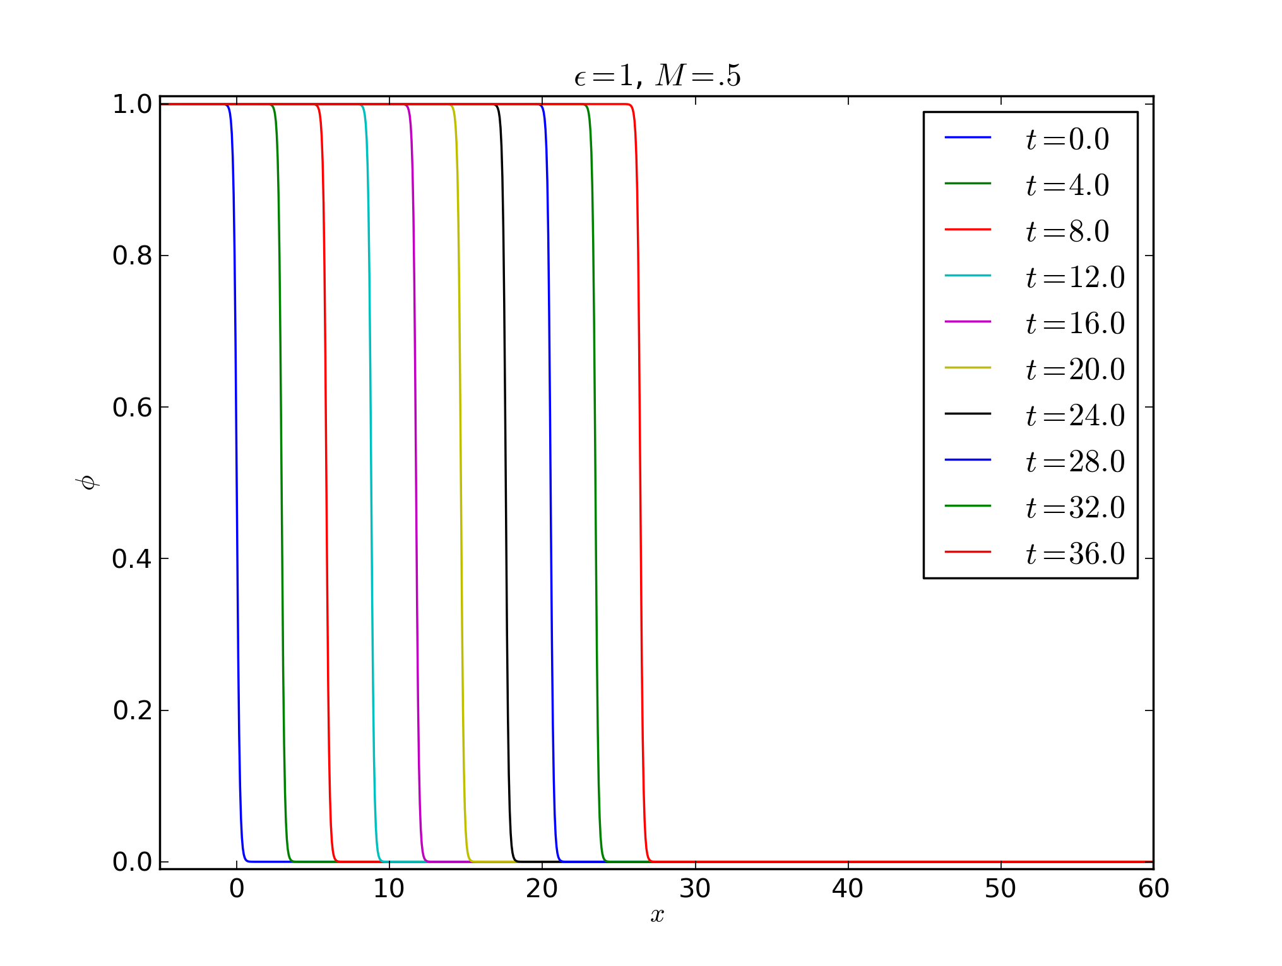
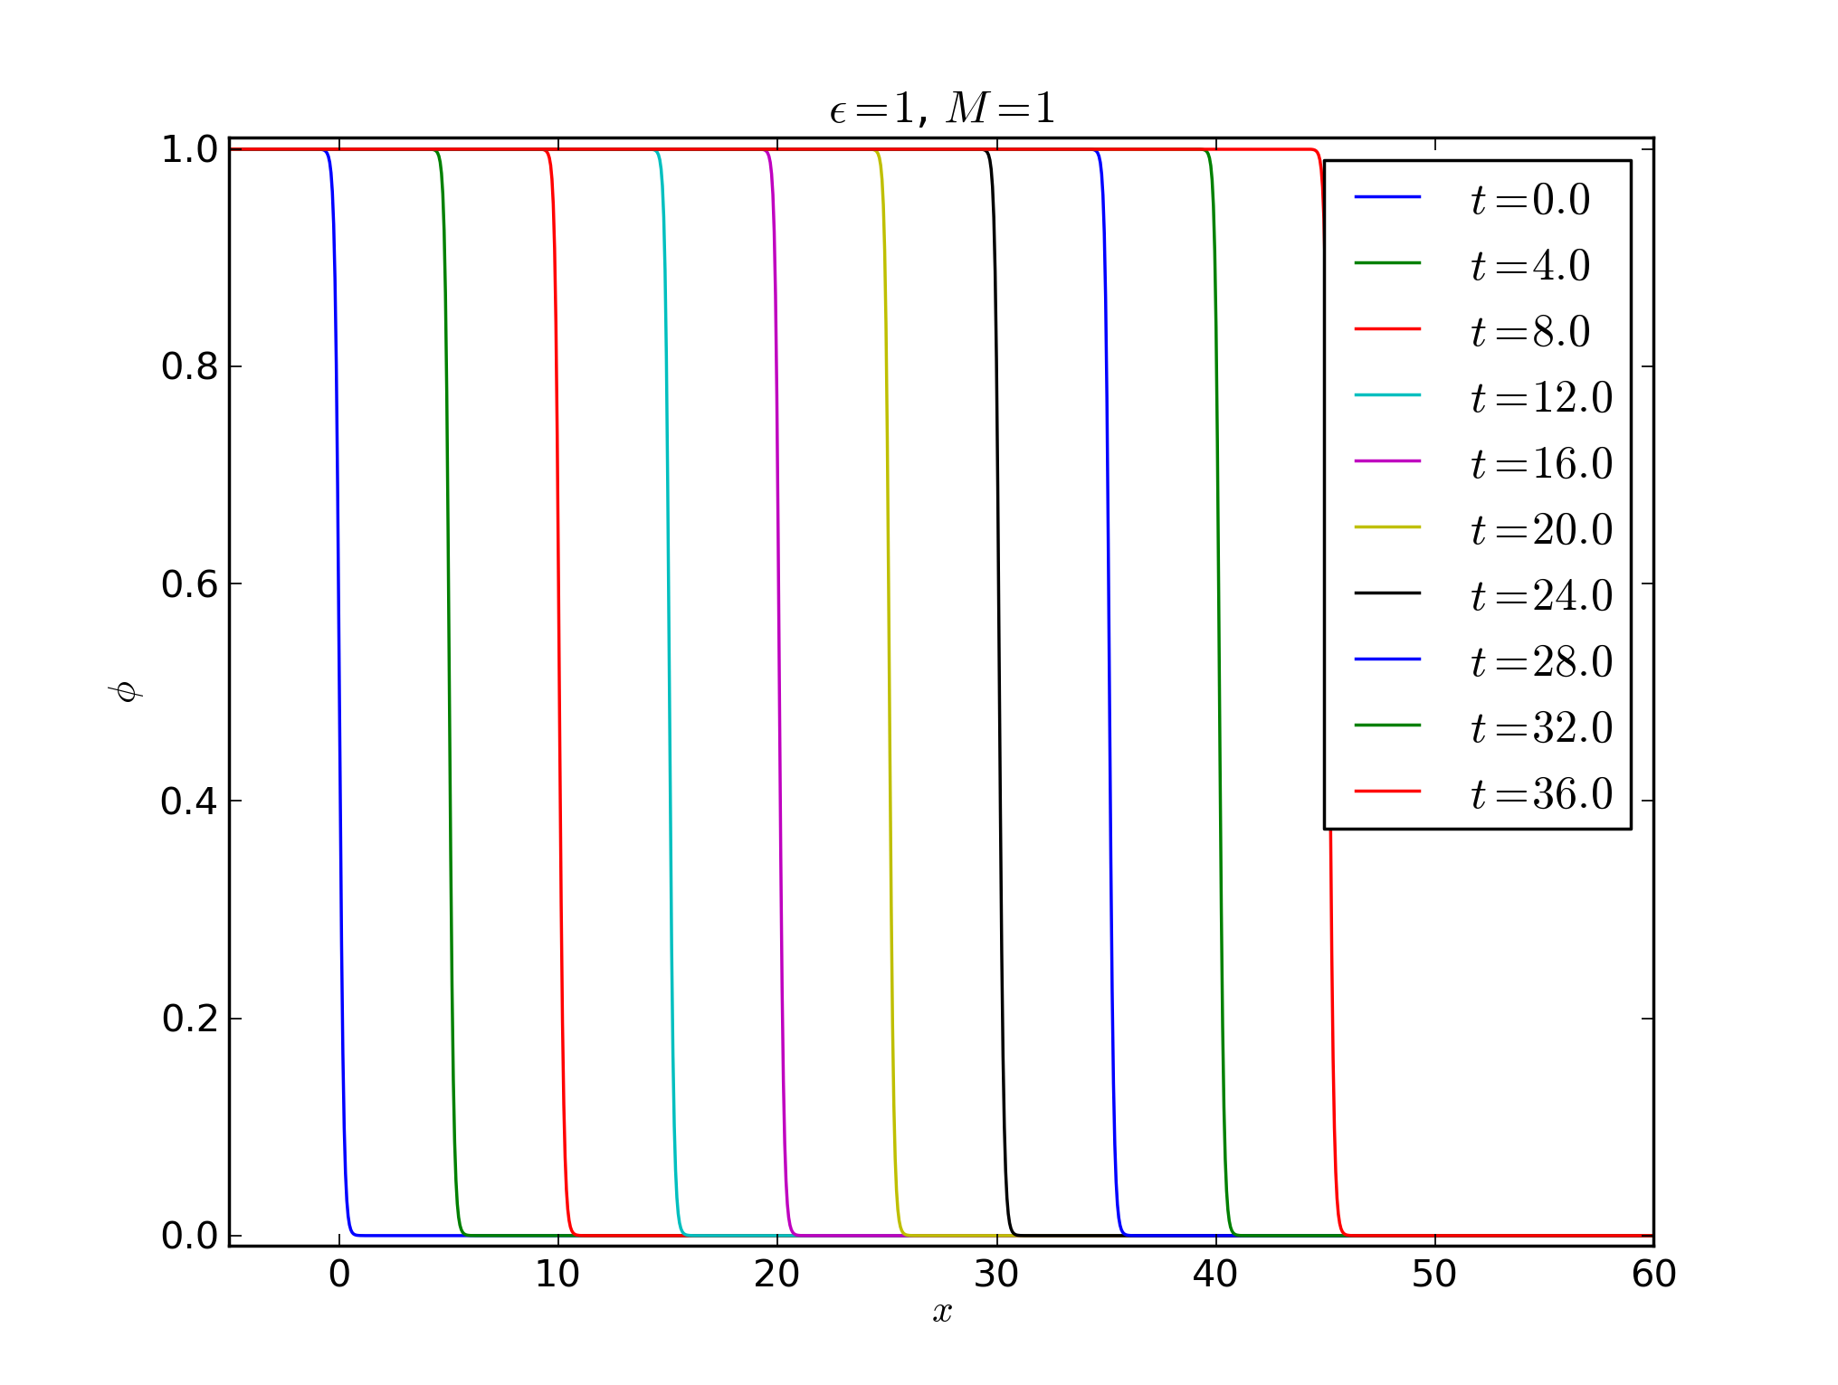
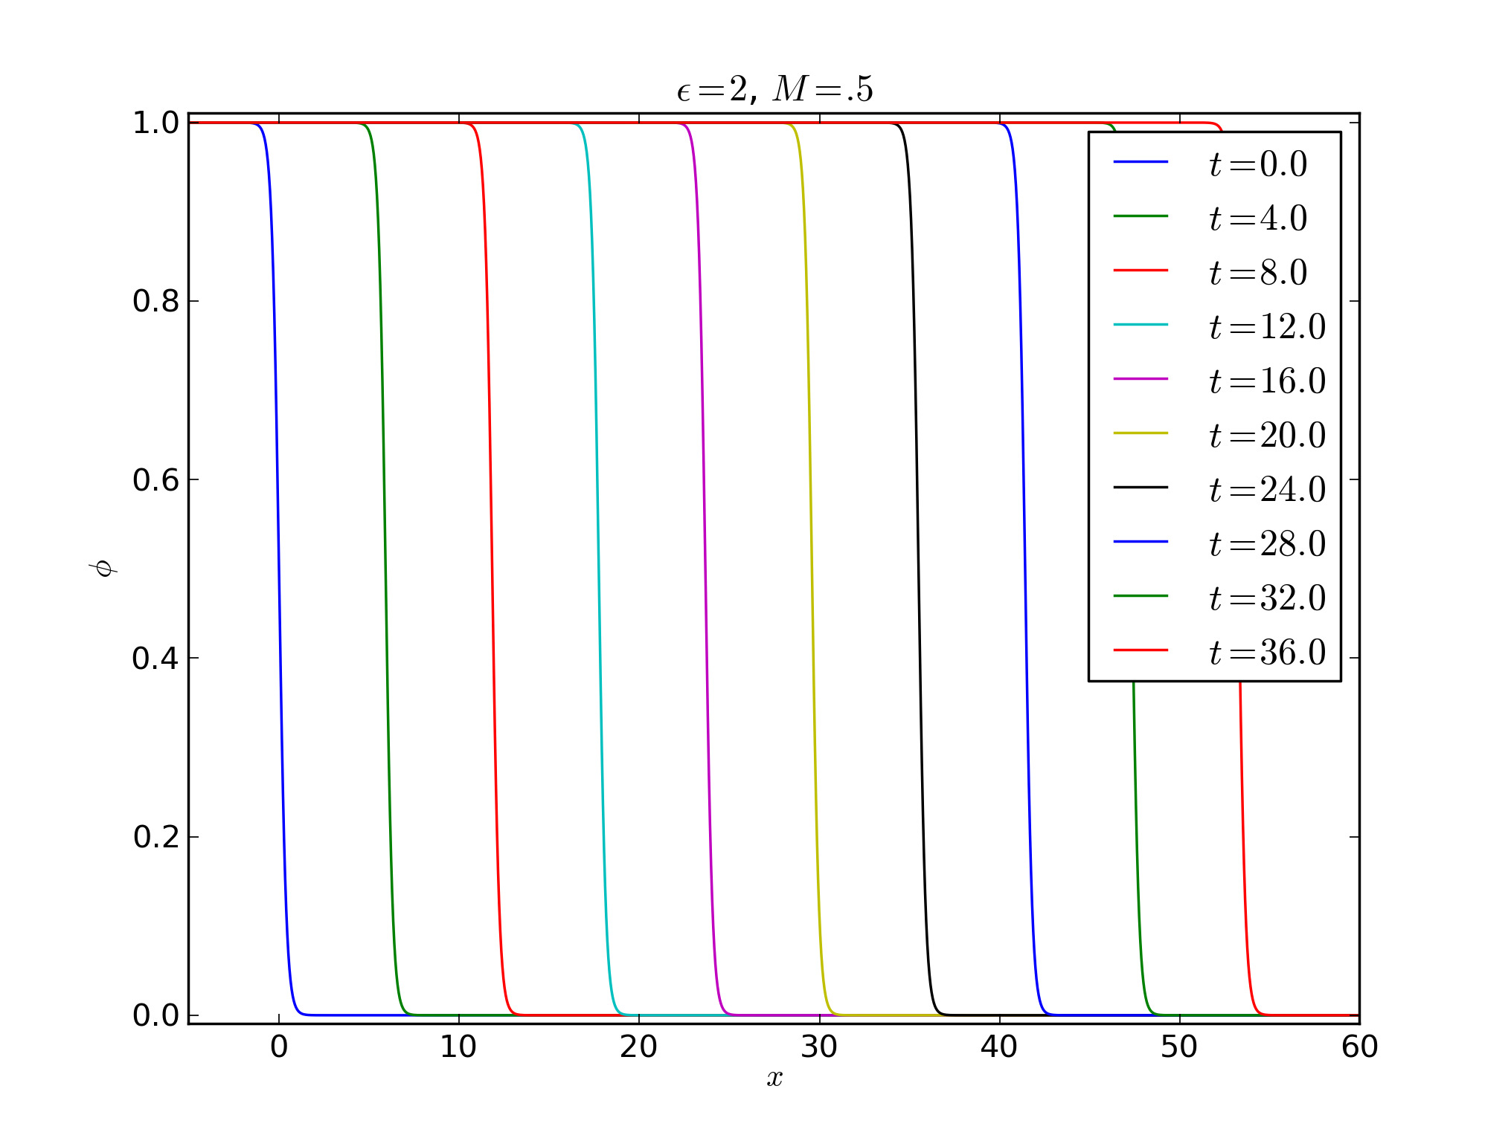
1D Solidification of ~Ni
ε = 1
M = 1
  φ
t
ε = 2
M = 0.5
ε = 1
ε = 1
M = 0.5
M = 0.5
x

