Slide 1
Apparied cases

Slide 2
I. Raw data

Slide 3
I.1. Feces

Slide 4

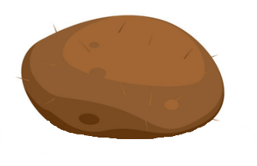
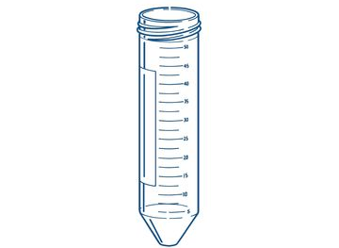
Mass row
nb_item_per sample | 1
nb_indiv_per_sample | 1
is_indiv_known | 0
error_meaning | NA
obs_id | reference_ID_oX
obs_resolution | Individual
obs_id_nested | NA
Carbon row
nb_item_per sample | 1
nb_indiv_per_sample | 1
is_indiv_known | 0
error_meaning | NA
obs_id | reference_ID_oX
obs_resolution | Individual
obs_id_nested | NA
mass, carbon, nitrogen, phosphorus etc…
Etc…

Slide 5
Mass
nb_item_per sample | 1
nb_indiv_per_sample | 1
is_indiv_known | 1
error_meaning | NA
obs_id | reference_ID_oX
obs_resolution | Individual
obs_id_nested | NA
alpha
Carbon
nb_item_per sample | 1
nb_indiv_per_sample | 1
is_indiv_known | 1
error_meaning | NA
obs_id | reference_ID_oX
obs_resolution | Individual
obs_id_nested | NA
mass, carbon, nitrogen, phosphorus etc…
Etc…

Slide 6
Mass
nb_item_per sample | >1 (IG: « 3 »)
nb_indiv_per_sample | 1
is_indiv_known | 1
error_meaning | NA
obs_id | reference_ID_oX
obs_resolution | Individual
obs_id_nested | NA
alpha
alpha
alpha
Carbon
nb_item_per sample | >1 (IG: « 3 »)
nb_indiv_per_sample | 1
is_indiv_known | 1
error_meaning | NA
obs_id | reference_ID_oX
obs_resolution | Individual
obs_id_nested | NA
mass, carbon, nitrogen, phosphorus etc…
Etc…

Slide 7
Mass
nb_item_per sample | >1 (IG: « 3 »)
nb_indiv_per_sample | 1
is_indiv_known | 0
error_meaning | NA
obs_id | reference_ID_oX
obs_resolution | individual
obs_id_nested | NA
Carbon
nb_item_per sample | >1 (IG: « 3 »)
nb_indiv_per_sample | 1
is_indiv_known | 0
error_meaning | NA
obs_id | reference_ID_oX
obs_resolution | individual
obs_id_nested | NA
mass, carbon, nitrogen, phosphorus etc…
Etc…

Slide 8
Mass
nb_item_per sample | >1
nb_indiv_per_sample | >1
is_indiv_known | 1
error_meaning | NA
obs_id | reference_ID_oX
obs_resolution | population
obs_id_nested | NA
bravo
alpha
charlie
Carbon
nb_item_per sample | >1
nb_indiv_per_sample | >1
is_indiv_known | 1
error_meaning | NA
obs_id | reference_ID_oX
obs_resolution | population
obs_id_nested | NA
mass, carbon, nitrogen, phosphorus etc…
Etc…

Slide 9
I.2. Food

Slide 10
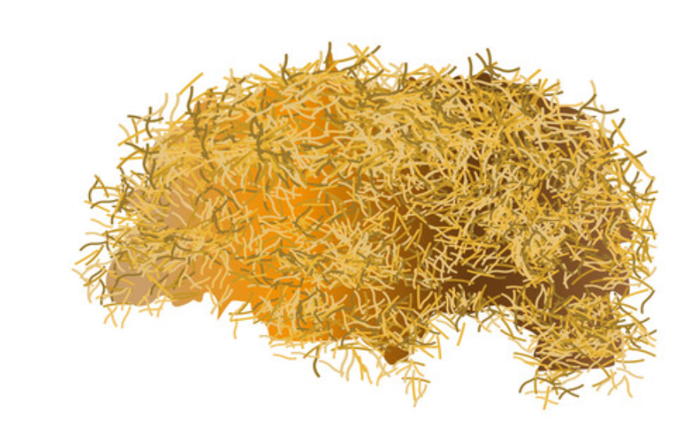
Mass
nb_item_per sample | NA
nb_indiv_per_sample | NA
is_indiv_known | NA
error_meaning | NA
obs_id | reference_ID_oX
obs_resolution | ?
obs_id_nested | NA
Carbon
nb_item_per sample | NA
nb_indiv_per_sample | NA
is_indiv_known | NA
error_meaning | NA
obs_id | reference_ID_oX
obs_resolution | ?
obs_id_nested | NA
mass, carbon, nitrogen, phosphorus etc…
Etc…

Slide 11
I.3. Body

Slide 12

Carbon
nb_item_per sample | 1
nb_indiv_per_sample | 1
is_indiv_known | NA
error_meaning | NA
obs_id | reference_ID_oX
obs_resolution | individual
obs_id_nested | NA
Nitrogen
nb_item_per sample | 1
nb_indiv_per_sample | 1
is_indiv_known | NA
error_meaning | NA
obs_id | reference_ID_oX
obs_resolution | individual
obs_id_nested | NA
carbon, nitrogen, phosphorus etc…
Etc…

Slide 13
Carbon
nb_item_per sample | 1
nb_indiv_per_sample | >1
is_indiv_known | NA
error_meaning | NA
obs_id | reference_ID_oX
obs_resolution | population
obs_id_nested | NA
Nitrogen
nb_item_per sample | 1
nb_indiv_per_sample | >1
is_indiv_known | NA
error_meaning | NA
obs_id | reference_ID_oX
obs_resolution | Population
obs_id_nested | NA
carbon, nitrogen, phosphorus etc…
Etc…

Slide 14
I.4. Food – body - feces

Slide 15


Food C, food N, food P, etc.
nb_item_per sample | NA
nb_indiv_per_sample | NA
is_indiv_known | ?
error_meaning | NA
obs_id | reference_ID_oX
obs_resolution | ?
obs_id_nested | NA
Body C, body N, body P, etc.
nb_item_per sample | 1
nb_indiv_per_sample | 1
is_indiv_known | NA
error_meaning | NA
obs_id | reference_ID_oX
obs_resolution | ?
obs_id_nested | NA
carbon, nitrogen, phosphorus etc…
Etc…
Notes:
This is our favorite case

Slide 16
II. Statistical data

Slide 17
II.1. One item per sample

Slide 18
II.1.i. Feces

Slide 19


Carbon
nb_item_per sample | 1
nb_indiv_per_sample | 1
is_indiv_known | 1
error_meaning | intra_indiv_rep
obs_id | reference_ID_oX
obs_resolution | NA
obs_id_nested | NA
alpha
alpha
alpha
Nitrogen
nb_item_per sample | 1
nb_indiv_per_sample | 1
is_indiv_known | 1
error_meaning | intra_indiv_rep
obs_id | reference_ID_oX
obs_resolution | NA
obs_id_nested | NA
carbon, nitrogen, phosphorus etc…
Statistics → average, variance
Etc…

Slide 20
Carbon
nb_item_per sample | 1
nb_indiv_per_sample | 1
is_indiv_known | 1
error_meaning | inter_indiv_rep
obs_id | reference_ID_oX
obs_resolution | NA
obs_id_nested | NA
alpha
bravo
charlie
Nitrogen
nb_item_per sample | 1
nb_indiv_per_sample | 1
is_indiv_known | 1
error_meaning | inter_indiv_rep
obs_id | reference_ID_oX
obs_resolution | NA
obs_id_nested | NA
carbon, nitrogen, phosphorus etc…
Statistics → average, variance
Etc…
Notes:
Other examples exist, and can be found in the non-apparied data powerpoint.

Slide 21
II.1.ii. Food

Slide 22
Carbon
nb_item_per sample | NA
nb_indiv_per_sample | NA
is_indiv_known | NA
error_meaning | intra_food_rep ?
obs_id | reference_ID_oX
obs_resolution | NA
obs_id_nested | NA
Nitrogen
nb_item_per sample | NA
nb_indiv_per_sample | NA
is_indiv_known | NA
error_meaning | intra_food_rep
obs_id | reference_ID_oX
obs_resolution | NA
obs_id_nested | NA
carbon, nitrogen, phosphorus etc…
Statistics → average, variance
Etc…

Slide 23



Carbon
nb_item_per sample | NA
nb_indiv_per_sample | NA
is_indiv_known | NA
error_meaning | inter_food_rep ?
obs_id | reference_ID_oX
obs_resolution | NA
obs_id_nested | NA
Nitrogen
nb_item_per sample | NA
nb_indiv_per_sample | NA
is_indiv_known | NA
error_meaning | inter_food_rep
obs_id | reference_ID_oX
obs_resolution | NA
obs_id_nested | NA
carbon, nitrogen, phosphorus etc…
Statistics → average, variance
Etc…

Slide 24
II.1.iii. Body

Slide 25
Carbon
nb_item_per sample | 1
nb_indiv_per_sample | 1
is_indiv_known | NA
error_meaning | Inter_indiv_rep
obs_id | reference_ID_oX
obs_resolution | NA
obs_id_nested | NA
Nitrogen
nb_item_per sample | 1
nb_indiv_per_sample | 1
is_indiv_known | NA
error_meaning | Inter_indiv_rep
obs_id | reference_ID_oX
obs_resolution | NA
obs_id_nested | NA
carbon, nitrogen, phosphorus etc…
Statistics → average, variance
Etc…
Notes:
Other examples exist, and can be found in the non-apparied data powerpoint

Slide 26
II.2. Several items per sample

Slide 27
II.2.i. Feces

Slide 28

Carbon
nb_item_per sample | >1
nb_indiv_per_sample | 1
is_indiv_known | 1
error_meaning | intra_indiv_rep
obs_id | reference_ID_oX
obs_resolution | NA
obs_id_nested | NA
alpha
alpha
alpha
Nitrogen
nb_item_per sample | >1
nb_indiv_per_sample | 1
is_indiv_known | 1
error_meaning | intra_indiv_rep
obs_id | reference_ID_oX
obs_resolution | NA
obs_id_nested | NA
carbon, nitrogen, phosphorus etc…
Statistics → average, variance
Etc…
Notes:
Other examples exist, and can be found in the non-apparied data powerpoint

Slide 29
II.2.ii. Food
Notes:
Irrelevant cases

Slide 30
II.2.iii. Body
Notes:
Irrelevant cases

