Slide 1
Non-apparied cases

Slide 2
I. Raw data

Slide 3
I.1. Feces

Slide 4

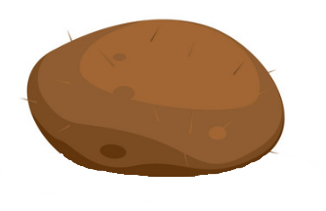
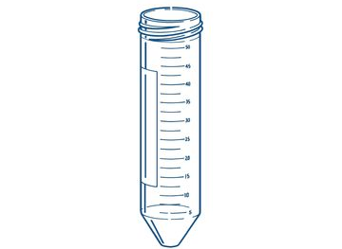
nb_item_per sample | 1
nb_indiv_per_sample | 1
is_indiv_known | 0
error_meaning | NA
obs_id | reference_ID_oX
obs_resolution | individual
obs_id_nested | NA
Notes:
We do not have an error_meaning because there is only one data, thus no error can be computed.

Slide 5
alpha
nb_item_per sample | 1
nb_indiv_per_sample | 1
is_indiv_known | 1
error_meaning | NA
obs_id | reference_ID_oX
obs_resolution | individual
obs_id_nested | NA
Notes:
This is our favorite case.

Slide 6

t₁
nb_item_per sample | 1
nb_indiv_per_sample | 1
is_indiv_known | 1
error_meaning | NA
obs_id | reference_ID_oX
obs_resolution | individual
obs_id_nested | reference_ID_rep1_t1
t₁
t₂
t₃
alpha
alpha
alpha
t₂
nb_item_per sample | 1
nb_indiv_per_sample | 1
is_indiv_known | 1
error_meaning | NA
obs_id | reference_ID_oX
obs_resolution | individual
obs_id_nested | reference_ID_rep1_t2
time
Etc…
Notes:
For the case of time series, we use the obs_id_nested

Slide 7
Rep 1
nb_item_per sample | 1
nb_indiv_per_sample | 1
is_indiv_known | 1
error_meaning | NA
obs_id | reference_ID_oX
obs_resolution | individual
obs_id_nested | reference_ID_rep1_t1
Rep 1
alpha
Rep 2
Rep 2
nb_item_per sample | 1
nb_indiv_per_sample | 1
is_indiv_known | 1
error_meaning | NA
obs_id | reference_ID_oX
obs_resolution | individual
obs_id_nested | reference_ID_rep2_t1
alpha
Etc…
Notes:
For the case of measurments made on the same individual, we use the obs_id_nested.

Slide 8
alpha
alpha
nb_item_per sample | >1
nb_indiv_per_sample | 1
is_indiv_known | 1
error_meaning | NA
obs_id | reference_ID_oX
obs_resolution | individual
obs_id_nested | NA
alpha

Slide 9
Weird case alert !
nb_item_per sample | >1
nb_indiv_per_sample | 1
is_indiv_known | 1
error_meaning | NA
obs_id | reference_ID_oX
obs_resolution | individual
obs_id_nested | NA
Notes:
We do not know the name of the individual, but know that all items likely come from only one individual. We put a 1 in is_indiv_known

Slide 10
bravo
alpha
nb_item_per sample | >1
nb_indiv_per_sample | >1
is_indiv_known | 1
error_meaning | NA
obs_id | reference_ID_oX
obs_resolution | population
obs_id_nested | NA
charlie

Slide 11
Weird case alert !
nb_item_per sample | >1
nb_indiv_per_sample | >1
is_indiv_known | 1
error_meaning | NA
obs_id | reference_ID_oX
obs_resolution | population
obs_id_nested | NA
Notes:
We do not know the name of the individuals, but know that items likely come from different individuals. We put a 1 in is_indiv_known

Slide 12
I.2. Food

Slide 13
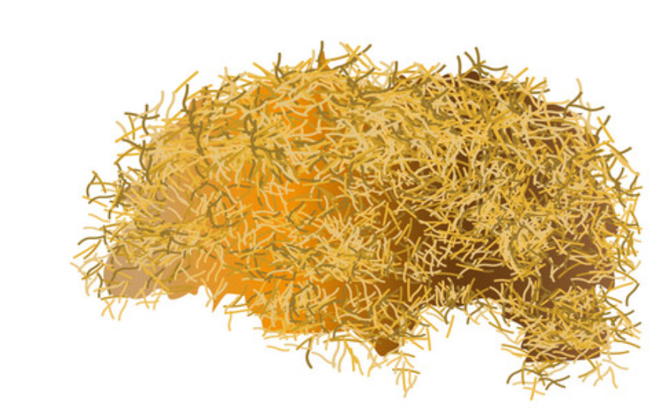
nb_item_per sample | NA
nb_indiv_per_sample | NA
is_indiv_known | NA
error_meaning | NA
obs_id | reference_ID_oX
obs_resolution | NA
obs_id_nested | NA

Slide 14

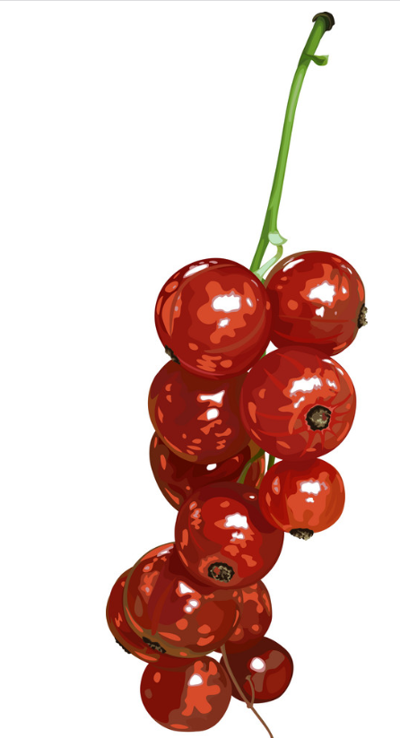

nb_item_per sample | NA
nb_indiv_per_sample | NA
is_indiv_known | NA
error_meaning | NA
obs_id | reference_ID_oX
obs_resolution | NA
obs_id_nested | NA

Slide 15
I.3. Body

Slide 16

nb_item_per sample | 1
nb_indiv_per_sample | 1
is_indiv_known | NA
error_meaning | NA
obs_id | reference_ID_oX
obs_resolution | individual
obs_id_nested | NA

Slide 17
nb_item_per sample | >1
nb_indiv_per_sample | 1
is_indiv_known | NA
error_meaning | NA
obs_id | reference_ID_oX
obs_resolution | population
obs_id_nested | NA

Slide 18

nb_item_per sample | 1
nb_indiv_per_sample | 1
is_indiv_known | NA
error_meaning | NA
obs_id | reference_ID_oX
obs_resolution | individual
obs_id_nested | NA
Notes:
There is a column, not shown here, allowing to inform about the body part

Slide 19
II. Statistical data

Slide 20
II.1. One item per sample

Slide 21
II.1.i. Feces

Slide 22

alpha
alpha
alpha
nb_item_per sample | 1
nb_indiv_per_sample | 1
is_indiv_known | 1
error_meaning | intra_indiv_rep
obs_id | reference_ID_oX
obs_resolution | NA
obs_id_nested | NA
Statistics → average, variance

Slide 23
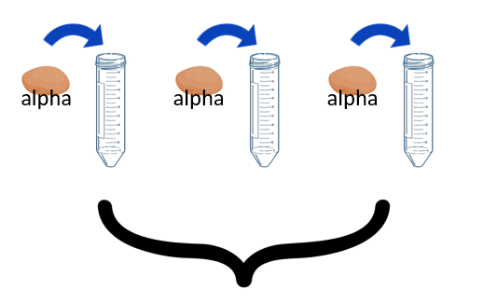
t₁
t₁
t₂
t₃
nb_item_per sample | 1
nb_indiv_per_sample | 1
is_indiv_known | 1
error_meaning | intra_indiv_rep
obs_id | reference_ID_oX
obs_resolution | NA
obs_id_nested | reference_ID_rep1_t1
Rep 1
t₁
Rep 2
nb_item_per sample | 1
nb_indiv_per_sample | 1
is_indiv_known | 1
error_meaning | intra_indiv_rep
obs_id | reference_ID_oX
obs_resolution | NA
obs_id_nested | reference_ID_rep2_t1
time
Etc…

Slide 24
Rep 1
nb_item_per sample | 1
nb_indiv_per_sample | 1
is_indiv_known | 1
error_meaning | intra_indiv_rep
obs_id | reference_ID_oX
obs_resolution | NA
obs_id_nested | reference_ID_rep1_t1
Rep 1
Rep 2
Rep 2
nb_item_per sample | 1
nb_indiv_per_sample | 1
is_indiv_known | 1
error_meaning | intra_indiv_rep
obs_id | reference_ID_oX
obs_resolution | NA
obs_id_nested | reference_ID_rep2_t1

Slide 25
Weird case alert !
nb_item_per sample | 1
nb_indiv_per_sample | 1
is_indiv_known | 1
error_meaning | intra_indiv_rep
obs_id | reference_ID_oX
obs_resolution | NA
obs_id_nested | NA
Statistics → average, variance
Notes:
Case where it is likely that all tubes recieved items from the same individual. We put a 1 in is_indiv_known

Slide 26
alpha
bravo
charlie
nb_item_per sample | 1
nb_indiv_per_sample | 1
is_indiv_known | 1
error_meaning | inter_indiv_rep
obs_id | reference_ID_oX
obs_resolution | NA
obs_id_nested | NA
Statistics → average, variance

Slide 27
Weird case alert !
nb_item_per sample | 1
nb_indiv_per_sample | 1
is_indiv_known | 1
error_meaning | inter_indiv_rep
obs_id | reference_ID_oX
obs_resolution | NA
obs_id_nested | NA
Statistics → average, variance
Notes:
Case where it is likely that all tubes recieved items from different individual. We put a 1 in is_indiv_known

Slide 28
Weird case alert !
nb_item_per sample | 1
nb_indiv_per_sample | 1
is_indiv_known | 0
error_meaning | NA
obs_id | reference_ID_oX
obs_resolution | NA
obs_id_nested | NA
Statistics → average, variance
Notes:
Case where we have no clue whether items come from different individual or of the same. Therefore, we can not fill the error meaning or the obs_resolution.

Slide 29
II.1.ii. Food

Slide 30
nb_item_per sample | NA
nb_indiv_per_sample | NA
is_indiv_known | NA
error_meaning | intra_food_rep
obs_id | reference_ID_oX
obs_resolution | NA
obs_id_nested | NA
Statistics → average, variance

Slide 31
nb_item_per sample | NA
nb_indiv_per_sample | NA
is_indiv_known | NA
error_meaning | inter_food_rep
obs_id | reference_ID_oX
obs_resolution | NA
obs_id_nested | NA
Statistics → average, variance

Slide 32
II.1.iii. Body

Slide 33
nb_item_per sample | 1
nb_indiv_per_sample | 1
is_indiv_known | NA
error_meaning | inter_indiv_rep
obs_id | reference_ID_oX
obs_resolution | NA
obs_id_nested | NA
Statistics → average, variance

Slide 34
II.2. Several items per sample

Slide 35
II.2.i. Feces

Slide 36
alpha
alpha
alpha
nb_item_per sample | >1
nb_indiv_per_sample | 1
is_indiv_known | 1
error_meaning | intra_indiv_rep
obs_id | reference_ID_oX
obs_resolution | NA
obs_id_nested | NA
Statistics → average, variance

Slide 37
alpha
bravo
charlie
nb_item_per sample | >1
nb_indiv_per_sample | 1
is_indiv_known | 1
error_meaning | inter_indiv_rep
obs_id | reference_ID_oX
obs_resolution | NA
obs_id_nested | NA
Statistics → average, variance

Slide 38
alpha
bravo
bravo
bravo
alpha
alpha
charlie
charlie
charlie
nb_item_per sample | >1
nb_indiv_per_sample | >1
is_indiv_known | 1
error_meaning | intra_pop_rep
obs_id | reference_ID_oX
obs_resolution | NA
obs_id_nested | NA
Statistics → average, variance

Slide 39
alpha
bravo
echo
hotel
delta
golf
charlie
foxtrot
india
nb_item_per sample | >1
nb_indiv_per_sample | >1
is_indiv_known | 1
error_meaning | inter_pop_rep
obs_id | reference_ID_oX
obs_resolution | NA
obs_id_nested | NA
Statistics → average, variance

Slide 40
nb_item_per sample | >1
nb_indiv_per_sample | 1
is_indiv_known | 0
error_meaning | NA
obs_id | reference_ID_oX
obs_resolution | NA
obs_id_nested | NA
Statistics → average, variance
Notes:
Case where we have no clue whether items come from different individual or of the same. Therefore, we can not fill the error meaning or the obs_resolution.

Slide 41
II.2.ii. Food
Notes:
Irrelevant cases

Slide 42
II.2.iii. Body
Notes:
Irrelevant cases

