Slide 1
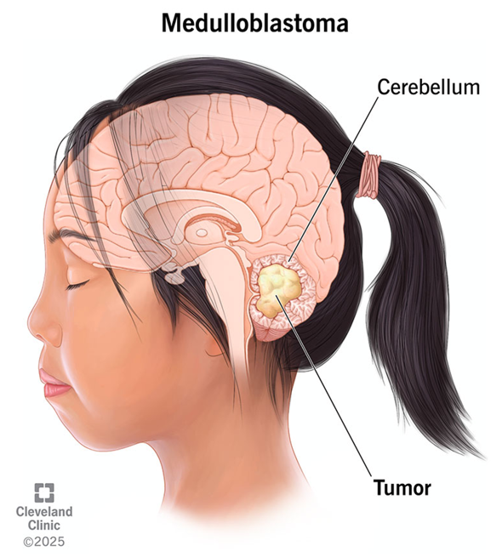
SHH-Activated Medulloblastoma: The Basics
Arises from cerebellar granule neuron precursors (GNPs) driven by constitutive Sonic hedgehog signaling
SHH
→
PTCH1
⊣
SMO
→
SUFU
⊣
GLI1/2
→
MYCN
Cyclin D1
SHH from Purkinje cells → GNP proliferation. Red = recurrently mutated or amplified in SHH medulloblastoma.
Epidemiology
Genetics
~25–30% of medulloblastomas
Bimodal: infants (<3 y) and adults
Often in a cerebellar hemisphere
Infants: SUFU, PTCH1
Children: TP53, MYCN/GLI2 amplification
Adults: PTCH1, SMO, TERT promoter
Germline: Gorlin, Li-Fraumeni, ELP1
Pathology & WHO CNS5
Treatment
Desmoplastic/nodular; MBEN in infants
SHH TP53-wild-type vs. TP53-mutant
TP53-mutant: poorest outcome
Resection + CSI (age ≥3) + chemotherapy
Infants: radiation-sparing regimens
SMO inhibitors: upstream mutations only
Growth-plate fusion risk in children
Illustration © 2025 Cleveland Clinic. Northcott PA, et al. Nat Rev Dis Primers. 2019;5(1):11. PMID: 30765705. Louis DN, et al. Neuro Oncol. 2021;23(8):1231–1251. PMID: 34185076. Robinson GW, et al. J Clin Oncol. 2015;33(24):2646–2654. PMID: 26169613.
Notes:
SHH-activated medulloblastoma arises from cerebellar granule neuron precursors, which normally proliferate in response to Sonic hedgehog secreted by Purkinje cells. In the tumor, the pathway is constitutively active: loss of PTCH1 or SUFU, activating SMO mutations, or GLI2/MYCN amplification. It accounts for about a quarter to a third of medulloblastomas, with peaks in infancy and adulthood, and often arises in a cerebellar hemisphere. Infants typically carry SUFU or PTCH1 alterations, children TP53 mutations (frequently germline Li-Fraumeni) with MYCN/GLI2 amplification, and adults PTCH1, SMO and TERT promoter mutations. Germline predisposition includes Gorlin syndrome (PTCH1/SUFU), Li-Fraumeni (TP53) and ELP1. WHO CNS5 separates SHH TP53-wild-type from SHH TP53-mutant tumors; the TP53-mutant group has the worst outcome, while infants with desmoplastic/nodular or MBEN histology do well. Standard therapy is maximal safe resection, craniospinal irradiation for children 3 and older, and chemotherapy. SMO inhibitors such as vismodegib work in tumors with alterations upstream of SMO (PTCH1, SMO) but not downstream (SUFU, GLI2, MYCN), and they can cause premature growth-plate fusion in skeletally immature children (Robinson et al., JCO 2015).

