Slide 1
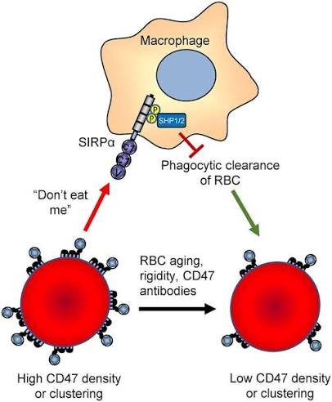
Calreticulin (“eat me”)

