Slide 1
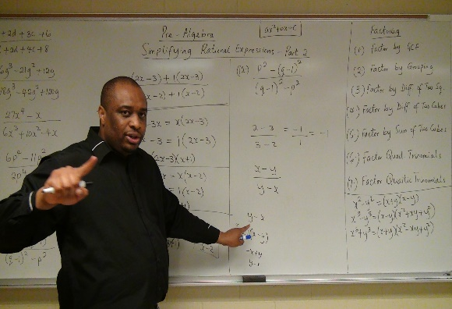



Buying a car in the u.S. – part 1 www.samuelchukwuemeka.com The Joy of a Teacher is the Success of his Students. – Samuel Chukwuemeka Calculator: www.finance-calculators.appspot.com
Samuel Chukwuemeka
B.Eng., A.A.T, M.Ed., M.S

Slide 2
Vocabulary words
Installment Loan
Amortization
Closed-End Lease
Open-End Lease
Appraised Value
Residual Value
Auto Insurance
Liability Coverage
Bodily Injury Liability
Property Damage Liability
Collision Coverage
Comprehensive Coverage

Slide 3
objectives
At the end of this presentation, students will:
Define the terms used in car purchases and leases.
Differentiate between a closed-end lease and an open-end lease.
Compare and contrast “Leasing” versus “Buying”.
Define the basic kinds of car insurance.
Calculate the monthly payments for a car loan.
Calculate the interests for a car loan.
Calculate the annual fuel expense for cars.
Pre-requisite Video: Mathematics of Finance

Slide 4
Definitions / terms 1
When buying a car in the U.S (used or new), you can either
Pay cash/check or
Take out an installment loan by accepting the financing of the car.
It is always a good practice to negotiate the “sticker price” on the car. The sticker prices are not the actual purchase prices.
If you pay cash/check, the purchase price becomes reduced even further.
If you accept the financing of the car, the price is higher than if you pay cash/check.
Before the car dealer finances your car via a financial institution, a collateral is usually required.

Slide 5
Definitions / terms 2
The collateral could be a proof that you work such as regular pay stubs; bank accounts; and other valuable property among others.
In addition, a down payment is usually required.
The interest rate on the car loan depends on several factors including your credit score and history, your job/profession and annual salary, the amount of the loan and the repayment period among others.
An installment loan is a loan/money you borrow, and agree to pay back in installments. This means that you make equal periodic payments over the term of the loan. The periodic payments could be weekly payments, bi-weekly payments, monthly payments, or some other periodic payments as the case may be.

Slide 6
Definitions / terms 3
Installment loans allow consumers to finance high price purchases of some things that they would otherwise not be able to afford immediately. These includes cars and homes among others.
Amortization is defined as the repayment of loan by installments.
In the U.S, almost all installment loans are based on monthly payments and the interest on the loan is compounded on a monthly basis. The Amortization Formula is used for these calculations.
Leasing a car is the act of paying a specified amount of money to use a car over a period of time. There are two types of leasing contracts: a closed-end lease and an open-end lease.
The difference between a closed-end lease and an open-end lease typically lies on who is financially responsible for the decline in value of the leased vehicle.

Slide 7
Definitions / terms 4
In a closed-end lease, you make a fixed monthly payment based on estimated usage. When the lease ends; you return the car, pay for any excess mileage, and pay for any damage. However, the dealer or the leasing company is financially responsible for any difference between the appraised value of the car and the residual value.
In an open-end lease, you make a fixed monthly payment based on the residual value of the car. When the lease ends, you return the car and make a payment based on the appraised value of the car at that time compared to it’s residual value. If the appraised value is less than the residual value, you pay all or part of the difference. If the appraised value is equal to the residual value, you owe nothing. If the appraised value is greater than the residual value, you may receive a refund.

Slide 8
Definitions / terms 5
The appraised value of a car is the assessed value of the car.
The residual value of a car is the estimated resale value of the car at the end of the lease.
Would you buy a new or used car?
A new car loses an average of 12% of its value as soon as it is driven off the dealer’s car lot. Even before you get home, it is already a used car.
Used cars are a good option – especially a one-year to three-year old car because the annual depreciation in price is greatest over the first few years.

Slide 9
Definitions / terms 6
The two most commonly used sources of pricing information for used cars are the:
National Automobile Dealers Association Official Used Car Guide
Kelley Blue Book Used Car Guide
Do you need an auto insurance? YES, YOU DO!
Auto insurance is necessary whether you own or lease a car!
Purchasing auto insurance means buying protection against damage or loss associated with unexpected events.
A policyholder is one who purchases auto insurance policy.
Auto insurance rates depends on several factors including younger drivers with limited driving experience, many tickets and points on driving history, poor driving record, place of residence, value of the car, and the number of miles driven each year among others.

Slide 10
Definitions / terms 7
Auto Insurance coverage includes:
Liability Coverage
Collison Coverage
Comprehensive Coverage
Liability Coverage is the coverage required by almost all U.S states. It is the insurance guarding against damage or loss that the policyholder may cause another person in the form of bodily injury or property damage. Liability Coverage includes:
Bodily Injury Liability
Property Damage Liability

Slide 11
Definitions / terms 8
Bodily Injury Liability covers the costs of lawsuits if someone is injured or killed in an accident in which the policyholder is at fault.
Property Damage Liability covers damage to other cars and property from the operation of the car of the policyholder.
Collision Coverage and Comprehensive Coverage is also required when one is paying for a car loan or when one is leasing a car.
Collison Coverage covers the damage or loss of the car of the policyholder if the policyholder is involved in an accident.
Comprehensive Coverage covers the damage or loss of the car due to perils such as fire, falling objects, theft, collision with an animal and acts of nature.

Slide 12
Buying versus leasing
Buying | Leasing
A down payment is usually required. | A down payment may or may not be required.
Loan monthly payments are higher when compared to lease monthly payments. | Lease monthly payments are lower than loan monthly payments.
When you finish paying for the car, you own the car. | When the lease ends, you do not own the car.
There is no limit on the mileage you put on the car because you are buying it. | There is a mileage limit (usually 12000 – 15000 per year) when you lease the car. If you exceed the number of miles allowed, you pay for excess mileage.
Sometimes, refinancing your car can reduce your monthly payments and lower the overall cost of your car. But, you are responsible to pay off the old loan. | There are penalties when you end your lease early.
You, the buyer has the risk of your car’s market value when you trade or sell it. | You, the lessor has the risk of the future market value of the car.

Slide 13
Driving safety tips
Enroll in a driving school. Take a mature driver course. Test and get your driver license.
Obey traffic regulations including child passenger safety among others.
Click It or Tick-et! Always wear your seat / safety belt when you get in your car.
If you must drive, don’t drink. If you must drink, don’t drive.
Avoid road rage. Stop aggressive driving.
Better be late than the late. Stop speeding.
Everyone is a pedestrian…and the tips continue

Slide 14

Formulas 1
Amortization Formula
$PMT=\frac{PV}{m}∗[\frac{r}{1−{\left(1+\frac{r}{m}\right)}^{−mt}}]$ 1st Formula
$PMT=PV∗[\frac{i}{1−{\left(1+i\right)}^{−n}}]$ 2nd Formula
$i=\frac{r}{m}$
$n=mt$

Slide 15
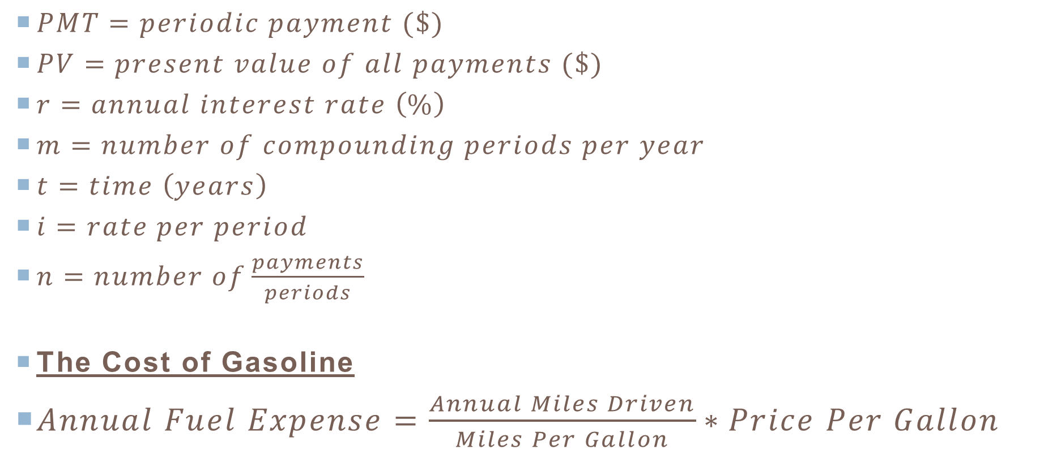
Formulas 2
$PMT=periodic payment (\$)$
$PV=present value of all payments (\$)$
$r=annual interest rate \left(\%\right)$
$m=number of compounding periods per year$
$t=time \left(years\right)$
$i=rate per period$
$n=number of\frac{payments}{periods}$
The Cost of Gasoline
$Annual Fuel Expense=\frac{Annual Miles Driven}{Miles Per Gallon}∗Price Per Gallon$

Slide 16
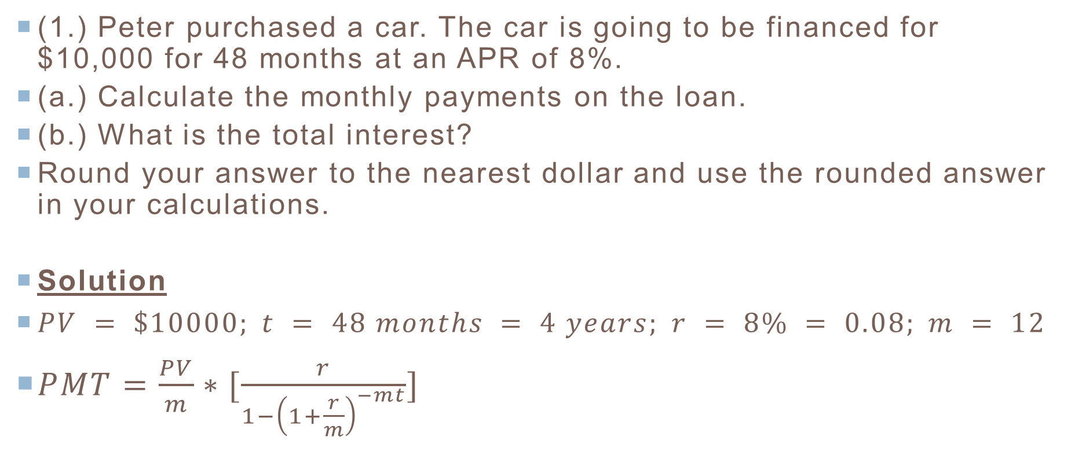
Question 1
(1.) Peter purchased a car. The car is going to be financed for $10,000 for 48 months at an APR of 8%.
(a.) Calculate the monthly payments on the loan.
(b.) What is the total interest?
Round your answer to the nearest dollar and use the rounded answer in your calculations.
Solution
$PV = \$10000; t = 48 months = 4 years; r = 8\% = 0.08; m = 12$
$PMT=\frac{PV}{m}∗[\frac{r}{1−{\left(1+\frac{r}{m}\right)}^{−mt}}]$

Slide 17
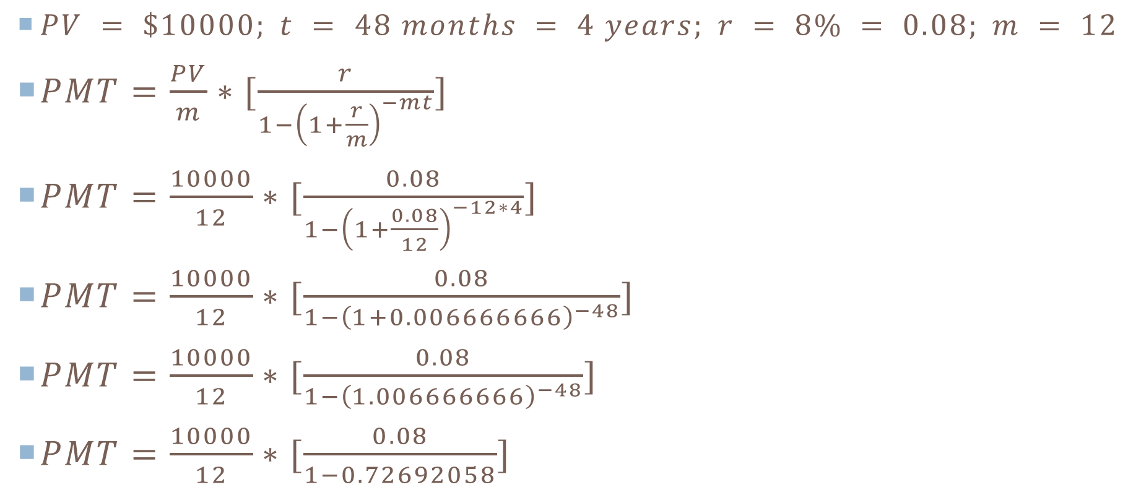
Solution to Question 1 1
$PV = \$10000; t = 48 months = 4 years; r = 8\% = 0.08; m = 12$
$PMT=\frac{PV}{m}∗[\frac{r}{1−{\left(1+\frac{r}{m}\right)}^{−mt}}]$
$PMT=\frac{10000}{12}∗[\frac{0.08}{1−{\left(1+\frac{0.08}{12}\right)}^{−12∗4}}]$
$PMT=\frac{10000}{12}∗[\frac{0.08}{1−{\left(1+0.006666666\right)}^{−48}}]$
$PMT=\frac{10000}{12}∗[\frac{0.08}{1−{\left(1.006666666\right)}^{−48}}]$
$PMT=\frac{10000}{12}∗[\frac{0.08}{1−0.72692058}]$

Slide 18
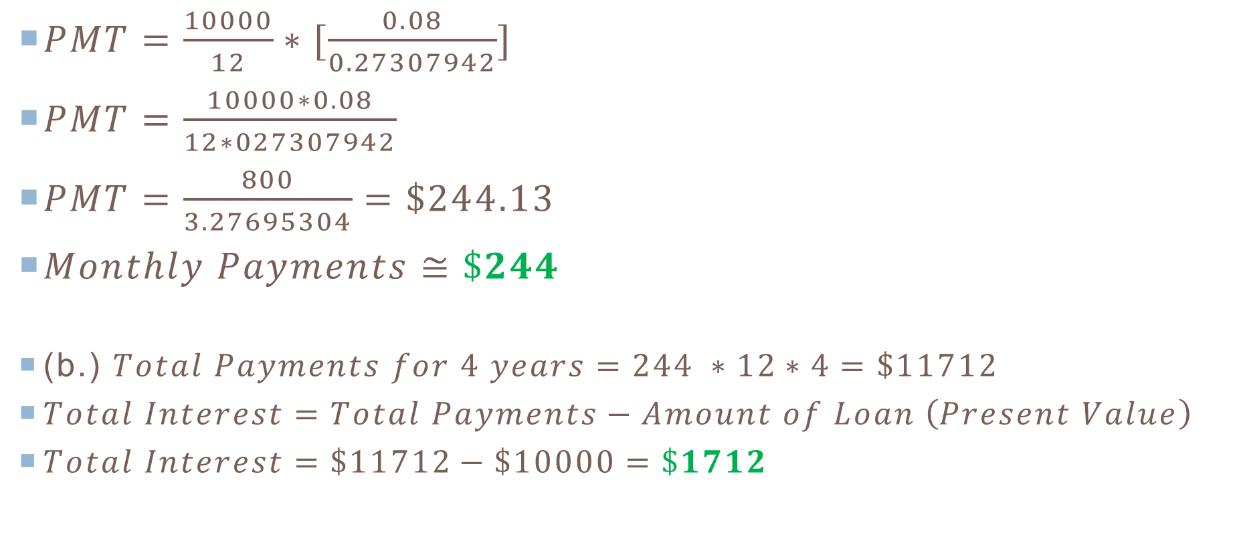
Solution to Question 1 2
$PMT=\frac{10000}{12}∗[\frac{0.08}{0.27307942}]$
$PMT=\frac{10000∗0.08}{12∗027307942}$
$PMT=\frac{800}{3.27695304}=\$244.13$
$Monthly Payments≅\$244$
(b.) $Total Payments for 4 years=244 ∗12∗4=\$11712$
$Total Interest=Total Payments−Amount of Loan \left(Present Value\right)$
$Total Interest=\$11712−\$10000=\$1712$

Slide 19
Question 2
(2.) Paul is shopping for a new car. He found a nice energy efficient car he liked and negotiated a good price with the dealer: $21,995 including taxes and license fees. In addition, the car manufacturer offered him two options:
He can choose between a $2000 manufacturer’s rebate and then finance the balance at the dealer’s going rate of 6% APR for a 60-month loan.
OR
He can use a special financing at 2.4% APR for 60 months.
Which option should he choose? How much savings would he have when comparing the two options over the period of the loan? Round all answers to the nearest dollar.

Slide 20
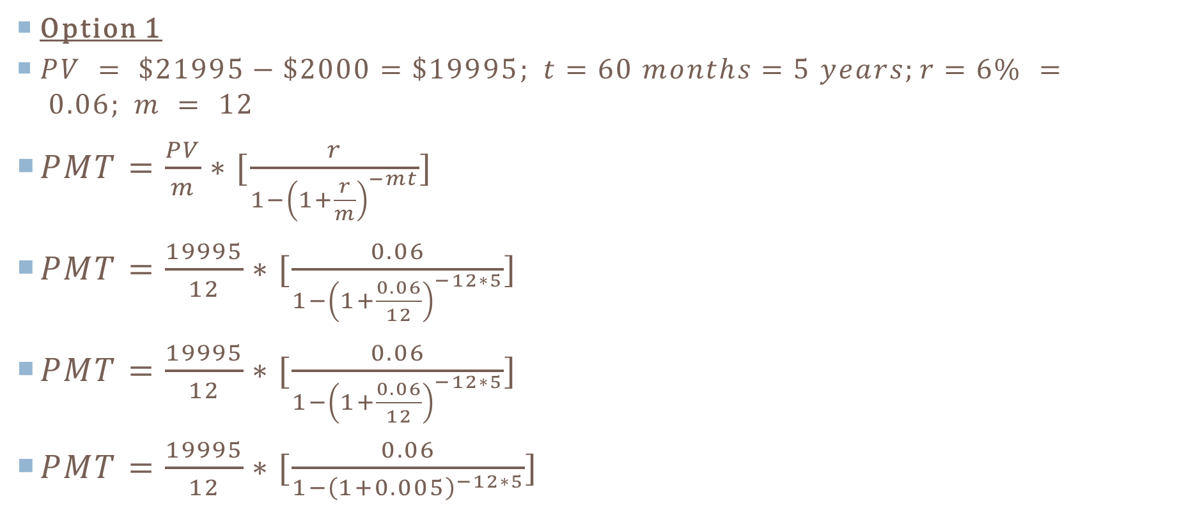
Solution to Question 2 1
Option 1
$PV = \$21995−\$2000=\$19995; t=60 months=5 years;r=6\% = 0.06; m = 12$
$PMT=\frac{PV}{m}∗[\frac{r}{1−{\left(1+\frac{r}{m}\right)}^{−mt}}]$
$PMT=\frac{19995}{12}∗[\frac{0.06}{1−{\left(1+\frac{0.06}{12}\right)}^{−12∗5}}]$
$PMT=\frac{19995}{12}∗[\frac{0.06}{1−{\left(1+\frac{0.06}{12}\right)}^{−12∗5}}]$
$PMT=\frac{19995}{12}∗[\frac{0.06}{1−{\left(1+0.005\right)}^{−12∗5}}]$

Slide 21
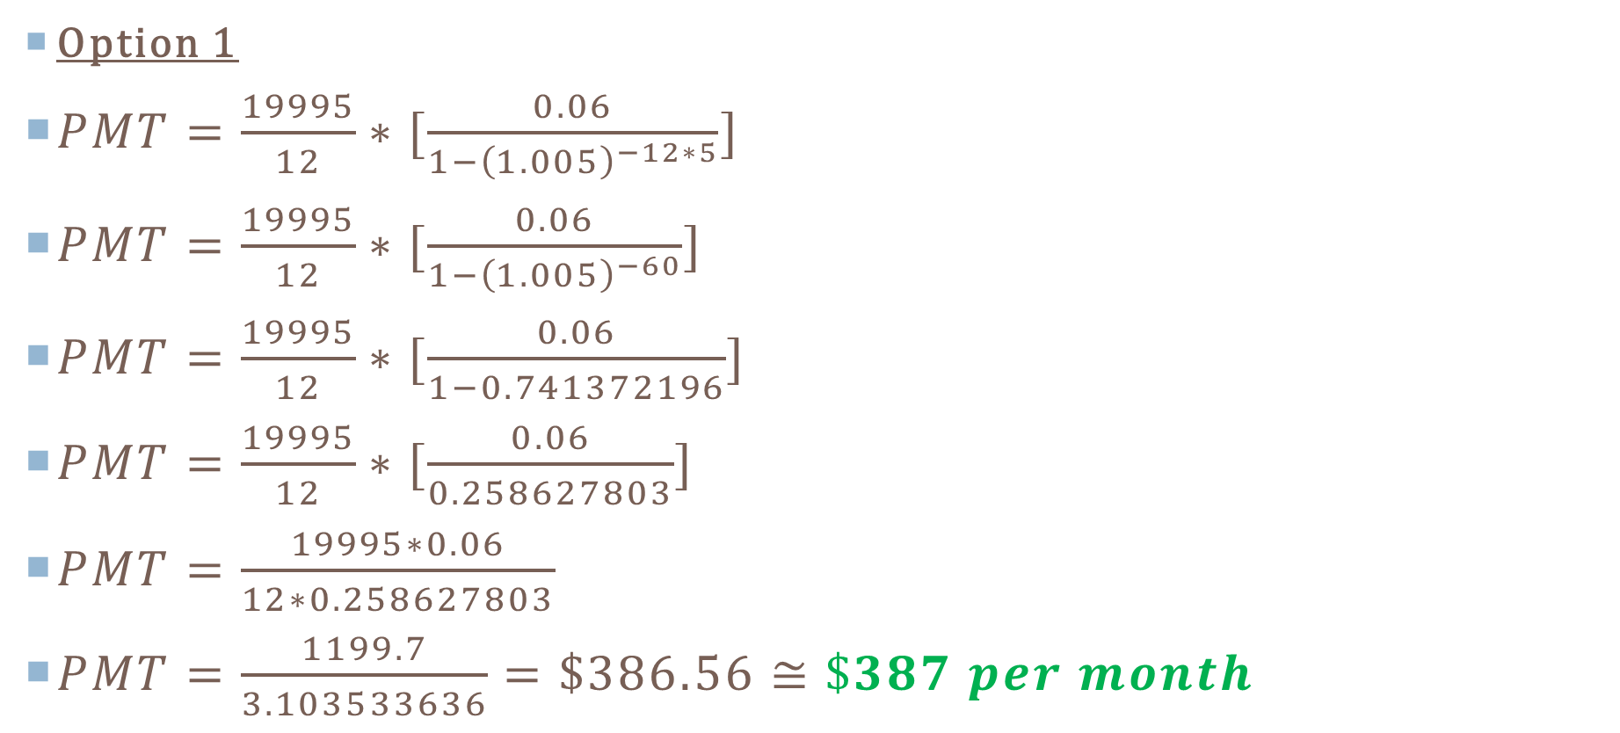
Solution to Question 2 2
Option 1
$PMT=\frac{19995}{12}∗[\frac{0.06}{1−{\left(1.005\right)}^{−12∗5}}]$
$PMT=\frac{19995}{12}∗[\frac{0.06}{1−{\left(1.005\right)}^{−60}}]$
$PMT=\frac{19995}{12}∗[\frac{0.06}{1−0.741372196}]$
$PMT=\frac{19995}{12}∗[\frac{0.06}{0.258627803}]$
$PMT=\frac{19995∗0.06}{12∗0.258627803}$
$PMT=\frac{1199.7}{3.103533636}=\$386.56≅\$387 per month$

Slide 22
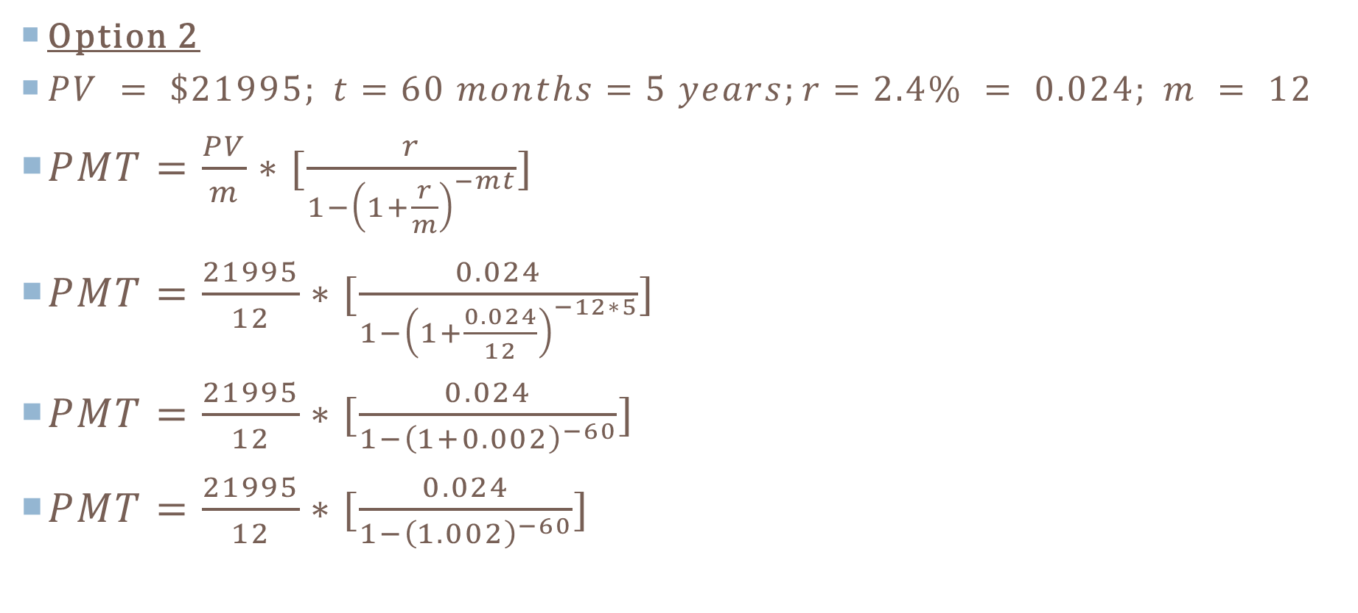
Solution to Question 2 3
Option 2
$PV = \$21995; t=60 months=5 years;r=2.4\% = 0.024; m = 12$
$PMT=\frac{PV}{m}∗[\frac{r}{1−{\left(1+\frac{r}{m}\right)}^{−mt}}]$
$PMT=\frac{21995}{12}∗[\frac{0.024}{1−{\left(1+\frac{0.024}{12}\right)}^{−12∗5}}]$
$PMT=\frac{21995}{12}∗[\frac{0.024}{1−{\left(1+0.002\right)}^{−60}}]$
$PMT=\frac{21995}{12}∗[\frac{0.024}{1−{\left(1.002\right)}^{−60}}]$

Slide 23
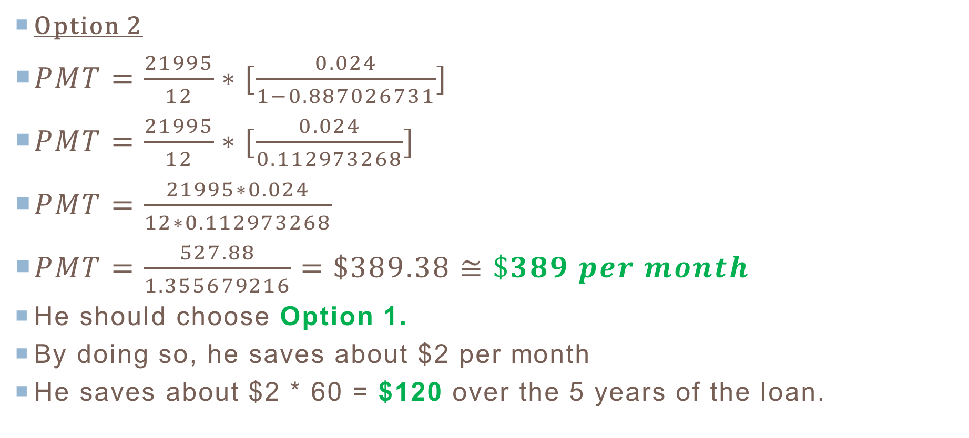
Solution to Question 2 4
Option 2
$PMT=\frac{21995}{12}∗[\frac{0.024}{1−0.887026731}]$
$PMT=\frac{21995}{12}∗[\frac{0.024}{0.112973268}]$
$PMT=\frac{21995∗0.024}{12∗0.112973268}$
$PMT=\frac{527.88}{1.355679216}=\$389.38≅\$389 per month$
He should choose Option 1.
By doing so, he saves about $2 per month
He saves about $2 * 60 = $120 over the 5 years of the loan.

Slide 24
Question 3
(3.) Daniel is 40 years old. He intends to start his own company. At his last job, he usually drives 40000 miles per year and gas averages $4 per gallon.
(a.) He wanted to buy a hybrid car that averages 40 miles per gallon rather than an SUV that averages 16 miles per gallon. Did he make a good decision? How much would he save in annual fuel expenses by doing so?
(b.) He intends to deposit the monthly fuel savings at the end of each month into an annuity that pays 5.2% compounded monthly. If he decides to retire in 20 years, how much would he have saved?
Round all answers to the nearest dollar.

Slide 25
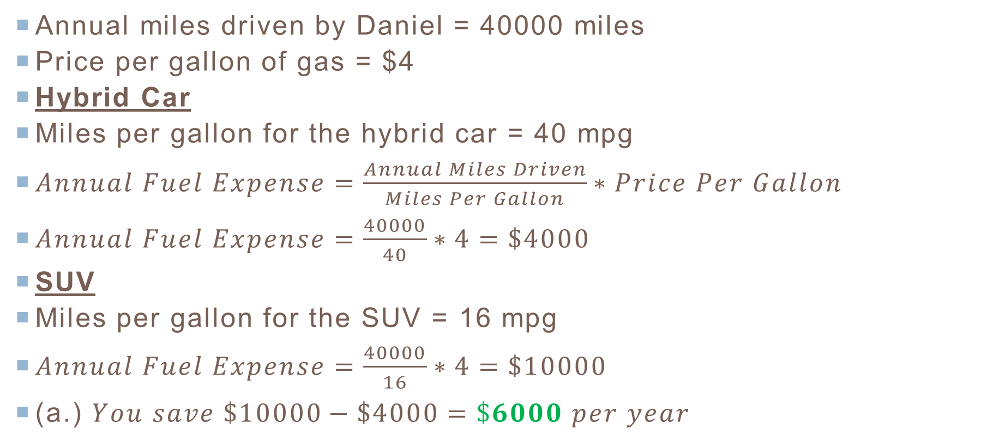
Solution to Question 3 1
Annual miles driven by Daniel = 40000 miles
Price per gallon of gas = $4
Hybrid Car
Miles per gallon for the hybrid car = 40 mpg
$Annual Fuel Expense=\frac{Annual Miles Driven}{Miles Per Gallon}∗Price Per Gallon$
$Annual Fuel Expense=\frac{40000}{40}∗4=\$4000$
SUV
Miles per gallon for the SUV = 16 mpg
$Annual Fuel Expense=\frac{40000}{16}∗4=\$10000$
(a.) $You save \$10000−\$4000=\$6000 per year$

Slide 26
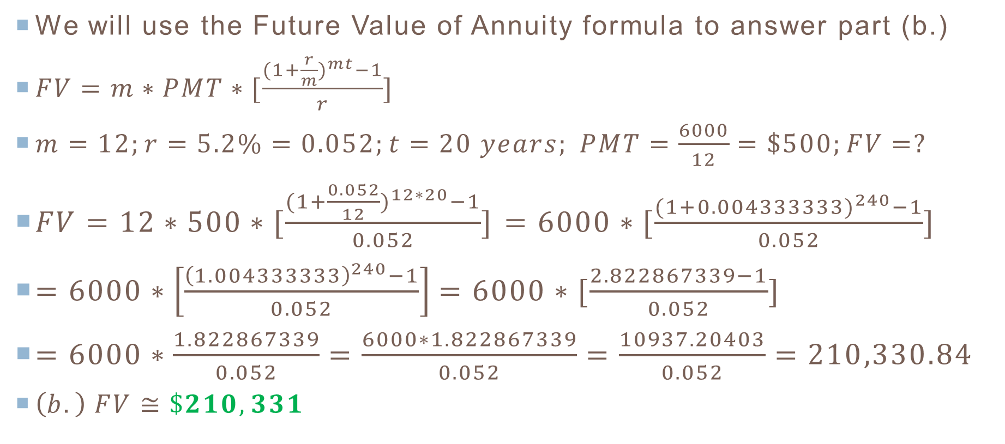
Solution to Question 3 2
We will use the Future Value of Annuity formula to answer part (b.)
$FV=m∗PMT∗[\frac{{(1+\frac{r}{m})}^{mt}−1}{r}]$
$m=12;r=5.2\%=0.052;t=20 years; PMT=\frac{6000}{12}=\$500;FV=?$
$FV=12∗500∗[\frac{{(1+\frac{0.052}{12})}^{12∗20}−1}{0.052}]$ $=6000∗[\frac{{(1+0.004333333)}^{240}−1}{0.052}]$
$=6000∗\left[\frac{{\left(1.004333333\right)}^{240}−1}{0.052}\right]=6000∗[\frac{2.822867339−1}{0.052}]$
$=6000∗\frac{1.822867339}{0.052}=\frac{6000∗1.822867339}{0.052}=\frac{10937.20403}{0.052}=210,330.84$
$\left(b.\right) FV≅\$210,331$

Slide 27
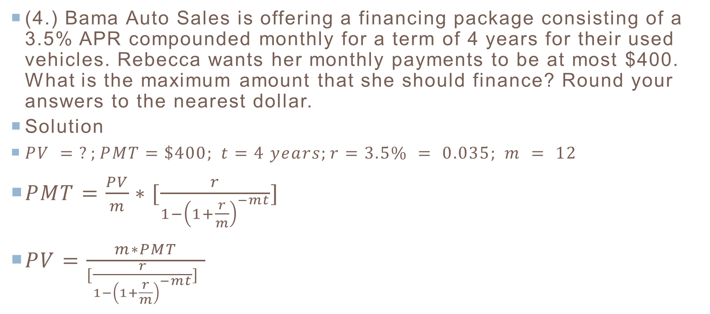
Question 4
(4.) Bama Auto Sales is offering a financing package consisting of a 3.5% APR compounded monthly for a term of 4 years for their used vehicles. Rebecca wants her monthly payments to be at most $400. What is the maximum amount that she should finance? Round your answers to the nearest dollar.
Solution
$PV = ?;PMT=\$400; t=4 years;r=3.5\% = 0.035; m = 12$
$PMT=\frac{PV}{m}∗[\frac{r}{1−{\left(1+\frac{r}{m}\right)}^{−mt}}]$
$PV=\frac{m∗PMT}{[\frac{r}{1−{\left(1+\frac{r}{m}\right)}^{−mt}}] }$

Slide 28
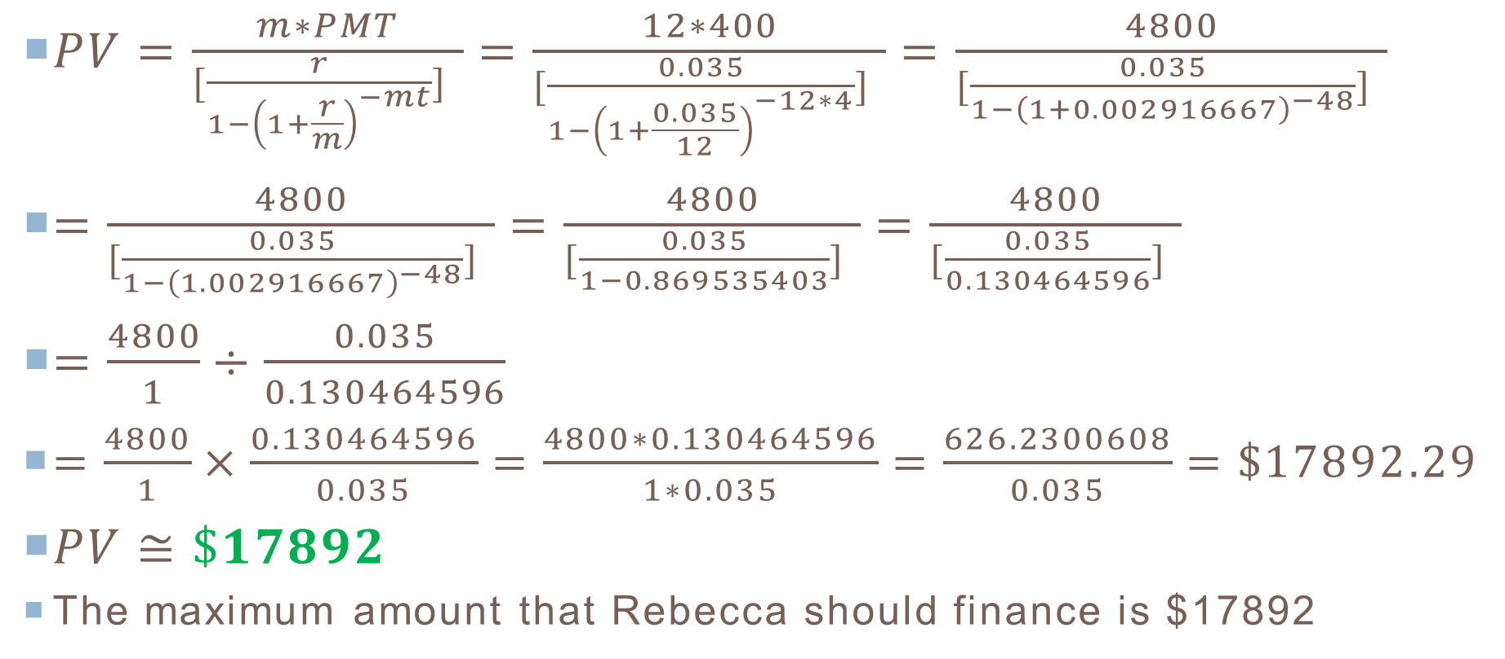
Solution to Question 4 1
$PV=\frac{m∗PMT}{[\frac{r}{1−{\left(1+\frac{r}{m}\right)}^{−mt}}] }=\frac{12∗400}{[\frac{0.035}{1−{\left(1+\frac{0.035}{12}\right)}^{−12∗4}}] }=\frac{4800}{[\frac{0.035}{1−{\left(1+0.002916667\right)}^{−48}}] }$
$=\frac{4800}{[\frac{0.035}{1−{\left(1.002916667\right)}^{−48}}] }=\frac{4800}{[\frac{0.035}{1−0.869535403}] }=\frac{4800}{[\frac{0.035}{0.130464596}] }$
$=\frac{4800}{1}÷\frac{0.035}{0.130464596}$
$=\frac{4800}{1}×\frac{0.130464596}{0.035}=\frac{4800∗0.130464596}{1∗0.035}=\frac{626.2300608}{0.035}=\$17892.29$
$PV≅\$17892$
The maximum amount that Rebecca should finance is $17892

Slide 29
Question 5
(5.) Ave Maria Cars is offering two incentives for first time buyers willing to buy new cars. Jude has saved $8,000 for a down payment on a truck that costs $56,000 including taxes and license fees.
The first incentive is a 4-year loan financed at 12.5% including a rebate of $10,000.
The second incentive has free financing / no interest for 4 years, but has no cash rebate.
Calculate the monthly payments. Which incentive should he choose?
How much savings would he have when comparing the two incentives over the period of the loan?
Calculate the total interests for each incentive.
Round all answers to the nearest dollar and use in your calculations.

Slide 30
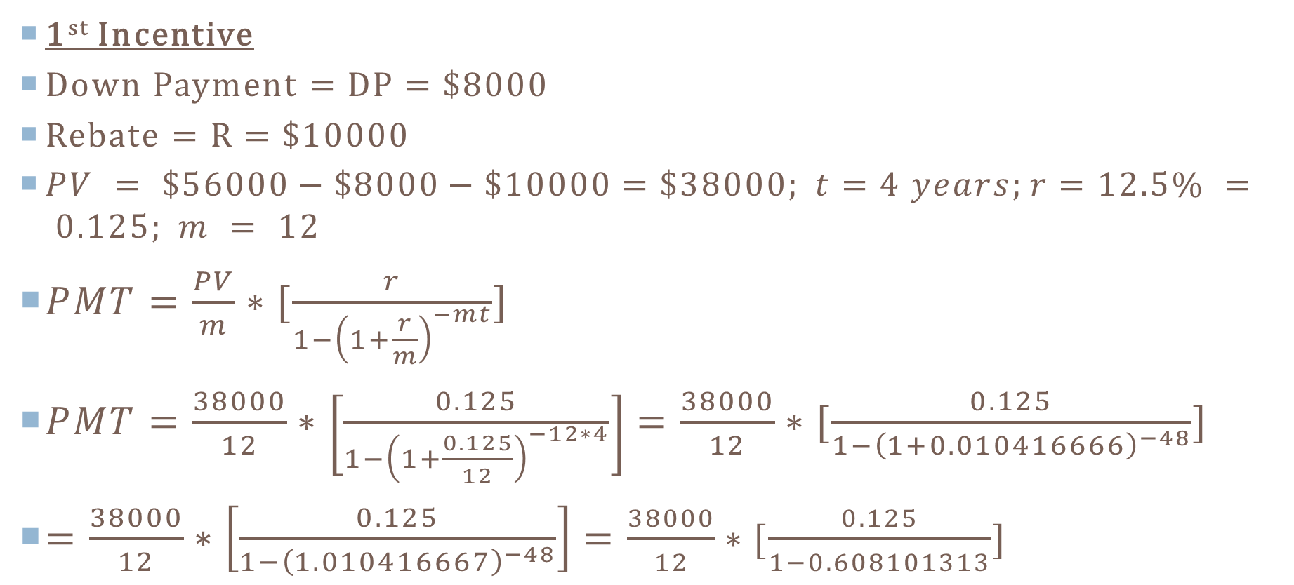
Solution to Question 5 1
1st Incentive
Down Payment = DP = $8000
Rebate = R = $10000
$PV = \$56000−\$8000−\$10000=\$38000; t=4 years;r=12.5\% = 0.125; m = 12$
$PMT=\frac{PV}{m}∗[\frac{r}{1−{\left(1+\frac{r}{m}\right)}^{−mt}}]$
$PMT=\frac{38000}{12}∗\left[\frac{0.125}{1−{\left(1+\frac{0.125}{12}\right)}^{−12∗4}}\right]=\frac{38000}{12}∗[\frac{0.125}{1−{\left(1+0.010416666\right)}^{−48}}]$
$=\frac{38000}{12}∗\left[\frac{0.125}{1−{\left(1.010416667\right)}^{−48}}\right]=\frac{38000}{12}∗[\frac{0.125}{1−0.608101313}]$

Slide 31
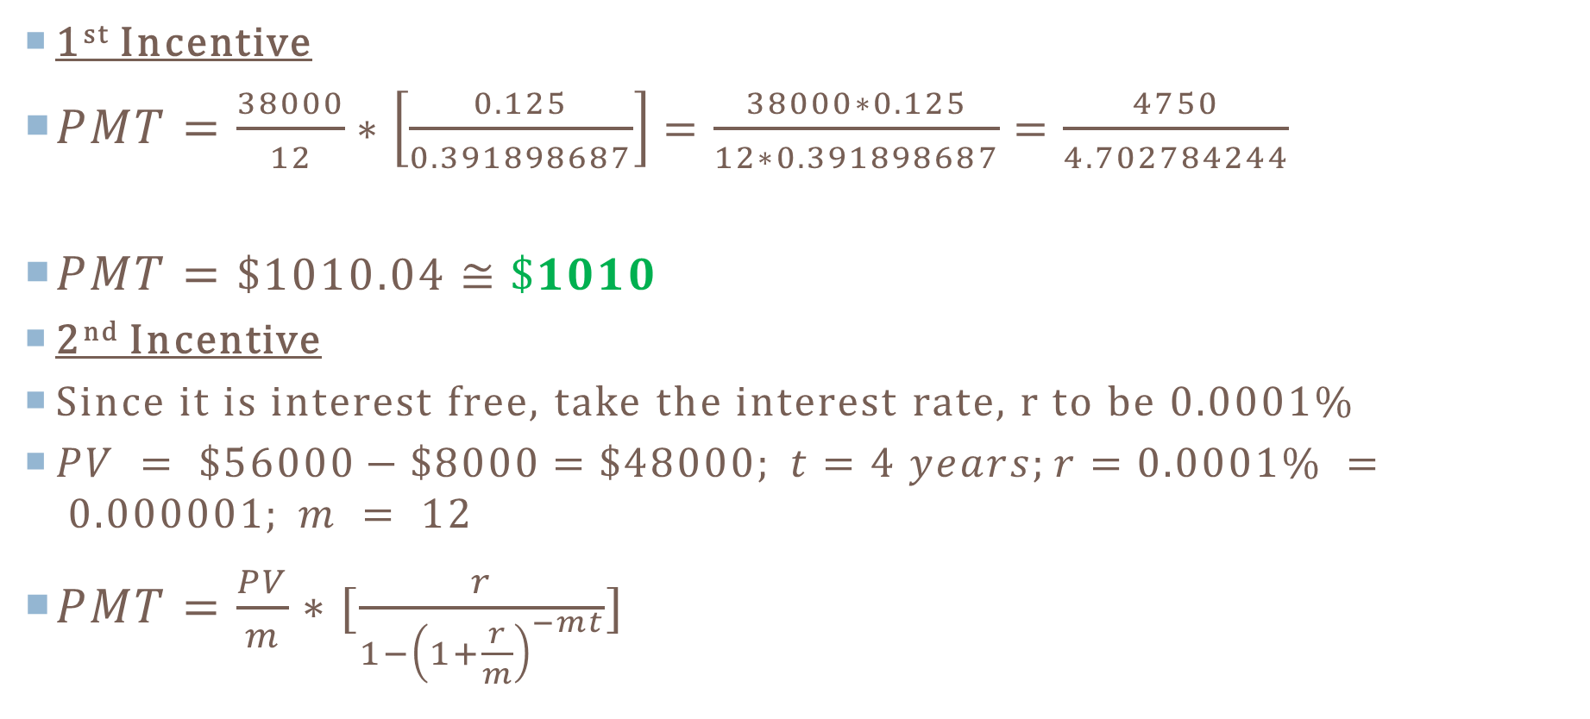
Solution to Question 5 2
1st Incentive
$PMT=\frac{38000}{12}∗\left[\frac{0.125}{0.391898687}\right]=\frac{38000∗0.125}{12∗0.391898687}=\frac{4750}{4.702784244}$
$PMT=\$1010.04≅\$1010$
2nd Incentive
Since it is interest free, take the interest rate, r to be 0.0001%
$PV = \$56000−\$8000=\$48000; t=4 years;r=0.0001\% = 0.000001; m = 12$
$PMT=\frac{PV}{m}∗[\frac{r}{1−{\left(1+\frac{r}{m}\right)}^{−mt}}]$

Slide 32
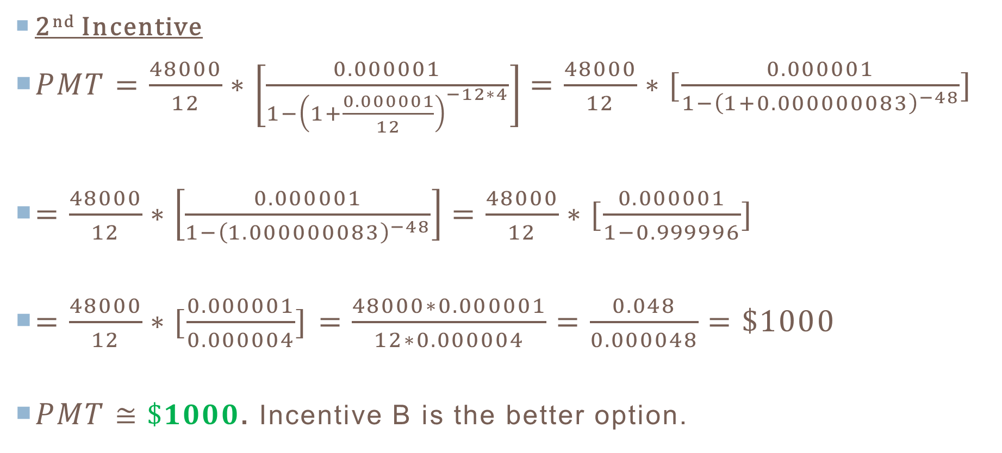
Solution to Question 5 3
2nd Incentive
$PMT=\frac{48000}{12}∗\left[\frac{0.000001}{1−{\left(1+\frac{0.000001}{12}\right)}^{−12∗4}}\right]=\frac{48000}{12}∗[\frac{0.000001}{1−{\left(1+0.000000083\right)}^{−48}}]$
$=\frac{48000}{12}∗\left[\frac{0.000001}{1−{\left(1.000000083\right)}^{−48}}\right]=\frac{48000}{12}∗[\frac{0.000001}{1−0.999996}]$
$=\frac{48000}{12}∗[\frac{0.000001}{0.000004}]$ $=\frac{48000∗0.000001}{12∗0.000004}=\frac{0.048}{0.000048}=\$1000$
$PMT≅\$1000$. Incentive B is the better option.

Slide 33
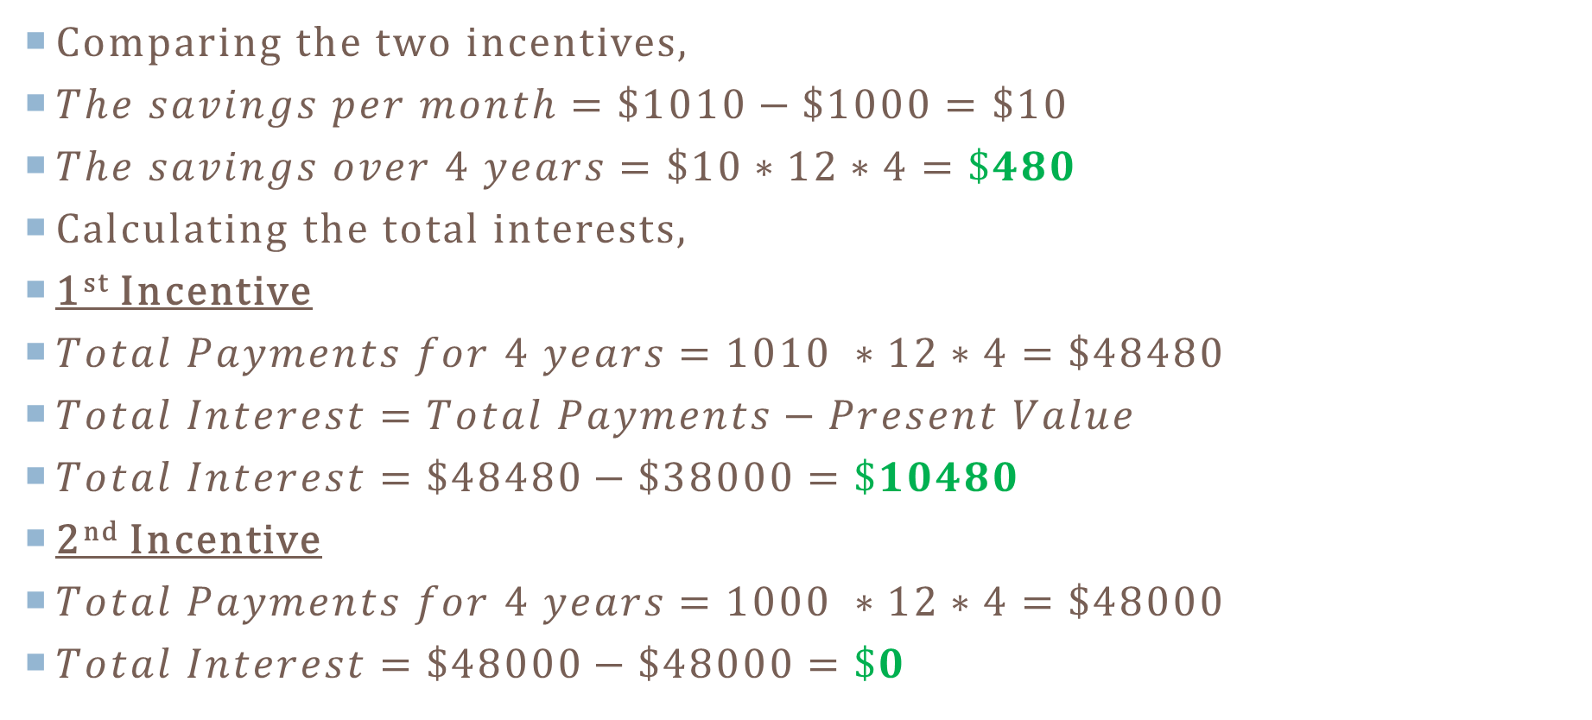
Solution to Question 5 4
Comparing the two incentives,
$The savings per month=\$1010−\$1000=\$10$
$The savings over 4 years=\$10∗12∗4=\$480$
Calculating the total interests,
1st Incentive
$Total Payments for 4 years=1010 ∗12∗4=\$48480$
$Total Interest=Total Payments−Present Value$
$Total Interest=\$48480−\$38000=\$10480$
2nd Incentive
$Total Payments for 4 years=1000 ∗12∗4=\$48000$
$Total Interest=\$48000−\$48000=\$0$

Slide 34
References / referenced websites
http://www.nada.com/
http://www.kbb.com/
http://www.federalreserve.gov/pubs/leasing/
http://www.nhtsa.gov/Driving+Safety
http://www.ehow.com/about_7488832_closed-leases-vs-open-end.html
http://www.thesupercars.org/
Blitzer, R. (2015). Thinking Mathematically Plus New Mymathlab With Pearson Etext Access Card. Pearson College Div.
Tannenbaum, P. (2014). Excursions in modern mathematics (8th ed.). Boston: Pearson Education.
Gas Price Locator by AllState Insurance

