Slide 1

MediTREX
Laboratory of Advanced Programming Report
Agnese Maria Capparelli 1794326
Andrea Orlandi 1847682
Rosapia Laudati 1894372
Samuele Cervo 1883147
A.Y.
2023-2024

Slide 2





MediTREX is a web app aimed to improve the management of medical treatments and personal health conditions.
MAIN FEATURES
DOCTOR – PATIENT COMMUNICATION
APPOINTMENT BOOKING
MEDICAL RECORDS MANAGEMENT
NEWS AND DAILY PAPERS ABOUT THE MEDICAL FIELD

Slide 3
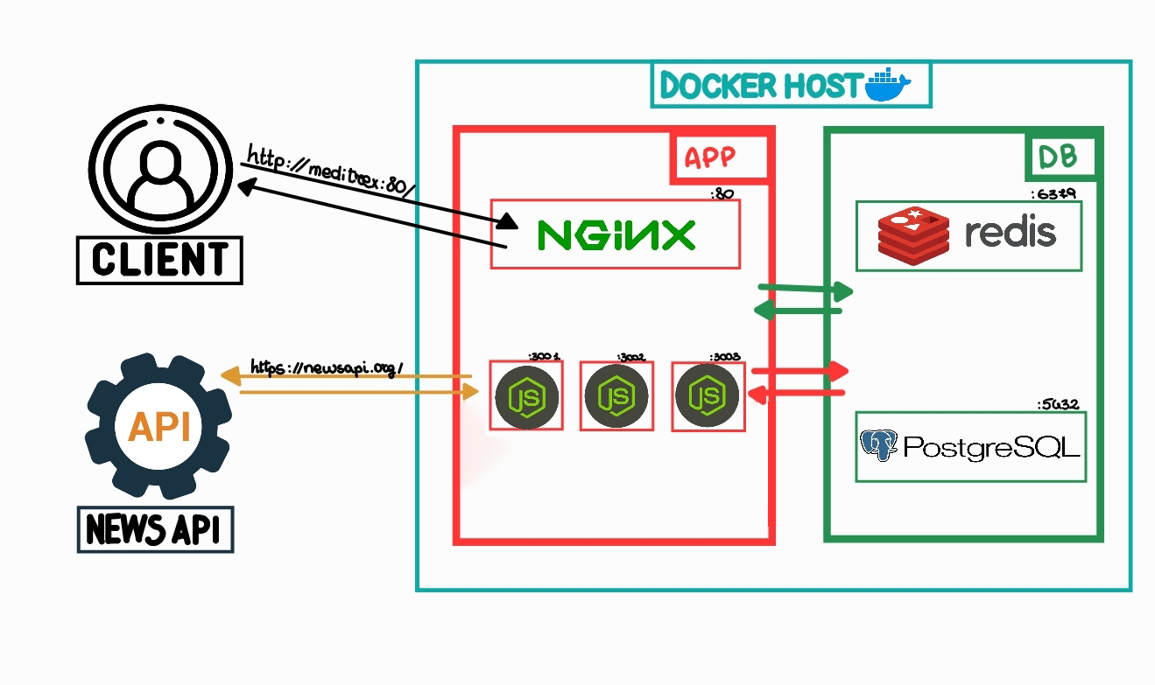
THE ARCHITECTURE
Notes:
OVERCOME LIMITATIONS
PRIMARY GOAL -> ENSURE DEP.
DOCKER
NODEJS AND REPLICAS (AVAIL. AND REL.)
3 MECHANISM

Slide 4
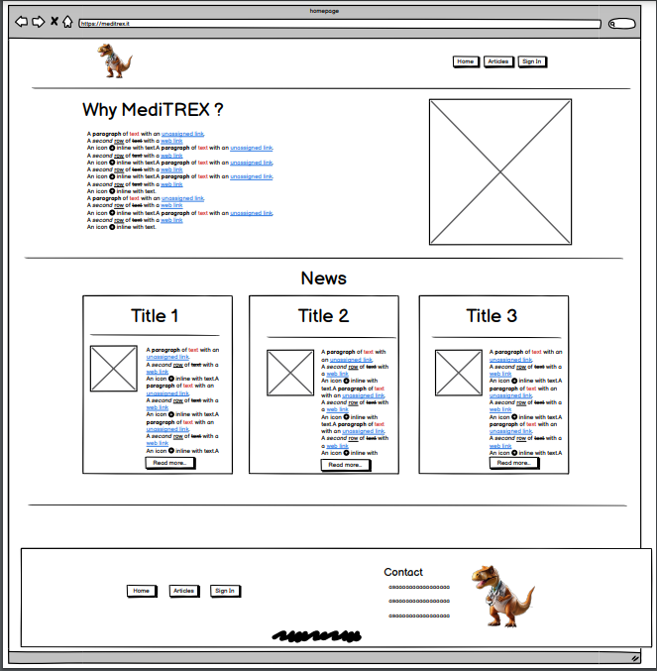
As an unregistered user I want to access the homepage so that I can read some main medical articles and news.
MOCKUPS & USER-STORIES:
HOMEPAGE
Notes:
WHY
THE ALGORITHM

Slide 5
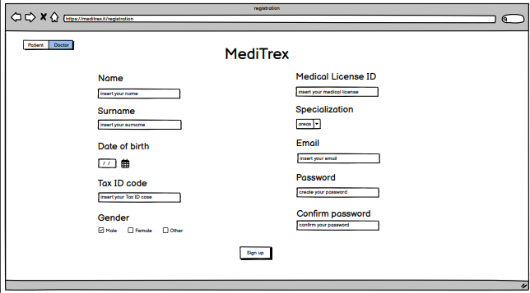
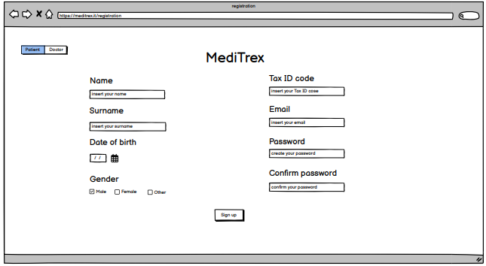
As an unregistered user I want to access the Sign-Up page so that I can create an account as a patient.
As an unregistered user I want to access the Sign-Up page so that I can create an account as a doctor.
MOCKUPS & USER-STORIES:
SIGN-UP
Notes:
WHY
THE ALGORITHM

Slide 6
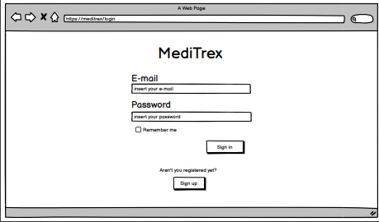
As a user I want to access the Sign-In page so that I can login with email and password.
As a user I want to logout so that I can end my session.
MOCKUPS & USER-STORIES:
SIGN-IN
Notes:
WHY
THE ALGORITHM

Slide 7
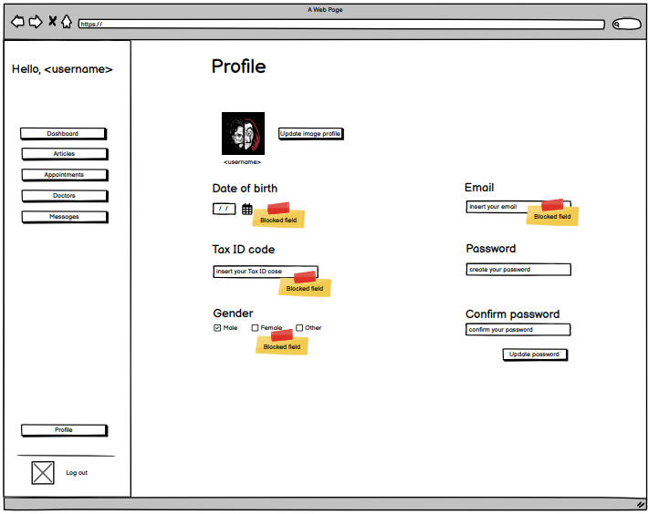
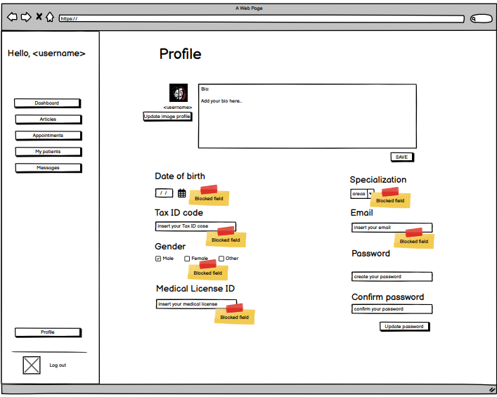
As a user, I want to be able to edit my profile, so that I can customize information about me.
As a doctor (either specialized or GP) I want to update my biography within the app to provide information about my specialization and expertise to potential patients.
MOCKUPS & USER-STORIES:
EDIT-PROFILE
Notes:
WHY
THE ALGORITHM

Slide 8
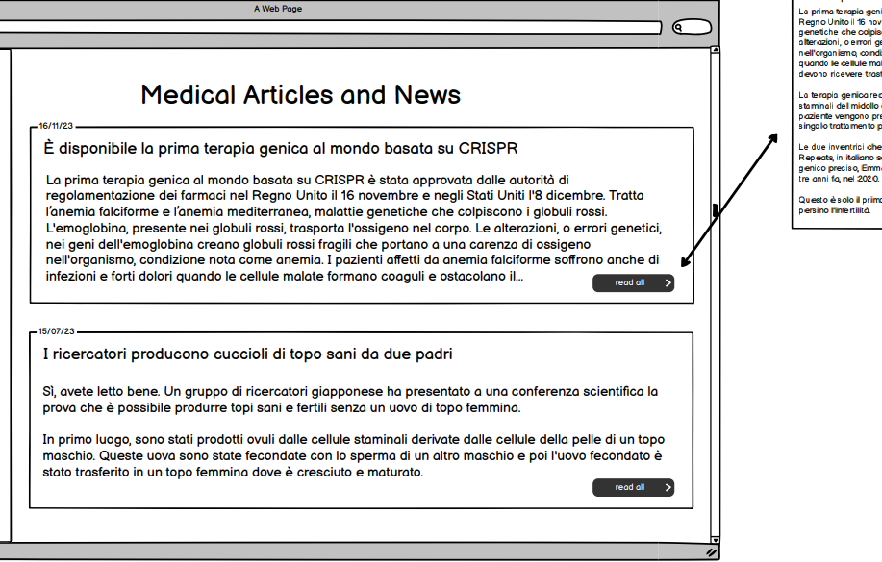
As an unregistered user I want to click on a main article so that I can read it all.
As an unregistered user I want to access article page so that I can visualize all medical articles and news.
MOCKUPS & USER-STORIES:
ARTICLE PAGE
Notes:
WHY
THE ALGORITHM

Slide 9
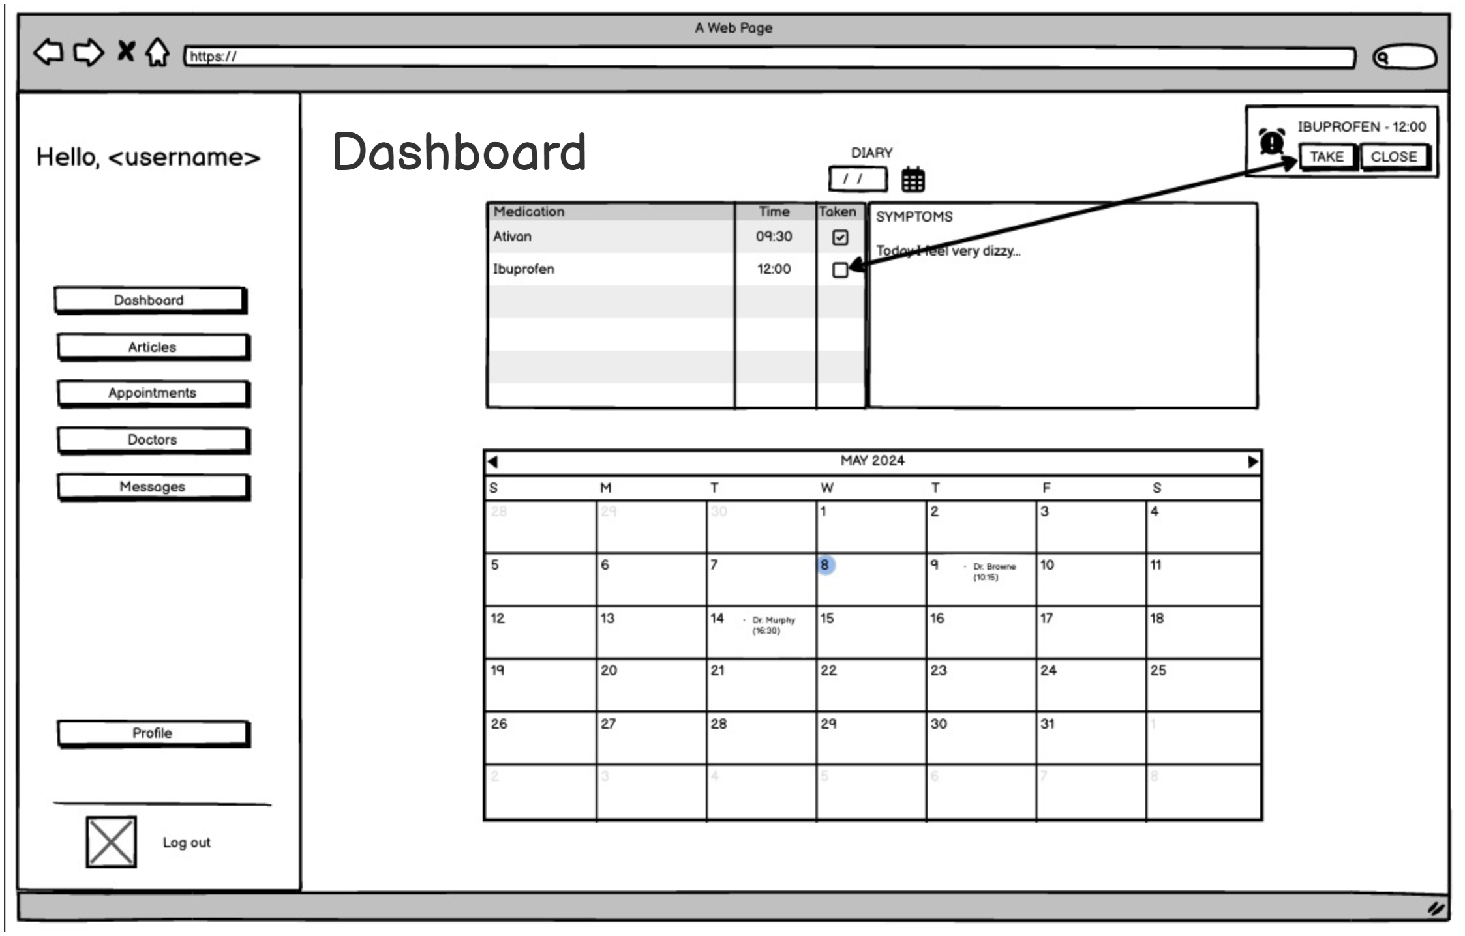
As a Patient I want to access my Dashboard so that I can view my prescriptions and appointments.
As a Patient I want to have access to my Dashboard to keep track of my
symptoms.
As a Patient I want to access my calendar so that I can view my upcoming
appointments with my GP and any specialist.
MOCKUPS & USER-STORIES:
CLIENT DASHBOARD
Notes:
WHY
THE ALGORITHM

Slide 10
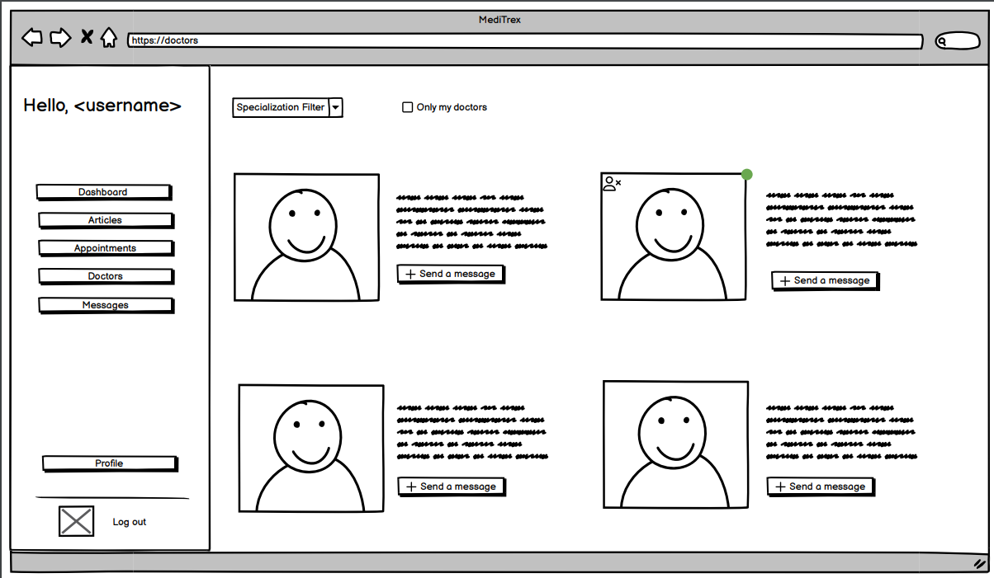
As a Patient I want to visualize a list of all the doctors so that I can add my
GP and choose the best specialists for me..
As a Patient I want to send a request to a doctor so that I add them to my
doctors.
MOCKUPS & USER-STORIES:
DOCTOR'S LIST
Notes:
WHY
THE ALGORITHM

Slide 11
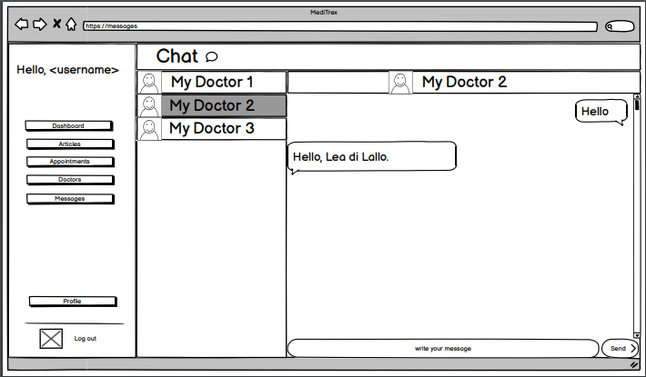
As a Patient I want to send a request to a doctor so that I can start chatting with them.
As a Patient I want to communicate with my GP and any specialist I follow so that I can ask questions and report concerns.
MOCKUPS & USER-STORIES:
PATIENT CHAT
Notes:
WHY
THE ALGORITHM

Slide 12
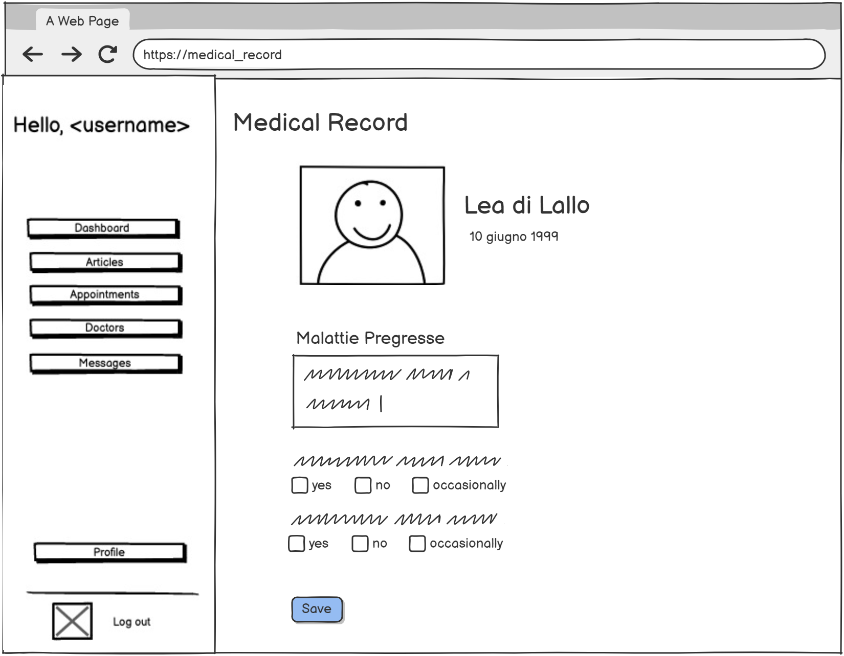
As a Patient I want to view my complete medical record, including medical history and allergies.
MOCKUPS & USER-STORIES:
PATIENT MEDICAL RECORD
Notes:
WHY
THE ALGORITHM

Slide 13
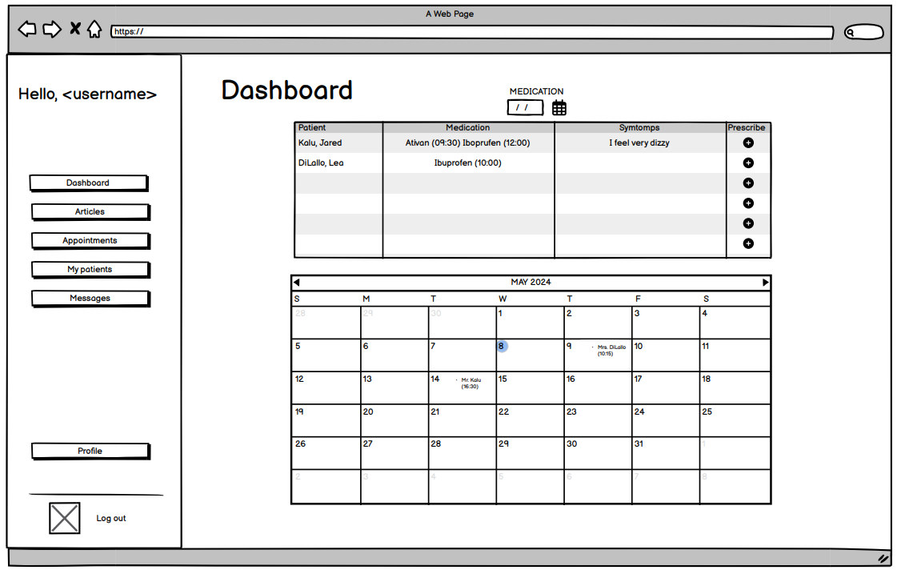
As a GP I want to access my Dashboard so that I can prescribe medications for my patients.
As a doctor (either specialized or GP) I want to access my calendar so that I can view and manage my upcoming appointments with my patients.
MOCKUPS & USER-STORIES:
DASHBOARD – DOCTOR'S SIDE
Notes:
WHY
THE ALGORITHM

Slide 14
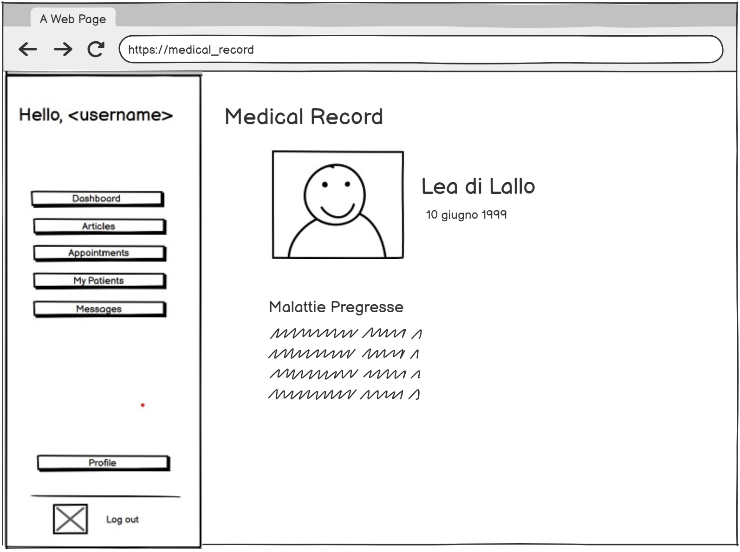
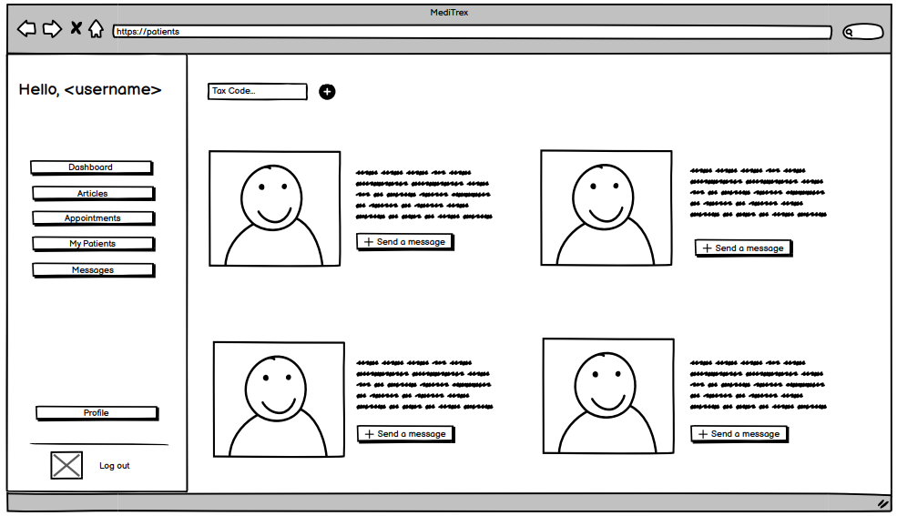
As a Doctor, I want to be able to see my patients, so that I can keep track of them.
As a GP I want to access my patient page so that I can view their medical records.
As a specialized doctor I want to review my patient medical records so that I have a comprehensive understanding of their medical histories.
MOCKUPS & USER-STORIES:
PATIENTS
Notes:
WHY
THE ALGORITHM

Slide 15
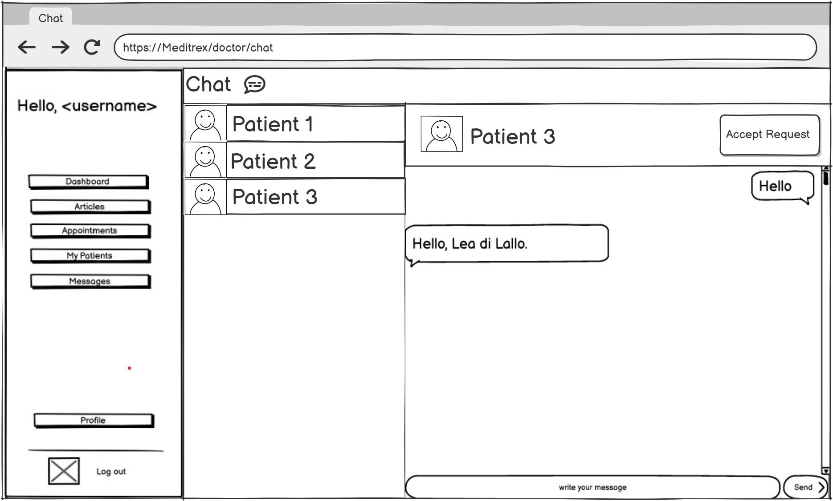
As a GP I want to accept my patient requests so that I can add new patients.
As a GP I want to access my messages so that I can chat with my patients.
MOCKUPS & USER-STORIES:
DOCTOR'S CHAT
Notes:
WHY
THE ALGORITHM

Slide 16

FUNCTION POINTS
MediTREX DB
EI
ILF
EQ
EIF
EO

Slide 17
FUNCTION POINTS – INTERNAL LOGICAL FILE (ILF)
SPECIALTIES
1 RET – 3 DET
IN TREATMENT
1 RET – 5 DET
7 FP
7 FP
PRESCRPITIONS
1 RET – 8 DET
SYMPTOMS
1 RET – 4 DET
7 FP
7 FP
MESSAGES
1 RET – 5 DET
APPOINTMENTS
1 RET – 6 DET
7 FP
7 FP
USERS
1 RET – 13 DET
MEDICAL RECORD
1 RET – 8 DET
7 FP
7 FP
TAKEN PRESCRIPTIONS
1 RET – 6 DET
7 FP

Slide 18
FUNCTION POINTS – EXTERNAL INPUT (EI)
SIGN-UP
2 RET – 13 FTR
MEDICAL RECORD
2 RET – 6 FTR
4 FP
4 FP
SIGN-IN
1 RET – 2 FTR
DOCTOR PROFILE
1 RET – 3 FTR
3 FP
3 FP
LOGOUT
1 RET – 1 FTR
P-D COMMUNICATION
1 RET – 5 FTR
3 FP
3 FP
PATIENT DASHBOARD
1 RET – 2 FTR
GP REQUEST
1 RET – 3 FTR
3 FP
3 FP

Slide 19
FUNCTION POINTS – EXTERNAL INQUIRY (EQ)
MAIN ARTICLE
1 RET – 6 FTR
PATIENT DASHBOARD
3 RET – 9 FTR
3 FP
4 FP
ARTICLE PAGE
1 RET – 6 FTR
MEDICAL RECORD
5 RET – 16 FTR
3 FP
6 FP
FUNCTION POINTS – EXTERNAL OUTPUT (EO)
DOCTOR LIST
3 RET – 8 FTR
5 FP

Slide 20



COCOMO II
FUNCTION
POINTS
LINES
OF CODE
ESTIMATED
TIME
110
unadjusted FP
8800
SLOC
9.8
months

Slide 21
SCRUM: WORKFLOW ORGANIZATION
Sprint 1
Sprint 2
Sprint 3
Account Management
Personal Area
Treatment Management
Notes:
OVERCOME LIMITATIONS
PRIMARY GOAL -> ENSURE DEP.
DOCKER
NODEJS AND REPLICAS (AVAIL. AND REL.)
3 MECHANISM

Slide 22
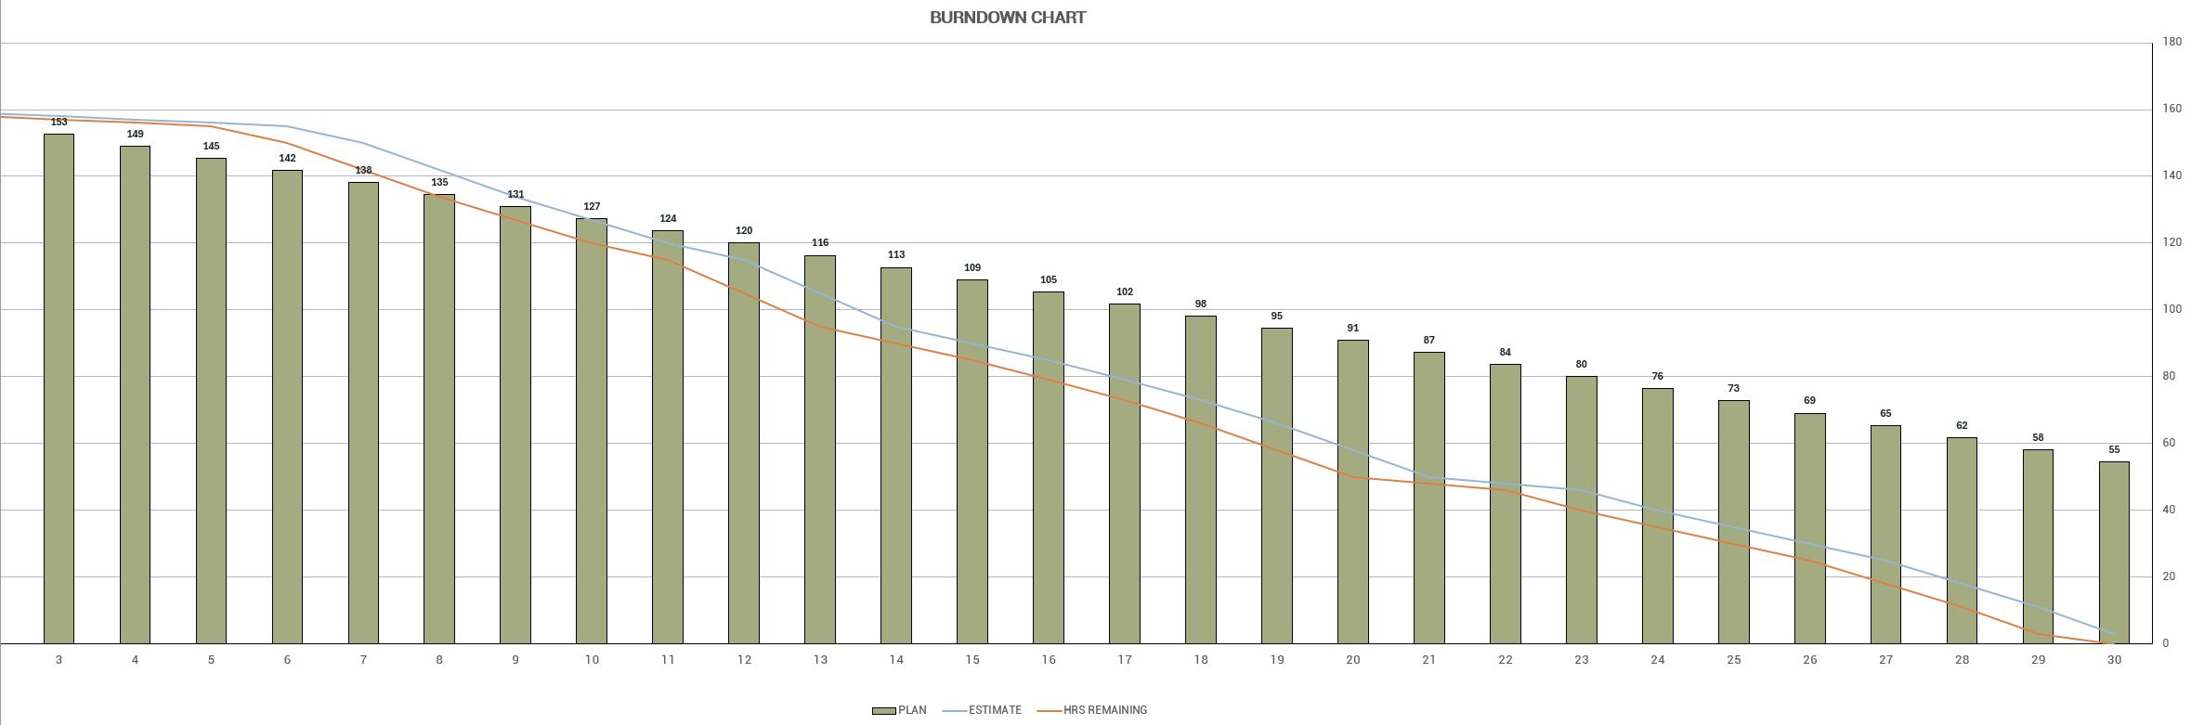
SCRUM: BURNDOWN CHART
Notes:
OVERCOME LIMITATIONS
PRIMARY GOAL -> ENSURE DEP.
DOCKER
NODEJS AND REPLICAS (AVAIL. AND REL.)
3 MECHANISM

Slide 23
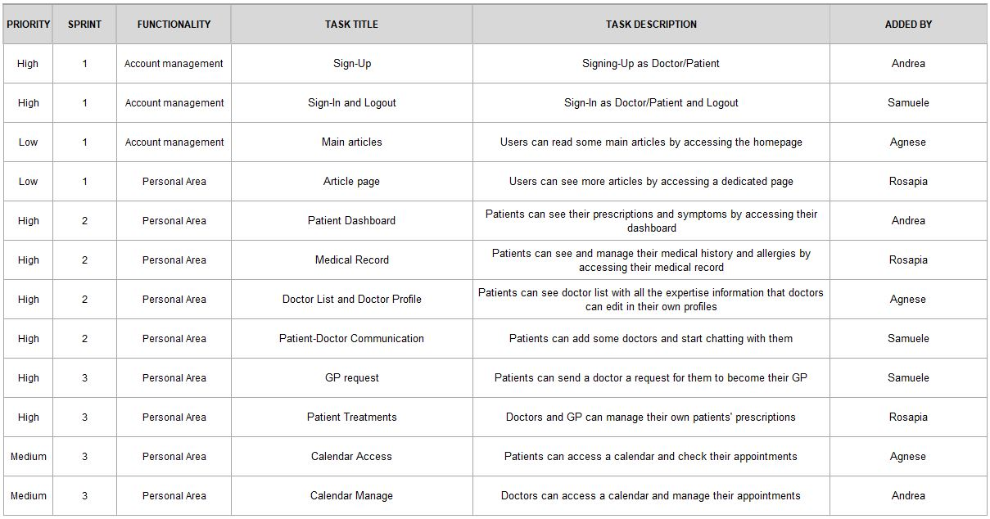
SCRUM:
PRODUCT BACKLOG
Notes:
WHY
THE ALGORITHM

Slide 24
Thanks for your attention!
TREX Team

