Slide 1

MediTREX
Laboratory of Advanced Programming Report
Agnese Maria Capparelli 1794326
Andrea Orlandi 1847682
Rosapia Laudati 1894372
Samuele Cervo 1883147
A.Y.
2023-2024

Slide 2





MediTREX is a web app aimed to improve the management of medical treatments and personal health conditions.
MAIN FEATURES
DOCTOR – PATIENT COMMUNICATION
APPOINTMENT BOOKING
MEDICAL RECORDS MANAGEMENT
NEWS AND DAILY PAPERS ABOUT THE MEDICAL FIELD

Slide 3
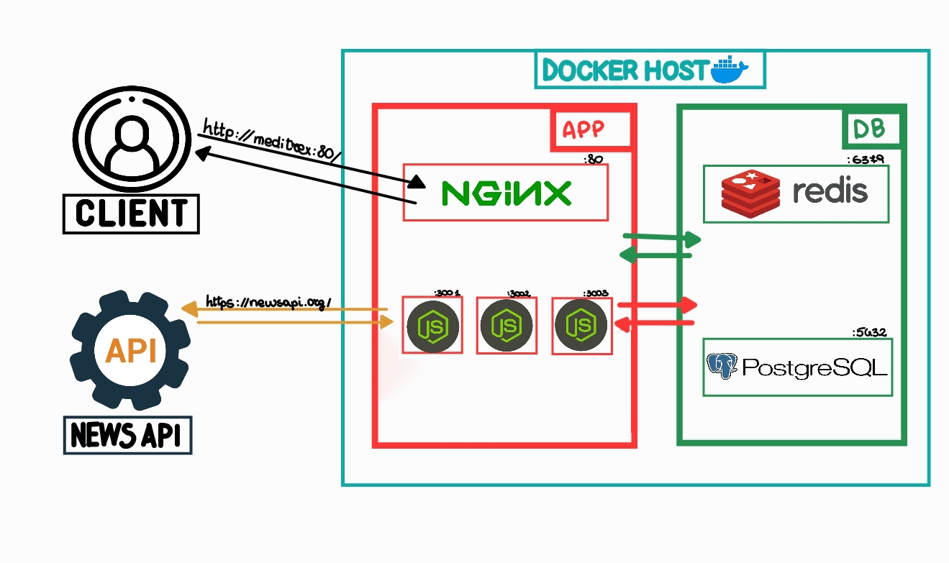
THE ARCHITECTURE

Slide 4
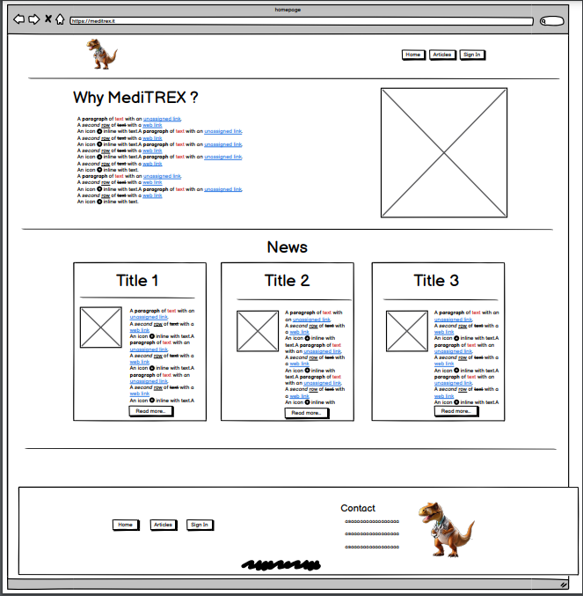
As an unregistered user I want to access the homepage so that I can read some main medical articles and news.
MOCKUPS & USER-STORIES:
HOMEPAGE

Slide 5
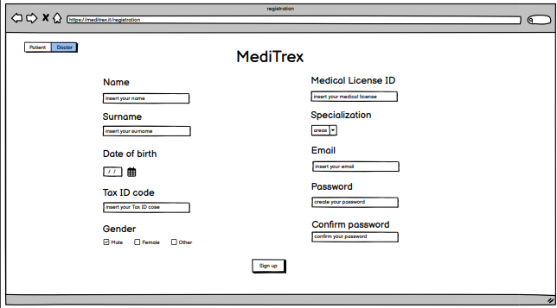
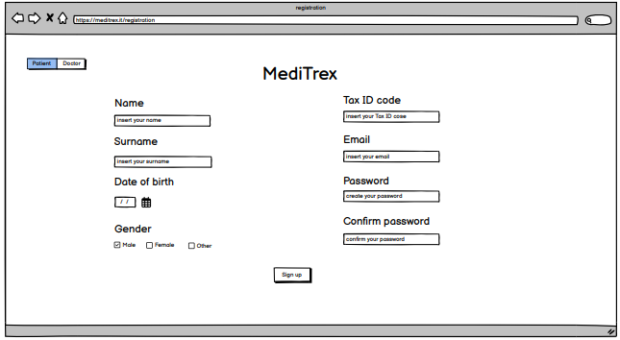
As an unregistered user I want to access the Sign-Up page so that I can create an account as a patient.
As an unregistered user I want to access the Sign-Up page so that I can create an account as a doctor.
MOCKUPS & USER-STORIES:
SIGN-UP

Slide 6
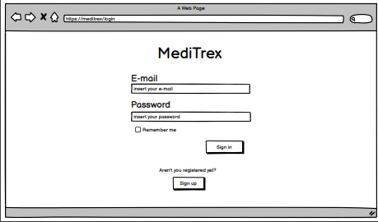
As a user I want to access the Sign-In page so that I can login with email and password.
As a user I want to logout so that I can end my session.
MOCKUPS & USER-STORIES:
SIGN-IN

Slide 7
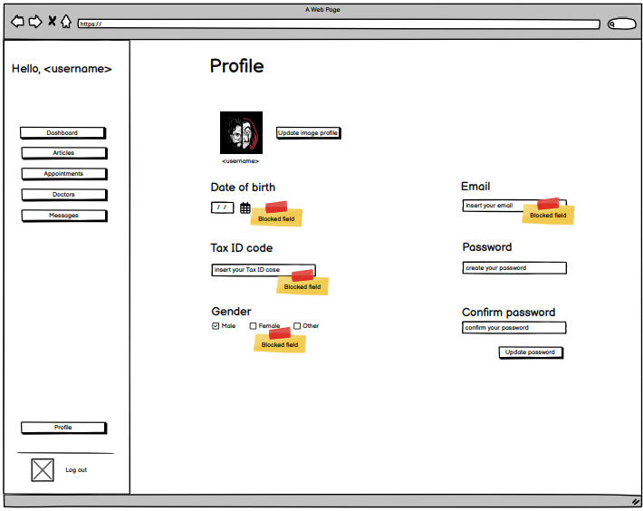
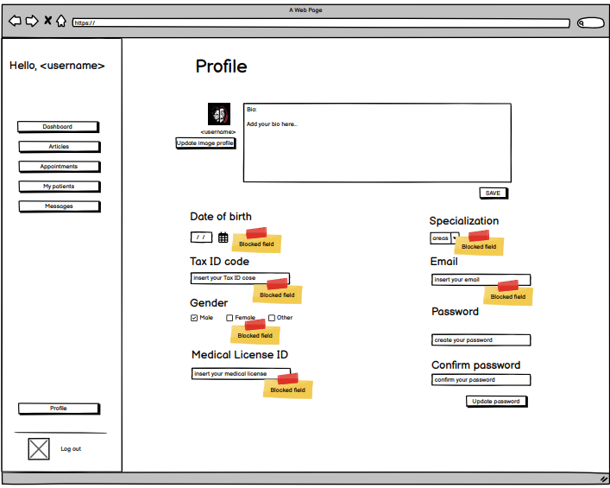
As a user, I want to be able to edit my profile, so that I can customize information about me.
As a doctor (either specialized or GP) I want to update my biography within the app to provide information about my specialization and expertise to potential patients.
MOCKUPS & USER-STORIES:
EDIT-PROFILE

Slide 8
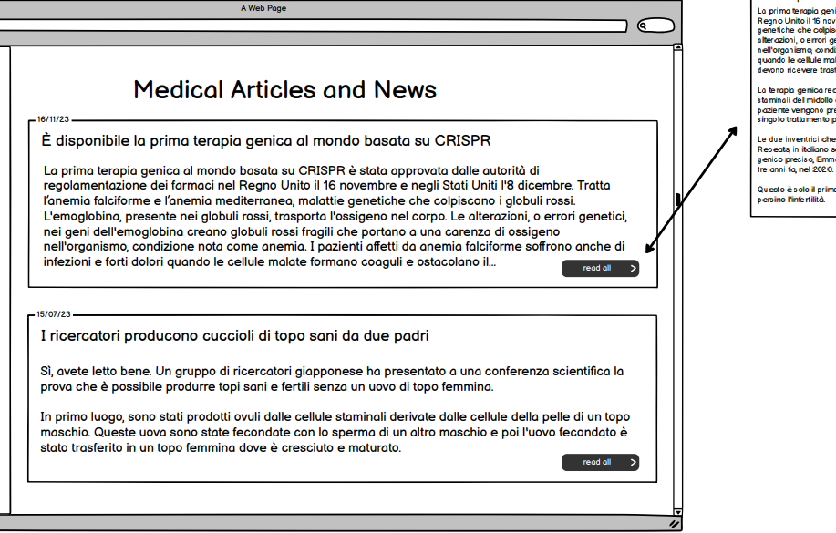
As an unregistered user I want to click on a main article so that I can read it all.
As an unregistered user I want to access article page so that I can visualize all medical articles and news.
MOCKUPS & USER-STORIES:
ARTICLE PAGE
Notes:
WHY
THE ALGORITHM

Slide 9
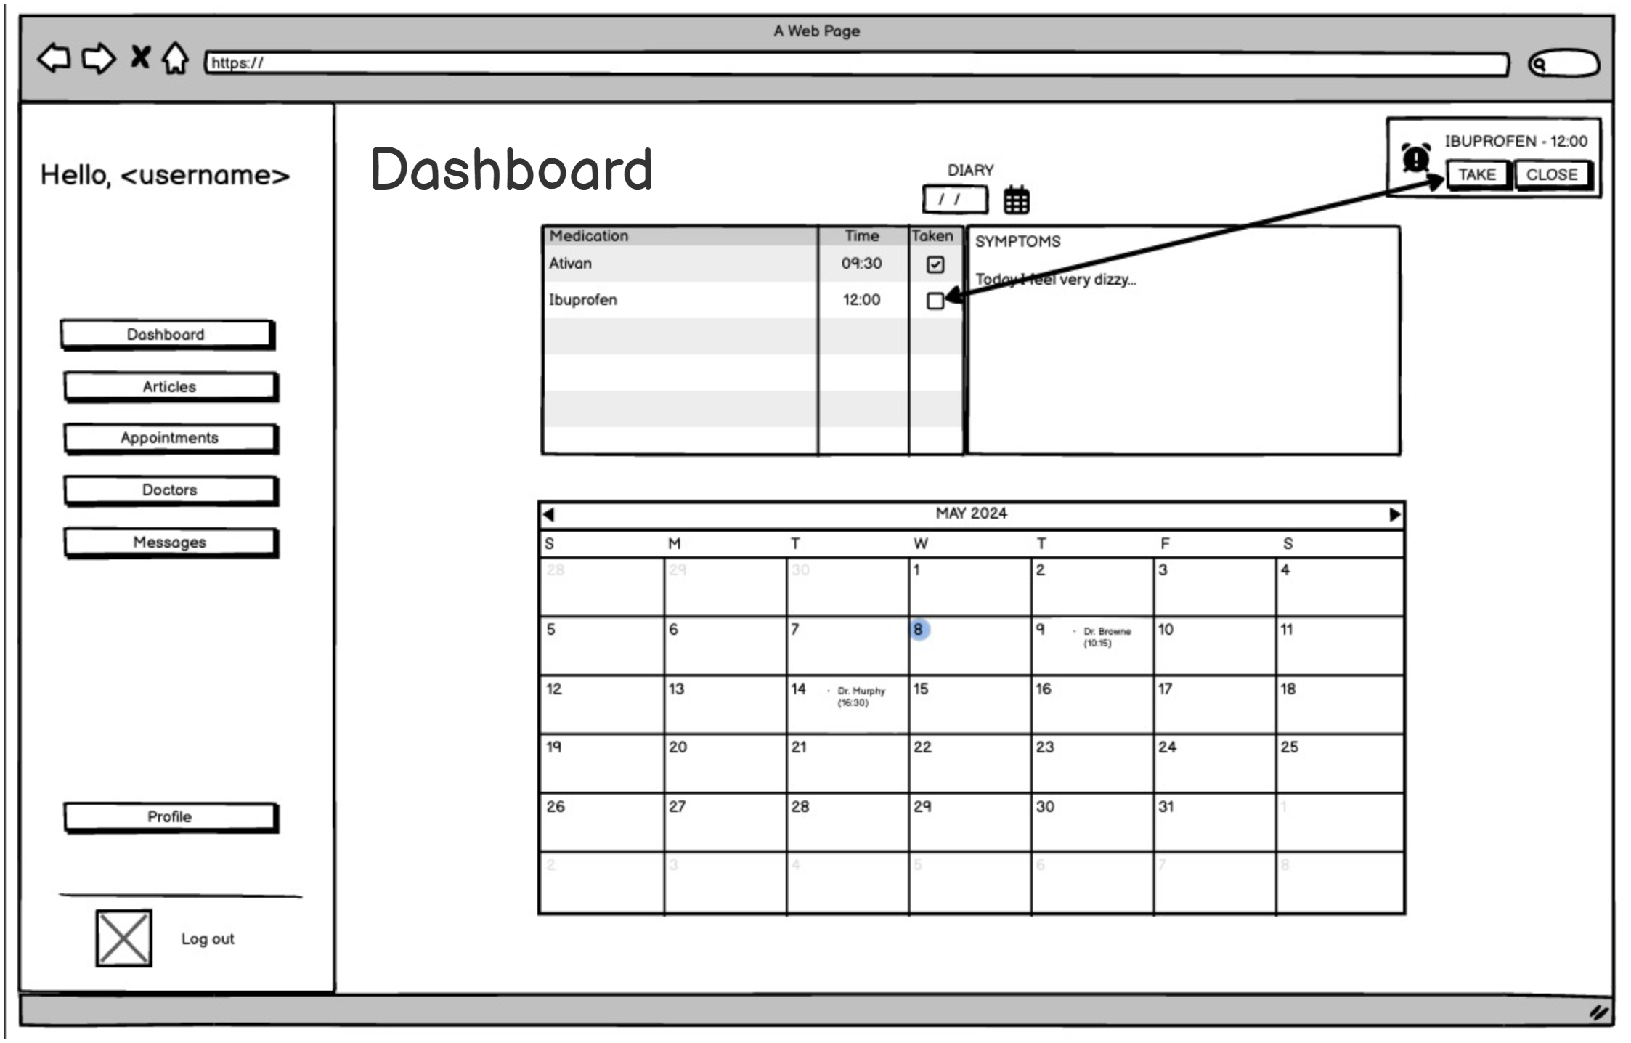
As a Patient I want to access my Dashboard so that I can view my prescriptions and appointments.
As a Patient I want to have access to my Dashboard to keep track of my
symptoms.
As a Patient I want to access my calendar so that I can view my upcoming
appointments with my GP and any specialist.
MOCKUPS & USER-STORIES:
PATIENT DASHBOARD

Slide 10
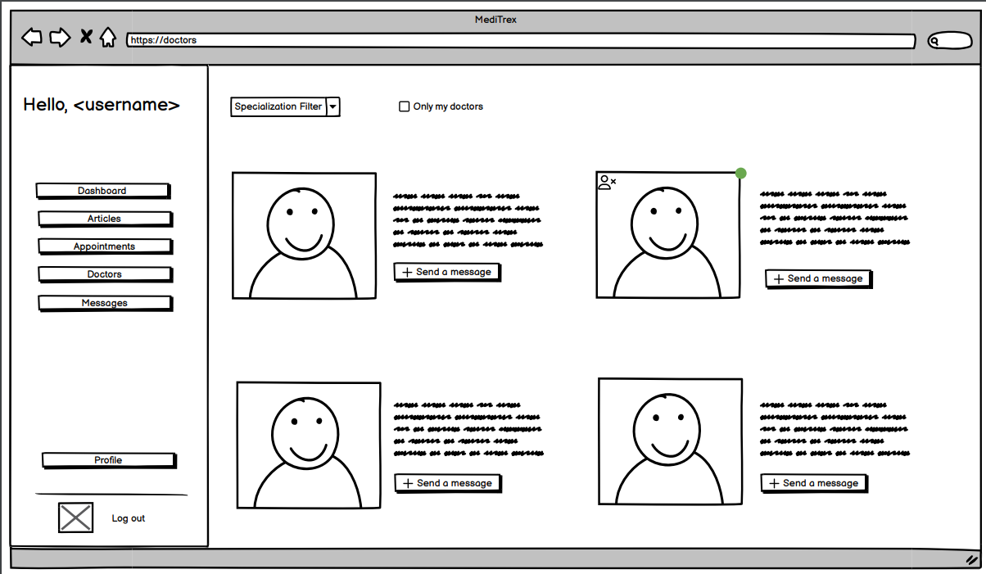
As a Patient I want to visualize a list of all the doctors so that I can add my
GP and choose the best specialists for me..
As a Patient I want to send a request to a doctor so that I add them to my
doctors.
MOCKUPS & USER-STORIES:
DOCTOR'S LIST

Slide 11
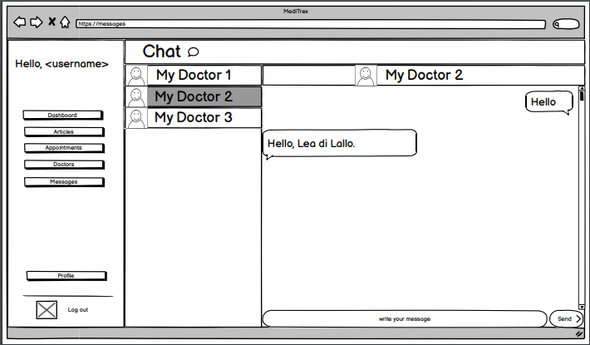
As a Patient I want to send a request to a doctor so that I can start chatting with them.
As a Patient I want to communicate with my GP and any specialist I follow so that I can ask questions and report concerns.
MOCKUPS & USER-STORIES:
PATIENT CHAT

Slide 12
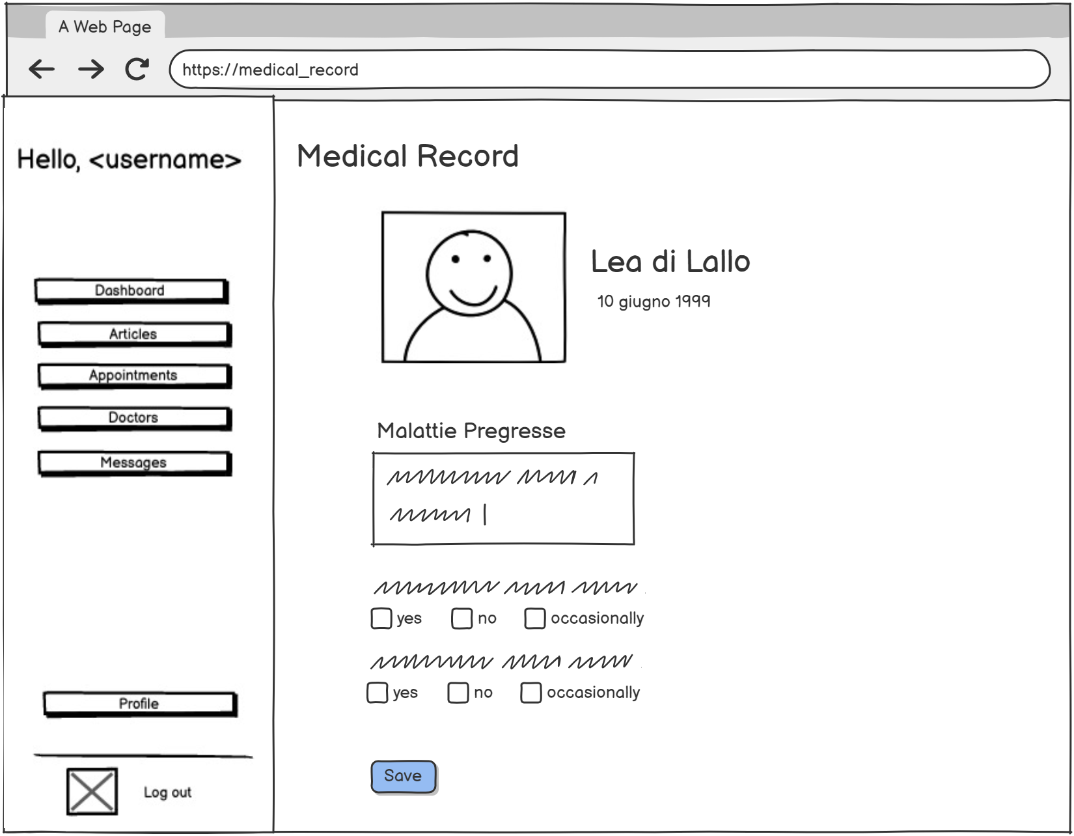
As a Patient I want to view my complete medical record, including medical history and allergies.
MOCKUPS & USER-STORIES:
PATIENT MEDICAL RECORD
Notes:
WHY
THE ALGORITHM

Slide 13
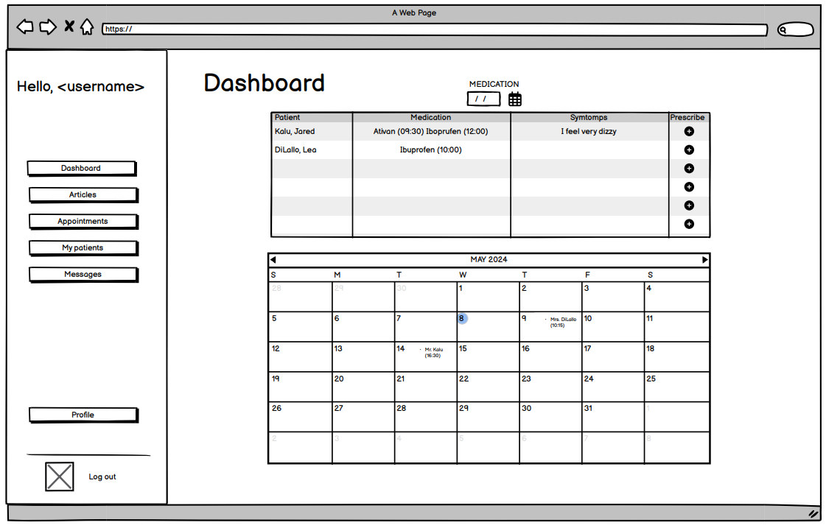
As a GP I want to access my Dashboard so that I can prescribe medications for my patients.
As a doctor (either specialized or GP) I want to access my calendar so that I can view and manage my upcoming appointments with my patients.
MOCKUPS & USER-STORIES:
DASHBOARD – DOCTOR'S SIDE
Notes:
WHY
THE ALGORITHM

Slide 14
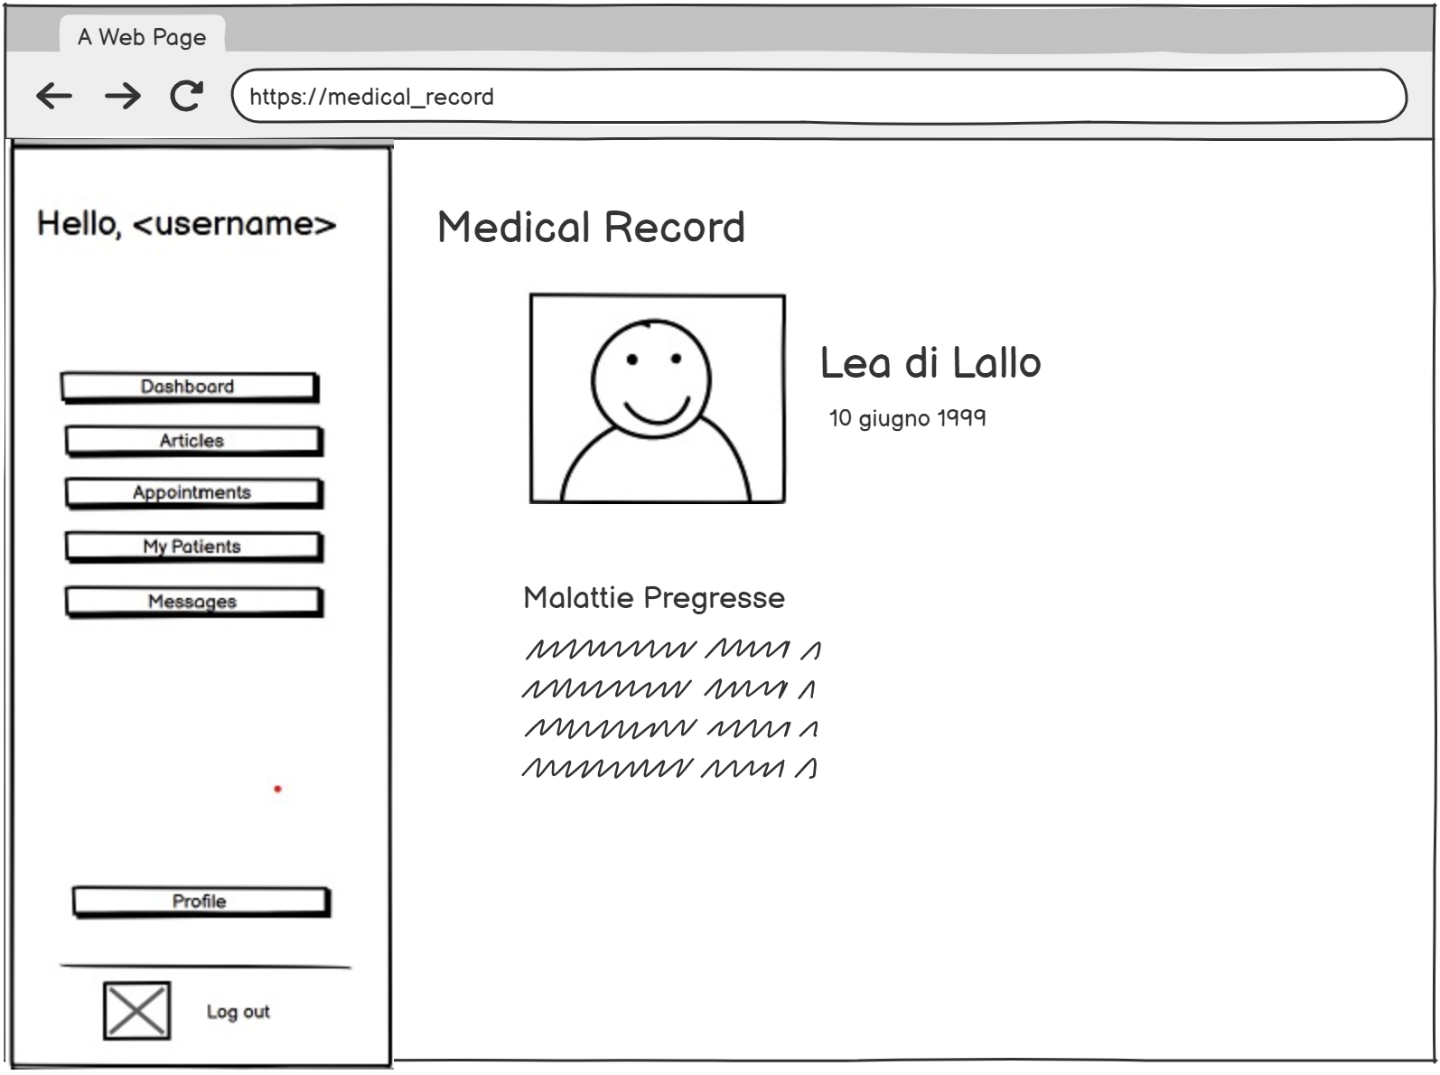
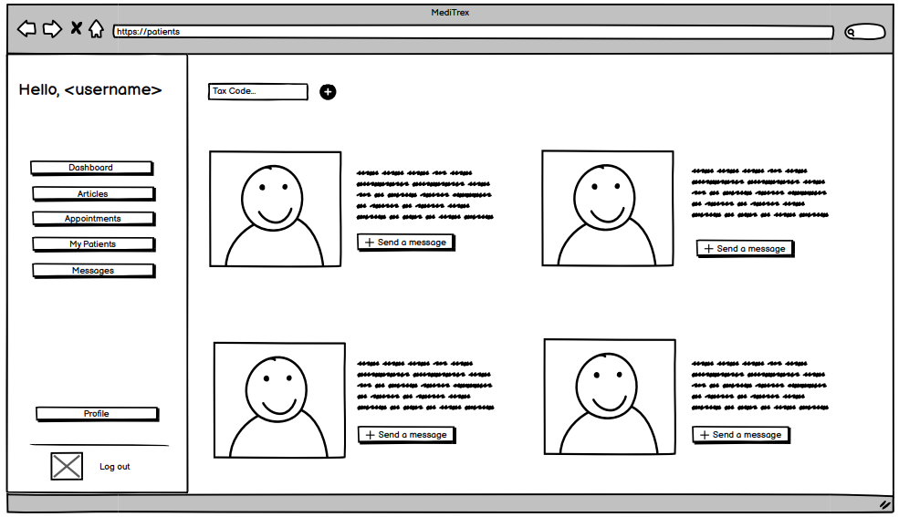
As a Doctor, I want to be able to see my patients, so that I can keep track of them.
As a GP I want to access my patient page so that I can view their medical records.
As a specialized doctor I want to review my patient medical records so that I have a comprehensive understanding of their medical histories.
MOCKUPS & USER-STORIES:
PATIENTS
Notes:
WHY
THE ALGORITHM

Slide 15
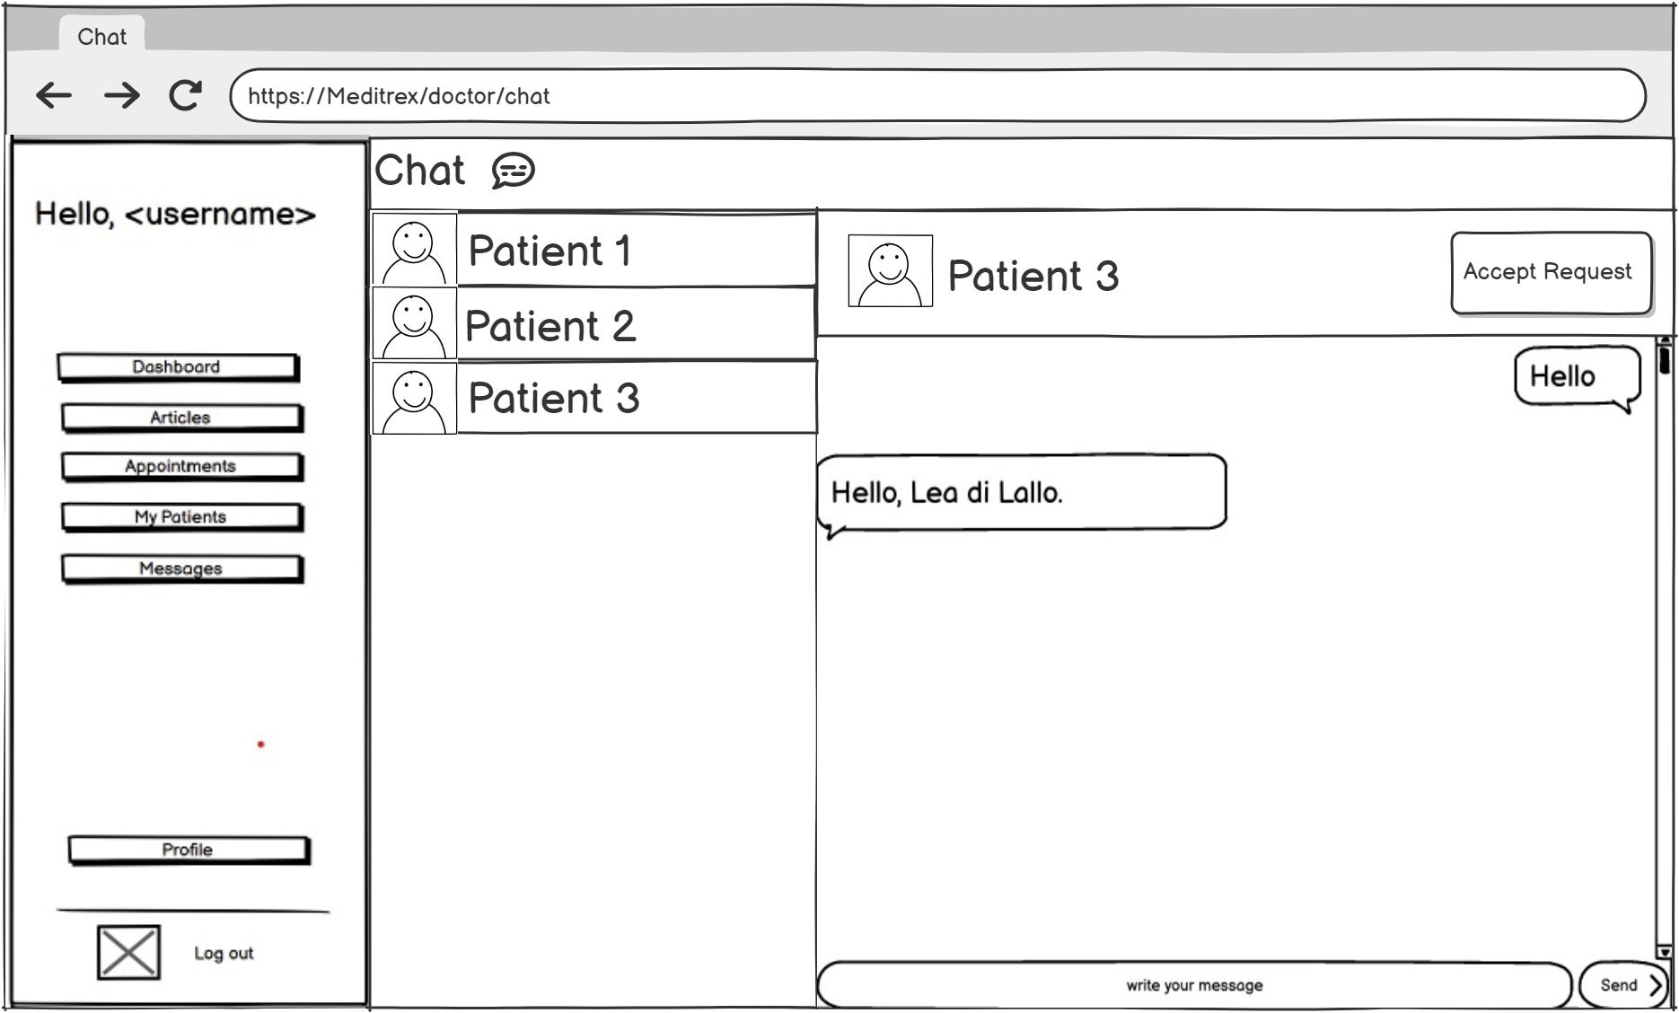
As a GP I want to accept my patient requests so that I can add new patients.
As a GP I want to access my messages so that I can chat with my patients.
MOCKUPS & USER-STORIES:
DOCTOR'S CHAT
Notes:
WHY
THE ALGORITHM

Slide 16

FUNCTION POINTS
MediTREX DB
EI
ILF
EQ
EIF
EO

Slide 17
FUNCTION POINTS – INTERNAL LOGICAL FILE (ILF)
SPECIALTIES
1 RET – 3 DET
IN TREATMENT
1 RET – 5 DET
7 FP
7 FP
PRESCRPITIONS
1 RET – 8 DET
SYMPTOMS
1 RET – 4 DET
7 FP
7 FP
MESSAGES
1 RET – 5 DET
APPOINTMENTS
1 RET – 6 DET
7 FP
7 FP
USERS
1 RET – 13 DET
MEDICAL RECORD
1 RET – 8 DET
7 FP
7 FP
TAKEN PRESCRIPTIONS
1 RET – 6 DET
7 FP

Slide 18
FUNCTION POINTS – EXTERNAL INPUT (EI)
SIGN-UP
2 RET – 13 FTR
MEDICAL RECORD
2 RET – 6 FTR
4 FP
4 FP
SIGN-IN
1 RET – 2 FTR
DOCTOR PROFILE
1 RET – 3 FTR
3 FP
3 FP
LOGOUT
1 RET – 1 FTR
P-D COMMUNICATION
1 RET – 5 FTR
3 FP
3 FP
PATIENT DASHBOARD
1 RET – 2 FTR
GP REQUEST
1 RET – 3 FTR
3 FP
3 FP

Slide 19
FUNCTION POINTS – EXTERNAL INQUIRY (EQ)
MAIN ARTICLE
1 RET – 6 FTR
PATIENT DASHBOARD
3 RET – 9 FTR
3 FP
4 FP
ARTICLE PAGE
1 RET – 6 FTR
MEDICAL RECORD
5 RET – 16 FTR
3 FP
6 FP
FUNCTION POINTS – EXTERNAL OUTPUT (EO)
DOCTOR LIST
3 RET – 8 FTR
5 FP

Slide 20



COCOMO II
FUNCTION
POINTS
LINES
OF CODE
ESTIMATED
TIME
110
unadjusted FP
8800
SLOC
9.8
months

Slide 21
SCRUM: WORKFLOW ORGANIZATION
Sprint 1
Sprint 2
Sprint 3
Account Management
Personal Area
Treatment Management
Notes:
Entire dev process: 6 weeks, totaling around 160 work hours

Slide 22
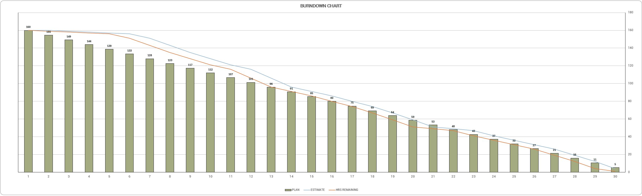
SCRUM: BURNDOWN CHART
Notes:
- Quickly spot any delays and make adjustments to stay on schedule

Slide 23
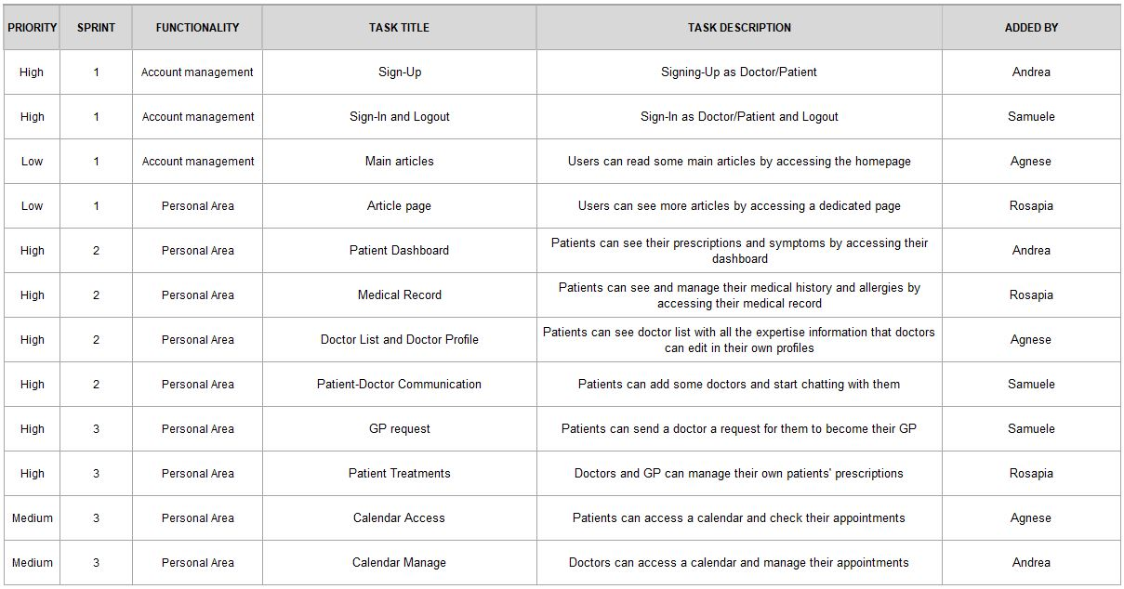
SCRUM:
PRODUCT BACKLOG
Notes:
To ensure clear responsibility for each activity
Co mpprehensive view of the work to be done, the priorities and individual responsibilities, helping us to keep the project on track

Slide 24
Thanks for your attention!
TREX Team

