Slide 1


Data Management
A DataWarehouse Design
AGNESE MARIA CAPPARELLI
SAMUELE CERVO

Slide 2
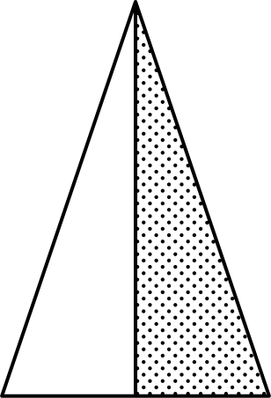

What we have done
What we have done
Project Timeline
First ETL Processes
Cleansing and filtering the original data
Logical Modeling
Analysis with Tableau
Snowflake Schema
Data gathering
Conceptual Modeling
ROLAP Queries
Retrieving some data sources online.
SQL Queries
DFM Schema

Slide 3
Data Gathering
Different data sources
covid_cases
informations about covid cases, hospedalizations, new positives, swabs and other data during covid period per regions and date.
DPC
regions
that contains regions name, region_code and region_abbreviation
ISTAT
population20XX
information about population per regions, divided by males, females in the year 20XX
ISTAT
vaccinations
that contains information about vaccination during the covid period divided by age range, males, females, vaccine name, region and date
OpenData
vaccines
informations about every single vaccine, like supplier, name and technology
GitHub OpenData

Slide 4

ETL Process
covid_cases (Dataset from DPC)
Cleansing and integratio in phases of the original data were made through Python scripts.
Below there are detailed operations performed on each of the csv files.
  Renamed coloumns
  Replaced date from time code to yy/mm/dd
  Uniformed region_code field with a 2 characters string
  Filtered unnecessary coloumns
  Uniformed empty fields with 0 and null values.
date | country_code | region_code | latitude | logitude | hospitalized | intensitive_care | total_hospitalized | home_isolation | total_positives
variation_total_positive | new_positives | recovered | deceased | suspected_ cases | screaning_cases | total_cases | intensitive_care_ admission | positive_ molecular_test | positive_rapid_antigen_test
molecular_ swabs | rapid_antigen_swabs | nuts1_code | nuts2_code | notes | test_notes | case_notes | swabs | tested_cases

Slide 5
ETL Process
population20XX (6 dataset from 2019 to 2024 from ISTAT)
Cleansing and integratio in phases of the original data were made through Python scripts.
Below there are detailed operations performed on each of the csv files.
  Renamed coloumns
  Union the 6 dataset in one dataset grouped by year and region
year | region | sex | population

Slide 6
ETL Process
covid_cases (Dataset from DPC)
Cleansing and integratio in phases of the original data were made through Python scripts.
Below there are detailed operations performed on each of the csv files.
  Renamed coloumns
region_code | region_name | region_abbr

Slide 7
ETL Process
covid_cases (Dataset from DPC)
Cleansing and integratio in phases of the original data were made through Python scripts.
Below there are detailed operations performed on each of the csv files.
  Renamed coloumns
  Replaced date from time code to yy/mm/dd
  Uniformed region_code field with a 2 characters string
  Filtered unnecessary coloumns
  Uniformed empty fields with 0 and null values.
date | country_code | region_code | latitude | logitude | hospitalized | intensitive_care | total_hospitalized | home_isolation | total_positives
variation_total_positive | new_positives | recovered | deceased | suspected_ cases | screaning_cases | total_cases | intensitive_care_ admission | positive_ molecular_test | positive_rapid_antigen_test
molecular_ swabs | rapid_antigen_swabs | nuts1_code | nuts2_code | notes | test_notes | case_notes | swabs | tested_cases

Slide 8
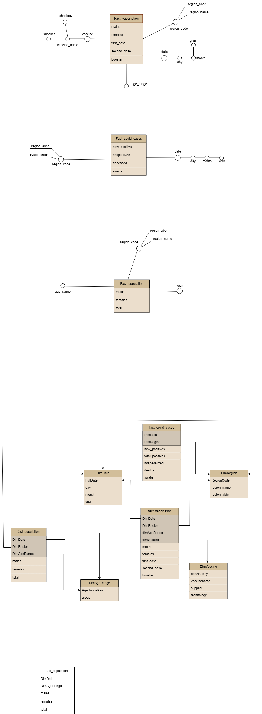
Conceptual modeling
DFM Schema

Slide 9
Conceptual modeling
DFM Schema

Slide 10
Conceptual modeling
DFM Schema

Slide 11

Logical modeling
SNOWFLAKE schema

Slide 12
Views for ROLAP Queries
CREATE OR REPLACE VIEW dw_layer.vw_vaccination_cumulative AS
SELECT
date_key,
region_key,
age_key,
SUM(first_dose) OVER (PARTITION BY region_key, age_key ORDER BY date_key)
AS cumulative_first_dose
FROM dw_layer.fact_vaccination;
Cumulative first doses
CREATE OR REPLACE VIEW dw_layer.vw_covid_monthly AS
SELECT
d.year,d.month,fc.region_key,
SUM(fc.new_positives) AS monthly_new_cases,
SUM(fc.hospitalized) AS monthly_hospitalized
FROM dw_layer.fact_covid_cases fc
JOIN dw_layer.dimDate d
ON fc.date_key = d.date_key
GROUP BY d.year, d.month, fc.region_key;
Monthly covid cases

Slide 13
Rolap Queries
Monthly Aggregation of New COVID-19 Cases and Cumulative First Dose Vaccinations by Region
SELECT r.region_name,
d.year,
d.month,
AVG(c.new_positives) AS avg_new_positives,
MAX(vc.cumulative_first_Dose) AS vaccination
FROM dw_layer.fact_covid_cases c
JOIN dw_layer.vw_vaccination_cumulative vc
ON c.region_key = vc.region_key AND c.date_key = vc.date_key
JOIN dw_layer.dimRegion r
ON c.region_key = r.regionKey
JOIN dw_layer.dimDate d
ON c.date_key = d.dateKey
GROUP BY r.region_name, d.year, d.month
ORDER BY d.year, d.month, r.region_name;

Slide 14
Rolap Queries
Yearly Vaccination Coverage by Region and Age Group with Population-Based Vaccination Rate
SELECT
d.year,r.region_name,a.age_group,
MAX(vc.cumulative_first_dose) AS total_vaccinations,
fp.total_count AS population,
ROUND(MAX(vc.cumulative_first_dose)::NUMERIC / fp.total_count * 100, 2) AS vaccination_rate_percent
FROM dw_layer.vw_vaccination_cumulative vc
JOIN dw_layer.dimDate d
ON vc.date_key = d.date_key
JOIN dw_layer.fact_population fp
ON vc.region_key = fp.region_key
AND vc.age_key = fp.age_key
AND d.year = fp.year
JOIN dw_layer.dimRegion r
ON vc.region_key = r.regionKey
JOIN dw_layer.dimAgeRange a
ON vc.age_key = a.age_key
GROUP BY d.year,r.region_name,a.age_group,fp.total_count
ORDER BY d.year,r.region_name,a.age_group;

Slide 15
Rolap Queries
Vaccination Totals and Coverage Percentages by Region and Age Group for 2024
SELECT
r.region_name,
v.age_key AS age_group,
SUM(fv.first_dose) AS total_first_dose,
SUM(fv.second_dose) AS total_second_dose,
SUM(fv.booster) AS total_booster,
fp.total_count AS population_2024,
ROUND(SUM(fv.first_dose)::numeric / NULLIF(fp.total_count,0) * 100, 2) AS pct_first_dose,
ROUND(SUM(fv.second_dose)::numeric / NULLIF(fp.total_count,0) * 100, 2) AS pct_second_dose,
ROUND(SUM(fv.booster)::numeric / NULLIF(fp.total_count,0) * 100, 2) AS pct_booster
FROM dw_layer.fact_vaccination fv
JOIN dw_layer.dimRegion r ON fv.region_key = r.regionKey
JOIN dw_layer.dimAgeRange v ON fv.age_key = v.age_key
LEFT JOIN dw_layer.fact_population fp
ON fv.region_key = fp.region_key
AND fv.age_key = fp.age_key
AND fp.year = 2024
GROUP BY r.region_name, v.age_key, fp.total_count
ORDER BY r.region_name, v.age_key;

Slide 16
Rolap Queries
Annual COVID-19 Deaths and Population by Region (2020–2022)
SELECT
d.year, r.region_name, p.population,
MAX(fc.deceased) AS total_deaths
FROM dw_layer.fact_covid_cases fc
JOIN dw_layer.dimDate d
ON fc.date_key = d.datekey
JOIN dw_layer.dimRegion r
ON fc.region_key = r.regionKey
JOIN (
SELECT year, region_key, SUM(total_count) AS population
FROM dw_layer.fact_population
GROUP BY year, region_key
) p
ON p.region_key = fc.region_key
AND p.year = d.year
WHERE d.year BETWEEN 2020 AND 2022
GROUP BY d.year, r.region_name, p.population
ORDER BY d.year, r.region_name;

Slide 17
Rolap Queries
Annual cumulative first-dose vaccinations by vaccine technology with population and coverage percentage
SELECT
d.year, v.technology AS vaccine_technology,
SUM(fv.first_dose) AS total_vaccinations_cumulative, p.total_population,
ROUND(SUM(fv.first_dose)::numeric / NULLIF(p.total_population,0), 4) * 100 AS pct_vaccinated
FROM dw_layer.fact_vaccination fv
JOIN dw_layer.dimVaccine v
ON fv.vaccine_key = v.vaccine_name
JOIN dw_layer.dimDate d
ON fv.date_key = d.dateKey
JOIN (
SELECT year, SUM(total_count) AS total_population
FROM dw_layer.fact_population
GROUP BY year
) p
ON d.year = p.year
GROUP BY d.year, v.technology, p.total_population
ORDER BY d.year, v.technology;

Slide 18
Rolap Queries
Monthly COVID-19 Cases, Hospitalizations, and Vaccination Coverage by Age Group in Selected Regions (2021–2023)
SELECT
d.year, d.month, r.region_name, a.age_group,
MAX(vc.cumulative_first_dose) AS total_vaccinations_cumulative,
cm.monthly_new_cases AS total_new_positives, cm.monthly_hospitalized AS total_hospitalized,
fp.total_count AS population,
ROUND(cm.monthly_new_cases::NUMERIC / NULLIF(fp.total_count, 0) * 100000, 2) AS incidence_per_100k,
ROUND(MAX(vc.cumulative_first_dose)::NUMERIC / NULLIF(fp.total_count, 0) * 100, 2) AS pct_vaccinated
FROM dw_layer.vw_vaccination_cumulative vc
JOIN dw_layer.dimDate d
ON vc.date_key = d.datekey
JOIN dw_layer.vw_covid_monthly cm
ON cm.region_key = vc.region_key AND cm.year = d.year AND cm.month = d.month
JOIN dw_layer.dimRegion r
ON vc.region_key = r.regionKey
JOIN dw_layer.dimAgeRange a
ON vc.age_key = a.age_key
JOIN dw_layer.fact_population fp
ON vc.region_key = fp.region_key AND vc.age_key = fp.age_key AND d.year = fp.year
WHERE r.region_name IN ('Lombardia', 'Lazio') AND d.year BETWEEN 2021 AND 2023
GROUP BY d.year, d.month, r.region_name, a.age_group, cm.monthly_new_cases, cm.monthly_hospitalized, fp.total_count
ORDER BY d.year, d.month, r.region_name, a.age_group;

Slide 19
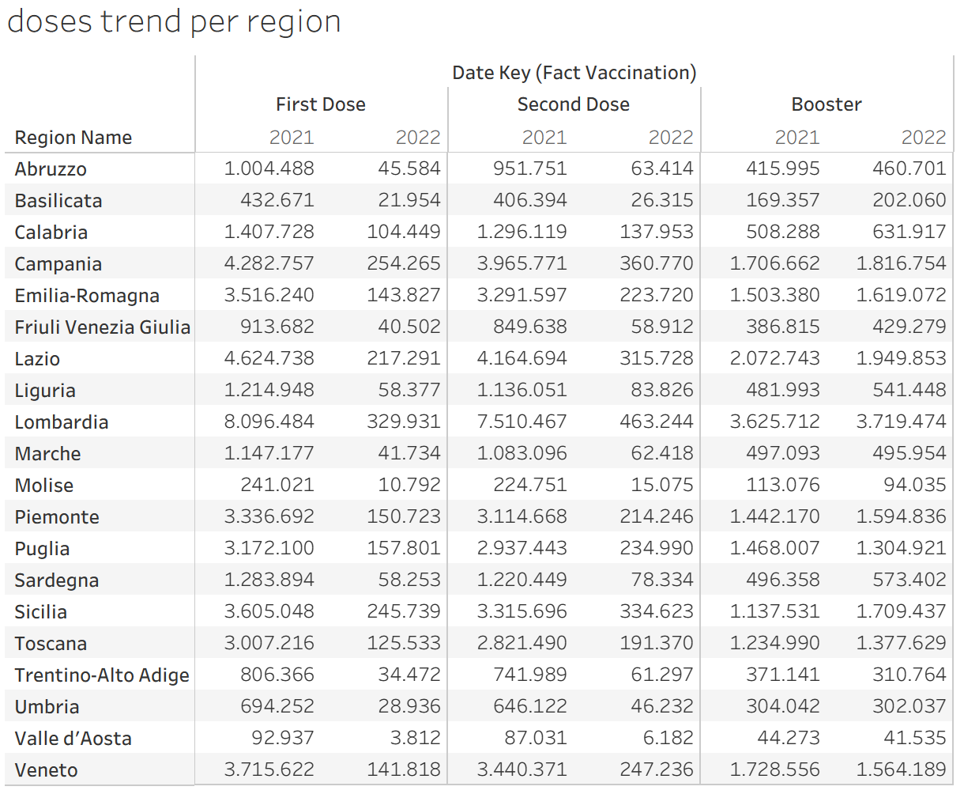
Tableau Analysis

Slide 20
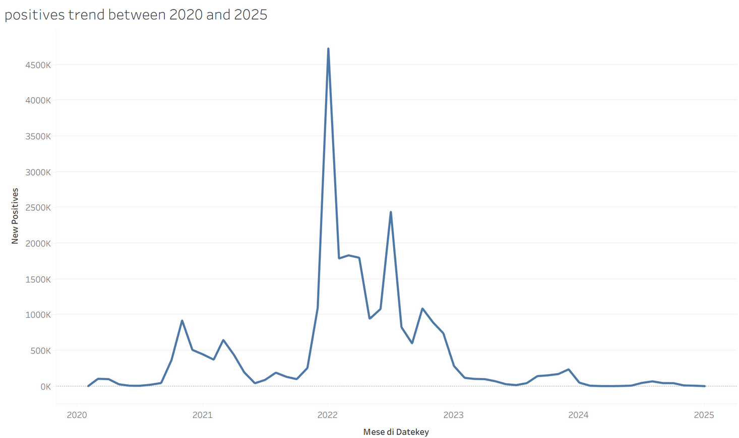
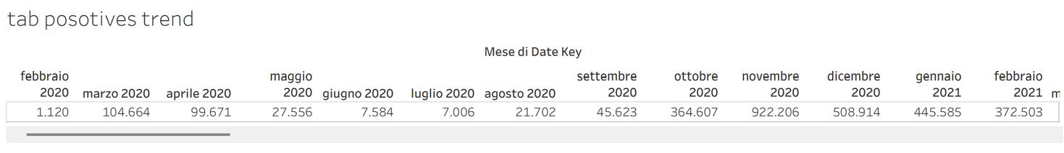
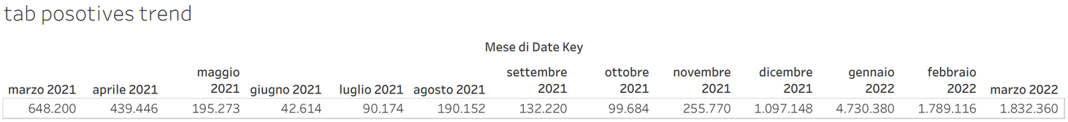
Tableau Analysis

Slide 21
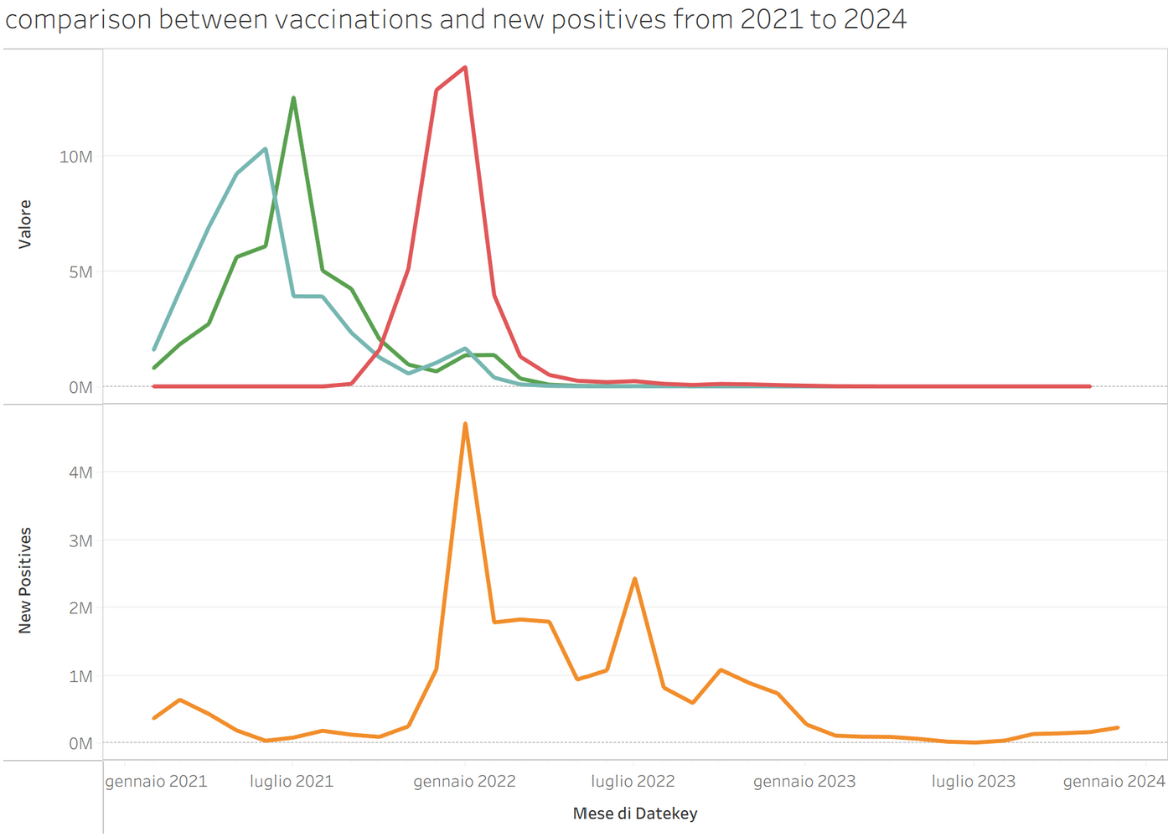
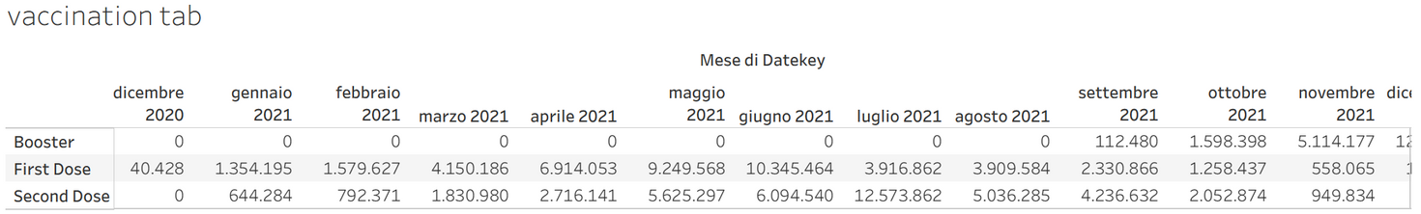
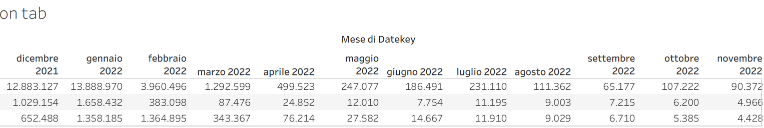
Tableau Analysis

Slide 22

Thanks for your attention!

