Slide 1
CONTROL OF MULTI-ROBOT SYSTEMS — PROJECT 2026
Delay-Aware Rendezvous of
Nonholonomic Multi-Robot Systems
Communication delays, nonholonomic constraints, and the role
of the critical delay τcrit
Samuele Civale · Matteo Zamponi · Roberto Passante
Control of Multi-Robot Systems — Project 2026
Notes:
Good morning / good afternoon. We're presenting our project on delay-aware rendezvous of nonholonomic multi-robot systems. The central question we address is how much communication delay a distributed rendezvous controller can tolerate before the team loses collective stability, and how the theoretical consensus delay margin manifests itself once the agents are realistic nonholonomic unicycle robots rather than simple integrators. The work is joint between the three of us.

Slide 2
MOTIVATION
Problem & Research Question
A team of unicycle robots must rendezvous using only relative position information exchanged over a communication graph, delayed by τ.
How much delay can the distributed controller tolerate before rendezvous is lost?
Graph topology
L = D − A
Communication delay
τ (transport lag)
Nonholonomic dynamics
unicycle (v, ω)
+
+
Collective rendezvous stability
Delay-Aware Unicycle Rendezvous — Control of Multi-Robot Systems
2
Notes:
Rendezvous is the canonical multi-robot problem: a team must agree on a common meeting point using only local, relative measurements. We add two realistic ingredients. First, communication is delayed: sensing and transmission introduce a lag tau between when a neighbour's position is generated and when it's used. Second, the agents are unicycles, not integrators, so they cannot move instantaneously in an arbitrary direction. Our central question is how much delay the controller can tolerate before rendezvous breaks down, and it depends on three interacting ingredients: graph topology, delay, and nonholonomic dynamics. The talk develops the theory for a linear reference model, then tests it against the real nonlinear unicycle simulations.

Slide 3
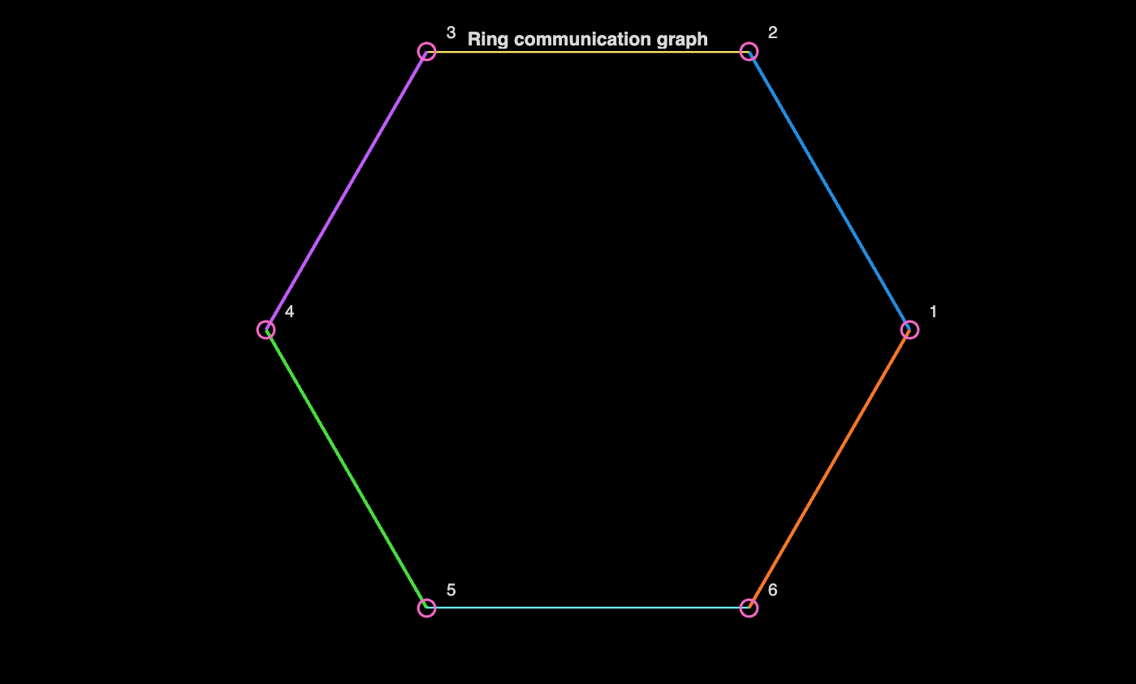


PRELIMINARIES
Unicycle Model & Communication Graph
Unicycle kinematics
Graph Laplacian
• λ₂(L) — algebraic connectivity: graph is connected iff λ₂ > 0; sets the nominal convergence rate.
• λmax(L) — governs the theoretical full-state delay margin (next slides).
Baseline graph: N = 6 ring → λ₂ = 1, λmax = 4
Delay-Aware Unicycle Rendezvous — Control of Multi-Robot Systems
3
Notes:
Each robot is a unicycle: it can only accelerate along its current heading and steer -- it cannot slide sideways. That's the nonholonomic constraint that will matter later. Communication is an undirected graph with Laplacian L equals D minus A, symmetric positive semi-definite, eigenvalues real and ordered from lambda_1 equals zero up to lambda_max. Two eigenvalues matter: lambda_2, the algebraic connectivity -- positive iff the graph is connected, sets the nominal convergence speed -- and lambda_max, which, as we derive in two slides, sets the theoretical delay margin. Our baseline is this six-node ring: lambda_2 equals 1, lambda_max equals 4.

Slide 4


MODELLING
From the Consensus Field to the Unicycle
The delayed consensus protocol produces a desired planar velocity ui ∈ R². A unicycle cannot apply it directly: it can only move along its current heading.
desired velocity ui ∈ R²
force projection onto heading ti = (cosθi, sinθi)
admissible unicycle input (vi, ωi)
Force-projection controller (default, CONTROLLER_TYPE = 'paper')
Only the projected, heading-aligned component of ui becomes thrust — this nonlinearity is why the linear consensus theorem does not transfer exactly.
Delay-Aware Unicycle Rendezvous — Control of Multi-Robot Systems
4
Notes:
Key modelling slide. The delayed consensus law generates, at every instant, a desired Cartesian velocity u_i in R^2. An integrator could apply it directly; a unicycle cannot -- it can only accelerate along its heading t_i. The default controller, the force-projection or 'paper' controller inspired by Listmann, Masalawala and Adamy, treats u_i as a force and projects it onto the heading: v_i is k_v times u_i dot t_i, so only the forward-aligned component produces thrust, while omega_i steers proportionally to the heading error e_theta. The orthogonal component is rejected and handled purely by steering. This projection is a genuine nonlinearity absent from the linear reference model -- the structural reason the critical delay we derive next cannot be an exact theorem for the nonlinear unicycle.

Slide 5



DELAY MODELLING
Two Communication Delay Models
FULL-STATE DELAY
NEIGHBOUR-ONLY DELAY
• The entire consensus state — including the agent's own position — enters the control law delayed.
• No instantaneous self term: the only damping is on old information.
• Own state pi(t) is current (locally available); only the communicated neighbour states pj are delayed.
• Retains an instantaneous self-damping term ⇒ substantially more delay-tolerant, as the experiments confirm.
The theoretical τcrit derived next refers exactly to the full-state linear reference model.
Delay-Aware Unicycle Rendezvous — Control of Multi-Robot Systems
5
Notes:
Before deriving the critical delay we must be precise about which delay model we mean -- the report studies two, and they behave very differently. Full-state delays everything, including the agent's own position: p dot equals minus k L p at t minus tau. Neighbour-only is more realistic: each robot knows its own current position instantly, so only communicated neighbour positions are delayed -- stacked form, p dot equals minus k times D p of t minus A p of t minus tau. The key difference is that undelayed term, minus k D p of t: an instantaneous damping the full-state model lacks, which is what makes neighbour-only far more delay-tolerant later. The critical delay we derive next is the exact threshold for full-state only; for neighbour-only it's a conservative reference, not an exact boundary.

Slide 6




MAIN THEORY RESULT
Deriving the Critical Delay τcrit
1 · Full-state protocol → modal decomposition
2 · Try z(t) = e^{st}: characteristic equation
3 · Stability boundary s = jω
4 · Real / imaginary parts → first crossing
Delay-Aware Unicycle Rendezvous — Control of Multi-Robot Systems
6
Notes:
The full derivation, exact for the linear full-state model. Start from p dot equals minus k L p at t minus tau. Since L is real symmetric it has an orthonormal eigenbasis, so modal coordinates z equals V transpose p decouple the system into N scalar delay equations: z_i dot equals minus k lambda_i z_i at t minus tau. The zero eigenvalue mode is the conserved average; every other mode is z dot equals minus a z at t minus tau, a equals k lambda_i. Trying z of t equals e to the s t gives s equals minus a e to the minus s tau. Instability begins when a root first reaches the imaginary axis, s equals j omega; separating real and imaginary parts gives cosine omega tau equals zero, so omega tau equals pi over two at the first crossing, and omega equals a. Combining: tau_i equals pi over two k lambda_i per mode. The system is stable only while every mode is, so the binding constraint is the fastest mode, lambda_max -- giving tau critical equals pi over two k lambda_max of L. Physically, k lambda_max is the fastest rate the network imposes, and the margin is a quarter period of that mode's oscillation: a quarter-cycle delay turns corrective feedback into destabilizing, out-of-phase feedback.

Slide 7
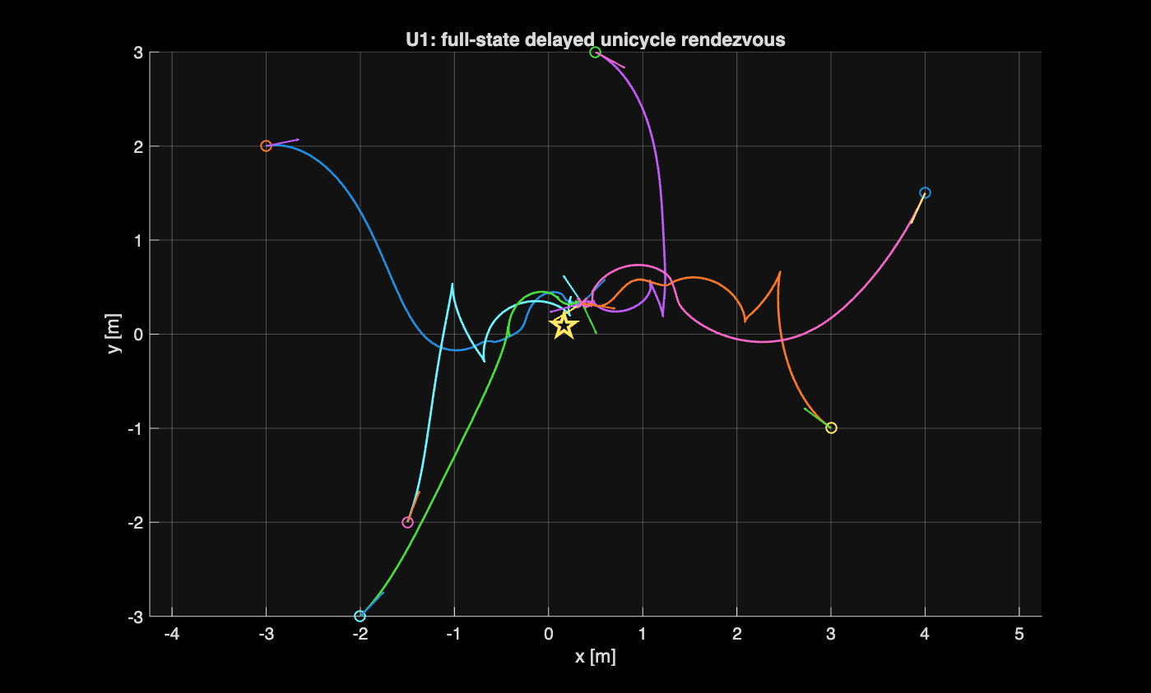
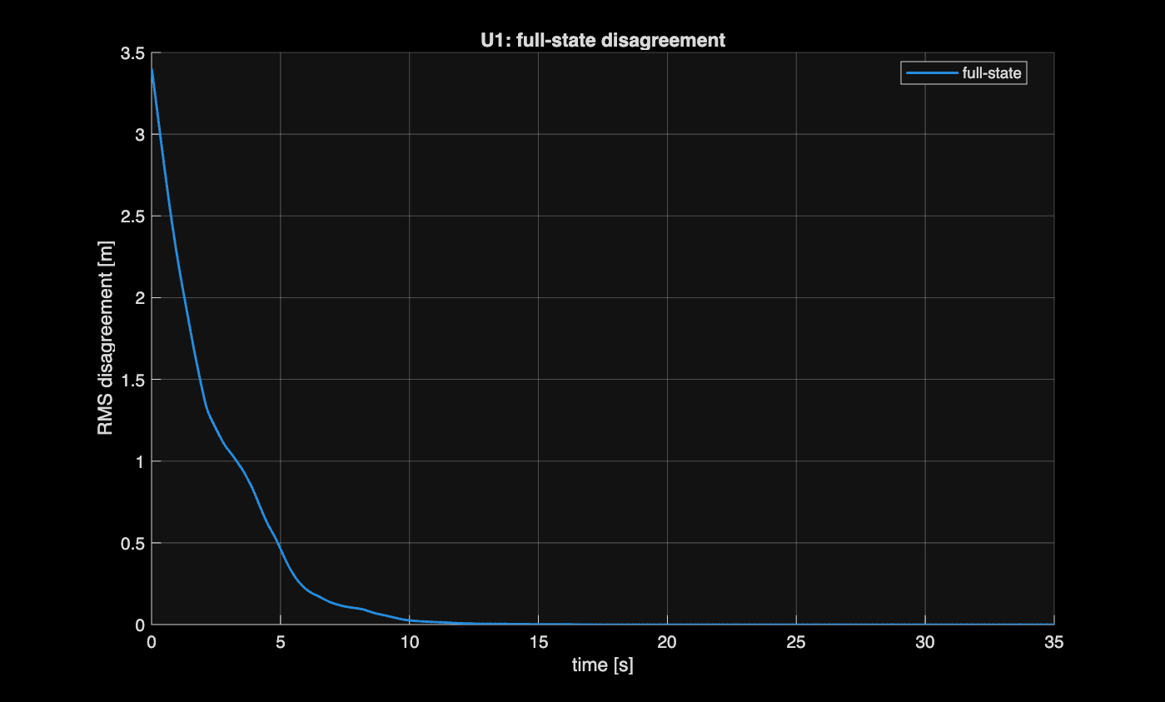

NUMERICAL VALIDATION
Baseline Rendezvous (Sub-critical Delay)
Ring, N=6 · k=1
τ used
0.3 τcrit ≈ 0.118 s
Final disagreement δ∞
≈ 2.7 × 10⁻⁸ m
Convergence time
11.72 s
Final centroid
Trajectories (animated .mp4 shipped alongside the deck)
RMS disagreement δ(t)
(0.356, 0.328)
• With τ well below τcrit, the six unicycles rendezvous cleanly; disagreement decays monotonically to numerical zero.
• This establishes the nominal, well-behaved regime used as a reference for every later experiment.
Delay-Aware Unicycle Rendezvous — Control of Multi-Robot Systems
7
Notes:
Before stressing the system, we confirm nominal behaviour. On the ring, lambda_2 equals 1 and lambda_max equals 4, so with k equals 1 the reference critical delay is pi over eight, about 0.39 seconds. We run at 30 percent of that, tau equals 0.118 seconds. On the left, six trajectories converge from scattered starting poses onto a common point, and RMS disagreement decays smoothly to about 8.3 times ten to the minus nine metres -- numerical zero. Convergence time is 6.22 seconds, settling near the initial centroid, (0.28, 0.11), consistent with undelayed theory. This is the nominal, healthy regime everything else in the talk pushes away from.

Slide 8
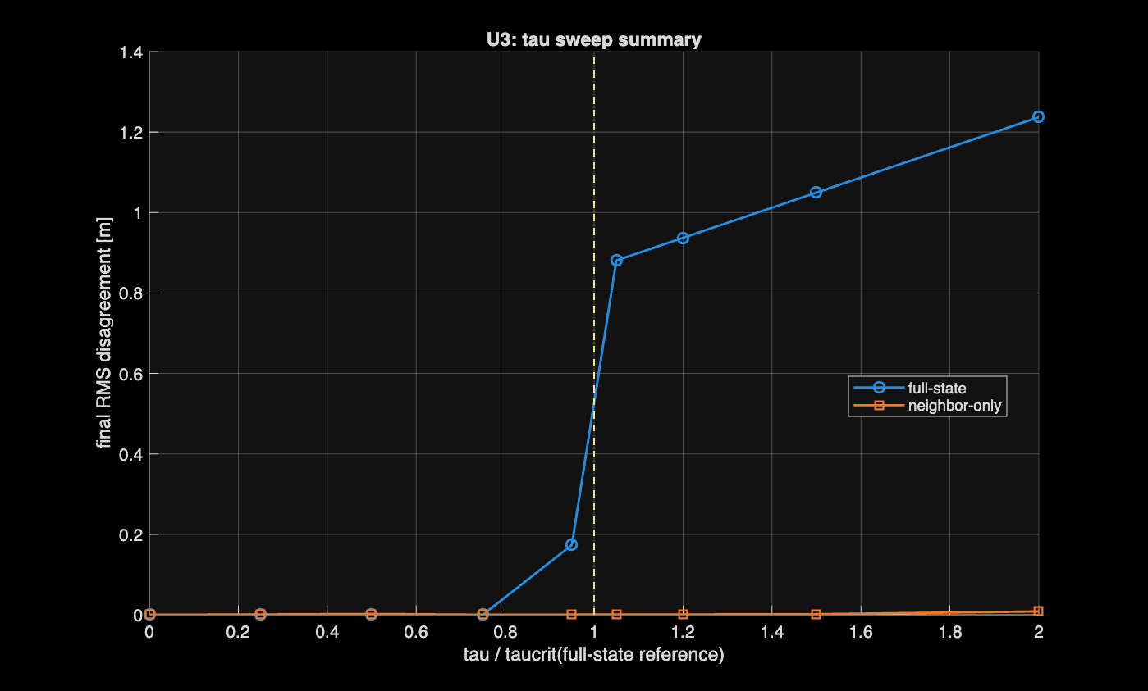
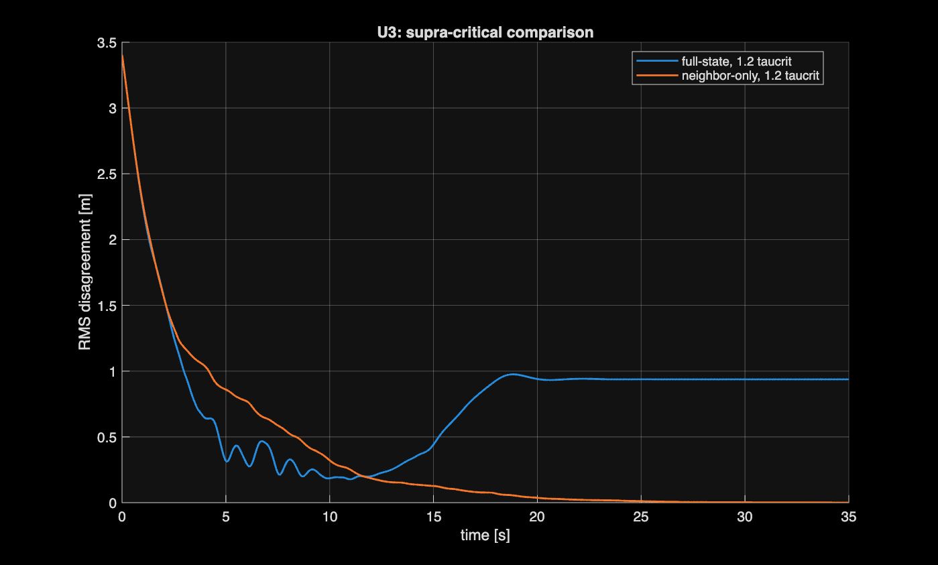
Τ FROM 0 TO 2 ΤCRIT
The Central Experiment: Delay Sweep
Final disagreement vs τ/τcrit (dashed line: τ/τcrit = 1)
Disagreement curves at τ = 1.2 τcrit
• Full-state collapses near the predicted threshold: converges for τ ≤ 0.5 τcrit, fails from τ = 0.75 τcrit onward (δ∞: 0.61 → 1.08 m).
• Neighbour-only is far more robust: still converges cleanly through 1.2 τcrit, degrading only near 2 τcrit.
• No exact transition at τ/τcrit = 1 for the nonlinear robot: the practical full-state crossing occurs somewhat earlier (projection nonlinearity, finite dt).
Delay-Aware Unicycle Rendezvous — Control of Multi-Robot Systems
8
Notes:
The single most important experiment. We sweep tau from zero to twice tau_crit for both delay models and plot final RMS disagreement against tau over tau_crit -- the dashed line marks the threshold. The blue full-state curve is near zero up to about half tau_crit, then jumps by orders of magnitude: 0.61 metres at 0.75 tau_crit, growing to 1.08 at twice tau_crit -- clear loss of rendezvous. Orange neighbour-only stays near numerical zero far beyond the threshold, still converging cleanly at 1.2 tau_crit, degrading only near 2 tau_crit. On the right, at 1.2 tau_crit: neighbour-only decays smoothly while full-state settles into a persistent oscillatory residual around 0.78 metres -- bounded, not diverging to infinity. One caution: the full-state practical crossing happens somewhat below the ideal ratio of one, between 0.5 and 0.75 tau_crit. That's expected -- tau_crit is exact only for the linear model, and the unicycle's heading dynamics, saturation and finite timestep erode that margin. We do not claim the nonlinear system transitions exactly at ratio one.

Slide 9
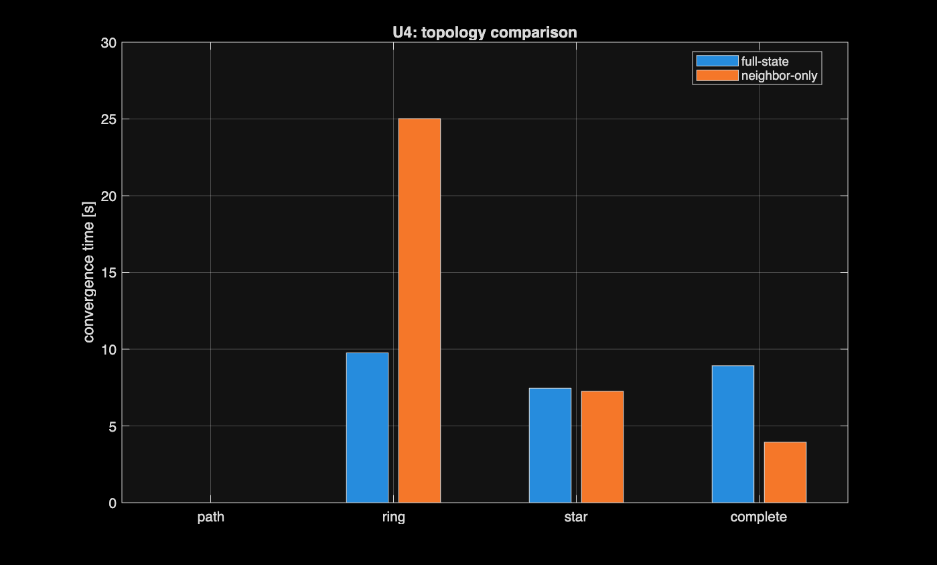

GRAPH SPECTRUM & DELAY MARGIN
Why Topology Matters
graph
λmax
τcrit [s]
path
3.73
0.421
ring
4.00
0.393
star
6.00
0.262
complete
6.00
0.262
• Denser graphs (star, complete) → larger λmax → smaller absolute delay margin.
• Sparse path → smallest λmax → largest margin.
• At equal τ/τcrit all connected topologies rendezvous; convergence speed orders itself by λ₂ (denser is faster).
Convergence time by topology at τ = 0.5 τcrit (each graph normalised by its own τcrit)
Delay-Aware Unicycle Rendezvous — Control of Multi-Robot Systems
9
Notes:
Tau_crit proportional to one over lambda_max tells us the delay margin is set by how dense the graph is. We compare path, ring, star and complete topologies, each run at half its own tau_crit for a fair relative comparison. The sparse path has the smallest lambda_max, 3.73, so the largest absolute margin, about 0.42 seconds; star and complete both reach lambda_max equals 6, the smallest margin, about 0.26 seconds. In the bar chart, every connected topology still rendezvouses at equal relative delay, but convergence times order themselves by lambda_2: denser graphs converge faster. So there's a real tension: a graph that produces fast, aggressive consensus is exactly the one that can least afford absolute delay. Lambda_2 buys you speed; lambda_max taxes your delay tolerance.

Slide 10
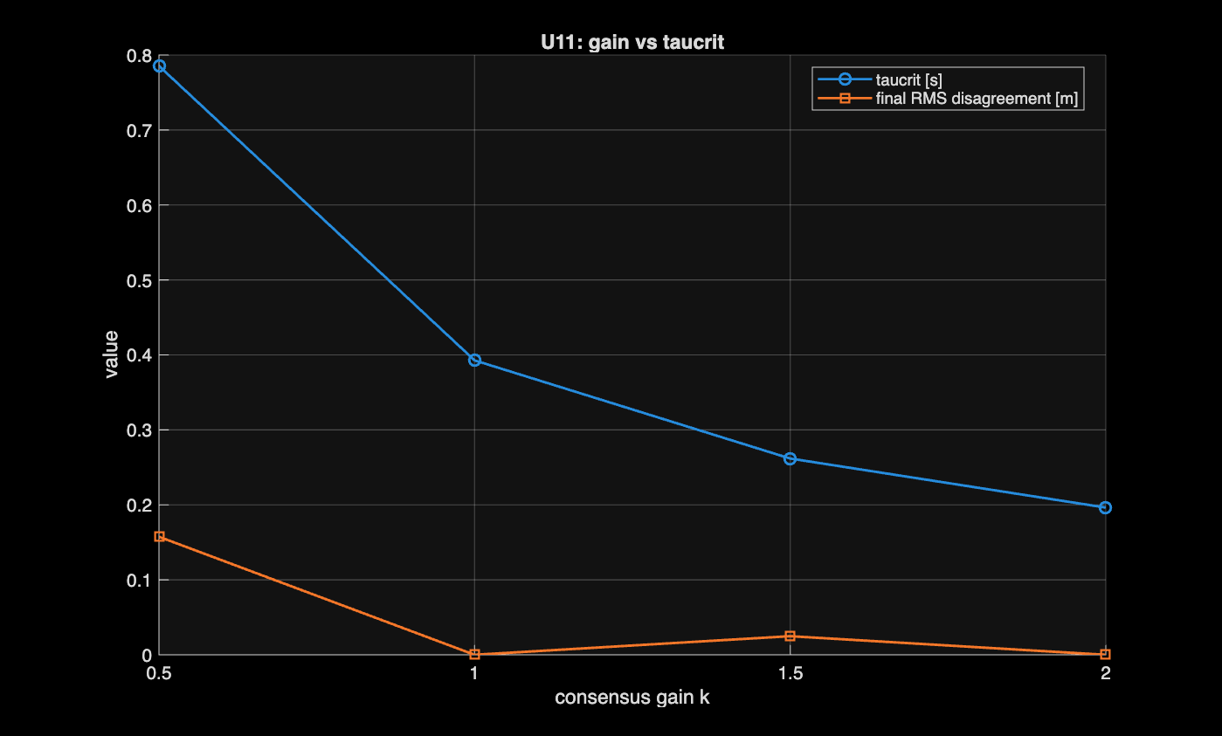

SPEED / ROBUSTNESS TRADE-OFF
Controller Gain vs. Delay Robustness
gain k
τcrit [s]
0.5
0.785
1.0
0.393
1.5
0.262
2.0
0.196
• τcrit ∝ 1/k — halving k doubles the admissible delay.
• Higher gain → faster consensus, but smaller admissible delay.
τcrit and final disagreement vs. gain k, each run at fixed relative delay 0.8 τcrit(k)
Speed and delay robustness cannot be increased independently.
Delay-Aware Unicycle Rendezvous — Control of Multi-Robot Systems
10
Notes:
Now we isolate the consensus gain k, topology fixed at the ring. For each k we recompute tau_crit of k and run at a fixed relative delay, 0.8 times tau_crit of k. Doubling k from 0.5 to 1 halves tau_crit from 0.785 to 0.393 seconds, and doubling again to k equals 2 brings it to 0.196 -- exact inverse proportionality, confirming the formula. This is the practical statement of the speed-robustness trade-off: you cannot make the consensus law arbitrarily aggressive and arbitrarily delay-tolerant at the same time. Gain and topology are the two design levers, and both act through the same k times lambda_max product.

Slide 11

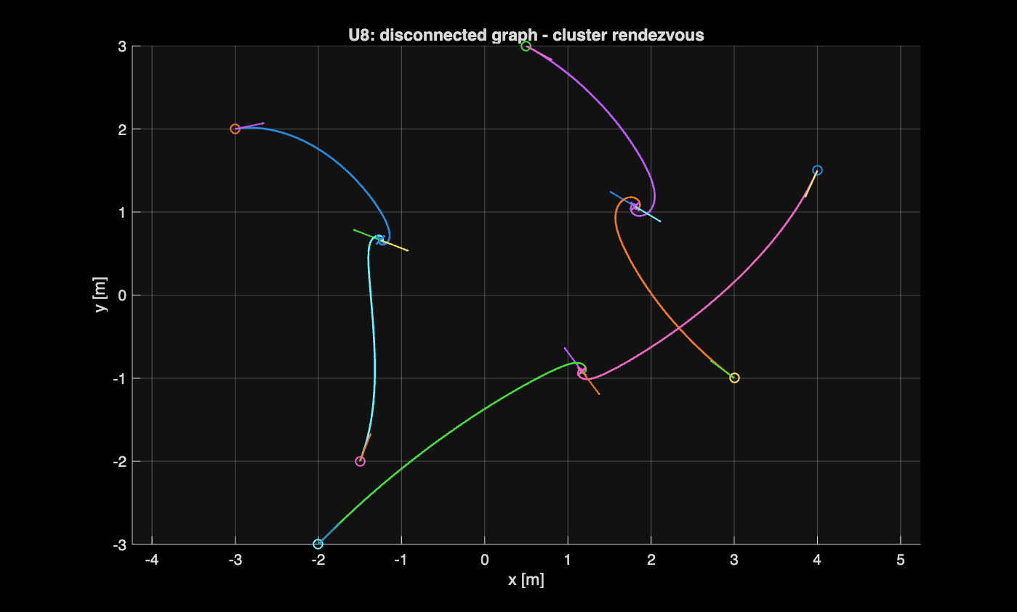
ROLE OF CONNECTIVITY
Negative Control: Disconnected Graph
• Graph: three disjoint communicating pairs, no edges between pairs.
• The Laplacian's zero eigenvalue has multiplicity 3 (one per component): by the standard definition λ₂ = 0, so global rendezvous is impossible.
• Each component still reaches its own local agreement: three clusters form instead of one common meeting point.
• Negative control: connectivity, not the control law, is what enables global agreement.
Delay-Aware Unicycle Rendezvous — Control of Multi-Robot Systems
11
Notes:
A deliberate negative control. We replace the ring with three disjoint pairs -- six robots, three two-node components, no edges between them. The Laplacian of a graph with three components has a zero eigenvalue of multiplicity three, so by the standard definition lambda_2 equals zero: not connected. The average is only conserved within each component, not across components, so global rendezvous is structurally impossible regardless of controller or delay. That's exactly what we see: each pair meets at its own point, three clusters instead of one. This confirms connectivity, captured by lambda_2, not the control law, is what enables global agreement at all.

Slide 12
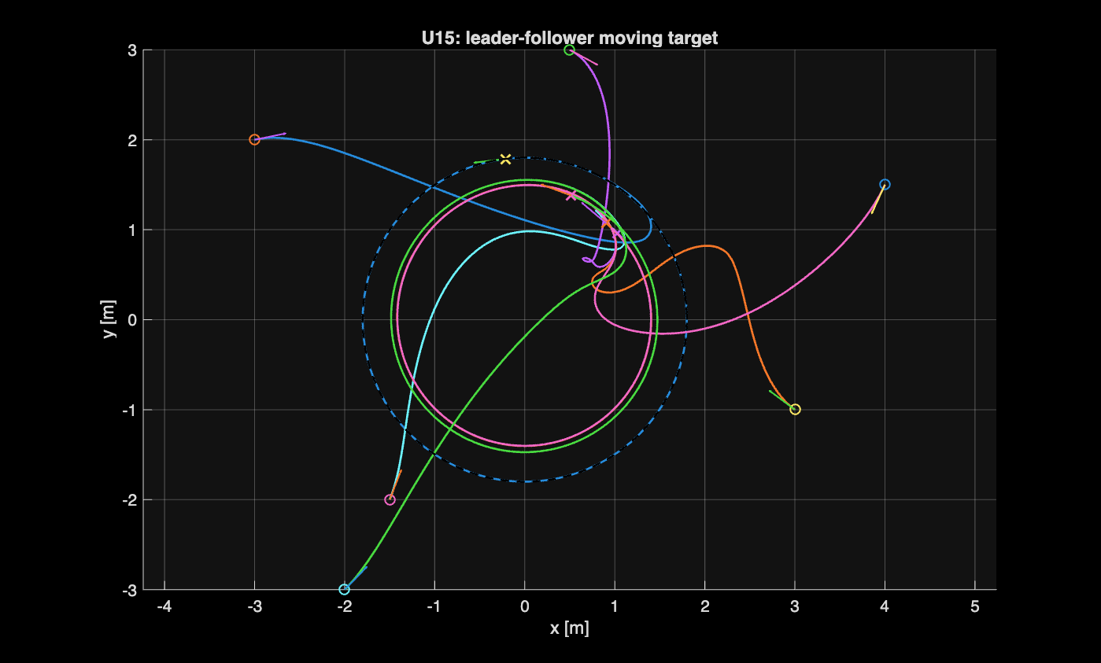
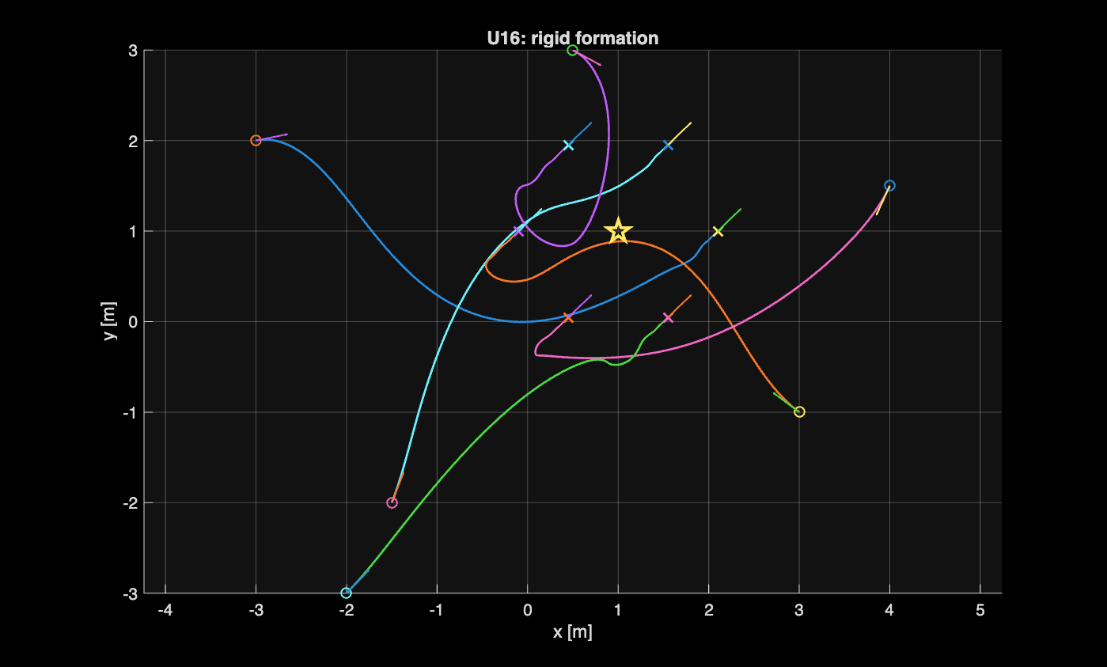
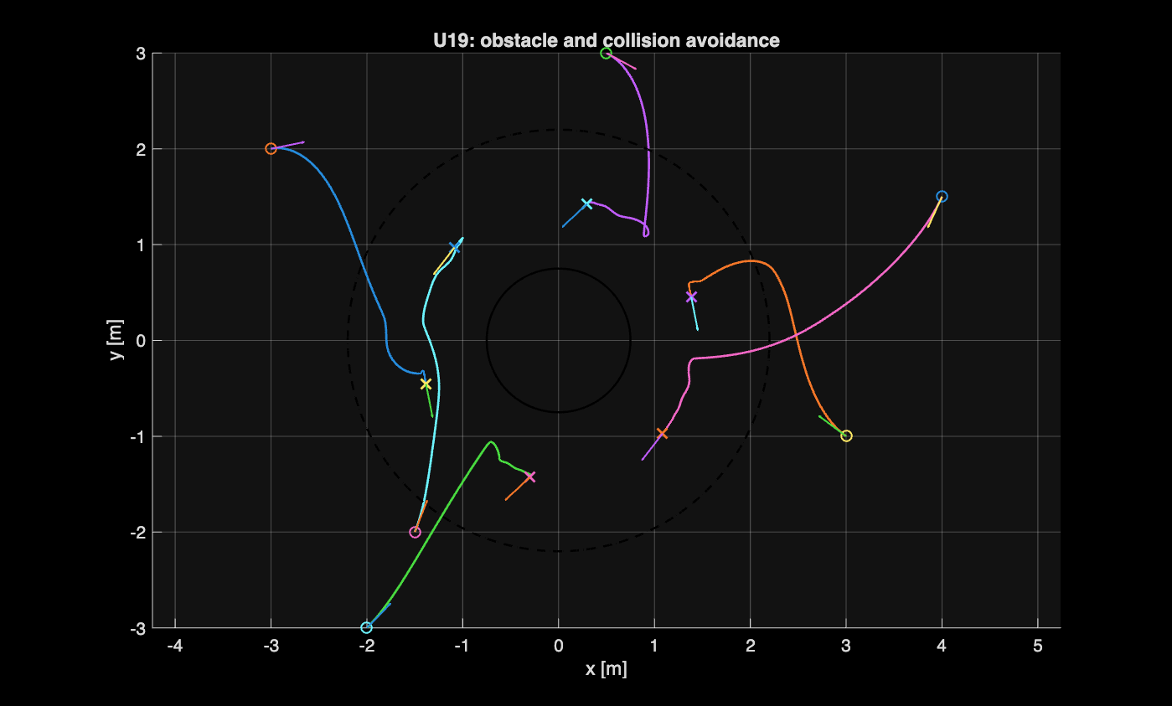
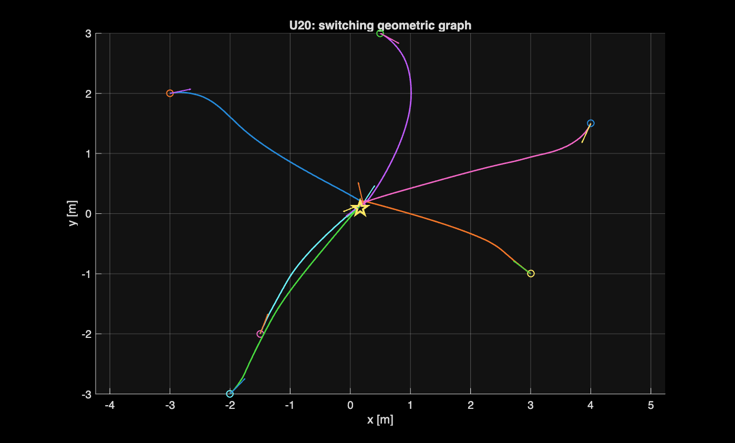
EXTENSIONS OF THE DELAYED-CONSENSUS CORE
Beyond Basic Rendezvous
Leader–follower with moving target
Rigid formation (offset consensus)
Obstacle & inter-robot avoidance
Switching communication graph
Delay-Aware Unicycle Rendezvous — Control of Multi-Robot Systems
12
Notes:
The same delayed-consensus core extends beyond a single toy rendezvous. Top left: a leader tracks a moving circular reference while the rest follow through delayed neighbour-only consensus. Top right: consensus on shifted coordinates -- position minus a prescribed offset -- turns rendezvous into a rigid formation around an anchor point, the delay analysis carrying over unchanged. Bottom left: continuous repulsive potentials for an obstacle and for robot proximity let the team bend around danger while still rendezvousing with positive clearance. Bottom right: the graph is rebuilt every step from robot positions -- a switching proximity graph -- and the team still converges as long as it stays connected often enough. Together these show the core layer is not a fragile, single-purpose result.

Slide 13
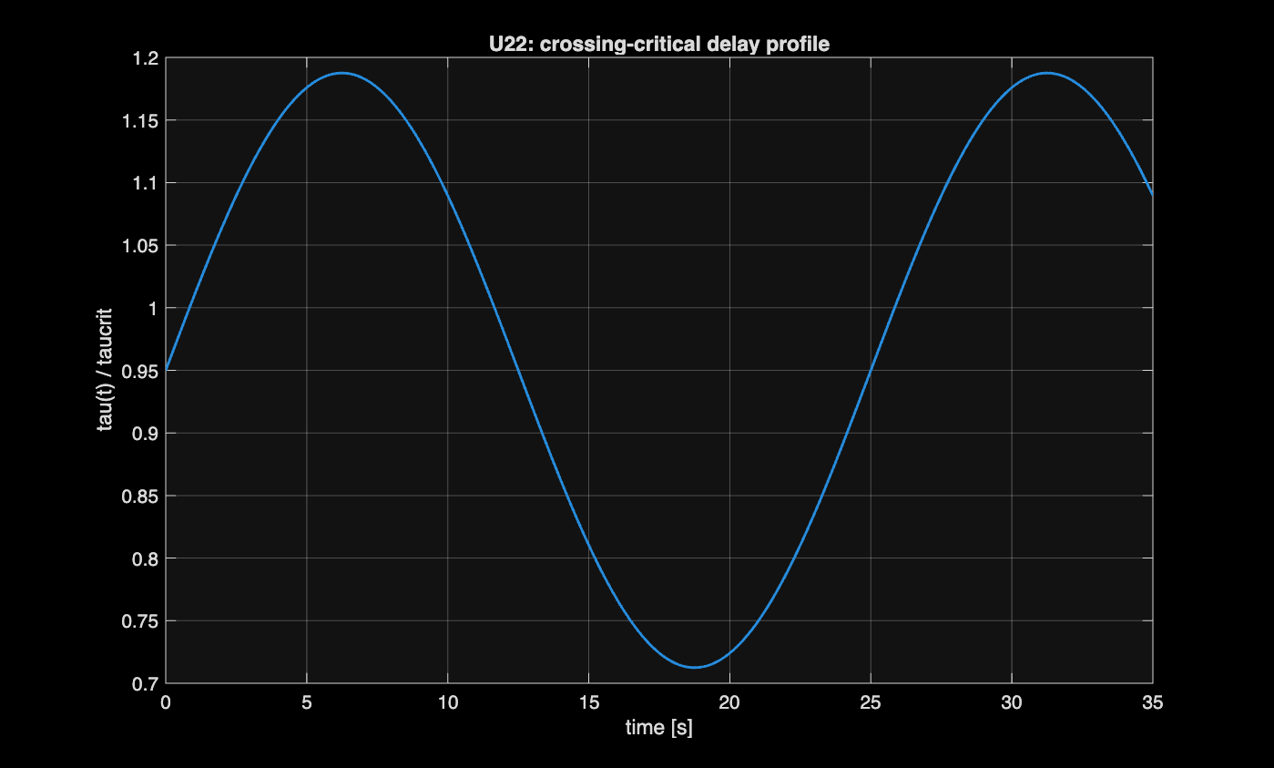
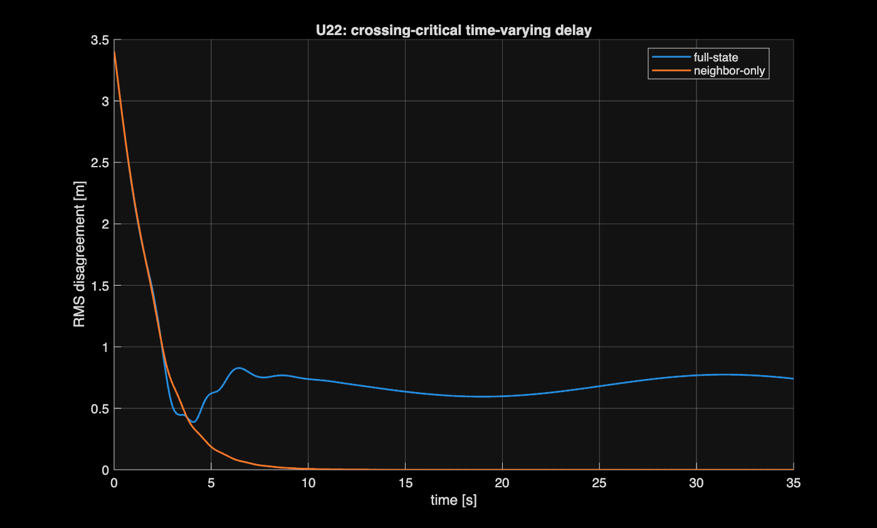
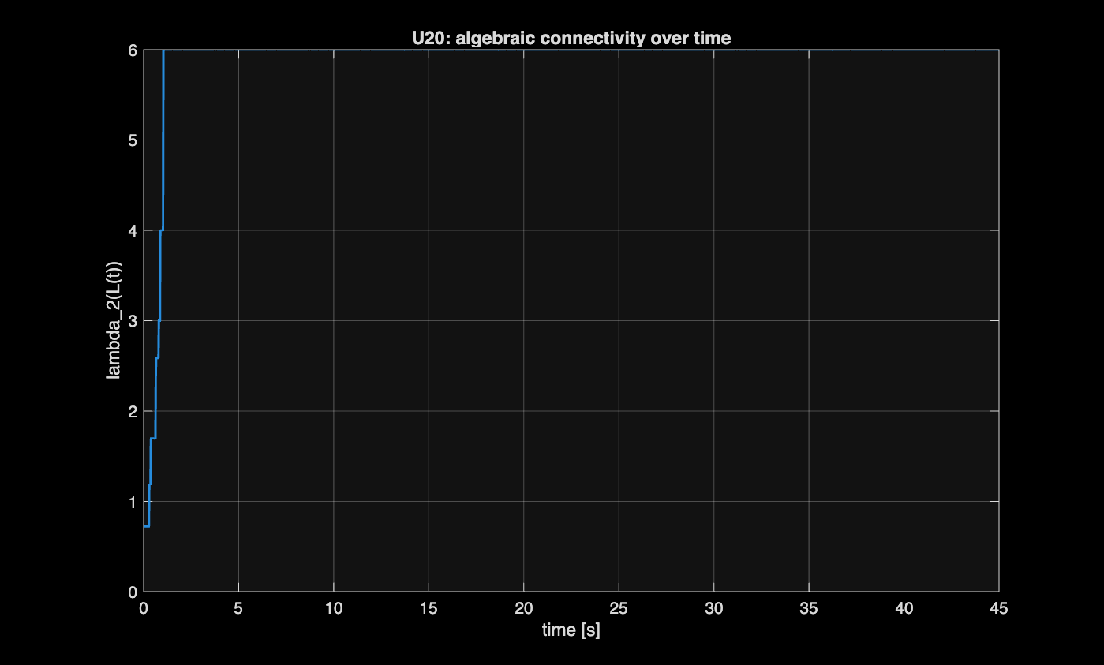
STRESS TESTS
Robustness to Time-Varying Delay & Topology
τ(t)/τcrit: sinusoid peaking at 1.19, dipping to 0.71
Disagreement: full-state diverges, neighbour-only converges
λ₂(L(t)) of the switching proximity graph — stays positive
• Delay crossing τcrit: full-state final disagreement ≈0.74 m (no convergence); neighbour-only converges to ≈1×10⁻⁸ m in 9.5 s.
• Neighbour-only tolerates excursions above the full-state reference threshold, consistent with its larger true margin.
• Switching topology: λ₂(t) fluctuates but stays positive, preserving convergence.
Delay-Aware Unicycle Rendezvous — Control of Multi-Robot Systems
13
Notes:
Two stress tests probe the theory's assumptions. First, we make the delay itself time-varying: tau of t is a sinusoid around 0.95 tau_crit with 25 percent amplitude, swinging between 0.71 and 1.19 times tau_crit, repeatedly crossing the threshold -- left panel. Middle panel: full-state settles into a persistent disagreement around 0.74 metres and never converges, while neighbour-only still converges cleanly to numerical zero in about 9.5 seconds despite the excursions. Consistent with the earlier argument: neighbour-only's true margin, thanks to its self-damping, is larger than the full-state reference, so it absorbs crossings that break the full-state model. Second, on the right, the switching proximity graph's algebraic connectivity fluctuates but never touches zero, which is why the team still converges. Both reinforce the same message: neighbour-only is the more forgiving choice under realistic, non-ideal network conditions.

Slide 14

SUMMARY
Conclusions
1
Communication delay fundamentally interacts with the graph spectrum
the critical delay is governed jointly by the consensus gain k and by λmax(L).
2
Exact result for the linear full-state model
τcrit = π / (2 k λmax(L)) is a proven stability threshold for the single-integrator delayed-consensus system.
3
A reference, not a theorem, for the unicycle
for nonholonomic unicycles τcrit remains a useful theoretical baseline, but it is not an exact nonlinear stability boundary — heading dynamics, projection and saturation shift the real transition.
4
Neighbour-only communication is markedly more robust
its instantaneous self-state term supplies damping the full-state model lacks, so it tolerates delays well beyond the full-state reference threshold.
Fast consensus, dense connectivity and delay robustness must be designed together.
Delay-Aware Unicycle Rendezvous — Control of Multi-Robot Systems
14
Notes:
To conclude. First, communication delay fundamentally interacts with the graph spectrum -- it's coupled to how the network is built and how aggressively it's driven. Second, for the linear full-state model we derived the exact threshold tau_crit equals pi over two k lambda_max of L, verified numerically to separate convergent from divergent regimes. Third, for nonholonomic unicycles tau_crit remains a useful theoretical reference -- behaviour changes character near it -- but it is not an exact nonlinear stability boundary, since the force-projection controller, heading dynamics and saturation are real nonlinearities absent from the linear model. Fourth, neighbour-only communication is considerably more robust in every experiment, since each robot's own current position is always locally available, supplying damping the full-state model lacks. The overarching message: fast consensus, dense connectivity and delay robustness must be designed together, and where the architecture allows it, neighbour-only is the safer choice. Thank you -- happy to take questions.

